Slide 1



Accelerated Diffusion-Weighted Hyperpolarized ¹²⁹Xe Gas Lung MRI
Fumin Guo¹, Matthew Fox^{2,3}, Grace Parraga^{4,5}, and Alexei Ouriadov^{3,2}
¹Sunnybrook Research Institute, University of Toronto, Toronto, Canada,
²Lawson Health Research Institute, London, Canada,
³Department of Physics and Astronomy, ⁴Robarts Research Institute,
⁵Department of Medical Biophysics, Western University, London, Canada
June 4, 2019
Physics & Astronomy

Slide 2

Declaration of Relevant
Financial Interests and/or Relationships
A. Ouriadov and all co-authors:
We have no relevant financial interests or relationships to disclose with regard to the subject matter of this presentation.

Slide 3
Thermal Polarization
Nuclei with spin = ½ are placed in an externally applied magnetic field
Polarization (P) arises from a population difference in energy levels of spin = ½ nuclei

Slide 4
Spin-Exchange Optical Pumping
Rubidium electrons are optically pumped into an excited state using circularly polarized laser light
The electronic polarization of Rb is transferred to the noble gas nuclei via collisions

Slide 5
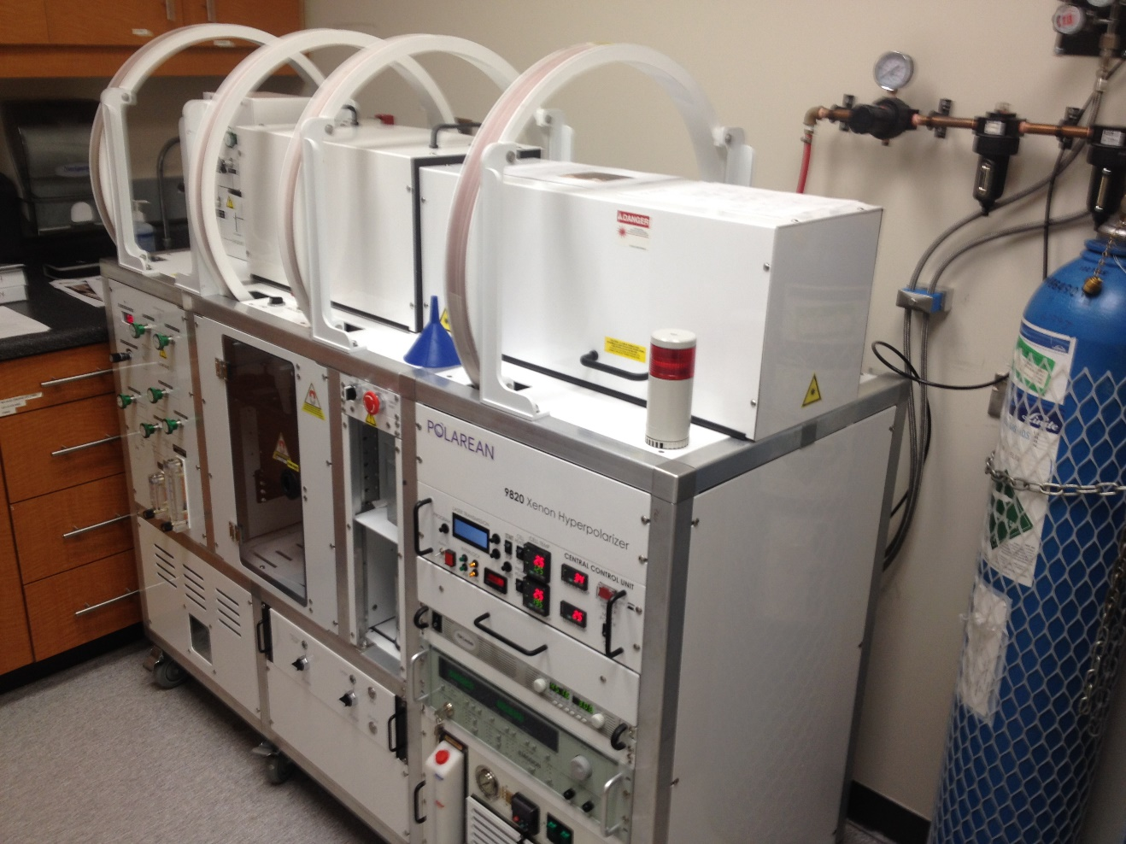
Spin-Exchange Optical Pumping
  ¹²⁹Xe Polarizer, Polarean, USA
  Polarization: 30%
  Cryogens required for operation
  Production Rate:
  ~800ml/hour

Slide 6
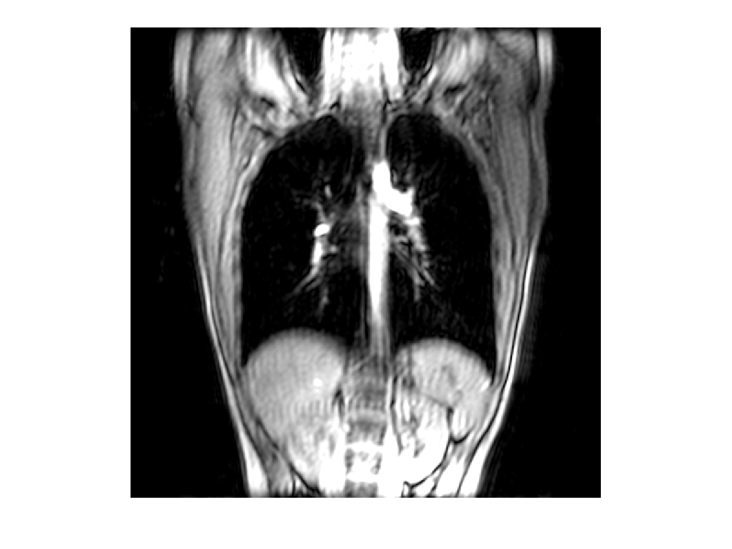
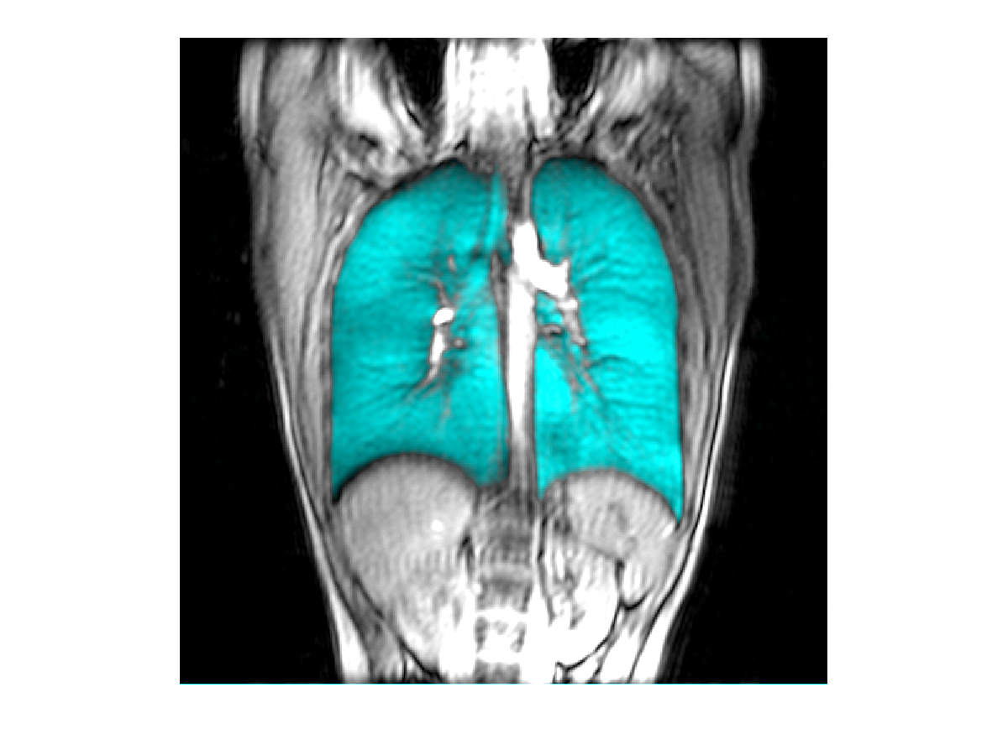
¹H MRI vs Hyperpolarized Gas MRI

Slide 7
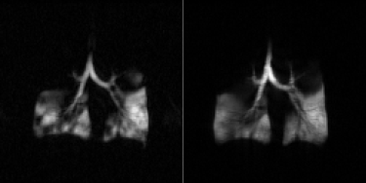
Hyperpolarized Gas MRI
Helium-3 Xenon-129
Kirby M. et al. Radiology 265, 600-610, (2012)

Slide 8
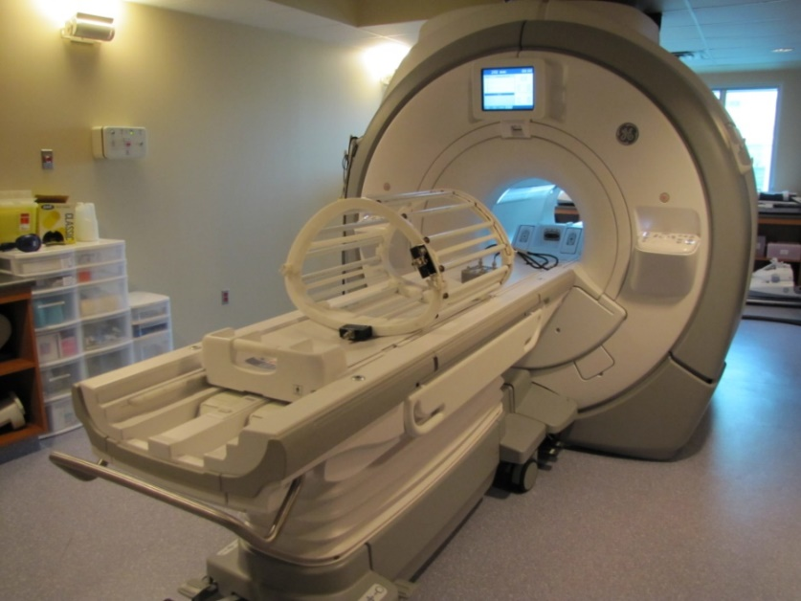
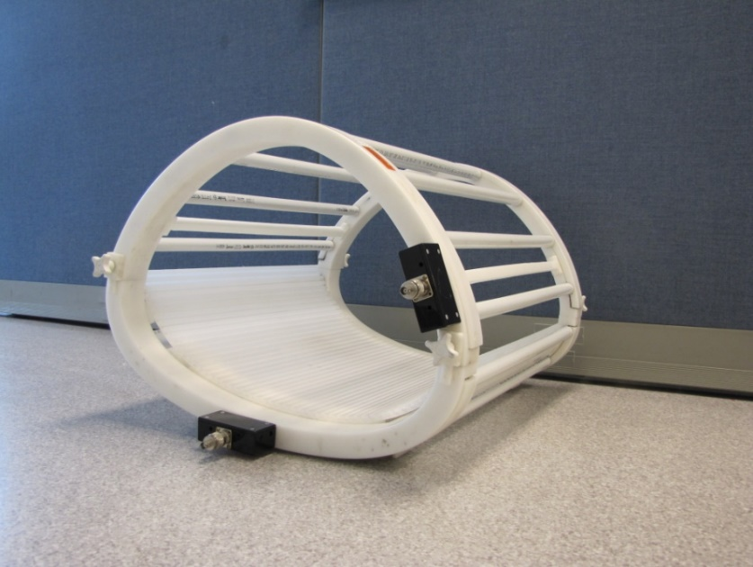
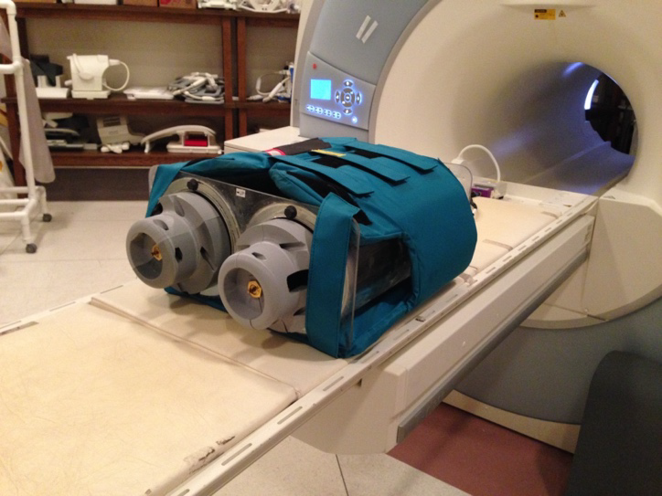
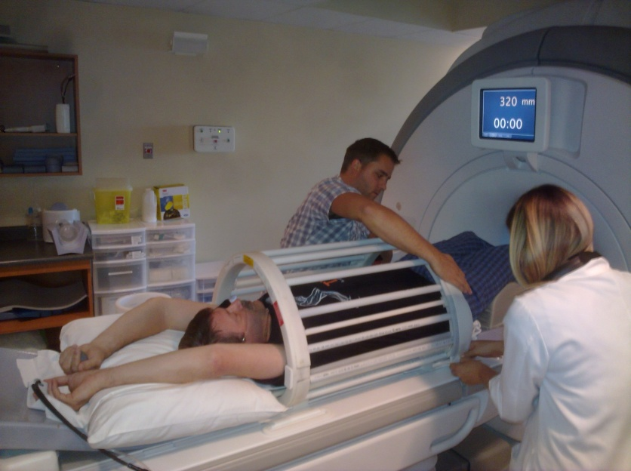
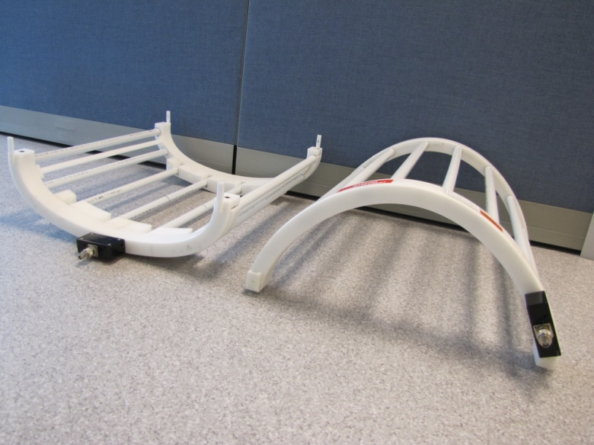
¹²⁹Xe MRI Hardware

Slide 9
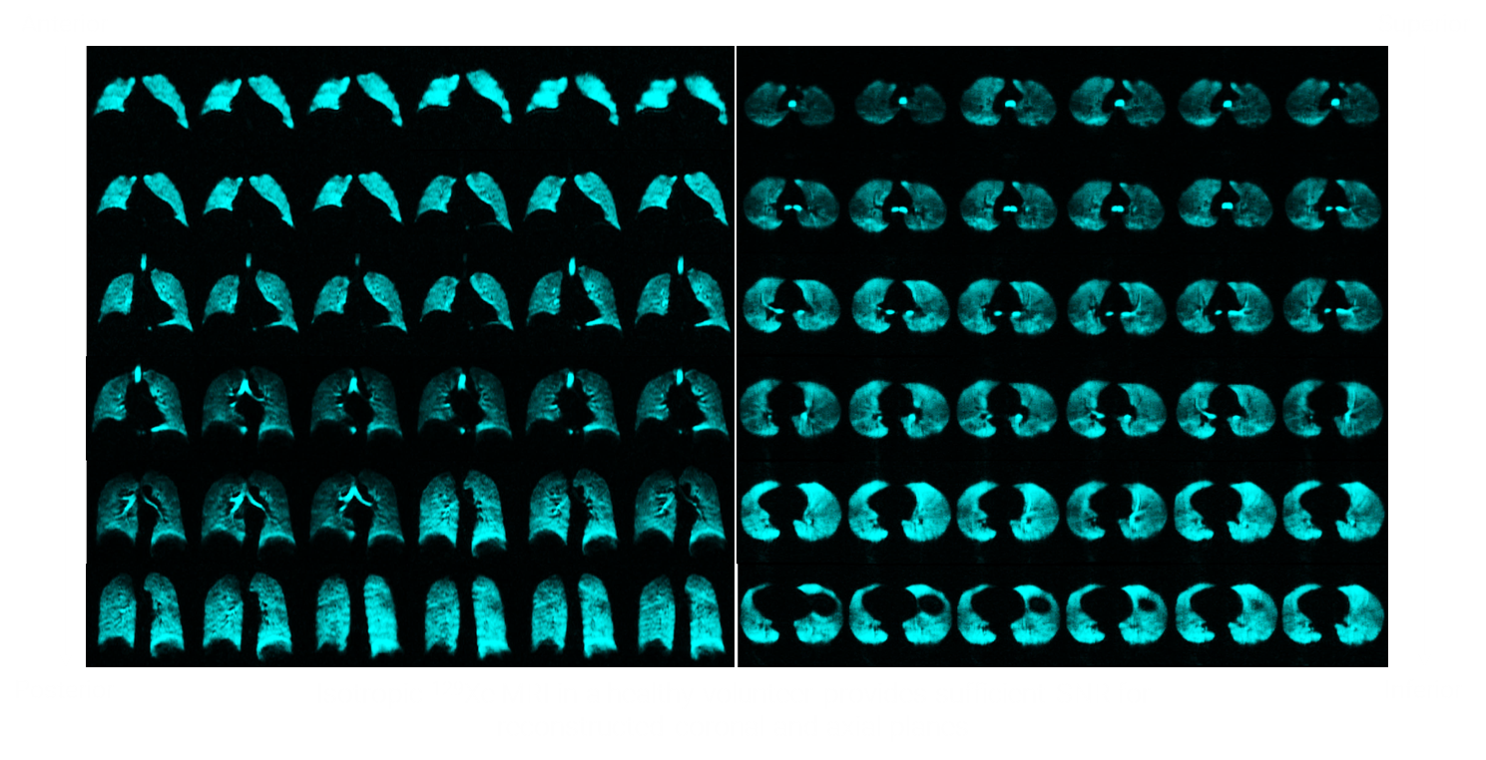
Single Breath-hold Isotropic ¹²⁹Xe MRI
Barker A, et all, ISMRM 2019

Slide 10
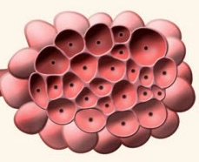
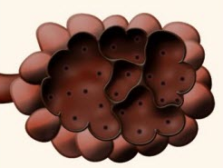
Emphysema: Pathology
Normal
Emphysema
Evaluating Emphysema
  Spirometry and Plethysmography
  Computed Tomography
  Diffusion-Weighted (DW) Hyperpolarized Gas MRI

Slide 11


DW Hyperpolarized Gas MRI
Healthy
Emphysema
r
r
ADC
ADC
ADC = apparent diffusion coefficient
r = distance the helium atoms diffuse
t =diffusion time

Slide 12
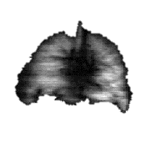
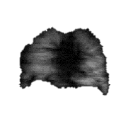
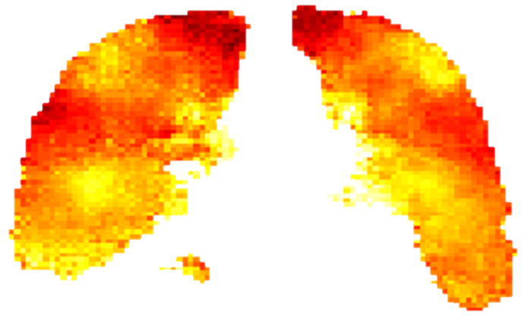



DW Hyperpolarized Gas MRI
$S\left(b\right)$= $S0exp⁡(−bADC)$
$b$= $0$
$b$= $1.6 s/cm2$
¹Ouriadov A, et all, Magn Reson Med 2018; 79: 439-448.

Slide 13
Limitations to DW Hyperpolarized Gas MRI
A stretched exponential method³ (SEM) combined with under-sampling (compressed sensing) in the imaging and diffusion directions⁴ was proposed for the evaluation of hyperpolarized gas multiple b-value diffusion-weighted MRI.
The major advantage of this method is the possibility to significantly speed up the data acquisition using acceleration factors (AF) between 7 and 10.⁴
Hyperpolarized Gas MRI-based emphysema biomarkers may help to evaluate and phenotype patients with COPD, Bronchopulmonary Dysplasia and Alpha-1 Antitrypsin Deficiency but these cannot be obtained in a single breath-hold (<16 sec)
This means that multi-breath methods² (which may lead to lung volume variability, patient distress or fatigue) will require longer duration scans (>90 sec for 129Xe with several breaths), reduction in number of b-values and a reduction in 3D image resolution to help reduce total scan time.
²Ouriadov A. et al. Magn Reson Med (2012)
³Chan H. F. et al. Magn Reson Med, (2016).
⁴Abascal J. F. A. et al. ArXiv, (2017)

Slide 14
Research Objective
To develop the accelerated SEM-based ¹²⁹Xe MRI approach and generate hyperpolarized gas MRI-based emphysema biomarkers in a small group of young healthy volunteers and Alpha-1 Antitrypsin Deficiency subjects.
Research Hypothesis
Accelerated (7 folds faster) methods can be developed to provide whole lung hyperpolarized gas MRI-based emphysema biomarkers including static-ventilation, T₂*, ADC and morphometry maps in a single 16 sec breath-hold.

Slide 15
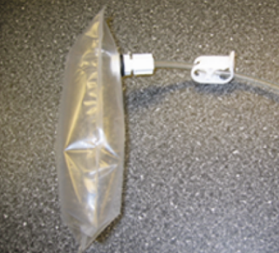
Methods: MRI Protocol
3.0 T Discovery MR750 (GEHC)
 | Hyperpolarized ¹²⁹Xe MRI
Pulse Sequence Parameters | Accelerated 2D Gradient Echo DW Short-TE/TE/TR/FA/BW = 2ms/10ms/5ms/4°/31.25kHz Matrix Size = 128x20, Acceleration Factor = 7 Diffusion time (Δ) = 5.2ms b-values =0, 0, 12, 20, 30, 45.5 s/cm² FOV =40x40cm², 8 slices, 30 mm slice thickness
Dose
Coil | CMRS flexible transmit/receive chest coil
¹²⁹Xe
⁴He

Slide 16

Methods: Image Analysis
Diffusion Attenuated MR Signal in SEM:
$S\left(b\right)$= $S0exp⁡(−b•DDC)$ $α$,
$where$ DDC= diffusivity, $α$= heterogeneity index;
and mean diffusion length (Lm_{D})=(2 Δ <DDC>)^{1/2}
⁴Ouriadov A. et al. Magn Reson Med (2017)
⁵COuriadov. et al. ISMRM, (2016).
⁶Yablonskiy D. A. et al. J Appl Physiol 107, 1258-1265, (2009).
⁷Kirby M. et al. Radiology 265, 600-610, (2012)

Slide 17
Methods: Pulse Sequence

Slide 18
Results: Accelerated ¹²⁹Xe MRI
Ouriadov A, et all, Submitted to Magn Reson Med

Slide 19
Results: Accelerated ¹²⁹Xe MRI
Ouriadov A, et all, Submitted to Magn Reson Med

Slide 20
Conclusions
Accelerated ¹²⁹Xe MRI provides a way to generate alveolar morphometry estimates to regionally characterize emphysema and airspace enlargement in patients with AATD in a single 16 sec breath-hold scan
The Signal-to-Noise Ratio (35-40) of the short-TE image was more than adequate for the calculation of the Ventilation Defect Percentage which may be simultaneously generated with T₂*, ADC and L_{m} values in a single rapid breath hold
This is the first in patient demonstration of this acceleration (7x) method for ¹²⁹Xe and it suggests that the acceleration factors of 10 fold are possible. It will help retain resolution, maintain high number of b-values
Ouriadov A, et all, ISMRM 2019

Slide 21

Translating ¹²⁹Xe MRI Across Canada
London ON:
Robarts Research Institute
Toronto ON:
The Hospital for Sick Children
Hamilton ON:
Firestone Institute for Respiratory Health
St. Joseph’s Healthcare
Thunder Bay ON:
Thunder Bay Regional Research Institute
Montreal QC:
CHU Sainte-Justine
Université de Montreal
Vancouver BC:
The Institute of Heart and Lung Health
St. Paul’s Hospital

Slide 22
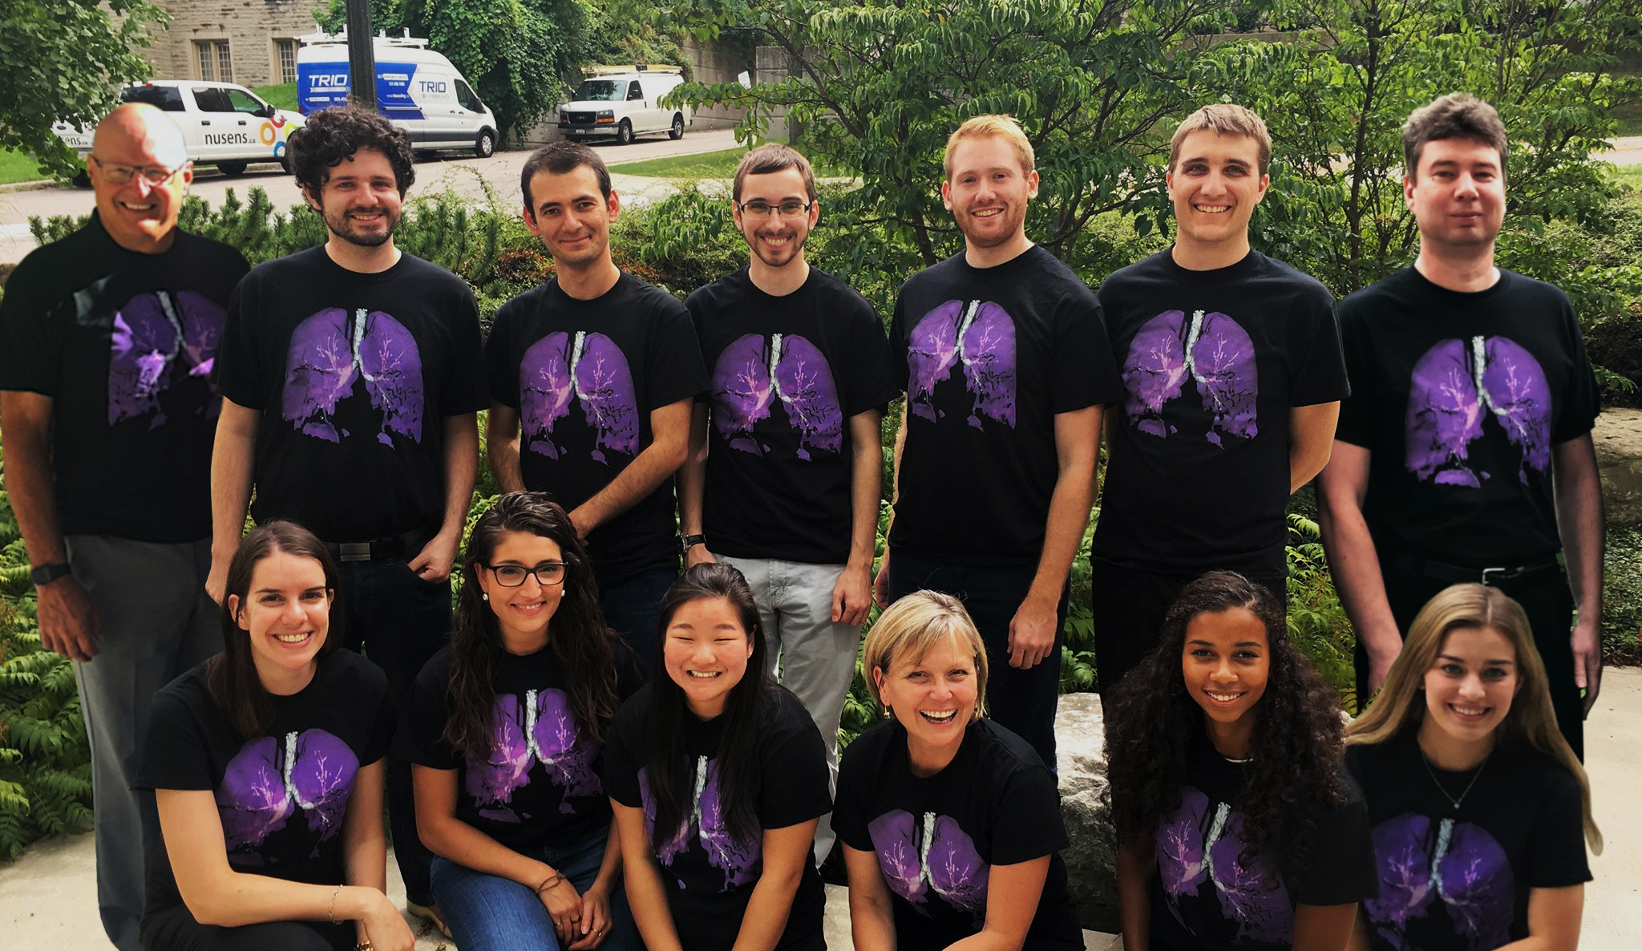




London Lung Imaging Research Team
Physics & Astronomy

