Slide 1


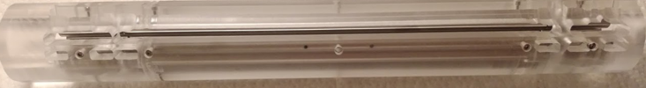
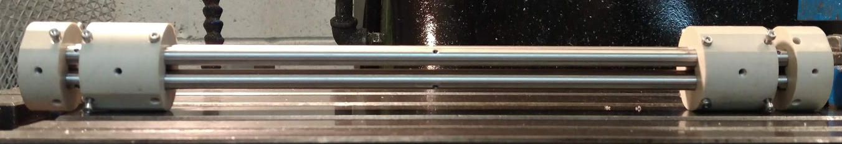
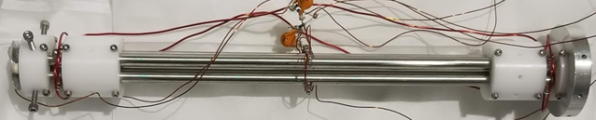
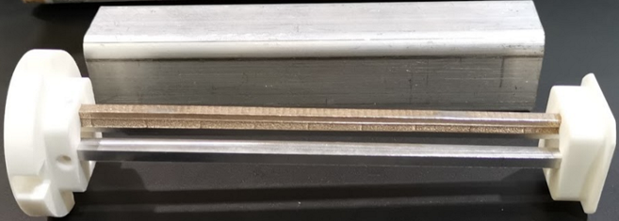
A linear quadrupole ion trap for barium tagging in nEXO
Yang Lan
for the nEXO collaboration
TRIUMF/UBC

Slide 2

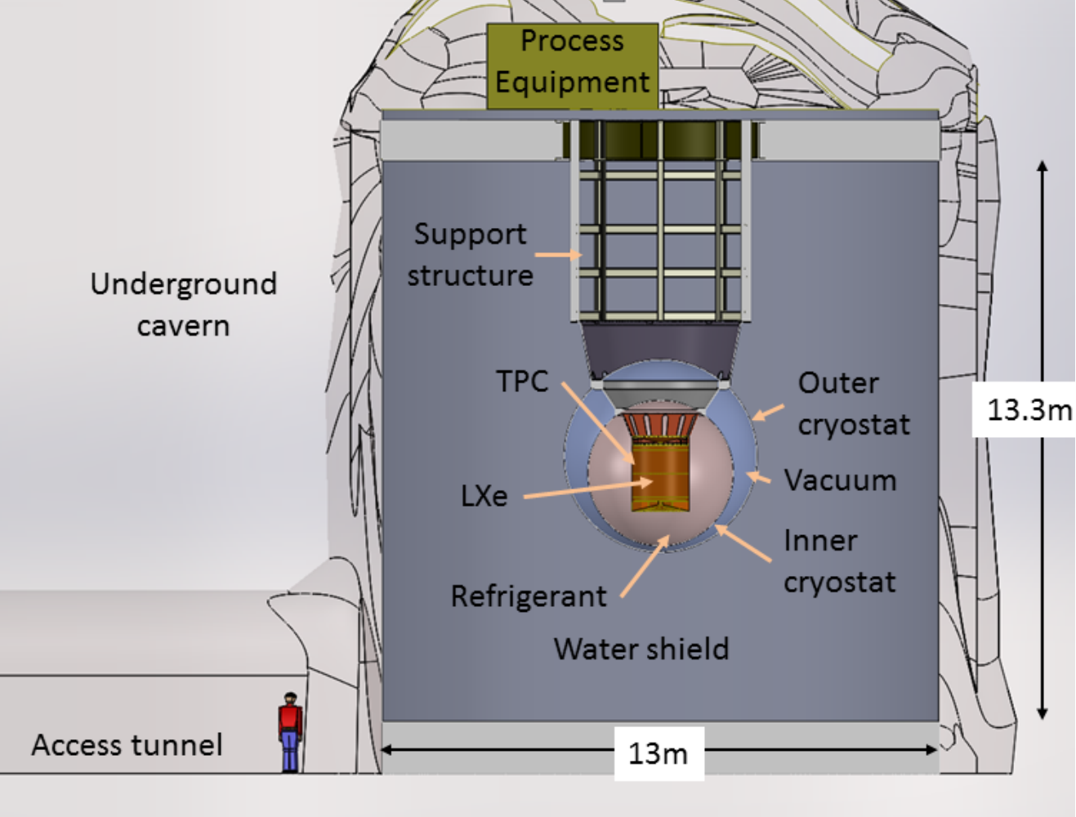
nEXO: a search for neutrinoless double beta decay (0νββ)
2νββ:
0νββ:
  If 0νββ detected,
    Validate neutrinos to be their own anti-particles (Majorana)
    Derive neutrinos’ absolute mass
    …
  Challenge: 0νββ half-life > 10²⁶ yrs
    Requires low background
      Underground detector
      Radiation shielding
      Barium tagging
        A 5-year upgrade to nEXO

Slide 3
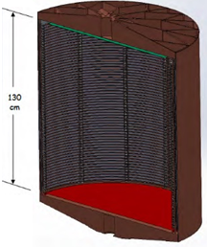
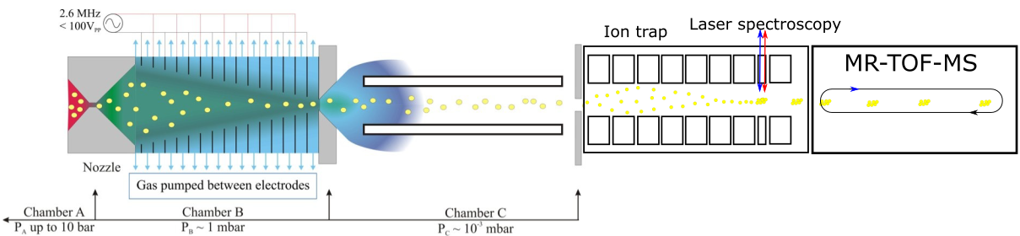
Barium tagging: the ultimate method for background rejection
Multiple approaches to barium tagging in nEXO:
  Stanford U: laser resonance ionization, mass spectrometry
  Colorado State U: cold probe, laser spectroscopy
  McGill, Carleton, TRIUMF: RF funnel, ion trap, laser spectroscopy, mass spectrometry
“An apparatus to manipulate and identify individual Ba ions from bulk liquid Xe”
K. Twelker et al., Rev. Sci. Instrum. 85, 095114 (2014)
“Imaging individual Ba atoms in solid xenon for barium tagging in nEXO”
C. Chambers, et al., Nature 569, 203-207 (2019)
“An RF-only ion-funnel for extraction from high-pressure gases”
T. Brunner, et al., Int. J. Mass Spec. 379, 110 (2015)
RF funnel
Mass spectrometry
nEXO TPC

Slide 4
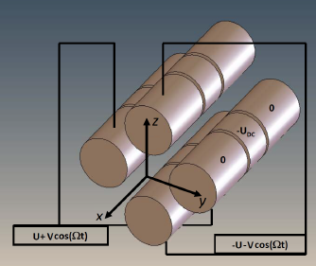

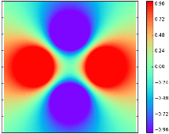
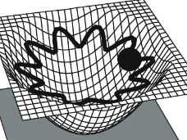
Linear quadrupole ion trap (LQIT): radial dimension
Radio frequency (RF) quadrupoles for ion confinement
- V_{RF}
V_{RF}
V_{RF}
- V_{RF}
Figure credit: Green (2010)
Vary at radio frequency
Radial confinement
Pseudopotential
Figure credit: Molhave (2000)

Slide 5
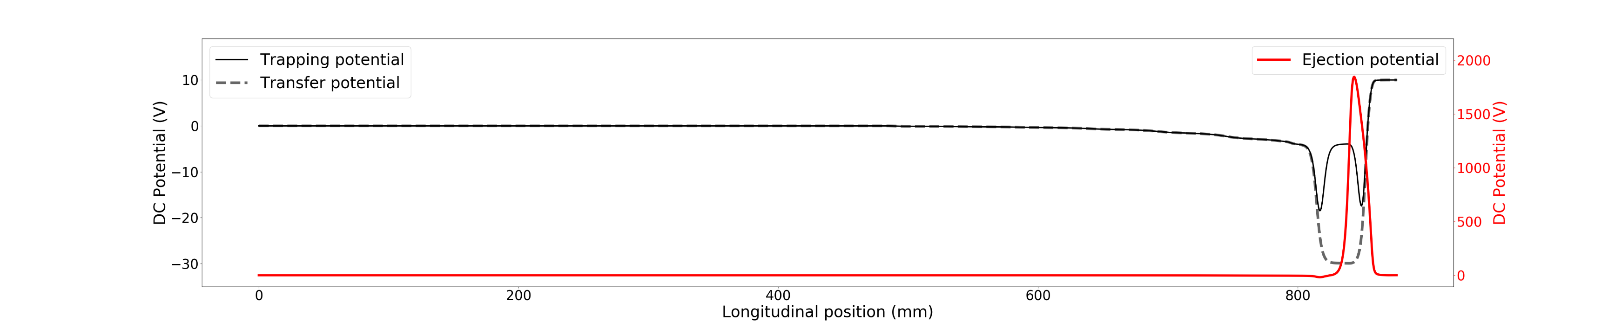
Linear quadrupole ion trap (LQIT): longitudinal dimension
Components:
  Quadrupole mass filter (QMF): ion purification according to ion mass-to-charge ratio
  Cooler: cool ions with helium buffer gas
  Ion storage: identify barium with laser spectroscopy
  Buncher: Ion ejection for a Multi-Reflection Time-of-Flight (MR-TOF) mass spectrometer
QMF
Cooler
Ion storage
Buncher
Ions from RF funnel
Ions to MR-TOF
Longitudinal confinement

Slide 6
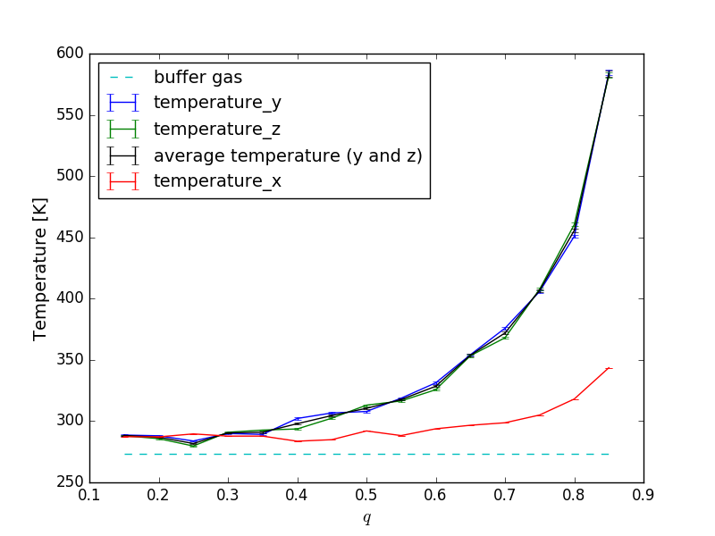
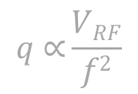
Simulations
High temperature ions are bad
  Doppler broadening in laser spectroscopy
  Worse time spread and energy spread of ions in MR-TOF
RF heating
$$q \text{∝}\frac{VRF}{f2}$$
AxialDepth: 4 V

Slide 7
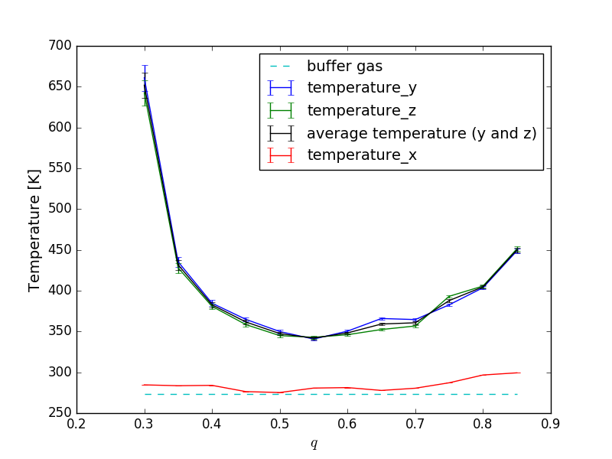
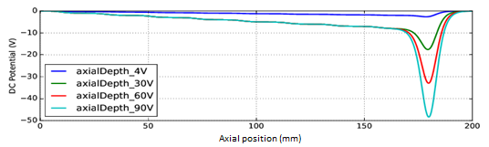
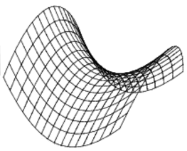

Simulations
Dependent on the axial trap depth and q value
  For a required axial trap depth of 30 V: lowest ion temperature at q = 0.55
AxialDepth: 30 V
Insufficient
trapping
RF heating
Laplace equation
quadrupole solution
$$q \text{∝}\frac{VRF}{f2}$$

Slide 8
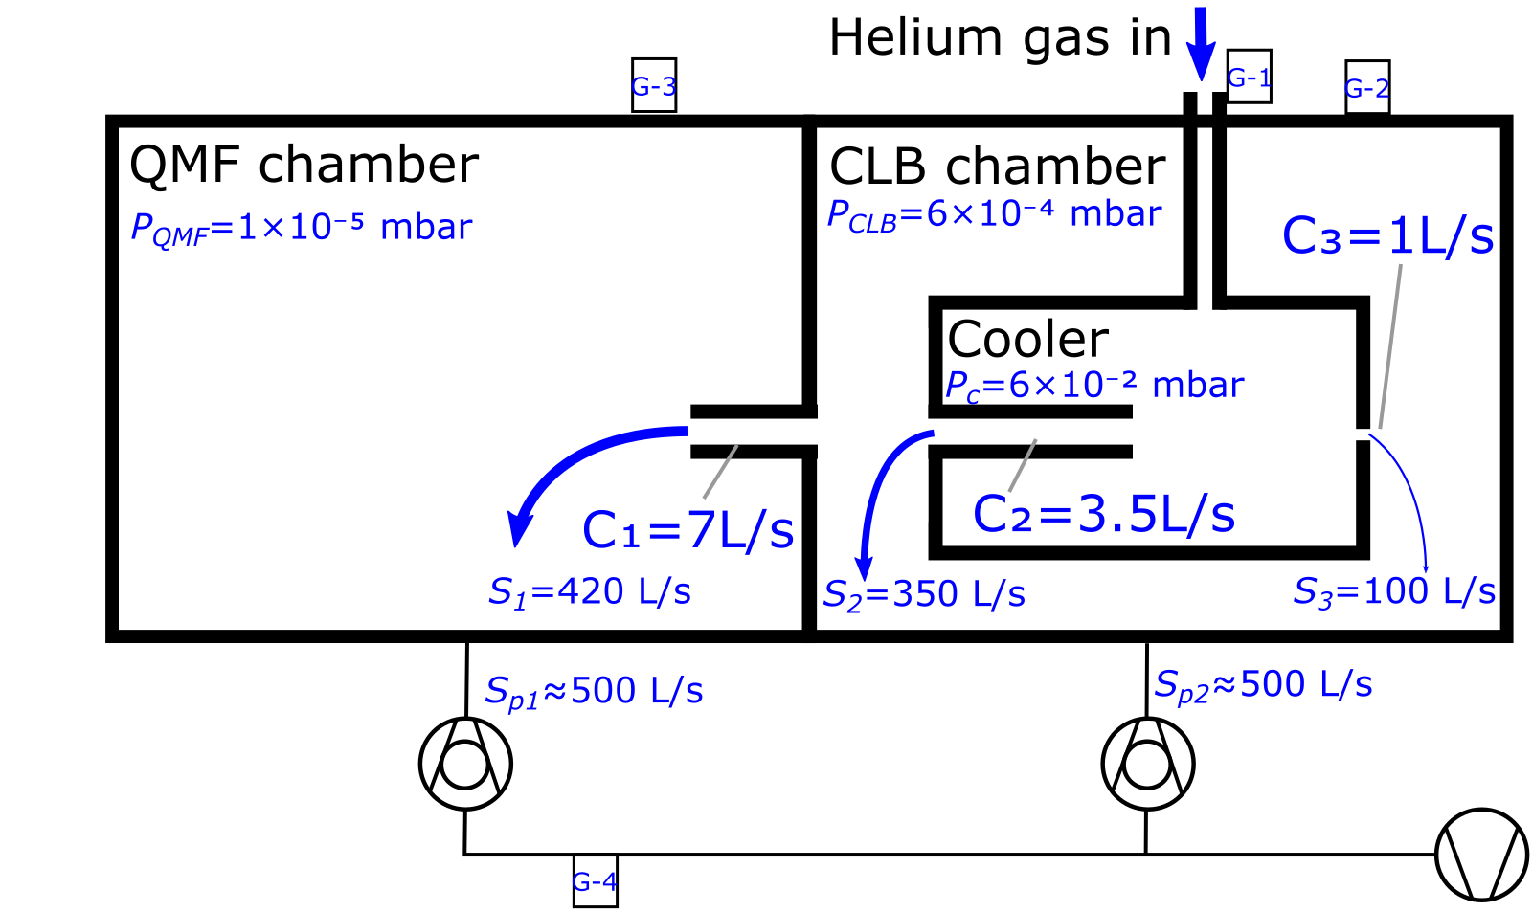
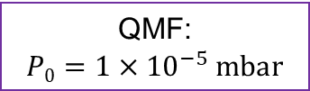


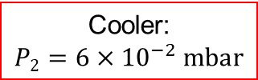

Vacuum requirements and design
  QMF requires as good vacuum as possible; cooler requires higher buffer gas pressure
QMF:
$$P0=1×{10}^{−5} mbar$$
Cooler:
$$P2=6×{10}^{−2} mbar$$
Laser Spec. region:
$$P3=6×{10}^{−4} mbar$$
Ion buncher:
$$P4=6×{10}^{−4} mbar$$
Pre-cooler:
$$P1=6×{10}^{−4} mbar$$
Differential
Pumping scheme:
Turbo molecular pump (TMP)
TMP
Backing pump

Slide 9
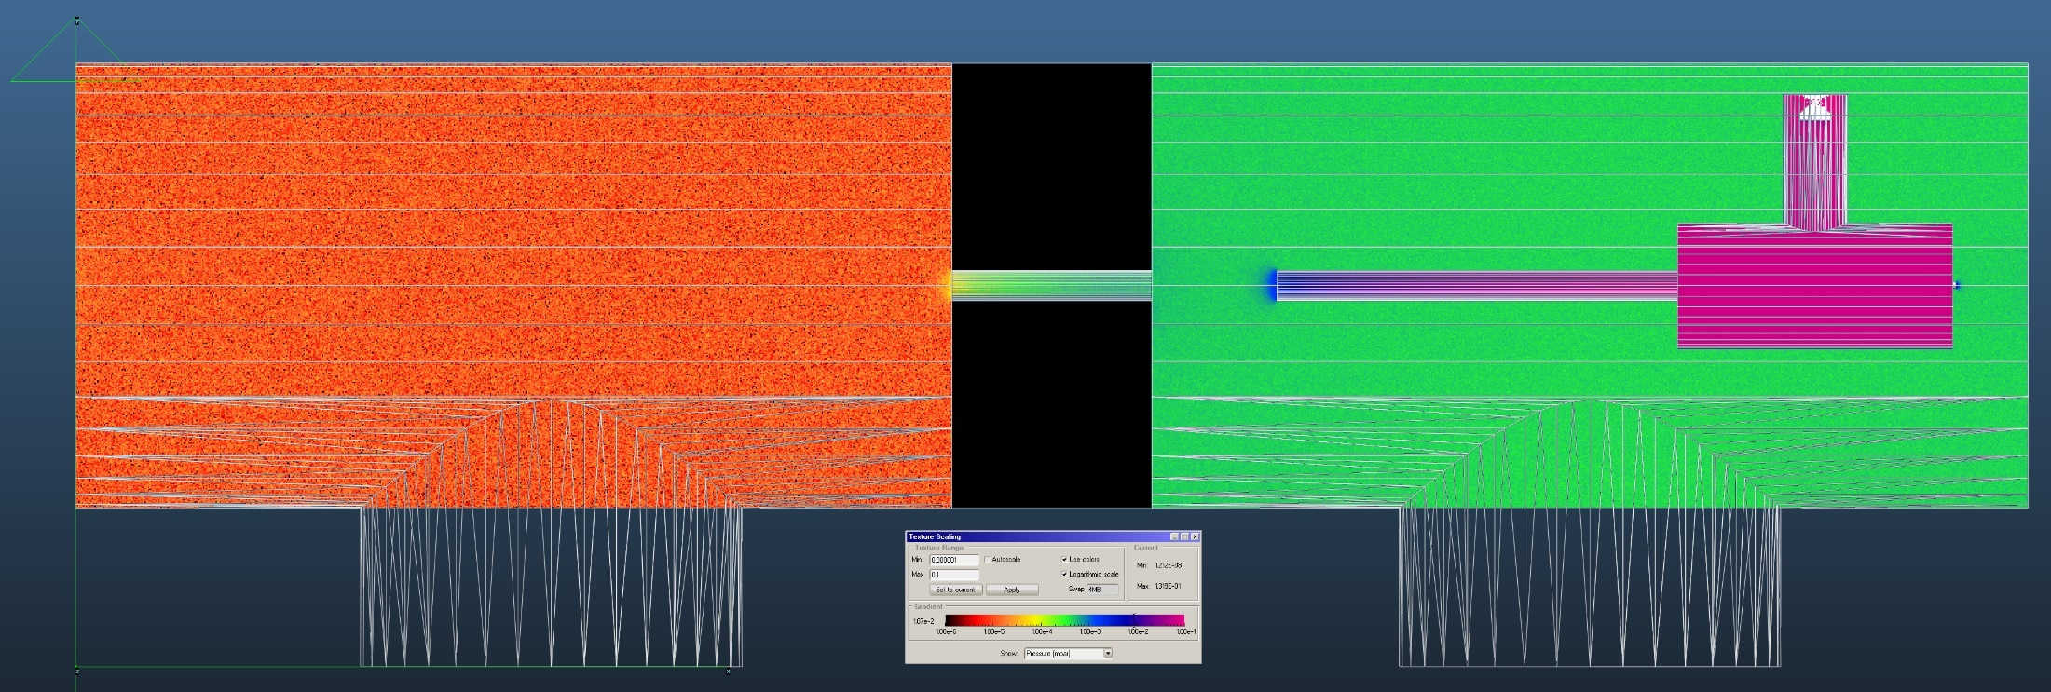
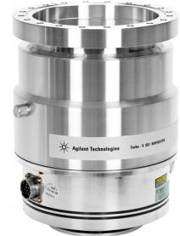
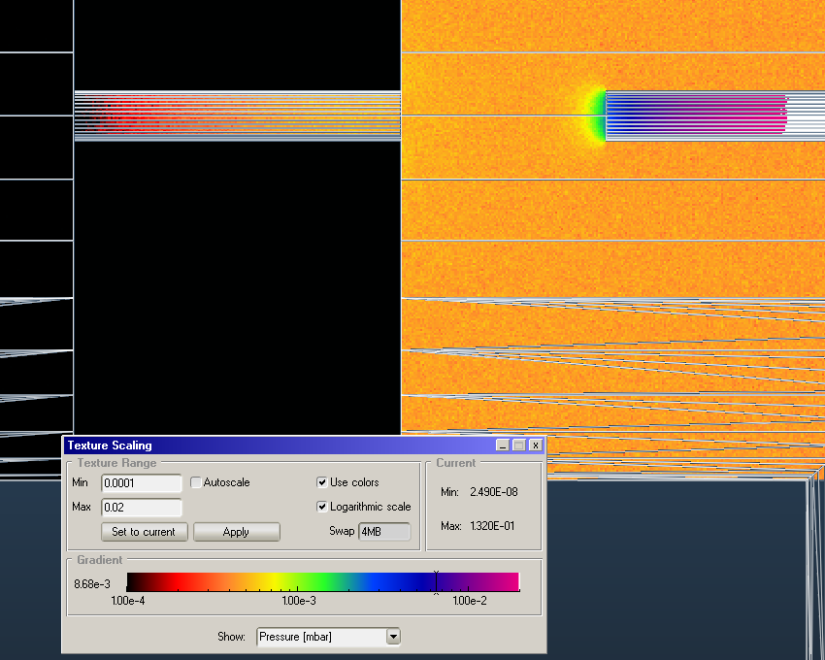
Vacuum simulation
Tool: Molflow+ (https://molflow.web.cern.ch)
  Molecular flow simulation using ray-tracing
Helium gas in
5 cm
1×10⁻⁵ mbar
6×10⁻² mbar
6×10⁻⁴ mbar
5×10⁻⁴ mbar
Pump
Pump
Avoid gas buildup

Slide 10
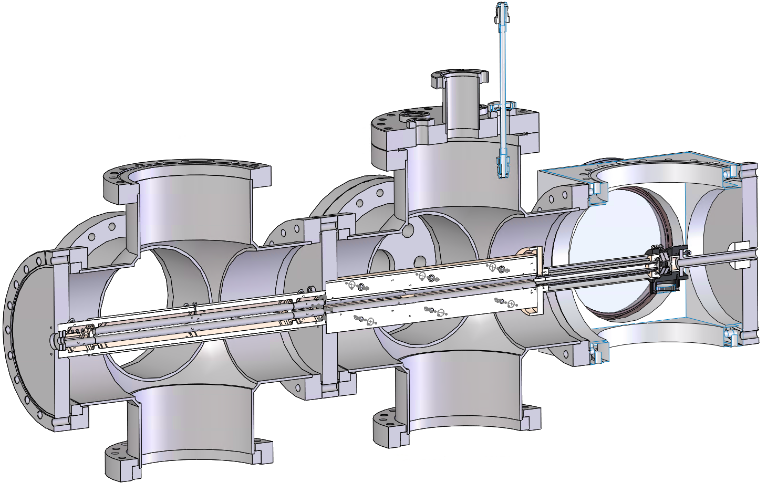
Mechanical design
Design and 3D drawings in Solidworks
  Completed in Nov 2018
Ions out
to MR-TOF
RF Cooler
Diff. pumping
QMF
Laser spec.
Ions in

Slide 11
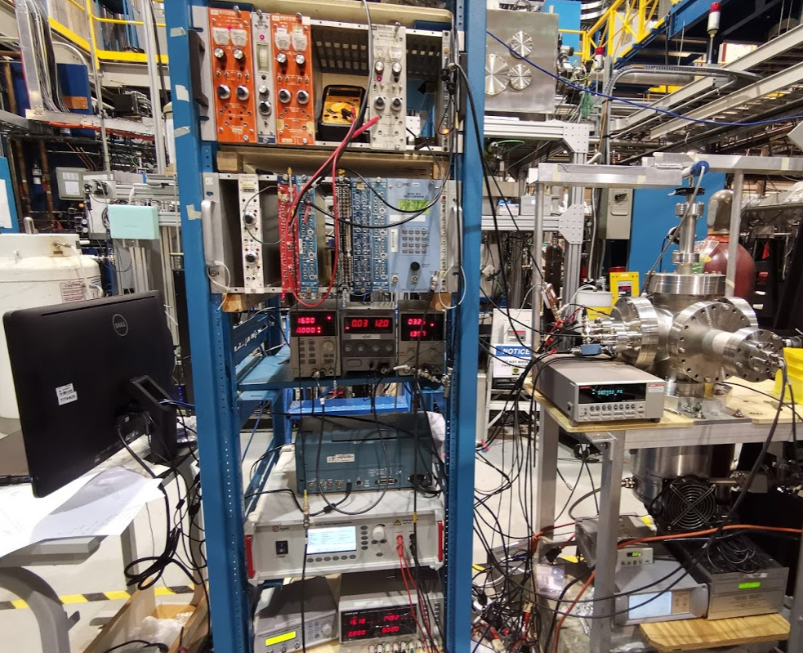
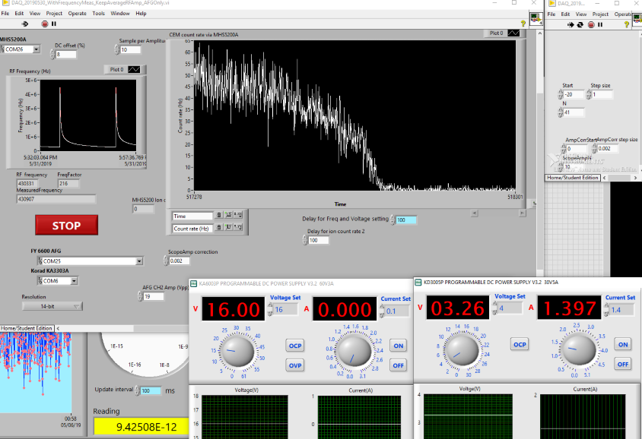
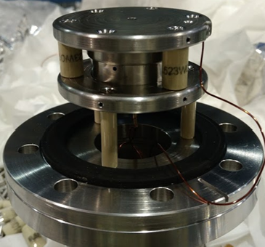
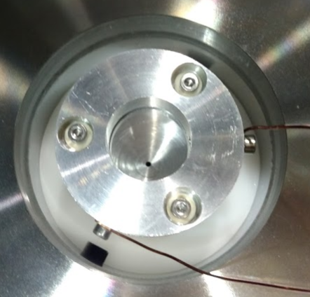
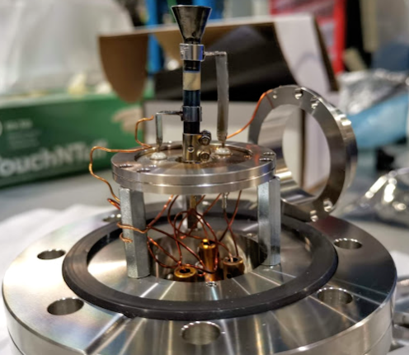
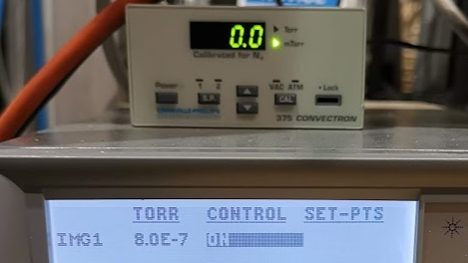
Experimental preparation
Electronics and data acquisition
Vacuum
Ion source
ion detector

Slide 12
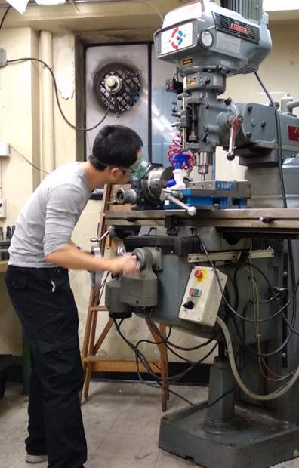
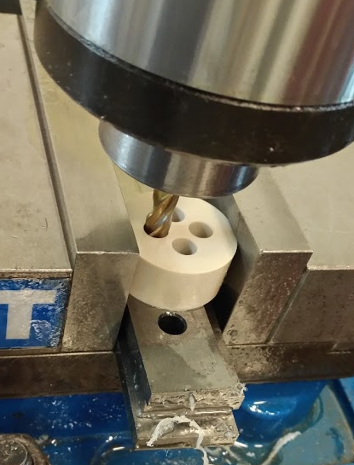
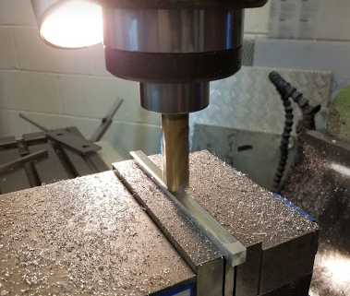
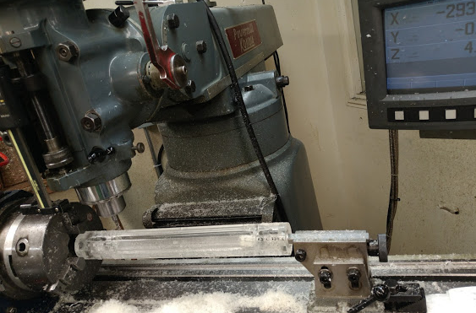
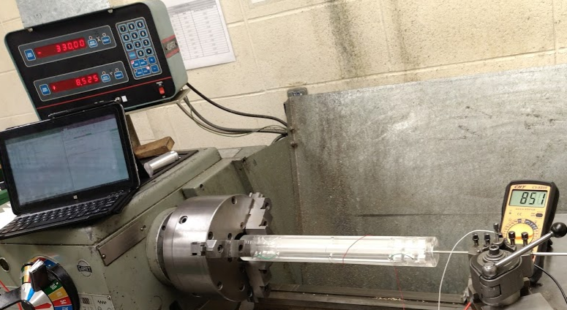
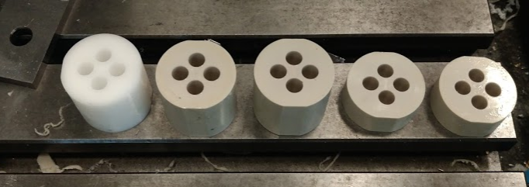
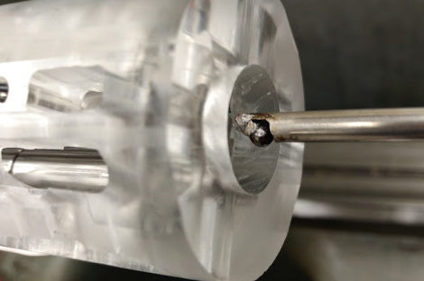
Prototypes
100+ happy hours in machine shop

Slide 13
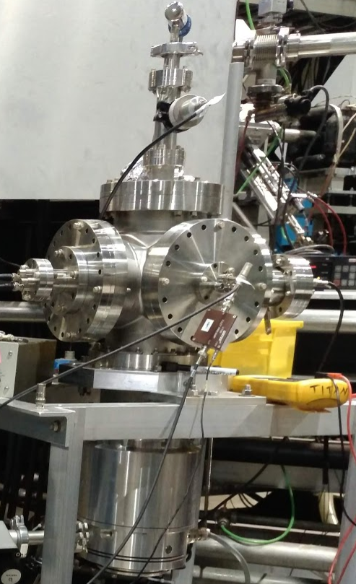
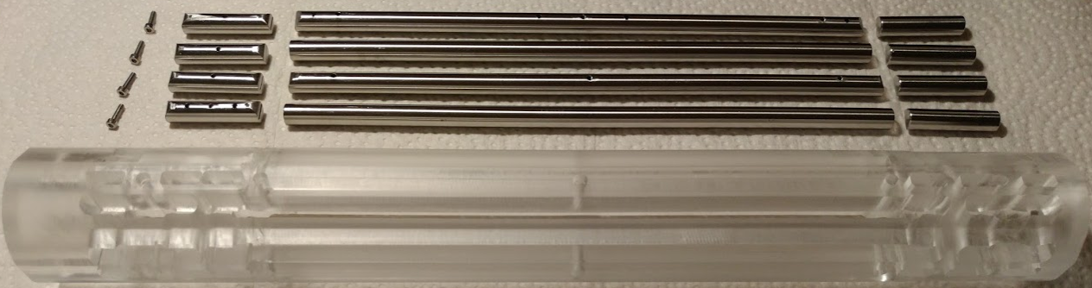

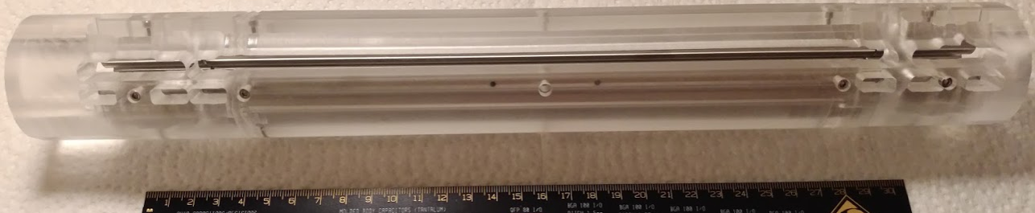
Quadrupole Mass Filter (QMF) prototypes
Acrylic QMF (V1.0)
  Novel design
  Mechanical tolerance ~ 0.2 mm
  Tested as an ion guide
    Saw optimum ion transmission at 20 Vpp, 530 kHz
    Things are working: electronics, DAQ, ion source, ion detector …
0.02 mm (20 μm) tolerance needed

Slide 14
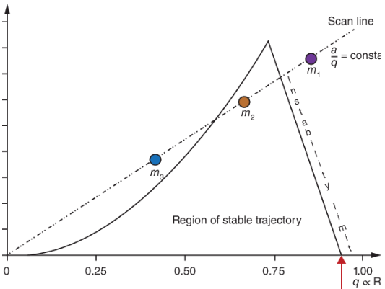
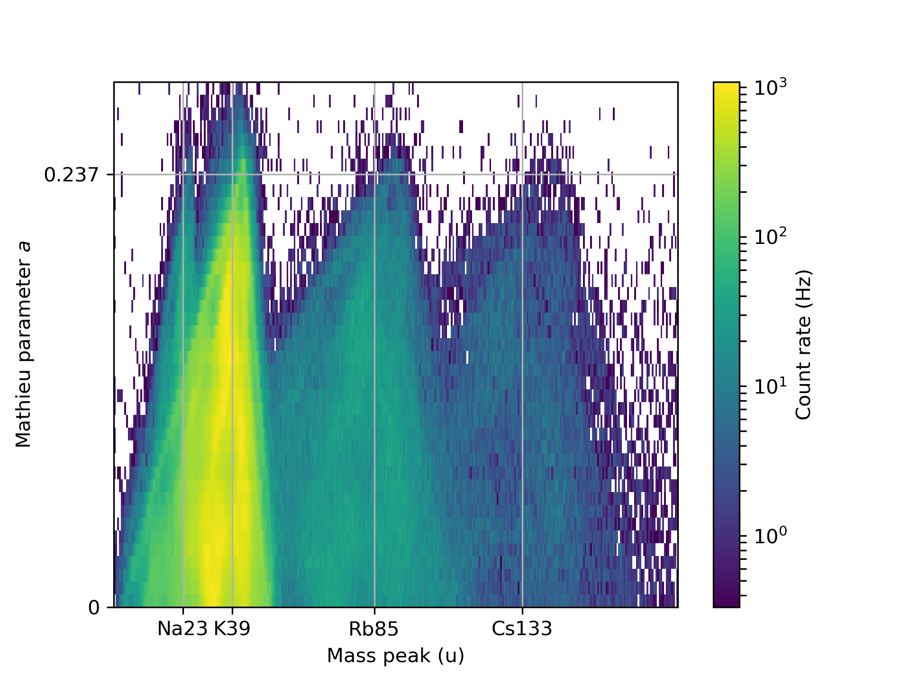
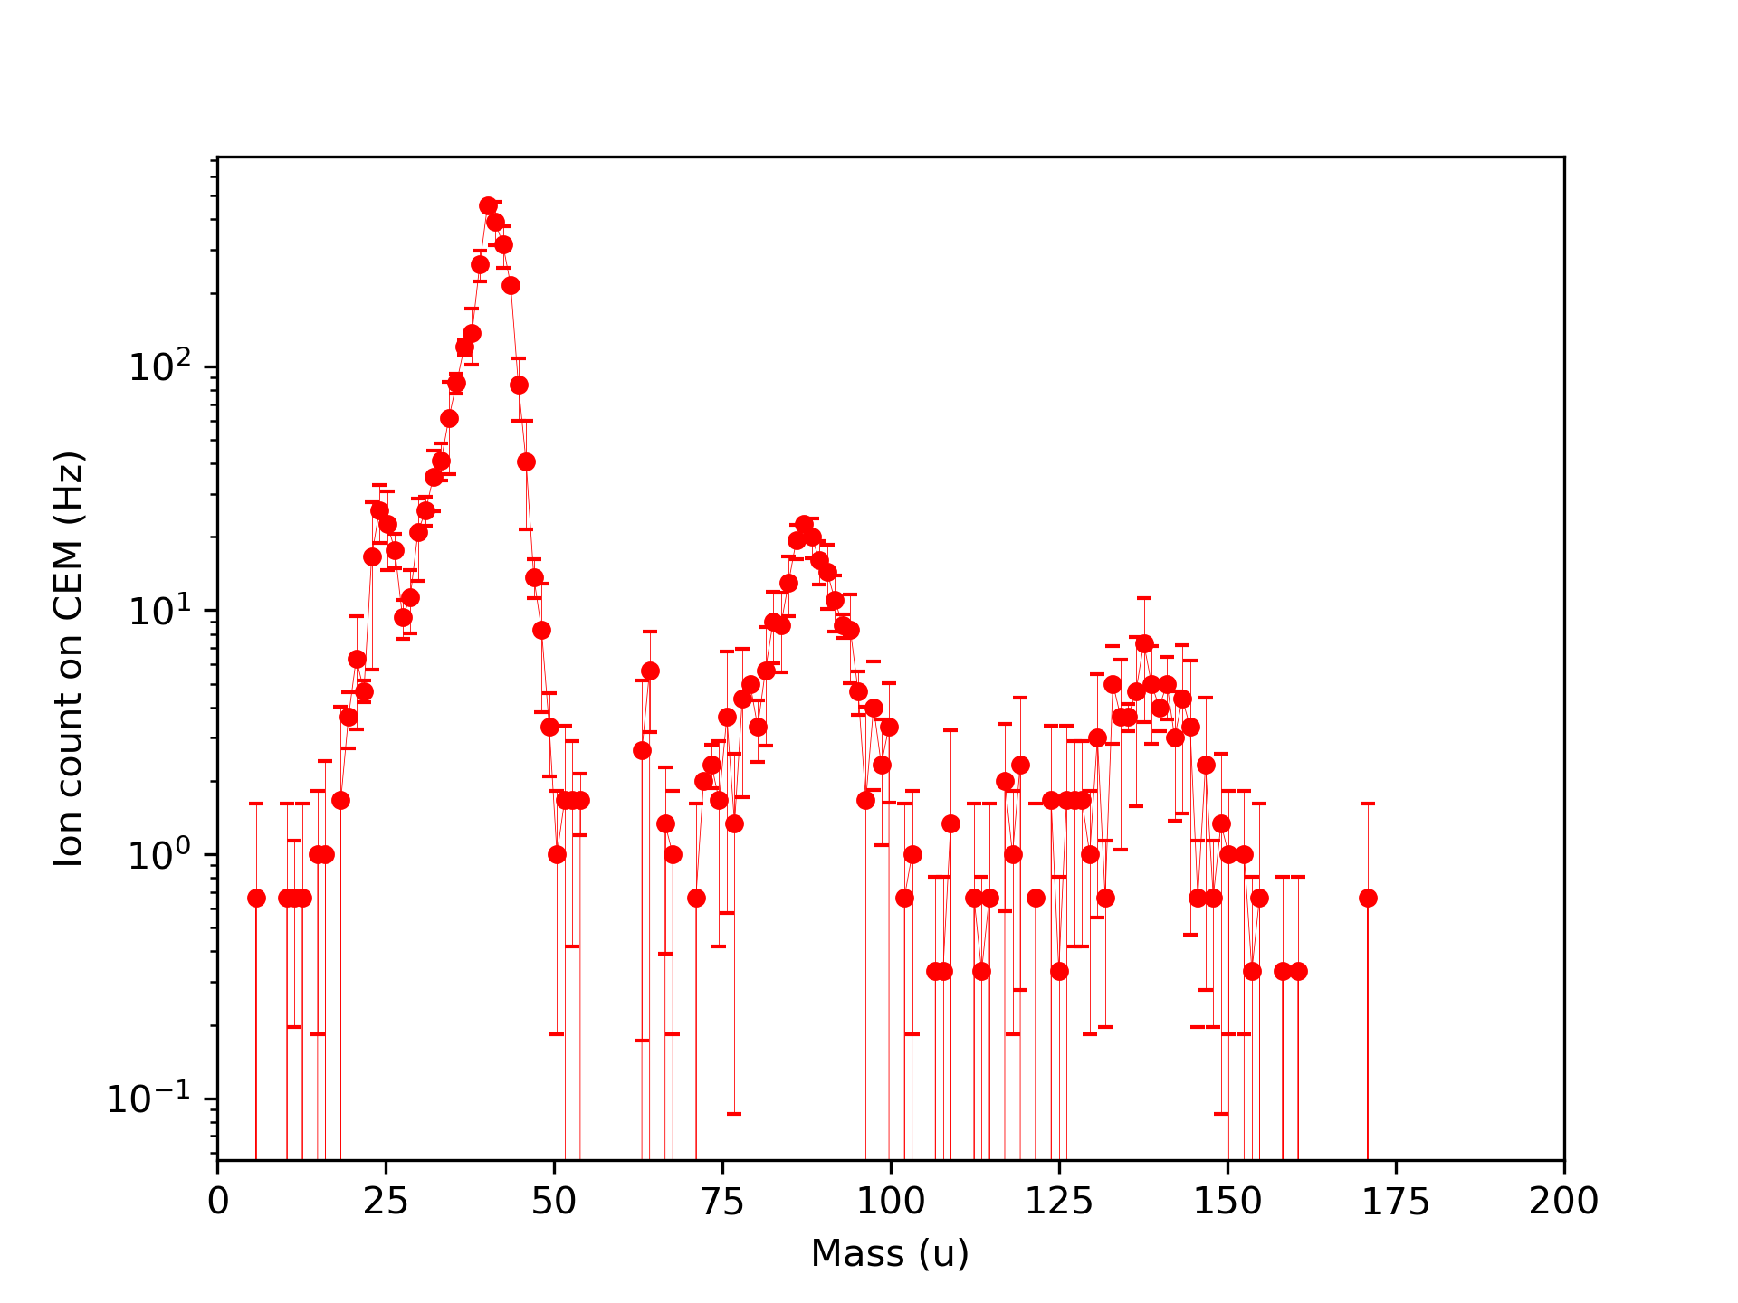
QMF V2.1
Mechanical tolerance ~ 50 μm (0.002'')
  RF amplitude: 20 Vp-p, frequency 0.3 to 0.9 MHz
Figure credit: Niessen (2017)
³⁹K
²³Na
⁸⁵Rb
¹³³Cs

Slide 15
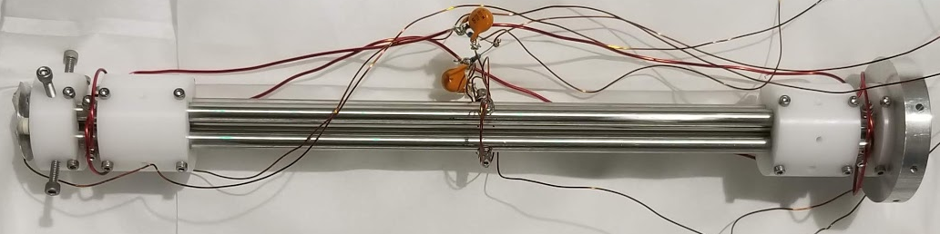
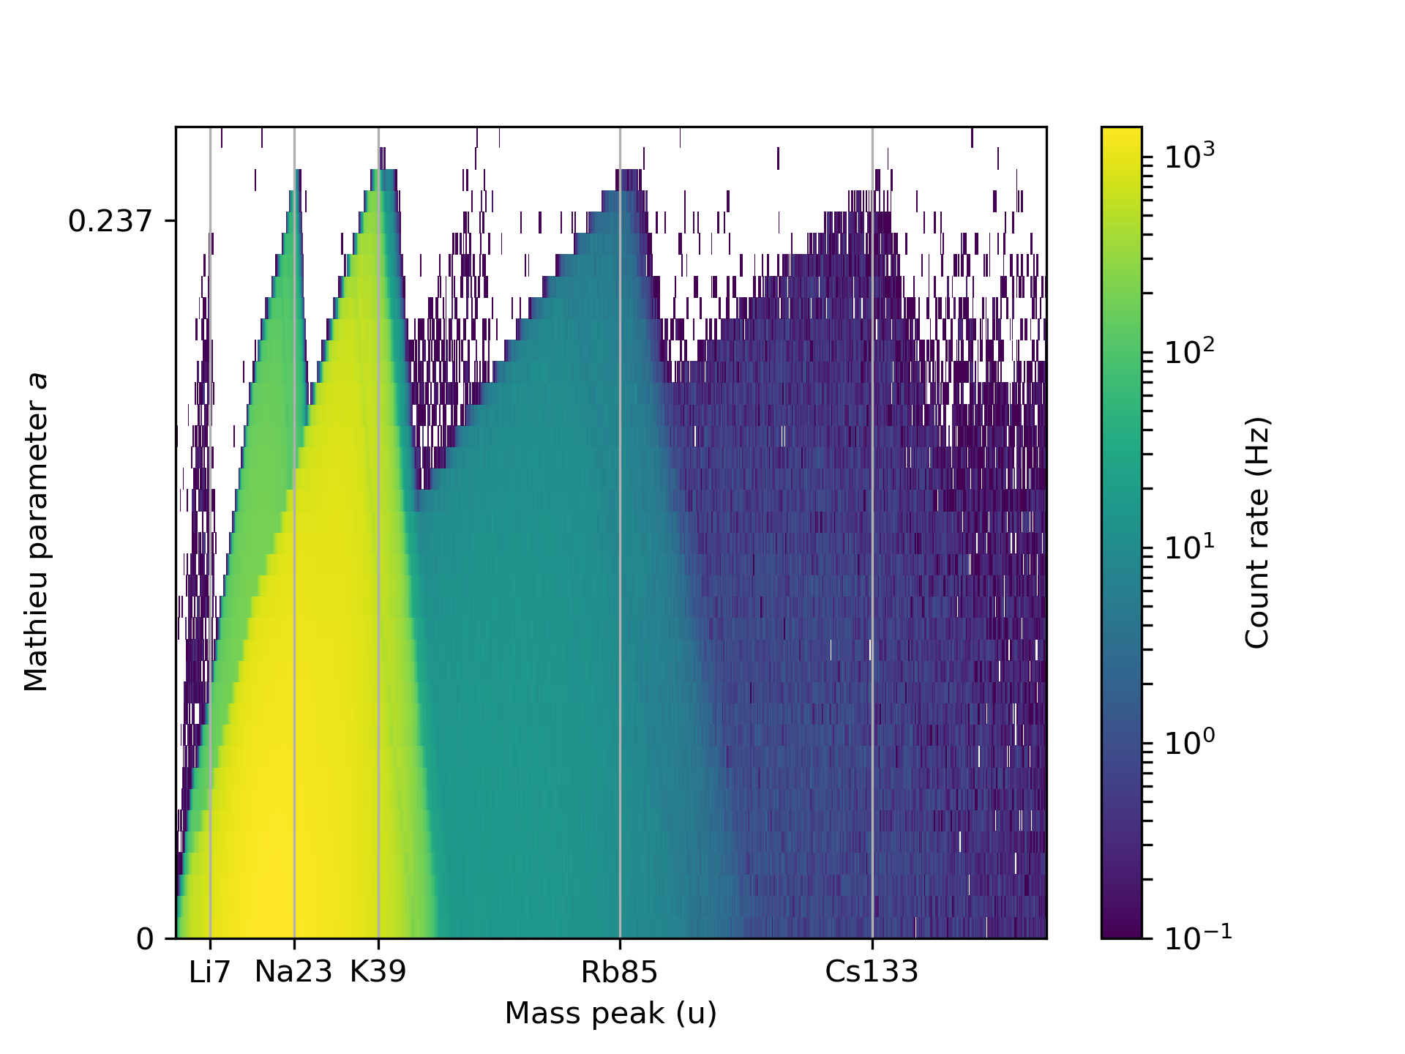
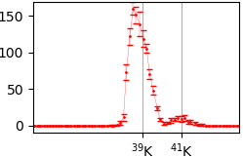
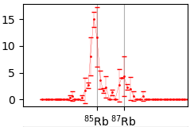
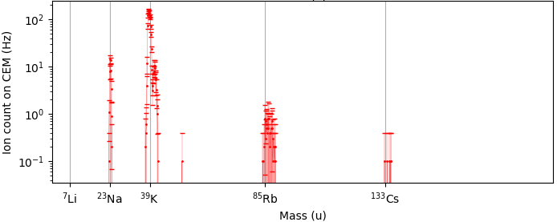
QMF V2.2
Mechanical tolerance <10 μm (0.0005'')
  RF amplitude: 200 Vp-p,
  frequency 0.7 to 1.8 MHz
Achievable mass resolving power: M/M_{FWHM}>100 ✓
Good enough to separate ¹³⁶Ba⁺ from its isotopes & contaminant ions

Slide 16
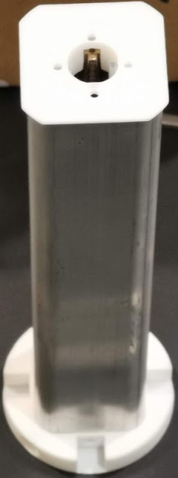
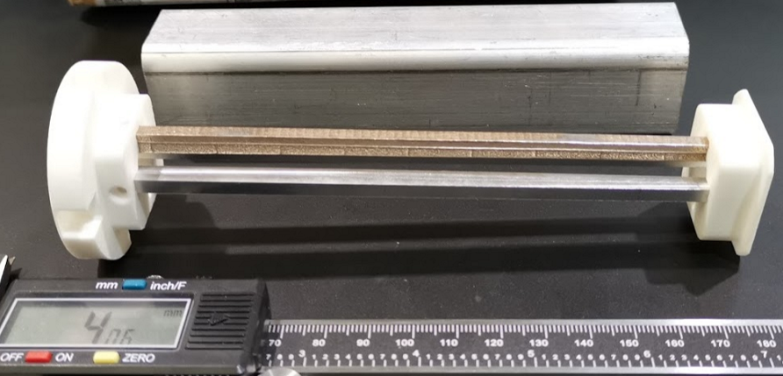
RF cooler prototype
More complicated geometries
Less tolerance requirement: 0.3 mm
Try 3D printing for rapid prototyping
  Tolerance ~ 0.1 mm ✓
  Tested vacuum compatibility
    Below 10⁻⁶ Torr within 10 hours of pumping ✓
Ongoing experiment with ion cooler:
  Ion trapping and ion ejection

Slide 17
Summary and outlook
Barium tagging is the unambiguous way for the ultimate background rejection of nEXO
A linear quadrupole ion trap (LQIT) is needed
  Simulated and designed
  Experimental setup
    A QMF prototype already meets requirements
    Tests with an RF cooler prototype are ongoing
MR-TOF under development at McGill
  The LQIT is to be tested together with RF funnel and
  MR-TOF next year

Slide 18


University of Alabama, Tuscaloosa AL, USA
M Hughes, O Nusair, I Ostrovskiy, A Piepke, AK Soma, V Veeraraghavan
University of Bern, Switzerland — J-L Vuilleumier
Brookhaven National Laboratory, Upton NY, USA
M Chiu, G Giacomini, V Radeka, E Raguzin, S Rescia, T Tsang
University of California, Irvine, Irvine CA, USA — M Moe
California Institute of Technology, Pasadena CA, USA — P Vogel
Carleton University, Ottawa ON, Canada
I Badhrees, R Gornea, C Jessiman, T Koffas, D Sinclair, B. Veenstra, J Watkins
Colorado State University, Fort Collins CO, USA
C Chambers, A Craycraft, D Fairbank, W Fairbank Jr, A Iverson, J Todd
Drexel University, Philadelphia PA, USA
MJ Dolinski, P Gautam, E Hansen, YH Lin, E Smith, Y-R Yen
Duke University, Durham NC, USA — PS Barbeau
Friedrich-Alexander-University Erlangen, Nuremberg, Germany
G Anton, J Hoessl, T Michel, M Wagenpfeil, T Ziegler
IBS Center for Underground Physics, Daejeon, South Korea — DS Leonard
IHEP Beijing, People’s Republic of China
G Cao, W Cen, Y Ding, X Jiang, Z Ning, X Sun, T Tolba, W Wei, L Wen, W Wu, X Zhang, J Zhao
IME Beijing, People’s Republic of China — L Cao, X Jing, Q Wang
ITEP Moscow, Russia
V Belov, A Burenkov, A Karelin, A Kobyakin, A Kuchenkov, V Stekhanov, O Zeldovich
University of Illinois, Urbana-Champaign IL, USA — D Beck, M Coon, J Echevers, S Li, L Yang
Indiana University, Bloomington IN, USA — JB Albert, SJ Daugherty, G Visser
Laurentian University, Sudbury ON, Canada
B Cleveland, A Der Mesrobian-Kabakian, J Farine, C Licciardi, A Robinson, U Wichoski
Lawrence Livermore National Laboratory, Livermore CA, USA
J Brodsky, M Heffner, A House, S Sangiorgio, T. Stiegler
University of Massachusetts, Amherst MA, USA S Feyzbakhsh, D Kodroff, A Pocar, M Tarka
McGill University, Montreal QC, Canada
T Brunner, K Murray, T Totev, L Darroch, S Al Kharusi, T McElroy
University of North Carolina, Wilmington, USA — T Daniels
Oak Ridge National Laboratory, Oak Ridge TN, USA — L Fabris, RJ Newby
Pacific Northwest National Laboratory, Richland, WA, USA
I Arnquist, EW Hoppe, JL Orrell, G Ortega, C Overman, R Saldanha, R Tsang
Rensselaer Polytechnic Institute, Troy NY, USA — E Brown, K Odgers
Université de Sherbrooke — F Bourque, S Charlebois , M Côté, D Danovitch, H Dautet,
R Fontaine, F Nolet, S Parent, JF Pratte, T Rossignol, J Sylvestre, F Vachon
SLAC National Accelerator Laboratory, Menlo Park CA, USA
S Delaquis, A Dragone, G Haller, LJ Kaufman, B Mong, A Odian, M Oriunno, PC Rowson, K Skarpaas
University of South Dakota, Vermillion SD, USA — T Bhatta, A Larson, R MacLellan
Stanford University, Stanford CA, USA — J Dalmasson, R DeVoe, D Fudenberg,
G Gratta, M Jewell, S Kravitz, G Li, M Patel, A Schubert, M Weber, S Wu
Stony Brook University, SUNY, Stony Brook NY, USA — K Kumar, O Njoya
Technical University of Munich, Garching, Germany — P Fierlinger, M Marino
TRIUMF, Vancouver BC, Canada — J Dilling, P Gumplinger, R Krücken, Y Lan, F Retière, V Strickland
Yale University, New Haven CT, USA — A Jamil, Z Li, D Moore, Q Xia
Also thanks to the TITAN group at TRIUMF for discussions and equipment!

Slide 19

Vacuum simulation
Tool: Molflow+ (https://molflow.web.cern.ch)
  Molecular flow simulation using ray-tracing
Simplified geometry

Slide 20


QMF performance
Transmission efficiency vs mass resolving power
G:\LinearPaulTrap\Experiment\Data\AcetalQMS_20190218\20190404\KPeaks_DC16.2Step0.5percent

Slide 21

QMS performance simulation
Transmission efficiency
  – acceptance
Mass resolving power
Validate mechanical tolerance

Slide 22





Measure QMS electrode tolerance
Use the digital readout on a lathe

Slide 23


RF ion cooler
Novel rectangular electrode for cooler
  Optimum configuration: width/r₀=0.7
    Thickness doesn’t matter much
For reference, circular quadrupole electrodes:
  r_{e}/r₀=1.145

Slide 24



Novel rectangular electrode for cooler
Housed in a floated metal tube (~ -100 V)
  Change electrode width to create DC drag field

Slide 25



Novel rectangular electrode for cooler
Width: 4 mm
Width: 2mm

Slide 26



Laser spectroscopy
Initial study at Stanford (~2005)
now at Carleton University

