Slide 1
Simultaneous Positron Emission Tomography/Magnetic Resonance (PET/MR) Imaging
Melanie Martin
University of Winnipeg
Presented on behalf of The University of Winnipeg Brain Imaging and Metabolic Research Lab with:
Sidney Leggett (University of Winnipeg); Vanessa Palmer (Cubresa, Inc); Sheryl Herrera (University of Winnipeg, Cubresa, Inc.); Katrina Armstrong (University of Manitoba); Katinka Stecina (University of Manitoba); Melissa Anderson (University of Winnipeg); Henri Sanness Salmon(University of Winnipeg); Huixin Zhang (Winnipeg Regional Health Authority); Michael Zhang (University of Winnipeg); Liping Huang (Chinese PLA General Hospital, Beijing, China)

Slide 2
Outline
MR (magnetic resonance) and PET (positron emission tomography) imaging
Simultaneous PET-MR (our latest development)
  What it is
  How it works
  Preliminary results

Slide 3
What is PET imaging?

Slide 4
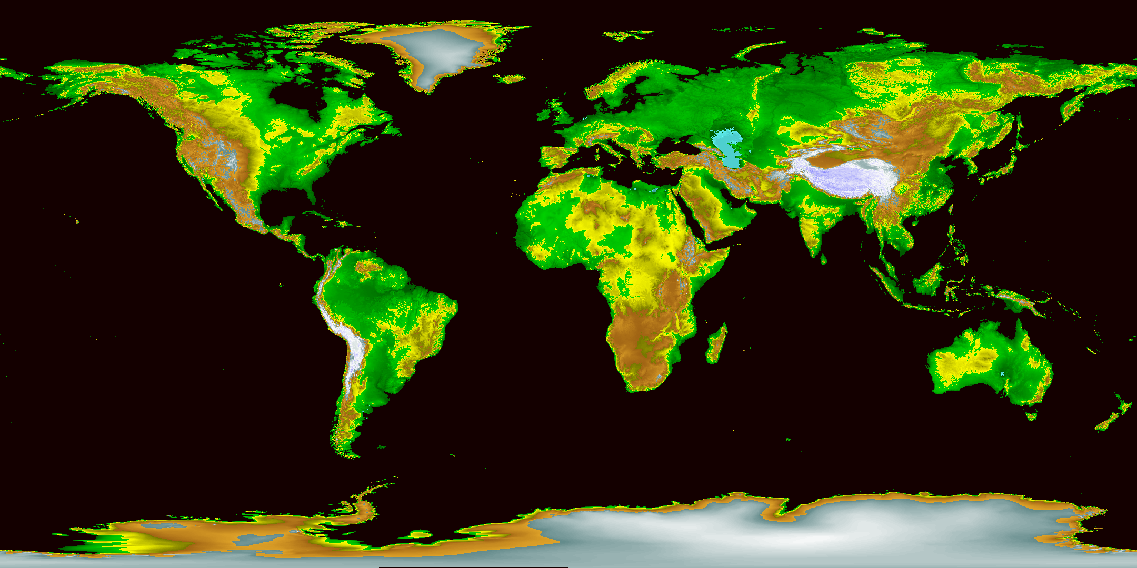
An Anatomical Image of the Earth
Slides courtesy of Andrew Goertzen, University of Manitoba

Slide 5
What is PET, and how is it different from MRI and CT?
PET
PET stands for Positron Emission Tomography
Is a functional imaging modality
Involves the injection of a positron emitting radio-nuclide to act as a tracer
Image is of the distribution of the radio-nuclide in the object being imaged
Slides courtesy of Andrew Goertzen, University of Manitoba

Slide 6
Physics of Positron Emission p → n + ν + β⁺ + energy
Unstable proton-rich ¹⁸F*
Conservation of energy and momentum
ν
¹⁸₉F₉
β+ slows down through collisions with electrons
-
β⁺ (ΚΕ=Ε)
+
¹⁸₈O₁₀
511 keV
e and β⁺ form positronium
short lived (0.1 ns)
+
-
+
-
electron-positron
annihilation
180°
* ¹⁸F is an isotope of the stable, natural fluorine ¹⁹₉F₁₀
511 keV
Notes:
A diagram of p emission process

Slide 7
PET System
The back-to-back photons produced in e⁺-e⁻ annihilation are detected using rings of detectors
The origin of the photons lies
on the line connecting the two detectors, called Line of Response (LOR)
An event is called coincidence when two photons are detected within a set time window (6-24 ns)
The recorded coincidence events make the image data
coincidence ?
yes
The event is recorded
An annihilation process

Slide 8
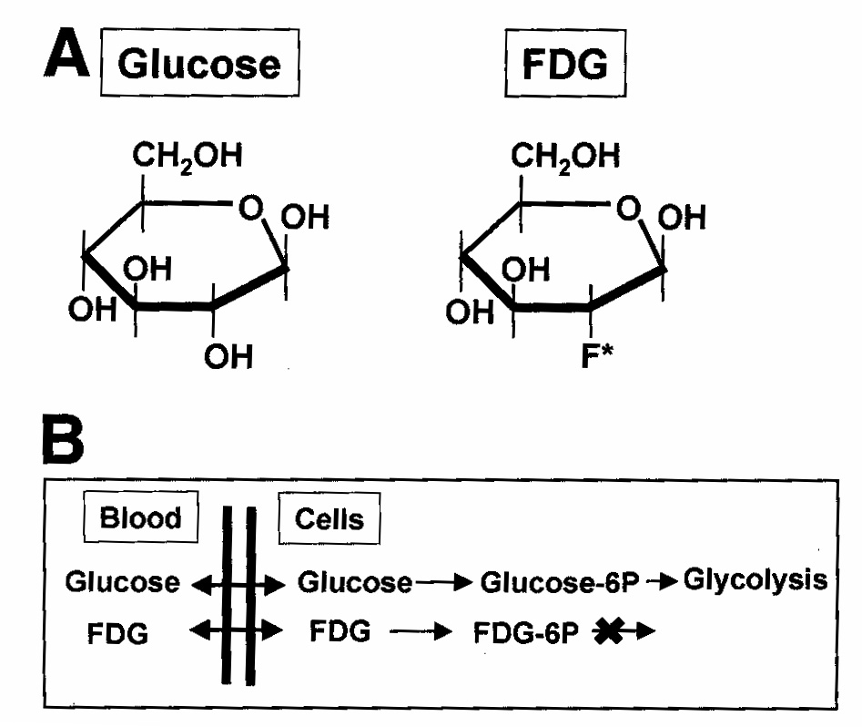
Synthesis of a PET Tracer
(Radiochemistry at Work)
PET radioisotope is attached to a biologically useful molecule
¹⁸F-FDG (fluorodeoxyglucose)
  an analog of glucose
  is a marker of glucose metabolism
  preferentially taken up in metabolically active cells
Figure from Mankoff DA et al. Sem in Rad Onc 2001;11(1):16-27
FDG is the most widely used PET radiopharmaceutical

Slide 9
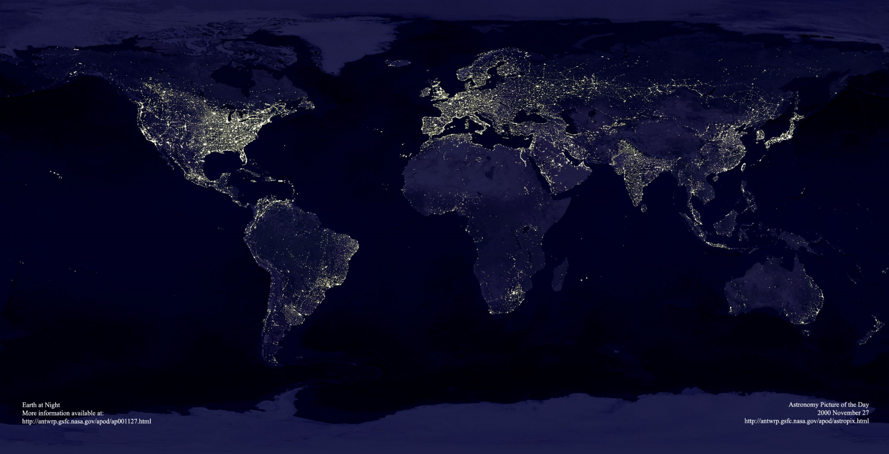
A Functional Image of the Earth
Slides courtesy of Andrew Goertzen, University of Manitoba

Slide 10
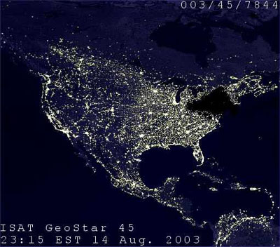
Functional Imaging of a Defect
Slides courtesy of Andrew Goertzen, University of Manitoba

Slide 11
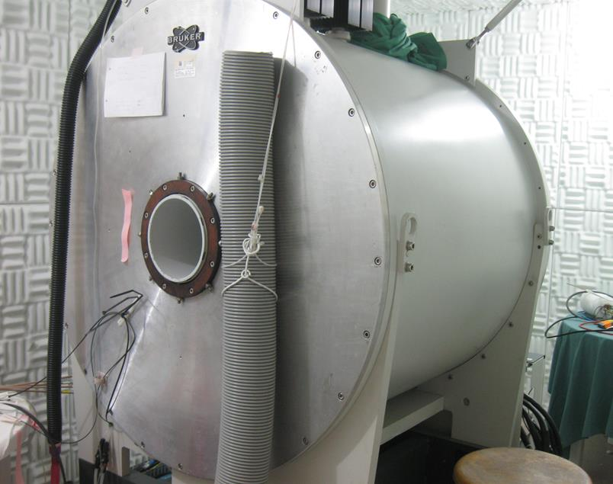
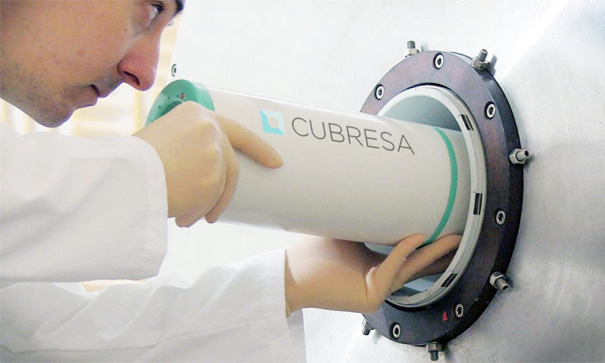
Simultaneous vs Sequential Multimodality Imaging
Traditionally images are collected from one modality, then the subject moved, and then images are collected from another modality. (Sequential)
If the subject moves between images or the anatomy and/or function changes with time, it is difficult to correlate the images.

Slide 12
Simultaneous vs Sequential Multimodality Imaging
Collecting both images simultaneously can overcome many of these problems
We use the NuPET system from Cubresa, Inc.
The PET scanner fits inside the bore of the MRI and images can be acquired simultaneously.

Slide 13
Simultaneous PET/MR images of rats
2 rats were imaged
PET tracer used was ¹⁸FDG
3D FISP MRI
Aims were to
  Register PET and MR images
  Segment out the brain
  Quantify SUV of FDG in the brain
  Describe the time course of the SUV
Aims 1 and 2 have been completed

Slide 14
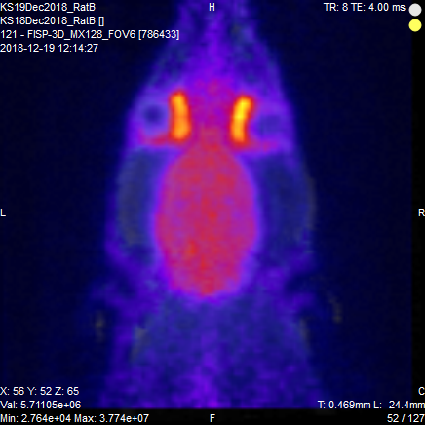
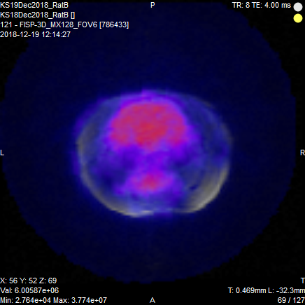
Images
eyes
harderian glands
brain

Slide 15
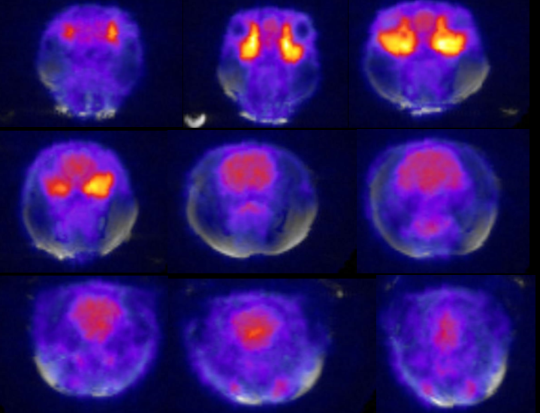
Images

Slide 16
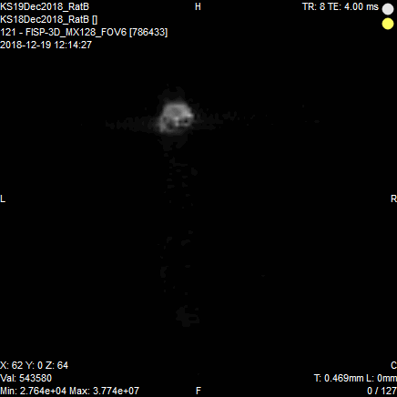
3D images – coronal view

Slide 17
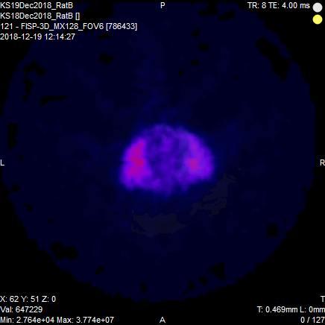
3D images – axial view

Slide 18
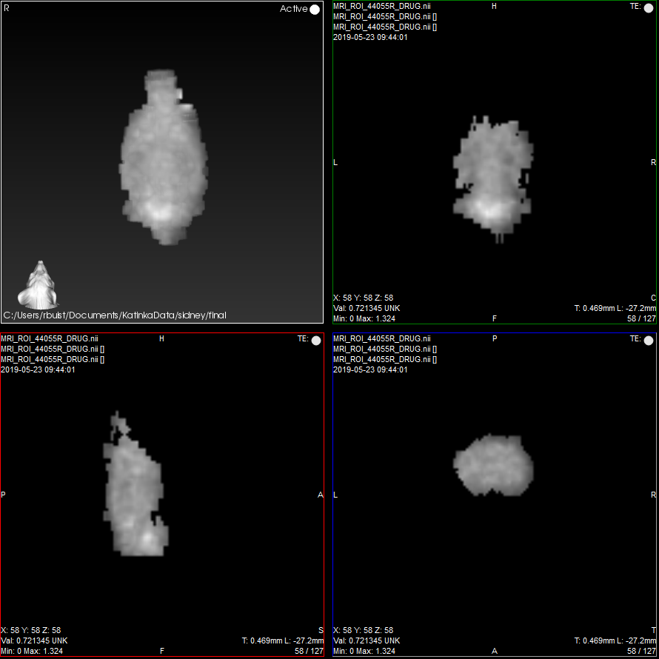
Segmented brain

Slide 19
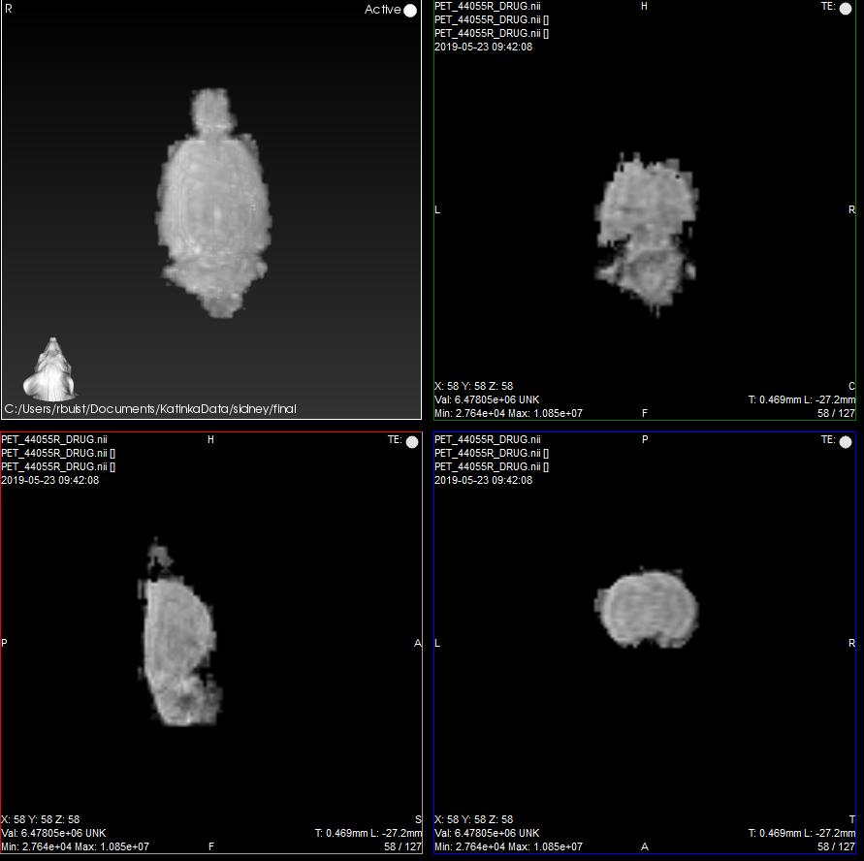
Segmented brain

Slide 20
Discussion and Conclusion
Simultaneous PET/MR allowed for
  The visualization of ¹⁸FDG uptake in the rat head
  Straight forward registration of the PET and MR images
  Straight forward segmentation of the brain
Next steps
  Quantify the FDG uptake
  Examine the time course

Slide 21
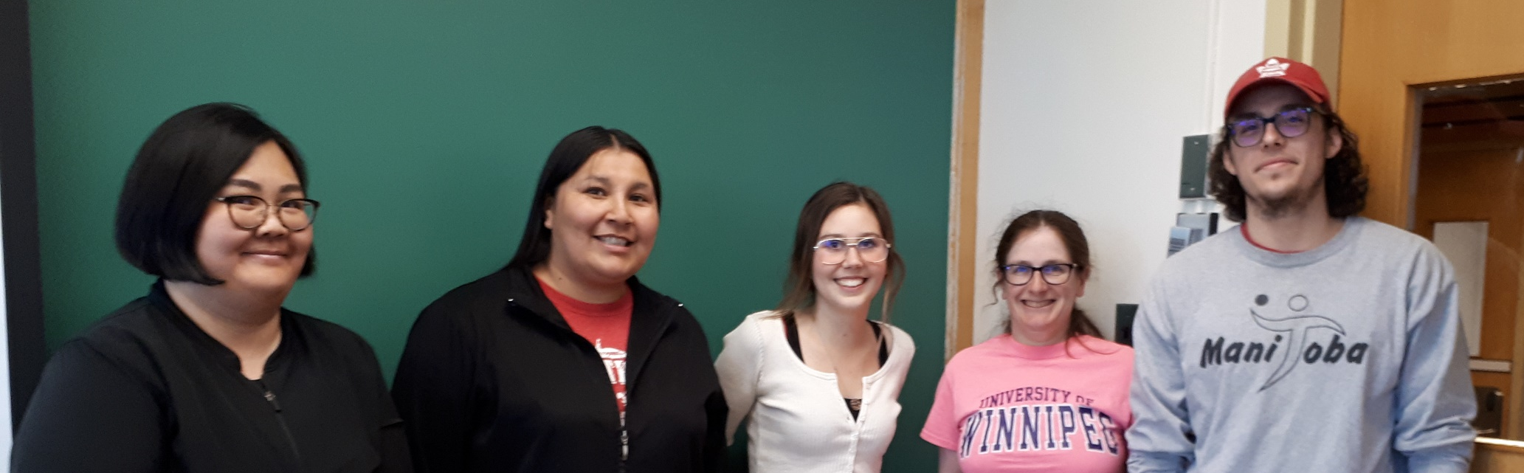

Acknowledgments

