Slide 1
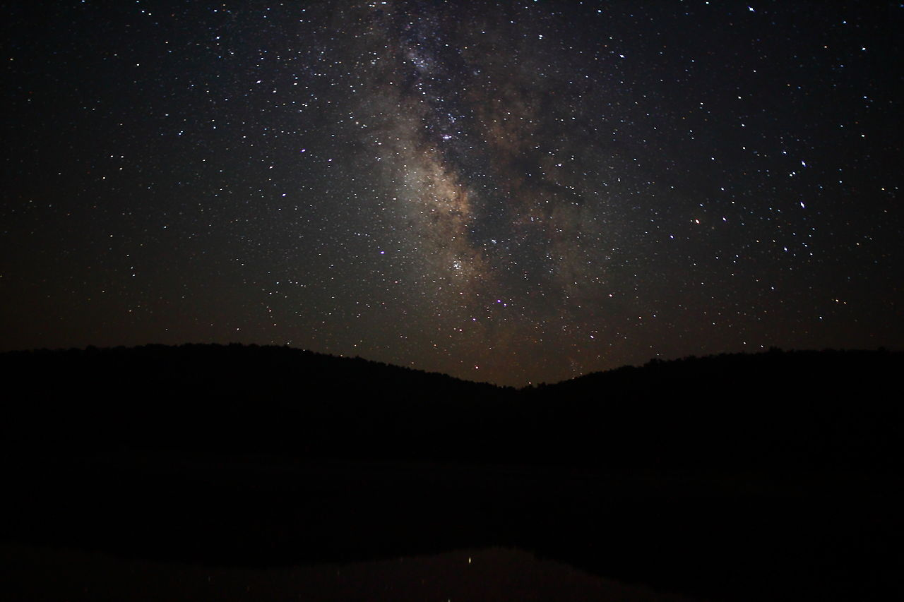

Status update on the McDonald Institute
Status update on CPARC
Tony Noble
Scientific Director, Queen’s University

Slide 2
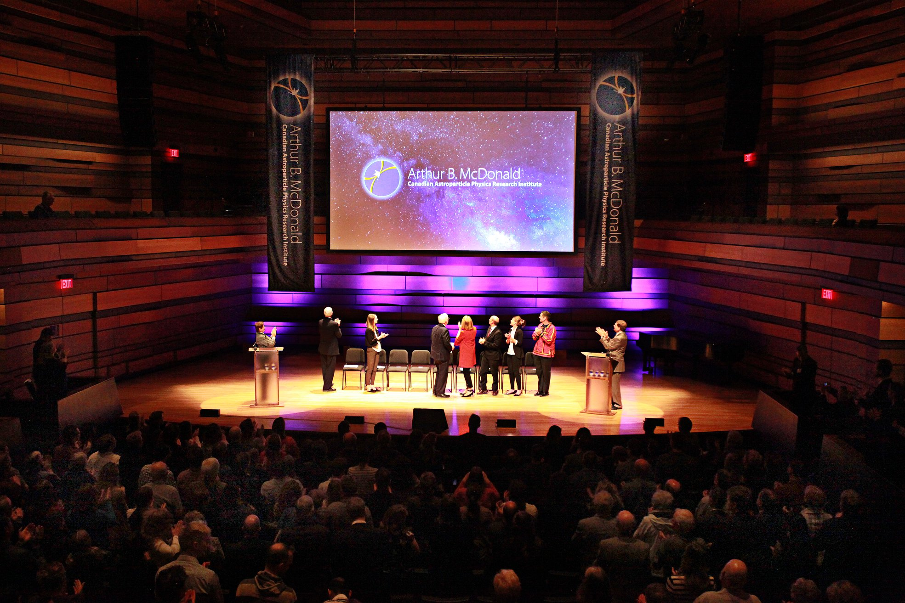
The Launch of the McDonald Institute

Slide 3
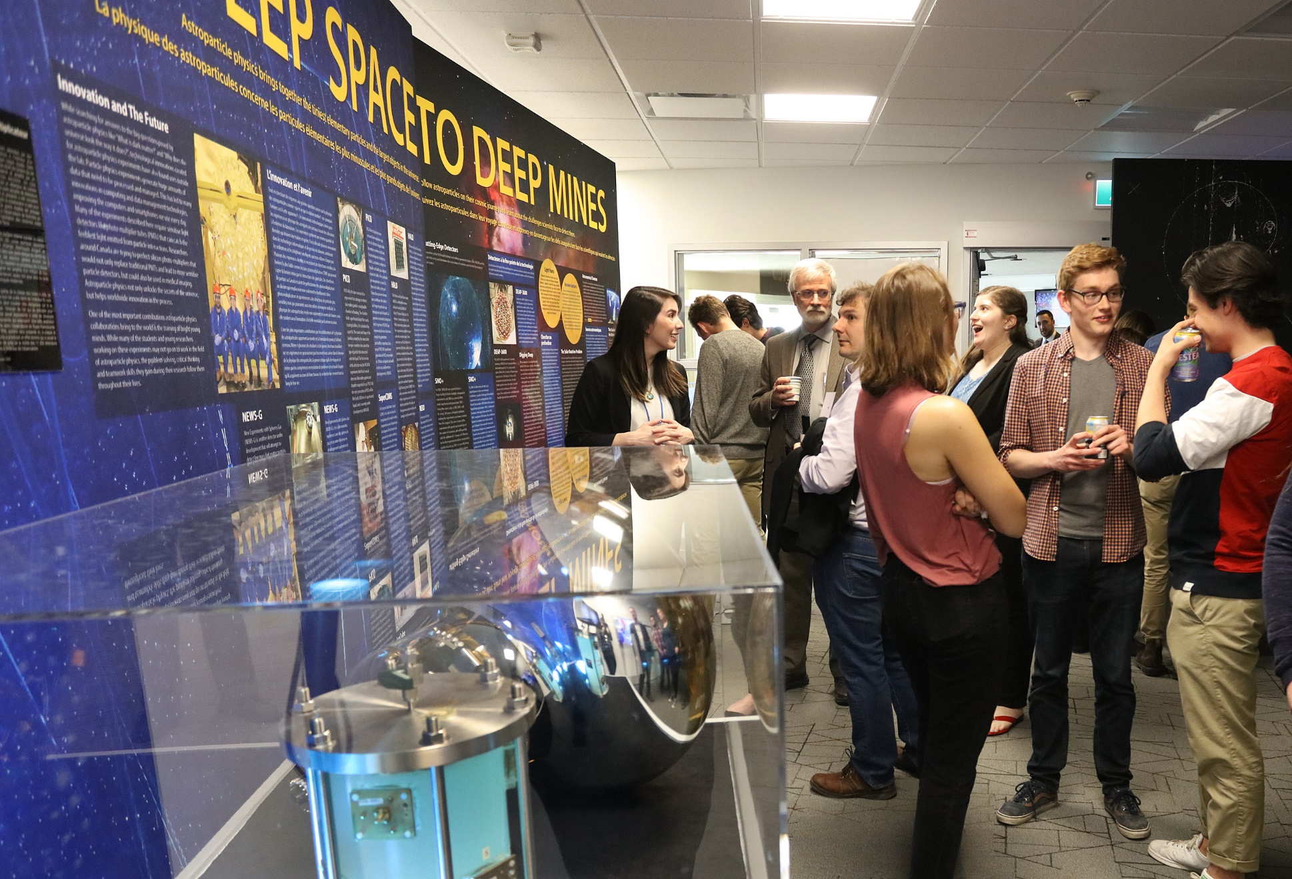

Slide 4
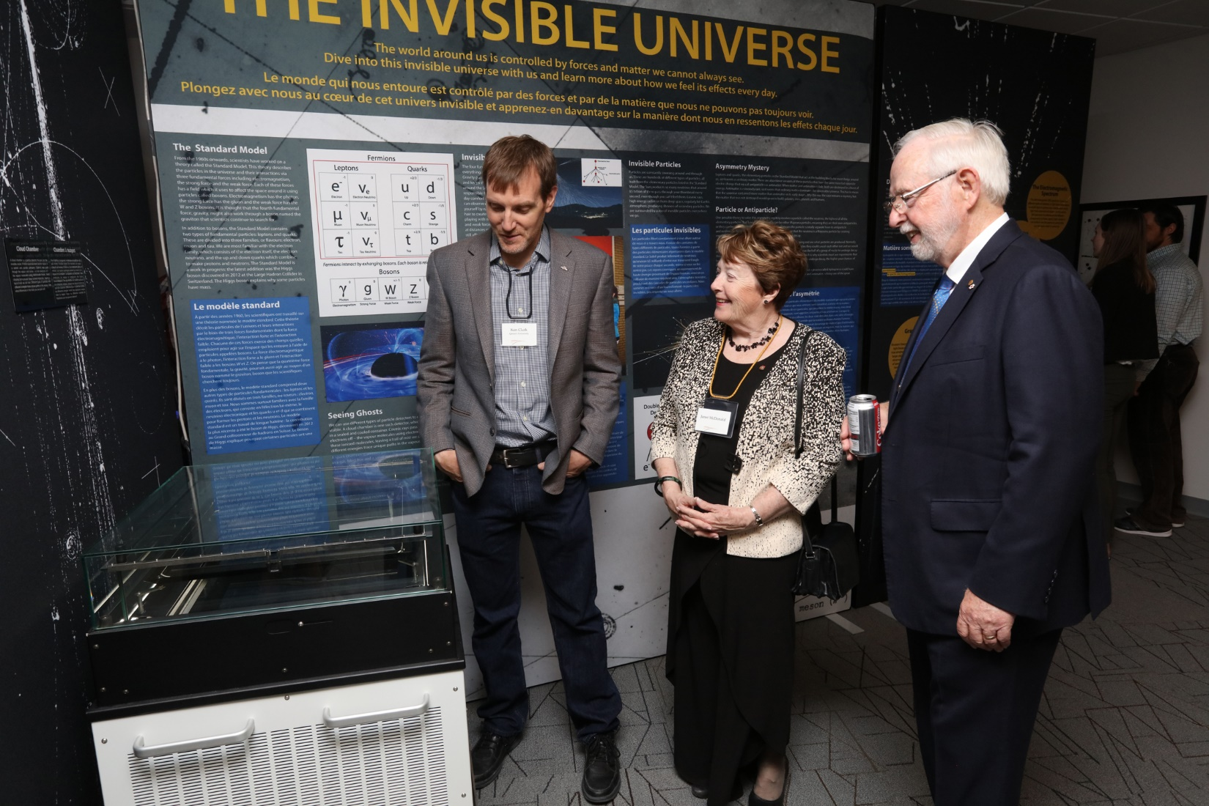
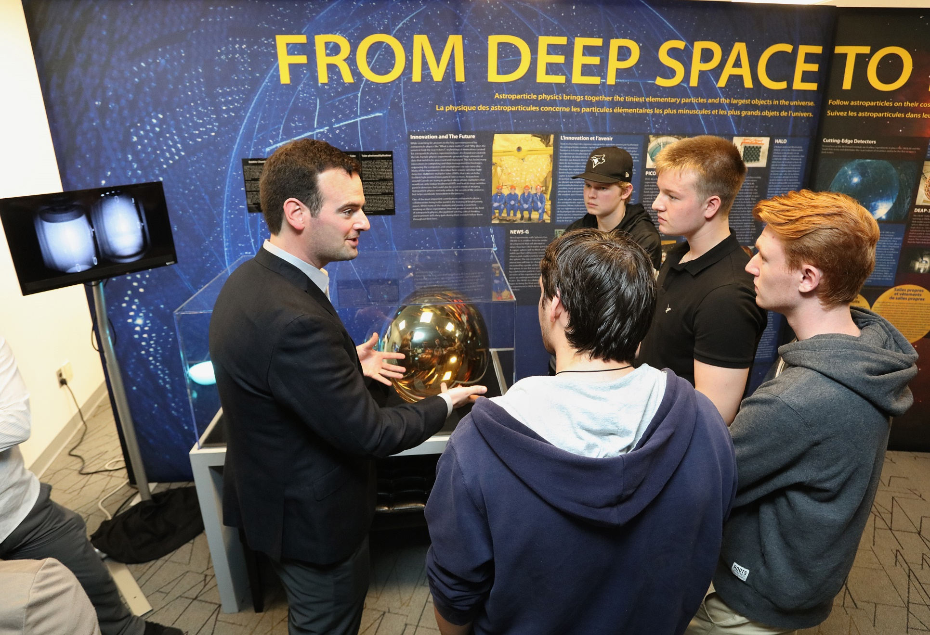
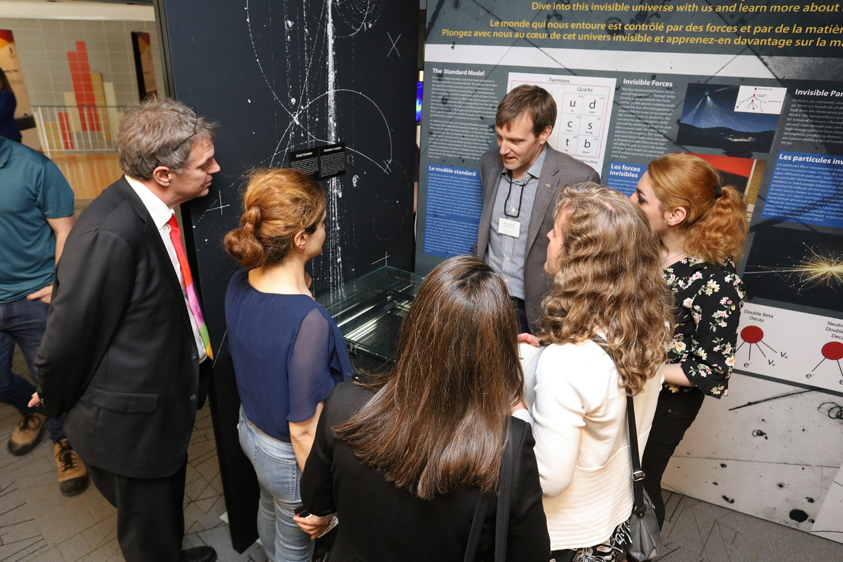
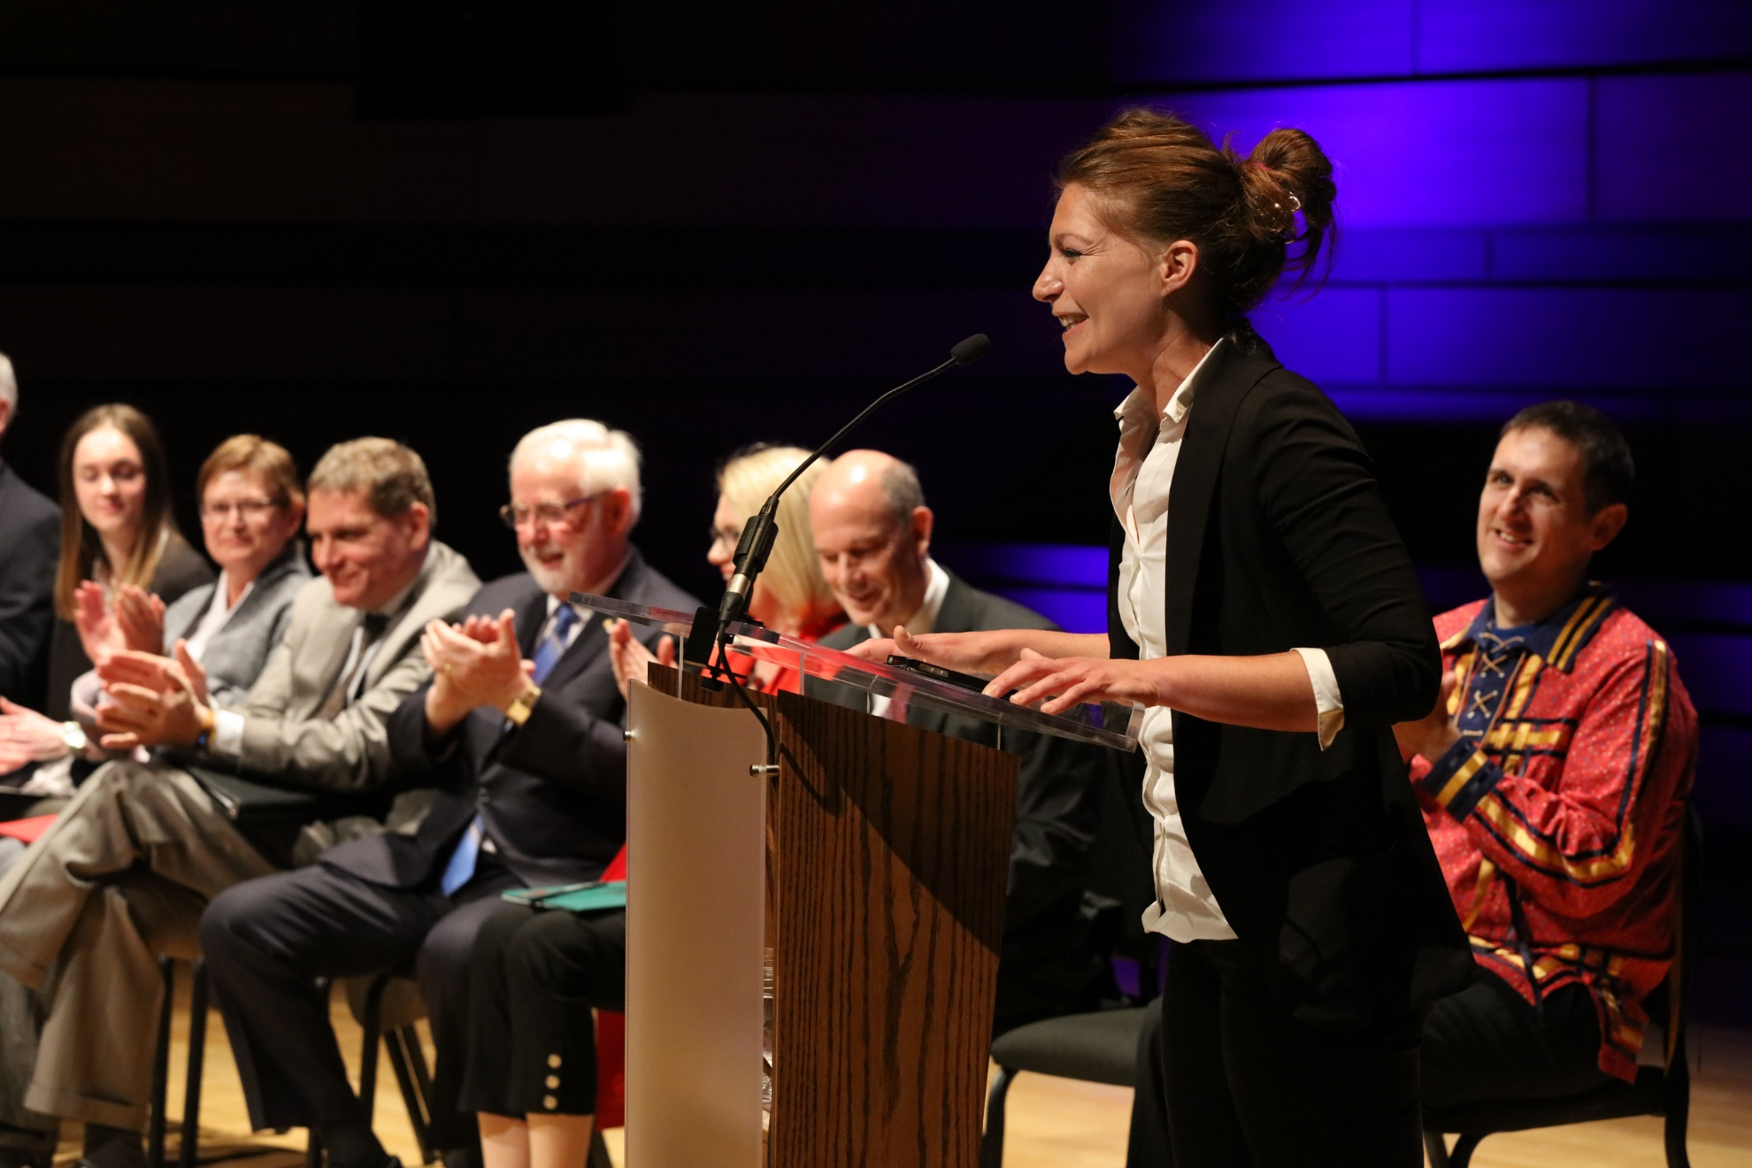

Slide 5
Funded through the Canada First Research Excellence Fund (CFREF) Award of ~$64 M$
Hosted at Queen’s University in partnership with the Canadian community
Queen’s University
University of Alberta
University of British Columbia
Carleton University
Laurentian University
McGill University
Université de Montréal
University of Toronto
CIFAR
IPP
PI
TRIUMF
SNOLAB
*Sherbrooke University

Slide 6
Vision:
“To be a globally recognized centre for research and learning, coalescing Canadian and international expertise in underground particle astrophysics and benefitting from the unique SNOLAB facility to deliver world-leading science focused on the big questions in particle astrophysics, cosmology and astronomy.”
Science
build a powerful and integrated team working on all aspects of astroparticle physics
create a research team with the critical mass and skills required to prepare and lead the next generation of increasingly challenging experiments.
extract maximal scientific output from the current suite of SNOLAB experiments
Education and Outreach
Provide training opportunities for students at all stages of their careers, developing experimental and foundational theory skills.
Engage non-expert audiences, including the general public, high school students and teachers
Engagement with Industry
Actively collaborate with industry to facilitate knowledge transfer and innovation.

Slide 7
University Research Development
HQP Training
McDonald Institute
Industry Engagement
Business Development Officer

Slide 8
Hiring of the team of faculty:
Particle Astrophysics Experiment:
1. Queen’s University: Guillaume Giroux July 1, 2017
2. Queen’s University: Joint w TRIUMF Ken Clark Sept 1, 2017
3. Université de Montréal Alan Robinson Nov 1, 2017
4. Carleton University Simon Viel Aug 1, 2017
5. University of Alberta Marie Cecile Piro Oct 1, 2017
6. University of Alberta Juan Pablo Yanez Garza June 1, 2018
7. Laurentian University Caio Licciardi Sept 1, 2017
8. TRIUMF Wolfgang Rau Sept 1, 2018
9. University of Toronto Ink is drying on offer Jan 1, 2019 ?
Astroparticle Physics Theory
10. Queen’s University Aaron Vincent Jan 1, 2018
11. Queen’s University Joe Bramante Sept 1, 2017
12. Carleton University TBD Sept 1, 2019 ?
Isotope Research/Radiochemistry
13. Queen’s University Geochemistry Matthew Leybourne Sept 1, 2017
14. Queen’s University Chemistry Peng Wang June 15, 2018
  Nuclear Materials
15. Queen’s University Mech. Eng Levente Balogh Jan 1, 2018

Slide 9
Research Areas for AP Experimentalists
Guillaume Giroux: News-G / PICO Dark Matter
Ken Clark: PICO / Icecube Dark Matter/Neutrino
Alan Robinson: SuperCDMS / PICO Dark Matter
Simon Viel: DEAP-3600 / LAr Dark Matter
Marie Cecile Piro: DEAP-3600 / PICO / News-G Low Background / DM
Juan Pablo Yanez Garza: SNO+ / Icecube Neutrino
Caio Licciardi: nEXO / PICO Neutrino / DM
Wolfgang Rau: SuperCDMS Dark Matter

Slide 10
Research support people: This is largely “the initial plan”. Being revised as hires are made and directions are refined….over 100 positions over the period of the grant.
15 new faculty members across Canada
3 Research Scientists and 3 project managers to support the SNOLAB scientific program.
4 Engineers, 1 designer, and 15 technical positions
~25 PDF and 40 graduate students supported annually.
Support for undergraduate summer research positions and internships in industry.
Administration
Scientific Director, Managing Director, Finance & HR Officer, Business Development Officer, Education and Outreach Officer, 2 Admin assistants

Slide 11
Recent Activities:
Most Faculty positions now in place. New faculty taking leadership positions on numerous experiments. Inter-institutional agreements signed, cash flowing to partners.
Most of the administrative team in place. Governance structures all in place.
Building of the research teams (technical support, engineering, students, postdocs), well underway.
Renovations completed to create a visitor centre, student offices and new lab space at Queen’s.
Education / Outreach activities:
  Launch of the McDonald Institute
  Visitor Centre Official Opening (May/18)
  Undergraduate summer school CAPSS completed (May/18)
  Graduate summer school (GRIDS 2018) in advanced stages of planning (Aug/18) (joint with TRIUMF)
  Launch of the George and Maureen Ewan lecture series. Kick off with speaker Barry Barish.
  Dark Matter day – UG conferences – High school visits and event support….
Launch of competitions for additional students/postdocs/PhD-exchanges…

Slide 12
“Pooled Resources” – Initially Unallocated
Anybody with research that is aligned with the goals of the McDonald Institute can be a member of the Institute and access the resources.
McDonald Institute members can compete for pooled resources which includes funding for:
  Postdoctoral fellows
  Graduate students
  Frontier Research Venture Fund (140k$/a to disburse)
  Sabbatical Support
  Travel support for collaboration building
  PhD exchange program
  Undergraduate research experience
A Scientific Advisory Committee has been established with a mandate to review applications for these resources. They meet every 3 months. We have just launched the second competition. The first awarded over 2 M$ in support to researchers across the program.

Slide 13
Next near term activities:
Launch of the visiting scientist program and frontier venture fund competitions (within a week)
Filling of final admin positions.
As an outcome of the McDonald Institute townhall scientific community meeting at Queen’s in May, the McDonald Institute will be hosting a “SNOmass” event, planning the future of astroparticle physics in Canada.
We will try to find a date and location that works this autumn for the majority of the community to have the initial meeting.
Input will be sought from the entire community to determine our research priorities and to develop the best strategy for the field as experiments will become necessarily larger and more complex, and the world will only have the resources for a few very large, next generation detectors.

