Slide 1

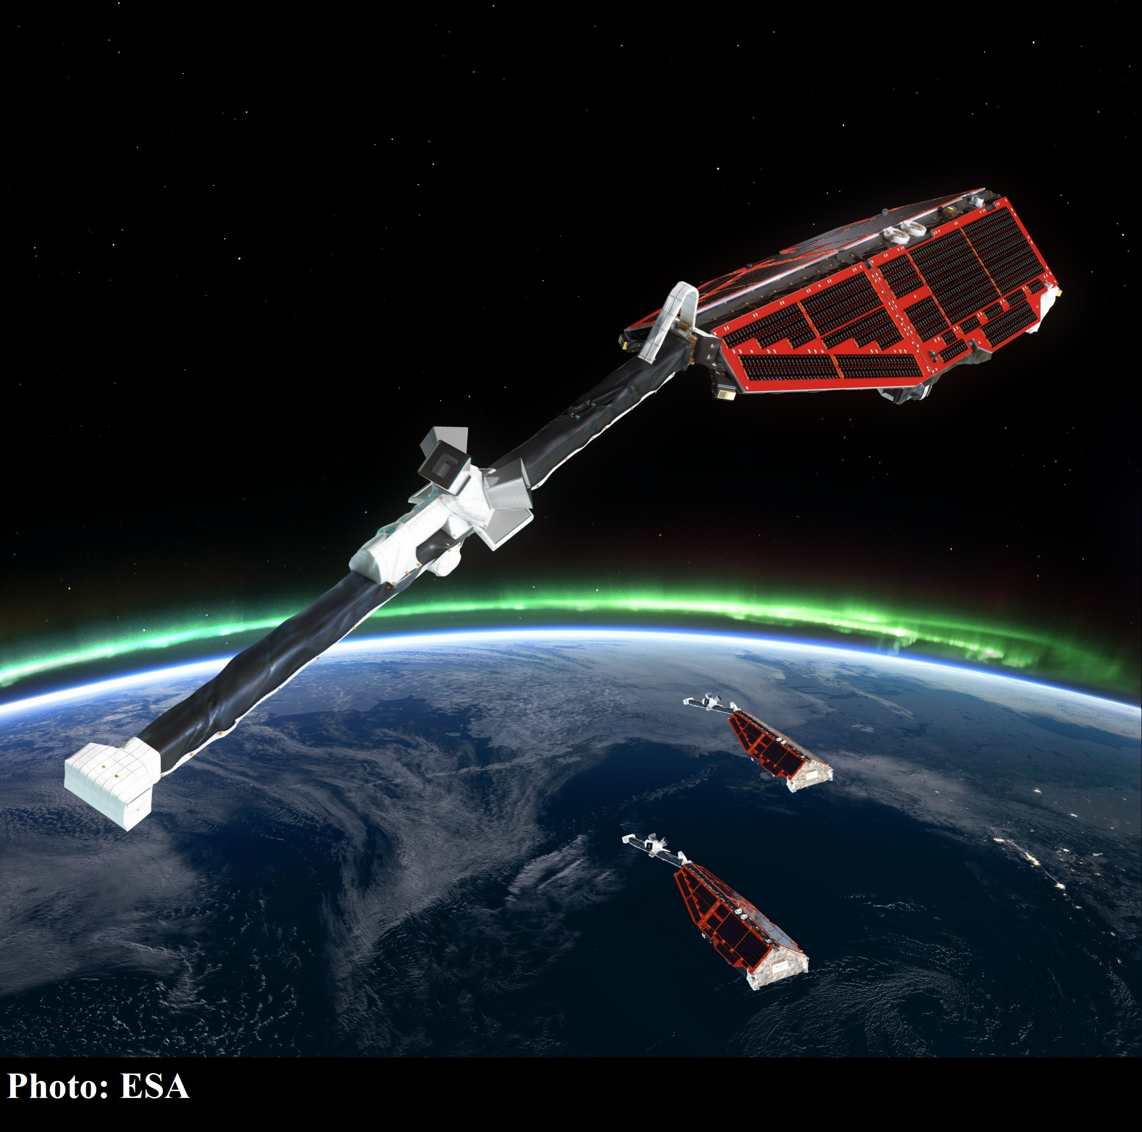


Effects of Surface Coatings on Swarm Langmuir Probe Measurements
Candice Quinn
Supervisors: Dr. Burchill, Dr. Knudsen
June 2018
Notes:
Candice, supervisors
LP show contamination?
My name is Candice and I am a first year masters student at the University of Calgary under the supervision of Dr. Burchill with Dr. Knudsen as my co-supervisor. I am starting my research on investigating if any of the Langmuir Probes on the three Swarm satellites show signs of contamination, and how that contamination may affect the data.

Slide 2
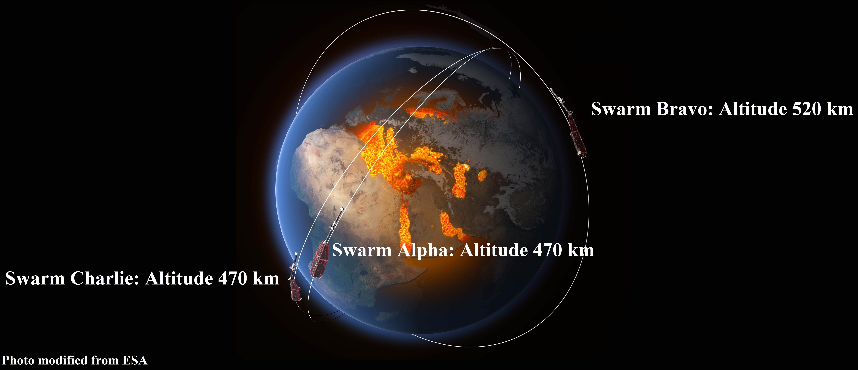
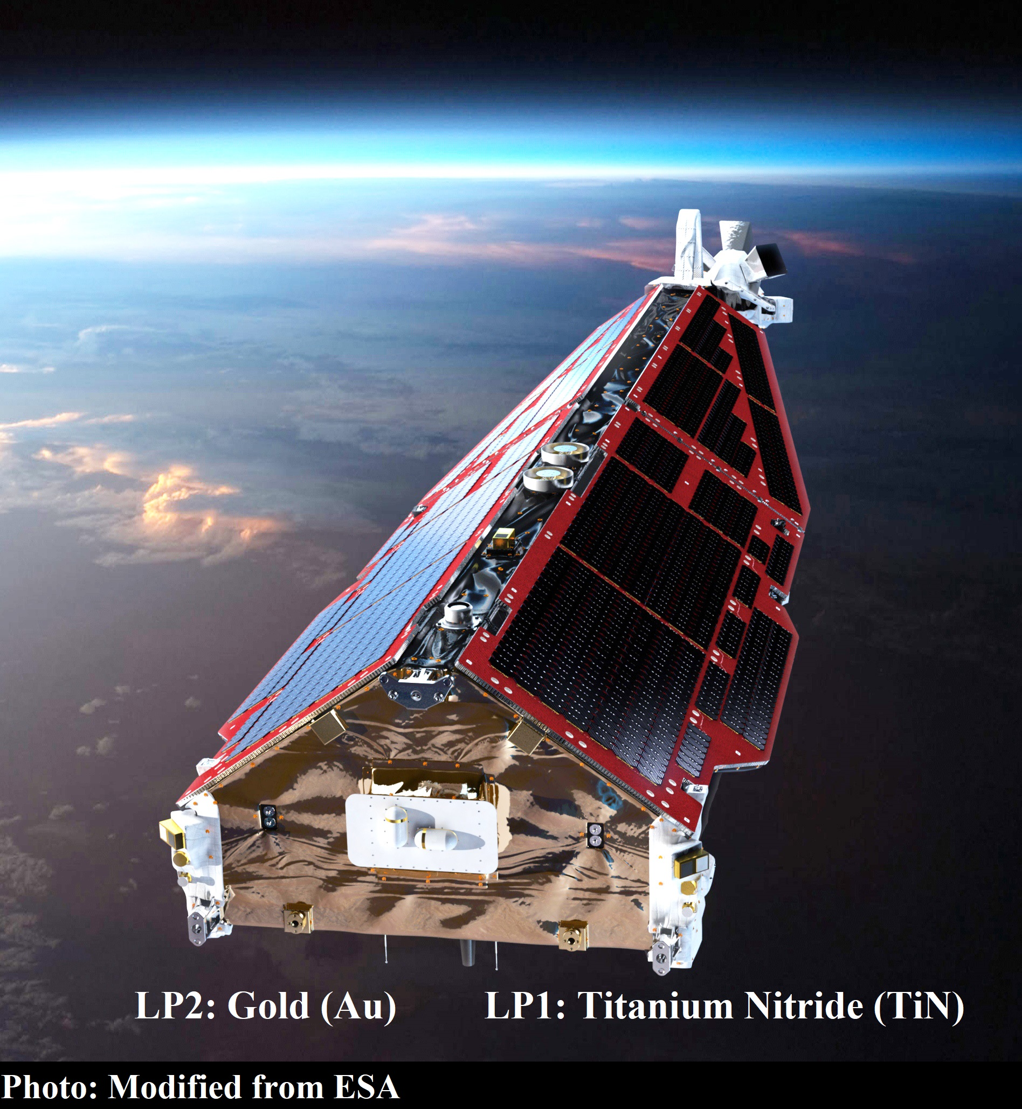
Swarm is a trio of satellites with two Langmuir Probes (LP) each
Langmuir probes measure current collected on an electrode as a function of applied voltage to obtain plasma density and electron temperature
Swarm’s spherical probes have Titanium nitride and gold (TiN and Au) coatings
TiN may be affected by neutral particles called contamination
Notes:
Swarm trio 2013 ESA survey E and B field
A and C 470 B 520 1.4 degree LONGITUDE C leads
4mm radius plasma current various properties
Right gold left titanium nitride
Last minute switch susceptible
Contamination neutral atomic O and H2O altering resistance capacitance
Research goal
Swarm is a trio of satellites: Alpha, Bravo and Charlie, and were launched in November 2013 by the European Space Agency. The goal of swarm is to survey the electric and magnetic field of Earth. The three satellites have two different orbital altitudes: Alpha and Charlie are at 470 km and Bravo is at 520 km. Charlie and Alpha share a similar orbit with a 1.4 degree longitude difference between them and Charlie leading Alpha. Each satellite is equipped with a similar suite of instruments including two Langmuir probes on the ram side, each with a 4 mm radius spherical tip. They are used to measure the plasma current and extract various properties of the plasma. The only difference between the probes are that one on Swarm’s right is coated in gold while the other is coated in titanium nitride. There was a last-minute decision before Swarm’s launch to change one of the titanium probes for gold out of concern that titanium is susceptible to contamination. Contamination occurs when neutral particles such as atomic oxygen or water affect the probes surface by altering its resistance and capacitance. My research goal is to determine if any of Swarms probes show any signs of contamination by comparing the measurements and analyzing any differences.

Slide 3
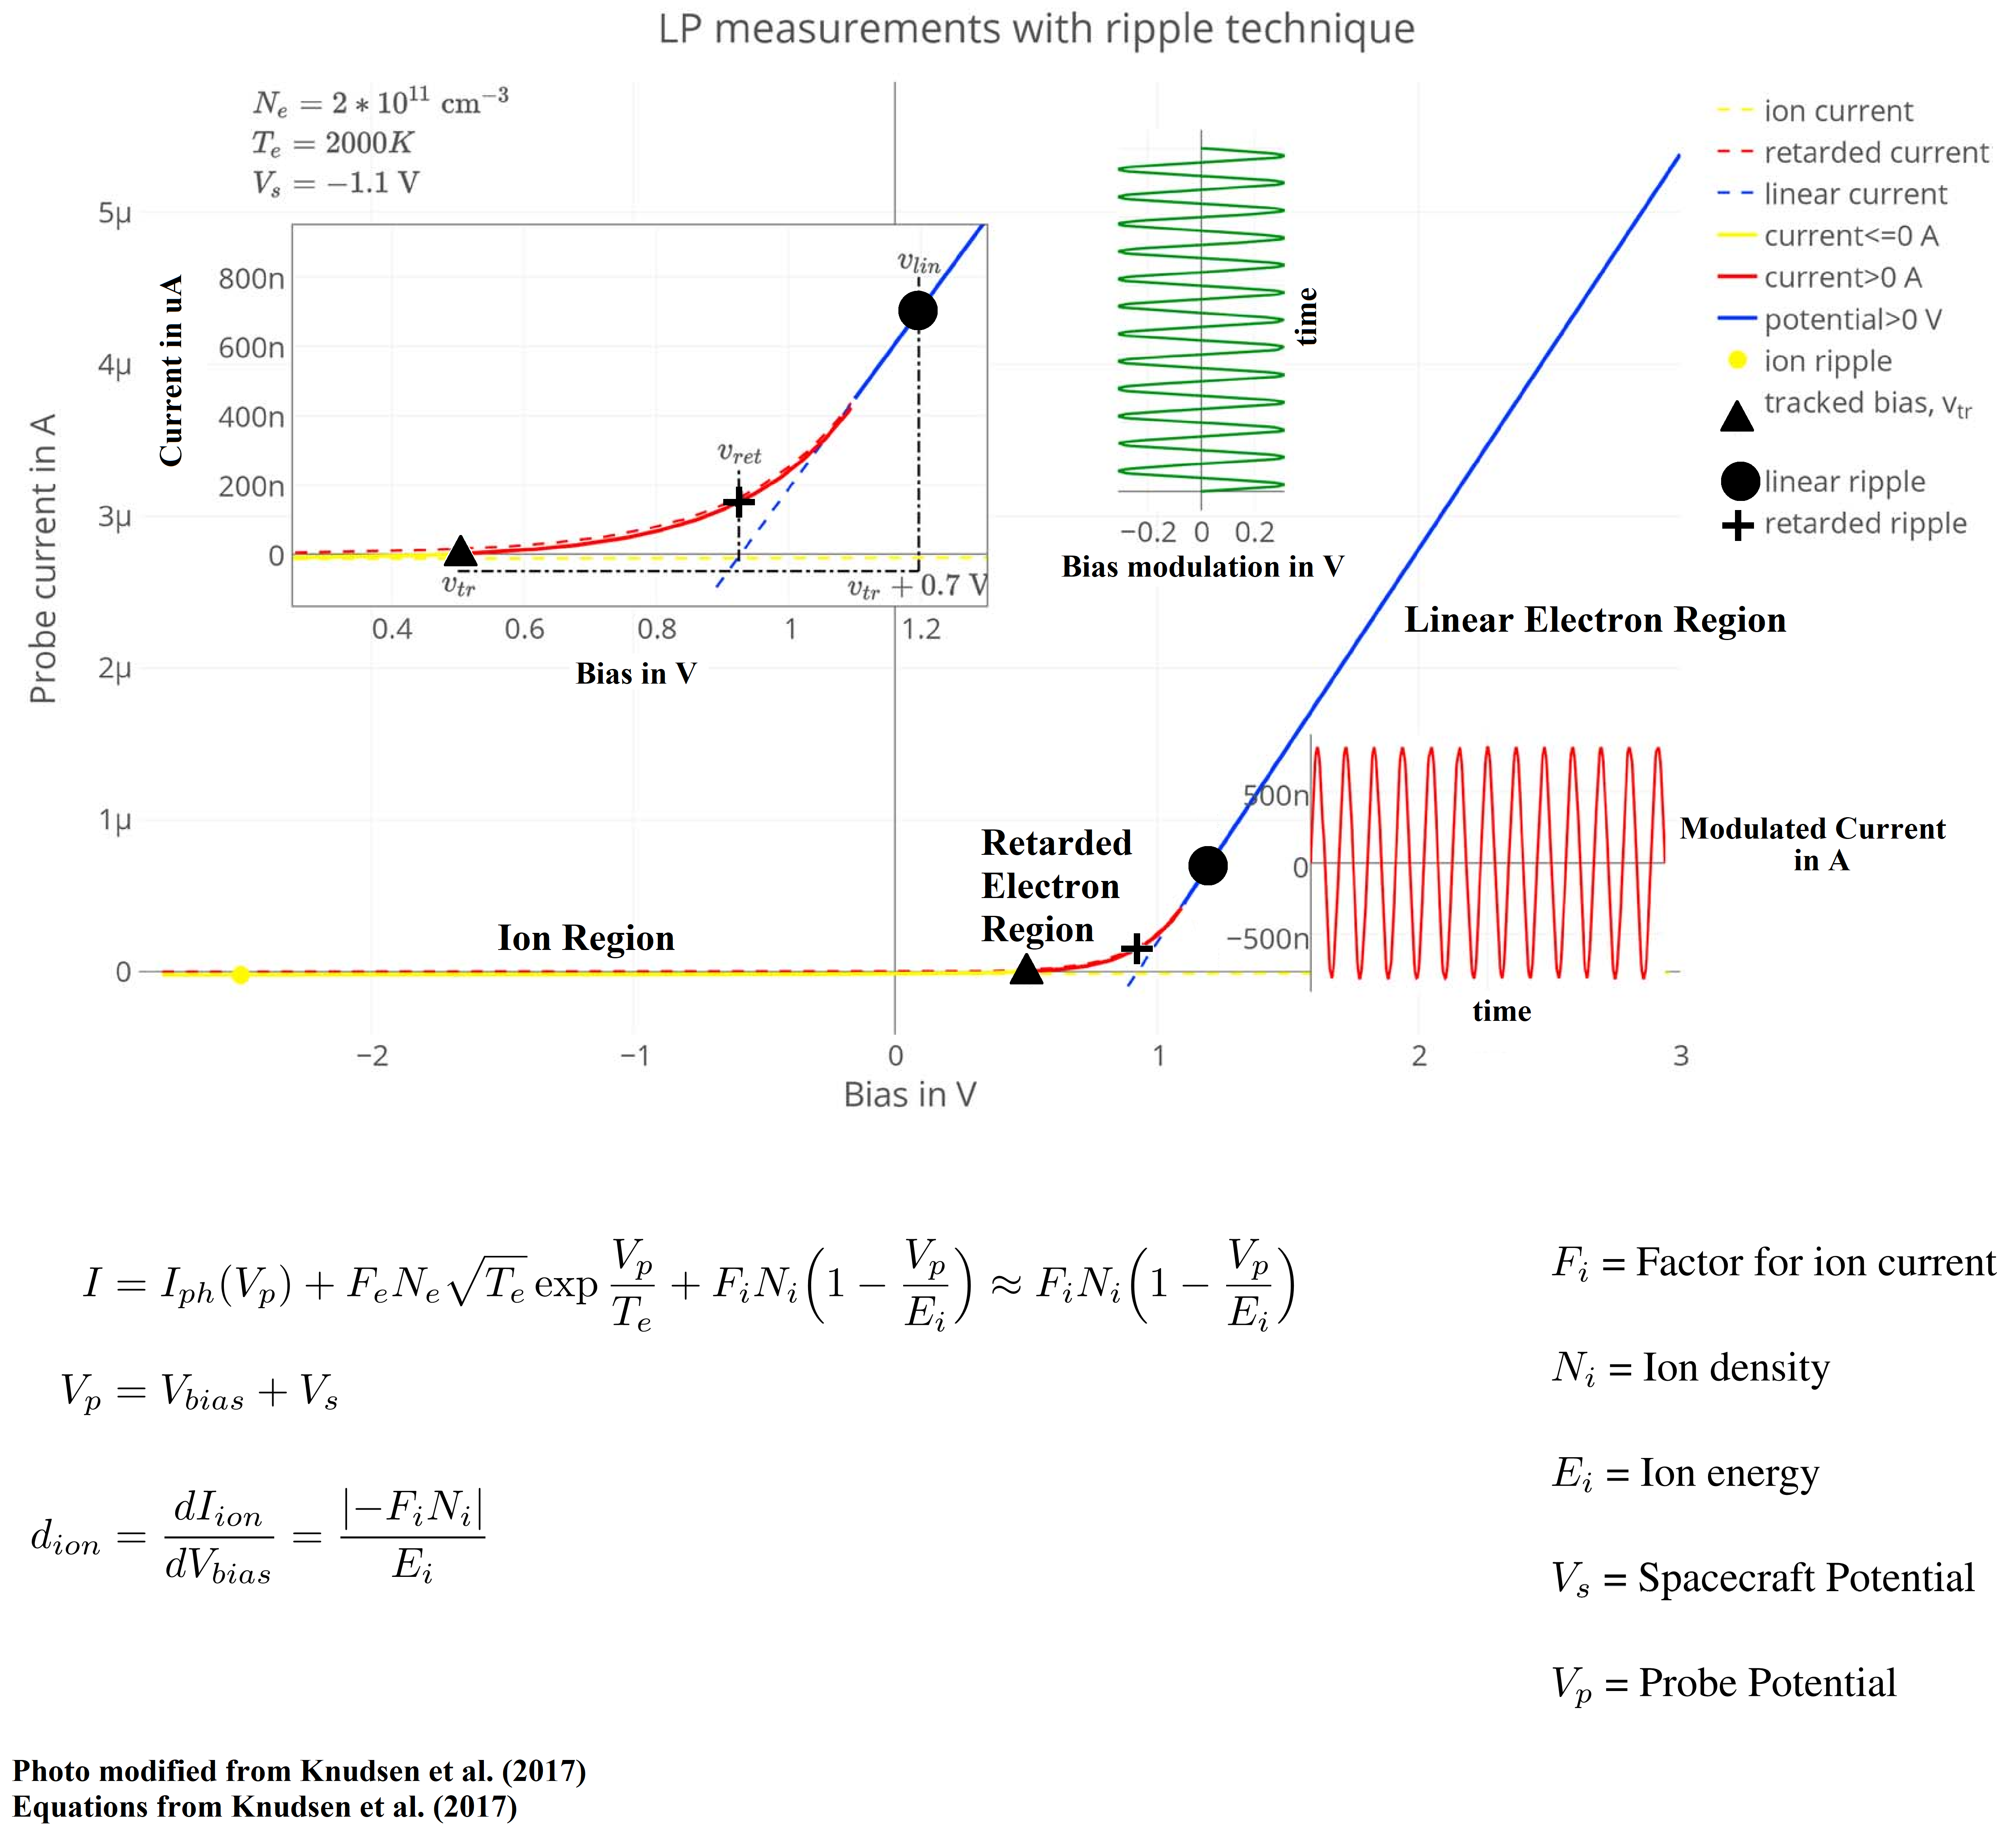
Swarm has two LP operation modes: Sweep and Harmonic
Convention: Sweep mode varies the probes voltages from +/- 5V and operates for a fraction of the time
Innovation: Harmonic mode is the primary operation mode and uses modulation to derive density
Notes:
Sweep and Harmonic
Sweep standard, up and down +/-5V I on yaxis V on xaxis 1/128 seconds
Harmonic over 99% ion region yellow ion dominates electrons repelled
Distinguishing feature modulated 128Hz to 4 kHz modulation technique current and admittances
Admittance Di/Dv calculate densities
First equation: photoelectrons, electrons, ions, assume darkness, electrons repelled
Second equation: probe potential relative to plasma plus bias sub and derive
Admittance proportional to density. Factor for ion current dependent on radius and ram velocity, constant
Ion energy kinetic constant
The Langmuir probes on the swarm satellites have two modes of operation: sweep and harmonic. Sweep is a standard operation mode for Langmuir Probes where the probe voltage is swept up and down through a range of voltages. In Swarms case, +/- 5V. This results in a graph with current on the y axis and voltage on the x axis for a standard current-voltage curve. However, Swarm only operates in this mode for 1 second out of every 128 seconds, so it is not the primary method of measurement with the probes.
Harmonic mode operates for just over 99% of the time. The distinguishing feature of harmonic mode when compared to the traditional sweep mode is that the bias voltage is modulated normally around 128 Hz but can go up to 4 kHz. This modulation technique lets us measure both current and admittances, where admittance is the derivative of the current with respect to the voltage and can be used to calculate plasma densities as described by the equations below. My research focuses on the ion region, shown in yellow, where electrons in the plasma are repelled from the negative bias voltage applied to the probe. In this environment, the ion current dominates.
This first equation has three contributions: This is the current from photoelectrons, this is the current from electrons and the ion current is the last term. Assuming the satellite is in total darkness, the contribution from the photoelectrons can be ignored. In the ion region the electrons are repelled and don’t contribute to the total current either, leaving the last term. The probes potential relative to the plasma, V_p is equal to the spacecraft potential plus the bias voltage. Subbing this into the first simplified equation and taking the derivative with respect to the bias voltage gives me my final term, showing that the admittance is proportional to the density. The factor for ion current, F_e, is dependent on the radius of the probe and the satellites ram velocity (nominal ram velocity of 7600 m/s) so it can be assumed to be constant. The ion energy is the kinetic energy of the ions and is also assumed to be constant.

Slide 4
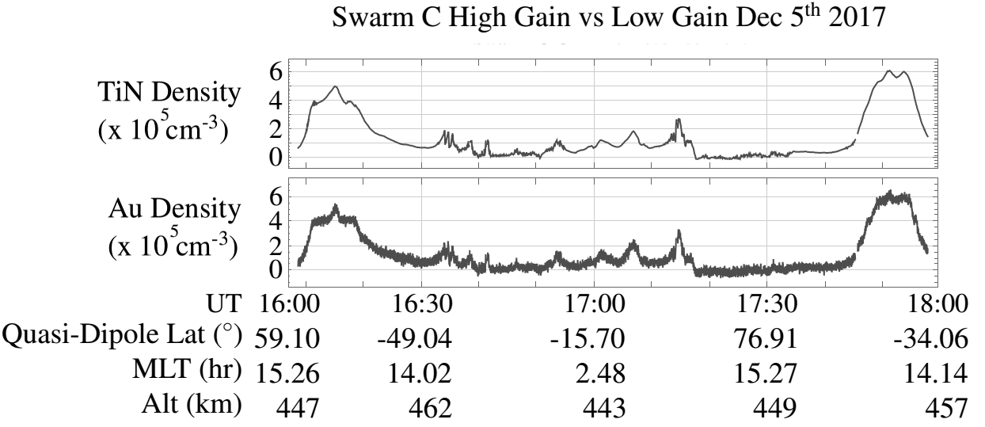
High gain is TiN and Low gain is Au
The TiN probe is high gain and amplifies current signals
The Au probe is low gain and is insensitive to ion currents
Notes:
Resulting density data
Normal operations, different gain modes in addition operation
TiN high gain, Au low gain, difference sensitivity
TiN amplifies weak current, Au works in e region
Data C dec 2017 normal operation difference in measurements
The resulting density data looks like this. In normal operations, the probes are placed in two different gain modes in addition to their operation mode. The titanium probe is in high gain mode and the gold is in low gain mode. The difference is their sensitivity when measuring the plasma current. The high gain probe works really well measuring ion currents as it amplifies the weak current signals well. The low gain probe is insensitive and noisy in the ion current region as seen here but it works really well in the electron current region. This is a data sampled taken from Swarm Charlie in December 2017. During this time, the titanium and gold probes were in their normal operation and you can see the difference in how each probe measures the plasma.

Slide 5
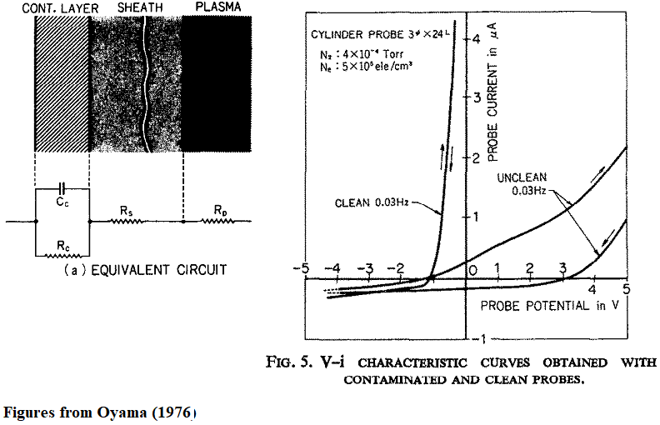
Contamination can be thought of as a parallel RC-circuit
The contaminants can have high resistance and capacitance
The frequency of the sweep can be increased to minimize the measured effect of the contamination
Once the on-board probes show indication of contamination, it is hard to remove
Notes:
Now talked LP work, contamination affects. Contamination neutral particles impedance
Affect TiN probes on rockets swarm dominated atomic oxygen additional impedance uncalibrated for
Understand, system is a circuit, Oyama 1976, resistor and capacitor in parallel, mag of impedance dependent
Cylindrical probe during sweep – valid spherical
Clean probe no variation contamination difference upsweep vs downsweep.
Hysteresis capacitor storing charge discharging later
Mitigated by increasing sweep rate cant discharge within one sweep cycle so impedance decreases
Preventative measures baking chemical cleaning, still occur, removal difficult
In addition to increasing sweep, baking tried, internal filaments baked off, unsuccessful unreliable
Now that I have talked about how the Swarm Langmuir probes work, I can explain what contamination is and how it affects data. As previously stated, contamination is when a neutral particles affect the probes surface adding an additional impedance. Contamination has been previously shown to affect titanium Langmuir probes, and as Swarm is in an area dominated by atomic oxygen it is likely that the probes suffer from an additional impedance previously uncalibrated for. To understand how neutral particles affects probe measurements, the system can be thought of as a circuit, previously demonstrated by Oyama in 1976. The contamination layer can be represented by a capacitor and resistor in parallel, with the magnitudes of the total impedance dependent on the contaminant. In this photo he demonstrates how a contaminant affects a cylindrical probe during sweep mode – this is also valid for spherical probes like the ones on Swarm. A clean probe will show no variation in the sweep path during one cycle, as shown here. However, if there is contamination there will be a difference in the upsweep vs downsweep. This difference is called hysteresis and it is the result the capacitor storing charge to discharge it at a later time. The effects of hysteresis can be mitigated by increasing the rate of the sweep because the stored charge in the capacitor wont discharge within one sweep cycle. This causes the impedance from the capacitor to decrease.
While preventative measures can be taken, such as baking the probes or chemical cleaning before launch, contamination can still occur. Once the probes are affected by neutral particles, removing the problem can be difficult. In addition to increasing the sweeping frequency, inflight baking has also been tried. Internal filaments are installed into the Langmuir probe circuitry so if any signs of contamination occur, an attempt to bake it off can be done. However, this method should not be relied on. Another method is ion bombardment where the probes have a really negative bias, which causes ions to bombard the probe and effectively knocks off the contamination. Unfortunately, it can come back.

Slide 6
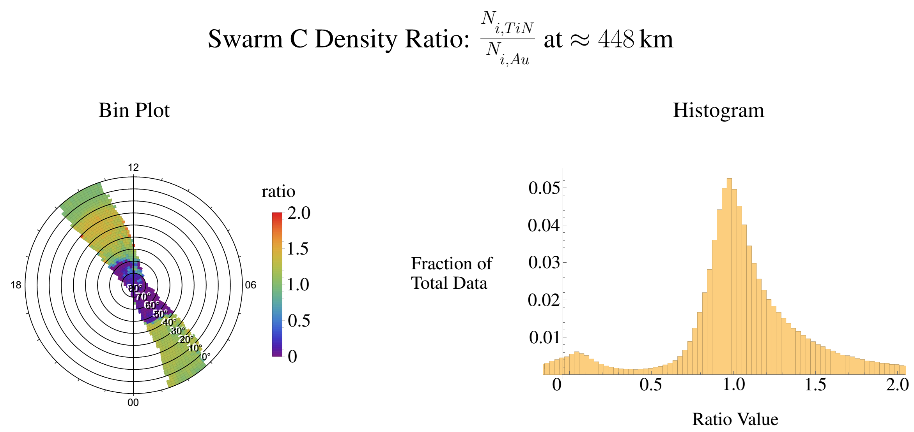
Charlie had TiN in high gain and Au low gain
Variables that need to be controlled:
  Probe angle relative to the Sun
  Probe mode and gain
  Plasma density and temperature
  Magnetic field lines
Dec 5th 16:00 UTC to Dec 14th 18:00 UTC, 2017
Notes:
Only difference coatings, removes environmental effects, probes relative to sun, mode, gain, density tempt, B field lines
Angle relative and mode. Solar zenith angle dark/light geometry shadow, throw away
Harmonic mode both high gain, only C
Take ratio of densities – TiN/Au difference relative, two forms, left EABP, ring Quasi-dipole lat 0 to 90, sections Magnetic local time, night/day
Histogram independent location
Demonstrate importance controlling gain, TiN high gain, Au low, no way to tell
Histogram has negative values, looking at Level 1a data, raw, no flags quality control, odd data values neg densities, initial phase quick easy raw data,
Finished initial phase, official data set, remove poor data without removing real contamination affects.
To see if there are any affects of contamination on Swarm’s Langmuir Probes, I need to make sure that the only difference between the probe pairs on each satellite are the coatings. This removes any environmental affects that may explain any variations in the measurements. These variables include the probes angles relative to the sun, the mode and gain the probes are in, the density and temperature of the plasma and the magnetic field lines.
Using the solar zenith angle, I know when the satellites are in the dark or in the light and using the geometry of the satellite I can determine if one probe is in the shade and eliminate any data where this is the case. Currently, I am only looking at Harmonic mode data at time when both the probes are in high gain mode. To date, Swarm C is the only satellite that has had both probes in high gain for any period of time so it is the only satellite data I have analysed.
I take the ratio of the probes on the same satellite – titanium divided by gold – and see how different the measurements are relative to one another. I put the data in two graphing forms shown here. The left most is called an Equal Area Bin Plot. Each ring is a Quasi-Dipole Latitude, here from 0 degrees to 90 degrees, and each section is the Magnetic Local Time so I know when the data is taken during the day or night. The histogram takes the same data set but shows the distribution, independent of the satellite location.
To demonstrate the importance of controlling the probe’s gain mode, I have taken density data from Charlie in December 2017. If you recall from the previous slide, the titanium probe was in high gain mode while the gold was in low gain. There is no way I can determine if the coatings have any affect on measurements because the data varies way too much.
Before I move on to both probes in high gain, I should point this out – the histogram has negative ratios. As I am in the beginning stages of my research, I am looking at Level 1a data, meaning that it is raw data and does not have any data flags for quality control. This can lead to odd data values such as negative densities. For my initial phase of research, I am looking at this data set as it is quick and easy access for me. Once I am finished my initial analysis of the data, I will then use the official data set with flagged data. This will remove poor data without removing any real contamination affects. However, for my initial purposes right now, L1a data is fine.

Slide 7
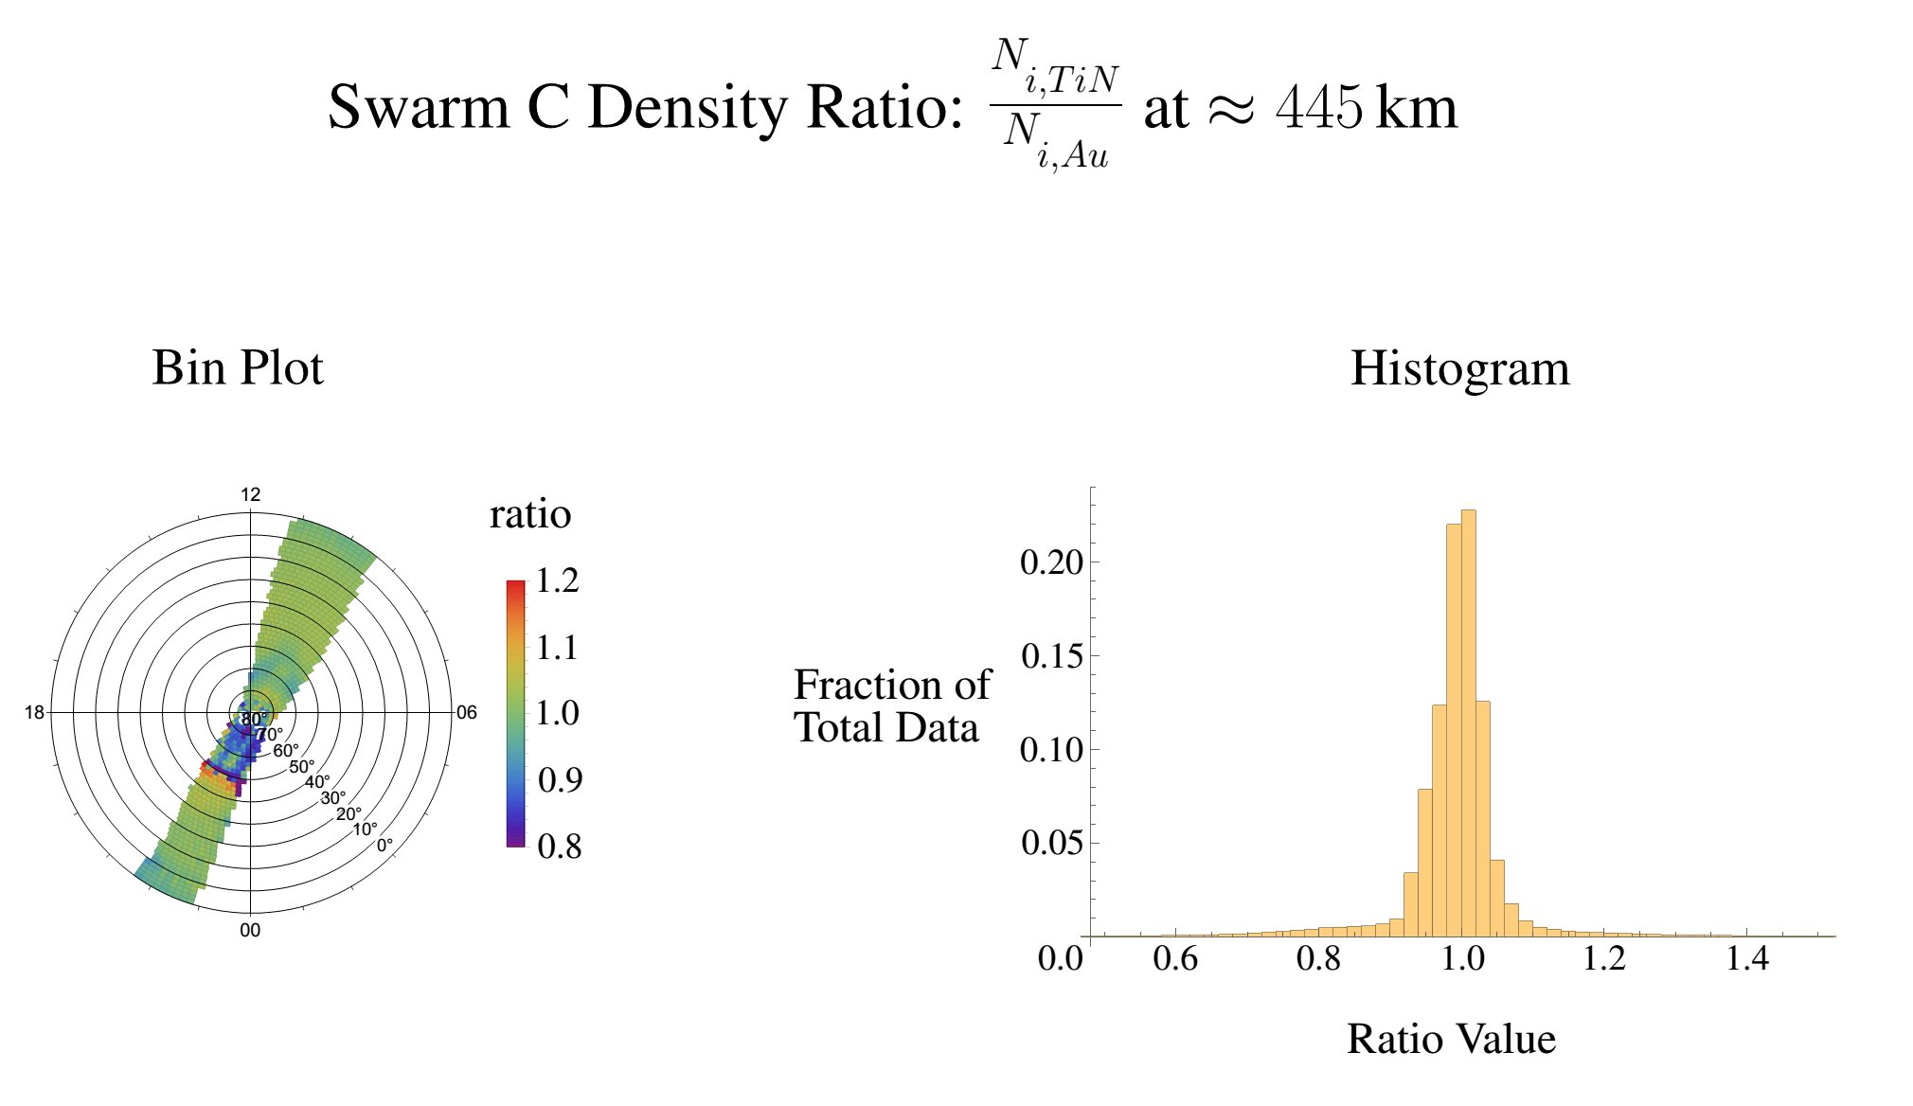
Charlie had both probes in high gain during harmonic mode
Jan 14th 19:00 UTC to Jan 22nd 09:30 UTC, 2018
Notes:
Both in high gain, histogram less spread density,
lower latitudes small variation, 70 degrees asymmetrical variation, cant say latitude-dependent effects
Future all three high gain, A and C experiencing same vs B different higher altitude, assuming contamination
Similar analysis on temperature measurements altered.
In this case both the probes are in high gain mode. Looking at the histogram, the spread of data is much less than previously shown. At lower latitudes, in the green/yellow regions, there is a small amount of variation. However around 70 degrees there is a substantial difference in measured densities. Much of the variation shown in the histogram is probably from this region. At this time, I am unable to say exactly what is causing this because I have not yet been able to further investigate any latitude-dependent effects. While I know there is variation in Charlies measurements, I have yet to determine if its caused by contamination or not.
In the future, would like to see all three satellites have their probes placed in high gain for a period of time so I can analyze and compare what each satellite measures. This will allow me to see if Alpha and Charlie are experiencing similar contamination affects as they are at the same altitude versus Bravo who may experience contamination differently as Bravo is at a higher altitude. This of course, is assuming they have any contamination. I will also be conducing a similar analysis on temperature, and how the measurements may be altered as well.

Slide 8
Summary
Swarm has three satellites: Alpha, Bravo, and Charlie with two LP
Au and TiN will be analyzed to determine if any have contamination
The probes must be in the same environment to isolate the probe coating
Swarm C shows some differences, but the cause has not been determined
Future work: Measure temperature, and perform analysis on Alpha and Bravo
Acknowledgements: Dr. Stephan Buchert and the University of Calgary’s Swarm research team for assistance and advice.
Notes:
Review A C B and TiN and Au, unaware contamination, same environment external effects
Contamination neutral particles atomic oxygen, changing impedance
Some variations already, no verification though
Future work flagged data, density and temperature, all satellites in high gain
Thank you Stephan buchert Swedish institute of space physics, research group, thank you time.
To review what was discussed, the swarm satellites, Alpha, Bravo, and Charlie have two Langmuir Probes with titanium nitride and gold coatings. We are currently unaware of any signs of contamination on the probes, but I am currently investigating it. To do this, I need to ensure they are in the same environment to eliminate any external affects that may cause a difference in current measurements. Recall that contamination is simply when neutral particles like atomic oxygen impact the surface of the probes, changing the impedance. I have just started analyzing Level 1a density data, and have noticed some variations in Charlies measurements. However, so far no contamination has been verified.
My future work will involve using flagged data with quality control for density and temperature, and hopefully analyzing Bravo and Alpha to understand the extend of contamination if there if any and how an altitude difference may affect it.
I would like to thank Dr. Buchert from the Swedish Institute of Space Physics for his help in answering some of my questions, and my research group at the University of Calgary for their assistance and advice throughout my research. Thank you for your time.

Slide 9
