Slide 1

Interpreting Satellite Observations of the OMI Ultraviolet Aerosol Index to Understand Aerosol Scattering and Absorption
Melanie S. Hammer¹, Randall V. Martin^{1,2}, Aaron van Donkelaar¹, Virginie Buchard^{3,4}, Omar Torres³, David A. Ridley⁵, Robert J.D. Spurr⁶, Chi Li¹, Max Manning¹, Brian Boys¹
1. Department of Physics and Atmospheric Science, Dalhousie University, Canada
2. Harvard-Smithsonian Center for Astrophysics, Cambridge, MA, USA
3. NASA/Goddard Space Flight Center, Greenbelt, MD, USA
4. GESTAR/Universities Space Research Association, Columbia, MD, USA
5. Department of Civil and Environmental Engineering, Massachusetts Institute of Technology, Cambridge, MA, USA
6. RT Solutions, Inc., 9 Channing Street, Cambridge, MA 02138, USA

Slide 2
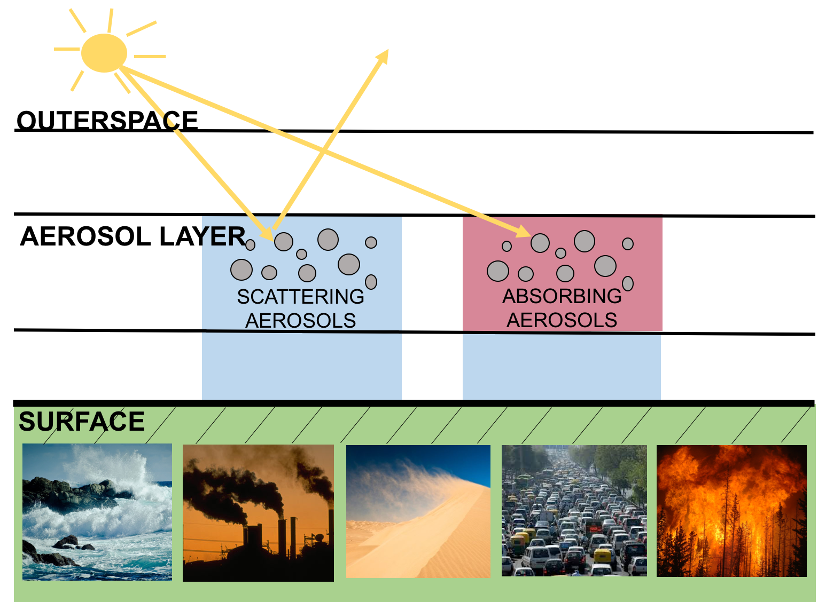

Slide 3
SATELLITE
Measures back-scattered solar radiation
Incoming solar radiation
Back-scattered ultraviolet radiation:
Increases due to aerosol scattering
Decreases due to aerosol absorption

Slide 4
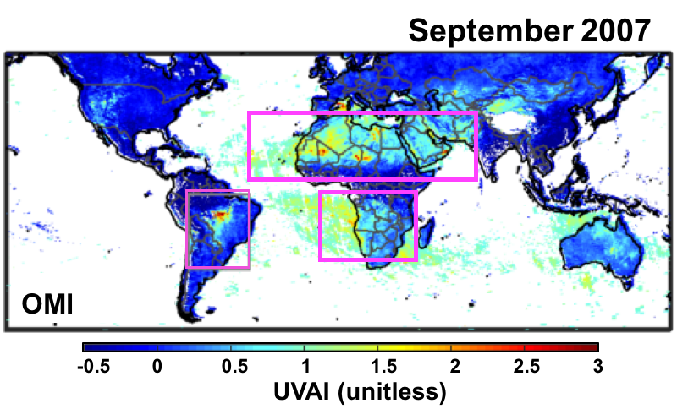
Ultraviolet Aerosol Index (UVAI):
  Method of detecting aerosol effects directly from satellite measured backscattered UV-radiances
UV-Absorbing Aerosols (Positive UVAI)
Desert Dust
Black Carbon (BC)
Brown Carbon (BrC)
Scattering Aerosols (Negative UVAI)
Inorganics
Scattering organics
Desert Dust
Biomass Burning
-0.5 0 0.5 1 1.5 2 2.5 3
UVAI (unitless)
NASA’s Ozone Monitoring Instrument (OMI) provides a long-term record of the observed UVAI:
2005-2015
Examining trends in the UVAI will provide information about changes in aerosol composition over time:
Scattering aerosol decreases the UVAI
Absorbing aerosol increases the UVAI

Slide 5
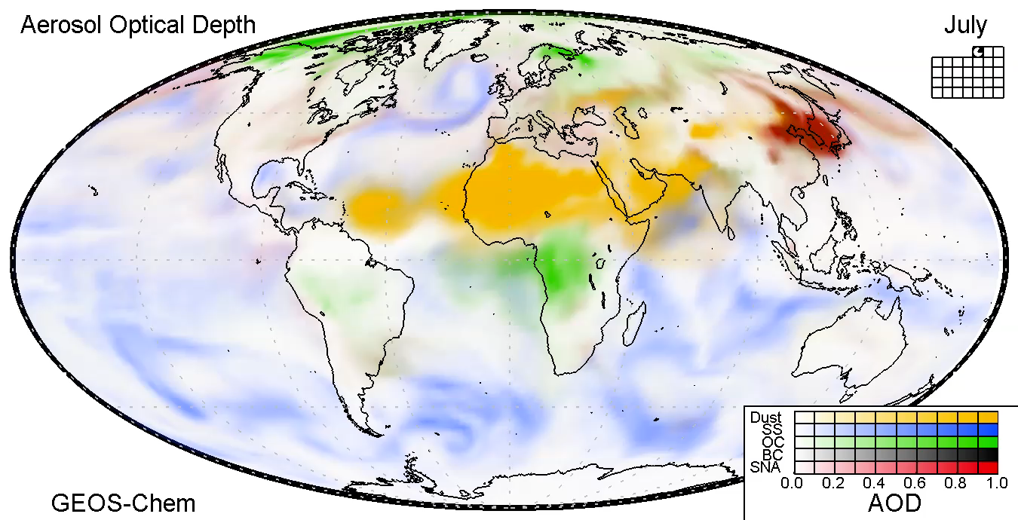
How to interpret the UVAI observations?
GEOS-Chem: a global chemical transport model
Emissions
Chemistry + Transport
Meteorology
Simulated atmospheric composition
Aerosol Simulation:
Allows for the interpretation of the UVAI observations

Slide 6
Framework for interpreting the UVAI observations
Simulated UVAI
GEOS-Chem
Aerosol
Composition
V11-01
MERRA2 meteorology
2x2.5 horizontal resolution
Surface Reflectance dataset derived from TOMS (Omar Torres)
VLIDORT radiative transfer model
OMI viewing geometry
Buchard et al., ACP 2015; Hammer et al., ACP 2016

Slide 7
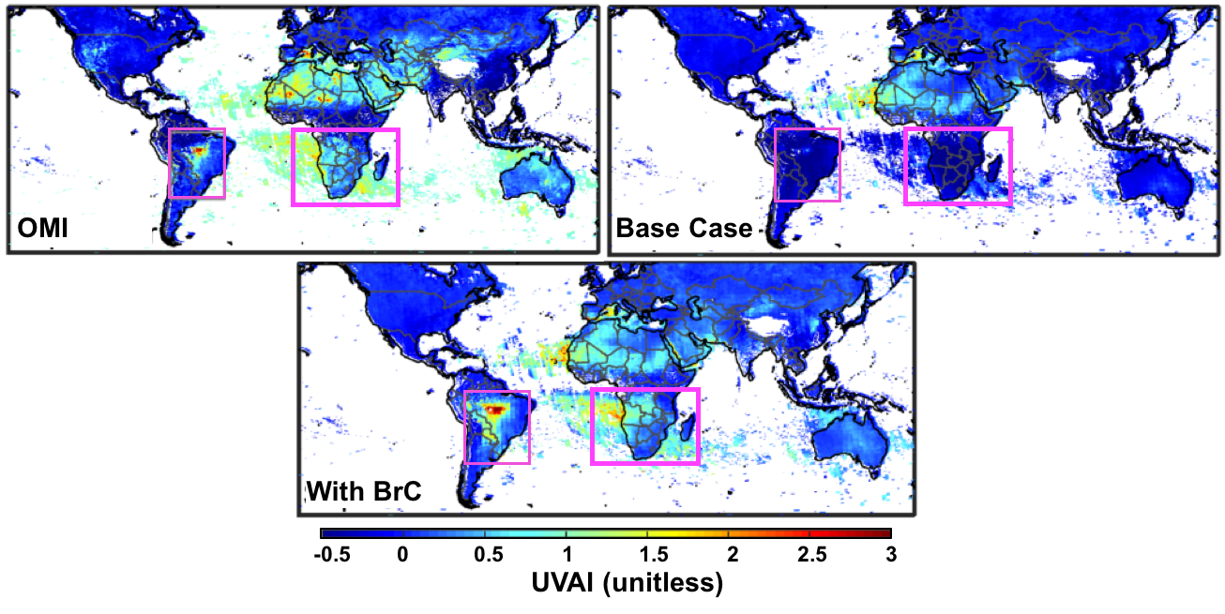
Base Case UVAI simulation underestimates absorption over biomass burning regions
September 2007
-0.5 0 0.5 1 1.5 2 2.5 3
UVAI (unitless)
Hammer et al., 2016

Slide 8

Brown Carbon (BrC)
Black carbon is typically treated as sole absorbing carbonaceous aerosol in chemical transport models (including GEOS-Chem)
Brown Carbon (BrC):
Strong absorption in UV, decreases into visible and near-IR
Emitted to atmosphere through low-temperature, incomplete combustion of biomass and biofuel
Found to contribute significantly to absorption by biomass burning aerosol
Typical Absorption Curve for BrC
Absorption
UV Visible Near-IR
Wavelength ($λ)$

Slide 9
Including Brown Carbon (BrC) improves bias over biomass burning regions
-0.5 0 0.5 1 1.5 2 2.5 3
UVAI (unitless)
Hammer et al., ACP 2016

Slide 10
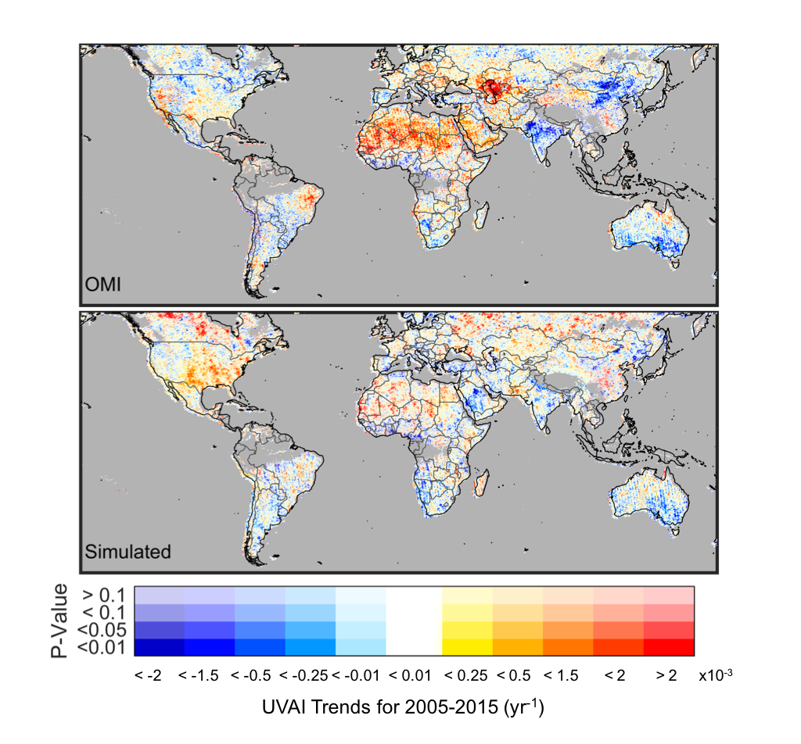
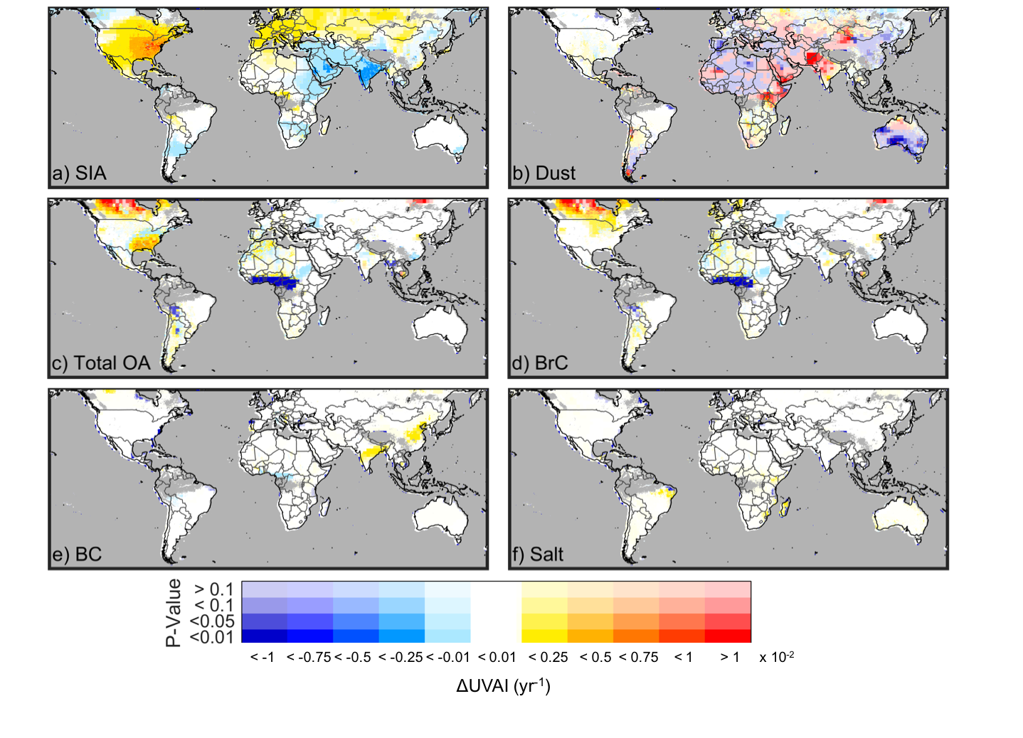
Positive UVAI trend over U.S. dominated by decrease in aerosol scattering
UVAI Trends
Change in simulated UVAI due to Scattering Aerosol
OMI
INORGANICS
ORGANICS
>0.1
<0.1
<0.05
<0.01
Simulation
P-Value
>0.1
<0.1
<0.05
<0.01
<-1 <-0.75 <-0.5 <-0.25 <-0.01 <0.01 <0.25 <0.5 <0.75 <1 > 1
ΔUVAI (x10⁻² yr⁻¹)
P-Value
<-2 <-1.5 <-0.5 <-0.25 <-0.01 <0.01 <0.25 <0.5 <1.5 <2 > 2
UVAI Trend for 2005-2015 (x10⁻³ yr⁻¹)
Hammer et al., ACP 2018

Slide 11
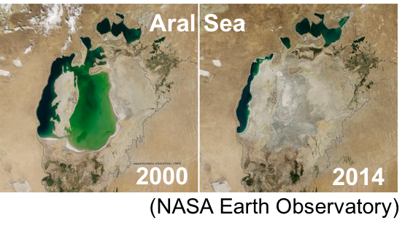
OMI UVAI captures trend in surface reflectance and dust due to drying up of Aral Sea
UVAI Trends
Positive trend in OMI UVAI near Aral Sea not captured by the simulation.
OMI
Simulation
NASA Earth Observatory
>0.1
<0.1
<0.05
<0.01
P-Value
<-2 <-1.5 <-0.5 <-0.25 <-0.01 <0.01 <0.25 <0.5 <1.5 <2 > 2
UVAI Trend for 2005-2015 (x10⁻³ yr⁻¹)
Hammer et al., ACP 2018

Slide 12
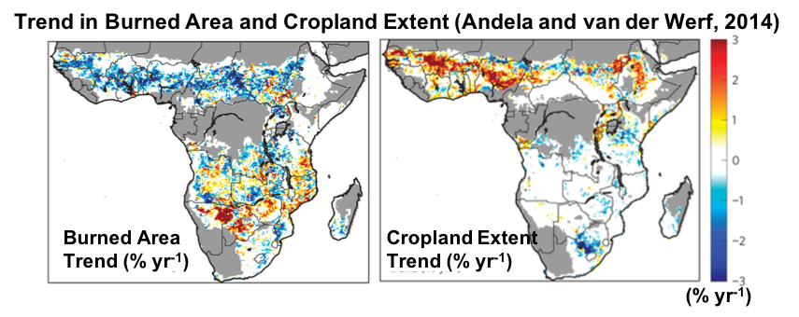
Negative UVAI trend over West-Africa due to negative trend in biomass burning
UVAI Trends
Change in simulated UVAI due to Absorbing Aerosol
OMI
BrC
>0.1
<0.1
<0.05
<0.01
P-Value
<-1 <-0.75 <-0.5 <-0.25 <-0.01 <0.01 <0.25 <0.5 <0.75 <1 > 1
ΔUVAI (x10⁻²)
Simulation
>0.1
<0.1
<0.05
<0.01
P-Value
<-2 <-1.5 <-0.5 <-0.25 <-0.01 <0.01 <0.25 <0.5 <1.5 <2 > 2
UVAI Trend for 2005-2015 (x10⁻³ yr⁻¹)
Hammer et al., ACP 2018

Slide 13
Conclusions
Detecting independent aerosol composition information from satellites: notoriously difficult
  Ultraviolet wavelengths: can separate aerosol absorption and scattering
UVAI: method of detecting aerosol effects from measured satellite UV-radiances
UVAI simulation with known aerosol composition allows us to interpret trends in satellite UVAI values
We find that global trends in the UVAI are largely explained by trends in absorption by desert dust, absorption by brown carbon, and scattering by inorganic aerosol.
Thank you

