Slide 1

Reflections on implementing physlets and physclips in undergraduate physics courses
Adriana Predoi-Cross
Dept. of Physics & Astronomy, University of Lethbridge, Alberta Canada.
Present address: 512 Silkstone Crescent West, Lethbridge, AB, Canada.

Slide 2
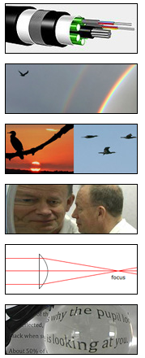
Talk Outline
Motivation
Elements of my teaching approach
Examples of instructional physlets, physclips, videos used during lectures
Concluding Remarks
References
Note: this presentation is based on my publication:
A. Predoi-Cross,Teaching Introductory Undergraduate Physics Courses Using Multimedia
Resources, Proceedings of ICWIP 2017, AIP publication, in press

Slide 3
Aims and Motivation
In recent years, I enriched my teaching activities on introductory physics courses in the Department of Physics and Astronomy at the University of Lethbridge by using videos, animations, physlets (Java applets used to demonstrate a concept or for solving problems), and more recently physclips (multimedia modules for introductory physics based on animations and video clips).
To fine-tune my approach, I have tested it on two introductory physics courses offered to two “audiences,” namely to
(i) science majors and science education students,
(ii) pre-engineering students and physics majors.
Based on feedback from students and my own observations of their performance, I refined my method and intend to develop similar resources for other physics courses.

Slide 4
Introduction
My goals are:
to create a stimulating and responsive learning environment that enhances the students’ critical thinking, nurtures their interest and curiosity in the topics presented in class.
to see my students get to a stage where they formulate questions using newly acquired physics concepts, contribute to related class discussions where they share their curiosity, and are ready to expand their knowledge.
Pedagogical research studies [1,2] have concluded that:
we need to create “responsive simulation environments of reality”.
“computational models controlling the simulations may contain idealization or limited ac­curacy – leading to misrepresentation of physical reality” [2].

Slide 5
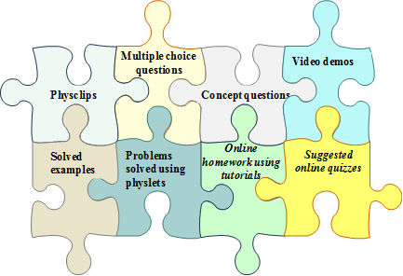
Instructional elements used in introductory physics teaching activities
Instructional elements used in introductory physics teaching activities. The labels in italic font correspond to at-home activities.
Notes:
I gradually narrowed down to a combination of methods that gave best results:
using multimedia resources during lectures,
in-class testing of student comprehension,
“multi level” homework.

Slide 6
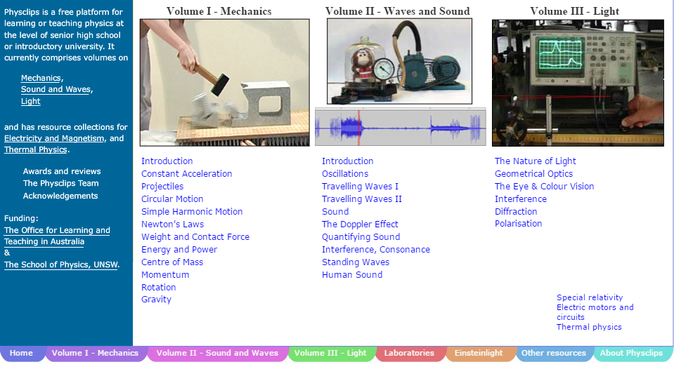

Physclips
Their role:
to be part of a “modified curriculum design that better accommodates the teaching of these “conceptual portals”, without which meaningful progress in the discipline is unattainable.” [3,4]

Slide 7
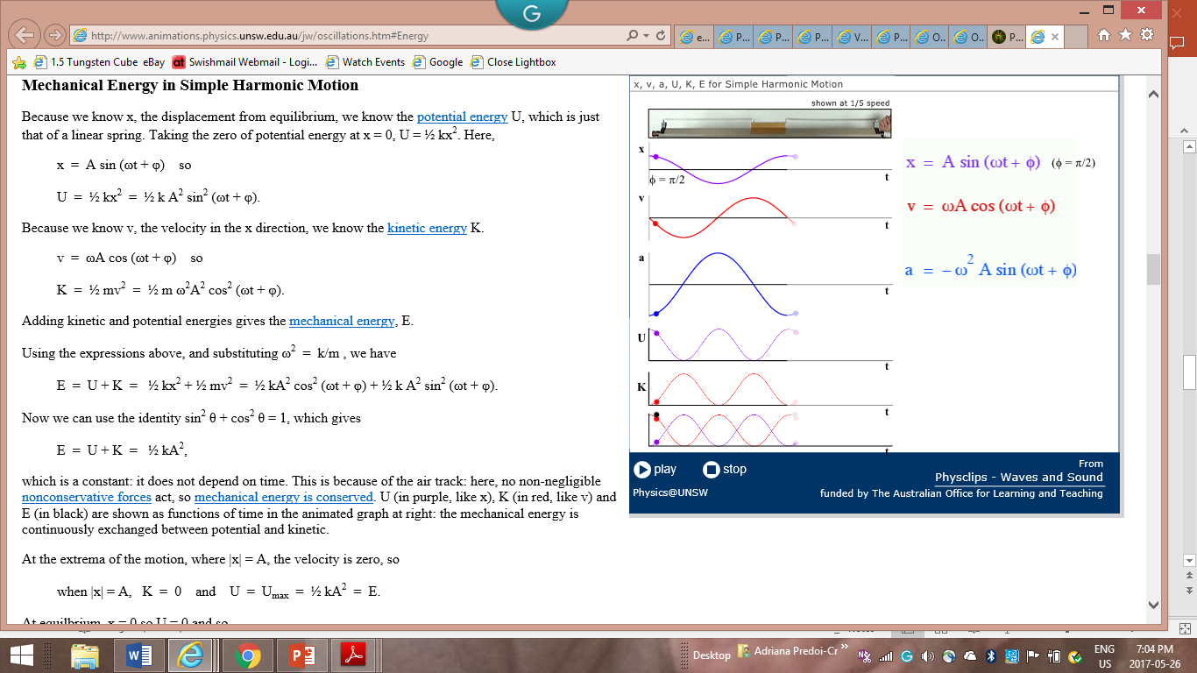
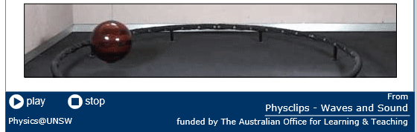
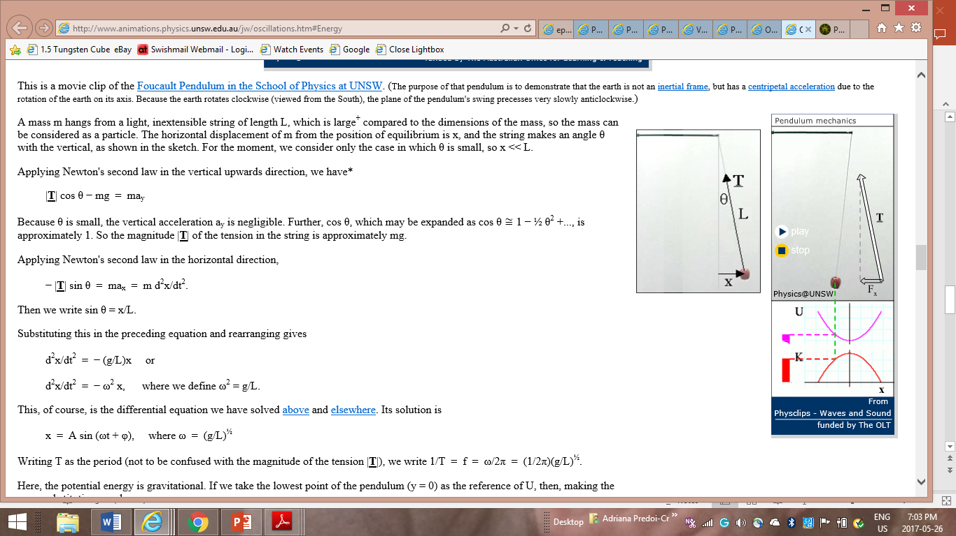
Physclips
Animations and short (~ 1 min long) videos are used when introducing new
concepts along with my slides, and to visualize mathematical expressions
Simple Harmonic Motion
Pendulum mechanics
http://www.animations.physics.unsw.edu.au/jw/foucault_pendulum.html
http://www.animations.physics.unsw.edu.au/jw/oscillations.htm#Pendulum
http://www.animations.physics.unsw.edu.au/jw/oscillations.htm#Energy

Slide 8
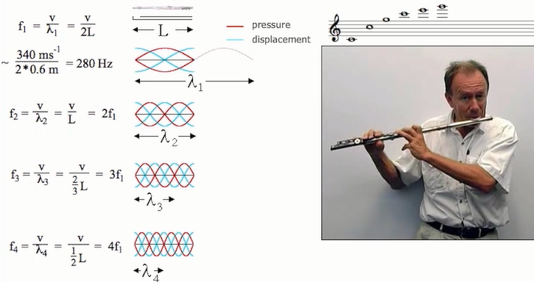
Example of Physclips
http://newt.phys.unsw.edu.au/jw/flutes.v.clarinets.html
Waves in pipes
http://www.animations.physics.unsw.edu.au/waves-sound/standing-waves/index.html#8.5

Slide 9
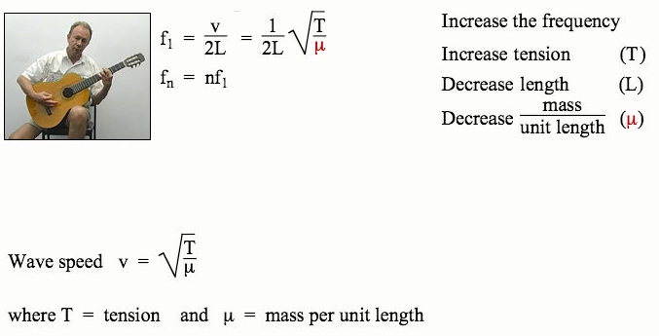
Physclips
All animations and videos presented in class are available to students
through physclips that combine concepts, examples, animations, videos. The physclips are available online and the slides posted on the class’s Moodle website include links to them.
I use the physclips in class to summarize the new concepts introduced during the lecture. Here are some examples:
Strings and harmonics
http://www.animations.physics.unsw.edu.au/waves-sound/standing-waves/index.html#8.4

Slide 10
Why Physclips Are an Effective Teaching Tool?
Today’s university-level physics teaching environments go beyond the traditional lecture style (see for example Refs. [1, 2]) to include hands-on activities and/or multimedia resources to enhance critical and independent thinking through self-discovery. These skills are refined by interaction with a “responsive simulation environment of reality,” complemented by carefully chosen at-home learning activities.
Educational research shows that learning is enhanced when the out-of-classroom activities are not limited to doing homework but instead include active learning through interactive video vignettes, pre-lecture readings, and preparation for “flipped classroom” teaching segments.
Note: In the “flipped classroom” teaching method the students are introduced to the new concepts through home reading and these concepts are practiced or demonstrated in class.

Slide 11
Why Physclips Are an Effective Teaching Tool?
V. Langley and R. Arieli state in Ref. [2] that computational models controlling the simulations may contain idealization or limited accuracy—leading to misrepresentation of physical reality.” Additionally, “simulations vary in their richness of content knowledge and representation methods, and the tools they provide for exploring the modeled subject” [2].
“Two features of visual ‘live’ simulations that help students build correct and appropriate mental models are the effect of seeing a system change and the effect of user control” [2].

Slide 12
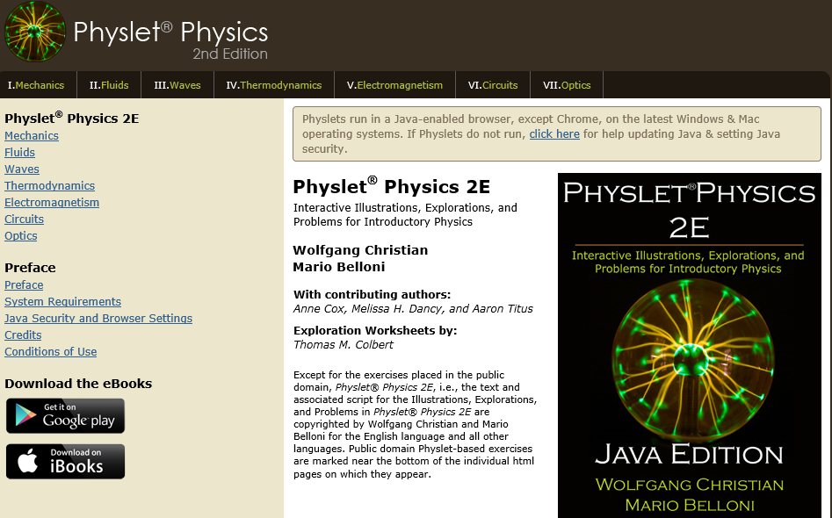
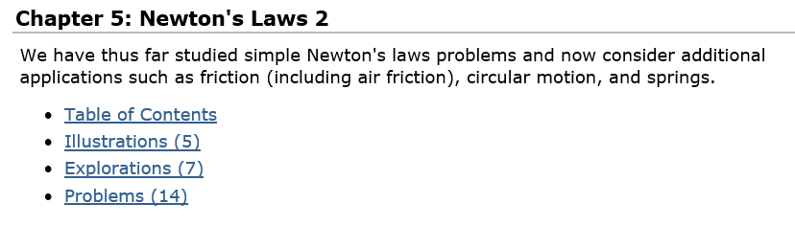
Exercises solved in class or at home using physlets
Problems solved using physlets
Several online resources for physics physlets exist such as: http://www.compadre.org/physlets/

Slide 13
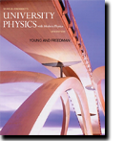
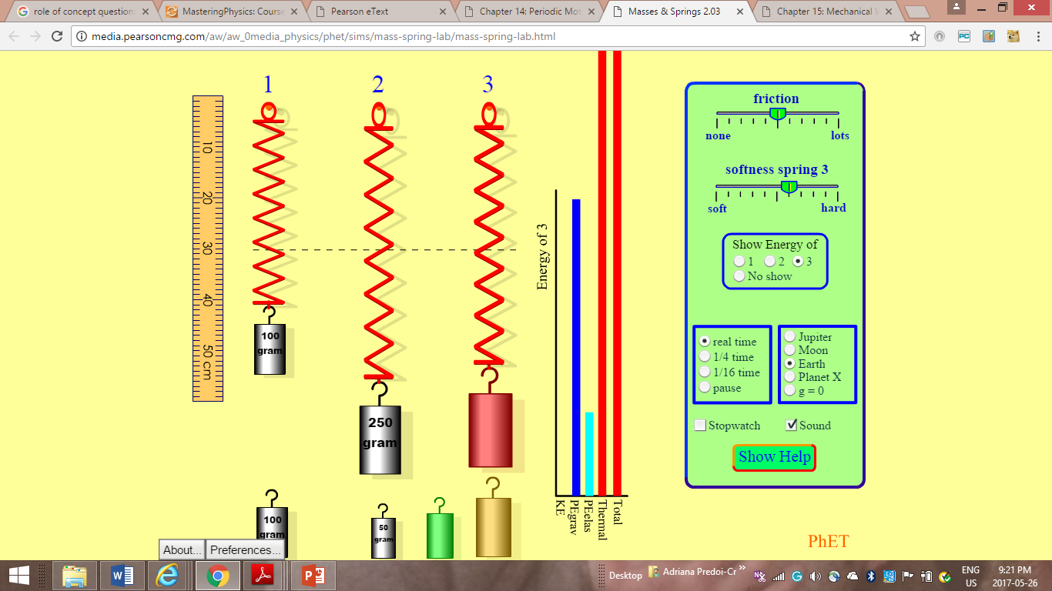
Exercises solved in class or at home using physlets
Physlets
or
PhET
Available to students as PhET Simulations in the “Study Area” of Mastering Physics.
Help students enhance their learning of concepts introduce in the class through explorations of interdependencies of physical variables
Masses and springs
University Physics with Modern Physics
14 edition
Young & Freedman
Pearson Education Inc.
http://media.pearsoncmg.com/aw/aw_0media_physics/phet/sims/mass-spring-lab/mass-spring-lab.html

Slide 14
The measures of performance used to assess the effectiveness of this teaching method were of qualitative and quantitative nature.
The qualitative performance indicators included:
students’ enthusiasm in learning physics,
students’ ability to answer in-class multiple-choice questions correctly,
students’ participation in discussions based on concept questions correctly
students’ written comments and feedback from class evaluations.
The quantitative performance indicators are:
(i) changes in the average class grades and in the individual grades of students involved in the two classes used as test subjects in this project
(ii) changes in the applicant’s scores on teaching evaluations.

Slide 15
Qualititative feedback received from students
Observations of student’s performance after using the teaching tools discussed here:
- the students curiosity and inquisitive nature is stimulated
the students give more complex and thorough or precise answers
the students make more effort to understand physics phenomena and explain them by themselves making reference to physical formulas
the students are more familiar with mathematical modelling and its uses to better understand physics concepts
improved overall class performance

Slide 16
Summary and directions for future pedagogical explorations
This approach helped me become a more effective teacher, a teacher that is flexible in her teaching / learning approaches and can adapt easily for example to new tasks such as teaching online courses.
In the future I intend to:
- Use Physlets in a “flipped classroom” approach
create more opportunities for the students to phrase questions for their peers based on the content taught in class,
to have the students work in small groups with a “spokesperson” for each group that would present the solution
to stimulate in class discussions by which the students can propose examples or situations relevant to the concepts
Acknowledgements
The author received funding from the University of Lethbridge for the duration of the teaching activities discussed here.

Slide 17
References
S. Kaya, Aus. Ed. Res. 42 429-441 (2015).
D.V. Langley and R. Arieli, Proceedings from the 20th Int. Conf. Mult. Phys. Teach. Learn. (European Physical Society, 2015), pp. 31–38.
http://www.animations.physics.unsw.edu.au/
G. Hatsidimitris and J. Wolfe, EdMedia: World Conference on Educational Media and Technology (2010), pp. 651-657.
I. Testa, A. Colantonio, S. Galano, S. Leccia, and E. Puddu, Proceedings from the 20th Int. Conf. Mult. Phys. Teach. Learn., edited by European Physical Society (2015), pp. 39–46.
P. Martínez-Jiménez, A. Pontes-Pedrajas, M. Climent-Bellido, and J. Polo, J. Chem. Ed. 80 346. (2003).
J. Corter, J. Nickerson, S. Esche, and C. Chassapis, Front. Ed., FIE 2004. 34th Annual IEEE. (2004) (pp. F1G–17).
H. D. Young and R. A. Freedman, University Physics, 14th ed. (Pearson Ed.,2015).
http://www.physicsworld.org/
http://www.compadre.org/physlets/
https://www.aapt.org/docdirectory/.../SM14/AAPT-2014July-final-KrisThompson.pdf

