Slide 1
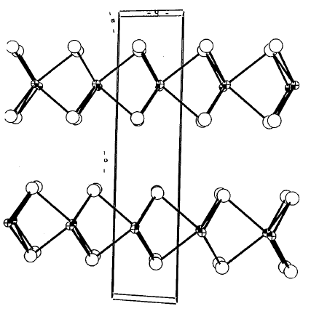
Structure and Properties of Exfoliated MoS₂-Polyaniline Nanocomposites
Erin Lyle², Douglas C. Dahn¹, Cody McAllister², and
Rabin Bissessur²
Departments of ¹ Physics, and ² Chemistry, UPEI
CAP 2018 Funding: UPEI and NSERC
Notes:
I’m presenting since I’m the one able to be here, and I’ll take responsibility for any errors, but co-authors have contributed more or less equally. Acknowledge funders.

Slide 2
Nanocomposites
Ongoing UPEI project investigating nanocomposites of layered materials and polymers
Notes:
One of the Layered Transition Metal Dichalcogenides
Also a 3R phase with same layer configuration but different stacking
Stacking 2H MoS2 AbA BaB
2H NbS2 AbA CbC
3R AbA CaC BcB
1T AbC

Slide 3
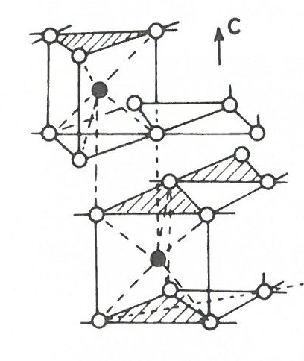
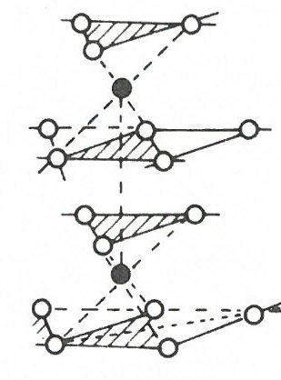
2H-MoS₂ 1T-MoS₂
Normal bulk MoS₂.
Semiconductor with
1.2 eV indirect gap
Equilibrium structure for bulk Li_{x}MoS₂
2H to 1T transition driven by electron transfer to MoS₂
Metastable after Li removed
Metallic
Notes:
One of the Layered Transition Metal Dichalcogenides
Also a 3R phase with same layer configuration but different stacking
Stacking 2H MoS2 AbA BaB Trigonal prismatic coordination of S around Mo.
2H NbS2 AbA CbC
3R AbA CaC BcB
1T AbC Octahedral coordination of S around Mo.

Slide 4
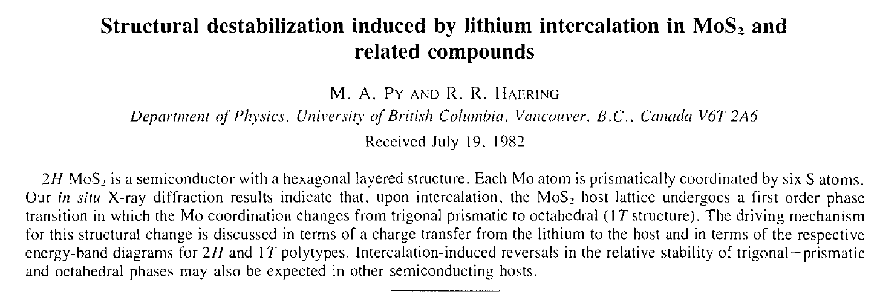
Discovery of 1T structure in Li_{x}MoS₂
Can. J. Phys. 61 (1983) 76

Slide 5
“Graphene-analogous” single-layer MoS₂
2H-type single layer has 1.9 eV direct band gap
Potential applications in electronics, optoelectronics, sensors, photoluminescence, catalysis, nanotubes, energy storage…
Produced by, for example:
Mechanical exfoliation of bulk 2H-MoS₂
Exfoliation by lithium intercalation - produces 1T phase²
Reaction of molybdic acid and thiourea - produces 2H-MoS₂ in exfoliated state¹
[1] H.S.S Ramakrishna Matte et al. (2010) Angewandte Chemie 122, 4153-4156.
[2] D. Yang et al. (1991) Phys. Rev. B 43, 12053. (Bob Frindt group, SFU)
Notes:
A graphene-analogous semiconducting material
(ultra-thin transistors) (supercapacitors, batteries)

Slide 6
Conducting polymer polyaniline (PANI)
Various forms. Doping of the emeraldine salt form required to form mobile charged polarons and bipolarons.
Electrical conductivity σ ~ 10⁻¹ to 10³ S/cm¹
(doping, disorder, chain length….)
1. Kaiser, Advanced Materials 13 (2001) 927
Notes:
Positive polaron is a radical cation, “a quasiparticle consisting of a single electronic charge dressed with a local relaxation of the bond lengths.” (Alan Heeger Nobel lecture) Charge +e, spin ½
Bipolaron is two polarons “bound together by the overlap of a common lattice distortion (enhanced geometrical relaxation of bond lengths)” Charge +2e, spin zero.
.
Conductivity depends on doping, disorder, molecular weight, etc.

Slide 7
MoS₂-PANI Nanocomposites
Worldwide research activity on related materials and applications, e.g.:
Supercapacitors (specific capacitance 400 - 600 F/g)¹
Li ion batteries
Electrochemical sensors…
Most literature on layered NCs, 1T-MoS₂ -PANI, large MoS₂:PANI ratios, and few-layer 2H-MoS₂-PANI
This work – Exfoliated single-layer 2H-MoS₂-PANI NC , small MoS₂:PANI ratios
Ansari et al, J Colloid and Interface Science 504 (2017) 276; Gopalakrishnan et al, Nano Energy 12 (2015) 52; Zhao et al, Chemical Engineering Journal 330 (2017) 462

Slide 8
Synthesis
2H-type exfoliated MoS₂ was prepared directly by combining molybdic acid with an excess of thiourea. Mixture heated at 500˚C for 3 hours under nitrogen atmosphere.
Nanocomposites synthesized using in-situ polymerization of the aniline monomer in the presence of exfoliated MoS₂. (MoS₂ added to a mixture of aniline and 1M HCl at 0º C, followed by addition of ammonium persulfate, vacuum filtration and isolation of the product.)
NCs containing 1% to 50% MoS₂ by weight of PANI
Two syntheses (“trials”) of each
Notes:
Exfoliated MoS₂ was ultrasonicated in deionized water for 20 minutes at 30% amplitude with a Cole-Parmer 750 watt ultrasonic processor. The solution was then added in a magnetically stirring mixture of aniline and 1 M HCl. This step of the synthetic process was completed under 0°C conditions as the reaction flask was surrounded by an ice bath. Once the addition of exfoliated MoS­₂ to the reaction vessel was complete, a cooled solution of ammonium persulfate (supplied by Sigma-Aldrich) and 1 M HCl was added in a dropwise fashion to the reaction vessel. The contents of the flask were allowed to stir for 90 minutes before vacuum filtration and isolation of the product occurred. This procedure was duplicated in order to create two trials of nanocomposites which contained 1, 5, 10, 15, 20, 30, 35, 40, 45, and 50% exfoliated MoS₂ by weight of PANI.

Slide 9
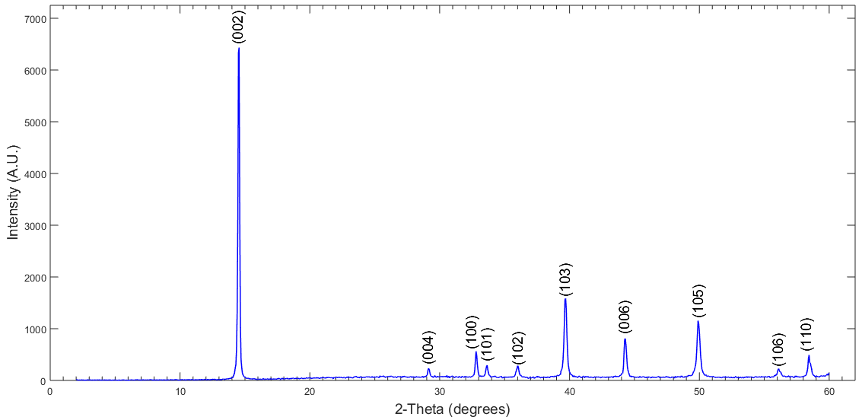
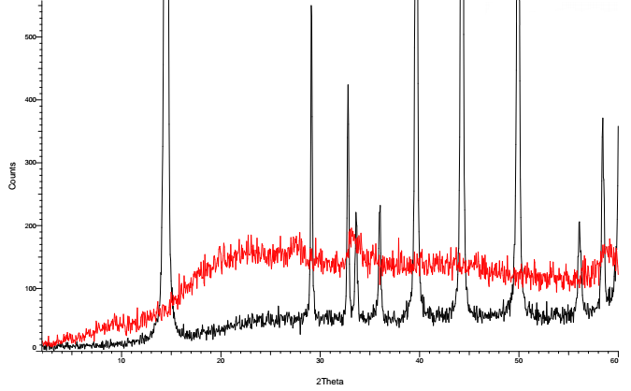
Powder XRD of MoS₂
Bulk 2H-MoS₂
Bulk 2H
MP
Exf MoS₂
Exfoliated
Notes:
Broad background, lack of 00l , 10l, consistent with an exfoliated material and with literature. Peak at about 28 deg not understood but probably not worth mentioning!

Slide 10
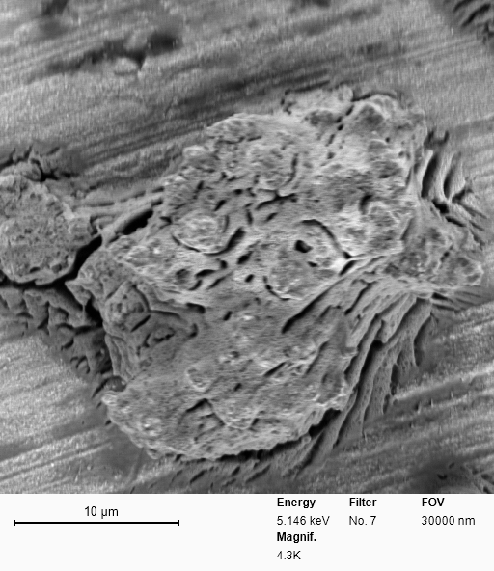
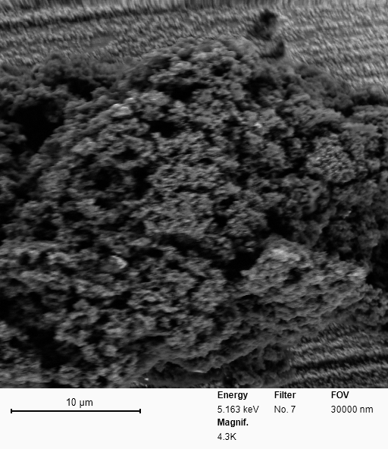
SEM
1% MoS₂-PANI trial 1
20% MoS₂-PANI trial 1
Notes:
Nanocomposite shows no sign of phase separation.

Slide 11
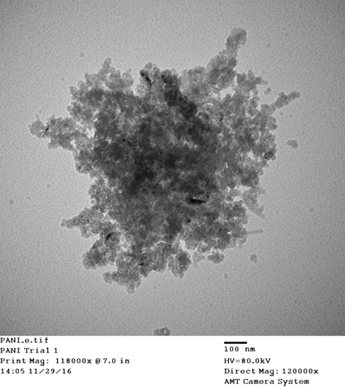
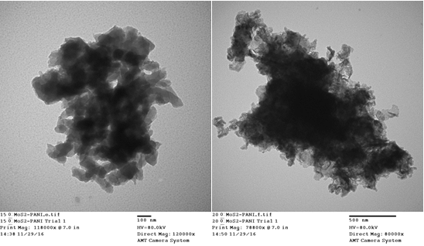
TEM
No evidence of MoS₂ layers restacking - Exfoliated NC
PANI 15% MoS₂-PANI 20% MoS₂-PANI

Slide 12
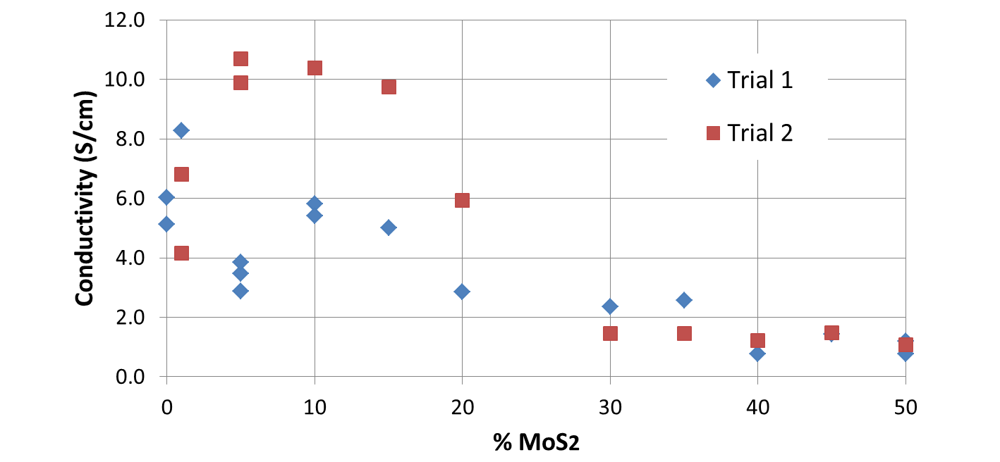
Room – Temperature Conductivity
van der Pauw method on pressed pellets in lab air
Some samples attracted visible water droplets – these measured in dry air desiccator
No detectable conductivity in exfoliated MoS₂
Notes:
Note some NC have higher cond than our PANI made same way without MoS2
Multiple data points are different pellets from same synthesis trial – some variability – Pressing pressure, age?

Slide 13
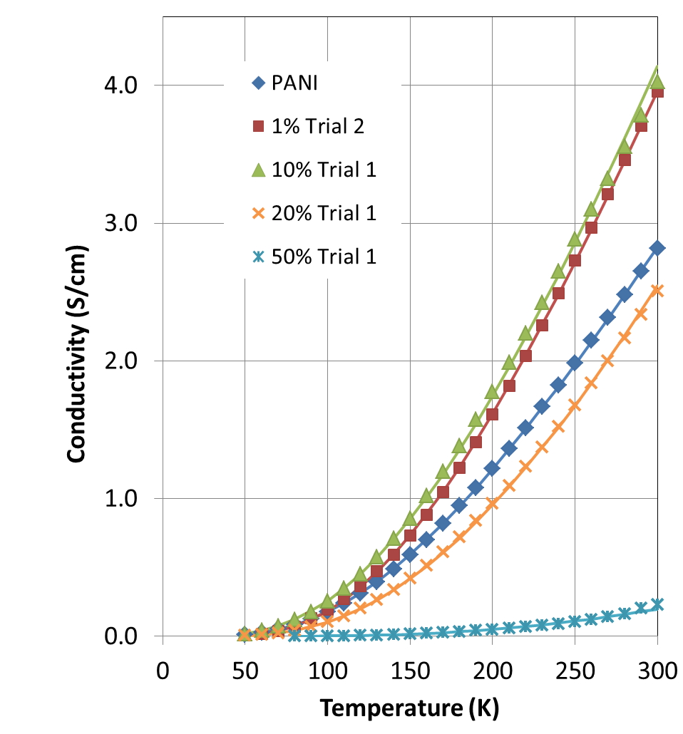
Variable-Temperature Conductivity
In vacuum
50 – 300K
Exposure to vacuum reduces room temperature conductivity. (Alters PANI doping?)
Lines are fits: next slide…

Slide 14
Fits to Heterogeneous Conduction Model
For lower-conductivity polymers,
conductivity σ often well-described by¹
First term: Good conduction in ordered regions (quasi-one-dimensional metal). Resistance often small. Not needed to fit our data.
Second term: Hopping-type conduction through disordered regions.
γ = 0.25 : Mott’s variable-range hopping (VRH) model in 3D.
γ = 0.5 : quasi-1D VRH (or 3D hopping with significant e-e interaction, or tunneling with charging effects…)
γ ≈ 0.5 determined from our fits to PANI and NC (0.4 to 0.6).
1. Kaiser, Advanced Materials 13 (2001) 927 and references therein
Notes:
Kaiser:
“For c = 0.25, the second
term is Mott's variable-range hopping law in three dimensions,[
114] while for c = 0.5 it represents either quasi-1D hopping,
or 3D hopping in the presence of electron±electron
interactions,[115] or tunneling between mesoscopic metallic
islands, in which the charging energy is significant.[116] For
hopping the prefactor r0 does have some temperature dependence,
but this is usually taken as small compared to that of
the exponential factor.[114]”

Slide 15
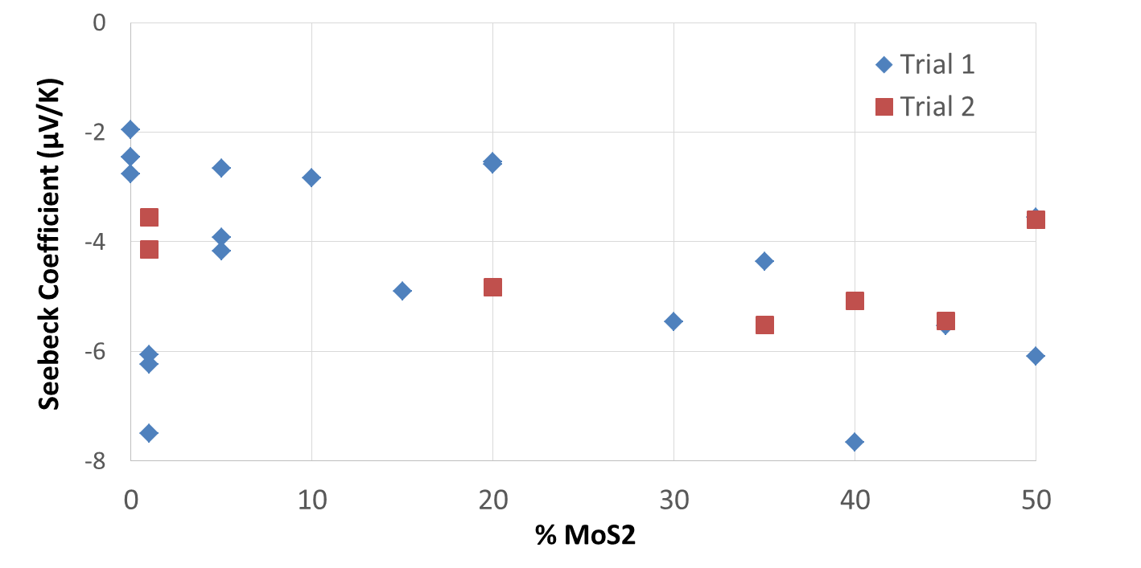
Seebeck coefficient
Room temp, pellet between polished Cu electrodes, one heated
Pellets attracting water or corroding Cu not included
PANI usually positive in literature, but sometimes negative

Slide 16
Discussion
Nanocomposites with 1 to 15 % MoS₂ sometimes have greater conductivity than PANI, much greater than 2H-MoS₂
A possible explanation: MoS₂ in some nanocomposites is in 1T form (metallic).
Alternatively, presence of MoS₂ during polymerization could influence order or doping level of PANI, improving its conductivity.
Seebeck: n-type metallic behaviour, same conduction mechanism for PANI and NC
Variable-T: consistent with an inhomogeneous conduction model
Notes:
Electron transfer from PANI to MoS₂ would drive 2H to 1T transition. Could occur during in situ polymerization

Slide 17
Future work
Attempt to determine1T or 2H structure in the nanocomposite – Raman spectroscopy?
Explore how PANI and NC properties depend on synthesis conditions
Related NCs
Applications?
QUESTIONS?
Notes:
Verify 1T by Raman (if we can get the right conditions) – literature Raman spectra are distinct – or perhaps by HRTEM?

