Slide 1


Competition During Reprogramming Gives Rise to Deterministically Elite Clones.
Sophie McGibbon-Gardner
Nika Shakiba
Peter Zandstra
Sidhartha Goyal

Slide 2
Reprogramming Trajectory
Skin-like
State
Unstable Stem-
like State
Stable Stem-like State
Notes:
natrual embryonic development

Slide 3
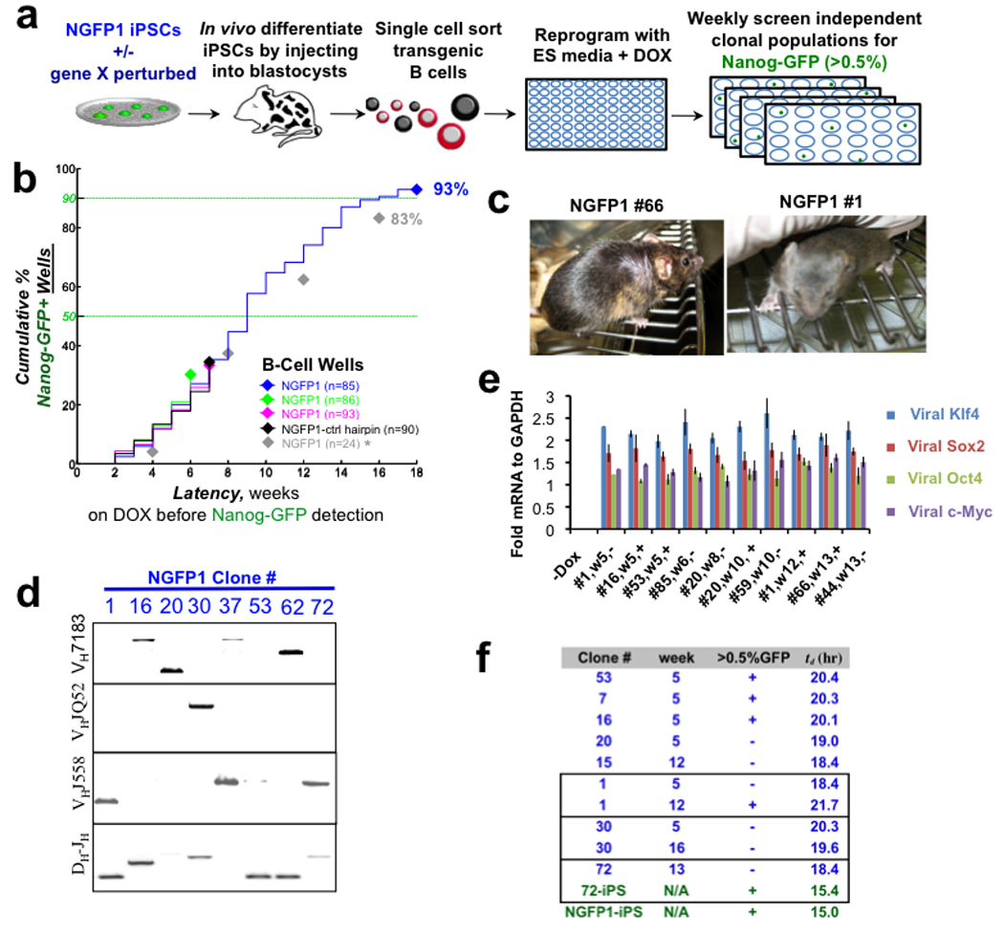
Equipotency Hypothesis
Hanna et al. Direct cell reprogramming is a stochastic process amenable to acceleration. Nature. 2009;462(7273):595-601. doi:10.1038/nature08592.

Slide 4
Equipotency Hypothisis
Relatively Small Clonal Contribution
Relatively Large Clonal Contribution
Hanna et al. Direct cell reprogramming is a stochastic process amenable to acceleration. Nature. 2009;462(7273):595-601. doi:10.1038/nature08592.

Slide 5
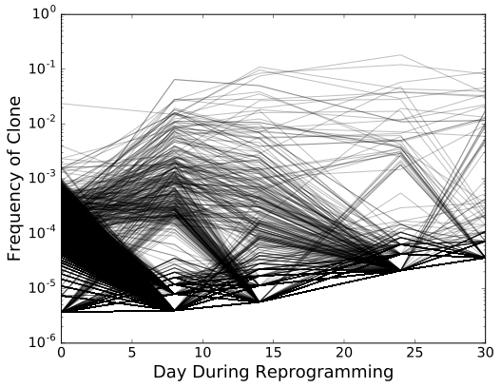
Skin-like
State
Unstable Stem-
like State
Stable Stem-like State
Notes:
put barcodes in here. log y axis, just one flask
could be multiple things, resolve using lineage traking
neutral systems give you a signature of clone sizes.

Slide 6
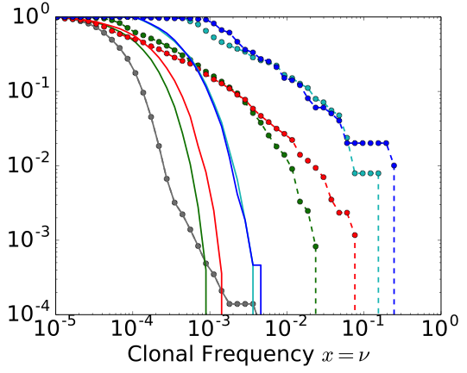
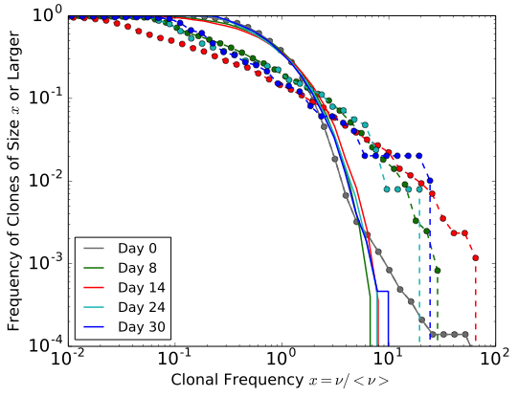
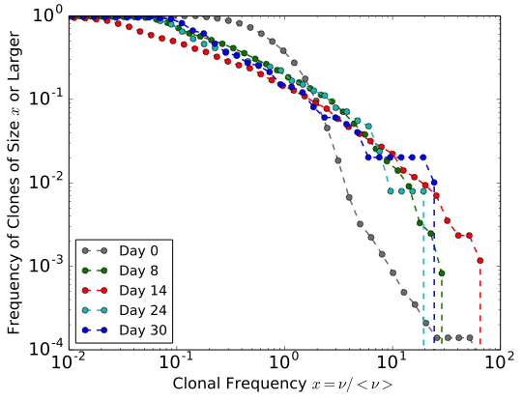
Clonal Frequencies From Experiment
Notes:
experimental resutls of lineage tracking. cannot address equipotency theory with this alone.
care about relative dynamics, not mean dynmaics (also depends on protocol)

Slide 7
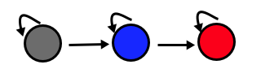
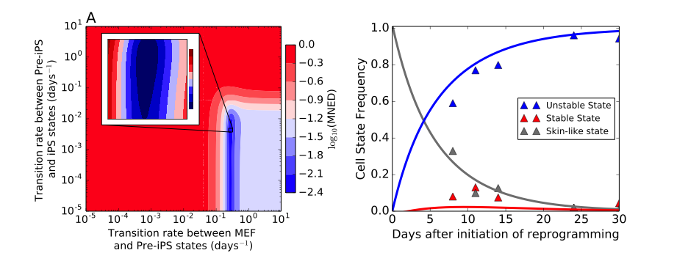
Constructing a Neutral Model
r₁
r₁
r₂
α
β
Skin-like State
Unstable Stem-Like State
Stable Stem-Like State
Notes:
So what does a neutral model look like in this case

Slide 8
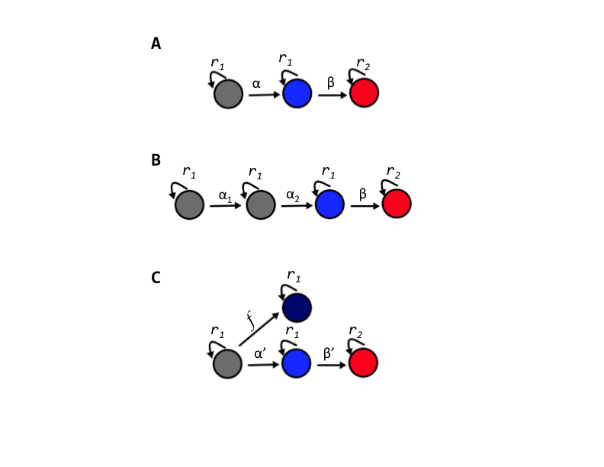
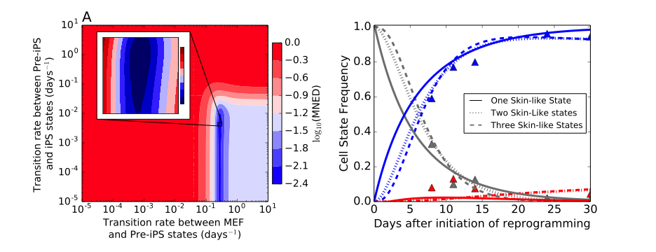
Terminal
State
Unstable Stem-Like State
Stable Stem-Like State
Skin-like State
Notes:
Changing things up doesn’t really help us.

Slide 9
Neutral stochastic simulation results
Notes:
clearly not ideal.
Inset -> show non-normalized axis

Slide 10
Splitting population as Day 0
Skin-like State
Unstable Stem-
like State
Stable Stem-like State
Skin-like State
Pre-reprogramming experiment
Flask 1
Flask 2
Notes:
do the same thing again but split at day zero

Slide 11
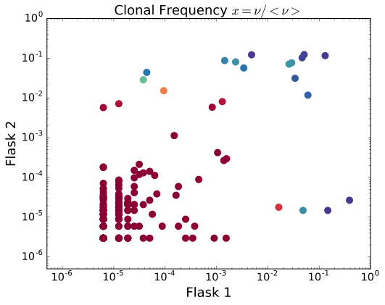
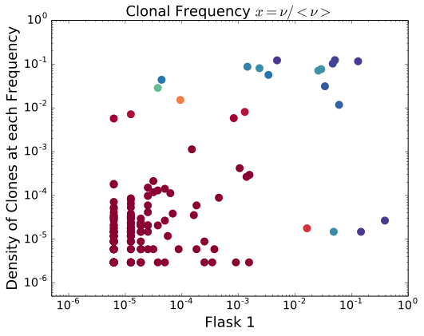
Correlations in Splitting Experiments
10⁻¹
10⁻³
Notes:
grab scatter plot, higher correlation than we expect for neutral or emergent. so we try adding in populations

Slide 12
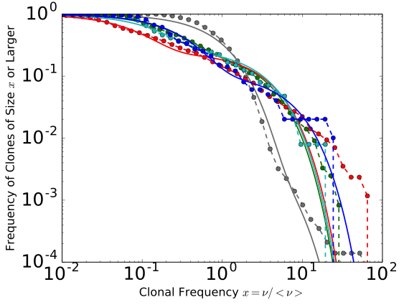
Introduction of subpopulations
Notes:
increasing populations, how many do we need to have?

Slide 13
Introduction of subpopulations
Notes:
increasing populations, how many do we need to have?

Slide 14
Comparison of Subpopulation numbers

Slide 15



Thank you
Sidhartha Goyal & Group
Nika Shakiba & Peter Zandstra
Zilman Group

Slide 16
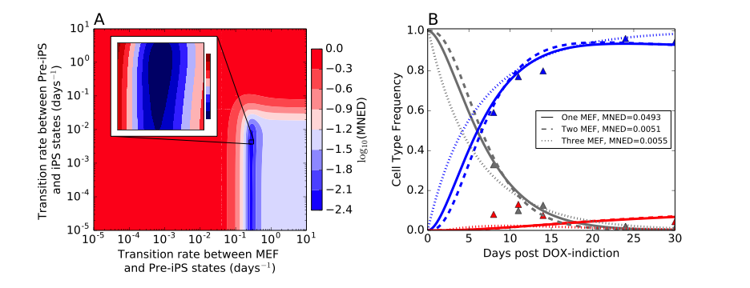

Slide 17

Cellular Reprogramming
Mouse embryo
Primary iPSCs
(DOX-inducible OKMS)
Secondary mouse
DOX-inducible secondary MEFs

