Slide 1

Monte Carlo simulations for magnetic resonance guided radiation therapy dosimetry
Victor N. Malkov (Carleton PhD supervisor : David W.O. Rogers)
Canadian Association of Physicist Conference
June 13th, 2018, Halifax, N.S.

Slide 2
Presentation overview
MRI in radiation therapy
Existing and developing MRgRT systems
Why do we need Monte Carlo for MRgRT?
Comparisons to ion chamber measurements and sensitive volume effects
Project ‘Air strike’
Initial MRgRT slides courtesy of Jochem W.H. Wolthaus (UMCU)

Slide 3
Presentation overview
MRI in radiation therapy
Existing and developing MRgRT systems
Why do we need Monte Carlo for MRgRT?
Comparisons to ion chamber measurements and sensitive volume effects
Project ‘Air strike’

Slide 4
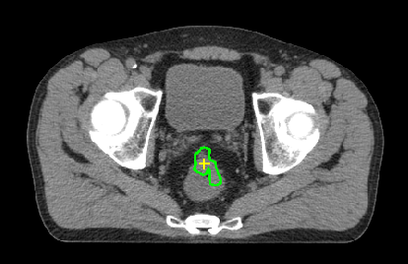
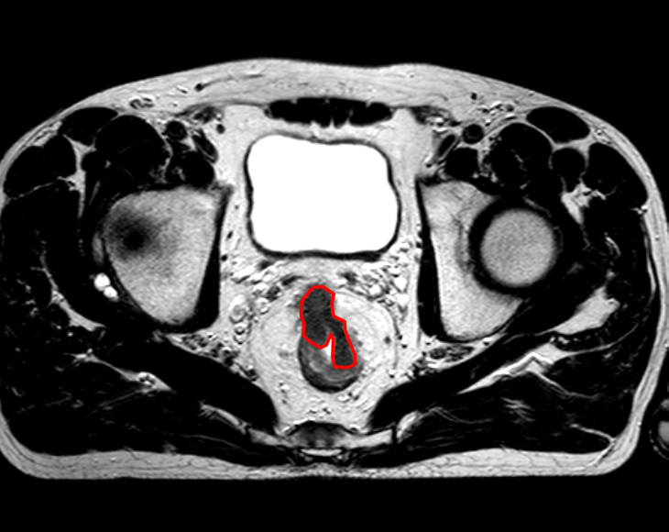
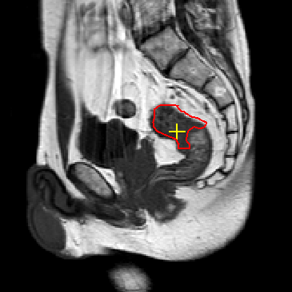
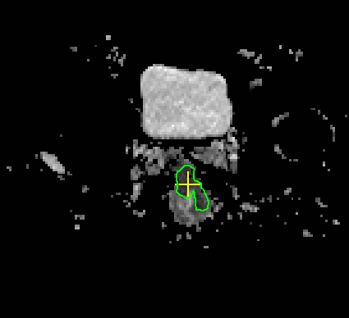
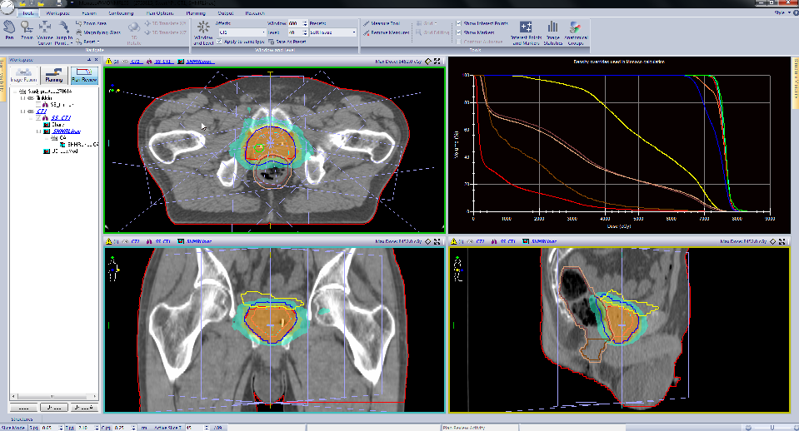
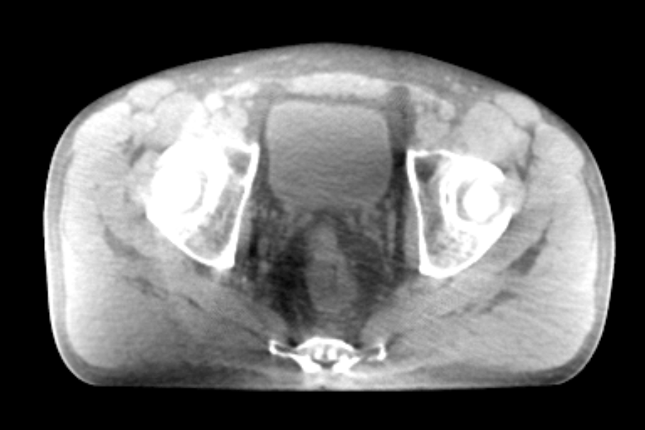
Reference Image
Imaging for target definition
CT
MRI (T2)
MRI (T1)
MRI (DWI)
Step1
Delineation
…
Image Registration
Step 2
Treatment
planning
CT
No direct imaging of tumor
Separate processes, no real-time adaptations
CBCT1
CBCT2
CBCT3
CT
CBCT n
Step 3
Treatment
delivery
Image Registration
Notes:
Remarks standard radiotherapy process
Image quality is not optimal during delivery
Direct imaging of the tumor is not possible
Each step is a separate process
Real time adaptation is almost impossible

Slide 5
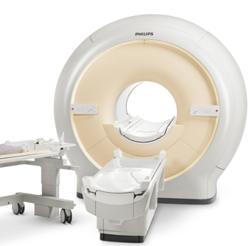
MRI Guided radiotherapy (MRgRT)
Goal: See what you treat and adapt
Needed:
  Soft tissue contrast: Direct tumor visualization
  On-line imaging
  Real time imaging
Solution: MRI!

Slide 6
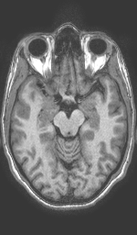
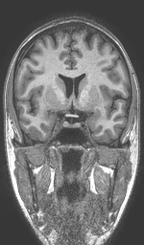
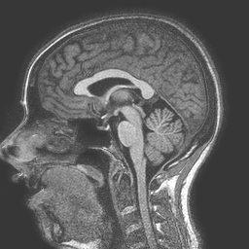
MRI has superior soft tissue contrast
T1 3D-TFE sequence of healthy volunteer
Courtesy of Mariëlle Philippens
Notes:
Endogenous contrast

Slide 7
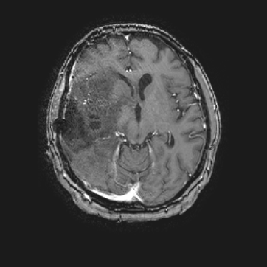
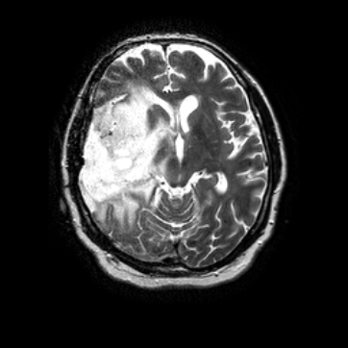
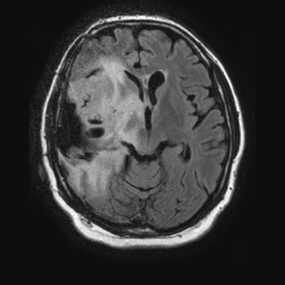
A wide variety of contrasts
T1gd
T2
T2-flair
Exogenous contrast
Endogenous contrast
patient with glioblastoma multiforme
Courtesy of Mariëlle Philippens

Slide 8
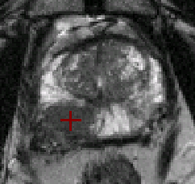
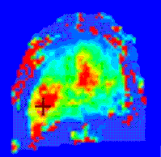
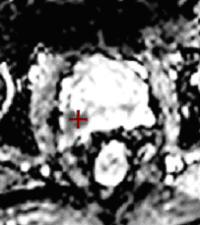
Anatomical and functional imaging
T2 MRI
DCE-MRI
DW-MRI
Prostate tumor inside prostate
Courtesy of Mariëlle Philippens

Slide 9
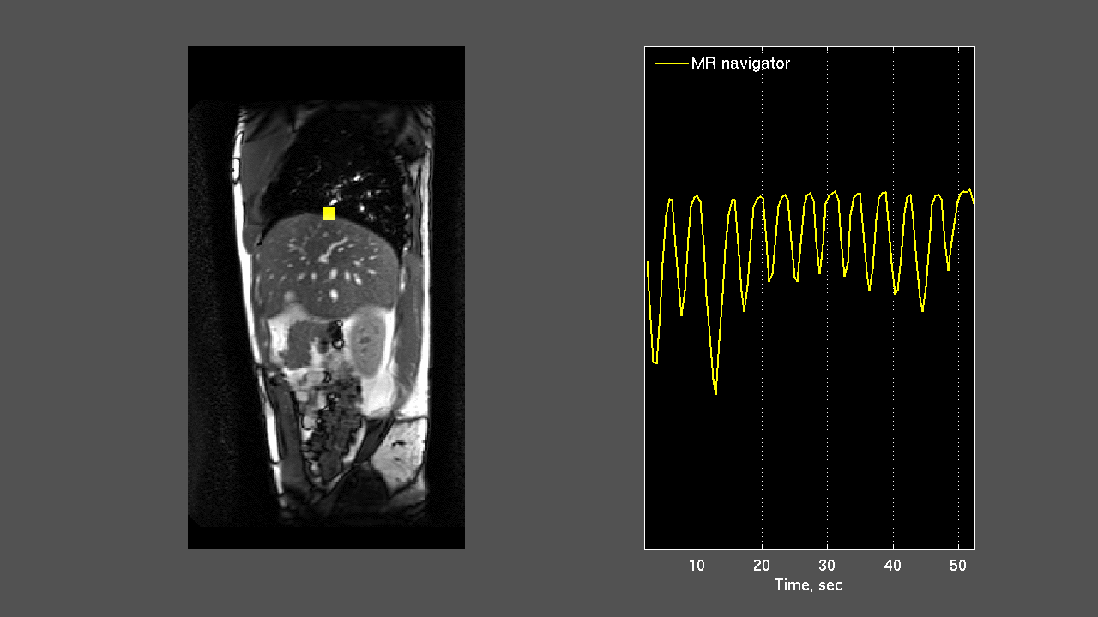
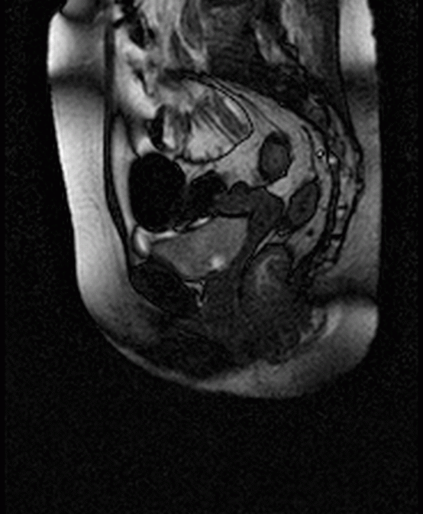
Fast / real time imaging
Liver
Rectal cancer
Courtesy of Anna Andreychenko

Slide 10
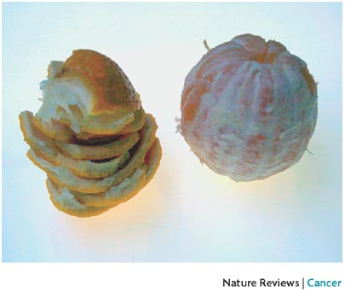
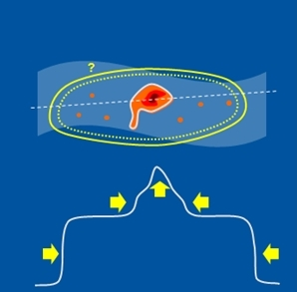
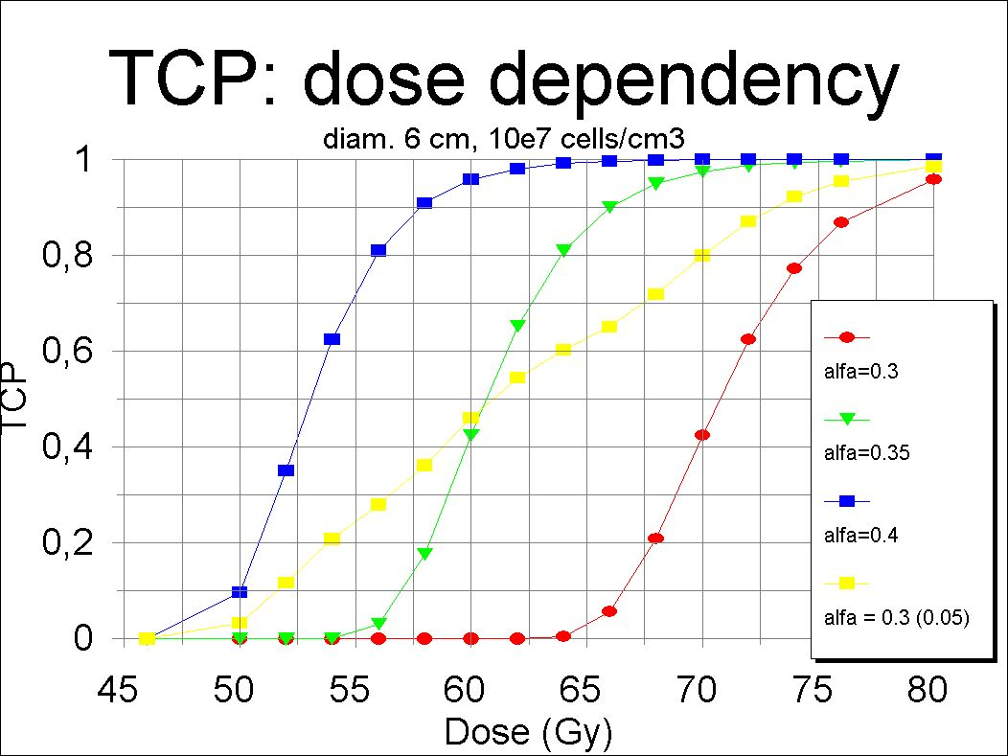
MRI Guided radiotherapy
MRI offers:
Imaging of Soft tissues
On-line imaging
Real time imaging
Seeing what you treat!
Margin reduction
Dose escalation
Improved tumor control
Courtesy of Dirk Verellen

Slide 11
Presentation overview
MRI in radiation therapy
Existing and developing MRgRT systems
Why do we need Monte Carlo for MRgRT?
Comparisons to ion chamber measurements and sensitive volume effects
Project ‘Air strike’

Slide 12
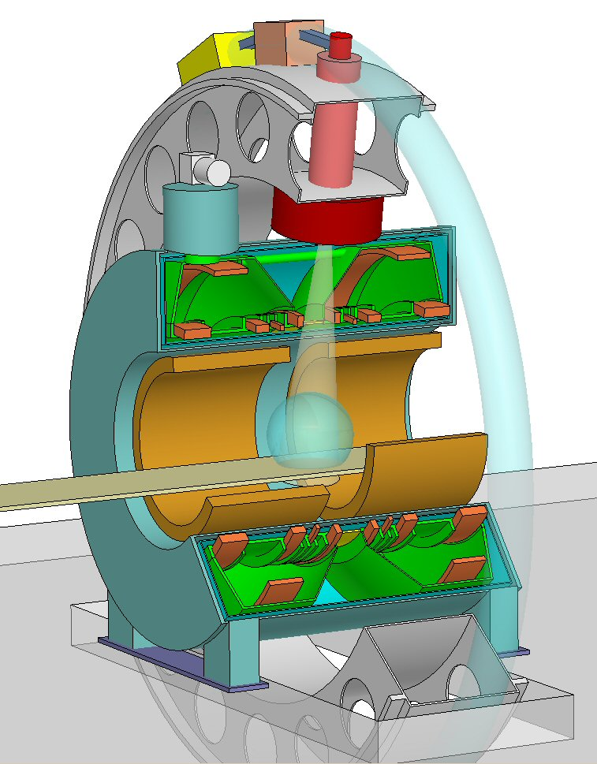
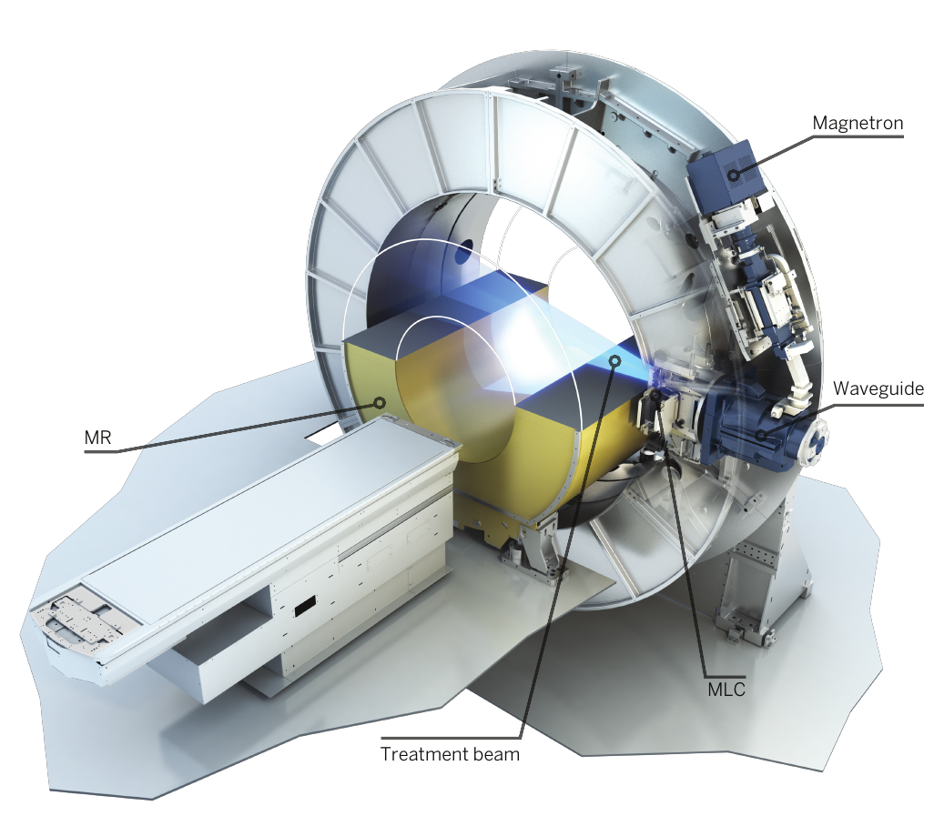
The MR-Linac system developed by UMC Utrecht and Elekta
Accelerator
Key specifications:
1.5 T MRI (diagnostic quality!)
7 MV linac
Cylindrical geometry
  70 cm Bore diameter
  Radiation perpendicular to B-field
MRI
beam
JJW Lagendijk et al. Semin Radiat Oncol 24:207-209 2014
JJW Lagendijk and Bakker, MRI guided radiotherapy - A MRI based linear accelerator Radiother Oncol. 56, S1, 2000, 220

Slide 13
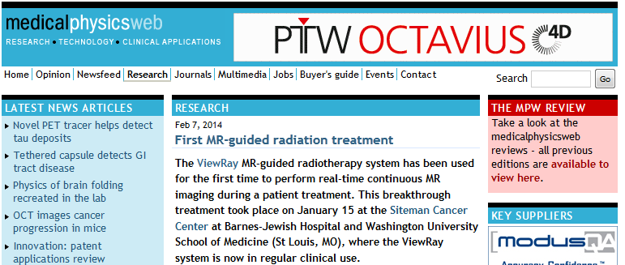
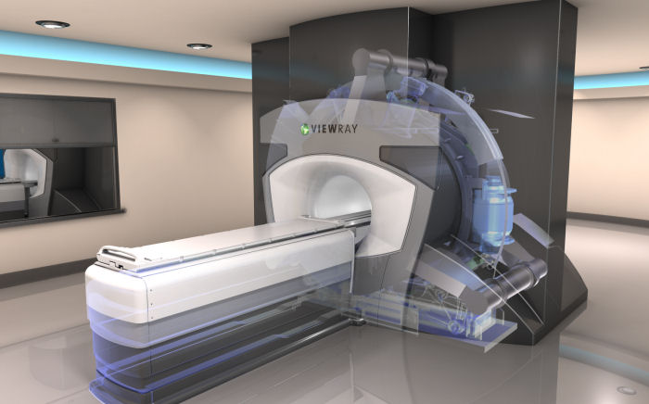
The MRIdian system
Viewray company
Key specifications:
0.35 T MRI
3 Co-60 sources (1 MV)
  Linac upgrade release ongoing
Cylindrical geometry
    70 cm bore diameter
    Radiation perpendicular to B-field
Mutic et al. Semin Radiat Oncol 24(3):196-199, www.viewray.com
Notes:
Split magnet
Magnetic field strength lower than 1.5T does not allow for functional imaging and fast real time imaging.
Real time plan adaptation will never be possible with these systems.
Field homogeniety is limited for biplanar geometry, thus resulting in geometrical image artifacts away from the isocenter.

Slide 14
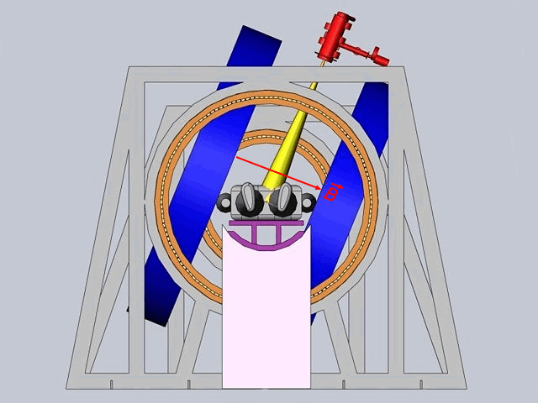
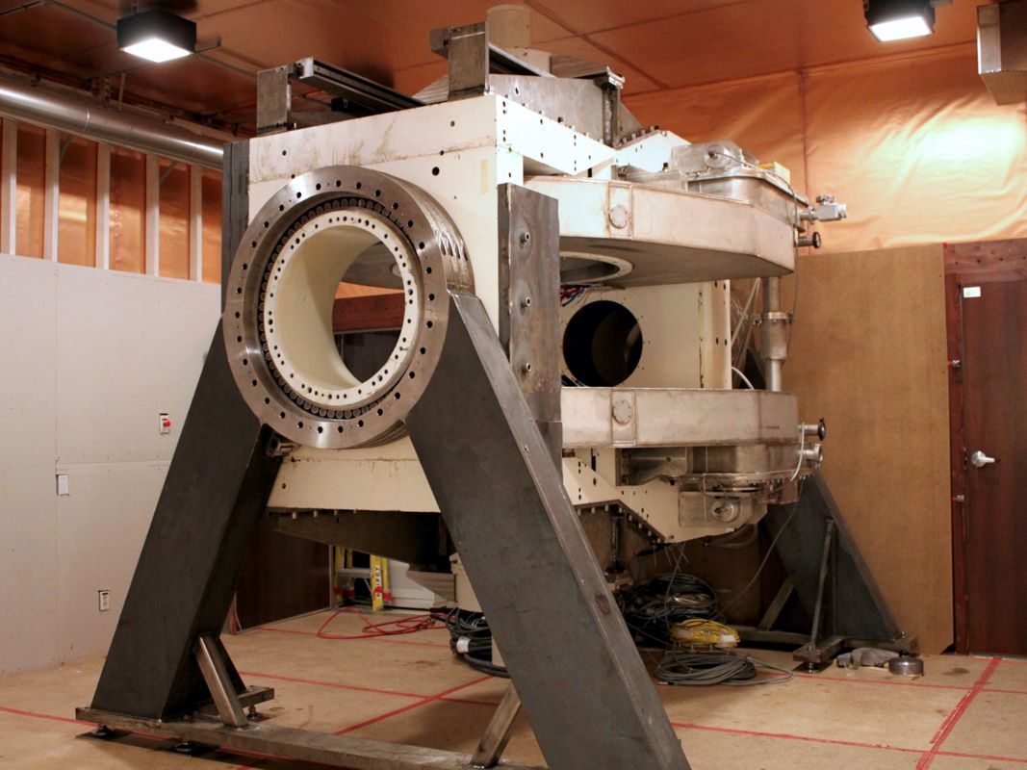
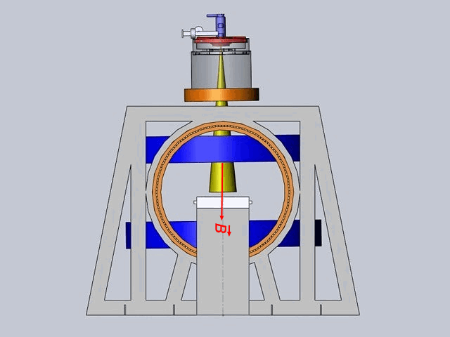
Linac-MR system of Cross Cancer Institute
Edmonton Canada
Perpendicular configuration
Key specifications:
0.5 T MRI
6 MV linac
Biplanar geometry
  Radiation perpendicular to B-field
  Radiation parallel to B-field
Parallel configuration
Prototype
Biagio Gino Fallone Semin Radiat Oncol 24:200-202, http://www.mp.med.ualberta.ca/linac-mr/

Slide 15
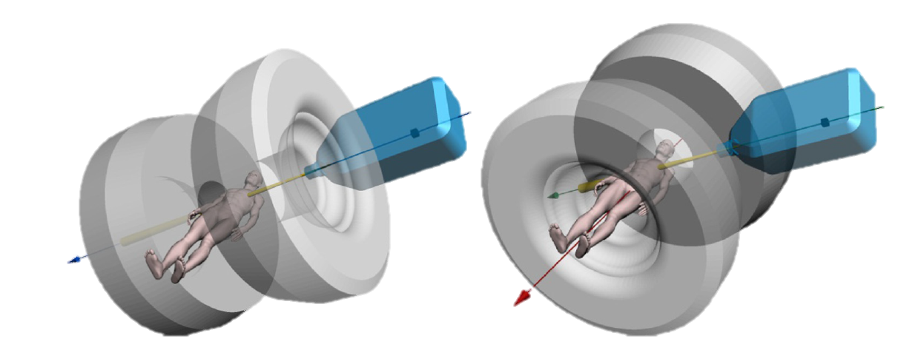
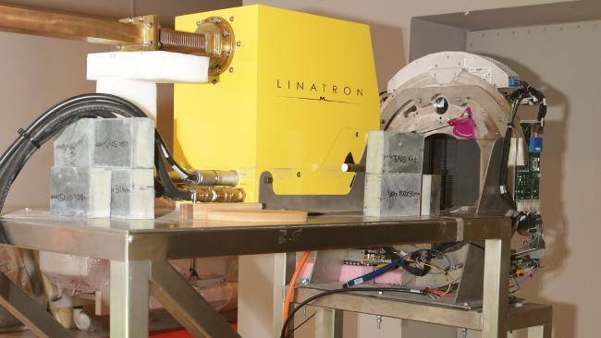
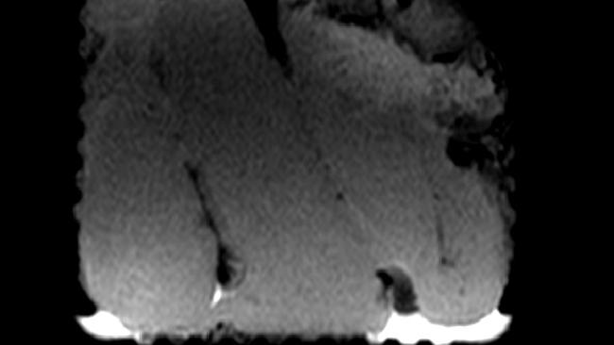
The Australian MRI-Linac program
University of Sydney
Key specifications:
1 T MRI
6 MV linac (Varian)
Cylindrical geometry
  82 cm bore
  Radiation perpendicular to B-field
Biplanar geometry
  50 cm gap
  Radiation parallel to B-field
Paul Keall et al. Semin Radiat Oncol 24:203-206, http://sydney.edu.au/medicine/radiation-physics/research-projects/MRI-linac-program.php

Slide 16
Presentation overview
MRI in radiation therapy
Existing and developing MRgRT systems
Why do we need Monte Carlo for MRgRT?
Comparisons to ion chamber measurements and sensitive volume effects
Project ‘Air strike’

Slide 17
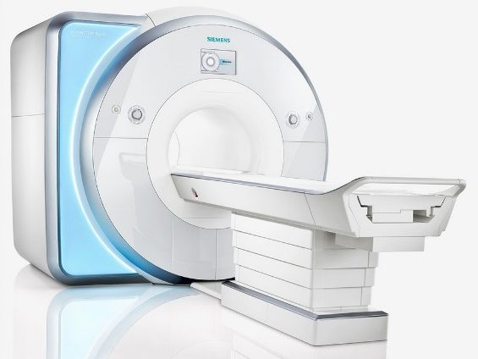
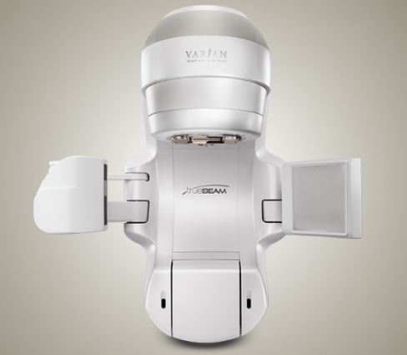
Project motivation: MRgRT
MRI
Radiation source (linac)
Sources: Co-60 or linacs (6 MV, 7 MV)
Magnetic fields: 0.35 – 1.5 T
The effects of the field leads to localized hot and cold spots in dose distributions and…
… influences detector response!

Slide 18
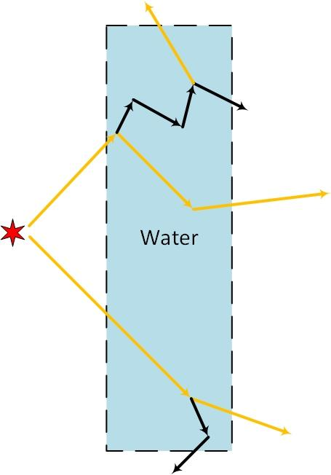
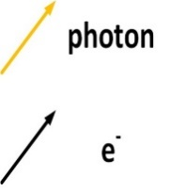
EGSnrc
Electron Gamma Shower code developed and maintained at NRCC
Monte Carlo (Random events!) code used for photon, electron, and positron transport.
Used for dose (J/kg) calculations for dosimetry and research

Slide 19
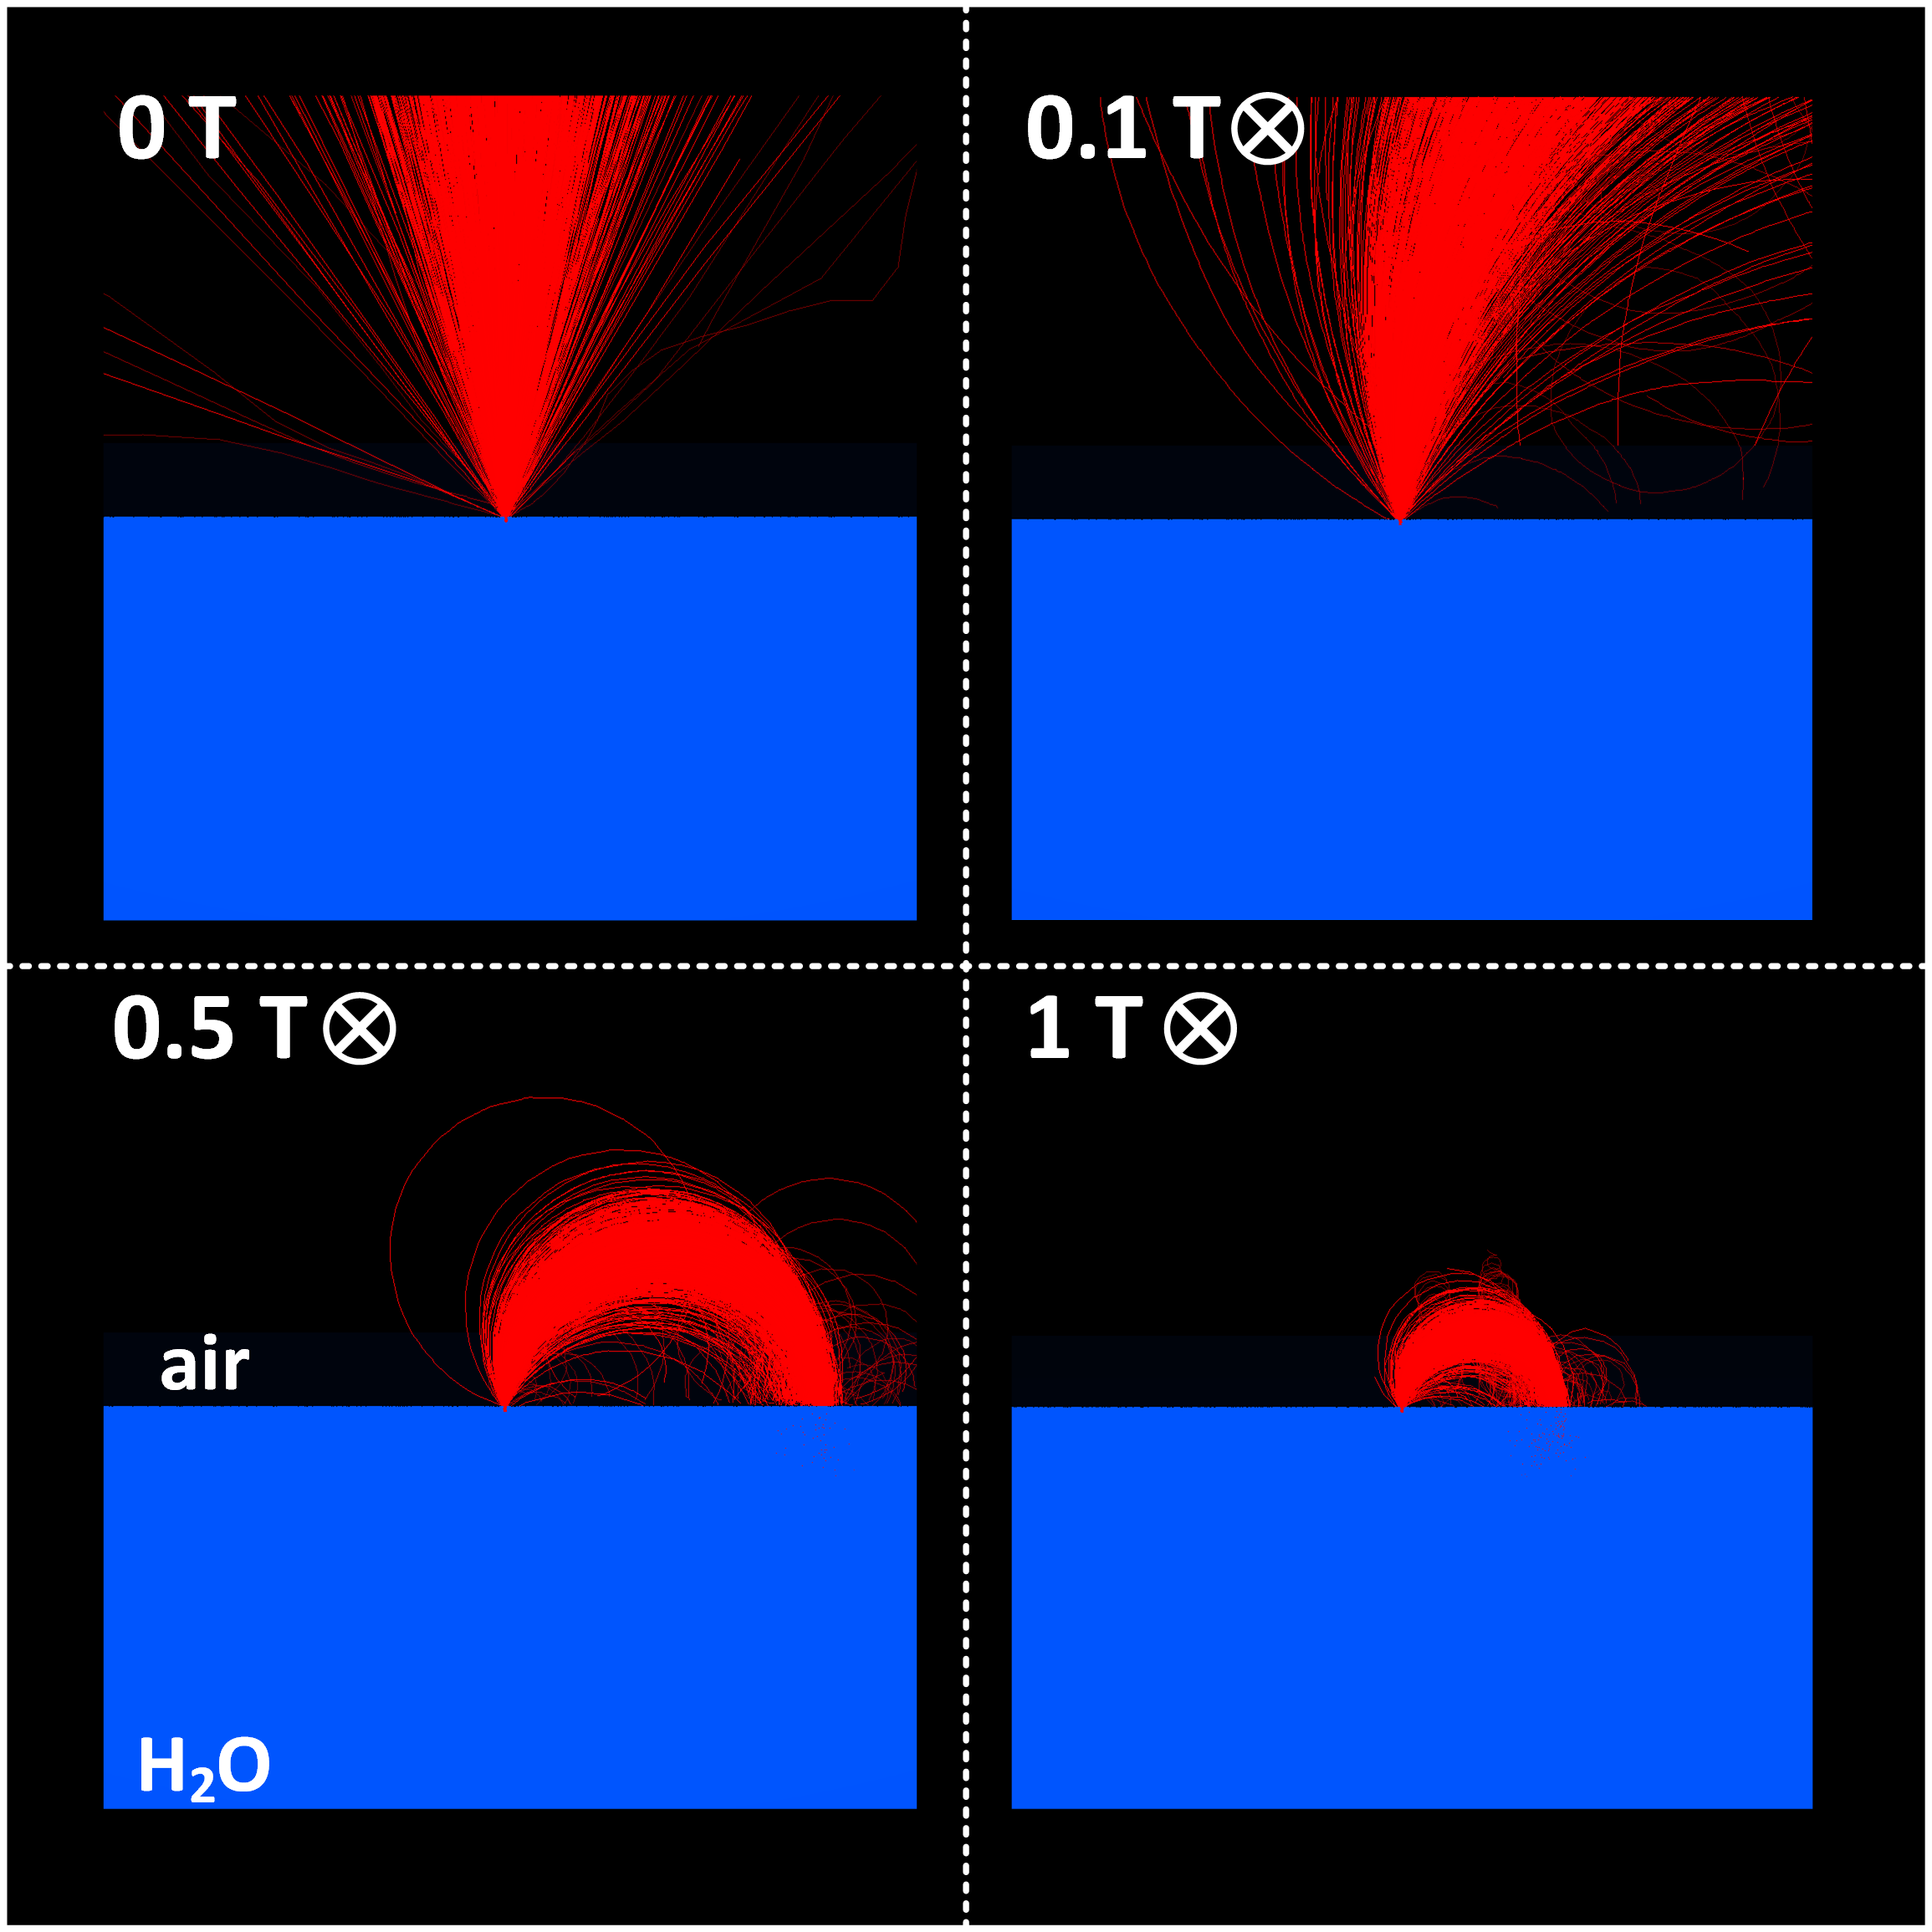
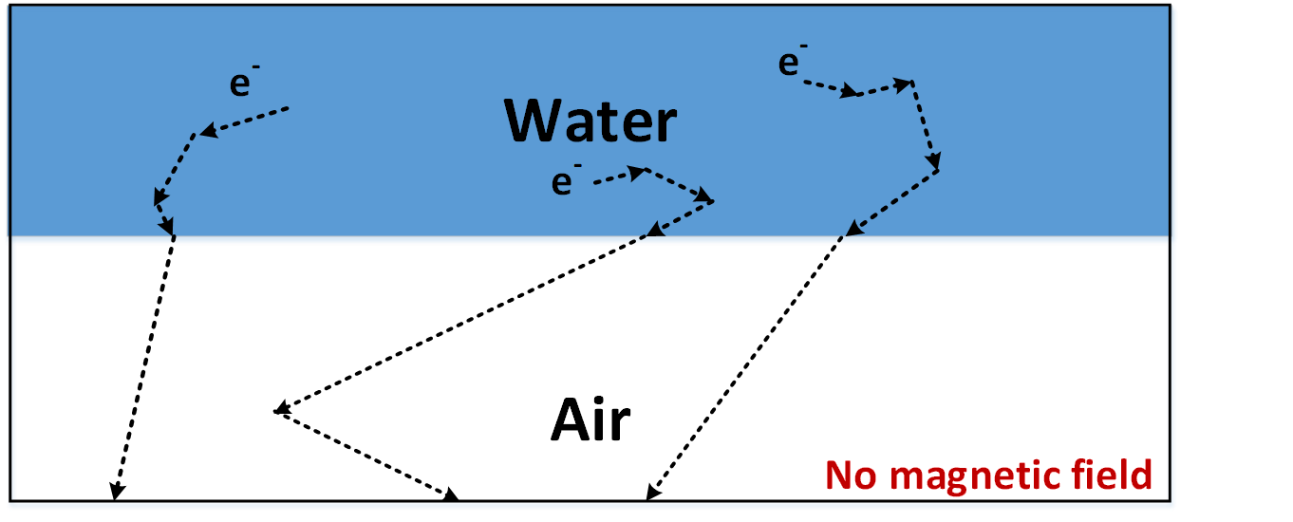
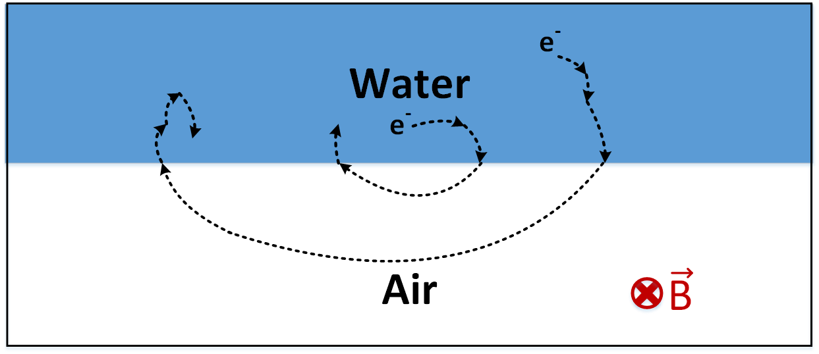
Impact of the magnetic field on electrons
Electron Return Effect

Slide 20
Impact of magnetic field in ion chambers
No field
Increasing magnetic field
Path length increases
Path length decreases

Slide 21
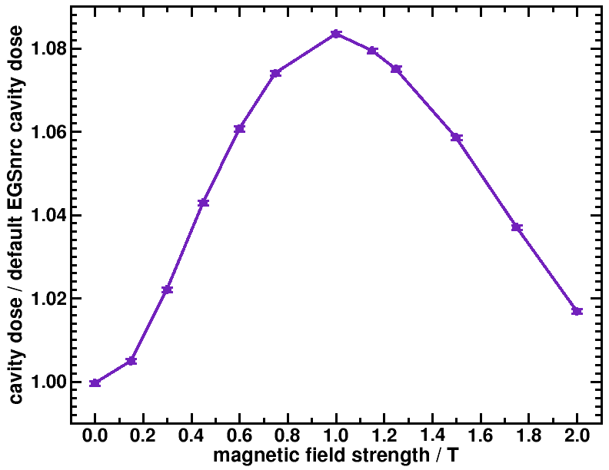

$$\frac{D_{cav}(B)}{D_{cav}(0 T)}$$
EGSnrc to the rescue!
~ 8%
NE2571
6MV beam

Slide 22
Presentation overview
MRI in radiation therapy
Existing and developing MRgRT systems
Why do we need Monte Carlo for MRgRT?
Comparisons to ion chamber measurements and sensitive volume effects
Project ‘Air strike’

Slide 23

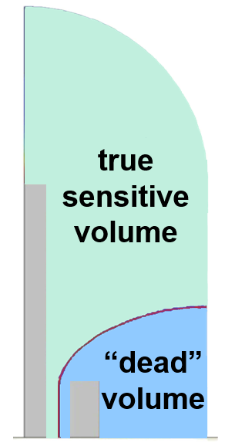
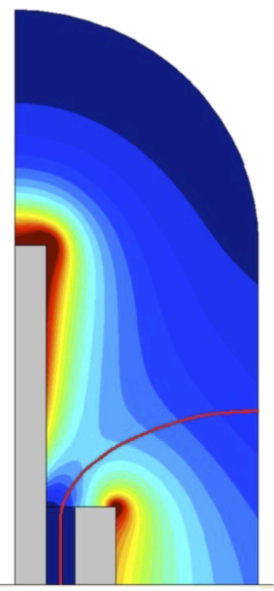
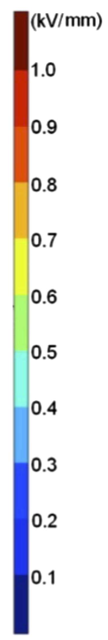
Ion chamber sensitive volume problem
Agnew et al. from NPL produced a great set of experimental data, but there were several percent difference with MC
Fringing of the charge collecting electric field inside the ion chamber.
In MC, usually the geometric sensitive volume is used instead of the potentially unknow true sensitive volume.
No magnetic field = not a problem, but w/ a field there can be a dose gradient inside the chamber.
geometric sensitive volume
Electric field strength in an ion chamber
Miller, J. R et al. Med. Phys. 43(5), 2141-2152 (2016)

Slide 24
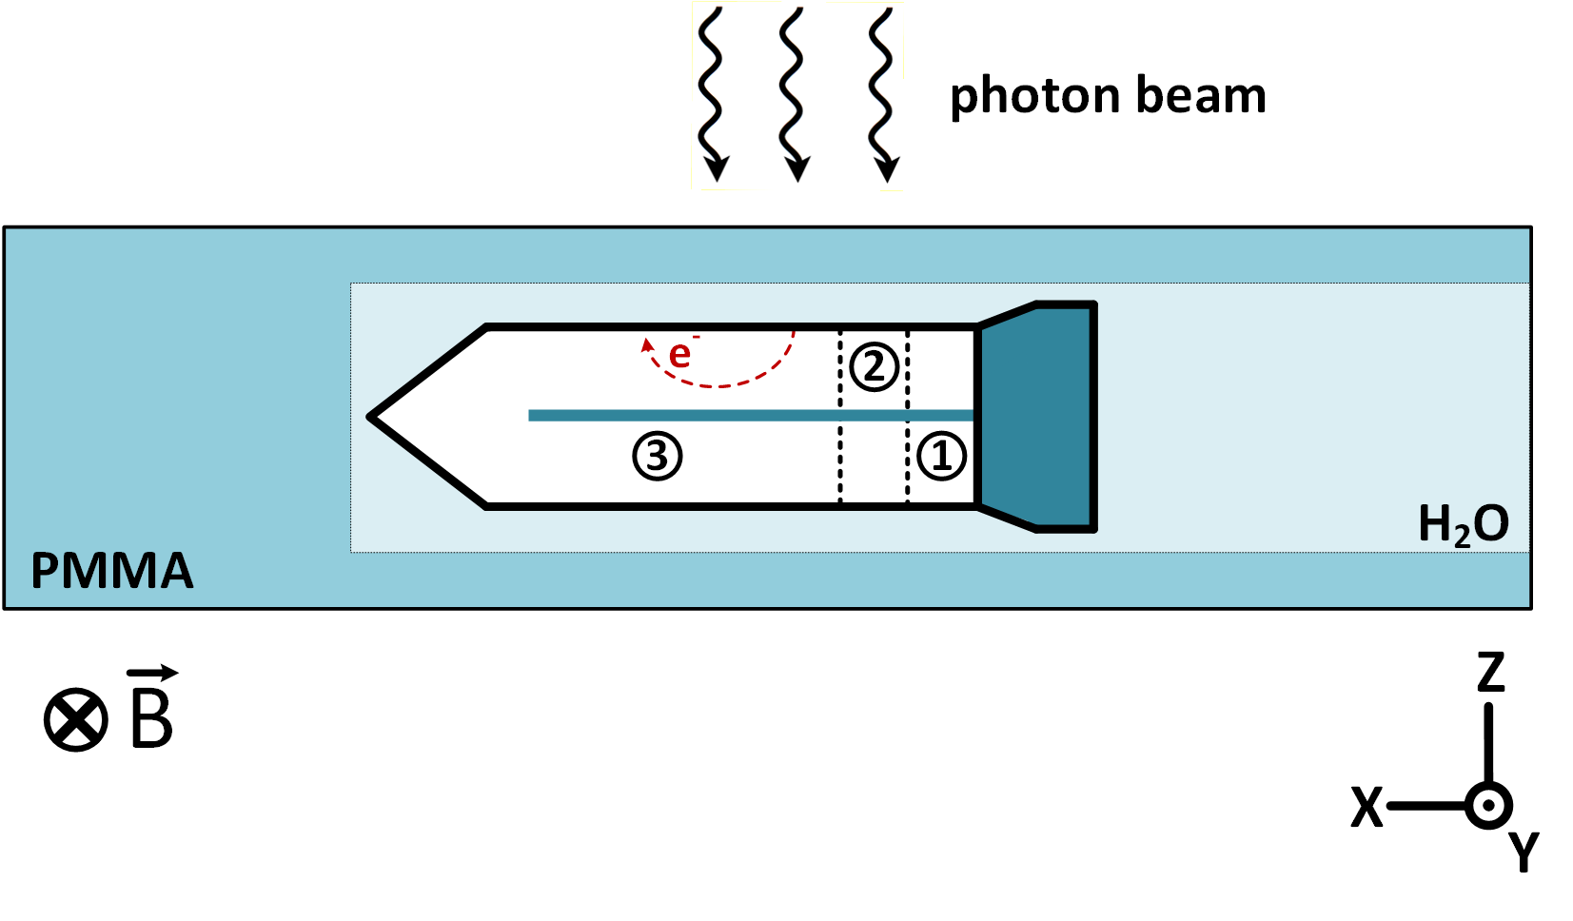

Ion chamber sensitive volume problem
Simulation set-up to compare to Agnew et al. and evaluate the effect of the sensitive volume on chamber dose in the presence of a magnetic field:
$$D_{norm}=\frac{D_{B}}{D_{0T}}$$

Slide 25
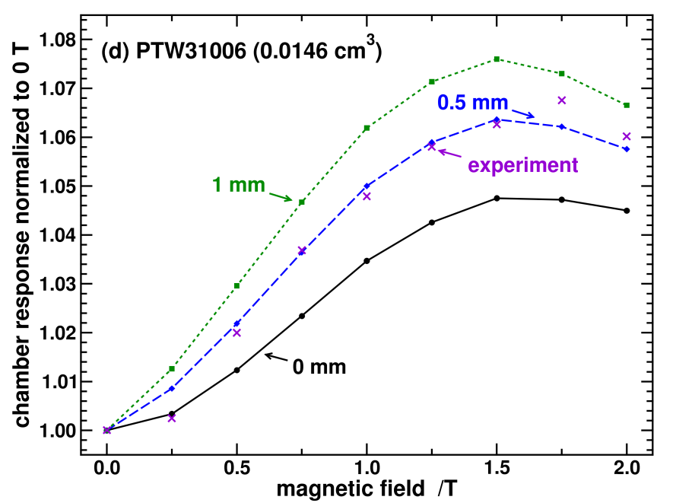
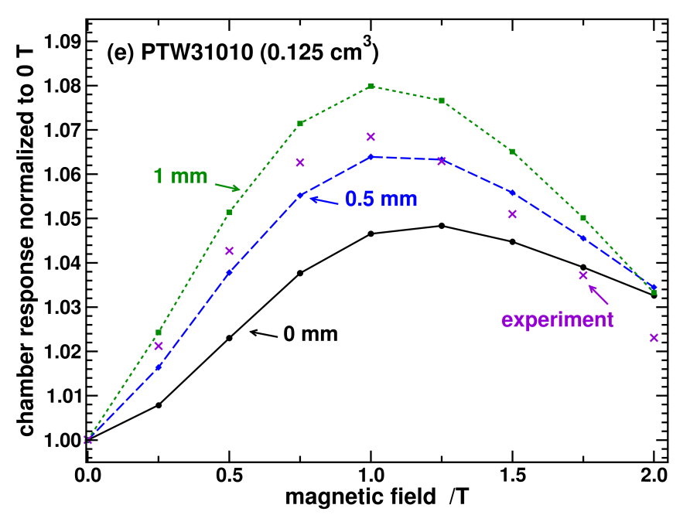
Ion chamber sensitive volume problem
The ‘dead’ volume region does not reflect the true sensitive volume
Correction factors: (i) simulate the E-field or (ii) optimal orientation

Slide 26
Presentation overview
MRI in radiation therapy
Existing and developing MRgRT systems
Why do we need Monte Carlo for MRgRT?
Comparisons to ion chamber measurements and sensitive volume effects
Project ‘Air strike’

Slide 27
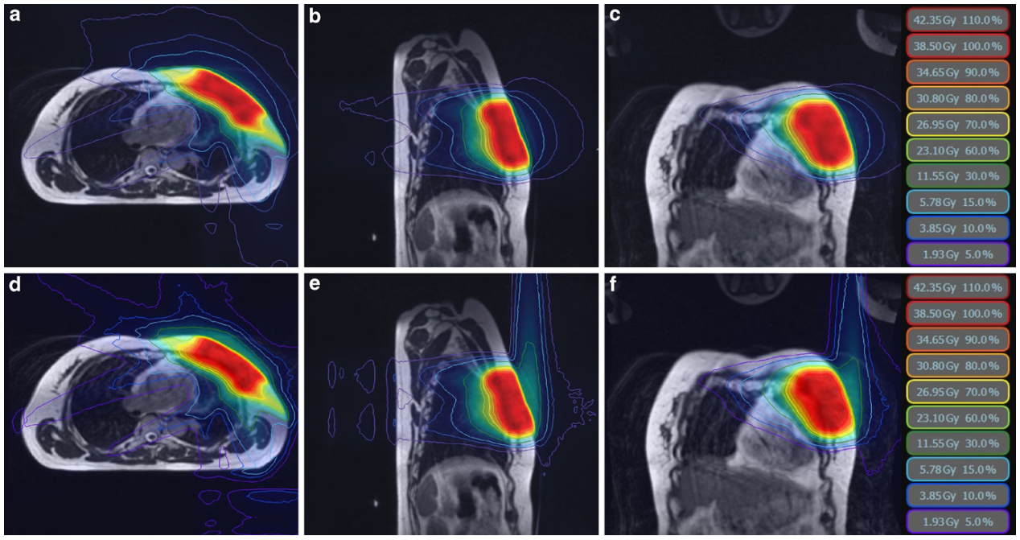
axial – 0T
sagittal – 0T
coronal – 0T
axial – 0.35T
sagittal – 0.35T
coronal – 0.35T
Park, J. M., et al. Strahlenther Onkol (2018)

Slide 28
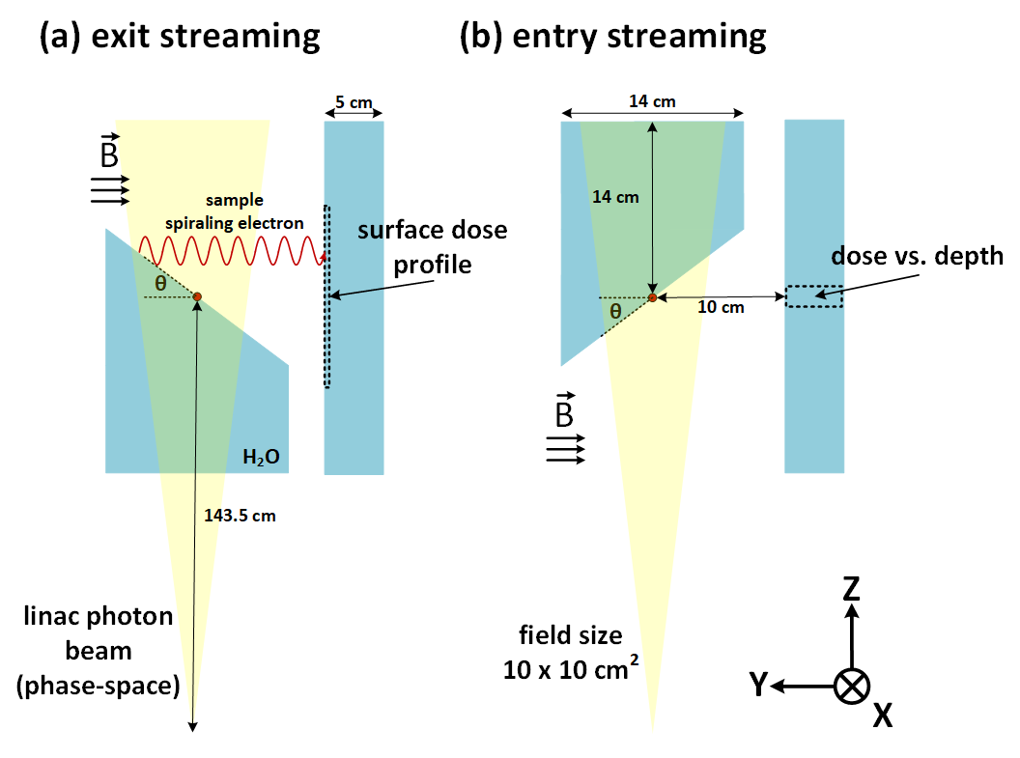
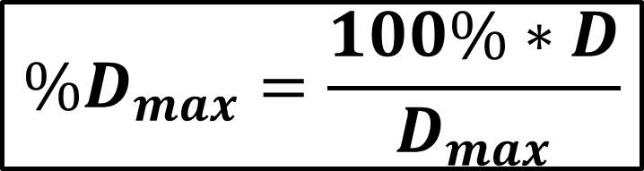
Electron streaming effect (ESE)
$$\%D_{max}=\frac{100\%∗D}{D_{max}}$$

Slide 29

Entry doses

Slide 30

Entry doses
1.5 T

Slide 31

Exit doses

Slide 32

Exit doses
1.5 T

Slide 33
Clinical consequences and recommendations
The ESE can produce fairly high doses outside the treatment field
  This is for a single beam → multiple beams, AP beams
  Angle dependent, and certain treatment sites are not as prone to high ESE doses
  Patient thickness dependent
In cases where ESE doses cannot be mitigated, a bolus would likely be needed.

Slide 34
Some concluding remarks
Magnetic resonance guided radiation therapy provides a great opportunity for tumour tracking and adaptive therapy.
Poses some solvable challenges for dosimetry/calibration.
Care must be taken for treatment planning, and there is lots of opportunity for Monte Carlo research.

Slide 35
Thank you!

Slide 36


Clinical reference dosimetry in B-fields
ion chamber meas.
calibration factor
quality corr. factor
$D_{w}=MN_{D,w}^{Co60}k_{Q}$
B = 0 T
dose to water
with magnetic field
$D_{w}=MN_{D,w}^{Co60}k_{Q}k_{B}$
B > 0 T
B-field corr. factor

Slide 37

Brief PhD findings summary
Evaluated correction factors as a function of angle, and the chamber parallel to magnetic field is best:
  The effect of the magnetic field is minimized
  The issue of the sensitive volume is eliminated
Produced correction factors for 32 Farmer type chambers and 3 parallel plate chambers!
  Evaluated beam quality dependence of the correction factors
  Parallel plate chambers were identified as not ideal
  Specific chambers had a reduced effect due to their composition

Slide 38

Where is this coming from?

Slide 39

ERE visual

Slide 40



Exploring further influences on the ESE
Patient/treatment area thickness
Distance away from the exit
Smaller field sizes
27.5 %
17.5 %
30 %
24 %
2 X 2 cm² field

Slide 41


Air born electrons – overview and set-up
depths
surface
1.4 mm
2.3 mm
4.0 mm
$$\%D_{max}=\frac{100\%∗D}{D_{max}}$$

Slide 42



experimental
[3] Hackett, S. L., et al. PMB (2018)

Slide 43





simulation

Slide 44


Moving the –Y panel further from iso-center
experiment
simulation

Slide 45

Depth dose curve in the panels

Slide 46
Clinical consequences
Effect on the order of scatter and leakage photons
Appears only in the first few millimeters
Smaller fields will produce less air born electrons
The percentage is a fraction of the contribution of that particular beam – multiple beams will spread the effect out even more.

