Slide 1
Plastic Scintillators as In-Vivo Dosimeters: Angular Dependence of Response
Ethan Avila Ruiz, MSc¹, Thalat Monajemi, PhD^{1,2}
¹Department of Physics and Atmospheric Science, Dalhousie University
²Department of Radiation Oncology, Dalhousie University

Slide 2
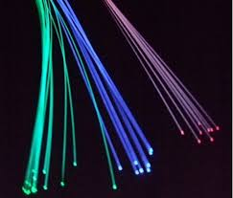
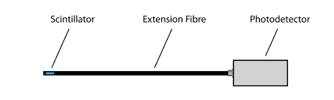
Plastic scintillation dosimetry (PSD)
Benefits of PSDs
  Similar density to water
  Less corrections
  High temporal resolution
  Linear response with dose

Slide 3
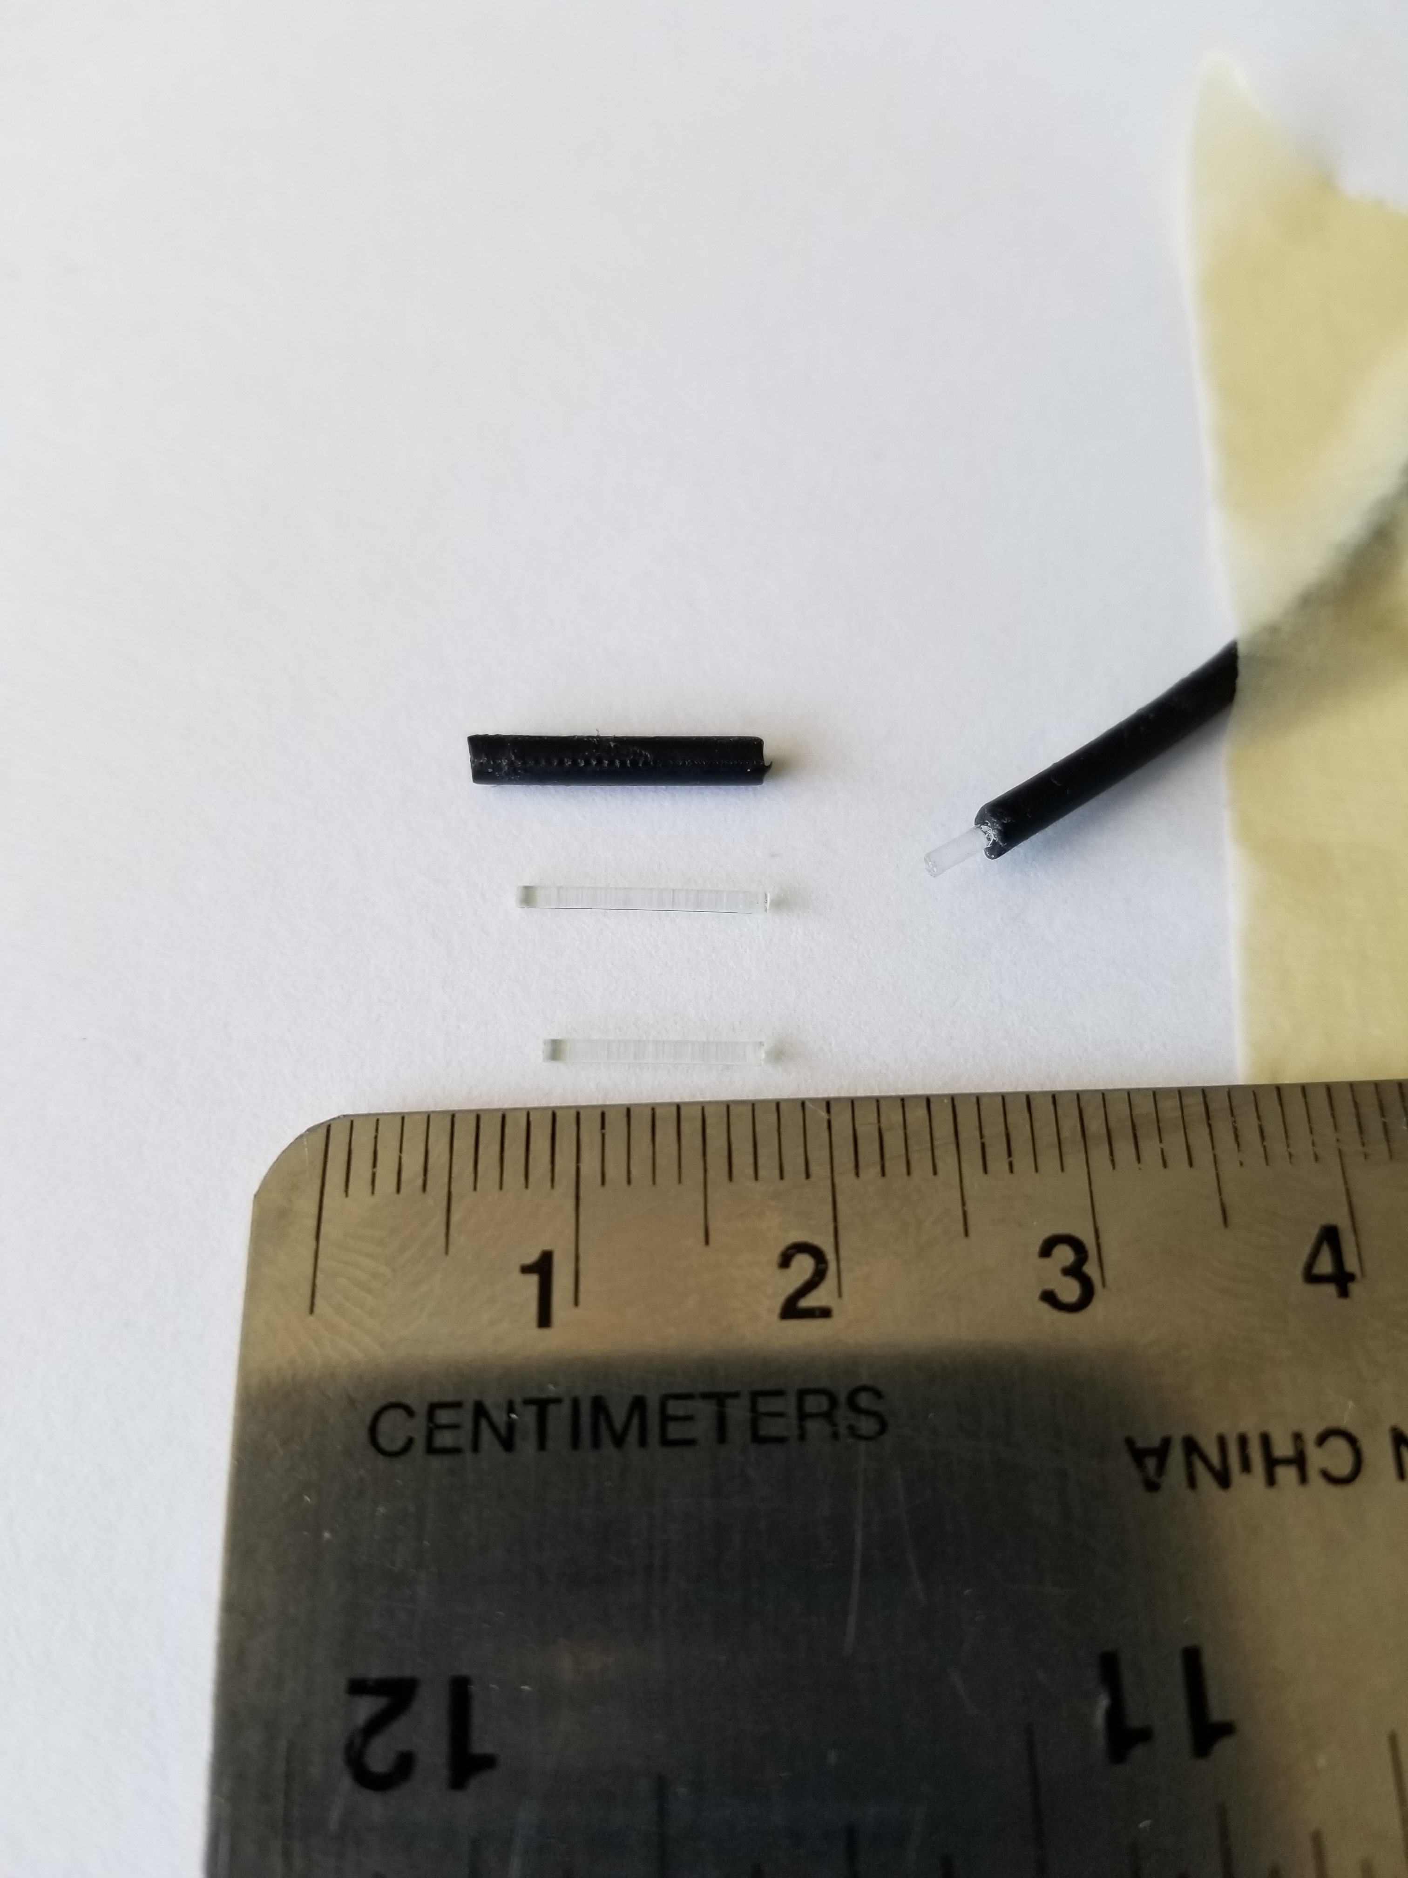
Scintillator with spectrometer setup
1 cm scintillator
40’ optical fiber
Exemplar plus spectrometer
Scintillation detector: components
Jacket
Placeholder
SC SF-3HF
PMMA core of
fiber-optic cable
SC SF-78

Slide 4
Validate spectral invariability of system signal
Well-characterized signal components in arbitrary dose measurements

Slide 5
Determination of scintillation signal
Total signal:
-Spectrometer signal
Scintillation:
Proportional to dose
Acquired by subtracting Cerenkov
Cerenkov:
Highest intensity at 45º
Obtained from stem measurement

Slide 6
Spectral variability with angle
Inline
Crossline

Slide 7
Spectral variability of stem signal
Inline
Crossline

Slide 8
Relative dose affected by variability
Inline
Crossline

Slide 9
Effect is reduced with depth
Inline
Crossline

Slide 10
Summary
Surface dosimetry requires a cautious approach
Subtraction correction does not account for Cerenkov in scintillator
Spectral correction more robust under all measurement conditions

