Slide 1



²H NMR Studies of Bacterial Membranes Disruption Resulting from the Interaction with Antimicrobial Peptides
Nury P. Santisteban, Michael Morrow and Valerie Booth
Memorial University of Newfoundland
CAP 2018

Slide 2



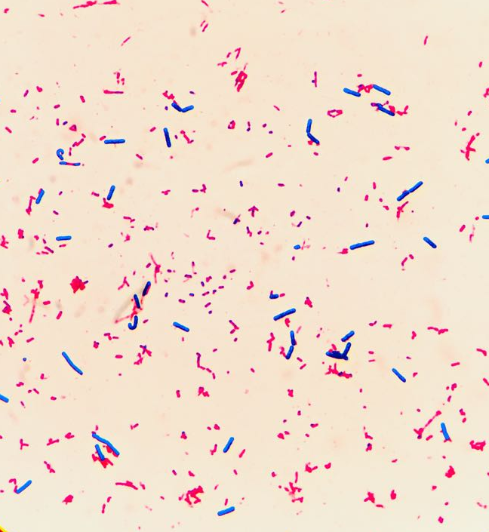



Introduction
Living creatures are in permanent contact with pathogenic microorganisms.
Antimicrobial peptides (AMPs) protect living organisms from pathogens.
Notes:
All living creatures are in permanent contact with diverse types of microorganisms.
Many of these organism are pathogens, which means that these microorganism can potentially cause infection and disease.
Living organism have developed different mechanism to protect themselves from pathogenic microorganism.
One of those mechanism are the antimicrobial peptides (AMPs).

Slide 3
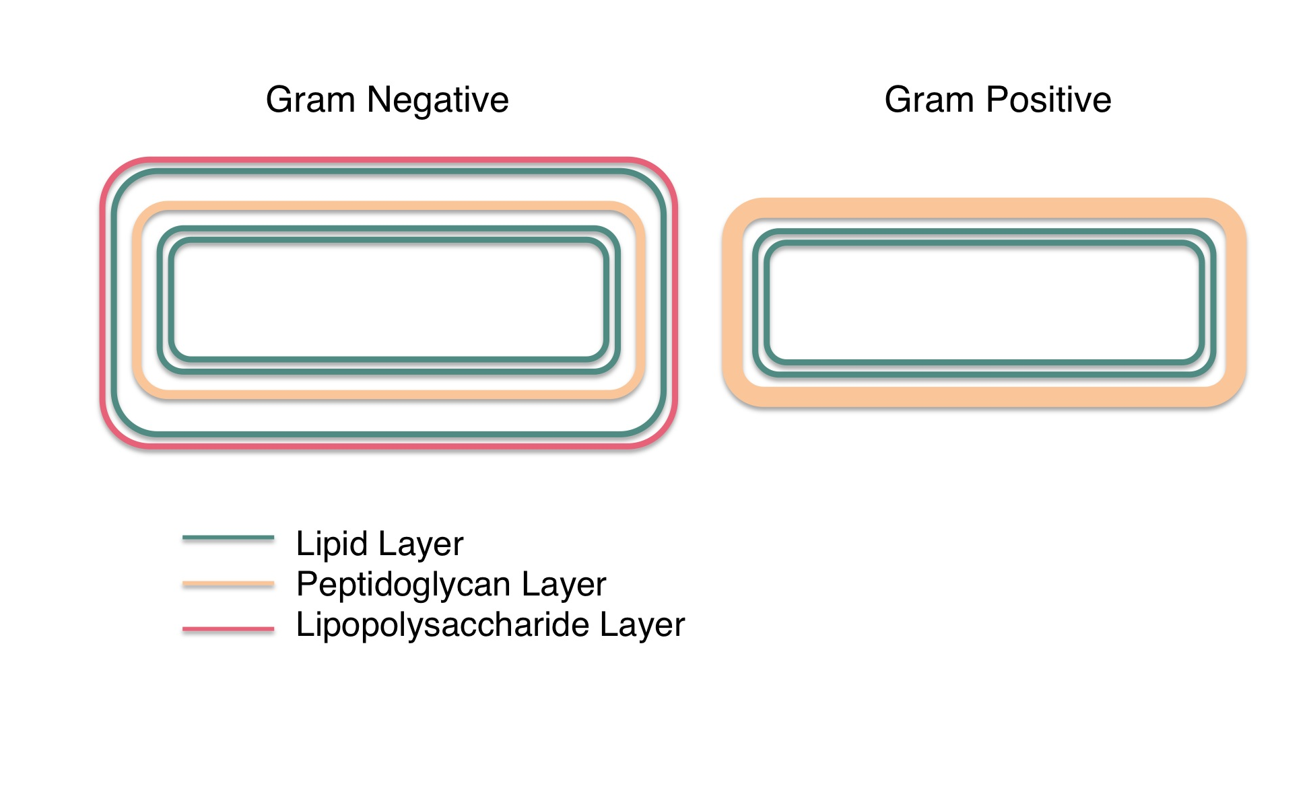
Bacterial envelopes
Lipids:
  Diverse in charge, acyl chain length and unsaturation level.
Peptidoglycan:
  Polysaccharide chains.
Notes:
Gram positive and gram negative bacteria could be differentiated due its bacterial envelopes compositions. Both of the have a cytoplasmic membrane. But
Gram negative bacteria are characterized for the presence of an outer membrane after the periplasmatic space and a thin peptidoglycan layer. And
Gram positive bacteria are characterized by a thick peptidoglycan layer after the cytoplasmic membrane.
The cytoplasmic membrane is composed by lipids, which are amphiphilic molecules with a hydrophobic acyl chain and a polar head group. Lipids in the cytoplasmic membrane are diverse in charge, acyl chain length and unsaturation level.
By its part the peptidoglycan layer is a group of polysaccharide chains cros-linked by peptide bridges forming a solid net.
Finally the lipopolysaccharides are amphiphilic molecules which are the result of a combination between lipids and polysaccharides and are present just in the outer leaflet of the outer membrane of the Gram – bacteria.

Slide 4
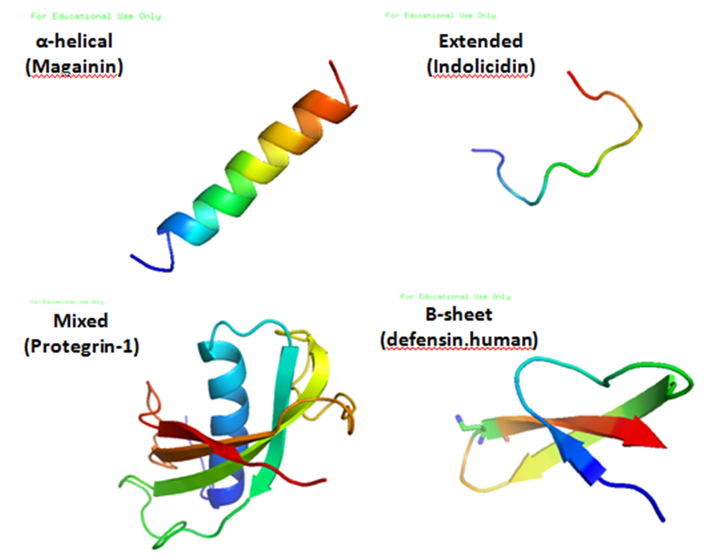
AMPs
AMPs
Most AMP (but not all) are
  Positively charged.
  Diverse structures.
  Length between 10 and 50 amino acids
Come from different natural immune system.
Ymahn at English Wikipedia [CC BY-SA 3.0 (https://creativecommons.org/licenses/by-sa/3.0) or GFDL (http://www.gnu.org/copyleft/fdl.html)], via Wikimedia Commons
Notes:
AMPs is the name of a big group of small molecules able to kill microbes.
All AMPs together have an antimicrobial capability against millions of pathogens.
Most of the AMPs are positively charged, have amphipathic and hydrophobic structures and have a length between 10 and 50 aa.
Also, AMPs come from different host’s natural immune system,
but the main characteristics that AMP possess are their selectivity against host cells and their antimicrobial effect.

Slide 5
AMP: How they work?
Is the permeabilizing effect the only mechanism of cell death?
Are the non-lipid components of the bacterial cell envelope important for AMP activity against bacteria?
Notes:
The AMP permeabilizing effect on the lipid bilayer is indeed one of the most studied characteristic of the AMPs.
Generally, AMPs are known for its ability to generate membrane pores and/or cross the membrane lipid bilayer.
For example, in the case of the alpha-helical AMPs, studies suggests that their mechanism of action consists on five or more steps:
First, the AMP needs to cross the outer layers of the cell wall
Second, if they have an external target, they need to act over it
Third, they reach the surface of the lipid bilayer
Fourth, they adopt its secondary structure
Fifth, after the arrival of more AMP molecules, the AMPs will start to form pores or to degrade the lipid bilayer
Sixth, Translocation
Seventh, Intracellular target- if they have.
However, it is not clear if this permeabilizing effect is the mechanism of cell death.
More recent studies suggest that antimicrobial peptides have another targets inside bacterial cell
So, the permeabilizing effect could be just one of the AMP’s effect over the bacteria cell envelope among others
So, an important question arises: are the non-lipidic components of the bacteria cell envelope important for the AMP-bacteria interaction?

Slide 6
AMPs: closing the gap between biophysics studies and biology studies.
Model systems
Real systems
  Let’s use the same techniques used by the biophysicist directly on bacteria!
🙋

Slide 7
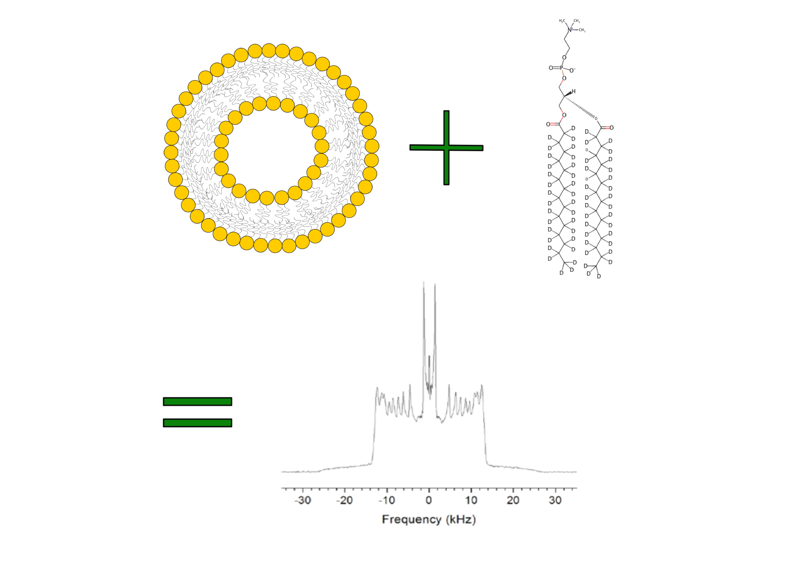
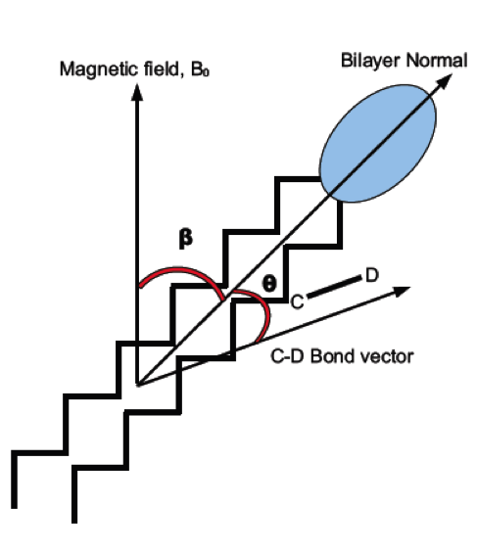
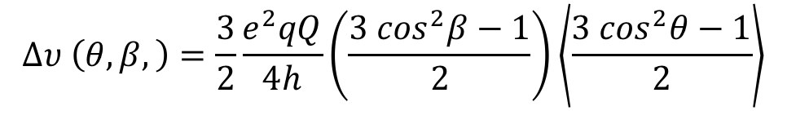

²H NMR: The biophysics technique used to study lipid membranes.
7
$$∆υ \left(θ,β,\right)=\frac{3}{2}\frac{e^{2}qQ}{4h}\left(\frac{3 \cos^{2}β−1}{2}\right)\left\langle \frac{3 \cos^{2}θ−1}{2}\right\rangle$$
²H NMR spectroscopy is a technique used in model systems to study the average fluctuations of the lipid’s acyl chains in the lipid bilayer.
Carbon-Deuterium bonds.
$$∆ν$$
Notes:
Rewriting the quadrupole splitiing we have:
And the average is over the motions that modulate theta on timescales in the order of the tenths of microseconds.
Depending on the geometry of the sample, the angle beta represents the orientation of the molecules oriented in a certain surface portion of the sample.
Meaning that the intensity of the spectrum varies with beta.
For example, in the case of vesicle samples, b changes between 0 and 90 degrees.
0 degrees represents all the molecules oriented parallel or antiparallel to the magnetic field and then, all the molecules in the vesicle poles
And 90 degrees represents all the molecules oriented perpendicular to the magnetic field and then, all the molecules on the vesicle equator.
Due to the number of molecules along the equator is bigger than the number of the molecules at the vesicle poles. A bigger intensity is expected at beta equals to 90 degrees.
By its side, this term… also called the orientational order parameter and it’s the factor that scales the splitting of each couple of peaks.
The superposition of this two peaks is the expected spectrum shape for a single C-D bond.
C-D bond close to the lipids head group have bigger orientational order parameter in comparison with the C-D bonds close to the end of the acyl chains.
As a result, in a vesicle sample with lipids labeled multiple times, the spectral shape is like the one showed here.

Slide 8
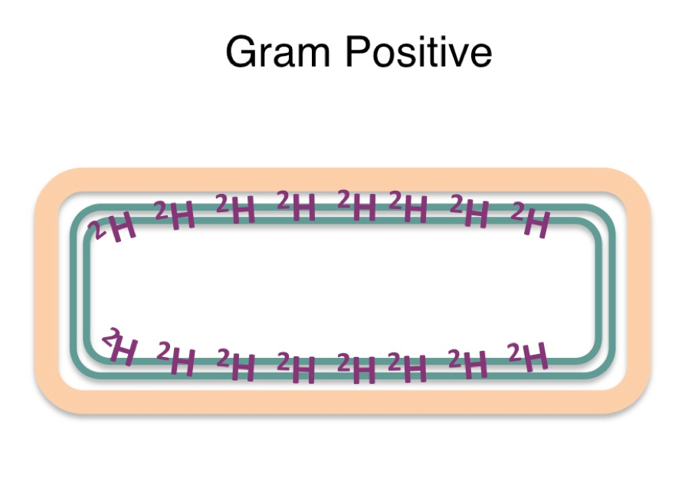
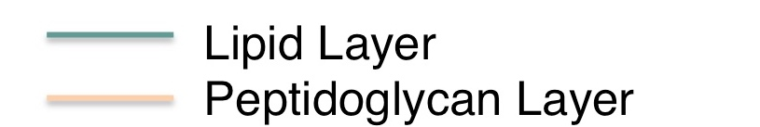
Using the biophysics technique (NMR) in whole bacteria cells: implementation.
Introducing deuterated acid chains in to the bacterial cytoplasmic membrane
  Use acyl chains encapsulated in DPC micelles.

Slide 9
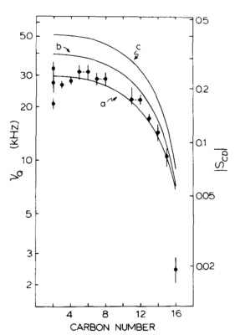
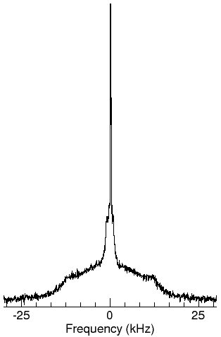
Plateau
w
m
m
p
p
Order profile of Acholeplasma laidawii rich deuterated membrane (Seelig, J. (1977). Deuterium magnetic resonance: theory and application to lipid membranes. Quarterly Reviews of Biophysics, 10(3), 353. )
Notes:
In the case of a deuterated bacterial membrane, it is difficult to recognize the peaks corresponding to each C-D bond.
However, there is a prominent edge that allows to recognize the C-D bonds close to the lipids head group and,
A methyl peak allows to recognize the C-D bonds close to the acyl chain ends.

Slide 10
Using the biophysics technique (NMR) in whole bacteria cells: Bacillus subtilis
²H NMR spectra of B.subtilis enriched with deuterated acyl chains from six different preparations. a) Raw Intensity spectra. b) Normalized to common area spectra. Each spectrum represents 32,000 scans recorded in eight hours at 37º C in a 9.4 T NMR spectrometer

Slide 11
Effect of MSI-78 in the ²H spectrum of B. subtilis
²H NMR spectra of B. subtilis enriched with deuterated acyl chains in the presence of absence of MSI-78. Each spectrum represents 32,000 scans recorded in eight hours at 37º C in a 9.4 T NMR spectrometer
Notes:
With the addition of MSI-78, a change in the spectrum shape is observed. AMP causes the disappearance of the shoulders at approx. 12.5 kHz as well as an increase in the intensity at ”smaller” splittings. Comparing with model membranes, this change is consistent with the disappearance of the plateau region in the order parameter profile, which means that it corresponds to a decrease in the order parameter specially in the plateau region.

Slide 12
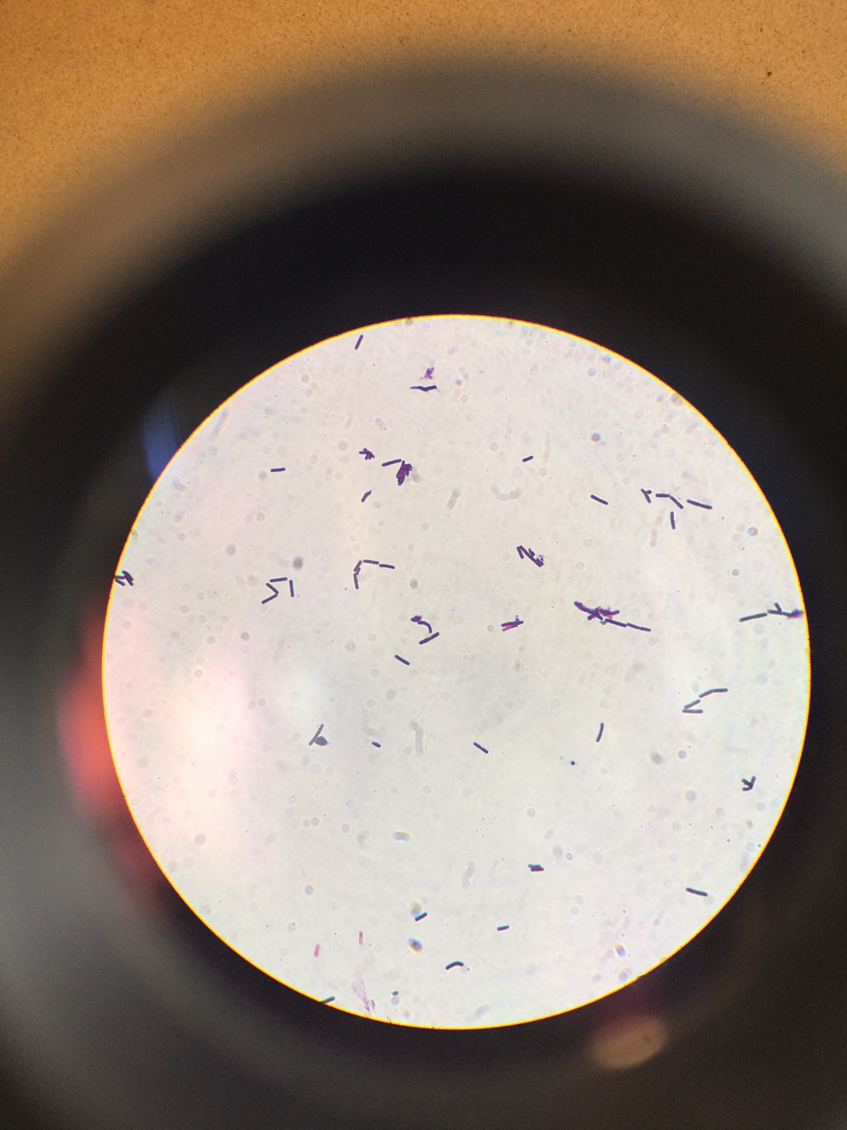
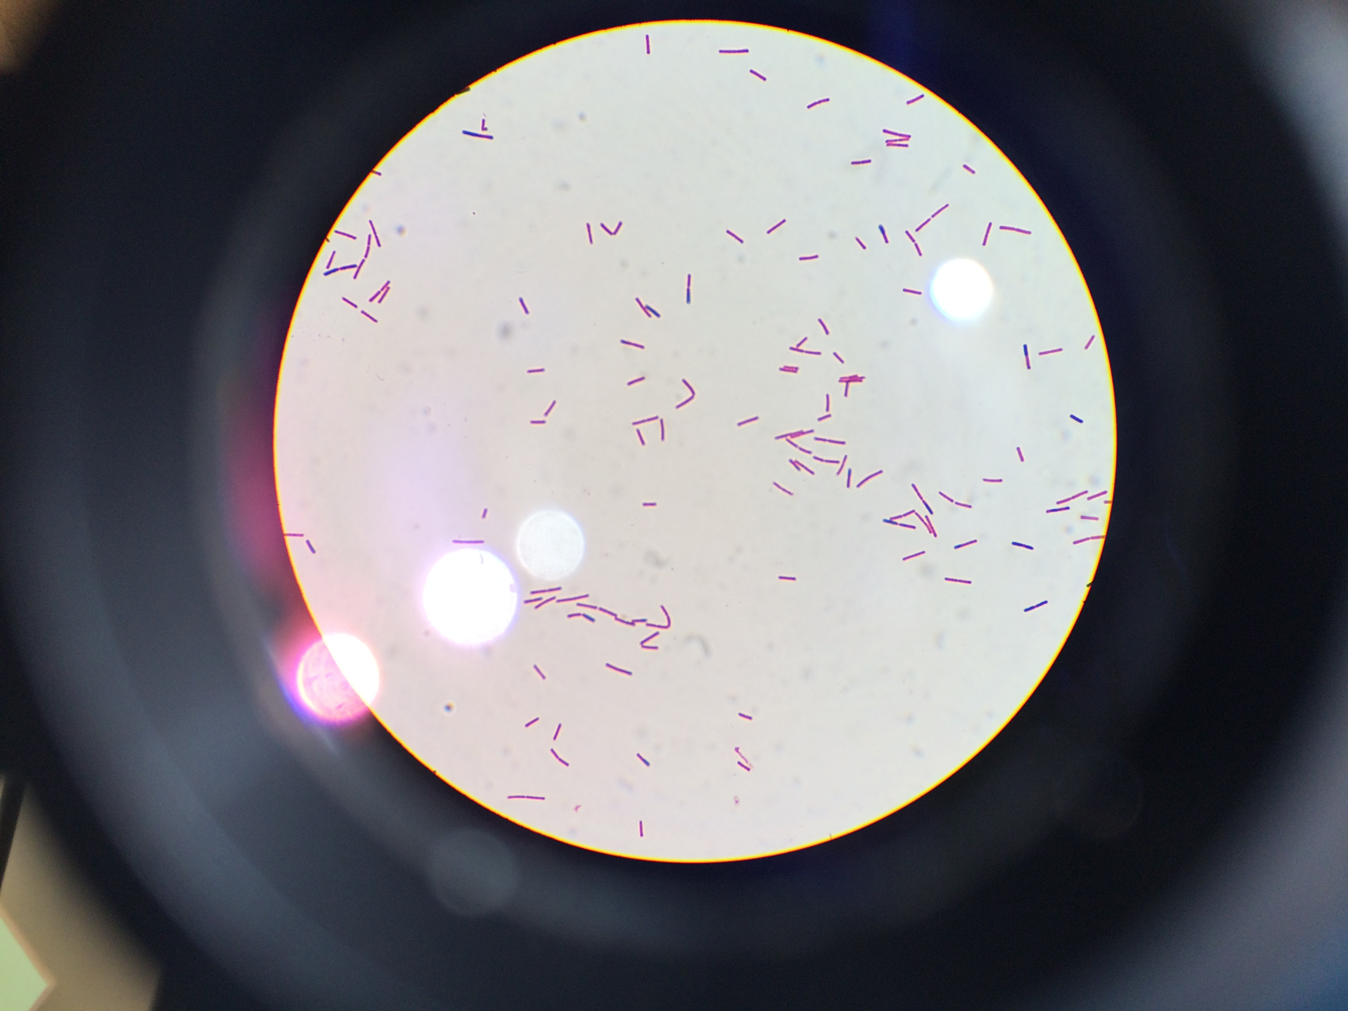
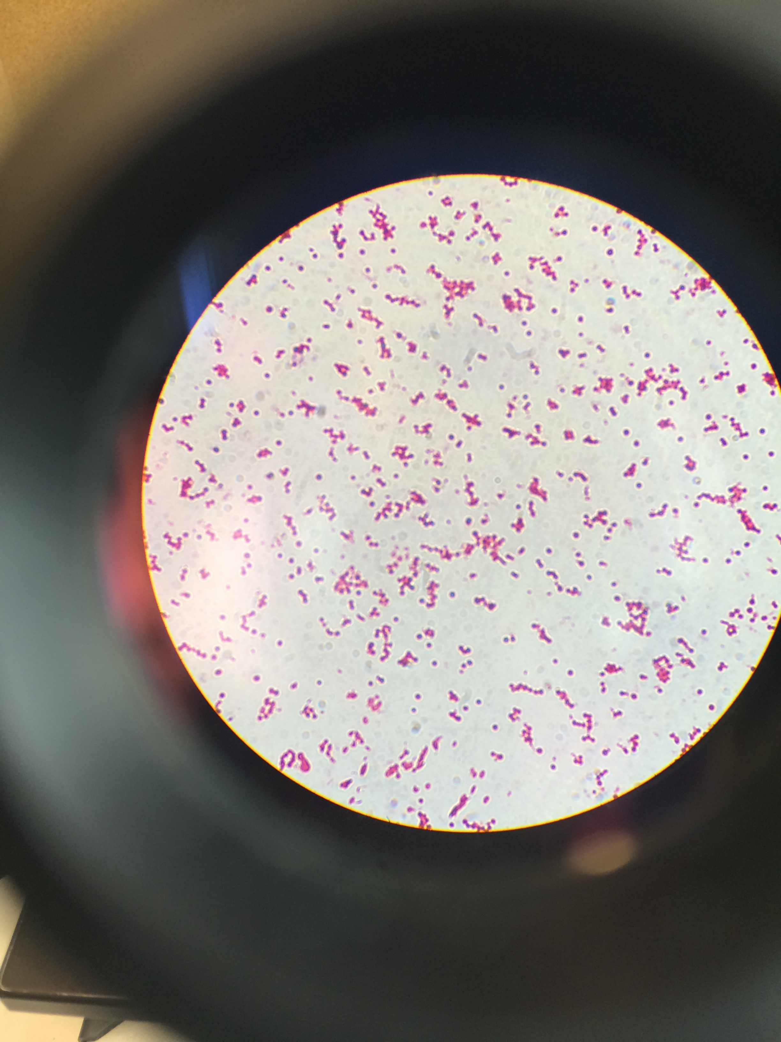
Disturbing the peptidoglycan layer in B. subtilis
Gram staining of Bacillus subtilis enriched with palmitic acid. From left to right: Without Lysozyme; 0.1 mg/mL of Lysozyme and 10 mg/mL of Lysozyme.

Slide 13
Partial or Complete removal of the PGN layer does not affect the ²H NMR spectra of B. subtilis
²H NMR spectra of B. subtilis enriched with deuterated acyl chains treated with up to 10 mg/mL of Lysozyme. Each spectrum represents 32,000 scans recorded in eight hours at 37º C in a 9.4 T NMR spectrometer

Slide 14
Conclusions
MSI-78 can cause changes in ²H NMR spectrum of B. subtilis consistent with significant changes in lipid’s acyl chain order.
Partial or complete removal of the peptidoglycan does not change the spectral shape.

