Slide 1


Radiation dosimeters incorporating organic
semiconducting films
Irina Valitova¹, Allan Hupman¹, Ian Hill¹, Alasdair Syme²
¹ Department of Physics & Atmospheric Science, Dalhousie University
² Department of Radiation Oncology, Dalhousie University
Irina.Valitova@dal.ca
Notes:
Floating gate can be charged with negative or positive impulses. During the negative impulse electrons and during the positive impulses holes are injected from the control gate to the FG by tunneling leading to the shift of Vth.
While in normal transistor during the bias stress leads to filling of traps and Vth shift after which Vth is stabilized at this point no matter it is positive or negative impulses.

Slide 2

Outline
• Introduction
  Applications
  Most common dosimeters
  Problem definition
• P3HT Schottky diode
• Pentacene floating gate transistor
• Conclusion
• Acknowledgements
Notes:
Accurate, quantitative measurements of radiation fields are essential prerequisites for the safe and effective use of ionizing radiation in diagnostic and therapeutic medical applications. Common examples of radiation detectors include: ionization chambers, thermoluminescent dosimeters (TLDs), films and various electronic devices. Semiconductor dosimeters such as p/n type silicon diodes and MOSFETs have found widespread adoption due to their high sensitivity and easy processing. A significant limitation of these devices, however, is their lack of tissue equivalence. The high atomic number (relative to soft tissue) of silicon causes these devices to over-respond to photon beams that include a significant low energy (e.g. kilovoltage) component due to an enhanced photoelectric interaction coefficient.
This work presents preliminary measurements with organic semiconductor diodes and organic floating gate (FG) transistors as dosimeters capable of providing a tissue equivalent response to ionizing radiation. The direct detection of X-rays from a medical linear accelerator using Phthalocyanine/C60 based organic planar heterojunction diodes is presented. The diodes produce a linear increase in current with increasing dose rate and show a stable response after exposure to doses up to 5000 cGy. The Pentacene-based organic floating gate transistors have also been investigated for dosimetry applications. The possibility of resetting the transistors for repeated use and sensitivity optimization by electrical charging of floating gate through Fowler-Nordheim tunneling is currently being investigated. The sensitivity of these devices has been determined from the transistor threshold voltage shift as a function of accumulated dose. After negative or positive pre-charge of floating gate the average sensitivity was 0.09V/Gy, 0.045V/Gy, 0.02 V/Gy, 0.01 V/Gy at 10 Gy, 20Gy, 30 Gy, 40 Gy, 50 Gy, 60 Gy, respectively. The sensitivity of FG pentacene transistors was stable after two pre – charge cycles of the

Slide 3
Introduction
Application areas
• Medical dosimetry
• Radiotherapy
• Diagnostic radiology
• Nuclear medicine
• Personnel dosimetry
•Extremity
• Whole body
• Environmental dosimetry
• Terrestrial
• Space
• High dose dosimetry
• Radiation processing
• Nuclear reactors
Notes:
Accurate, quantitative measurements of radiation fields are essential prerequisites for the safe and effective use of ionizing radiation

Slide 4
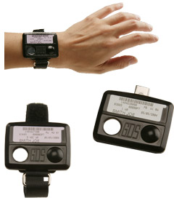
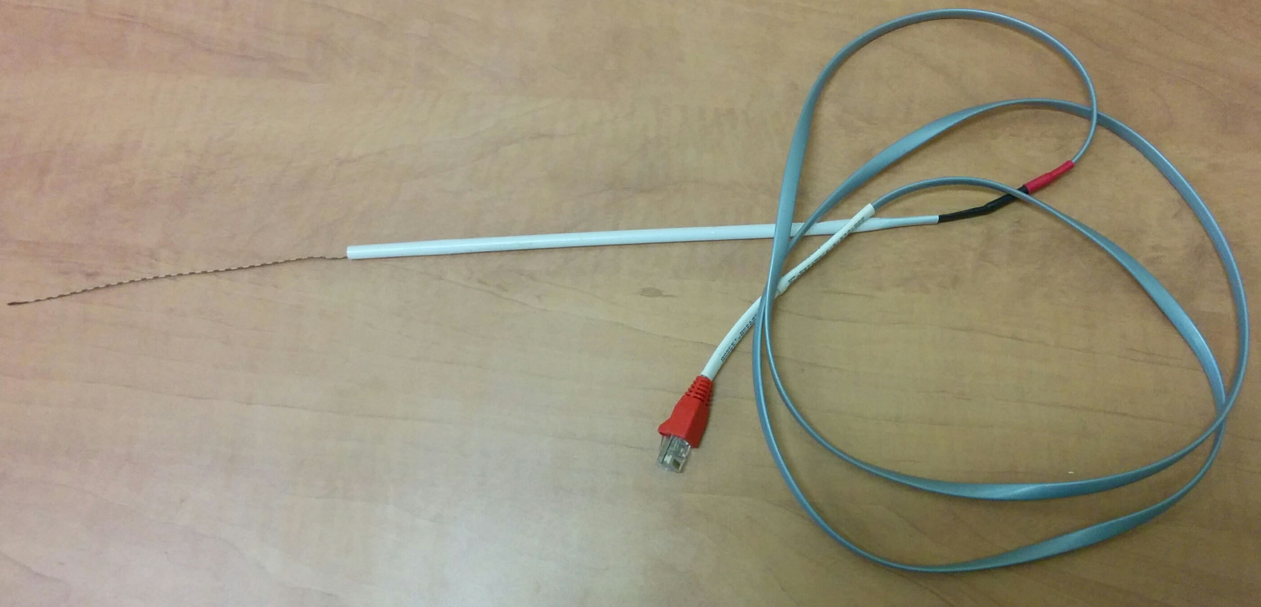
Introduction
Most common dosimeters:
Ionization chambers,
Thermoluminescent
dosimeters (TLDs),
Films,
Semiconductor dosimeters:
P/n type silicon diodes,
Silicon MOSFETs
TLD
Source: © 2004 JZ Imaging & Consulting
MOSFET
Notes:
A significant limitation of these devices, however, is their lack of tissue equivalence. The high atomic number (relative to soft tissue) of silicon causes these devices to over-respond to photon beams that include a significant low energy (e.g. kilovoltage) component due to an enhanced photoelectric interaction coefficient.
This work presents preliminary measurements with organic semiconductor diodes and organic floating gate (FG) transistors as dosimeters capable of providing a tissue equivalent response to ionizing radiation. The direct detection of X-rays from a medical linear accelerator using Phthalocyanine/C60 based organic planar heterojunction diodes is presented. The diodes produce a linear increase in current with increasing dose rate and show a stable response after exposure to doses up to 5000 cGy. The Pentacene-based organic floating gate transistors have also been investigated for dosimetry applications. The possibility of resetting the transistors for repeated use and sensitivity optimization by electrical charging of floating gate through Fowler-Nordheim tunneling is currently being investigated. The sensitivity of these devices has been determined from the transistor threshold voltage shift as a function of accumulated dose. After negative or positive pre-charge of floating gate the average sensitivity was 0.09V/Gy, 0.045V/Gy, 0.02 V/Gy, 0.01 V/Gy at 10 Gy, 20Gy, 30 Gy, 40 Gy, 50 Gy, 60 Gy, respectively. The sensitivity of FG pentacene transistors was stable after two pre – charge cycles of the

Slide 5
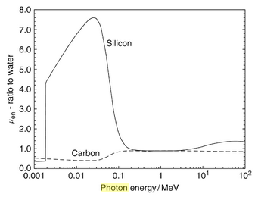
Introduction
Problem definition:
Silicon MOSFETs and diodes
Lack of tissue equivalence
Silicon Z=14
Soft tissue Z=7.4
Carbon Z=6
over response to low
energy photons
diagnostic imaging
radiation therapy
Ratio of the photon mass energy absorption coefficient μ_{en}¹
1. Fundamentals of Ionizing Radiation Dosimetry, P. Andreo, D. T. Burns, A. E. Nahum, J. Seuntjens, F. Attix
Notes:
A significant limitation of these devices, however, is their lack of tissue equivalence. The high atomic number (relative to soft tissue) of silicon causes these devices to over-respond to photon beams that include a significant low energy (e.g. kilovoltage) component due to an enhanced photoelectric interaction coefficient.
This work presents preliminary measurements with organic semiconductor diodes and organic floating gate (FG) transistors as dosimeters capable of providing a tissue equivalent response to ionizing radiation.

Slide 6
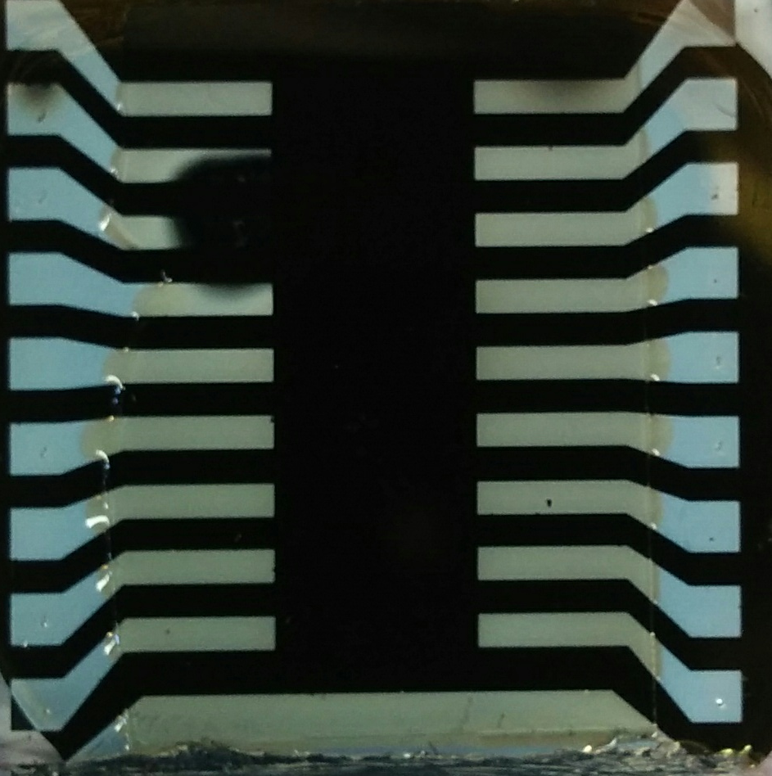
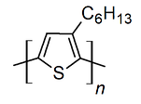
P3HT Schottky diodes
P3HT – poly(3-hexylthiophene-
2,5-diyl)
3 eV
Al
4.1eV
ITO
4.0-5.0eV
5eV
PEDOT:PSS
5.2-5.3 eV
P3HT

Slide 7
General requirements
• Sensitivity
• Radiation energy independence
• Linearity
• Tissue equivalence
• Long term stability
• Reproducibility
Notes:
Accurate, quantitative measurements of radiation fields are essential prerequisites for the safe and effective use of ionizing radiation in diagnostic and therapeutic medical applications. Common examples of radiation detectors include: ionization chambers, thermoluminescent dosimeters (TLDs), films and various electronic devices. Semiconductor dosimeters such as p/n type silicon diodes and MOSFETs have found widespread adoption due to their high sensitivity and easy processing. A significant limitation of these devices, however, is their lack of tissue equivalence. The high atomic number (relative to soft tissue) of silicon causes these devices to over-respond to photon beams that include a significant low energy (e.g. kilovoltage) component due to an enhanced photoelectric interaction coefficient.
This work presents preliminary measurements with organic semiconductor diodes and organic floating gate (FG) transistors as dosimeters capable of providing a tissue equivalent response to ionizing radiation. The direct detection of X-rays from a medical linear accelerator using Phthalocyanine/C60 based organic planar heterojunction diodes is presented. The diodes produce a linear increase in current with increasing dose rate and show a stable response after exposure to doses up to 5000 cGy. The Pentacene-based organic floating gate transistors have also been investigated for dosimetry applications. The possibility of resetting the transistors for repeated use and sensitivity optimization by electrical charging of floating gate through Fowler-Nordheim tunneling is currently being investigated. The sensitivity of these devices has been determined from the transistor threshold voltage shift as a function of accumulated dose. After negative or positive pre-charge of floating gate the average sensitivity was 0.09V/Gy, 0.045V/Gy, 0.02 V/Gy, 0.01 V/Gy at 10 Gy, 20Gy, 30 Gy, 40 Gy, 50 Gy, 60 Gy, respectively. The sensitivity of FG pentacene transistors was stable after two pre – charge cycles of the

Slide 8
P3HT Schottky diodes

Slide 9
Sensitivity
Notes:
At higher applied voltage the dose rate dependency deacrease.

Slide 10
Energy dependence
Notes:
Accurate, quantitative measurements of radiation fields are essential prerequisites for the safe and effective use of ionizing radiation in diagnostic and therapeutic medical applications. Common examples of radiation detectors include: ionization chambers, thermoluminescent dosimeters (TLDs), films and various electronic devices. Semiconductor dosimeters such as p/n type silicon diodes and MOSFETs have found widespread adoption due to their high sensitivity and easy processing. A significant limitation of these devices, however, is their lack of tissue equivalence. The high atomic number (relative to soft tissue) of silicon causes these devices to over-respond to photon beams that include a significant low energy (e.g. kilovoltage) component due to an enhanced photoelectric interaction coefficient.
This work presents preliminary measurements with organic semiconductor diodes and organic floating gate (FG) transistors as dosimeters capable of providing a tissue equivalent response to ionizing radiation. The direct detection of X-rays from a medical linear accelerator using Phthalocyanine/C60 based organic planar heterojunction diodes is presented. The diodes produce a linear increase in current with increasing dose rate and show a stable response after exposure to doses up to 5000 cGy. The Pentacene-based organic floating gate transistors have also been investigated for dosimetry applications. The possibility of resetting the transistors for repeated use and sensitivity optimization by electrical charging of floating gate through Fowler-Nordheim tunneling is currently being investigated. The sensitivity of these devices has been determined from the transistor threshold voltage shift as a function of accumulated dose. After negative or positive pre-charge of floating gate the average sensitivity was 0.09V/Gy, 0.045V/Gy, 0.02 V/Gy, 0.01 V/Gy at 10 Gy, 20Gy, 30 Gy, 40 Gy, 50 Gy, 60 Gy, respectively. The sensitivity of FG pentacene transistors was stable after two pre – charge cycles of the

Slide 11
Linearity
Notes:
The radiation beam was applied with different time span to accumulate different doses and you can see the linear dependences of accumulated charges vs doses

Slide 12
Floating gate transistor
S
D
Organic Semiconductor
Gate oxide
- - - - - FG
Tunnel oxide
- - - - - CG
Strong electric field between Source and
Control Gate allows charges to tunnel
through thin tunnel oxide

Slide 13
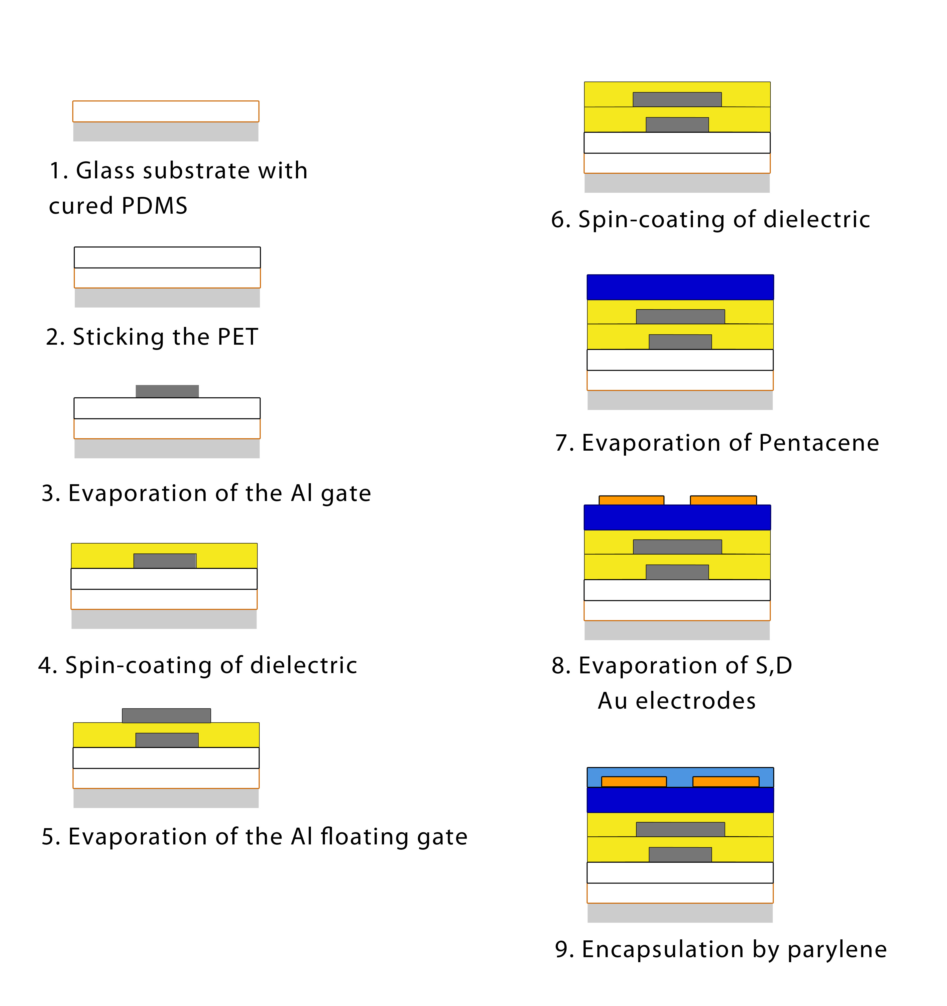
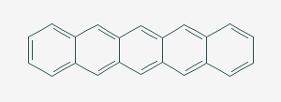
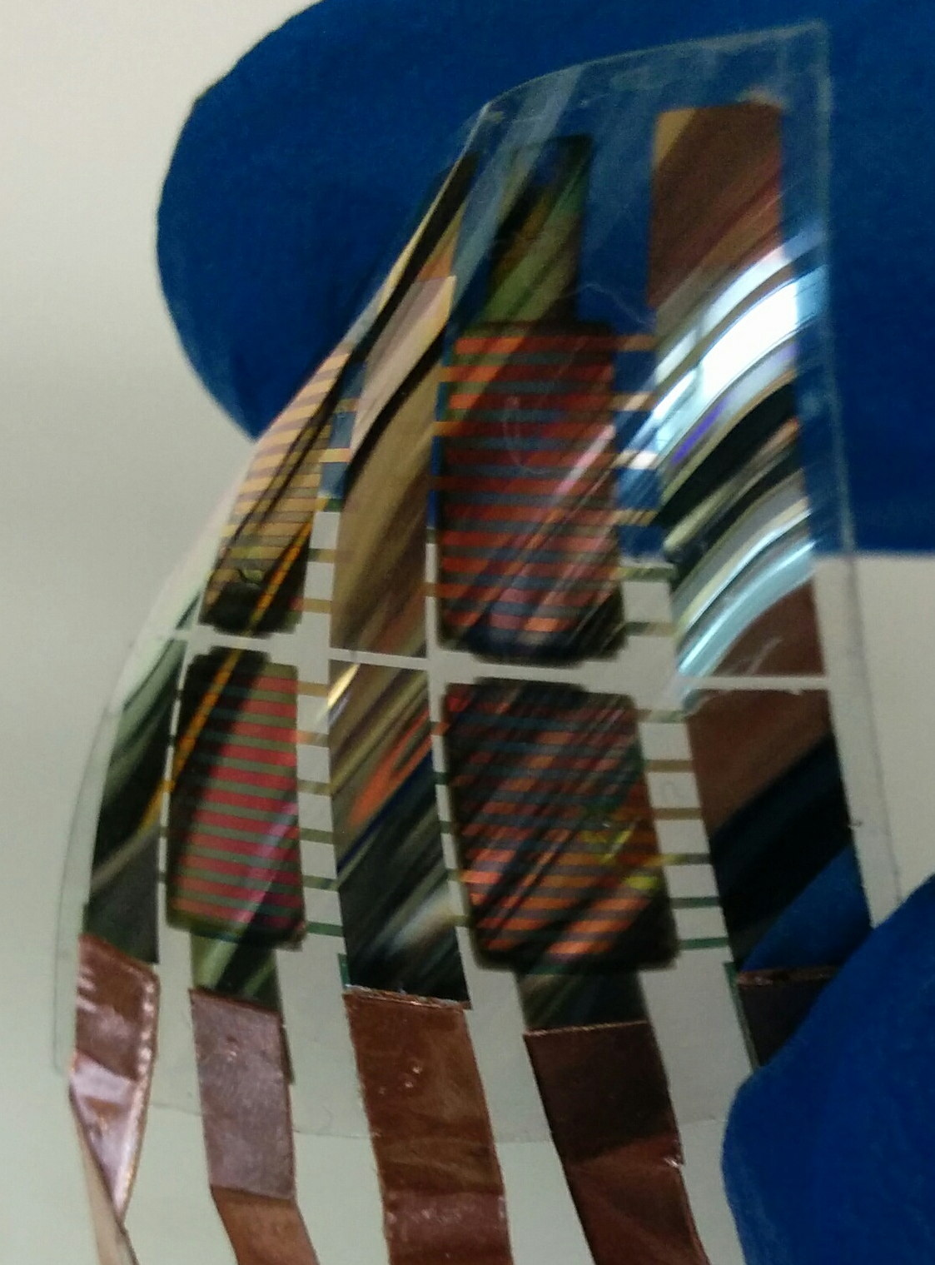
Floating Gate (FG) OTFT
PMMA (300 nm)
Deposition of dielectric
Parylene 10 nm
Deposition of dielectric
Notes:
Prior to irradiation the FG is charged with negative impulses. During the negative impulse electrons are injected from the control gate to the FG by tunneling. Radiation generated holes are collected on the FG leading to the shift of Vth.

Slide 14
Pentacene TFT
Normal TFT
Floating gate TFT
Notes:
Floating gate can be charged with negative or positive impulses. During the negative impulse electrons and during the positive impulses holes are injected from the control gate to the FG by tunneling leading to the shift of Vth.
While in normal transistor during the bias stress leads to filling of traps and Vth shift after which Vth is stabilized at this point no matter it is positive or negative impulses.

Slide 15
Reproducibility
First irradiation
Second irradiation
Notes:
Radiation generated charges are collected on the floating gate leading to threshold voltage shift. To check the reproducibility the FG of the same device was charged again and irradiated.

Slide 16
Conclusions
• Organic semiconducting dosimeters provided tissue equivalent response to ionizing radiation
• P3HT diode showed good linearity, radiation energy independence and sensitivity ≈ 31 nC/Gy at 10V
• Flexible Pentacene floating gate transistors with sensitivity of ≈ 0.1 V/Gy at 10 Gy – reusable, easy to pre set and no need to apply bias during irradiation

Slide 17

Acknowledgements
Professor Ian Hill
Professor Alasdair Syme
Allan Hupman
Charlotte Clegg
Eric Bergman
Samuel March
Notes:
Accurate, quantitative measurements of radiation fields are essential prerequisites for the safe and effective use of ionizing radiation in diagnostic and therapeutic medical applications. Common examples of radiation detectors include: ionization chambers, thermoluminescent dosimeters (TLDs), films and various electronic devices. Semiconductor dosimeters such as p/n type silicon diodes and MOSFETs have found widespread adoption due to their high sensitivity and easy processing. A significant limitation of these devices, however, is their lack of tissue equivalence. The high atomic number (relative to soft tissue) of silicon causes these devices to over-respond to photon beams that include a significant low energy (e.g. kilovoltage) component due to an enhanced photoelectric interaction coefficient.
This work presents preliminary measurements with organic semiconductor diodes and organic floating gate (FG) transistors as dosimeters capable of providing a tissue equivalent response to ionizing radiation. The direct detection of X-rays from a medical linear accelerator using Phthalocyanine/C60 based organic planar heterojunction diodes is presented. The diodes produce a linear increase in current with increasing dose rate and show a stable response after exposure to doses up to 5000 cGy. The Pentacene-based organic floating gate transistors have also been investigated for dosimetry applications. The possibility of resetting the transistors for repeated use and sensitivity optimization by electrical charging of floating gate through Fowler-Nordheim tunneling is currently being investigated. The sensitivity of these devices has been determined from the transistor threshold voltage shift as a function of accumulated dose. After negative or positive pre-charge of floating gate the average sensitivity was 0.09V/Gy, 0.045V/Gy, 0.02 V/Gy, 0.01 V/Gy at 10 Gy, 20Gy, 30 Gy, 40 Gy, 50 Gy, 60 Gy, respectively. The sensitivity of FG pentacene transistors was stable after two pre – charge cycles of the

Slide 18
Radiation dosimeters
P3HT – poly(3-hexylthiophene-2,5-diyl)
E_{C} 3 eV
Al 4.1eV
E_{A}
E_{V} 5eV
V_{bi}
W
Notes:
Accurate, quantitative measurements of radiation fields are essential prerequisites for the safe and effective use of ionizing radiation in diagnostic and therapeutic medical applications. Common examples of radiation detectors include: ionization chambers, thermoluminescent dosimeters (TLDs), films and various electronic devices. Semiconductor dosimeters such as p/n type silicon diodes and MOSFETs have found widespread adoption due to their high sensitivity and easy processing. A significant limitation of these devices, however, is their lack of tissue equivalence. The high atomic number (relative to soft tissue) of silicon causes these devices to over-respond to photon beams that include a significant low energy (e.g. kilovoltage) component due to an enhanced photoelectric interaction coefficient.
This work presents preliminary measurements with organic semiconductor diodes and organic floating gate (FG) transistors as dosimeters capable of providing a tissue equivalent response to ionizing radiation. The direct detection of X-rays from a medical linear accelerator using Phthalocyanine/C60 based organic planar heterojunction diodes is presented. The diodes produce a linear increase in current with increasing dose rate and show a stable response after exposure to doses up to 5000 cGy. The Pentacene-based organic floating gate transistors have also been investigated for dosimetry applications. The possibility of resetting the transistors for repeated use and sensitivity optimization by electrical charging of floating gate through Fowler-Nordheim tunneling is currently being investigated. The sensitivity of these devices has been determined from the transistor threshold voltage shift as a function of accumulated dose. After negative or positive pre-charge of floating gate the average sensitivity was 0.09V/Gy, 0.045V/Gy, 0.02 V/Gy, 0.01 V/Gy at 10 Gy, 20Gy, 30 Gy, 40 Gy, 50 Gy, 60 Gy, respectively. The sensitivity of FG pentacene transistors was stable after two pre – charge cycles of the

Slide 19
100 kV, different doses, no device
0 V
5 V
Notes:
Floating gate can be charged with negative or positive impulses. During the negative impulse electrons and during the positive impulses holes are injected from the control gate to the FG by tunneling leading to the shift of Vth.
While in normal transistor during the bias stress leads to filling of traps and Vth shift after which Vth is stabilized at this point no matter it is positive or negative impulses.

