Slide 1
Laser-Induced Breakdown Spectroscopy as a Rapid Diagnostic Tool for Bacterial Detection and Discrimination
Alexandra Paulick, Steven Rehse, Dylan Malenfant, Kevin Beaugrand, Mark Armstrong

Slide 2
Motivation
Current methods of bacterial identification in a clinical setting
  require expertise in microbiology
  labor-intensive
  slow
  For example: standard culturing techniques for bacterial identification take 1-3 days
Patients are treated with broad-spectrum drugs that have given rise to the crisis of antibiotic resistant bacteria
Rapid and accurate diagnosis of bacterial infection are required so that more targeted treatment can begin as soon as possible

Slide 3
  GOAL:
  Rapidly identify bacteria based on their elemental composition using laser-induced breakdown spectroscopy (LIBS)
  This includes developing a quick bacterial preparation method prior to testing that utilizes equipment and methods that are common in a clinical setting

Slide 4
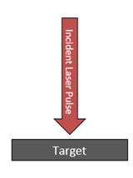
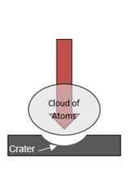
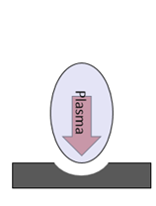
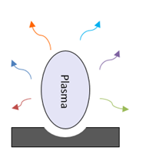
Laser-Induced Breakdown Spectroscopy (LIBS)
LIBS is an elemental analysis technique
Pulsed laser is focused on target surface which absorbs laser energy
Target material is vaporized, generating a cloud of atoms above the target surface
Cloud of atoms absorbs the remaining laser energy, forming a plasma
As the plasma cools, photons are emitted and collected for elemental analysis

Slide 5
LIBS Advantages
Can be done on solids, liquids, gases and bacteria
Little to no sample preparation
Requires only μg of sample
Fast: elemental composition can be determined in under 1 second
Simultaneously detects all elements in periodic table
The use of the laser allows for point sampling & elemental mapping

Slide 6
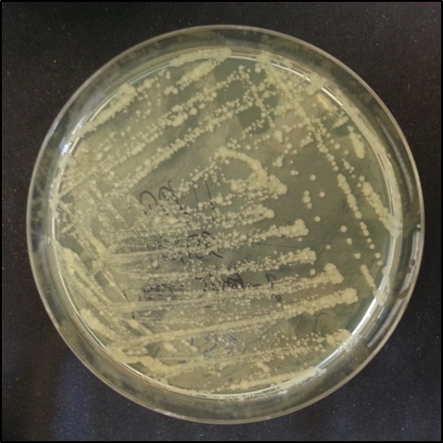
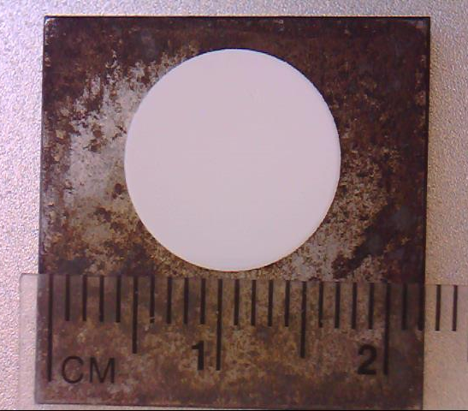
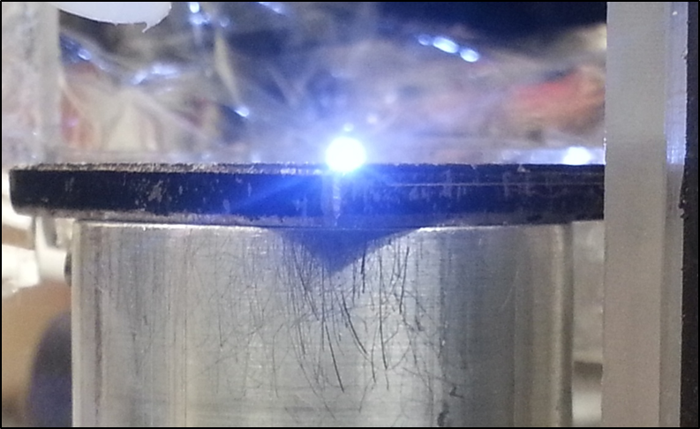
Overview of Methodology
1
3
Bacteria is cultured on TSA plates
Bacterial suspension is vortexed and deposited on nitrocellulose filter paper
2
Bacterial cells are removed and suspended in 1.5 mL deionized water
4
Filter paper is mounted on a steel piece and ablated with laser

Slide 7
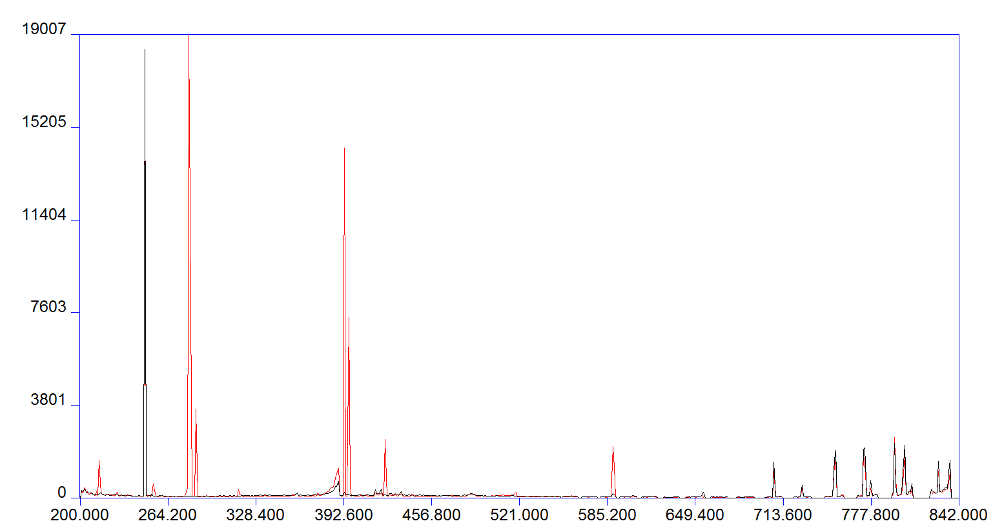
5
After laser ablation, light from the plasma is dispersed, revealing the sample’s elemental composition
C
Mg
Black – blank filter paper
Red – filter with bacteria
LIBS Intensity (A.U)
Ca
Ar
P
CN
Na
Wavelength (nm)

Slide 8
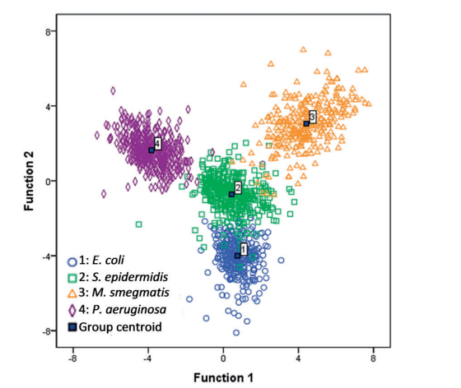
6
Bacteria are discriminated based on elemental composition
C, P, Mg, Ca, and Na can be used to identify a bacterium’s species
Bacterial spectra are classified using discriminant function analysis (DFA)
Unknown spectra are classified against a precompiled library of known spectra
Bacterial classification based on elemental composition measured by LIBS
Sensitivity 98 ± 2%
Specificity 99 ± 1%
Bacterial library:
164 independent variables (intensities of elemental lines and ratios of these lines to each other)
~ 1500 spectra acquired over 3 months from 4 species of bacteria (E. coli, S. epidermidis, M. smegmatis, P. aeruginosa)

Slide 9
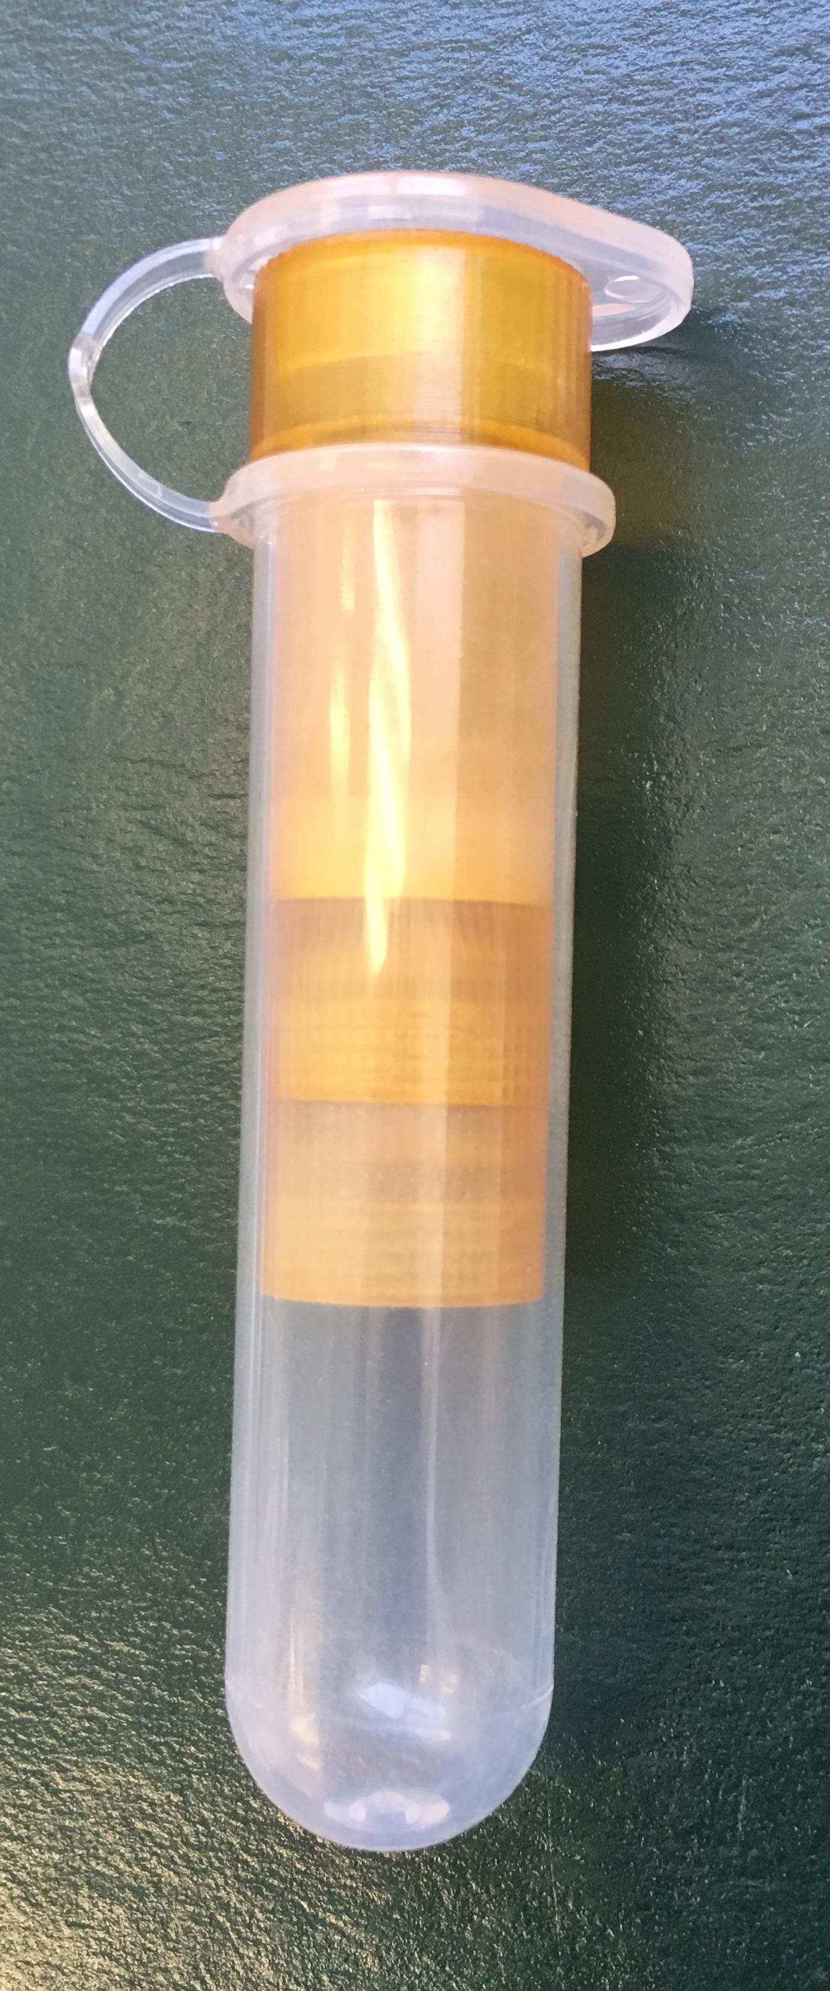
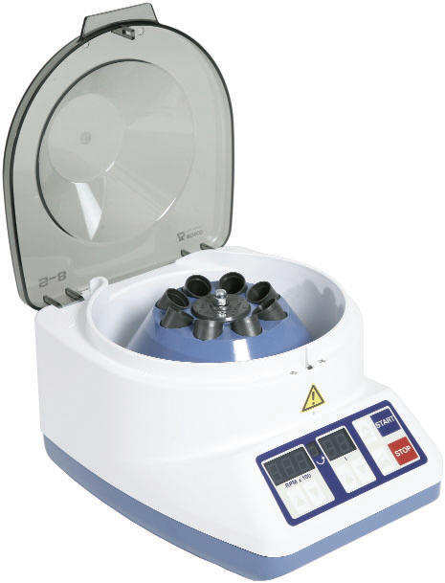

Preparation Method to Separate a Contaminant from a Bacterial Suspension
Biological samples (blood sample, swab sample, etc.) will likely contain unwanted cells that would need to be separated from the bacteria before testing with LIBS
Cell sizes:
Bacteria ~ 1 μm
Red blood cell ~ 6-8 μm
Eukaryotic cells ~ 10-100 μm
Isolate the bacteria using filter papers with different pore sizes (5 μm and 0.45 μm)
centrifuge tube insert
5 μm filter
0.45 μm filter
filter papers are placed here
centrifuge tube

Slide 10
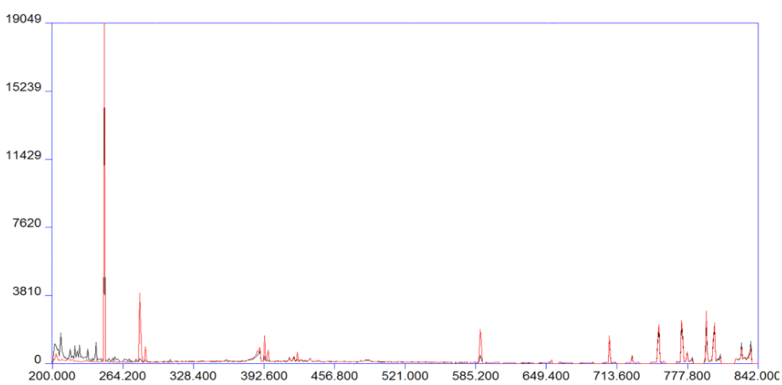
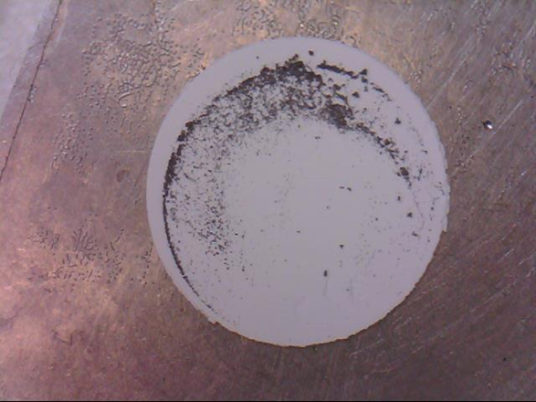
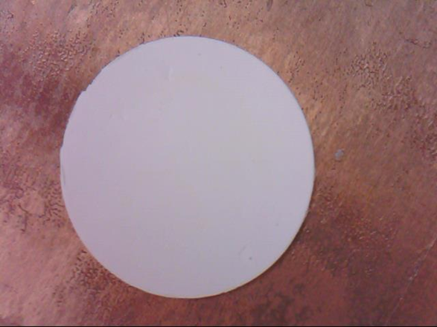
Tungsten powder (12 μm average particle size) added to E. coli suspension to simulate unwanted cells in a biological sample
5 μm filter
0.45 μm filter
C
Black – 5 μm filter
Red – 0.45 μm filter
W powder
LIBS Intensity (A.U)
5 μm filter
0.45 μm filter
W
Mg
Ca
Na
Wavelength (nm)

Slide 11
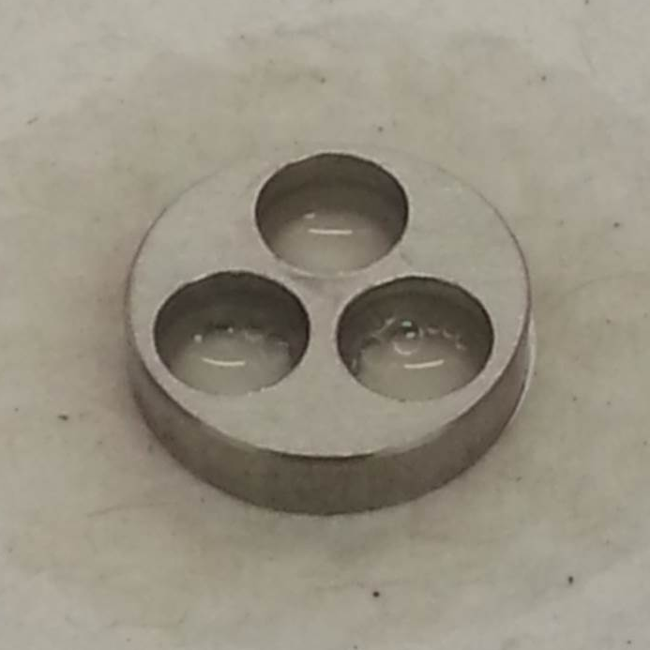
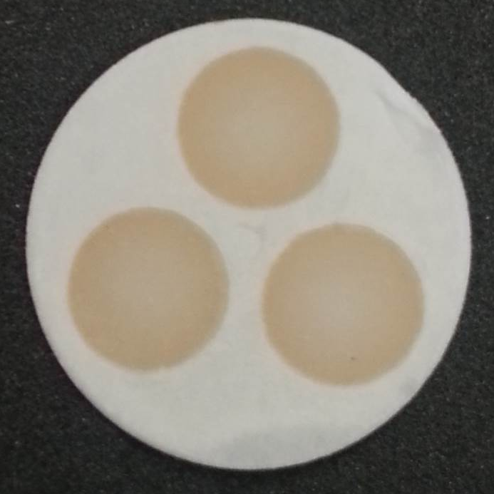
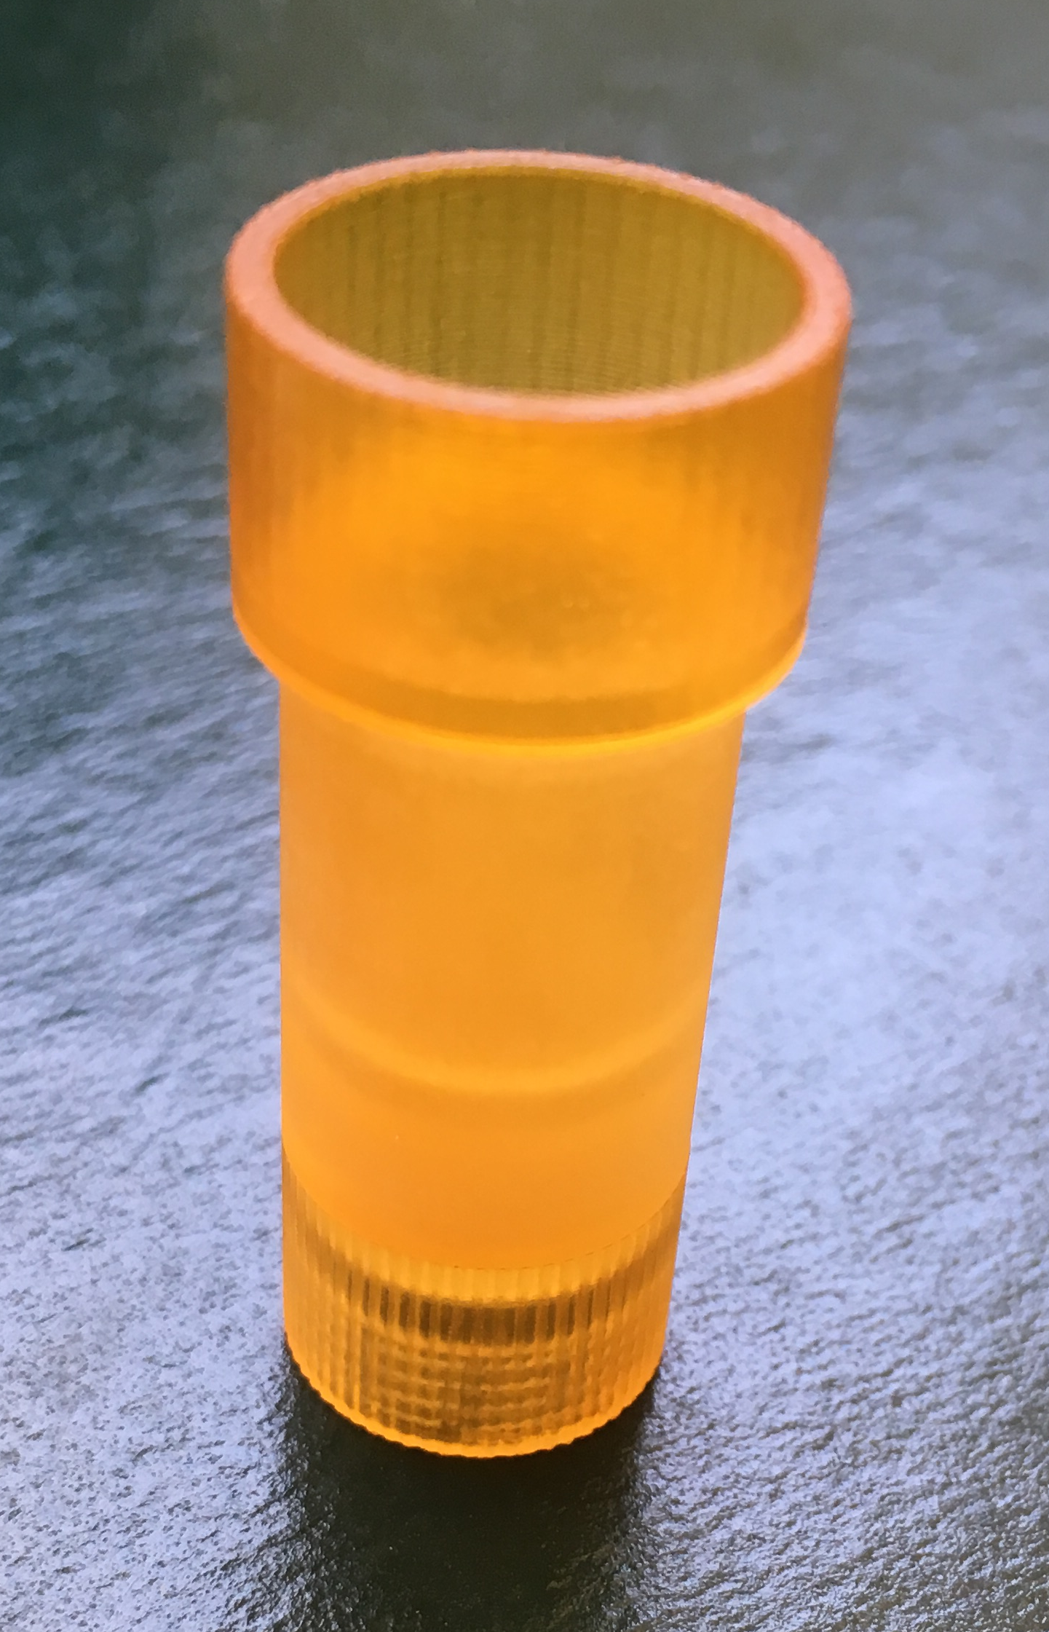
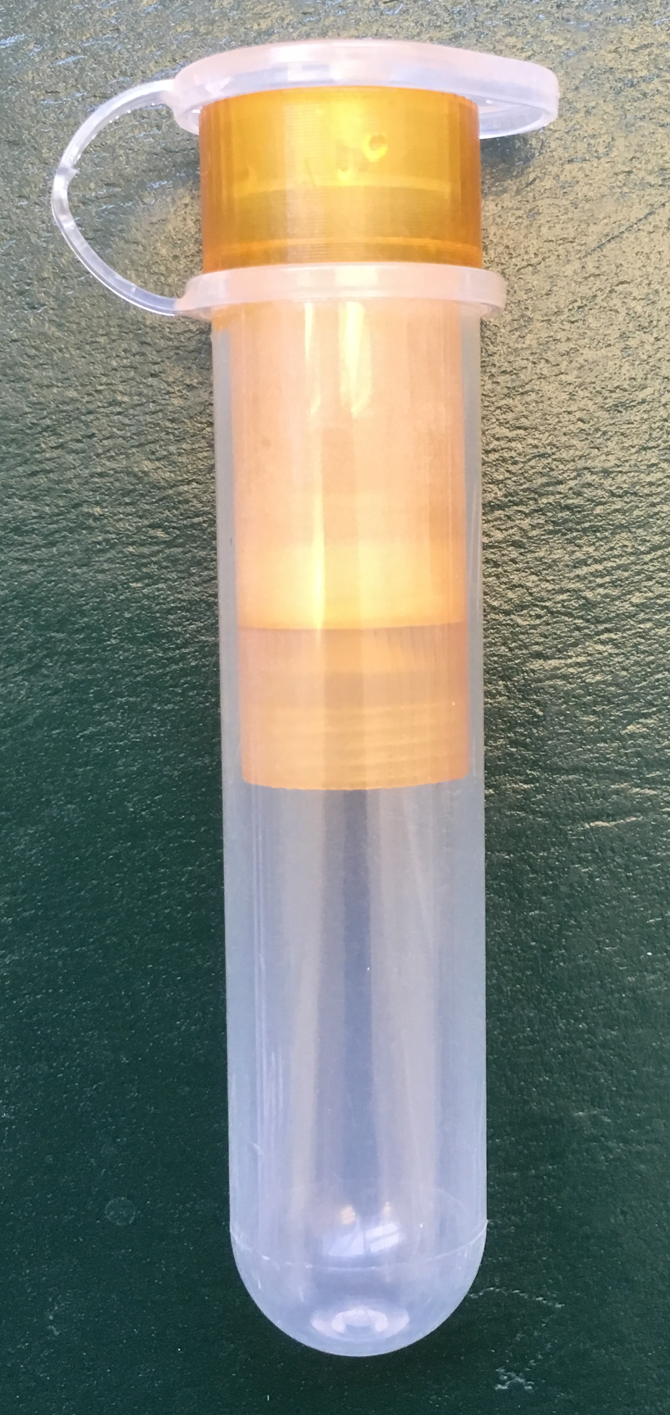
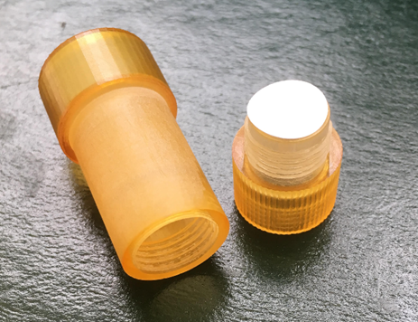
Previous Bacterial Deposition Procedures
1) Well-plate
2) Centrifuge tube insert
Bacterial LOD ~ 50 000 CFU per laser ablation event
Bacterial lawn
Bacterial LOD ~ 90 000 CFU per laser ablation event
filter paper
Number of bacterial cells present in clinical samples:
< 100 CFU/mL in blood
0-200 CFU in typical nasal swab
These LOD’s are not clinically relevant.
Bacterial LOD with LIBS MUST be lowered.

Slide 12
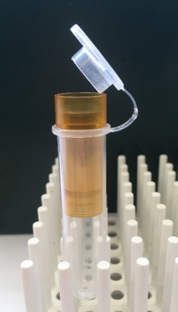
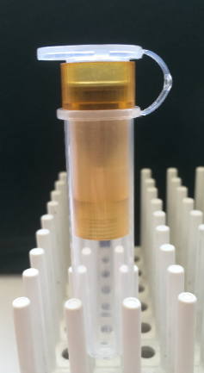
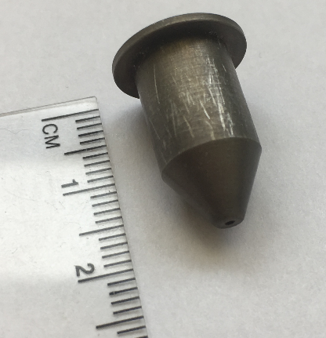
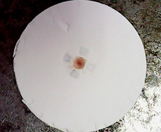
New Deposition Procedure: Metal Cone
Metal cone to force deposition of bacteria onto smaller region at center of filter paper
Why do this?
Increases the number of bacterial cells per unit area, leading to more bacterial cells ablated in a laser shot compared to previous deposition procedures
Method:
cap of centrifuge tube presses metal cone into filter paper
bacteria
metal cone
Bacteria is concentrated at center of filter paper
centrifuge tube insert
filter paper sits here

Slide 13
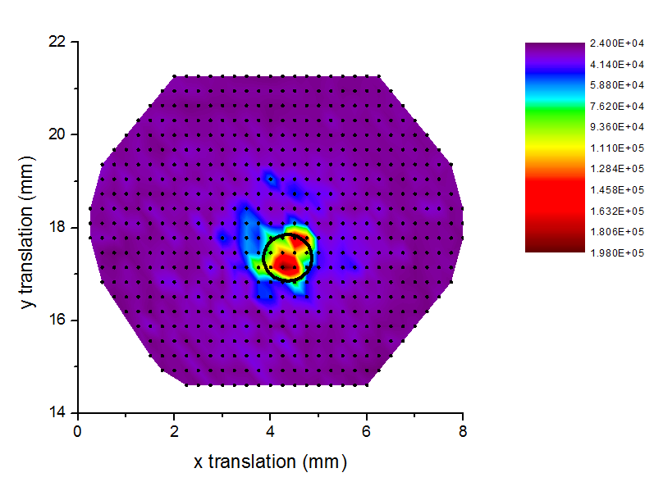
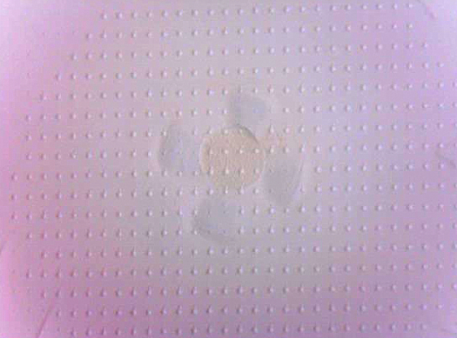
Metal Cone: Bacterial Concentration
E. coli deposited on filter paper with metal cone
569 LIBS spectra acquired across filter
Intensity map depicting bacterial deposition on filter paper for bacteria deposited with metal cone
Colour indicates bacterial LIBS intensity
→ purple: no bacterial signal
red: strong bacterial signal
Image of filter paper after data acquisition
Approximate location of where metal cone presses into filter paper
Discolouration due to presence of bacteria

Slide 14
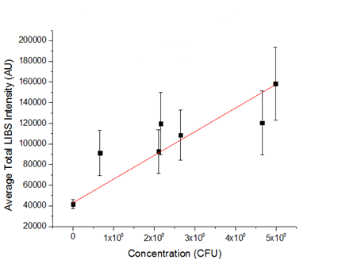
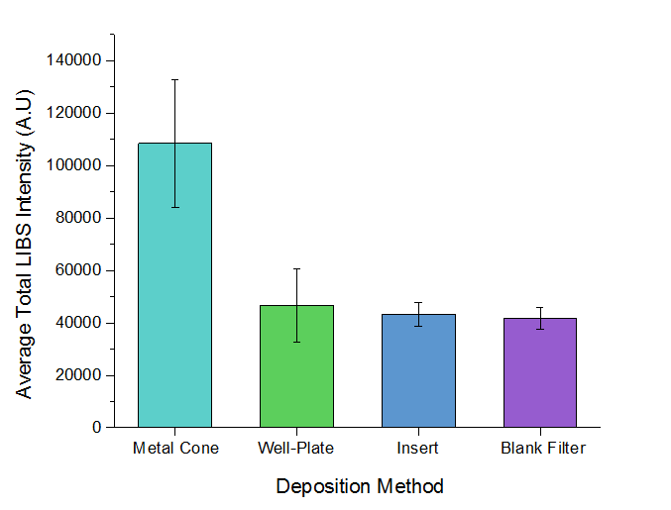
Comparison of LIBS Signal to Previous Deposition Methods
Metal Cone Limit of Detection
metal cone
well-plate
insert
blank filter
LOD ∼ 5 500 CFU per laser ablation event
Suggestive of a lower LOD for bacteria deposited with metal cone
Recall:
Well-plate → LOD ~ 50 000 CFU per laser ablation event
Insert → LOD ~ 90 000 CFU per laser ablation event

Slide 15
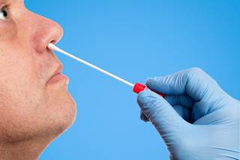
Conclusions
Preparation method to separate unwanted material from bacterial suspension was effective
Future work: test this method using a contaminant that more closely simulates biological cells
Metal cone:
  effective at concentrating bacterial cells to a small region of the filter paper
  significantly lowered bacterial LOD with LIBS compared to previous methods of bacterial deposition
Future work: LIBS analysis on bacteria collected with swabs that are used in hospitals

Slide 16
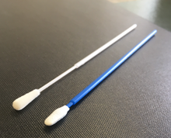
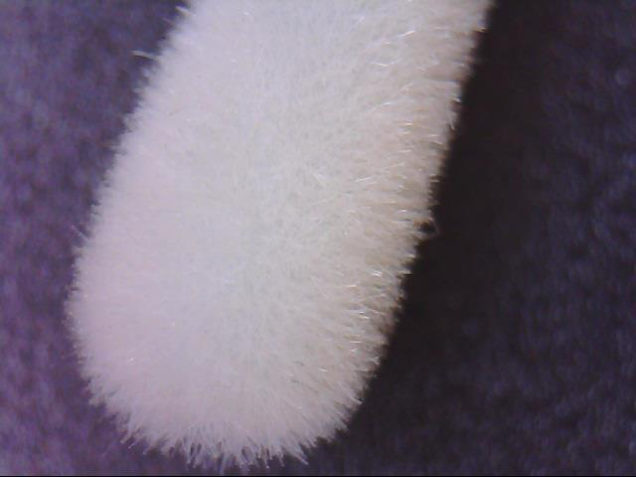
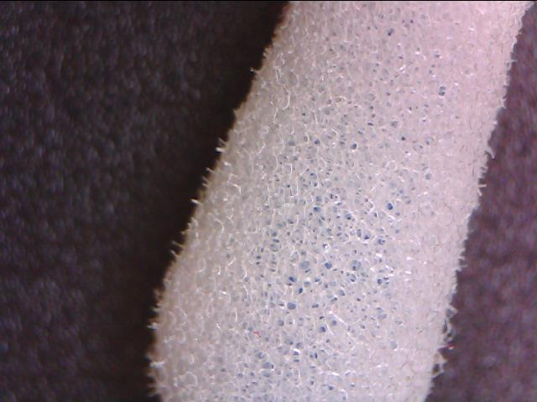
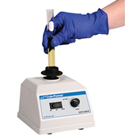
Flocked swab
Foam swab
flocked
foam
Cannot shoot right on the swab
Surface is too irregular
Bacterial cells are not concentrated

Slide 17
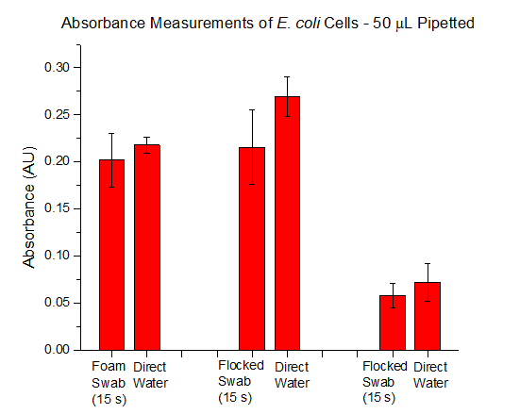
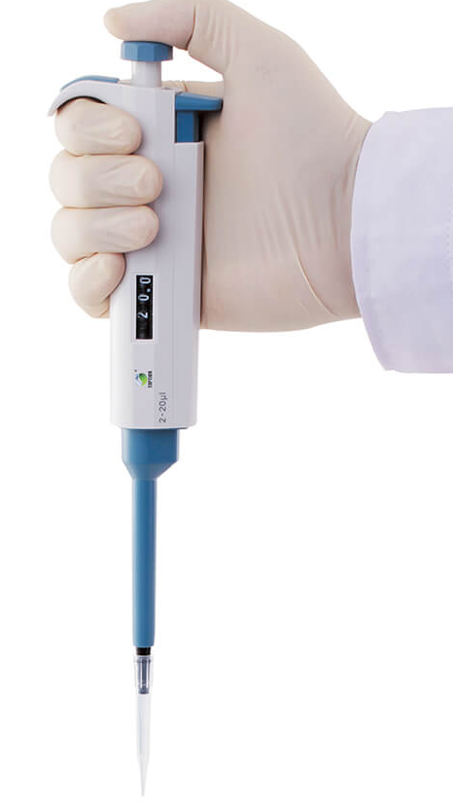
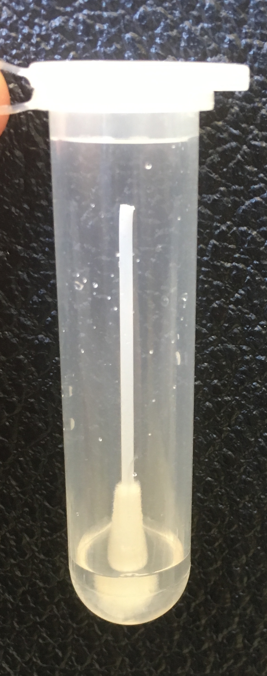
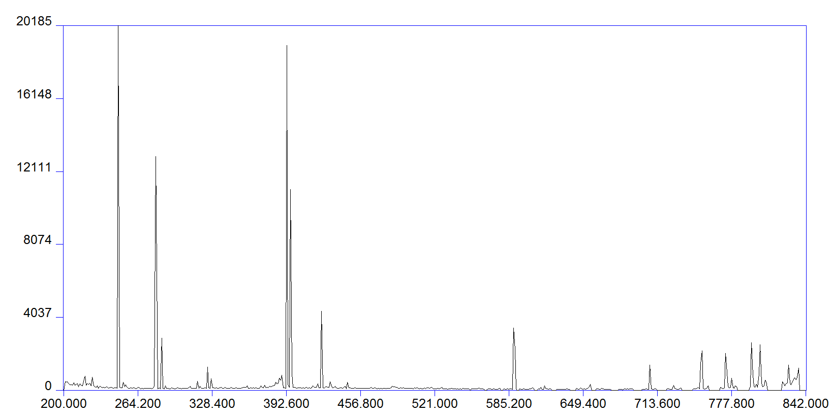
~ 80% of the bacterial cells were released from the flocked swab
C
Mg
LIBS Intensity (AU)
Ca
Na
P
Wavelength (nm)

Slide 18

Acknowledgments
NSERC
University of Windsor Student Life Enhancement Fund
University of Windsor Faculty of Science

Slide 19
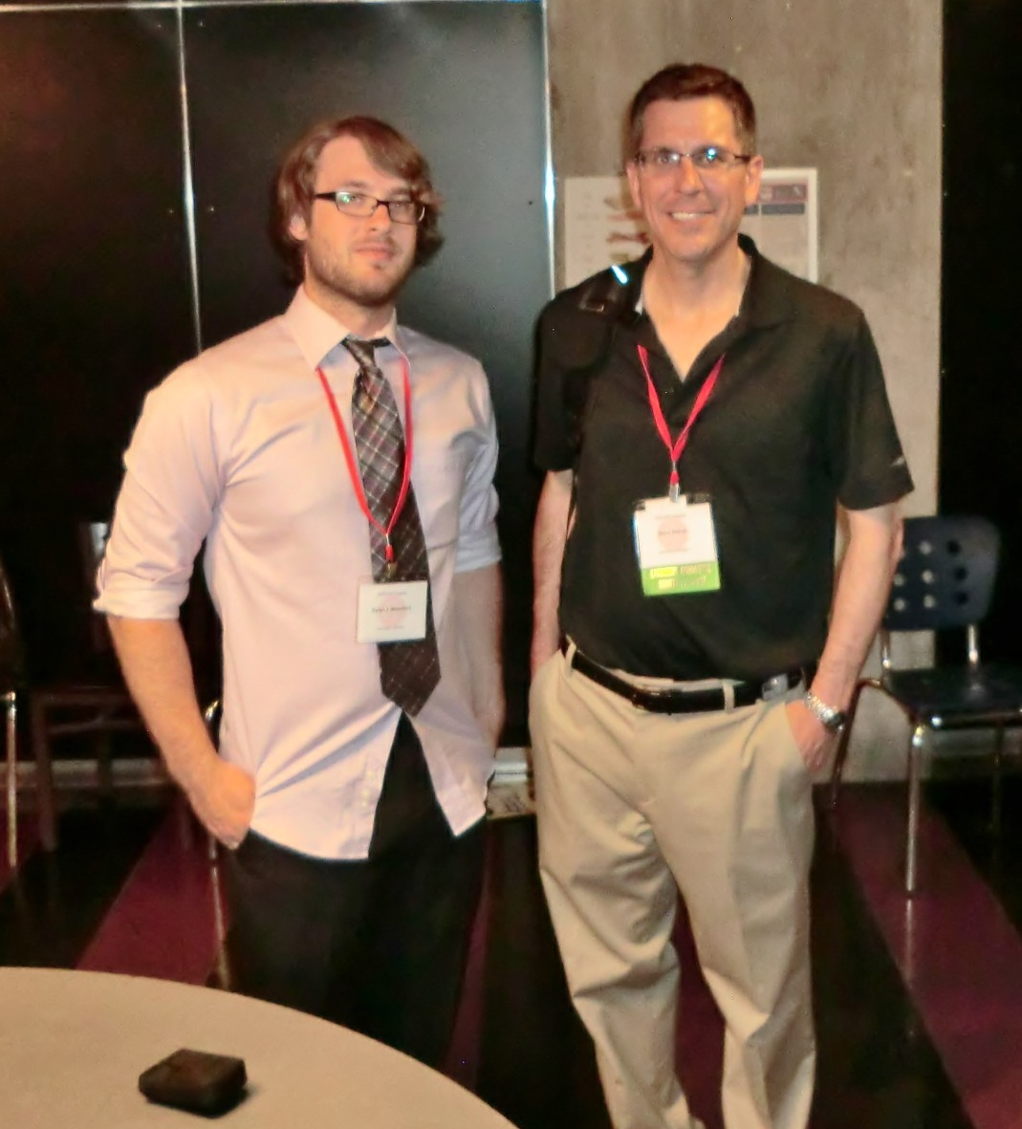
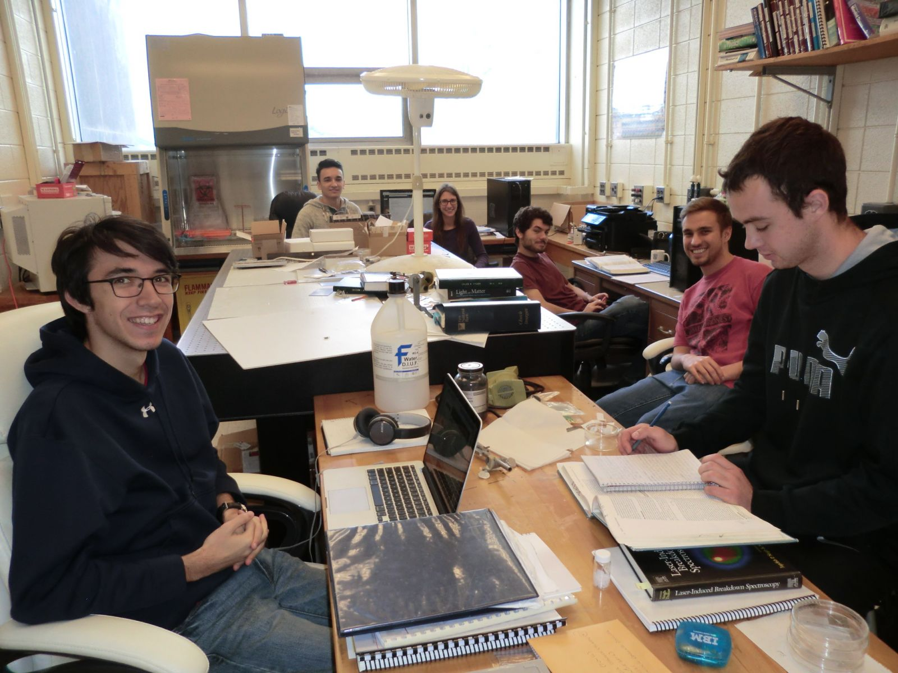
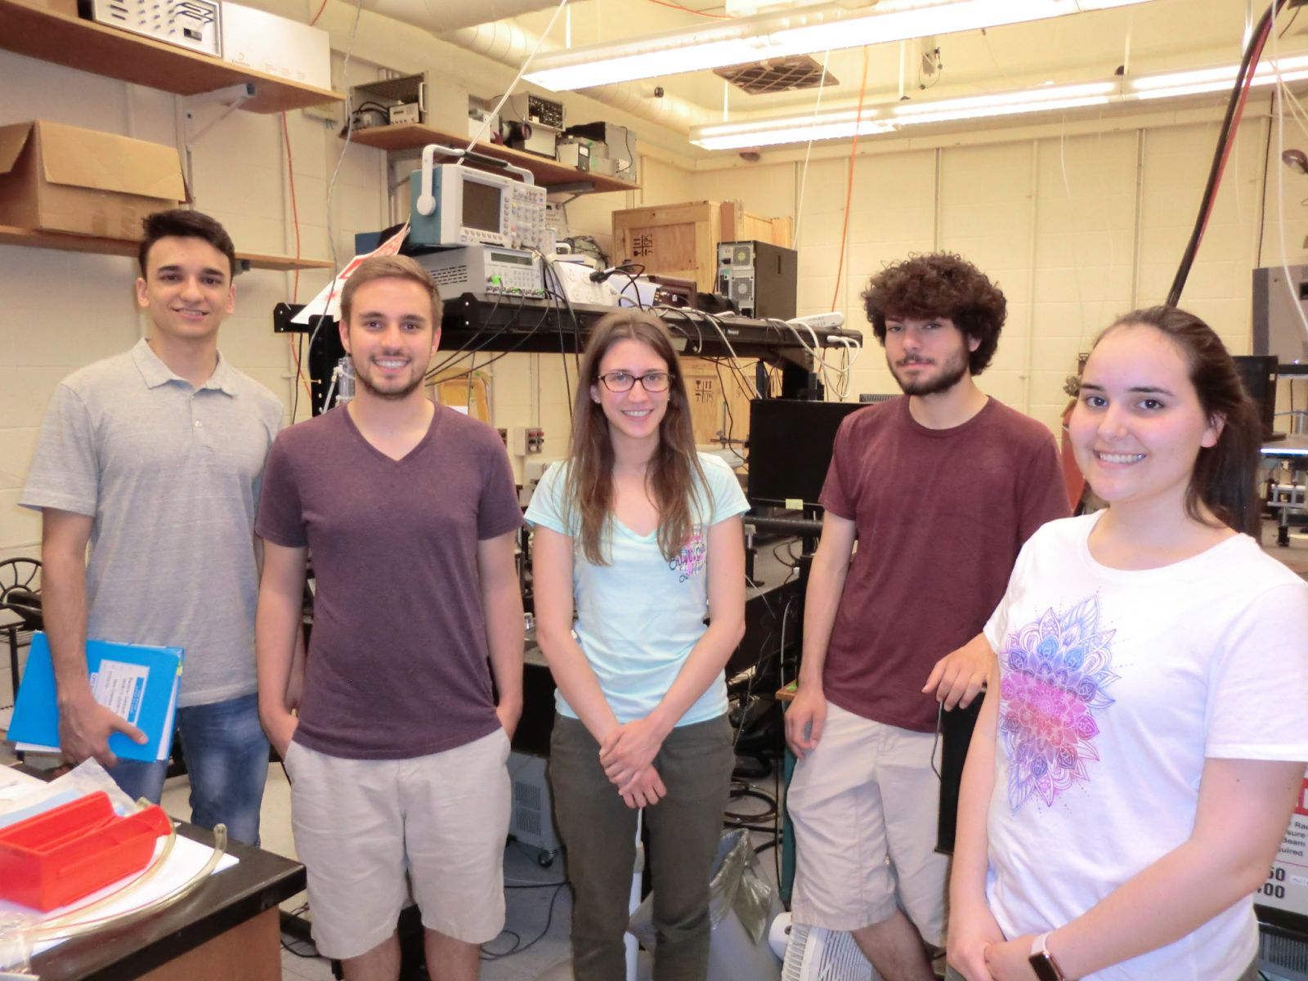
New students welcome!
If interested, contact Dr. Steven Rehse rehse@uwindsor.ca

Slide 20
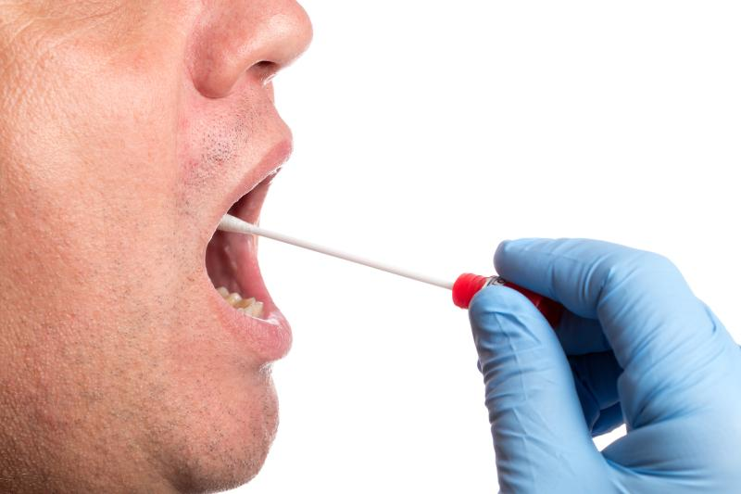
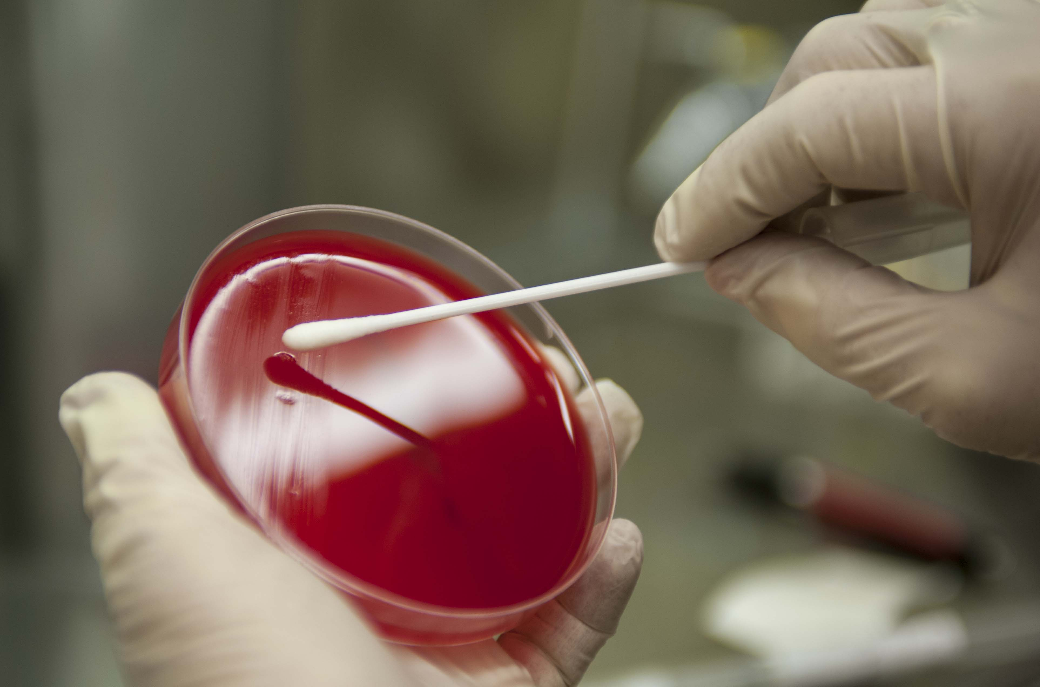
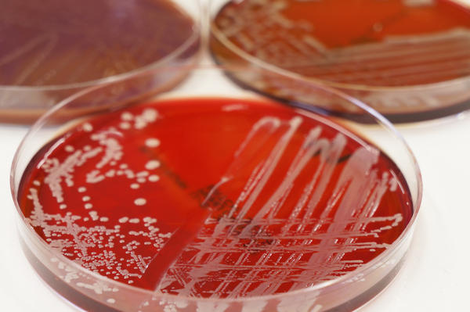
Bacterial Collection with Swabs
Some clinical specimens are collected with swabs
Swab is streaked on culture plate containing growth media for bacterial cells
If bacteria is present on the swab, it will grow on the plate
time consuming & require microbiology expertise
Can we use LIBS instead?

