Slide 1
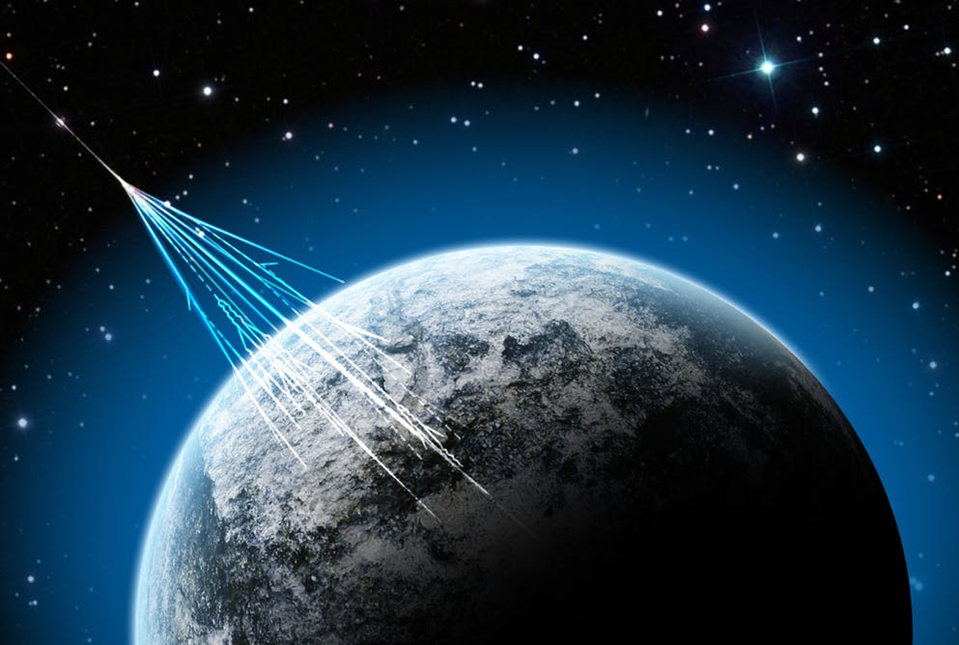


The HELIX Project: Calibration of Aerogel for Cherenkov Counter
Presented by Thomas Rosin
for HELIX Collaboration
SUPERVISOR : DaVID HANNA
GRADUATE STUDENT : EMMA ELLINGWOOD
Notes:
refs

Slide 2

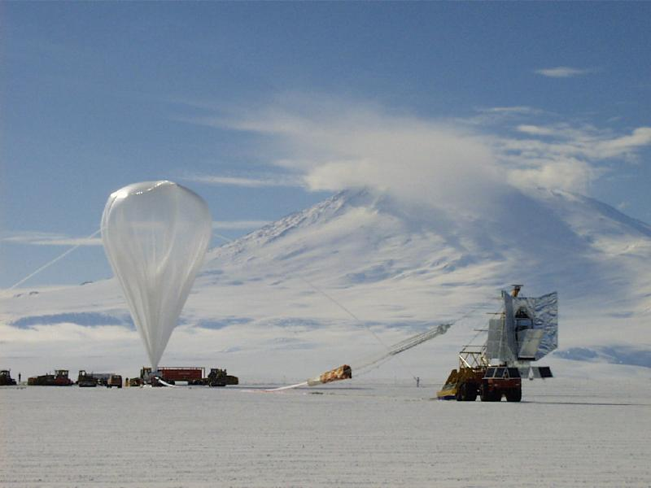

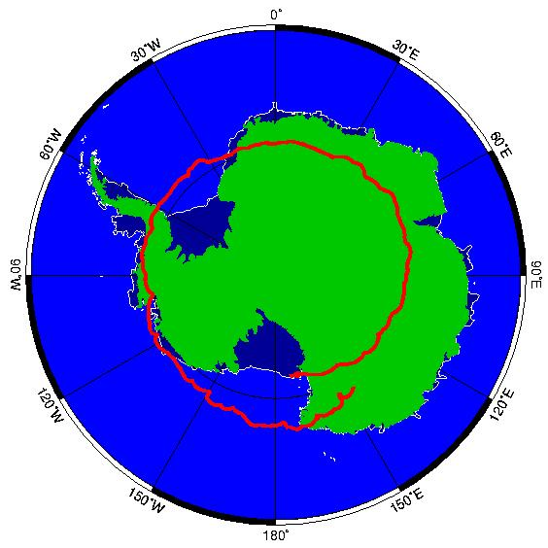
High Energy Light Isotope eXperiment
2
What is it?
A balloon-borne detector designed to measure the chemical and isotopic abundances of light cosmic ray nuclei.
When and Where?
Two stage experiment
Stage 1 : 14 day ﬂight(depend on He consumption) from NASA’s McMurdo Station facility in Antarctica during the 2020/21 austral summer.
Stage 2 : 28 day ﬂight
Thomas Rosin - McGill University

Slide 3







The collaboration
3
McGill University
  David Hanna, Emma Ellingwood, Thomas Rosin
University of Chicago
  Scott Wakely, Dietrich Müller , Nahee Park, Ian Wisher
Indiana University
  James Musser, Mark Gebhard, Brandon Kunkler, Mark Lang, Gerard Visser
Pennsylvania State University
  Stephane Coutu, Isaac Mognet
Northern Kentucky University
  Scott Nutter
University of Michigan
  Michael Schubnell, Gregory Tarle, Andrew Tomasch, Noah Green
Ohio State University
  Jim Beatty
Thomas Rosin - McGill University

Slide 4
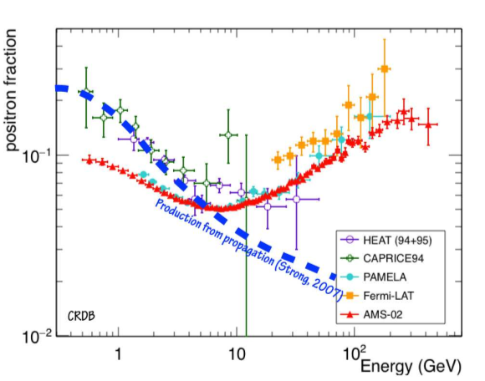

Cosmic Ray Propagation
4
We wish to explain the recent results from AMS-02(Alpha Magnetic Spectrometer).
The positron fraction excess can’t be explained by current cosmic ray propagation model.
Positron fraction = $\frac{e^{+}}{e^{+}+e^{−}}$
Hypothesis:
Positron production by nearby pulsars
Annihilation or decay of dark matter
Thomas Rosin - McGill University
Notes:
bullet

Slide 5
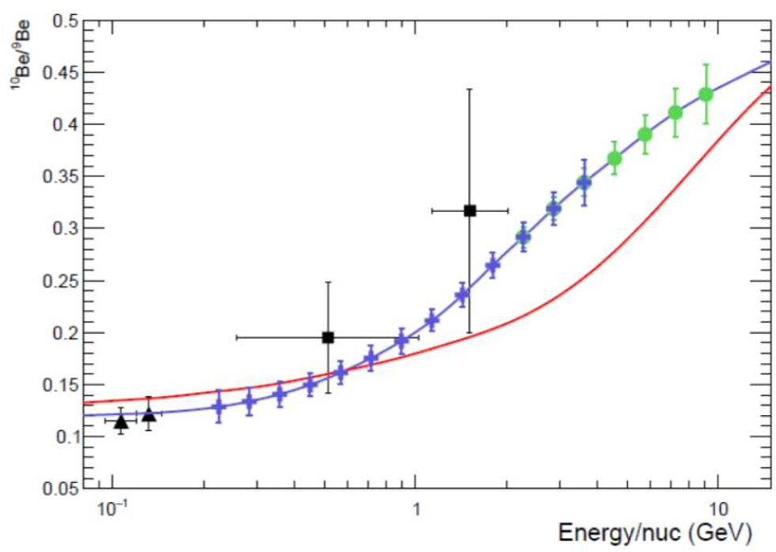

Beryllium-10 Clock Isotope
5
Properties of ${}_{ }^{10}{Be}$:
  Made in spallation reactions with interstellar medium
  Unstable element with half life of 1.5Myr (“clock isotope”).
A ${}_{ }^{10}{Be/{}_{ }^{9}{Be}}$measurement give an estimate of how long the cosmic ray have been travelling. This helps discriminate between many propagation models.
AMS-02 can’t make this measurement
Goal: Measuring ${}_{ }^{10}{Be/{}_{ }^{9}{Be}}$ between 0.1 to 3 GeV/n for Stage 1 up to 10 GeV/n for Stage 2
Diffusive Halo
Leaky Box
ISOMAX
ACE/CRIS
HELIX Stage 1
HELIX Stage 2
$$Cosmic ray+{}_{7}^{14}N \underset{→}{ISM }{}_{4}^{10}{Be}+{}_{2}^{4}{He}+e^{+}+v_{e}+spallation byproduct$$
Thomas Rosin - McGill University

Slide 6
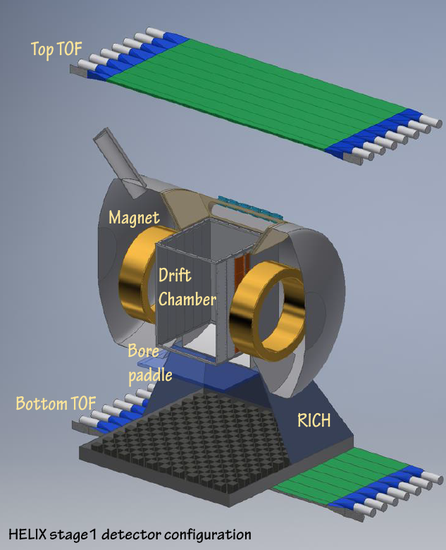

HELIX Payload
6
Experimental Method
  Measure charge to get Berylium
  Measure rigidity(momentum)
  Measure $β$(velocity)
  Particle ID using mass spectrometry
Magnet
  1T superconducting magnet
Drift Chamber Tracker
  Multiwire drift chamber with 72 sense layers
  Spatial resolution $\sim$65 $μm$ for Z>3
  Measure rigidity
Time-of-Flight(TOF) and Charge System
  1.5cm thickness scintillator, readout by SIPMs, 2.3m separation
  Timing resolution <50 psec for Z>3
  Measure charge (indentify Be element)
  Measure velocity up to 1GeV/n
Thomas Rosin - McGill University

Slide 7
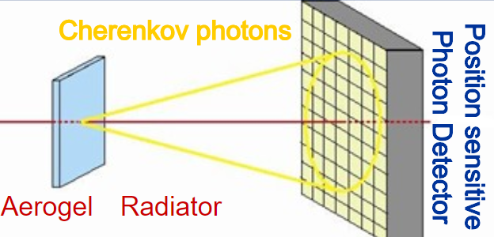

HELIX Payload
6
Ring Imaging Cherenkov Detector(RICH)
  Particles with v>c/n generates Cherenkov Photons emitted at an angle:
$$\cos\left(θ_{c}\right)=\frac{1}{nβ}$$
  $θ_{c}$ can be measured to get $β$
  70 cm x 70 cm aerogel radiator n$\sim$1.15
  1.3 $m^{2}$ readout plane covered by SiPMs arrays
  Measure velocity
Thomas Rosin - McGill University

Slide 8
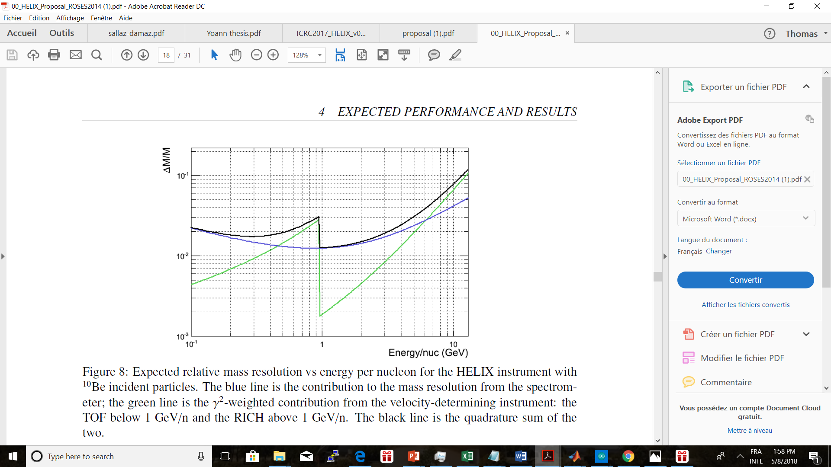
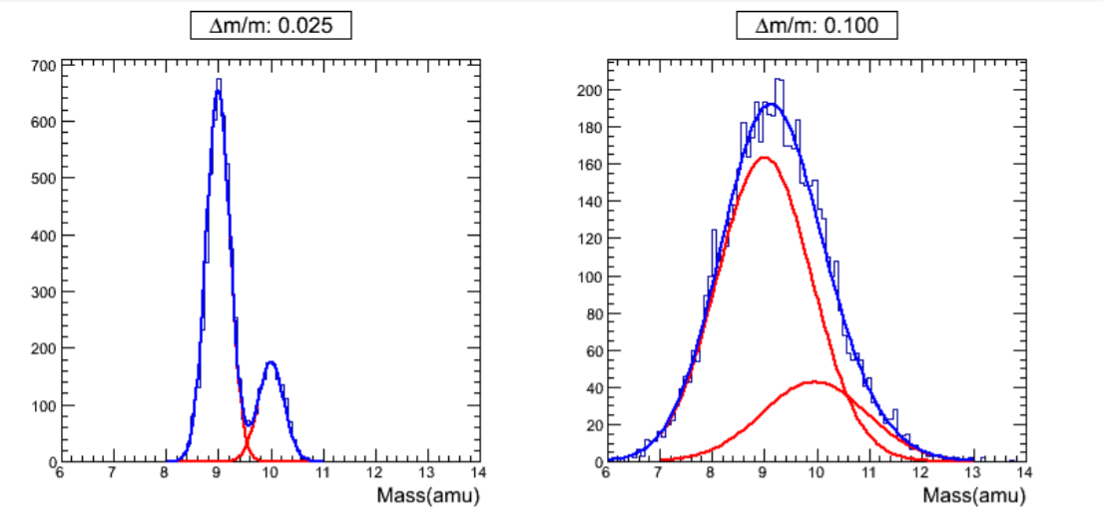
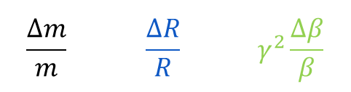
Mass Spectrometry
7
TOF
RICH
2.5%
$${\left(\frac{∆m}{m}\right)}^{2}={\left(\frac{∆R}{R}\right)}^{2}+{\left(γ^{2}\frac{∆β}{β}\right)}^{2}$$
Thomas Rosin - McGill University

Slide 9
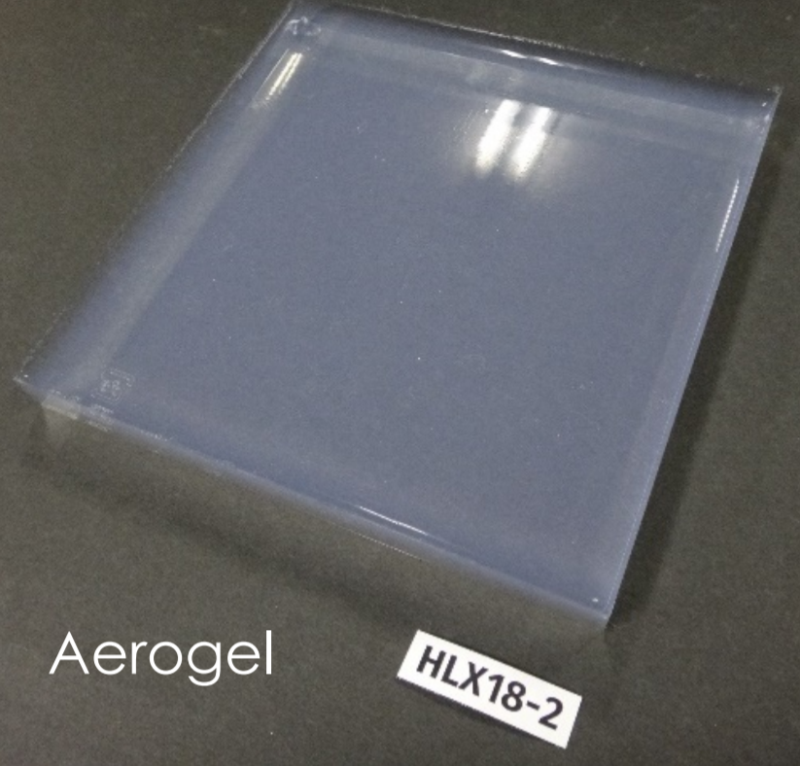

8
Aerogel Calibration
Radiator: Aerogel with refractive index 1.15
Aerogel Properties:
  refractive index is intermediate between gases (near 1.00) and conventional materials (water 1.33, glass 1.5) and can be tuned during production.
  optimize the geometry of the detector
  perform proximity focusing
n needs to be calibrated to a precision of
$\frac{∆n}{n}=7×{10}^{−4}$ to get accurate $β$ measurements.
The refractive index and the thickness have to be measured on a fine grid to calibrate the apparatus.
Produced in Japan by Makoto Tabata from Chiba University
92 aerogel tiles to calibrate
Thomas Rosin - McGill University

Slide 10
Calibration of Aerogel : Beam Calibration
9
Idea:
Scan the aerogel tile with an relativistic electron beam to find n.
Beam test at NRC: 35MeV electron linac in Ottawa
NRC linac
Thomas Rosin - McGill University

Slide 11
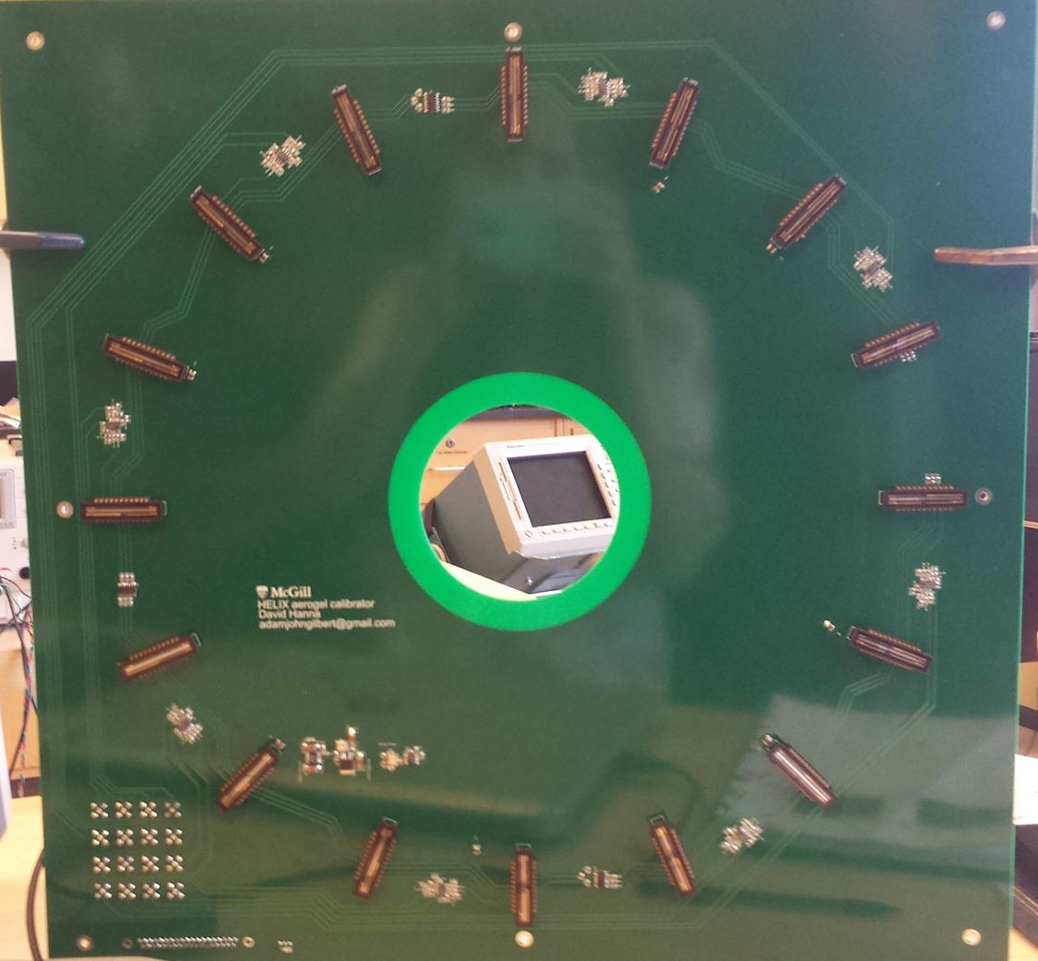
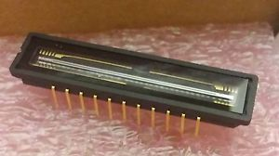
Calibration of Aerogel : Beam Calibration
9
NUCLEO-F401RE
PCB board
Use a circle of 16 one-dimensional CCDs to measure the Cherenkov ring
Nominal radius is 200 mm
We chose the Toshiba TCD1304AP:
  3648 pixels
  8 µm x 200 µm each
  electronic shutter
  high sensitivity low noise
Control signals from STMicroelectronics / NUCLEO-F401RE
readout into Acqiris DC270 FADC digitizers (8-bit 1 GS/s)
Acqiris DC270 FADC
CCD
Thomas Rosin - McGill University

Slide 12
Calibration of Aerogel : Gradient Index
10
based on Fermat’s principle of least action
gradient in the refractive index can deflect a laser beam traversing the tile
needs a knowledge of tile thickness
limited by surface roughness and Rayleigh scattering
Thomas Rosin - McGill University

Slide 13
10
Laser
Aerogel
Screen
Camera
Thomas Rosin - McGill University

Slide 14
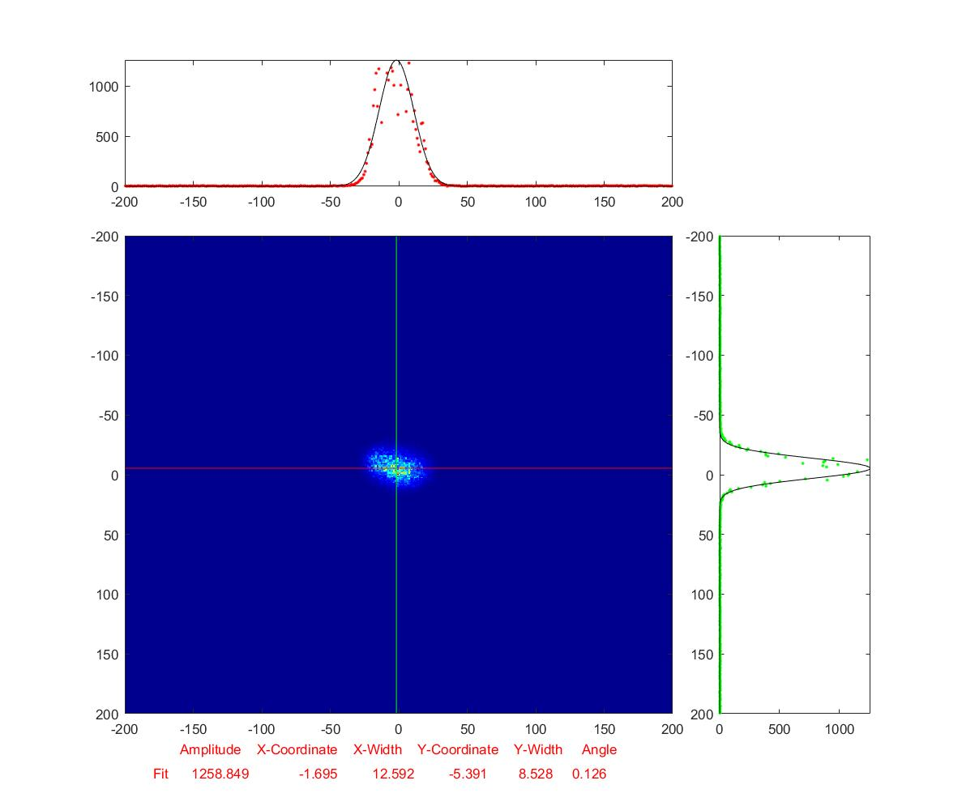
Calibration of Aerogel : Gradient Index
10
Scan tile in x and y
Measure deflection in x and y direction for each scan point
Compute index map using minimization algorithm
Correct using thickness map made with CMM(coordinate measuring machine)
Thomas Rosin - McGill University

Slide 15

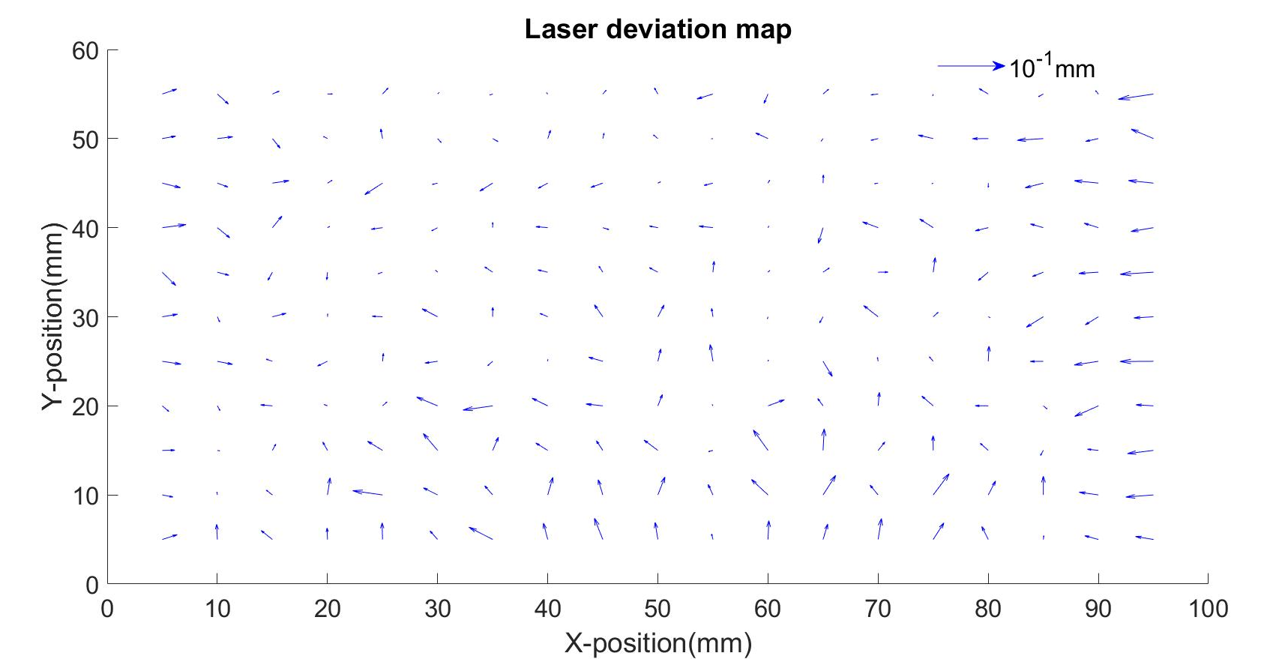




Slide 16
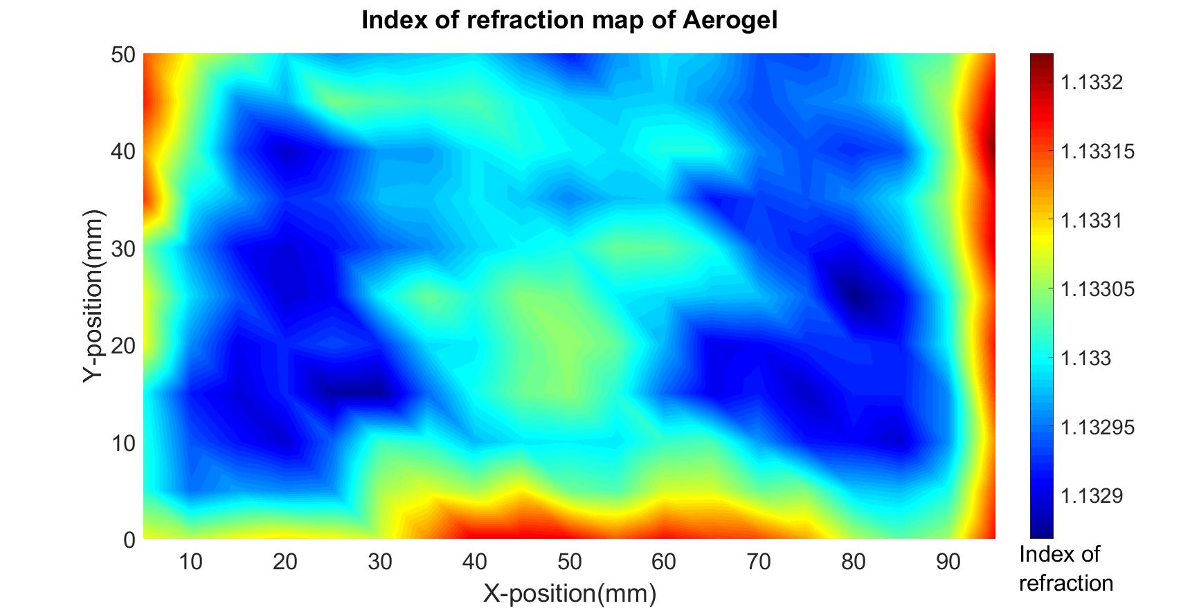

Slide 17
Questions?

