Slide 1



Reversibility of Magnetic Behavior in High Entropy Oxides
Tahereh Afsharvosoughi
Prof. David Crandles
Physics Department
Brock University

Slide 2
Outline
Introduction
Objective
Methodology
Results
Conclusion

Slide 3
Hot topic!
Year wise publications in the research area of HEAs (Based on the Scopus analyze search results for “High Entropy Alloys” as on Sep 12, 2017)¹.

Slide 4
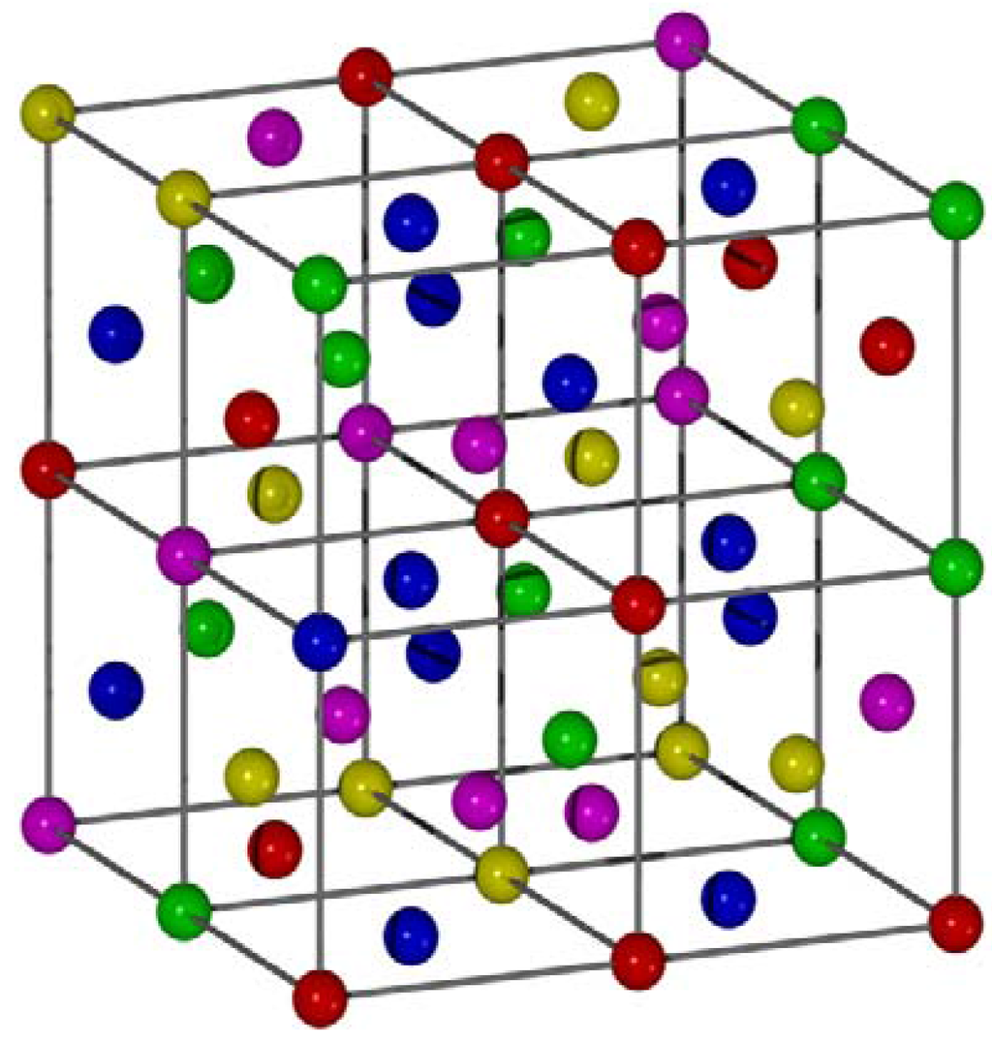
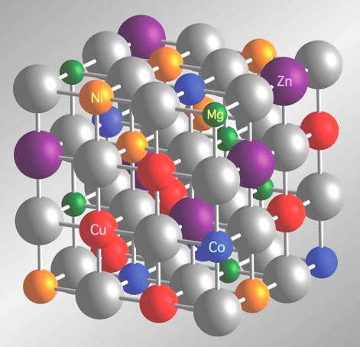

What are High Entropy Materials?
Mixtures of alloys (e.g: Cr, Mn, Fe, Co, Ni)²
Mixtures of oxides (e.g: NiO, CuO, MgO, CoO, ZnO)³

Slide 5
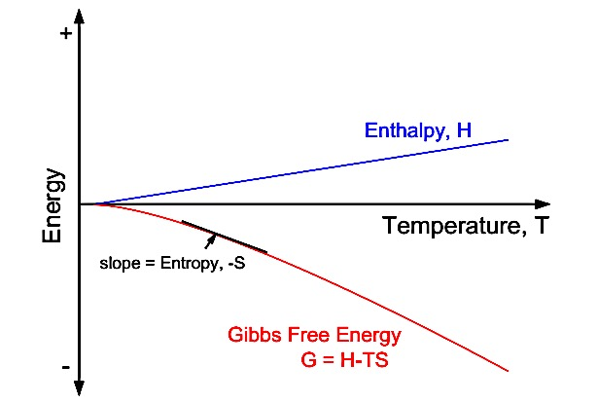
Why they are called high entropy materials?
Maximum achieve when equimolar mixtures ($x_{i}=\frac{1}{N} in S_{conf}={−k}_{B}\sum_{i=1}^{N}{x_{i}{log⁡(x}_{i})}$)⁴
Maximum achieve when equimolar mixtures (𝑥_𝑖=1/𝑁 𝑖𝑛 𝑆_𝑐𝑜𝑛𝑓=〖−𝑘〗_𝐵 ∑_(𝑖=1)^𝑁▒〖𝑥_𝑖 〖log⁡(𝑥〗_𝑖)〗)⁴
Facilitate formation of single phase solid solution⁵
High configurational entropy
(∆G = ∆H − T∆S_{conf})

Slide 6
Fascinating properties
HEAs
great hardness
toughness
HEOs
colossal dielectric constant⁶
Superionic conductivity⁷
Corrosion resistance⁵
Enhanced exchange bias⁴

Slide 7
What are we looking for ?
Whether the magnetic behavior just like structural behavior is reversible by sintering or not?

Slide 8
Reversibility of structural phase transition by sintering in HEOs
In 2015 ☛Rost et al showed reversible transition from multiphase to single phase by sintering at intermediate and high temperature and vice versa³

Slide 9
Methodology
Mixing MgO, CuO, NiO, ZnO, CoO in ball mill for 2 hours
Sample Preparation
Structural property measurement
Magnetic property measurement
Rigaku X-ray diffractometer with Cu-Kα radiation
Quantum Design Magnetic Properties Measurement System (MPMS)

Slide 10
X-ray diffraction measurement results

Slide 11
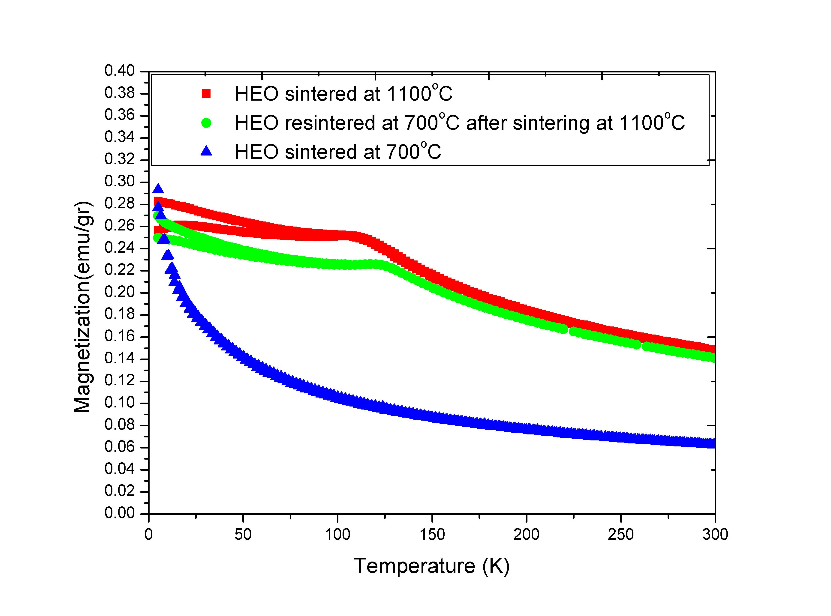
Magnetization measurement result

Slide 12
Four mixtures without CuO

Slide 13
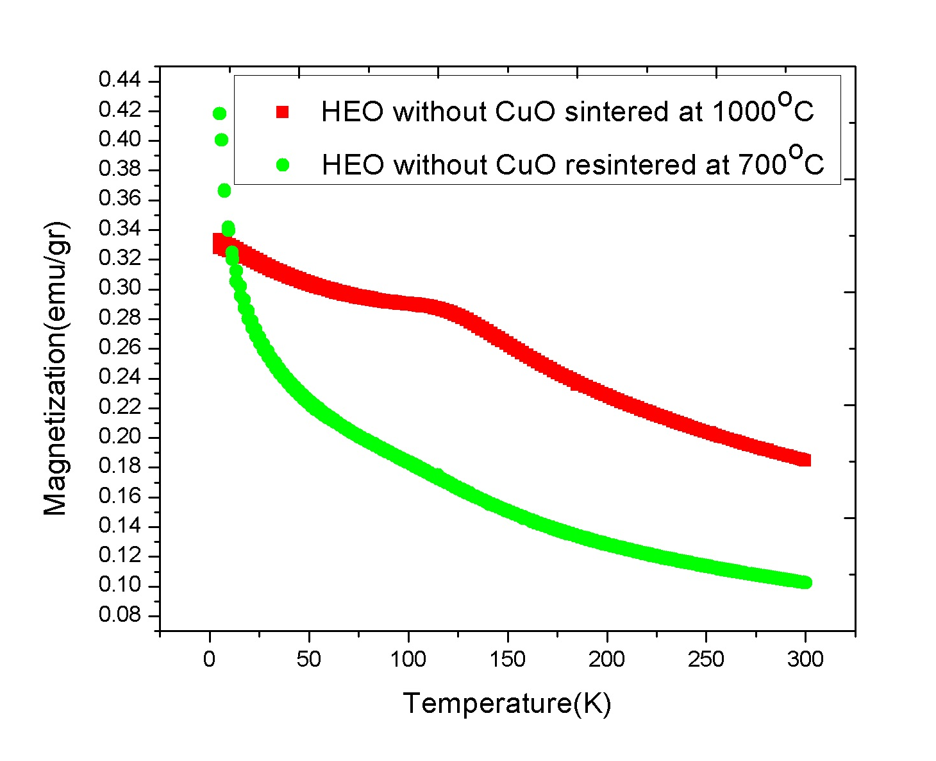
Magnetization measurement result

Slide 14
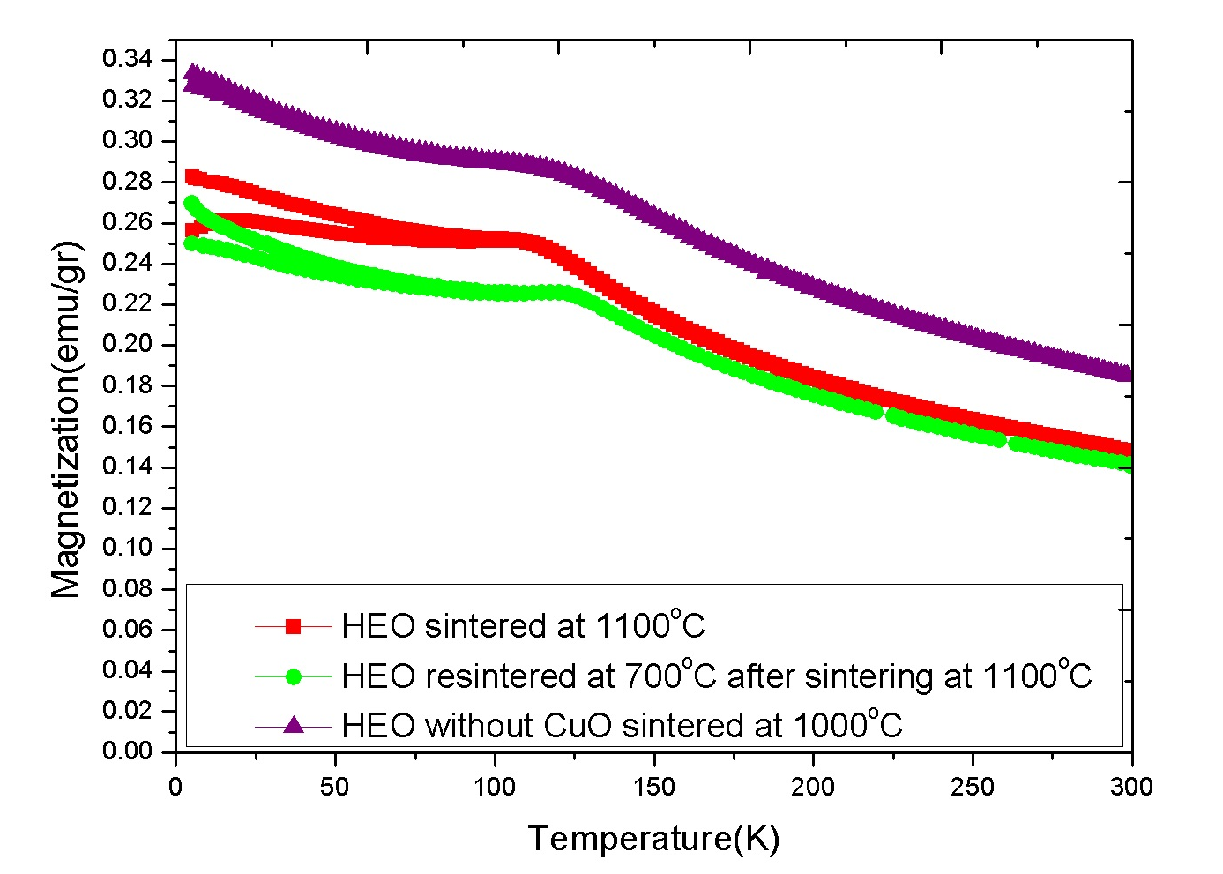
Comparison of five and four mixtures without CuO

Slide 15
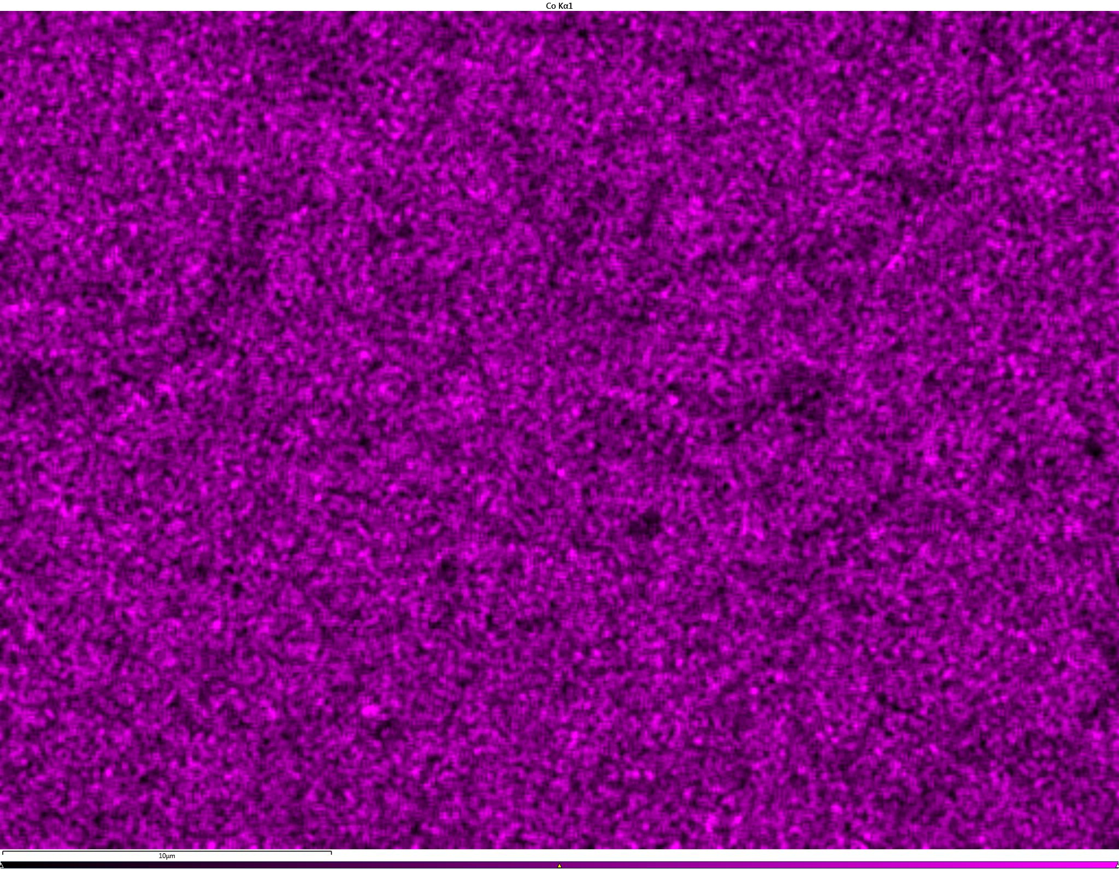
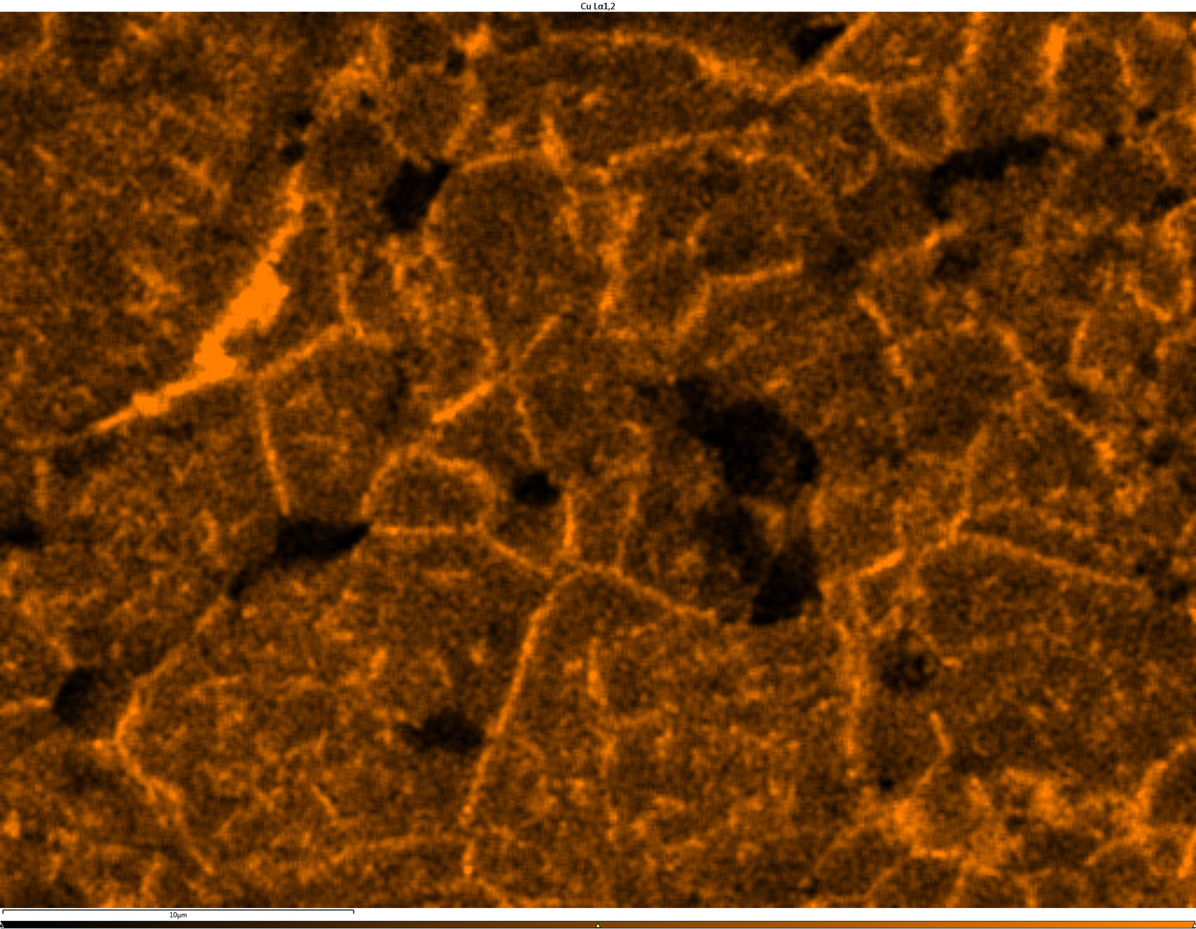
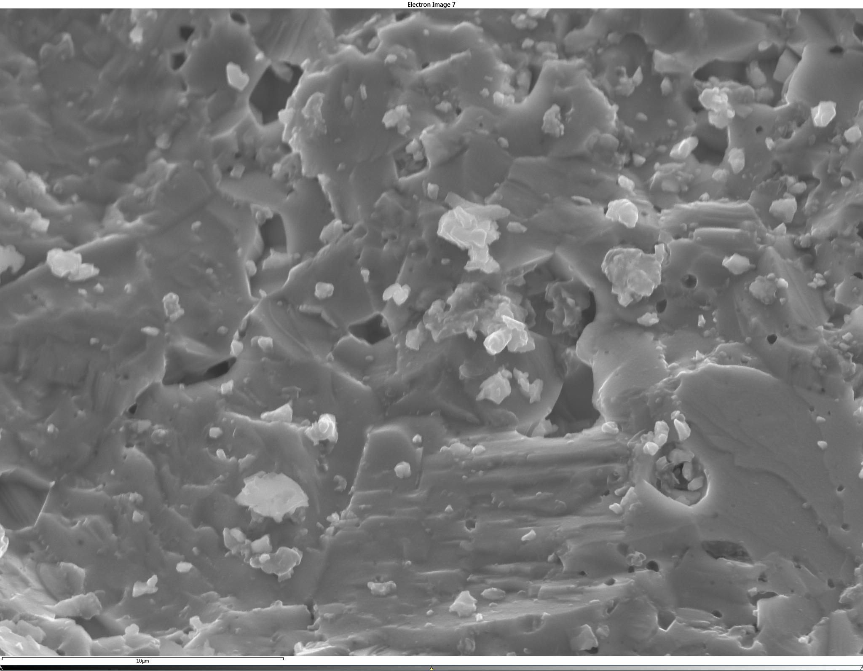
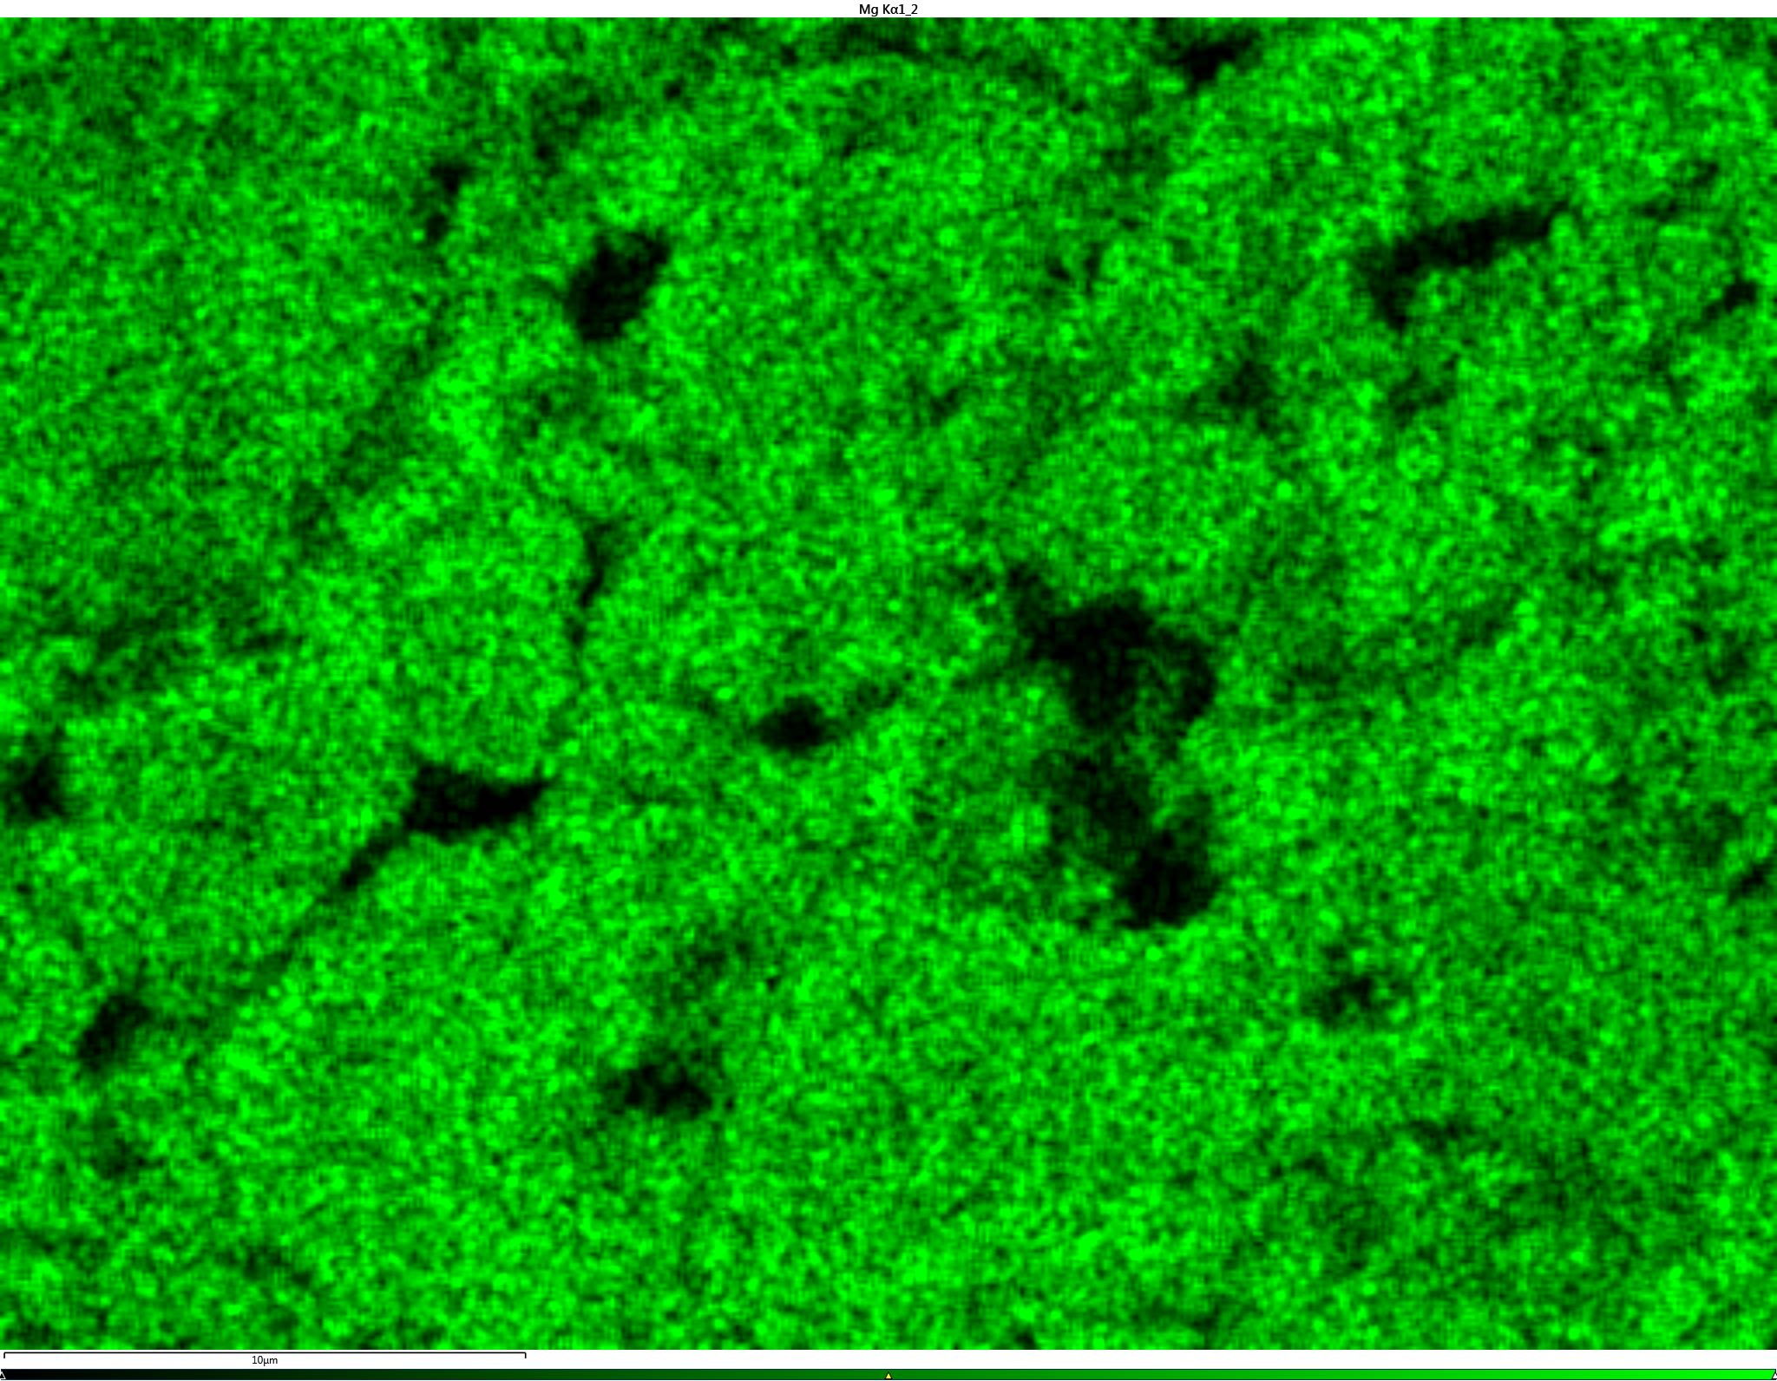
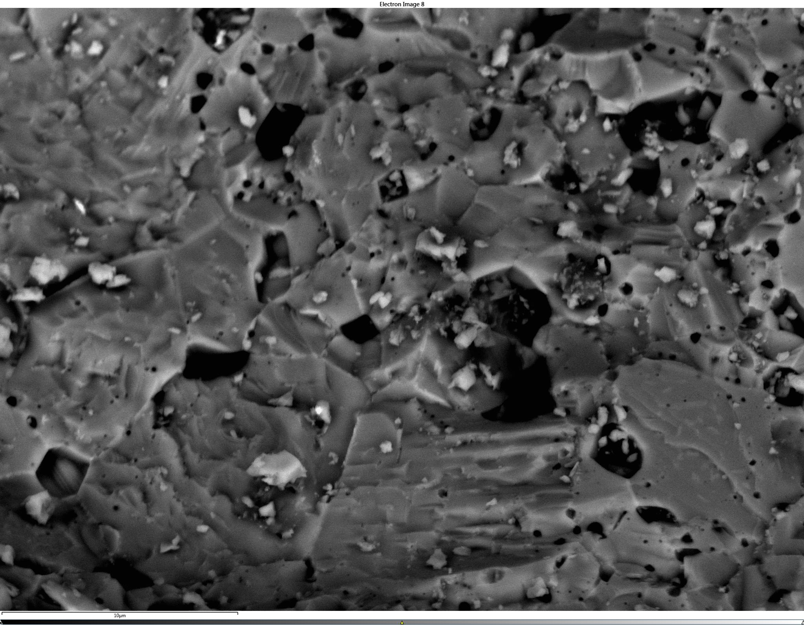
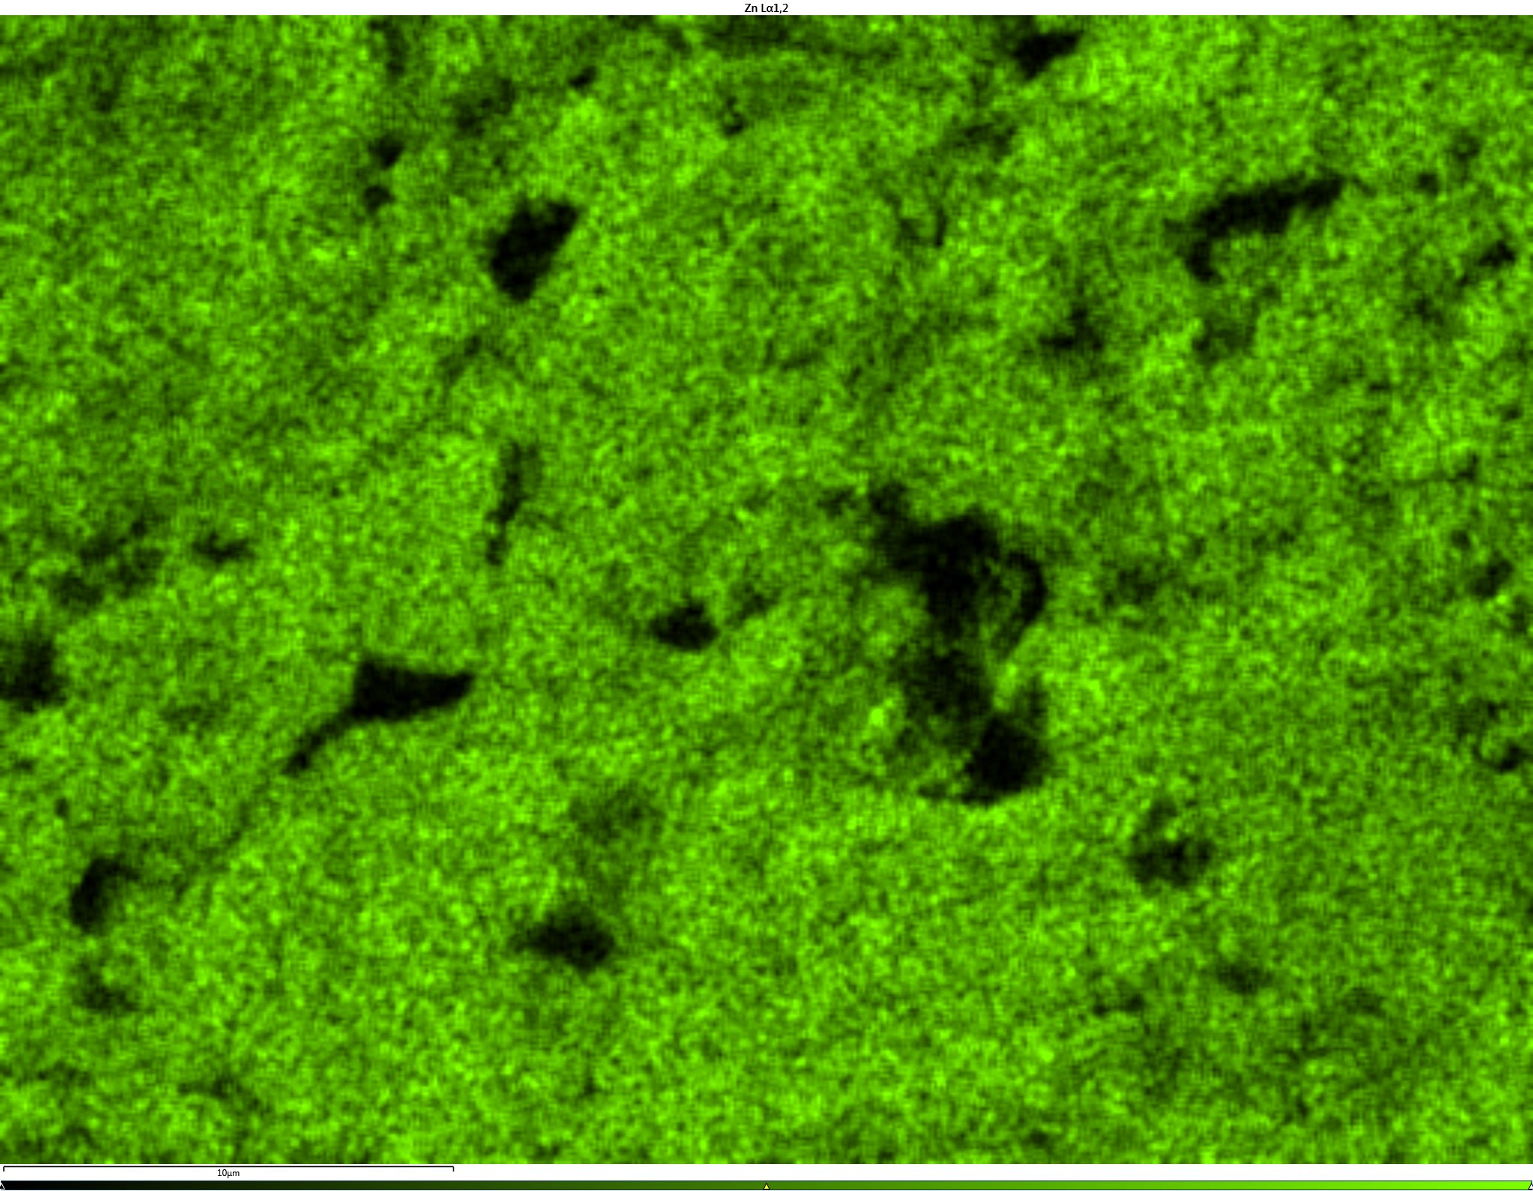
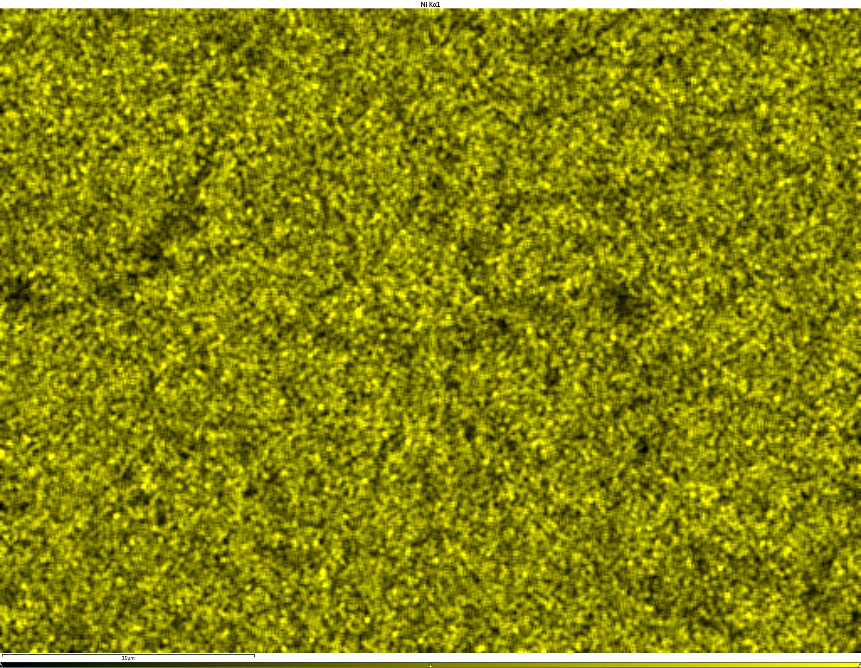
SEM result for five mixture resintered at 700ºC
Co-K𝜶1
Secondary electron image(SE)
Cu-K𝜶1
Mg-K𝜶1
Zn-K𝜶1
Backscattered electron image(BSE)
Ni-K𝜶1

Slide 16
Conclusion
The SEM, XRD and magnetization data all indicate segregation of CuO when resintering single phase FCC material at 700ºC.
There is an interplay between structural and magnetic behavior.

Slide 17

Thanks for Your Attention

