Slide 1
Observation of [some] local ionospheric anomalies and how they affect our understanding of coupling
Jean-Pierre St-Maurice
ISAS, U of Saskatchewan

Slide 2
Background
A look back at some intriguing problems I tackled over the years
What is an observation anomaly anyway?
Two themes of interest selected here
  A bread and butter plasma mode at low frequencies: ion-acoustic waves. How does it evolve from stable to unstable, to puzzling?
  E region electron temperatures and what they have to say about electric fields parallel to the geomagnetic field

Slide 3
What is an observational anomaly anyway?
Could be a rare occurrence but otherwise just an extreme case of a well known phenomenon
Could be something totally unexpected but that we have now seen enough to feel we have a reasonable understanding.
Could even be something that we have come to expect but for which we are unsure about in terms of mechanisms

Slide 4
Theme 1: ion –acoustic waves

Slide 5
Ion-acoustic waves
Ion-acoustic (Cs) waves are constantly excited in thermodynamic equilibrium.
  They are damped more slowly than other waves. We use this to our advantage in ISR radars to infer Te, Ti, the plasma density and the Doppler shift of the medium
  In thermal equilibrium with Te=Ti, the waves are damped in 2 or 3 oscillations. Damping is less if Te>Ti.
Large amplitude Cs waves are seen in the E region if E/B exceeds Cs. This simple fact has taken decades to be explained properly
Along the B field, also see bursts of large amplitude Cs waves

Slide 6
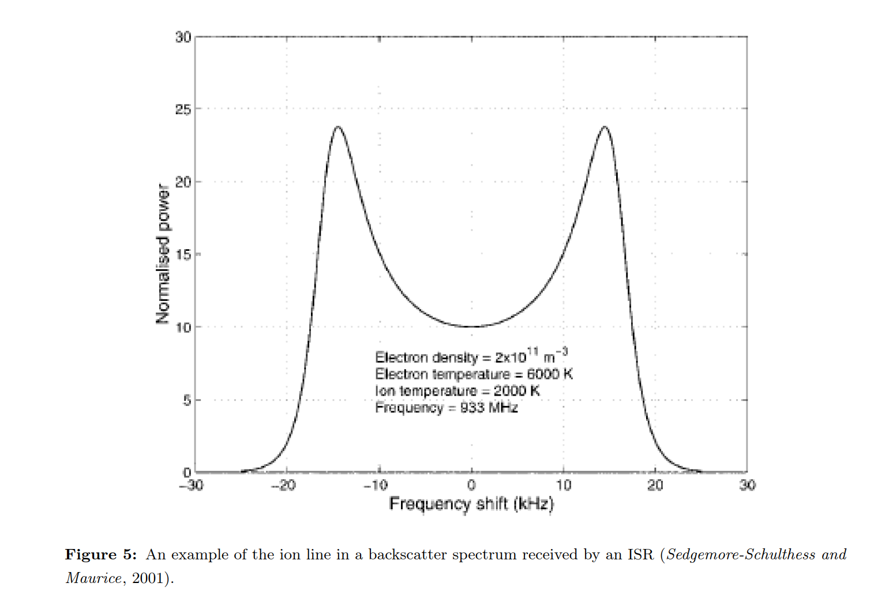
Typical ion-acoustic wave spectrum near thermal equilibrium

Slide 7
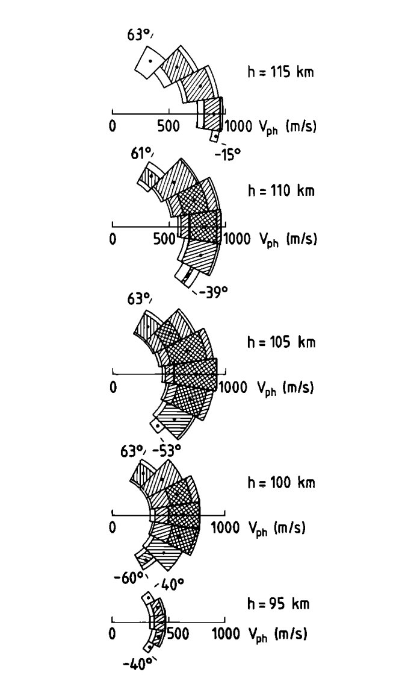
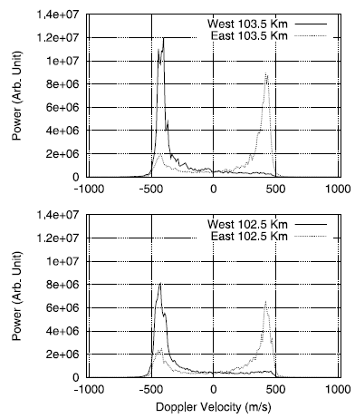
E region observation of Cs waves. The phase velocity should have been faster to much faster, according to maximum growth rate determination

Slide 8
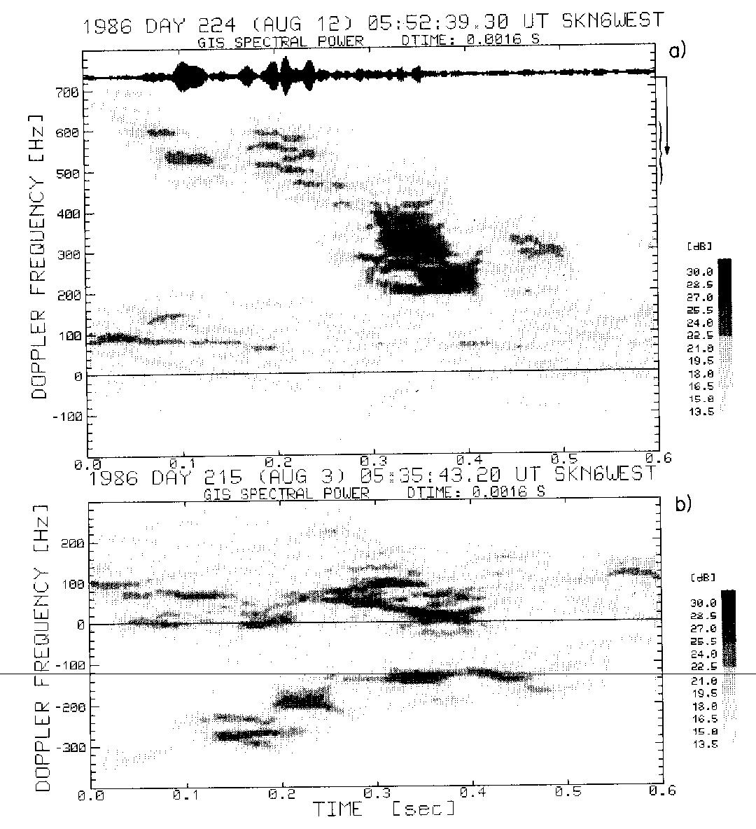
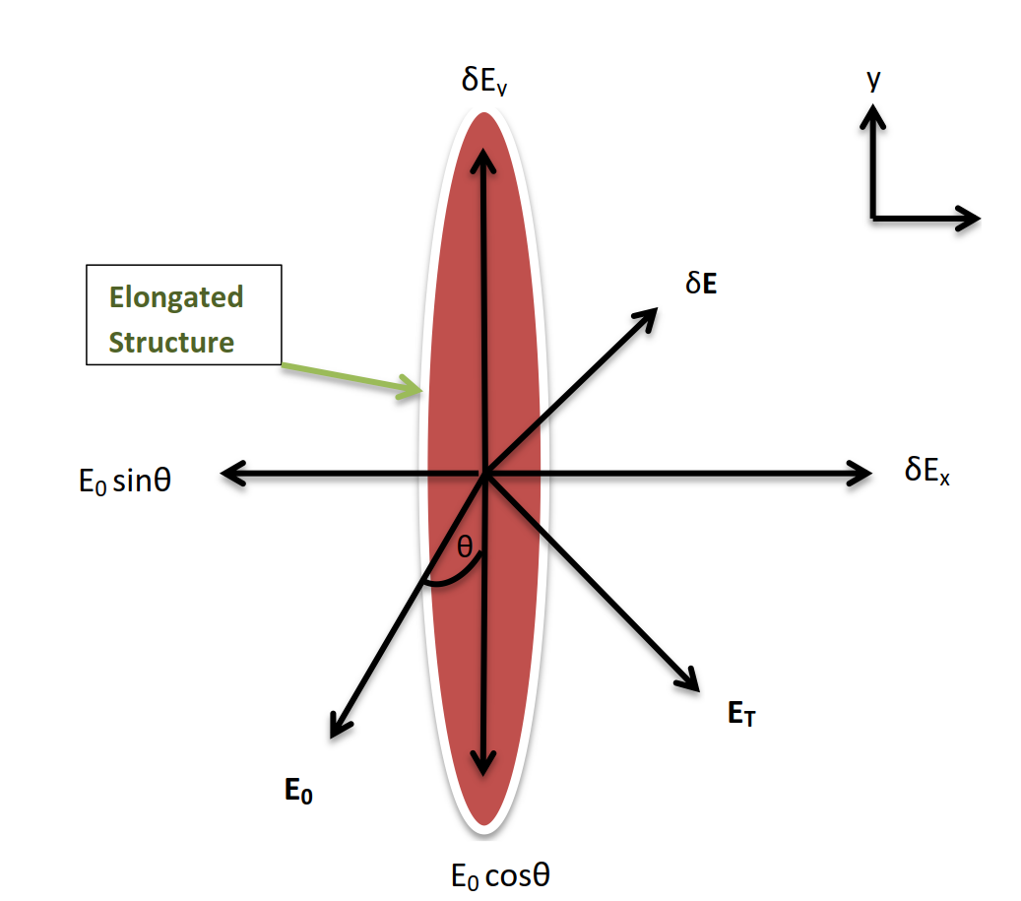
Why the unstable E region waves move at the threshold speed Cs at max amplitude
Inside unstable elongated structures a secondary electron Hall current flows along the long axis until a polarization reaction electric field is set up, which grows with the amplitude of the density structure. Net field goes down until the structure is quasi-stable
Prikryl et al, JGR, 1988; 50 MHz
(also see PSS, 1990)

Slide 9
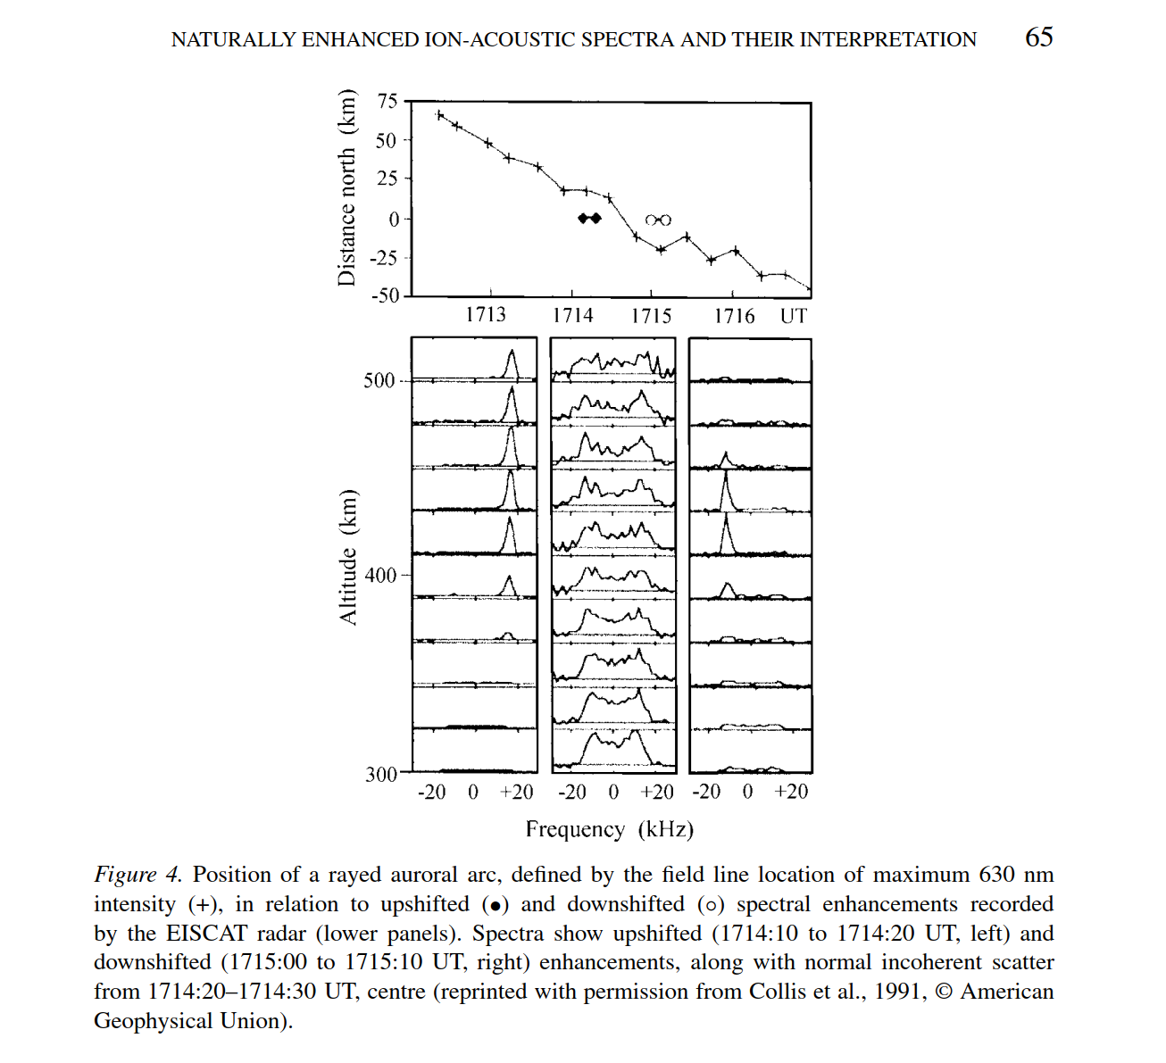
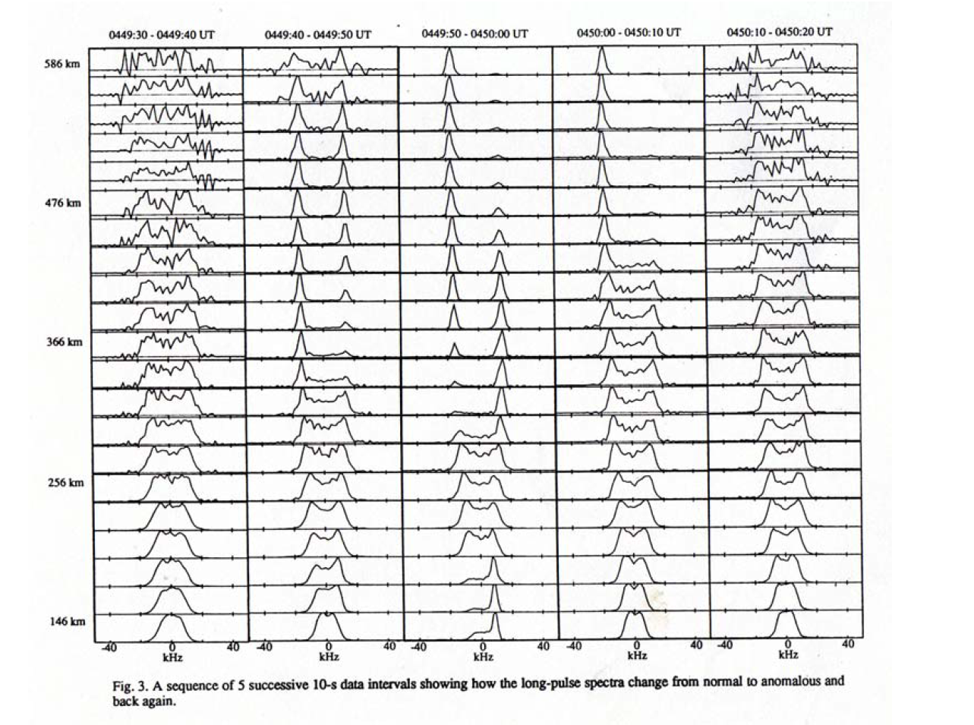
Large amplitude Cs have also been seen along B
From Rietveld et al, JGR, 1991

Slide 10
2 explanations for Cs along B
Thermal electron drifts going at a speed of order of the electron thermal speed (100 km/s) trigger a 2-stream instability
  Explains connection with position on the edge of intense precipitation structures
  Explains change in sign on each side of precipitation structures
Electron fluxes at the right energy produce Langmuir turbulence, which triggers Cs waves through modulation

Slide 11
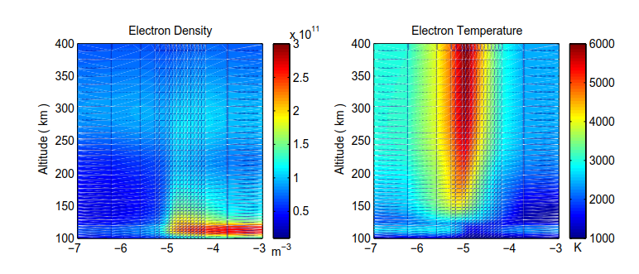
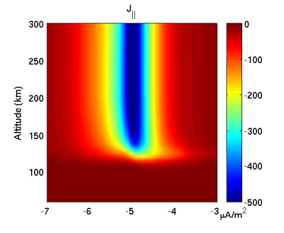
Parallel current mechanism
Electrons are pushed on one side of a precipitation region. If the precipitation and attendant conductivity has a sharp cutoffs, the parallel currents can have very high densities. The sign of the parallel current changes on each side of the precipitation region. This mechanism works well for Cs structures adjacent to precipitation regions (from Noel et al, 1999).

Slide 12
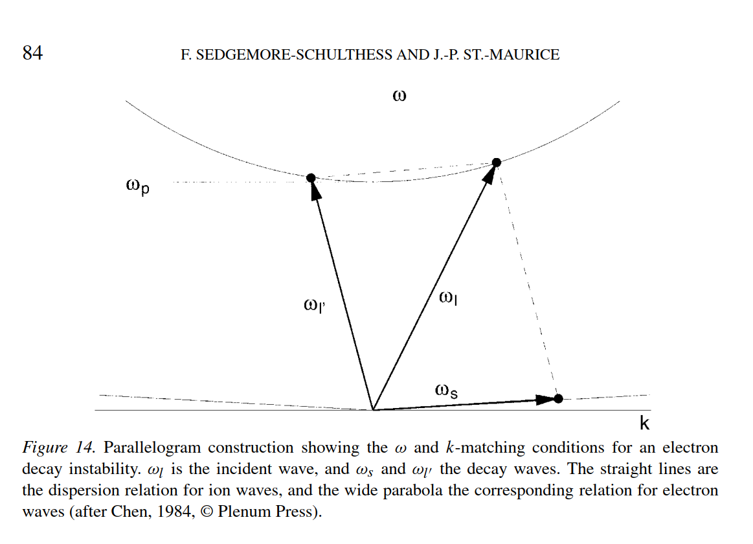
Langmuir turbulence mechanism
We know that electron fluxes with energies in the tens of eV can generate Langmuir turbulence and that Langmuir turbulence can easily produce ion-acoustic waves through mode-coupling, as shown here.
This mechanism should work in the center of intense precipitation regions

Slide 13
Theme 2: hot E region electrons

Slide 14
Rare but very interesting large excursions in the E region electron temperature
Background:
  Below 130 km, Te=Tn is the norm
  Reason: standard heating rates from photoionization (via photoelectrons) or from energetic precipitation are not enough to increase Te by much because inelastic cooling rates are very high compared to elastic cooling rates.
    Indeed: observations and calculations show that below 130 km electron precipitation does not introduce large departures of Te from Tn
  HOWEVER: at high latitude we see Te goes up with the ambient E field but only below 120 km. At low latitudes in early evening hours Te also goes up in the E region when/where Ne is small

Slide 15
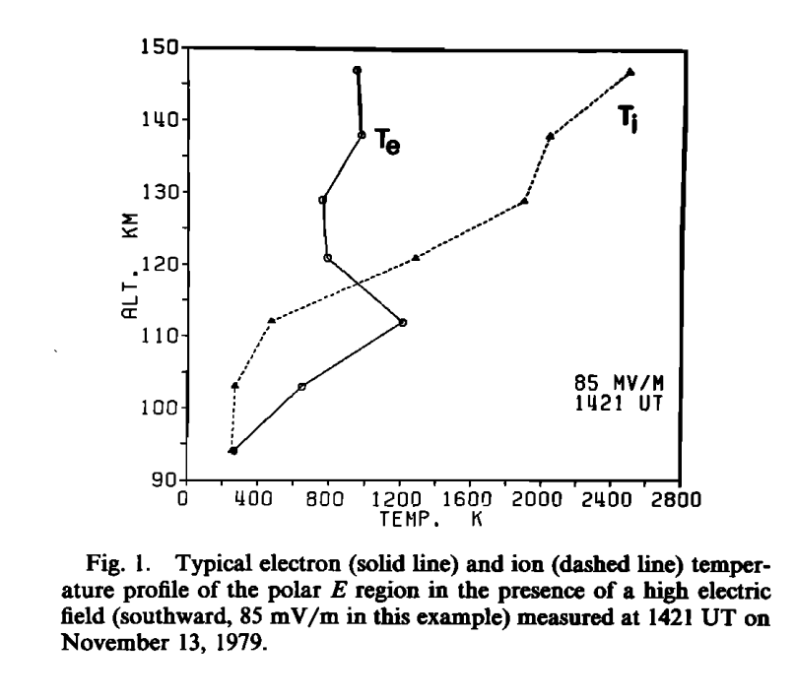
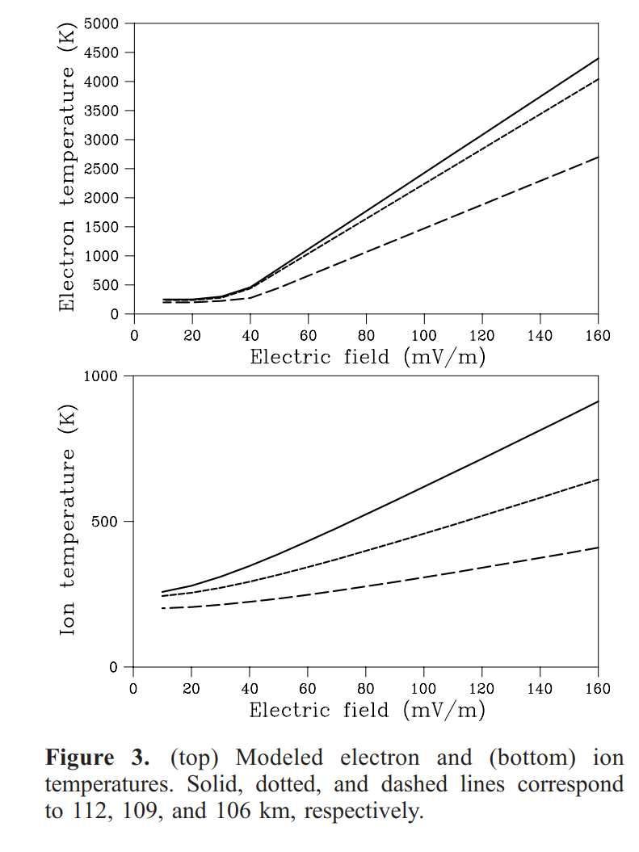
High latitude E region Te and perpendicular electric fields
From Schlegel and St-Maurice, JGR, 1981
From Bahcivan, GRL, 2007

Slide 16
Origin of High Te at high latitude
The same unstable Farley-Buneman waves that produce Cs waves perpendicular to B also dissipate through parallel E fields.
  The parallel electric fields increase monotonically in time
  Electrons get their heat from the electrostic enegy of the large amplitude structures.
Important: the perpendicular evolution leading to Cs at max amplitude is much faster than the parallel electric field evolution

Slide 17
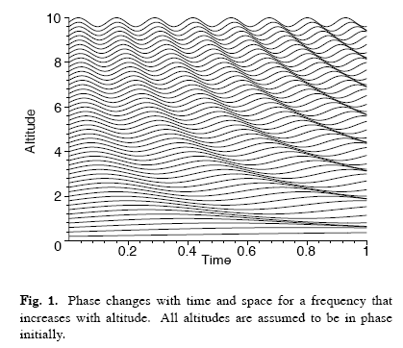
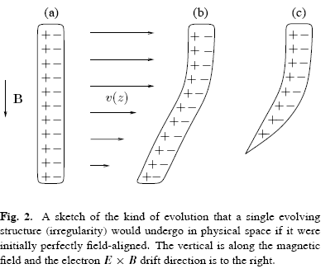
Nonlocal effects: eigenfrequency depends on altitude: aspect angle must grow and E_{ll} with it
Fourier space description
What happens in real space: shears

Slide 18
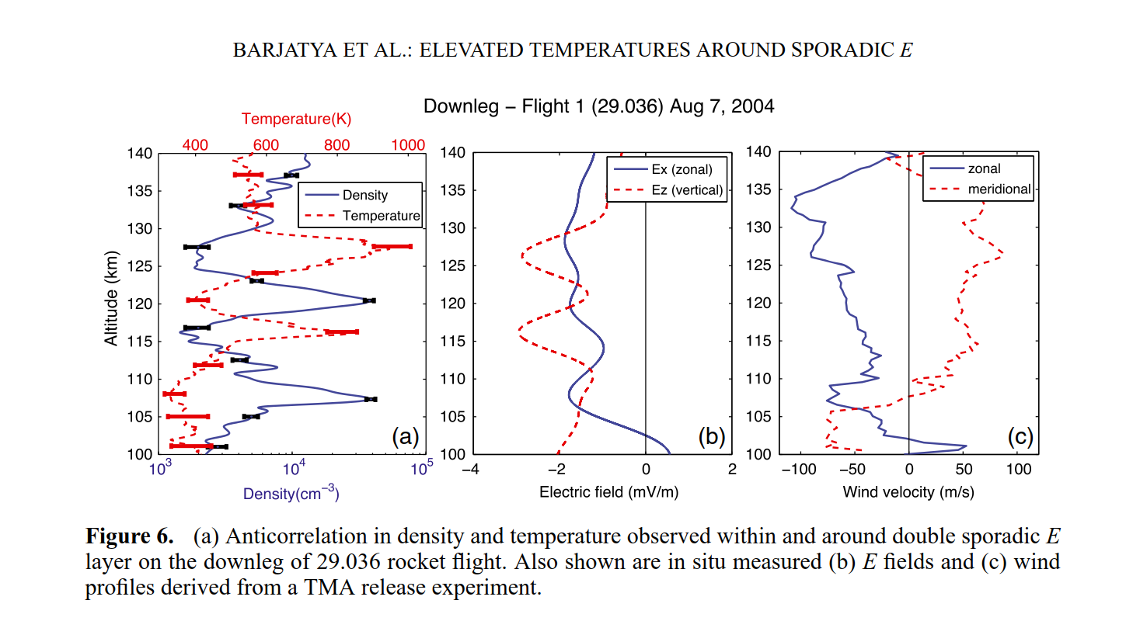
Large E region Te at lower latitudes at dusk
Es layer short circuit the F region dynamo. Top E layer produced by diverging ion currents. Relatively small current densities push electrons at 2 km/s along the B field because of the low density. We end up with friction induced by parallel electric field from Es and/or F region dynamos.

Slide 19
What I would take home from this talk
Simple electrostatic ion-acoustic waves can give us Te, Ti, Ne and Doppler shift when the waves are in near-thermal equilibrium with the plasma
When destabilized the perpendicular Cs waves change Te and conductivity at the basis of the magnetospheric boundary layer. This may have fundamental implications in the coupling with the magnetosphere
When Cs waves are destabilized along the B field, there has to be large localized electron fluxes and probably much larger current densities than average.
Very small electron densities at low latitude reveal that unexpected parallel currents are flowing from Es layers and/or night time F region dynamos.
  Hummmmmm: maybe there are more parallel currents than meet the eyes in our ionospheric system. Example: Japanese colleagues have long stated that electrons get hot at the heart of the Sq current system (not a bad place to generate parallel currents in fact).

