Slide 1
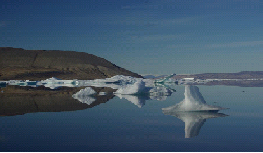
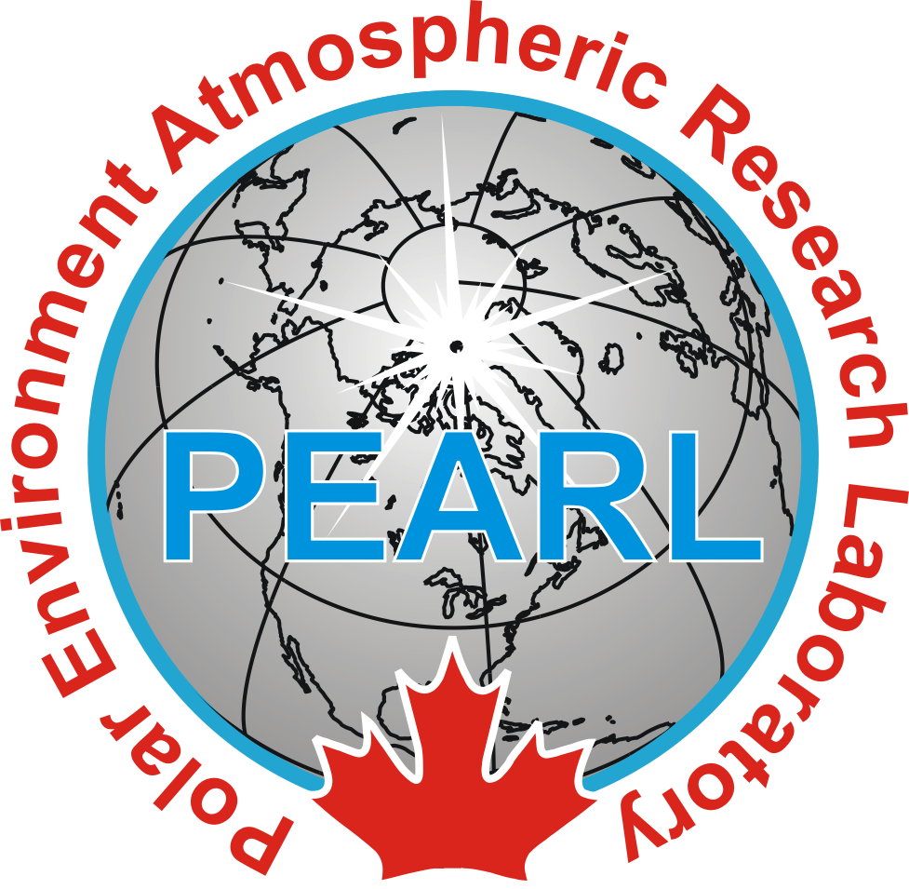
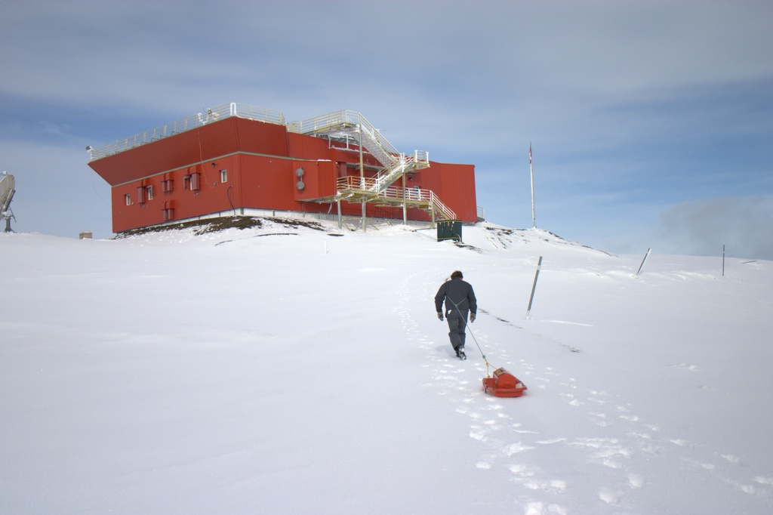

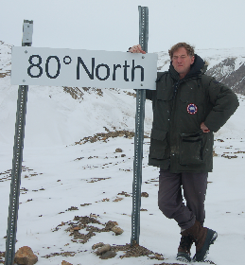
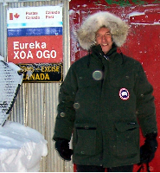

Atmospheric Research in the High Arctic: The PEARL Experience

Slide 2
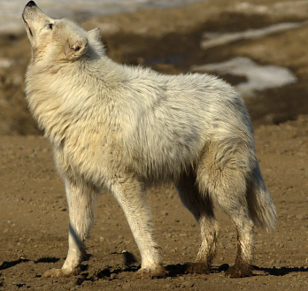
PEARL Science Team
Prof. James R. Drummond, Dalhousie U./U. of Toronto (Principal Investigator)
Prof. Kimberly Strong, University of Toronto (Deputy Principal Investigator)
Prof. Jean-Pierre Blanchet, Université du Québec à Montréal
Prof. Rachel Chang, Dalhousie University
Dr. P. Fogal, University of Toronto
Prof. Patrick Hayes, Université de Montreal
Prof. W. Hocking, University of Western Ontario
Prof. Alan Manson, University of Saskatchewan
Prof. Norman O'Neill, Université de Sherbrooke
Prof. Marianna Shepherd, York University
Prof. Robert Sica, University of Western Ontario
Prof. Kaley Walker, University of Toronto
Prof. William Ward, University of New Brunswick

Slide 3
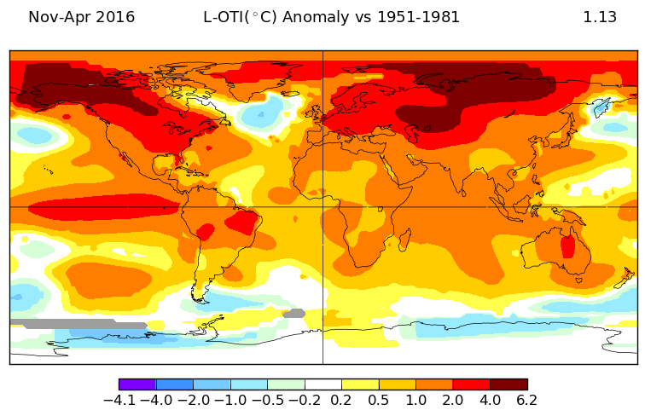
Global Temperature Trends
Present Day Surface Temperature Anomaly (°C) (1951-1981 baseline)
Notes:
-Global Temperatures have increased significantly in the last several decades, especially in the Arctic as shown in the figure (explain figure)
-Through the water vapour feedback effect, Water Vapour increases with temperature which further increases temperature since it is a greenhouse gas.
-Another reason for the larger warming in the Arctic is the decrease in sea ice due to increasing temperatures.
-Exposing more open ocean in the Arctic allows water vapour to be more easily uptaken by the atmosphere as well which further increases the influence the water vapour feedback effect.

Slide 4
The Need for Arctic Measurements
“Long-term monitoring of atmospheric composition at existing stations needs to be continued and integrated into a Pan-Arctic observation network…” Black Carbon and Ozone as Arctic Climate Forcers, Arctic Monitoring and Assessment Programme, 2015
“Focus should be given to … Establishing flagship observatories as part of this observing system of systems to provide comprehensive measurements over the entire Arctic region.” ICARP III Final Report, Integrating Arctic Research - a Roadmap for the Future, 3rd International Conference on Arctic Research Planning, IASC, 2016
US National Academy of Sciences report on The Future of Atmospheric Chemistry Research notes “the central importance of long-term research sites for comprehensive atmospheric chemistry research” (National Academies Press, 2016)

Slide 5
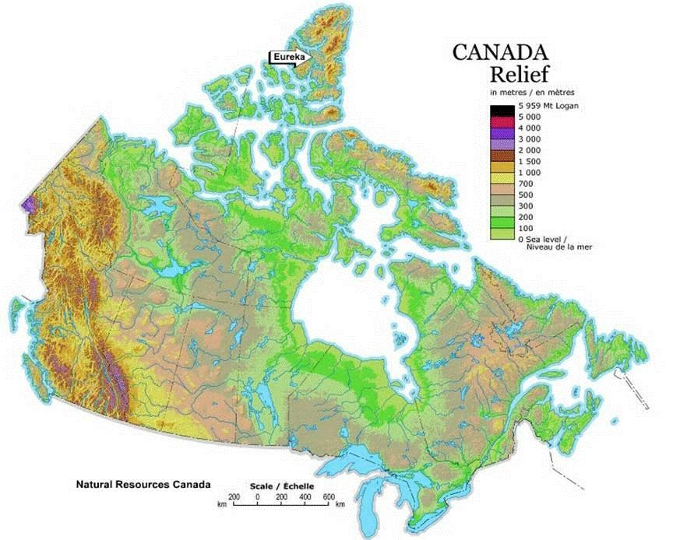



Alert
Halifax-Vancouver – 4,400km
Halifax – Eureka – 4,100km
Yellowknife – Eureka 2,000km
Resolute – Eureka 620km
Grise Fiord – Eureka 400km
Don’t forget your screwdriver!
PEARL/Eureka
Grise Fiord
Resolute Bay
Iqaluit
Yellowknife
Saskatoon
St. John’s
Edmonton
Sidney
Vancouver
Lethbridge
Rimouski
Winnipeg
Fredericton
Victoria
Dartmouth
Kelowna
Ottawa
Montreal
Toronto
Halifax
Notes:
It all starts South…

Slide 6
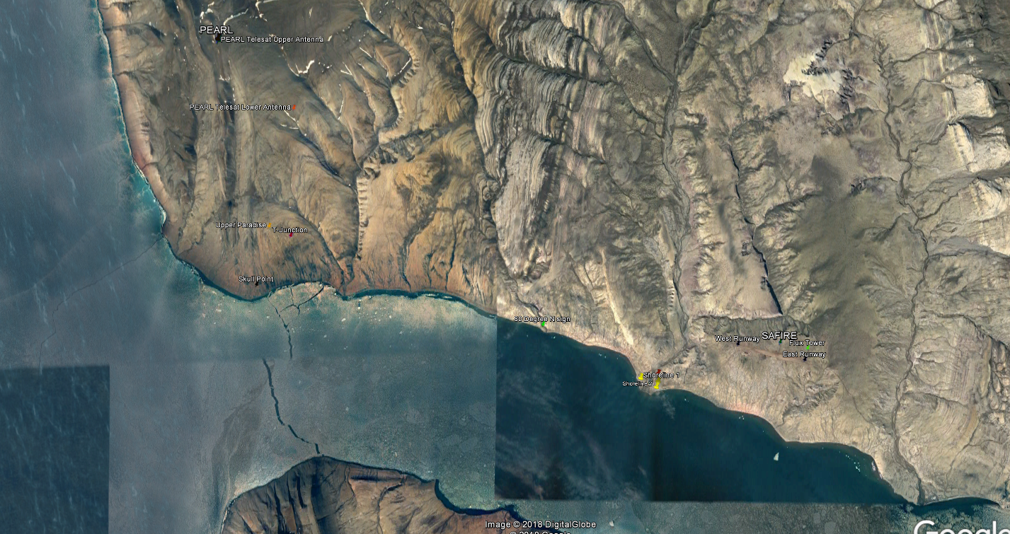
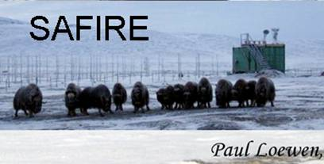
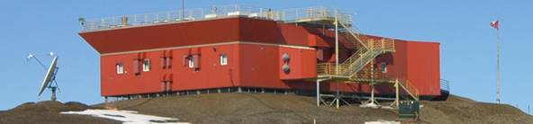
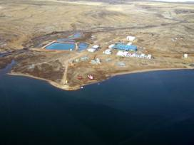
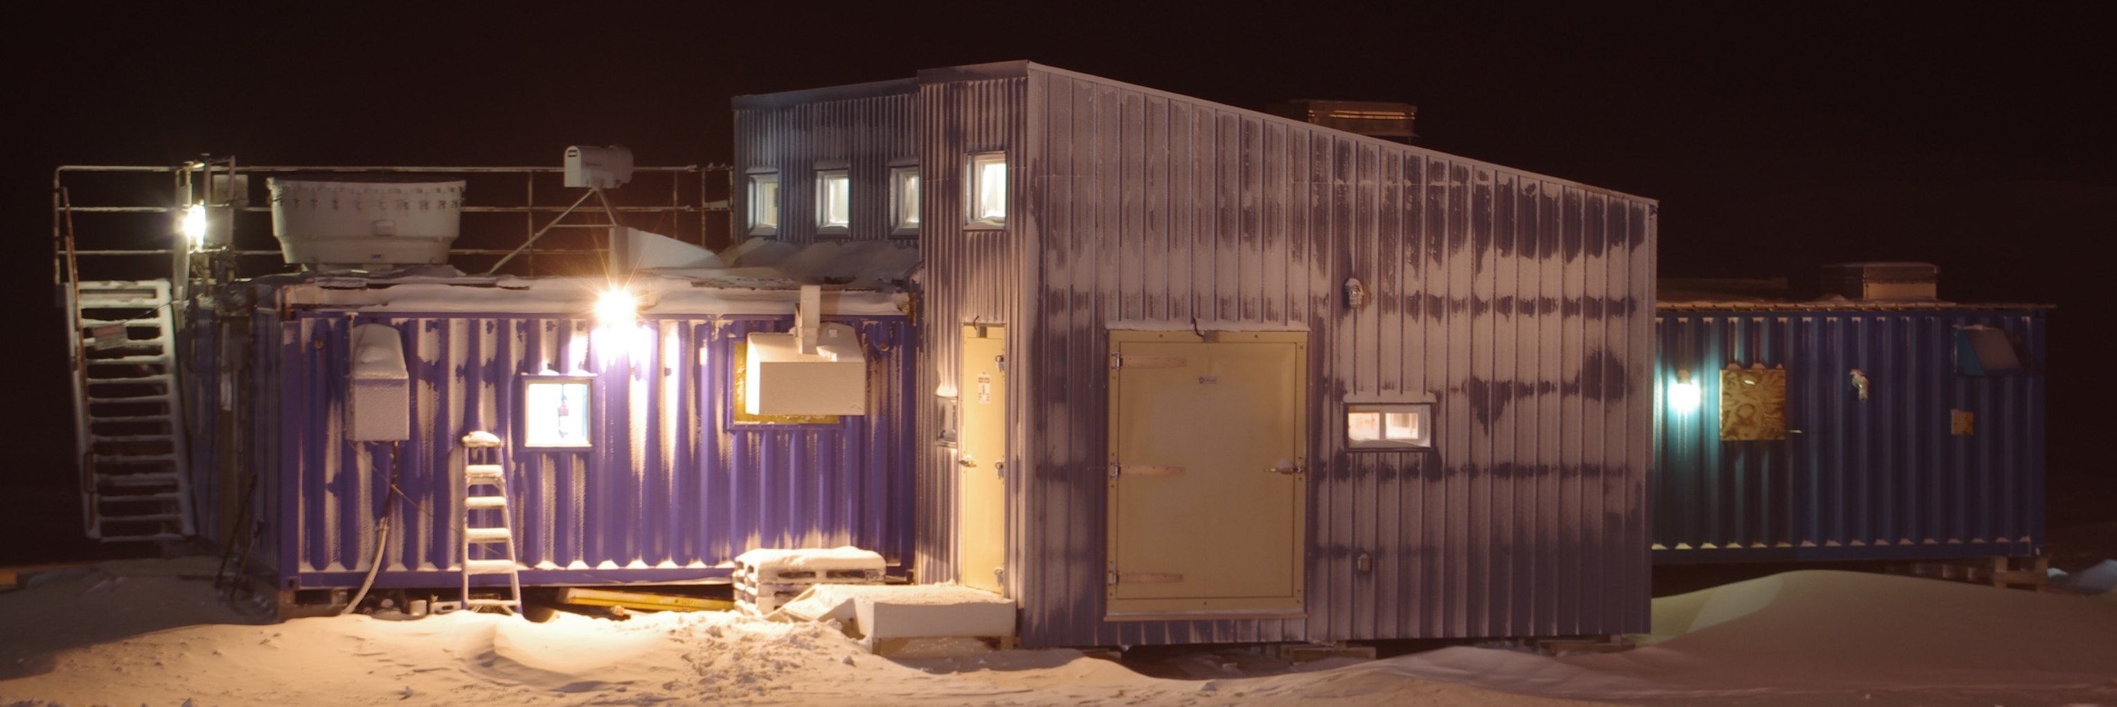
10km
Eureka Sound
Slidre Fiord
OPAL

Slide 7
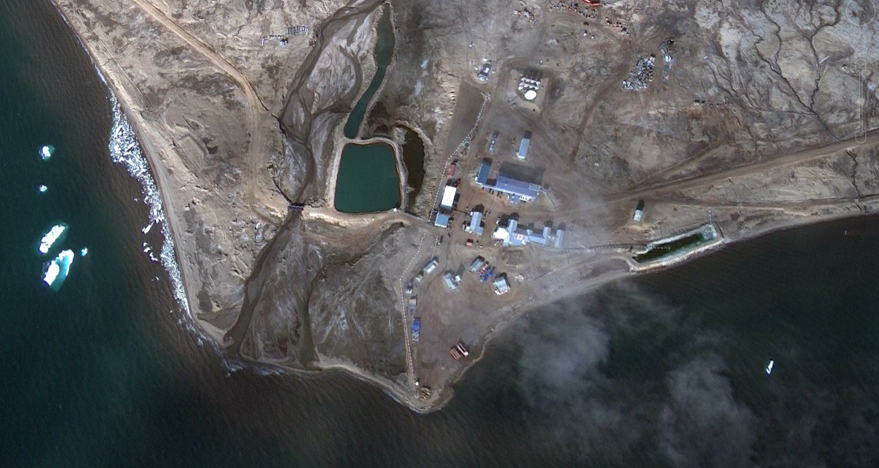
To Ridge Laboratory
Water Reservoir
Fuel Farm
Accommodation Block
To airport & SAFIRE
Diesel Generators
Sewage Lagoon

Slide 8
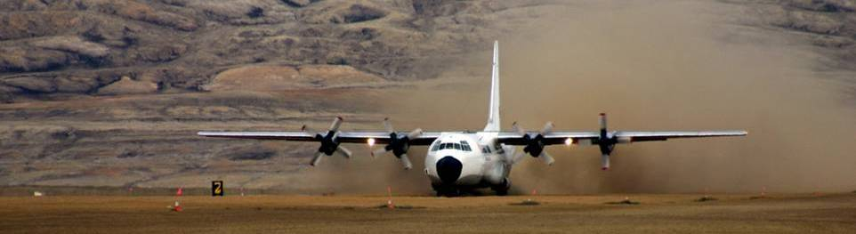
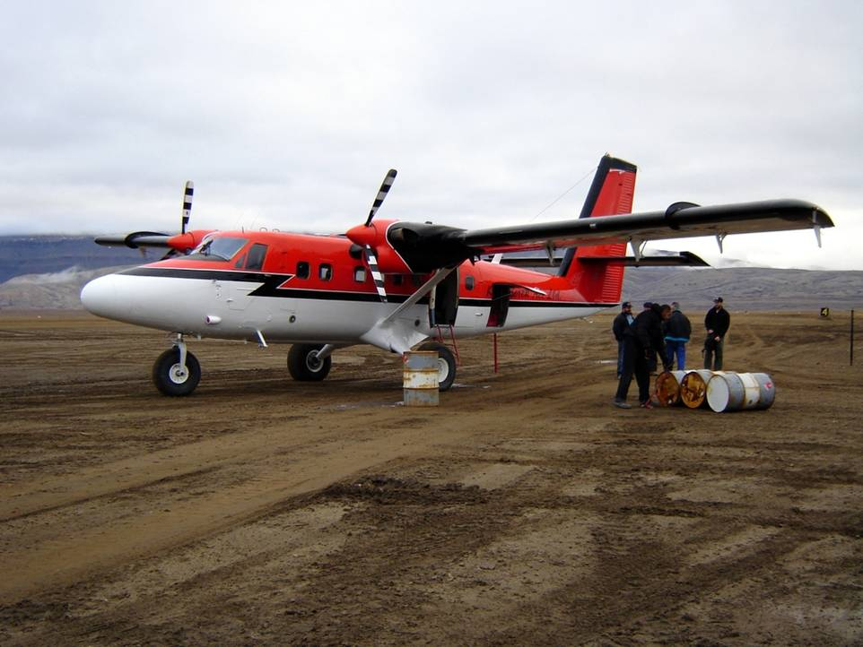
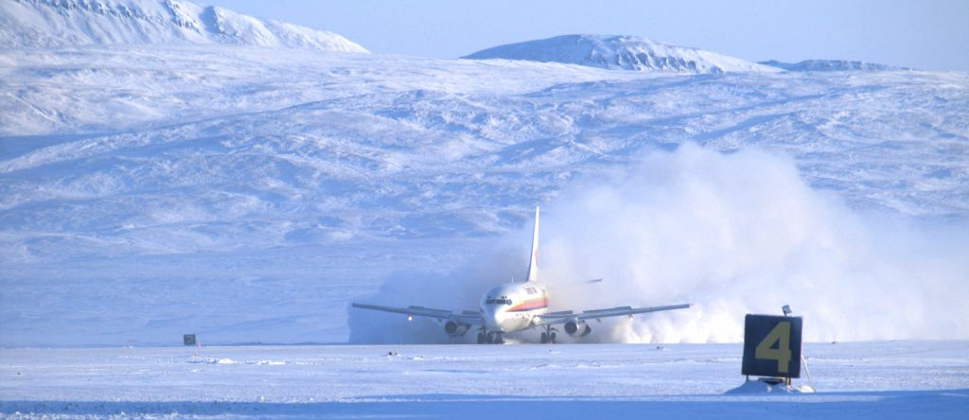
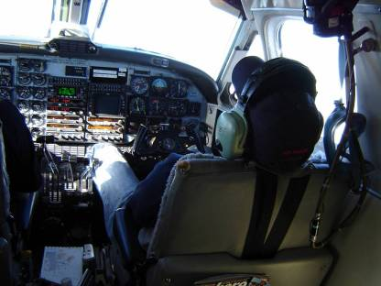
Getting There

Slide 9
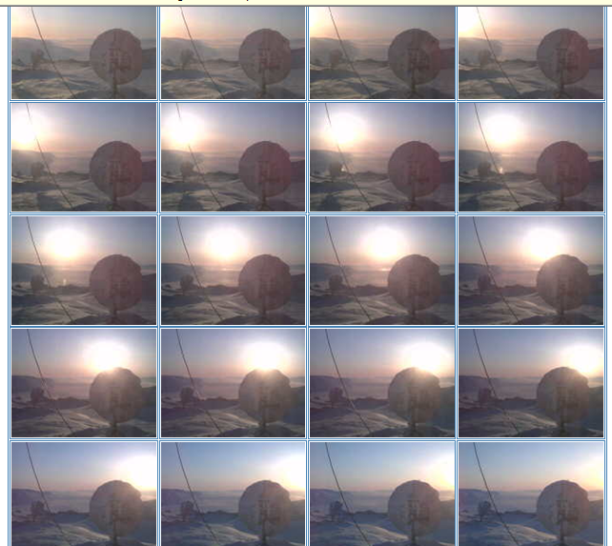
24 Hour Sunlight

Slide 10
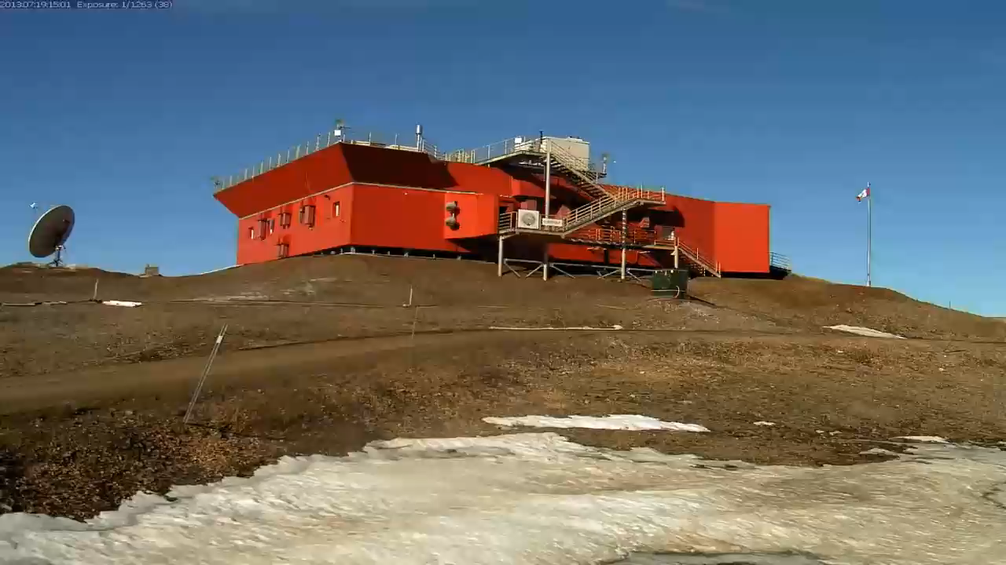

Slide 12
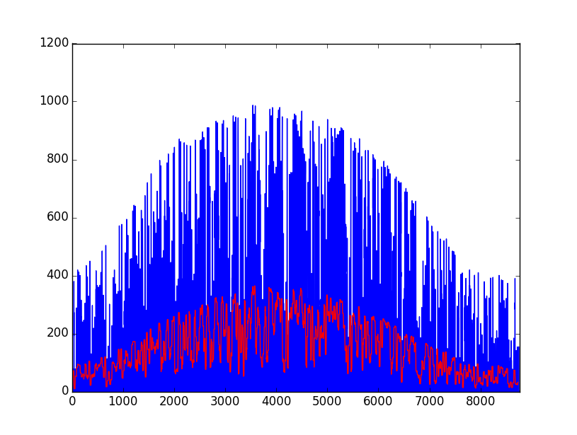
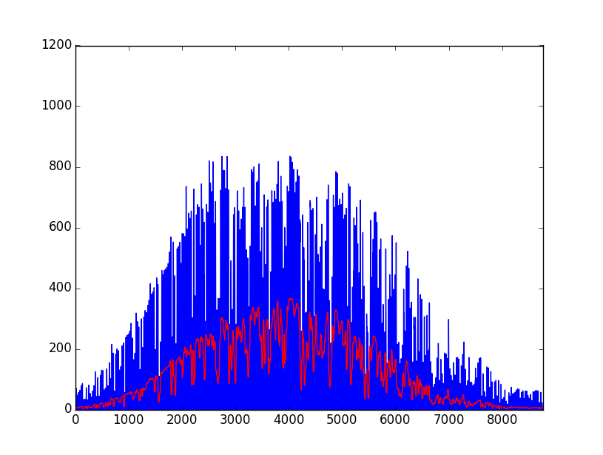
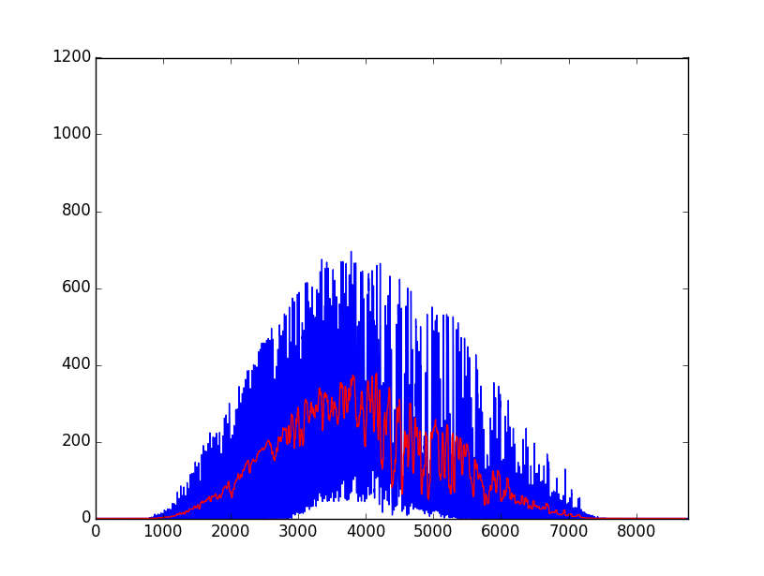
Insolation and Latitude
Halifax (44.6N)
Cambridge Bay (69N)
Eureka (80N)
W/m²
Blue – hourly average
Red – daily average
Time – 1 year

Slide 13
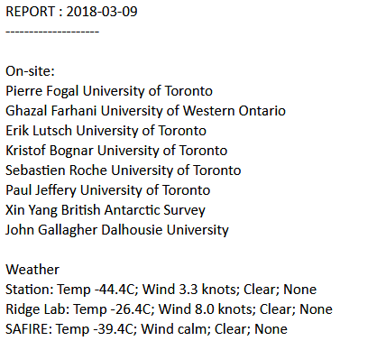
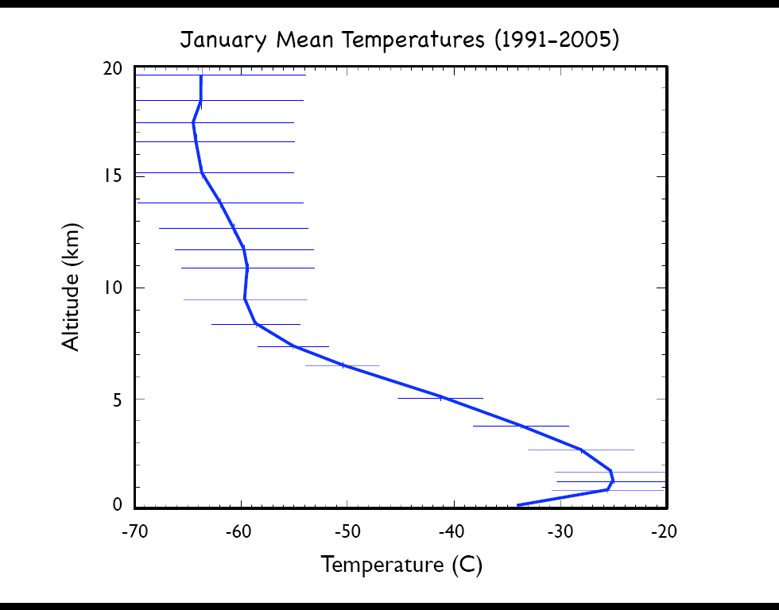
The Winter Inversion
Inversion Layer

Slide 14
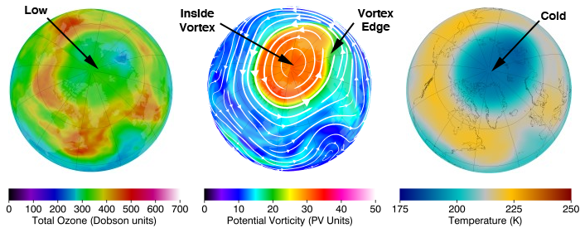
The Arctic Polar Vortex
22 February 2011
https://ozonewatch.gsfc.nasa.gov/facts/vortex_NH.html

Slide 15
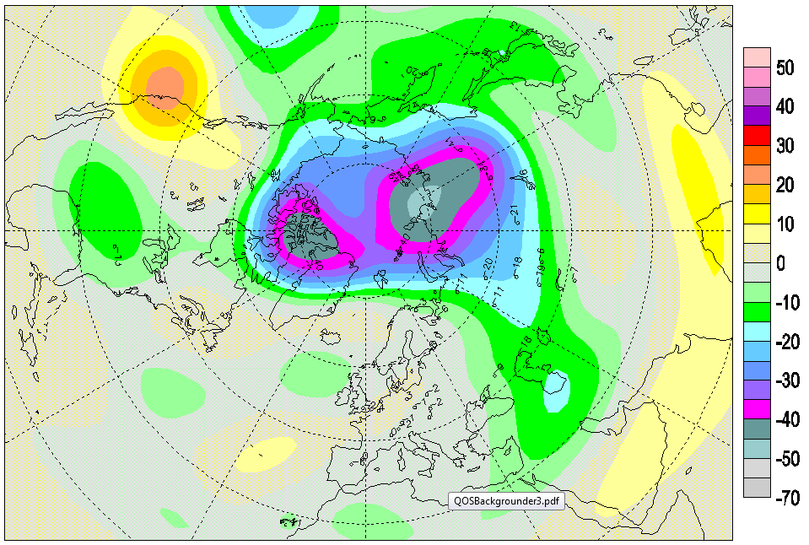
Ozone March 2011
PEARL

Slide 16
What are We Doing?
Addressing the issue of the variability of the atmosphere in the Canadian High Arctic.
Three major areas of research: Air quality, Ozone and Climate Change
Three major themes: Composition Measurements (CM), Polar Night (PN) and Satellite Validation (SV).
We have a comprehensive, well-calibrated set of measurements from the High Arctic that can be used in multiple ways to produce multiple outcomes.
Emphasis on the Polar Night

Slide 17
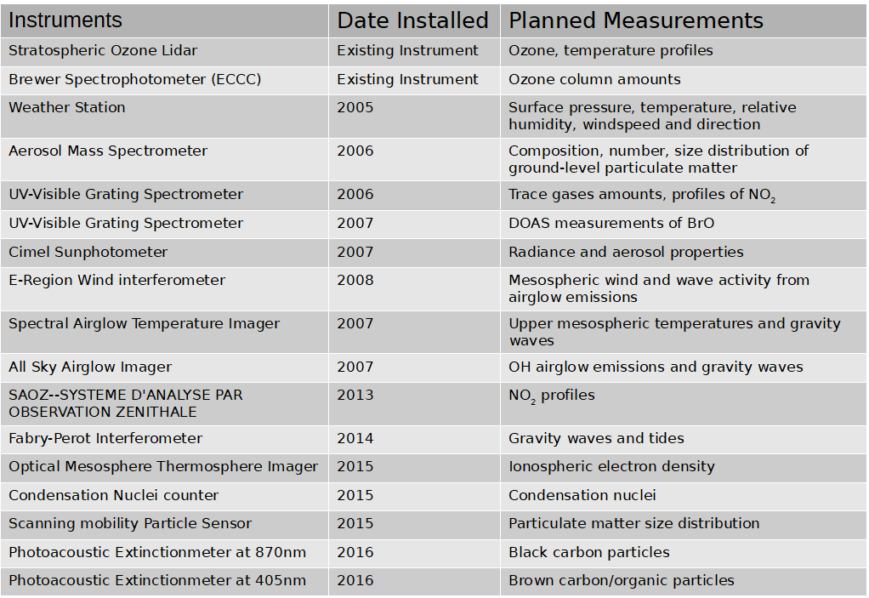
PEARL RidgeLab Instrumentation

Slide 18
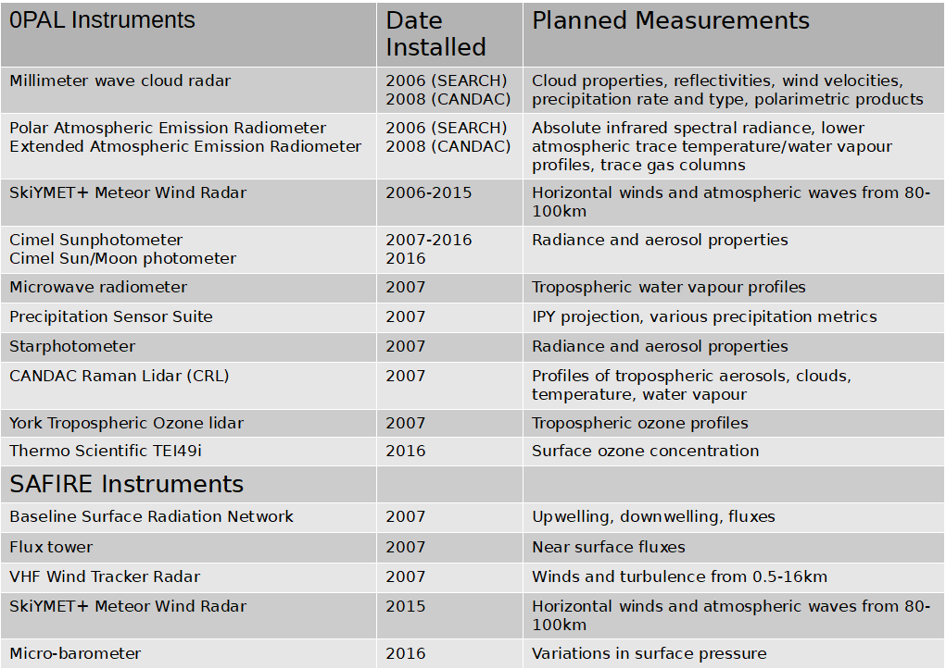
PEARL 0PAL and SAFIRE Instrumentation

Slide 19
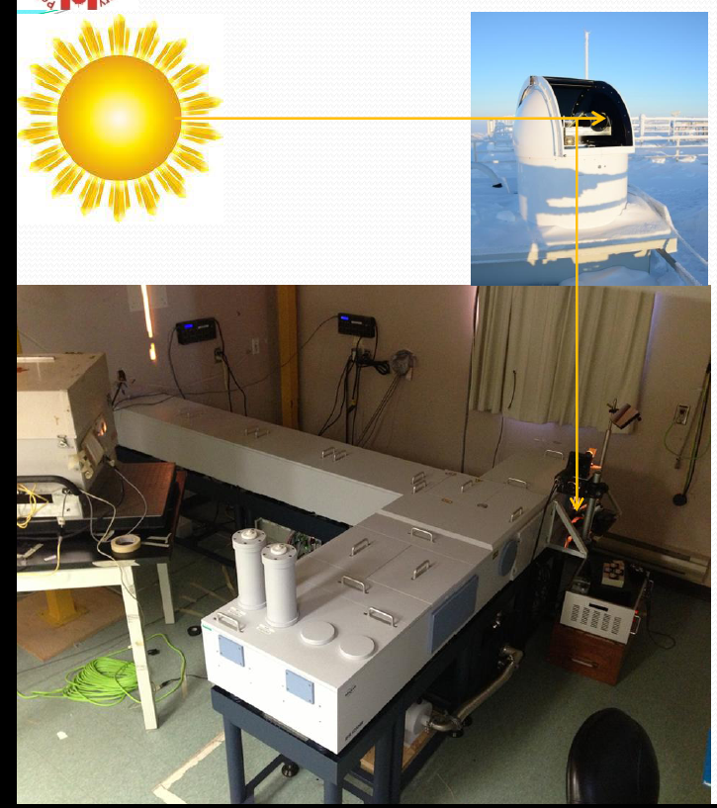
PEARL FTIR: Bruker 125HR
Fourier transform infrared (FTIR) spectrometer installed July 2006
  Replaced EC Bomem DA8, which was removed in 2009
Daily semi-automated solar infrared absorption measurements
  Late February to late October
Vertical profiles and columns of many gases retrieved
  O₃, NO, NO₂, HNO₃, ClONO₂, HCl, OClO, HF, N₂O, CFCs, CO, CH₄, C₂H₆, HCN, OCS, ...
Dan Weaver, Joseph Mendonca
Batchelor et al., JAOTech 2009; AMT 2010; Lindenmaier et al., JQSRT 2010; JGR 2011, ACP 2012; Viatte et al., Atmos-Ocean 2013; AMT 2013; ACPD 2014

Slide 20
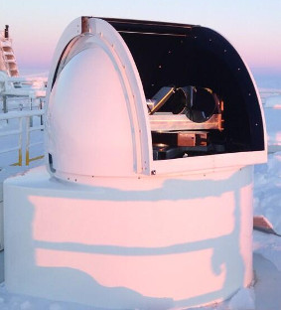
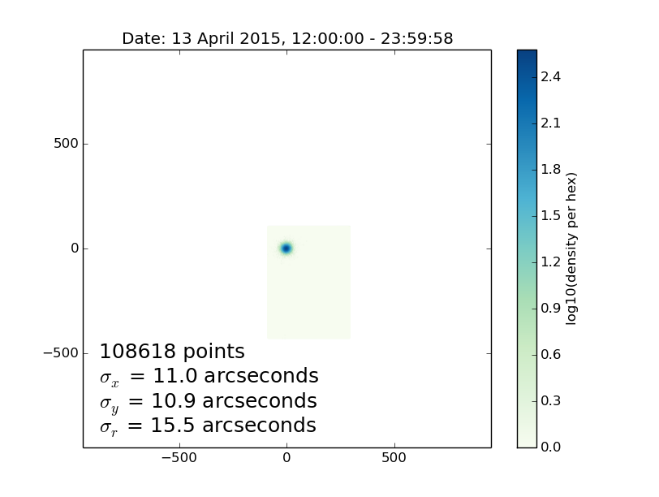
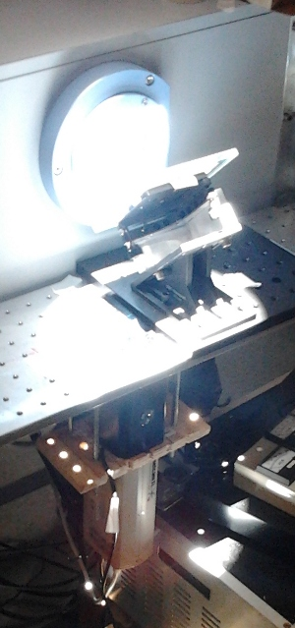
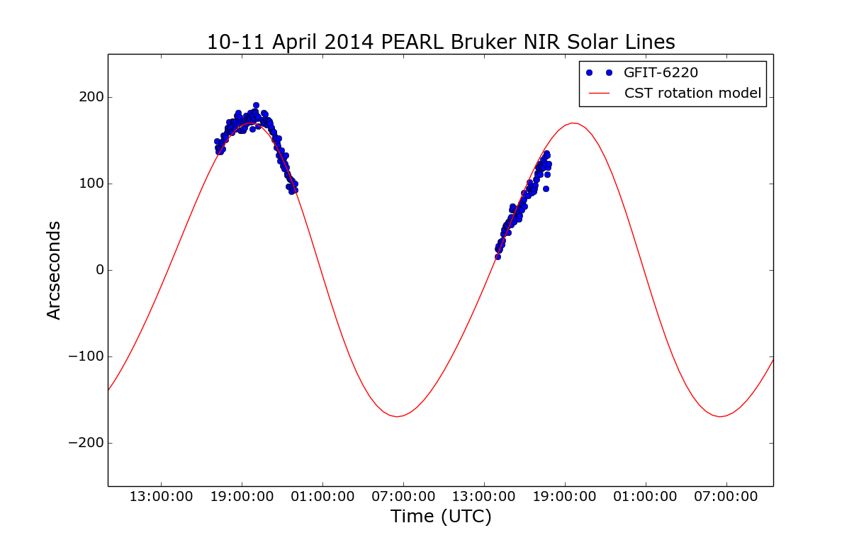
Sun-Tracker
Altitude-Azimuth platform
Ephemeris “passive” tracking with “active” corrections from network camera.
Protected by remotely operated RoboDome
Remote operation e.g. from the South
Transferable operation
  running for 24 hours at a time
Logs errors and provides estimate of accuracy

Slide 21
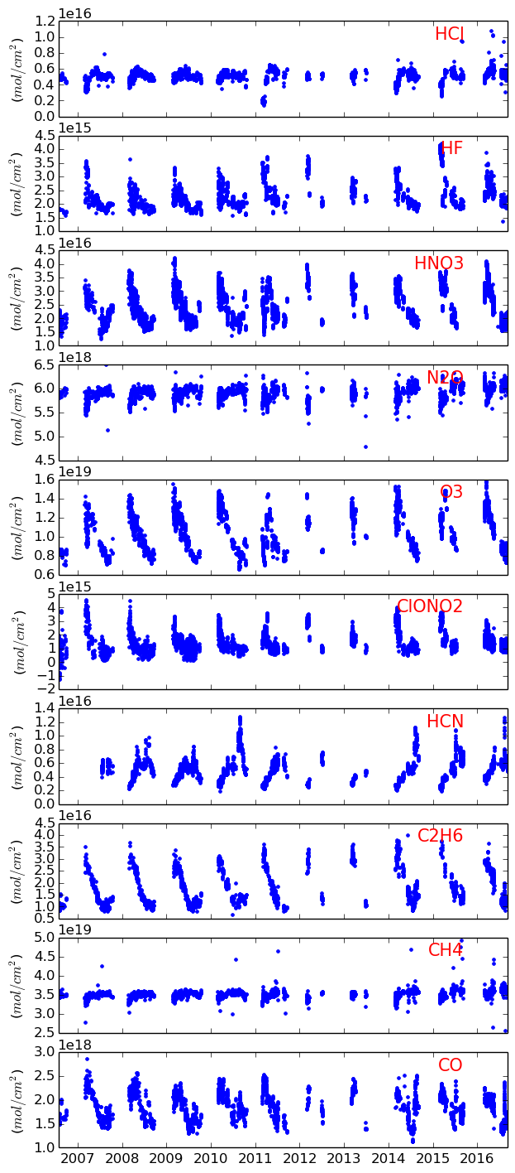
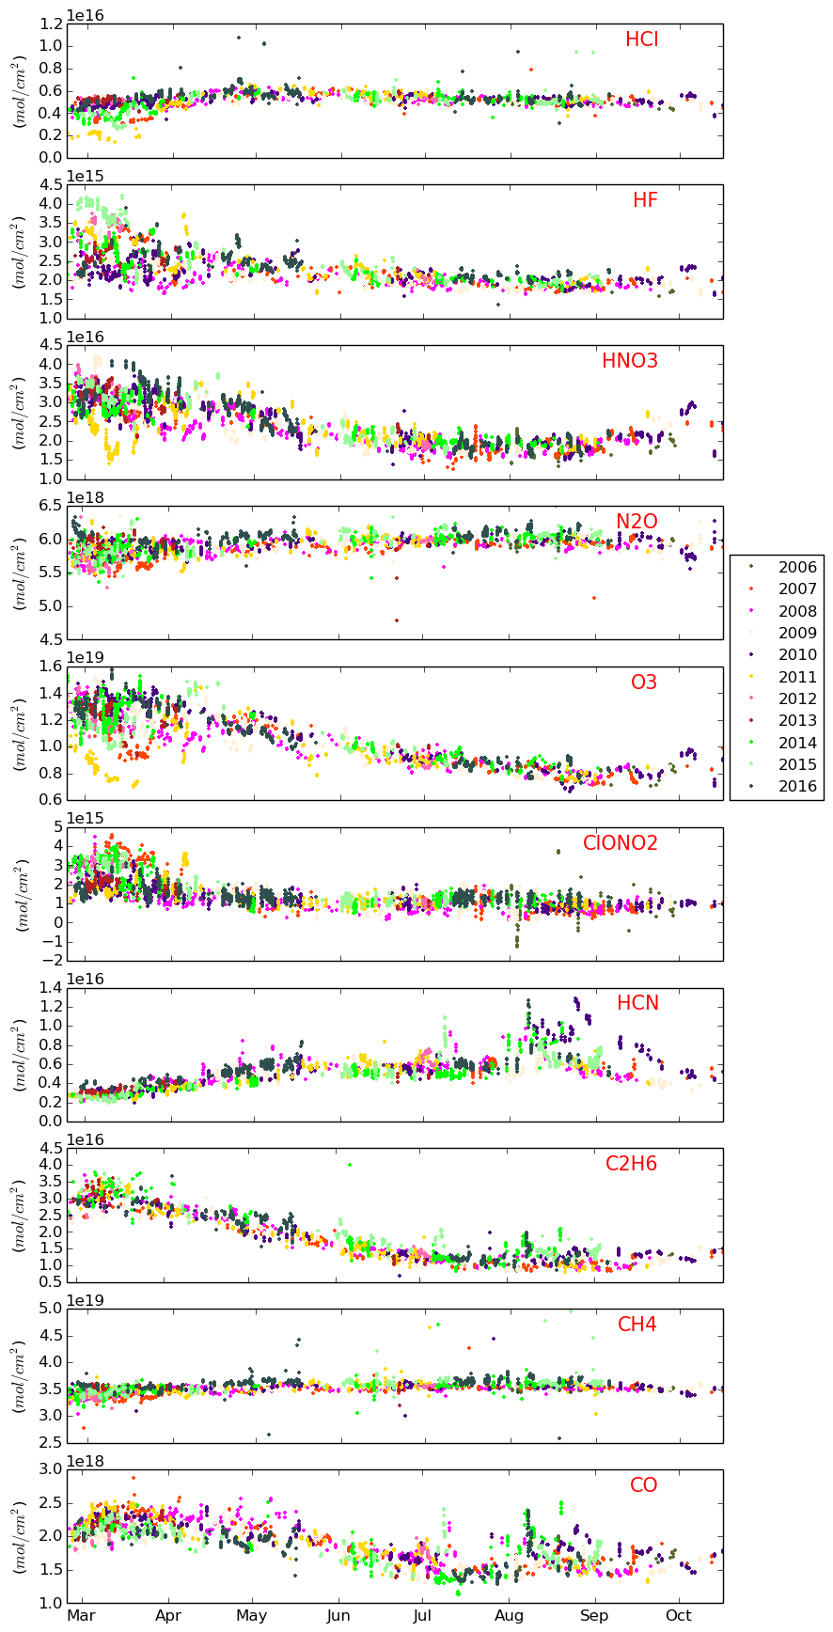
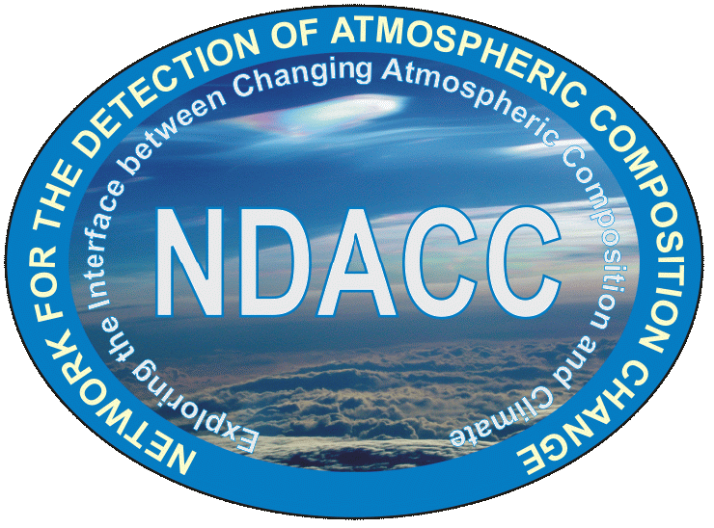
PEARL FTIR Time Series: 2006-2016
Total columns
Severe stratospheric ozone depletion in 2011
HCN enhancements due to 2010 Russian forest fires
Stephanie Conway, Erik Lutsch, Dan Weaver, Joseph Mendonca, Sebastien Roche, Camille Viatte, Rodica Lindenmaier, Rebecca Batchelor
Notes:
21

Slide 22
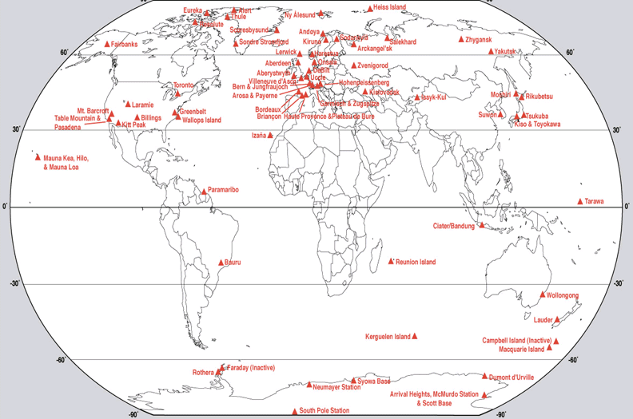
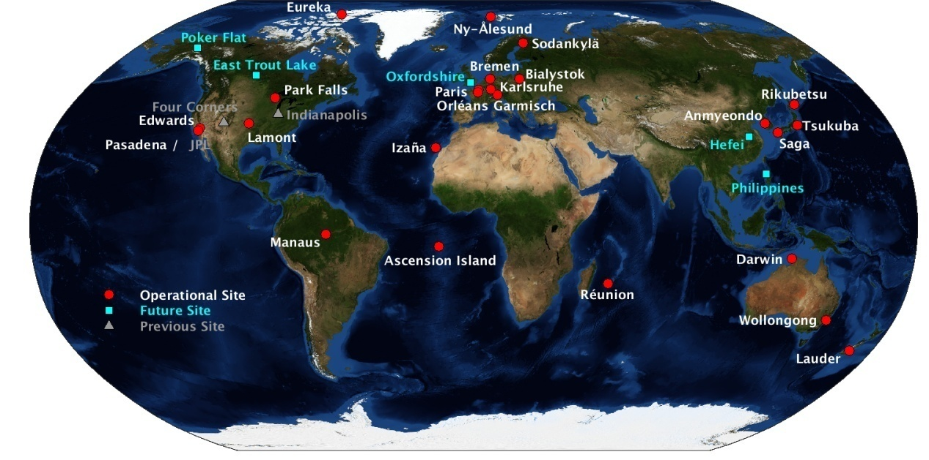
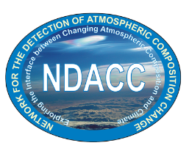
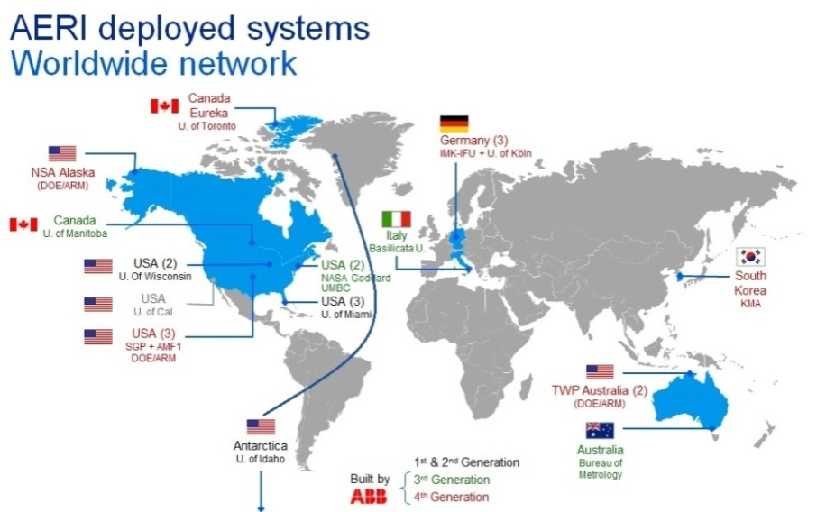
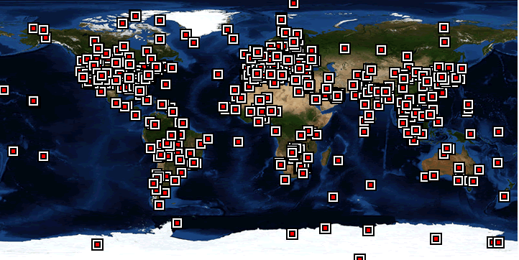
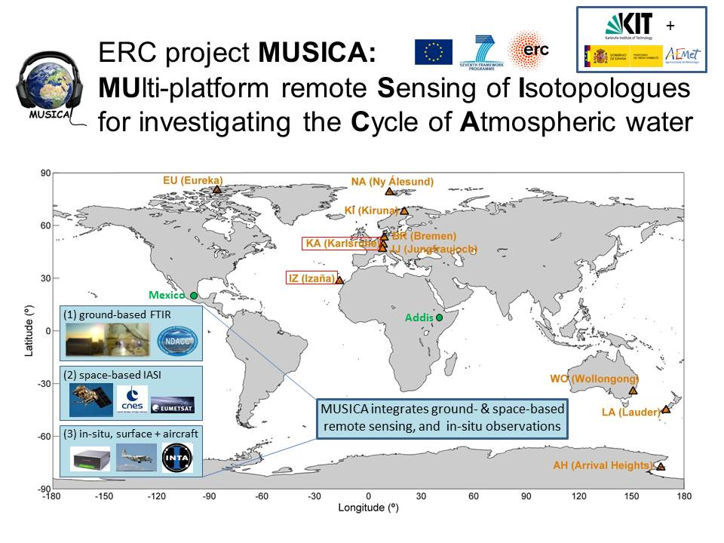


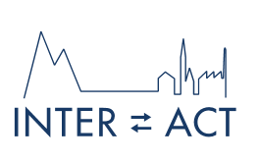
NDACC: Network for Detection of Atmospheric Composition Change
TCCON: Total Carbon Column Observing Network
Figure courtesy of ABB
www.ndacc.org
http://tccon.ornl.gov/
Figure courtesy of E. Sepúlveda, M. Schneider

Slide 23
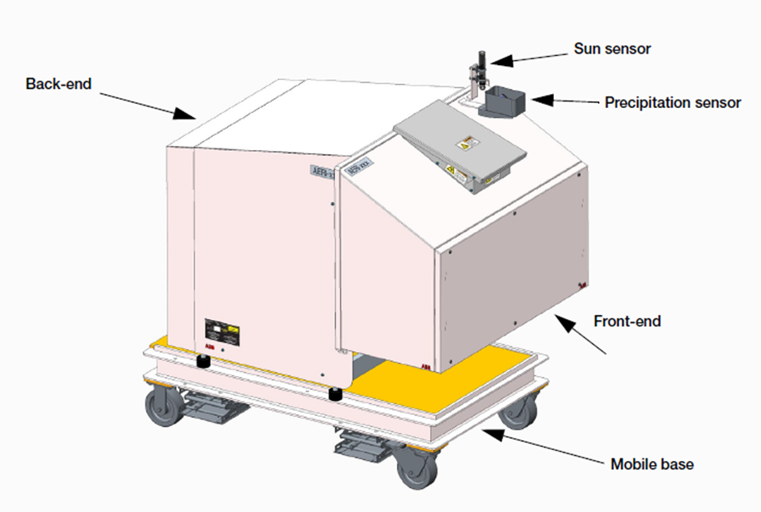
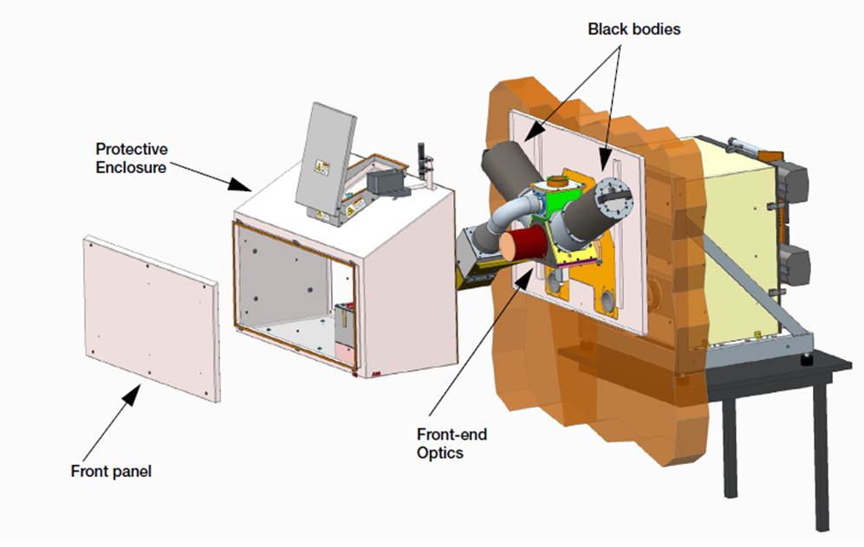
The Extended-Range Atmospheric Emitted Radiance Interferometer (E-AERI)
(Mariani et al., 2014)
(ABB Bomem)
Manufactured by ABB Bomem (Quebec).
Measures accurately calibrated downwelling infrared thermal emission from the atmosphere over a broad region of the infrared spectrum at high spectral resolution (1 cm⁻¹).
The E-AERI extends the spectral coverage range of a standard AERI (520-3000 cm⁻¹) to 400-3000 cm⁻¹ (3-25 µm). This spectral range includes the so-called “dirty window” (around 400 cm⁻¹, or 25 μm), where much of the infrared cooling occurs due to the dryness of air in the Arctic.
Spectra are recorded every 7 min, 24 hours a day, 365 days a year (precipitation permitting), independent of sunlight.

Slide 24
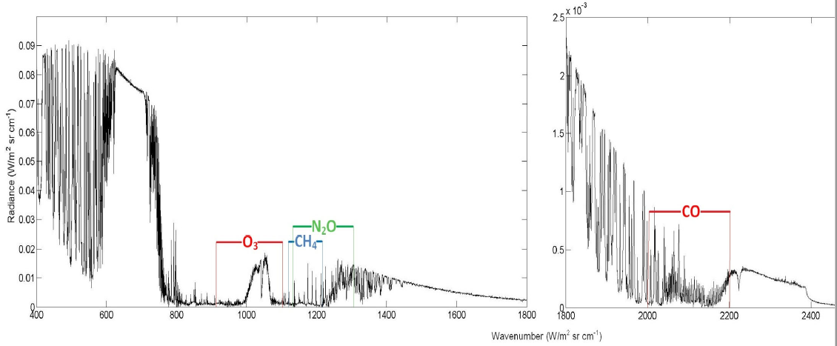
E-AERI Trace Gas Research: Introduction
The Arctic experiences prolonged periods of total darkness in the winter and continuous daylight in the summer, influencing its atmosphere and composition in ways that are still not fully understood.
Solar absorption Fourier Transform InfraRed (FTIR) measurements have improved knowledge of the atmospheric composition at Eureka but are limited to 8 months when the sun is up.
The AERI is sensitive to tropospheric trace gases and measurements are independent of sunlight.
Mariani et al. (2013) implemented the retrieval of CO, O₃, CH₄ and N₂O using AERI emitted radiance spectra.
Retrieval Windows, Mariani et al. (2012)

Slide 25
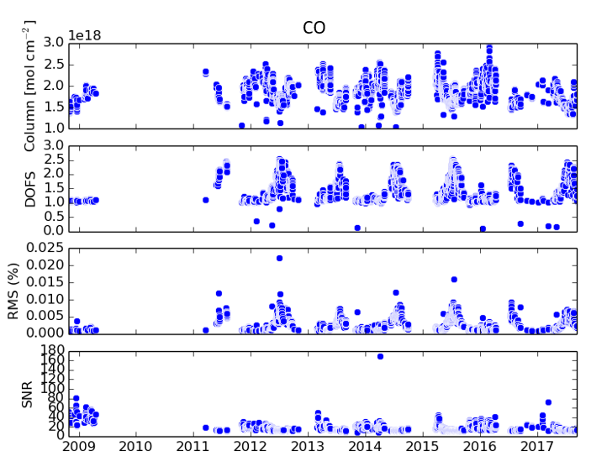
Status of Data Analysis: Trace Gas Retrievals
The seasonal cycle of CO has a maximum in March and decreases from
May to August primarily due to reaction with OH in summer.

Slide 26
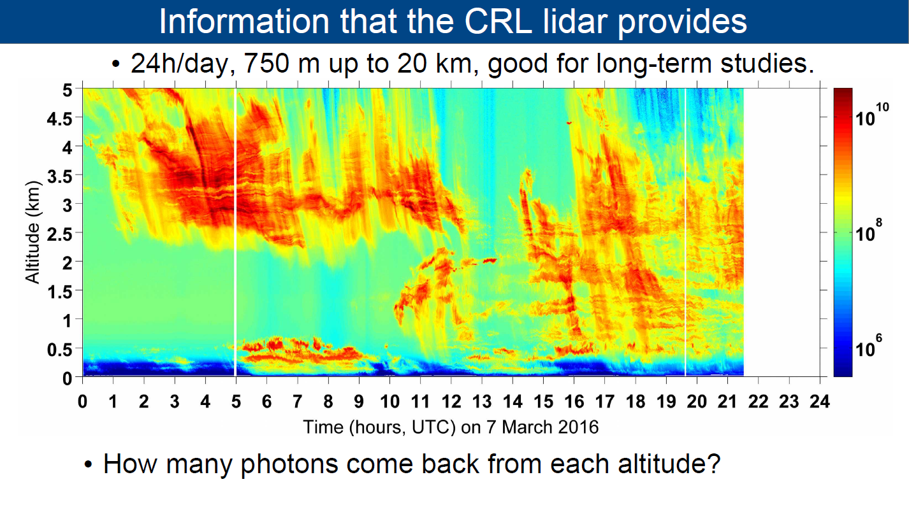

Slide 27
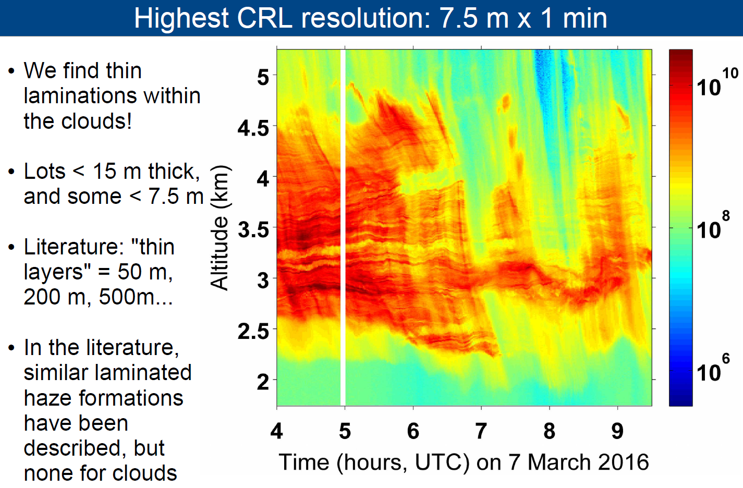

Slide 28


Slide 29



PEARL Upper Atmosphere Observations
D. Gamblin
All-sky Image above Eureka
Horizon
Spectral Airglow Temperature Imager Temperature 94 (O₂) and 87 km (OH).
E-region wind interferometer Wind - 3 km, 87 (OH), 94 (O₂), 97 km (O(¹S)).
All-Sky Imager Emission morphology, waves, 87 (OH), 90 (Na), 97 km (O(¹S))
Meteor Radar Winds (80-100km)
PEARL All Sky Difference Image of a Tidal Bore
Courtesy: Chris Vail/Dustin Fraser

Slide 30


Airglow Variation due to Gravity Waves
Analysis of the Airglow Images
2D Fourier Transform of image
Data are available for every winter except for the 10/11 season.
C. Vail/D. Gamblin

Slide 31

Winds
Courtesy: Q. Wu
ERWIN
Courtesy: Sam Kristoffersen
Fabry-Perot Thermospheric Red Line Winds

Slide 32
Save PEARL
The Canadian Climate and Atmospheric Research (CCAR) program of NSERC which was the main funding source for PEARL ended in early 2018 with no successor program
Six projects valued at $6M/year ended at that time
Only one of the eight programs (PAHA) has been saved and that only for another 18 months (Thanks to a campaign by “Evidence for Democracy”)
As of today, there is no successor program to CCAR

Slide 33
Conclusions
This research is far from over….
The Polar atmosphere deep in the Polar night is still relatively unknown territory – just like another planet
The situation is changing as fast as we can keep up with it
PEARL has a distinct research role that is internationally important
The research program is attracting interest from new researchers national and international as well as international groups

Slide 34

Thank You for Your Attention!
http://www.candac.ca

