Slide 1
Room Temperature Study of Nitrous Oxide in the Bending Band
Adriana Predoi-Cross¹, Robab Hashemi^{1.2}, V.M. Devi³, Hossein Naseri^{1,4}, Mary A.H. Smith⁵
¹Dept. of Physics & Astronomy, University of Lethbridge, Alberta T1K 3M4, Canada.
Present address: 512 Silkstone Crescent West, Lethbridge, Alberta T1J 4C1, Canada.
² Present address: Harvard-Smithsonian Center for Astrophysics, Atomic and Molecular Physics Division, Cambridge, Massachusetts 02138, USA
³Dept. of Physics, College of William and Mary, Williamsburg, Virginia 23187, USA.
⁴Present address: Farmers Edge, 4309 8 Ave N, Lethbridge, Alberta, Canada
⁵Science Directorate, NASA Langley Research Center, Hampton, Virginia 23681, USA.
Note: this talk is based on our joint publication: Canadian Journal of Physics, 2018, 96(4): 454-464, https://doi.org/10.1139/cjp-2017-0303

Slide 2
OUTLINE OF MY PRESENTATION
Research Context
Theoretical Explorations
Fourier transform spectroscopic studies of nitrous oxide
Conclusion and Directions for Future Work
References
Funding sources

Slide 3
Research Context
Gases included in the NxOy family (NO, NO₂, N₂O₂, N₂O, etc.) play a crucial role in terrestrial atmospheric chemistry. For example, these gases are produced during lightning, as a result of reaction of nitrogen and oxygen in air. In highly inhabited areas with heavy traffic, the production of nitrogen oxides is higher, leading to occurrences of acid rain and smog.
As a greenhouse gases, nitrous oxide (N₂O) is important in radiative transfer [1]. Accurate laboratory spectroscopic studies of molecular line shapes in different spectral ranges are needed to enable satellite- based, ground-based and air-borne remote sensing measurements of N₂O concentrations. To meet this demand, we present spectroscopic results of measured line intensities and line shape parameters to validate and update the existing knowledge and information on line parameters for the mixture of N₂O with air, stored in databases such as HITRAN2016 [2].
Source: Canadian Journal of Physics, 2018, 96(4): 454-464, https://doi.org/10.1139/cjp-2017-0303

Slide 4
Current state of knowledge
Lacome et al. [3] who had analyzed the Fourier transform spectra to obtain self-, N₂- and O₂-broadened line parameters of N₂O in the 4- and 8-μm spectral regions.
Toth [4] published N₂- and air-broadened line-widths and frequency-shifts for spectral lines in the 1800 to 4800 cm⁻¹ range; and reported the self-broadened line-widths and pressure shifts of N₂O in the 1800-2630 cm⁻¹ [5].
Nemtchinov et al. [6] have studied N₂- and O₂-broadened half-widths and their temperature dependences in the 4.5 µm region corresponding to the ν₃ fundamental band of N₂O.
Vitcu et al. [7] have investigated 03¹0←01¹0 parallel Q-branch of N₂O at 297 K. The line mixing effects for N₂O have also been the focus of other line-shape studies such as the one by Strow et al. [8] who reported line mixing in the ν₂ + ν₃ Q-branch of N₂O. Margottin-Maclou et al. [9] observed line mixing effects in N₂O absorption spectra recorded at room temperature using a Fourier transform spectrometer.
Loos et al. [10] have reported highly accurate room temperature measurements of air-broadening, pressure-shift, speed dependence and weak line mixing parameters for transitions in the ν₃ fundamental band of N₂O. Hartmann et al. [11] also have examined line mixing in N₂O Q-branches, broadened by N₂, O₂, and air, both in the laboratory environment and in atmospheric spectra.
Source: CJP, 2018, 96(4): 454-464, https://doi.org/10.1139/cjp-2017-0303

Slide 5
Our Challenge: “What is it that we are missing in the spectral characterization of atmospheric trace gases to be able to fully and accurately characterize the atmospheric spectra?”
Notes:
Science Advisory Groups for spectroscopic remote sensing missions have strongly recommended that new laboratory studies using the best experimental techniques and/or sophisticated theoretical models are required, to enable accurate retrievals of concentration profiles for trace atmospheric constituents. We need to understand and remove the sources of systematic errors in the forward model calculations related to spectral line parameters.
We believe the problems may be caused by inadequate molecular line shapes and therefore should carefully examine the appropriate line shape profiles and include sutle effects such as speed dependence and line mixing effects.

Slide 6
Analysis details for Fourier transform spectra recorded at different sets of pressure, temperatures and pathlength
The wavenumber scales were calibrated using line positions of water and N₂O in the HITRAN2016 database.
The interactive multispectrum nonlinear least squares fitting technique (Benner et al. (1995)) was used to analyze all spectra recorded, simultaneously. It uses the Levenberg-Marquardt algorithm that minimizes the sum of the squares of the residuals between the experimental spectra and the spectra calculated using the fixed and fitted parameters [6].
Including speed-dependence in our Voigt spectral profiles did improve the fit residuals (observed-calculated). Weak line mixing was necessary to accurately model the absorption.
Initial values for all line parameters were taken from the HITRAN2016 database.
Spectral backgrounds (including some channeling), zero transmission levels, instrument line shapes were appropriately modeled.

Slide 7
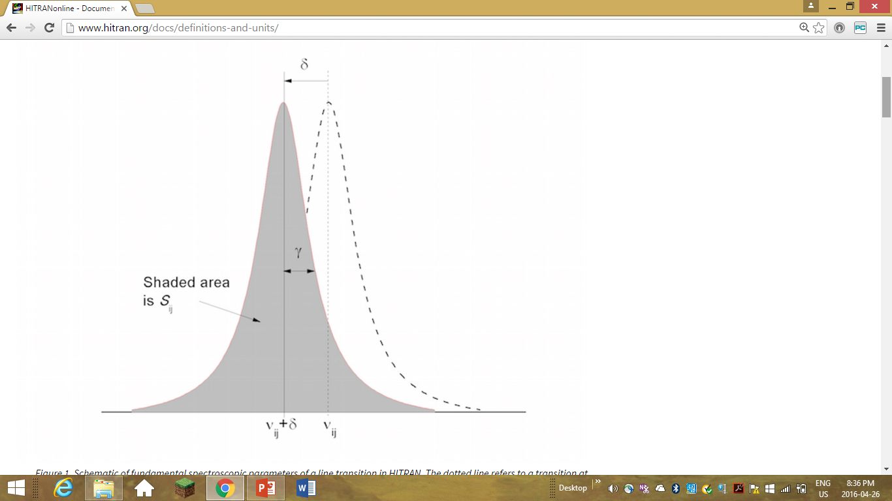
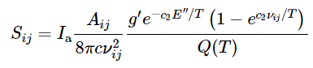
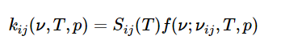
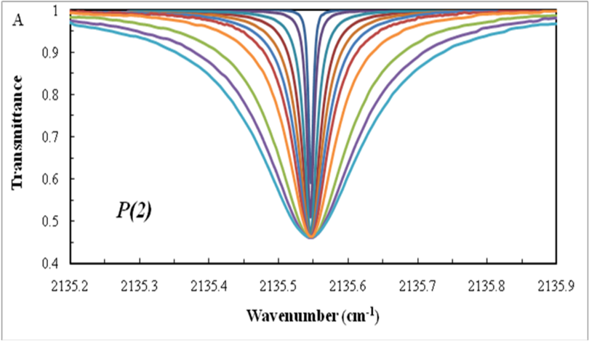
A few definitions
The spectral line intensity of the transition between two ro-vibronic states is given as
where A_{ij}(s⁻¹) is the Einstein coefficient for spontaneous emission, g′ is the upper state statistical weight, and E′′ is the lower state energy (cm⁻¹)
The monochromatic absorption coefficient
Schematic of fundamental spectroscopic parameters of a line transition. The dotted line refers to a transition at zero pressure with a negative pressure shift, δ).
Absorption profiles over a range of pressures below 1 atm
Source: www.hitran.org.

Slide 8
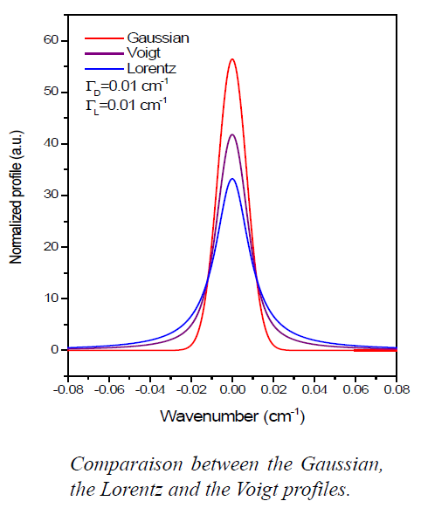
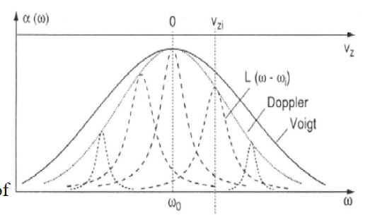
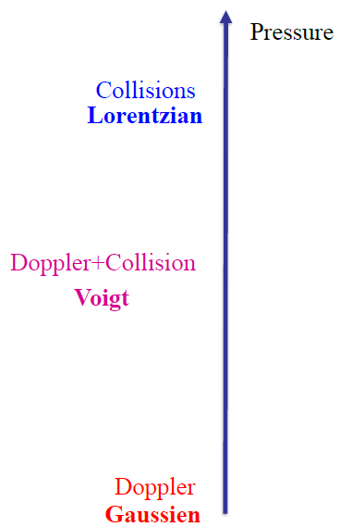
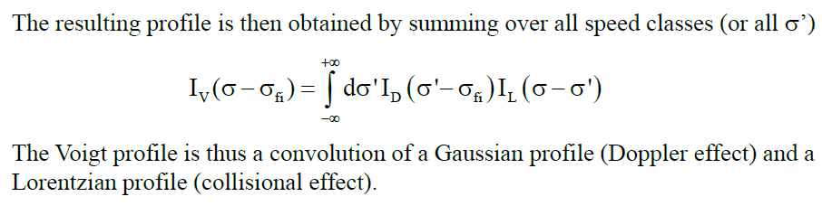
The Voigt Profile
The Voigt Profile
Ref. W. Demtroder, Atoms, Molecules and photons, Springer, 260.
Images and text adapted from slides of Ha Tran, LMD,France

Slide 9
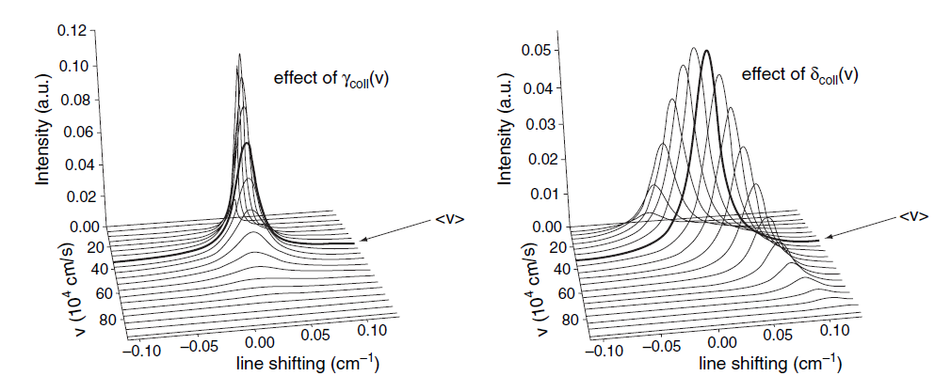
Non-Voigt approaches: the velocity changes effect
3-D plot of the effect of different molecular speeds on the line broadening (left) and line shifting parameter (right). Ref. J.-M. Hartmann, C. Boulet, D. Robert, Collisional Effects on Molecular Spectra (2011).
Notes:
In order to compensate for the velocity dependence we can define speed classes based on the Maxwell Boltzmann distribution of velocities. These can then be analysed and combined in order to form profiles that incorporate this speed dependence effect.

Slide 10
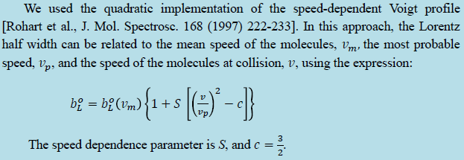
Taking into account the speed of the molecules
The default value for the speed dependence parameter in HITRAN2016 is 0.08 for all nitrous oxide transition.
We used as the initial default value the speed-dependence parameter calculated by the algorithm introduced by V. Kochanov [JQSRT 189 (2017) 18-23] assuming q = 6 in the effective potential V~r^{-q} (where r is the displacement from equilibrium position) for a mixture of nitrous oxide and dry air; this value was S = 0.0895.
Source: Canadian Journal of Physics, 2018, 96(4): 454-464, https://doi.org/10.1139/cjp-2017-0303

Slide 11
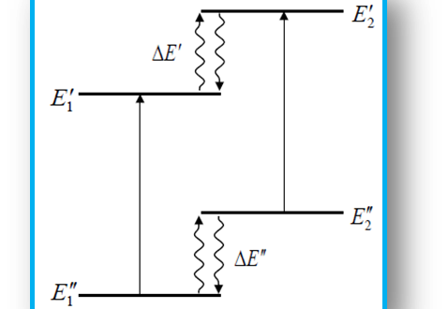
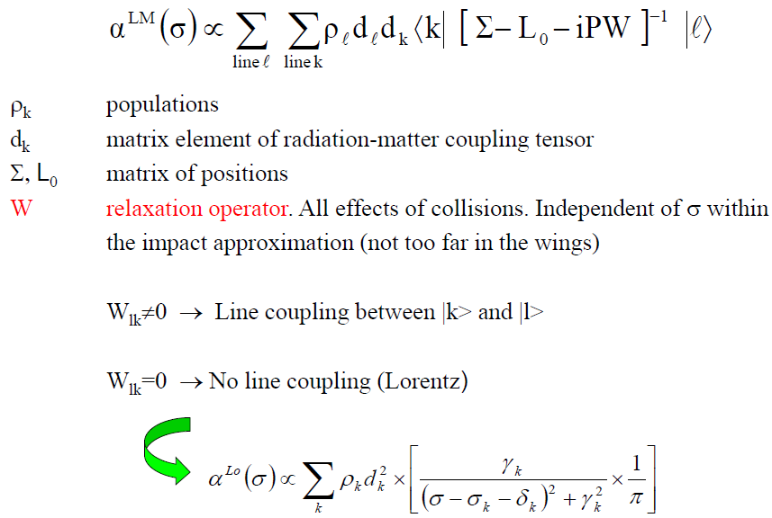
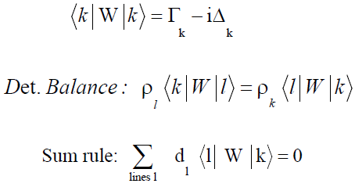
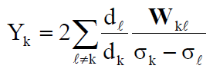
Line Mixing Effects
At elevated pressures molecular collisions induce transfers of populations between the levels of the two absorption lines that lead to transfers of intensity between the lines.
Absorption Coefficient
Ref. Ha Tran, Université Paris-Est Créteil, France, private communication

Slide 12
Experimental spectrum of the ν₃ band of nitrous oxide recorded at P= 1.012 Torr , T=294.15 K. The path length of the absorption cell is 50 cm.
Conditions for all used spectra:
Source: Canadian Journal of Physics, 2018, 96(4): 454-464, https://doi.org/10.1139/cjp-2017-0303

Slide 13
Expressions used in retrievals of line parameters
b_{L}(p,T) is the Lorentz halfwidth (in cm⁻¹) of the spectral line at pressure p and temperature T, and the broadening coefficient b_{L}⁰(Gas)(p₀,T₀) is the Lorentz halfwidth of the line at the reference pressure p₀ (1 atm) and temperature T₀ (296 K), and χ is the ratio of the partial pressure of N₂O to the total sample pressure in the cell. The temperature dependence exponents of the pressure-broadening coefficients are n1 and n2.
where ν₀ is the zero-pressure line position (in cm⁻¹), ν is the line position corresponding to the pressure p, δ⁰ is the pressure-induced line shift coefficient at the reference pressure p₀(1 atm) and temperature T₀(296 K) of the broadening gas.

Slide 14
Example of a fitted spectral interval of the ν₃ band of nitrous oxide broadened by air. Panel (A) shows the observed spectra, and Panel (B) shows the fit residuals obtained using the quadratic speed dependent Voigt profile with a weak line mixing component.
Source: Canadian Journal of Physics, 2018, 96(4): 454-464, https://doi.org/10.1139/cjp-2017-0303

Slide 15
Measured line position differences with values in the HITRAN2016 [2] and GEISA2015 [22] databases and with values reported by Nemtchinov et al. [6] and Loos et al. [10]. The average values are presented using dashed lines (see legend).
Note that m = −J for the P -branch transitions, m = J + 1 for the R-branch transitions, and J is the lower state rotational quantum number.
Source: Canadian Journal of Physics, 2018, 96(4): 454-464, https://doi.org/10.1139/cjp-2017-0303

Slide 16
Measured line intensity percentage difference of present study (PS) compared with HITRAN2016 and GEISA2015 databases ((Values in database-PS)×100/PS) and with the results of Nemtchinov et al. (2004). The average values are shown with dashed lines.
The spectral line intensity of the transition between two ro-vibronic states is given as
where A_{ij}(s⁻¹) is the Einstein coefficient for spontaneous emission, g′ is the upper state statistical weight, and E′′ is the lower state energy (cm⁻¹)
Source: Canadian Journal of Physics, 2018, 96(4): 454-464, https://doi.org/10.1139/cjp-2017-0303

Slide 17
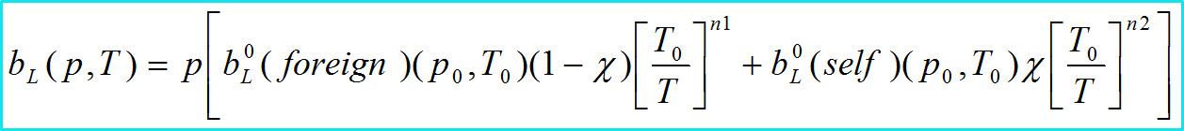
Air- broadening coefficients for N₂O transitions overlaid with published results by Toth et al. [4], Lacome et al. [3], Nemtchinov et al. [6], Loos et al. [10] and parameters stored in the HITRAN2016 [2] and GEISA2015 [22] databases. Lastly, the values for air-broadening coefficients calculated using the EPG scaling law are overlaid on the same plot.
Source: Canadian Journal of Physics, 2018, 96(4): 454-464, https://doi.org/10.1139/cjp-2017-0303

Slide 18
Retrieved SDV air-induced pressure shift coefficients for N₂O transitions of the ν₃ band of N₂O overlaid with measurements by Loos et al. [10], values from the HITRAN2016 [2] database, and results obtained from our spectra with the Voigt profile.
Source: Canadian Journal of Physics, 2018, 96(4): 454-464, https://doi.org/10.1139/cjp-2017-0303

Slide 19
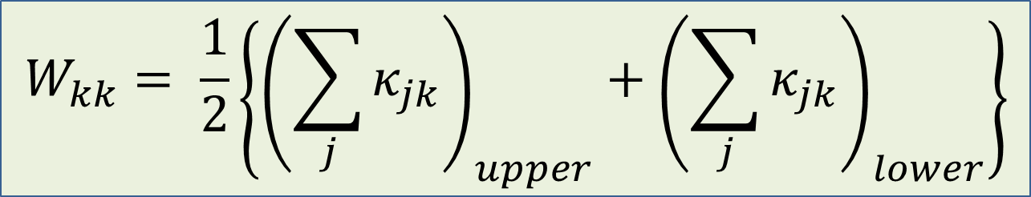
Scaling Laws: Exponential Power Gap Model
To find the relaxation matrix we use a nonlinear Marquardt algorithm to optimally fit the parameters a, b and c in the state to state transfer equation.
The best fit is found by optimizing the diagonal elements of the relaxation matrix to be equal to the experimentally determined broadening coefficients.
Optimized adjustable parameters for the EPG scaling law.
$$W_{kk}= \frac{1}{2}\left\{{\left(\sum_{j}{κ_{jk}}\right)}_{upper}+{\left(\sum_{j}{κ_{jk}}\right)}_{lower}\right\}$$

Slide 20
Line mixing coefficients for transitions in the ν₃ band of N₂O from the present study (both SDV and Voigt profiles) plotted overlaid with the results from Ref. [10] and values calculated using the EPG formalism.
Source: Canadian Journal of Physics, 2018, 96(4): 454-464, https://doi.org/10.1139/cjp-2017-0303

Slide 21
Conclusions
We report accurate line-shape parameters of air-broadened N₂O obtained from retrievals using the quadratic SDV profile with an additional component to account for line mixing. Line positions and intensities, air-broadened half-width coefficients, air-shift coefficients, and line mixing coefficients are retrieved.
The measured and calculated line mixing coefficients show very good agreement with the values obtained by Loos et al. [10].
A follow-up study involving several cold spectra of N₂O and air mixtures is underway, and in the future we expect to report our results for temperature dependences of line parameters.
Source: Canadian Journal of Physics, 2018, 96(4): 454-464, https://doi.org/10.1139/cjp-2017-0303

Slide 22
References
  Atmospheric Ozone 1985; WMO Global Ozone Research Monitoring Project 1986. Report No. 16, III, 835.
  Gordon, I.E., Rothman, L.S., Hill, C., Kochanov, R.V. et al. 2017. The HITRAN2016 molecular spectroscopic database. J Quant Spectrosc Radiat Transf. 203, 3-69.
  Lacome, N., Levy, A., Guelachvili, G. 1984. Fourier transform measurement of self-, N₂ and O₂ broadening of lines: temperature dependence of line-widths. Appl Opt. 23: 425–35.
  Toth, R.A. 2000. N₂ and air-broadened line-widths and frequency-shifts of N₂O. J Quant Spec- trosc Radiat Transf. 66: 285–304.
  Toth, R.A., 1993. Line strengths (900–3600 cm1), self-broadened linewidths, and frequency shifts (1800-2360 cm1) of N₂O Applied Optics. 32: 7326–7365.
  Nemtchinov, V., Sun, C., Varanasi, P. 2004. Measurements of line intensities and line-widths in the ν₃-fundamental band of nitrous oxide at atmospheric temperatures J Quant Spectrosc Radiat Transf. 83: 267–84.
  Vitcu, A., Ciurylo, R., Wehr, R., Drummond, J.R., May, A.D. 2004. Broadening, shifting, and line mixing in the 03¹0←01¹0 parallel Q branch of N₂O J Mol Spectrosc. 226: 71–80.
  Strow, L.L., Pine, A.S. 1988. Q-branch line mixing in N2O: effects of l-type doubling. J Chem Phys. 89: 1427–34.
  Margottin-Maclou, M., Henry, A., Valentin, A. 1992. Line mixing in the Q-branches of the ν₁ + ν₂ band of nitrous oxide and of the (1110)-(0220) band of carbon dioxide J Chem Phys. 96: 1715–23.
  Loos, J., Birk, M., Wagner, G. 2015. Pressure broadening, -shift, speed dependence and line mixing in the ν₃ rovibrational band of N₂O. J Quant Spectrosc Radiat Transf. 151: 300–309.
  Hartmann, J.M., Bouanich, J.P., Blanquet, G., Walrand, J., Bermejo, D., Domenech, J.L. and Lacome, N. 1999. Line-mixing effects in N₂O Q-branches: Model, laboratory, and atmospheric spectra. J. Chem. Phys. 110: 1344–56.
  Uber das, W.V., 1912. Sitzber, Bayr Akad. Mnchen. Ber. 603.
Source: Canadian Journal of Physics, 2018, 96(4): 454-464, https://doi.org/10.1139/cjp-2017-0303

Slide 23
References
13. Devi, V.M., Benner, D.C., Smith, M.A.H., Mantz, A.W., Sung, K., Brown, L.R., et al. 2012. Spectral line parameters including temperature dependences of self- and air-broadening in the 2-0 band of CO at 2.3 µm, J Quant Spectrosc Radiat Transf. 113: 1013–33.
14. Brown, L.R., Benner, D.C., Devi, V.M., Smith, M.A.H., Toth, R.A. 2005. Line mixing in self- and foreign-broadened water vapor at 6 micron, J Mol Structure. 742: 111–122.
15. Smith, M.A.H., Rinsland, C.P., Devi, V.M., Benner, D.C. 1992. Temperature-dependence of broadening and shifts of methane lines in the ν4 band, Spectrochimica Acta. 48A. 1257–1272.
16. Benner, D.C., Rinsland, C.P., Devi, V.M., Smith, M.A.H., Atkins, D. 1995. A multi-spectrum nonlinear least-squares fitting technique. J Quant Spectrosc Radiat Transf. 53: 705–21.
17. Levenberg, K. 1944. A method for the solution of certain problems in Least Squares, Quart. Appl. Math. 2: 164–168.
18. Marquardt, D.W. 1963. An algorithm for Least-Squares estimation of nonlinear parameters, J. Sot. Indust. Appl. Math. 11: 431.
19. Predoi-Cross, A., Unni, A.V., Heung, H., Devi, V.M., Benner, D.C., Brown, L.R. 2007. Line mixing effects in the ν2 + ν3 band of methane, J Mol Spectrosc. 246: 65–76.
20. Kochanov, V.P. 2017. On parameterization of spectral line profiles including the speed-dependence in the case of gas mixtures, J Quant Spectrosc Radiat Transf. 189: 18-23.
21. Collisional Effects on Molecular Spectra: Laboratory Experiments and Models, Consequences for Applications Author(s): Jean-Michel Hartmann, Christian Boulet and Daniel Robert ISBN: 978–0–444–52017–3.
22. Jacquinet-Husson, N., Armante, R., Scott, N.A., Chédin, A., et al. 2016. The 2015 edition of the GEISA spectroscopic database, J Mol Spectrosc. 327: 31-72.
23. Rothman, L.S., Gordon, I. E., Babikov, Y., Barbe, A., et al. 2013. The HITRAN2012 molecular spectroscopic database, J Quant Spectrosc Radiat Transf. 130: 4–50.
24. L.S. Rothman, L.S., Jacquemart, D., Barbe, A., Benner, D.C., et al. 2005. The HITRAN 2004 molecular spectroscopic database, J Quant Spectrosc Radiat Transf. 96: 139-204.
25. Predoi-Cross, A., Rohart, F., Bouanich, J.-P., Hurtmans, D. 2009. Xe-broadened CO line shapes in the fundamental band at 349 K, Can J Phys 87(5): 485-498.
Source: Canadian Journal of Physics, 2018, 96(4): 454-464, https://doi.org/10.1139/cjp-2017-0303

Slide 24

Funding sources for the duration of this project

