Slide 1
Precision antihydrogen gravity
Magnetic trap design in ALPHA-g
CAP 2018, 6-11-2018
Dr. Chukman So / TRIUMF

Slide 2
Antimatter gravity
Test of fundamental physics
  Weak equivalence principle
  Never before attempted
Antihydrogen
  Pure antimatter system
  Electrically neutral, not susceptible to electrostatic field
ALPHA’s antihydrogen production and trapping technology
  CERN’s AD + positron accumulator
  Penning trap manipulates antiprotons and positrons
  Magnetic trap confines antiatoms
  > 100 antiatoms trapped per experiment cycle
  Compatible with in-situ gravity measurement
How? Challenges?

Slide 3
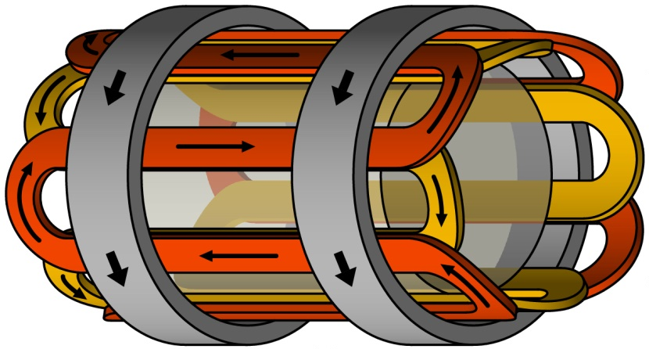
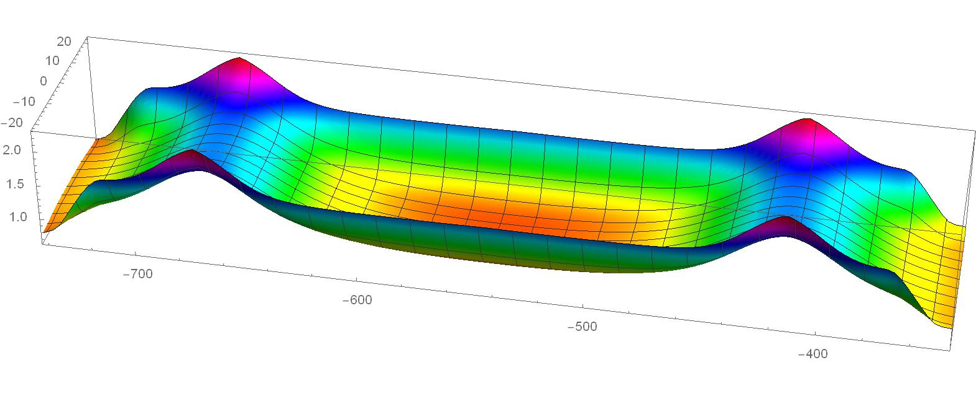
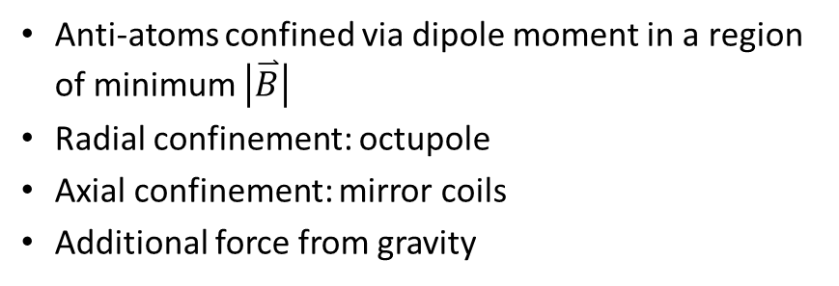
Magnetic minimum trap
Anti-atoms confined via dipole moment in a region of minimum $\left|\overset{⃑}{B}\right|$
Radial confinement: octupole
Axial confinement: mirror coils
Additional force from gravity
radial
octupole
mirror
mirror
|B|
axial

Slide 4
Measurement method
During gravity measurement:
  Anti-atom trapped
  Octupole stays on
  Mirror coils slowly turned off
  Observe antiatom escape, through outside annihilation detector
radial
octupole
mirror
mirror
|B|
axial

Slide 5
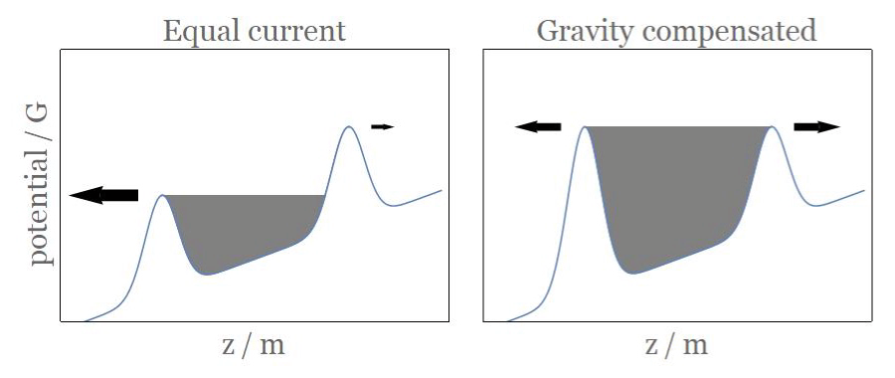
Measurement method
Simplified picture
  Up-down z motion in 1D
  x,y motion ignored
Equal coil currents
  Gravity favour downward escape
  Up-down measurement, sign of gravity
Slightly stronger bottom coil
  Equal escape infers gravity
  1% precision measurement

Slide 6
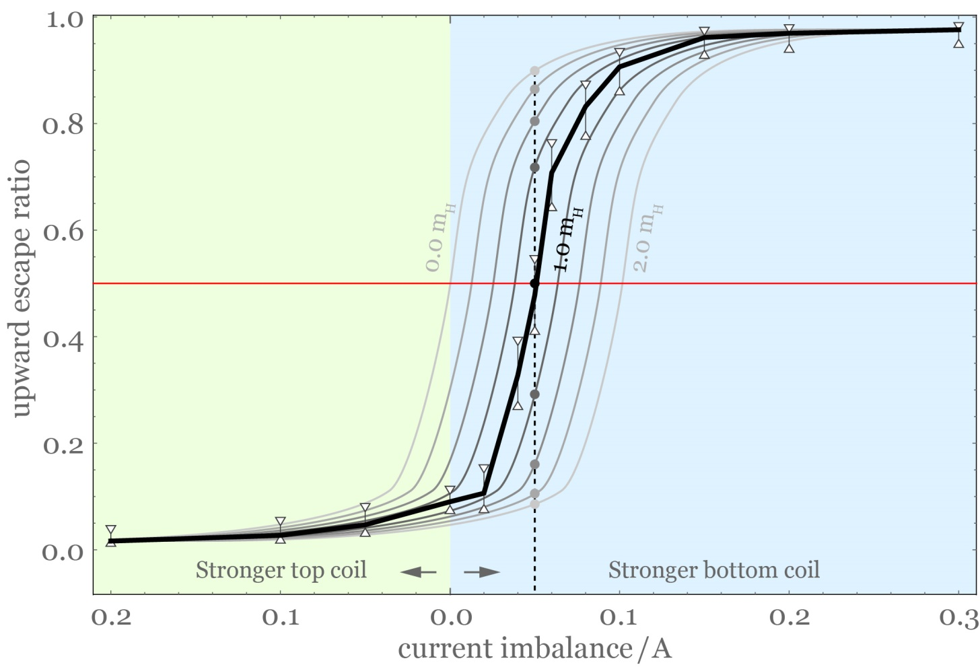
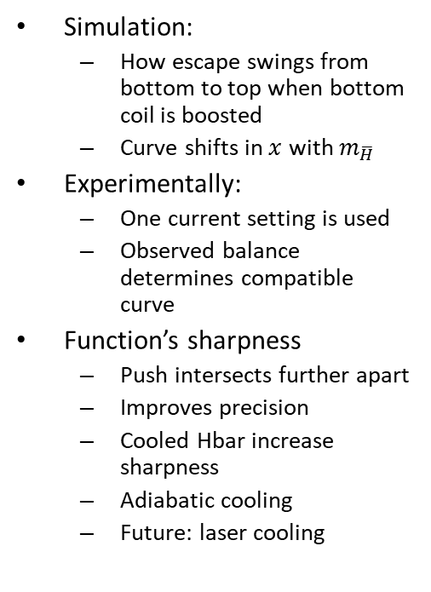
Measurement method
Simulation:
  How escape swings from bottom to top when bottom coil is boosted
  Curve shifts in $x$ with $m_{\overline{H}}$
Experimentally:
  One current setting is used
  Observed balance determines compatible curve
Function’s sharpness
  Push intersects further apart
  Improves precision
  Cooled Hbar increase sharpness
  Adiabatic cooling
  Future: laser cooling

Slide 7
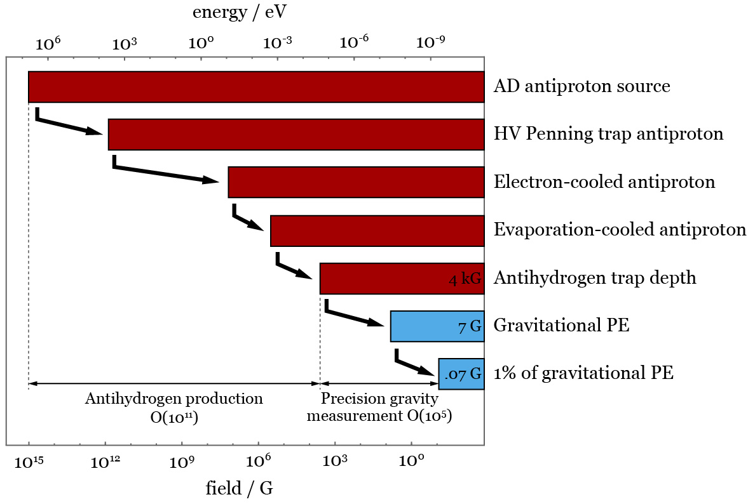
Challenges
Trapping antihydrogen
  O(10¹¹) decrease in energy
  Method developed and refined in ALPHA and ALPHA-2
Gravity measurement
  O(10⁵) further reduction in energy scale
  10 ppm magnetic control, to < 0.1 G level

Slide 8
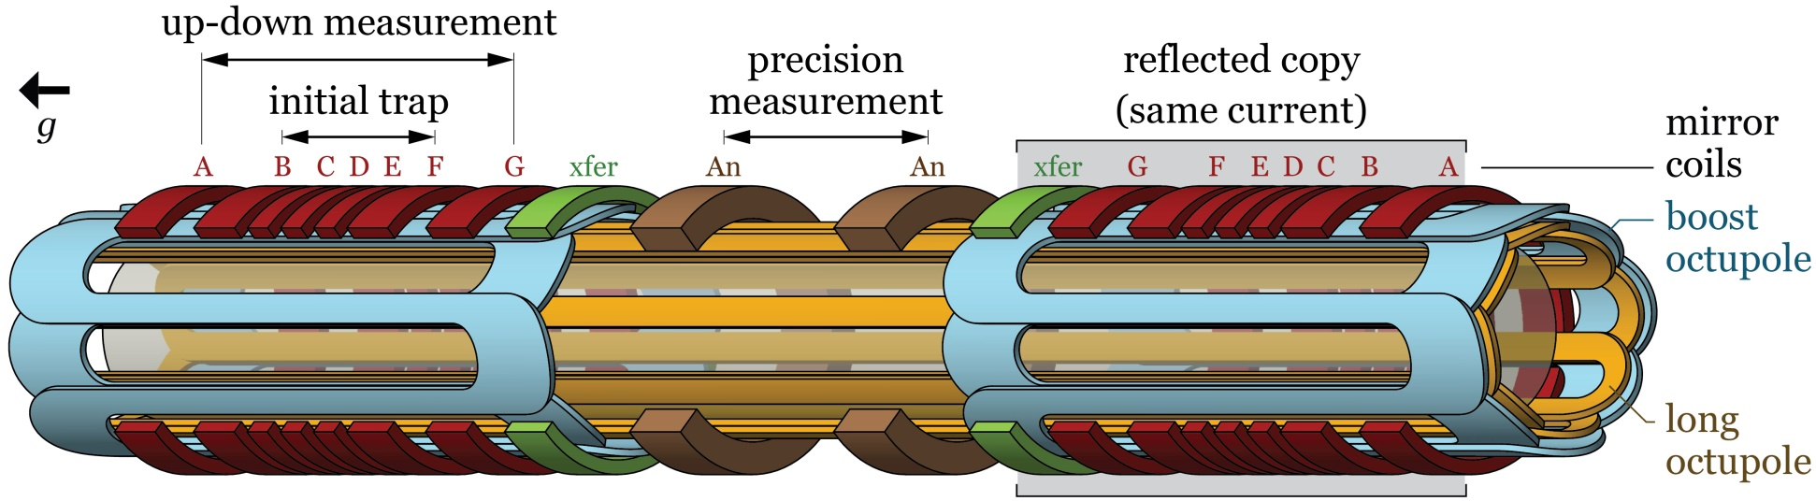
Overall magnet design
Number and position of elements carefully tailored to achieve 10 ppm B control
Centre: minimal magnet
  Precision measurement
Bottom: Strong magnets
  Initial trap & up-down measurement
Top: reflected copy
Factors that influenced the design:
  Persistent field
  Wire placement error
  Quasi-trapped antiatoms
  etc...

Slide 9
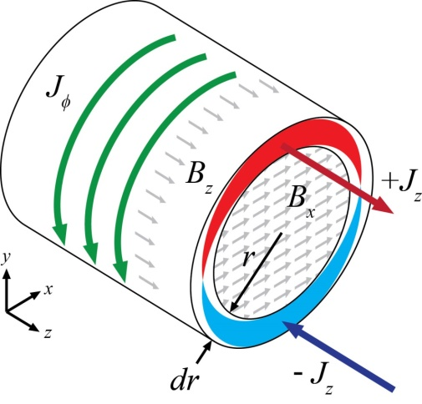
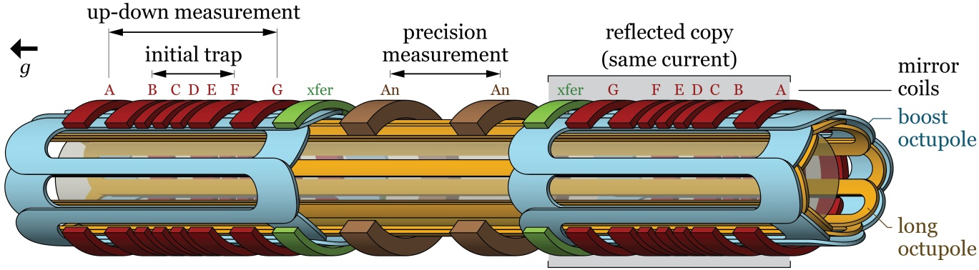
1. Persistent field
Induced field in superconductor
  Current loops induced in response to field changes
  Analogous to eddy current in normal conductors
  Indefinite memory, no direct control
ALPHA-2
  O(10 G) persistent field >> 0.1 G
Mitigation:
  Weak magnets, minimal NbTi around precision region
  Thin, numerous NbTi filaments in magnet wire, effect similar to lamination in iron transformer core
  Symmetrise magnetic history
  Expected to reach < 0.1 G

Slide 10
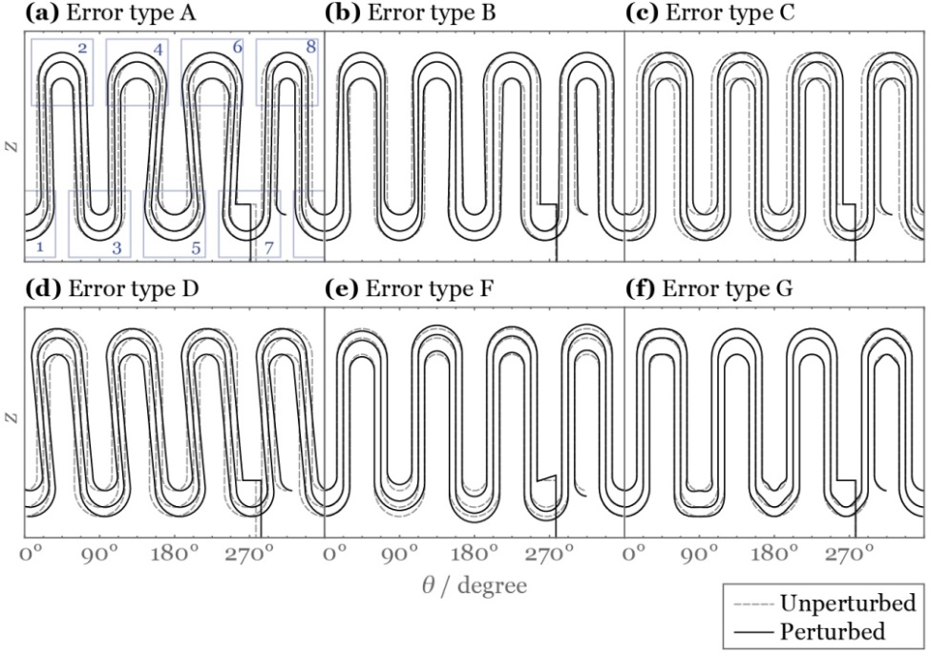
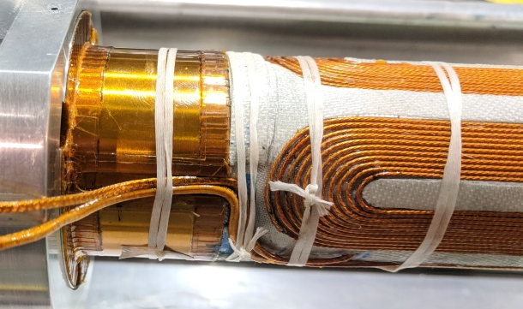
2. Wire placement
Two types of winding
Octupole winding
  CNC wire laying
  Impact of octupole error most severe near end turns
  Measurement regions avoid these zones
  Instead of 3 separate octupoles, full length + boost octupole minimises number of end turns in the middle

Slide 11
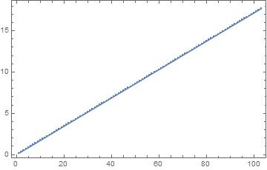
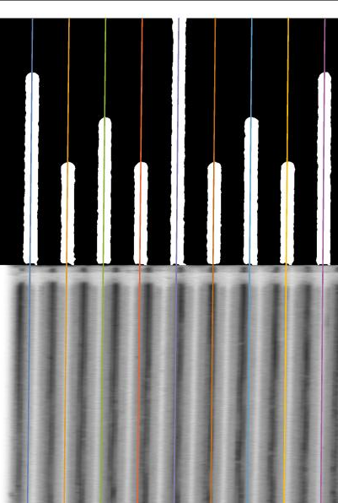
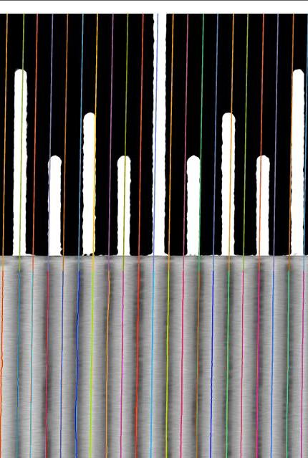
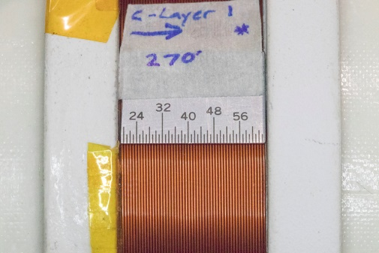
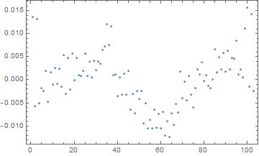
2. Wire placement
Coil winding
  Each layer is macro-photographed and precisely analysed
  Turns located to within ± 0.025 mm (1/1000”)
  Each coil trimmed by adaptive turn removal on outermost layer
Turn position / mm
Turn deviation
from linearity / mm
Macro photograph
(24 M pixel)
Fitting ruler markings
Fitting wires
Turn #

Slide 12
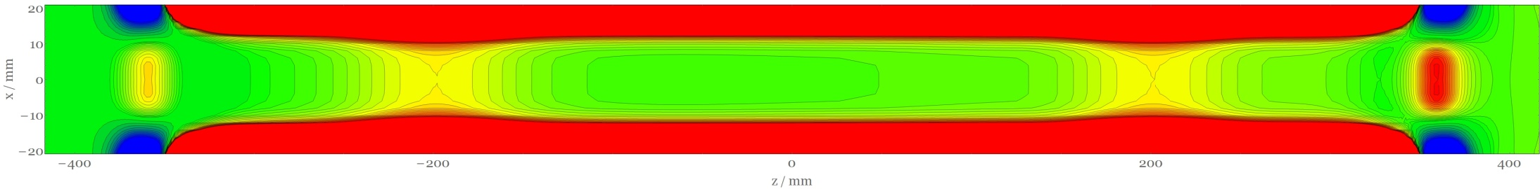
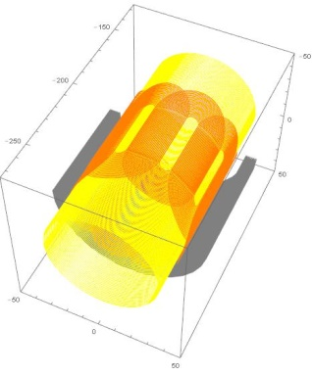
3. Quasi-trapped anti-atoms
bottom coil
top coil
Energetic escape very unlikely
  Requires hitting pin hole with all energy allocated to z
  Slow (x,y) and z energies mixing
  Anti-atoms mostly escape off-axis, at much later time
Tailor potential for all radii
  Balance escape under gravity
  Two extra correction coils to manipulate off-axis field

Slide 13
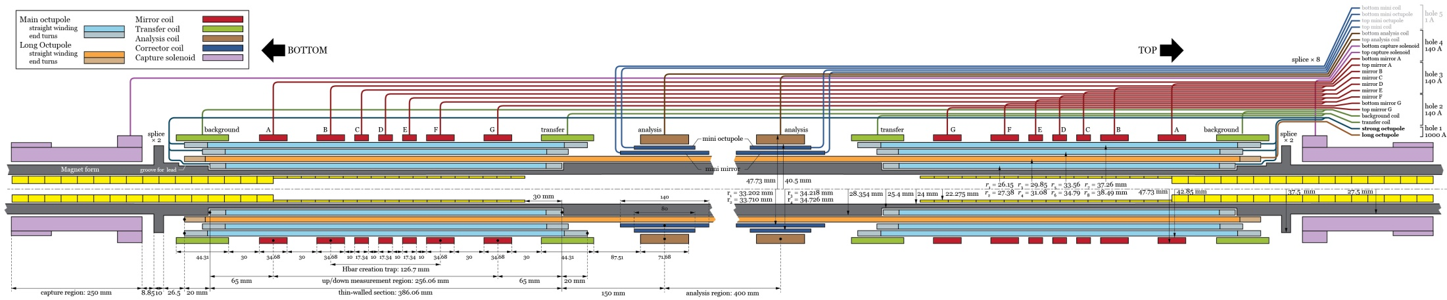
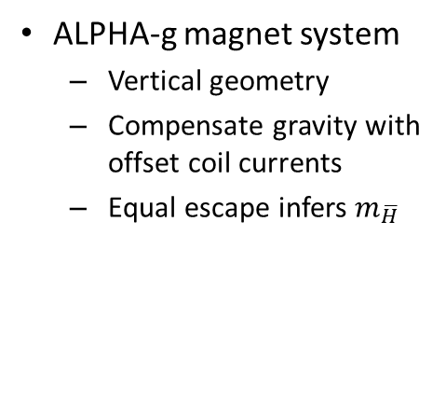
Summary
ALPHA-g magnet system
  Vertical geometry
  Compensate gravity with offset coil currents
  Equal escape infers $m_{\overline{H}}$
Currently being manufactured
  BNL, US: magnet windings
  Babcock, Germany: solenoid magnet
  RAL, UK: cryostat, beamline and support
  AMI, US: high current leads
  Triumf & York, Canada: annihilation detector, cosmic veto
  UBC & SFU, Canada: magnetometry
Assembly in Aug
Commissioning in Sept
Physics shortly after

Slide 14
End

Slide 15
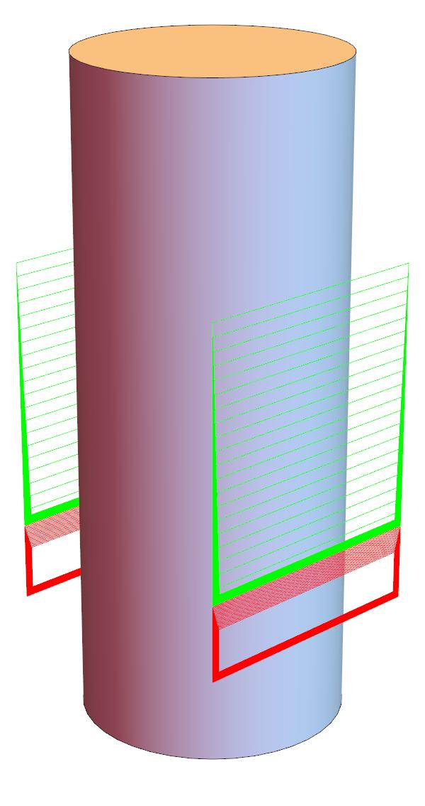
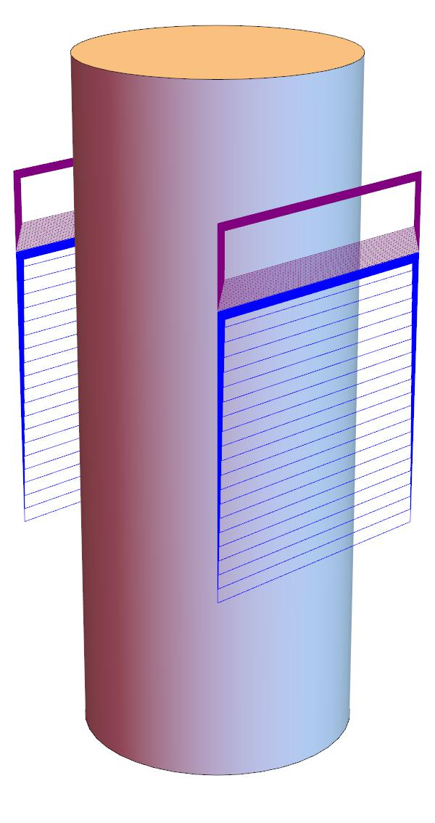
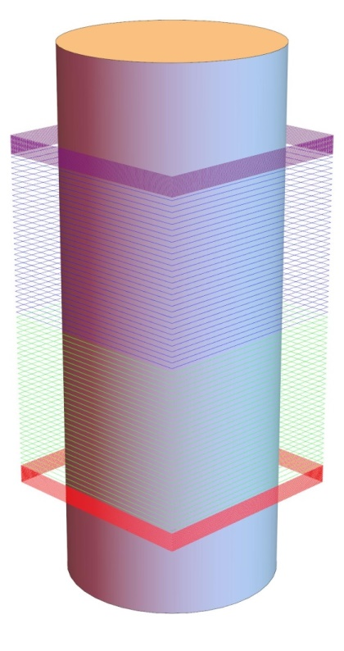

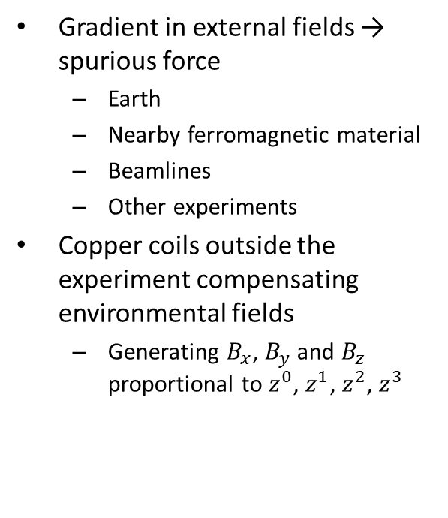

Environmental field
Gradient in external fields → spurious force
  Earth
  Nearby ferromagnetic material
  Beamlines
  Other experiments
Copper coils outside the experiment compensating environmental fields
  Generating $B_{x}$, $B_{y}$ and $B_{z}$ proportional to $z^{0}$, $z^{1}$, $z^{2}$, $z^{3}$
$B_{x}$ coils
$B_{z}$ coils

Slide 16

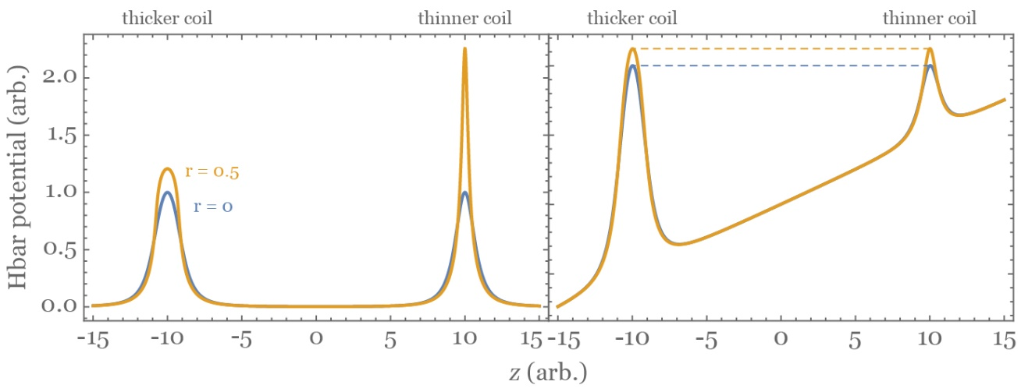
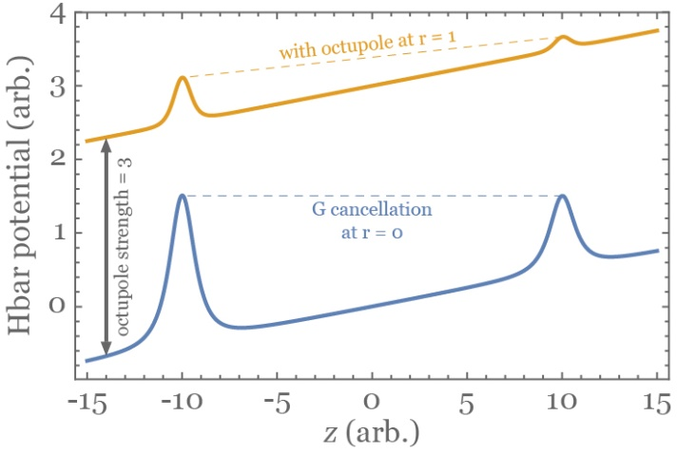
Quasi-trapped anti-atoms
Octupole – mirror coil interaction
  Fields add as vector, but anti-atom feels only |B|
  Quadrature stiffening
  Mirror coil less capable of increasing field at higher radii
Increase |B| by a short corrector octupole at each coil
Mirror coil – mirror coil interaction
  Off-axis field from coil is stronger than on-axis field
  Correctly compensating gravity for all radii requires coils of different widths
  Equivalent: two coils of different widths sharing current
Each barrier made of three bodies in total

