Slide 1
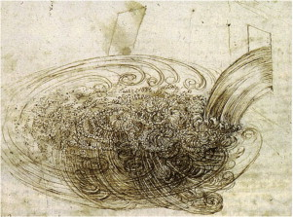
Magnetic Resonance Imaging of Fast Turbulent Gas Flow
“Instrumental or mechanical science is the noblest and, above all others, the most useful.”
-Leonardo da Vinci
Amy-Rae Gauthier, University of New Brunswick
Supervisor: Dr. Ben Newling
2018 CAP Congress, Halifax, NS

Slide 2
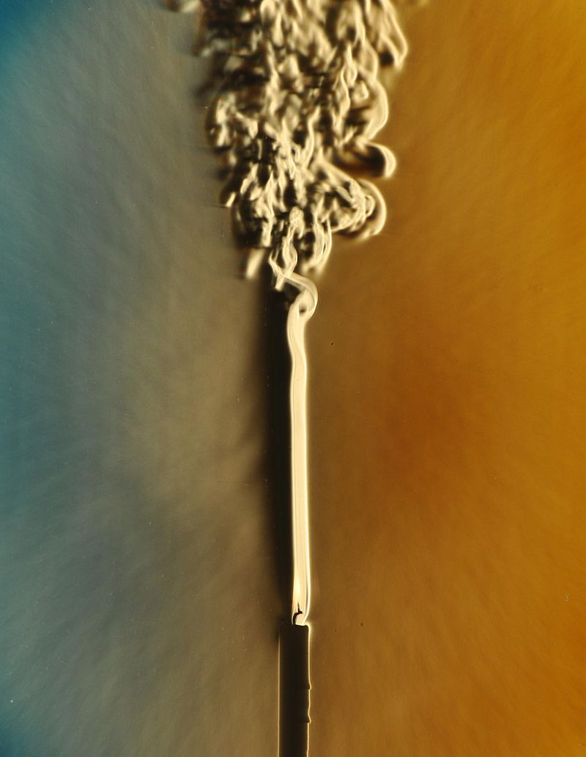
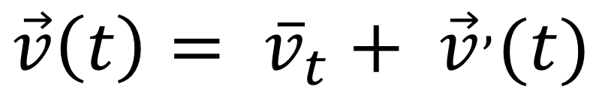
What’s so tricky about turbulence?
“When I meet God, I am going to ask him two questions: Why relativity? And why turbulence? I really believe he will have an answer for the first.”
-Werner Heisenberg
(similar quote by Horace Lamb)
$$\vec{v}\left(t\right)= {\overline{v}}_{t}+ {\vec{v}}^{,}(t)$$
-Smoke plume from a candle, Wikimedia Commons

Slide 3
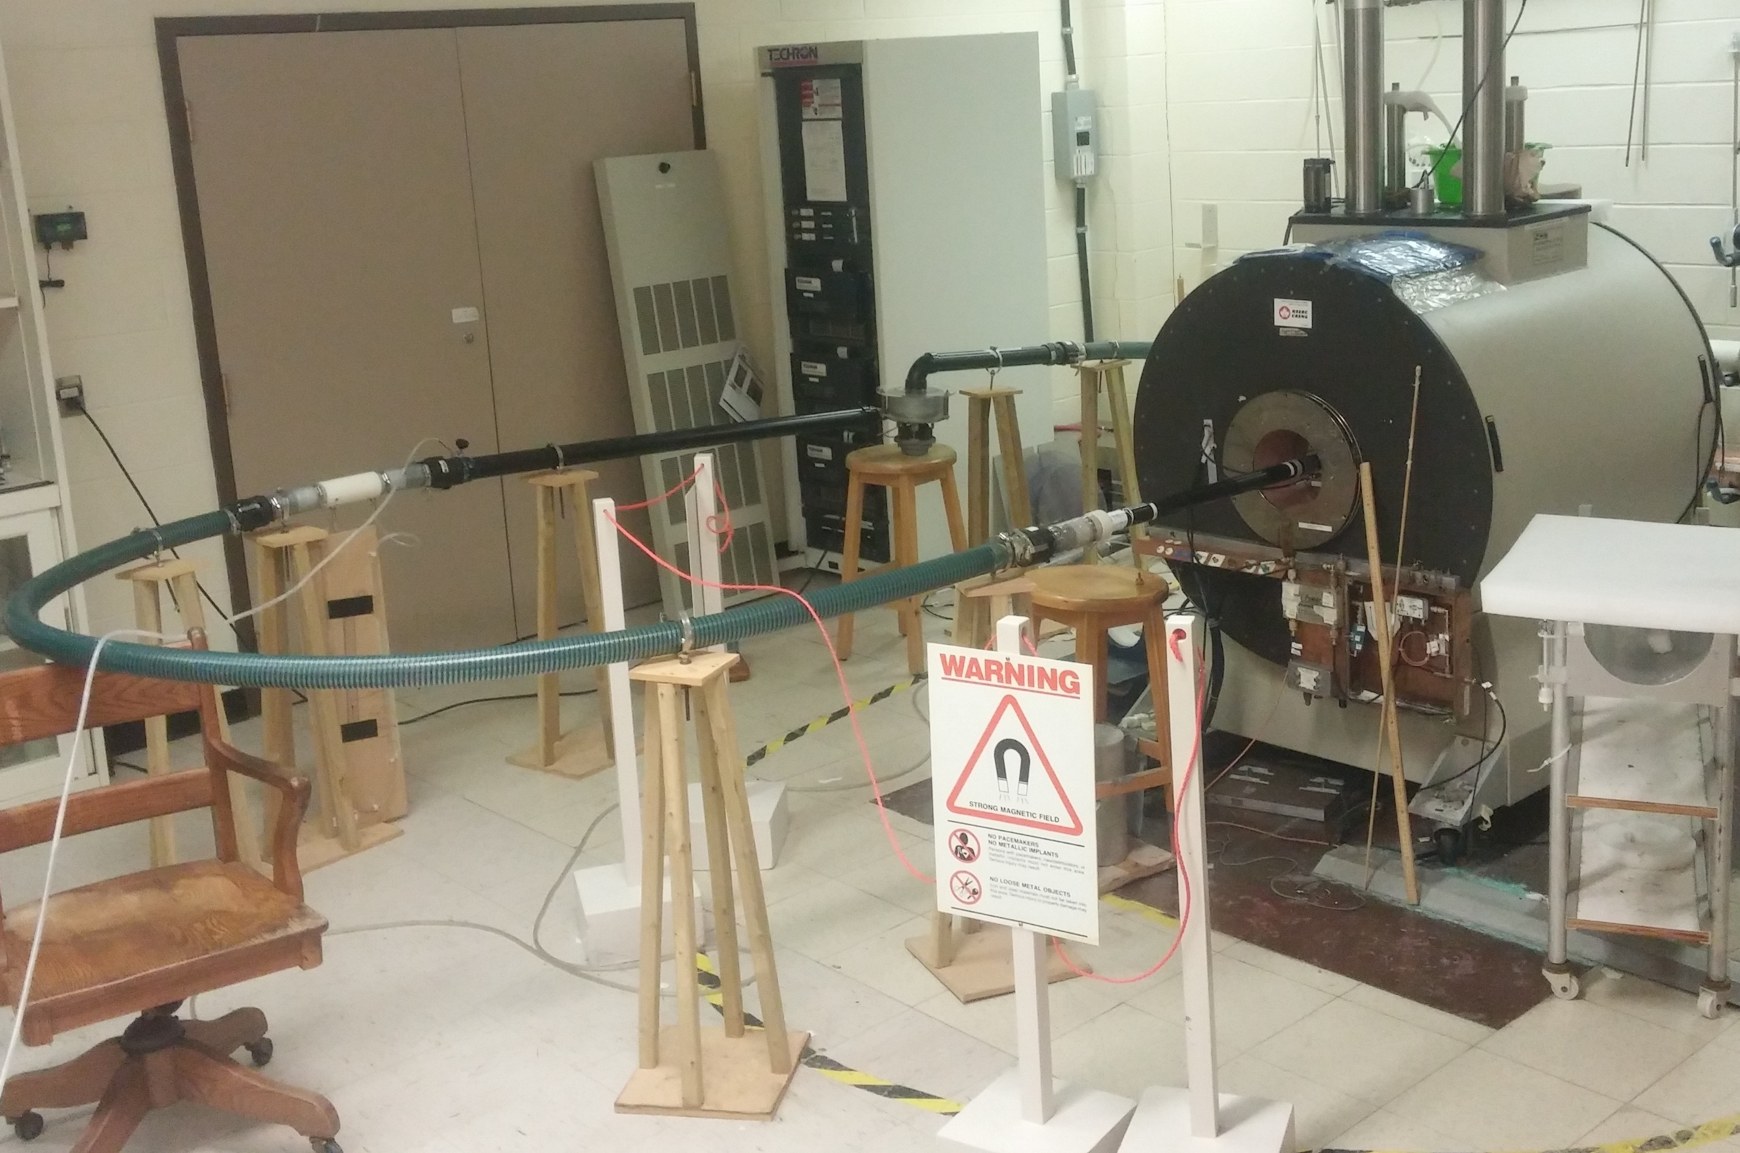
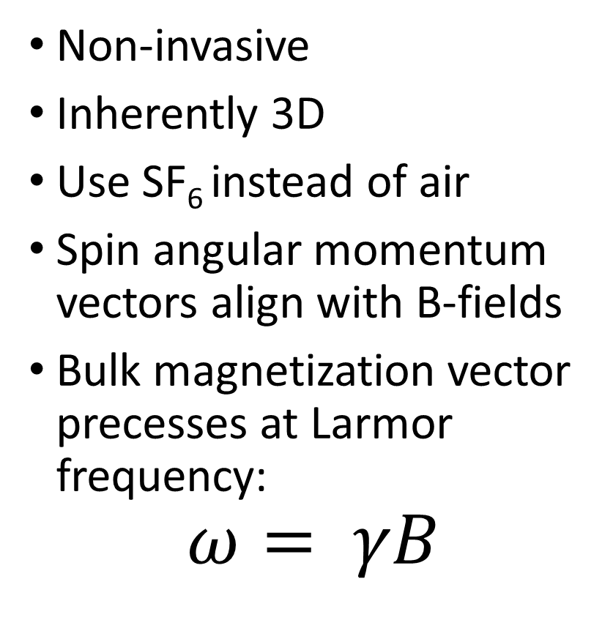
Why is MRI well-suited to turbulence?
Non-invasive
Inherently 3D
Use SF₆ instead of air
Spin angular momentum vectors align with B-fields
Bulk magnetization vector precesses at Larmor frequency:
$$ω= γB$$

Slide 4
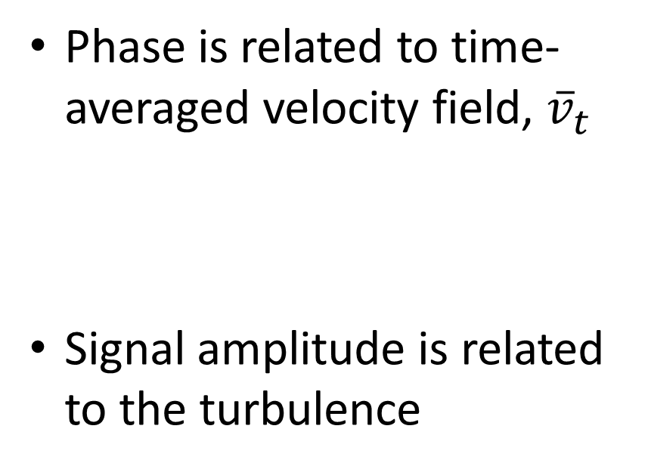
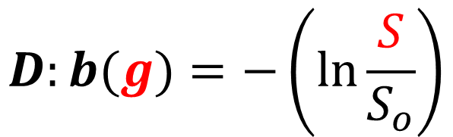

Motion-Encoded SPRITE MRI
Phase is related to time-averaged velocity field, ${\overline{v}}_{t}$
Signal amplitude is related to the turbulence
G(t)
g
$$φ=r\left(γt_{p}G\right)+ {\overline{v}}_{t}\left(\frac{γt_{p}^{2}}{4}g\right)+ …$$
G
t
t_{p}
$$D:b(g)=−\left(\ln{\frac{S}{S_{o}}}\right)$$

Slide 5
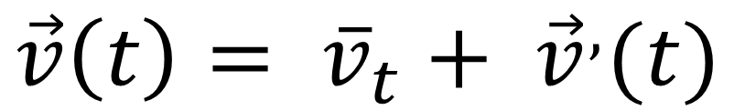
Turbulent System #1: The Recorder
Demonstration of time-averaged velocity field mapping
Expect to see gas moving through the flue, then oscillating above and below the edge
Direction of Flow
$$\vec{v}\left(t\right)= {\overline{v}}_{t}+ {\vec{v}}^{,}(t)$$

Slide 6
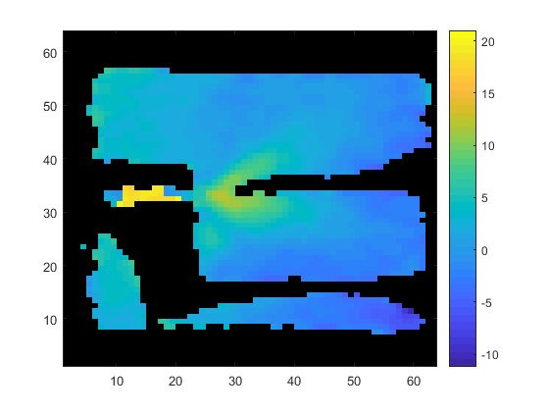
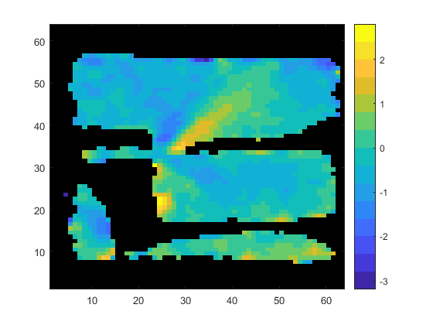
Turbulent System #1: The Recorder
20 m/s
3 m/s
Velocity z-component
Velocity y-component
y
y
z
z
-10 m/s
-3 m/s

Slide 7
Turbulent System #2: Obstructed Pipe
Demonstration of Eddy-Self Diffusivity measurement
Tells us where the turbulent fluctuations have the greatest effect
Expect the greatest turbulence when the gas hits the edge
y
Direction of Flow
z
y
$$\vec{v}\left(t\right)= {\overline{v}}_{t}+ {\vec{v}}^{,}(t)$$
x

Slide 8
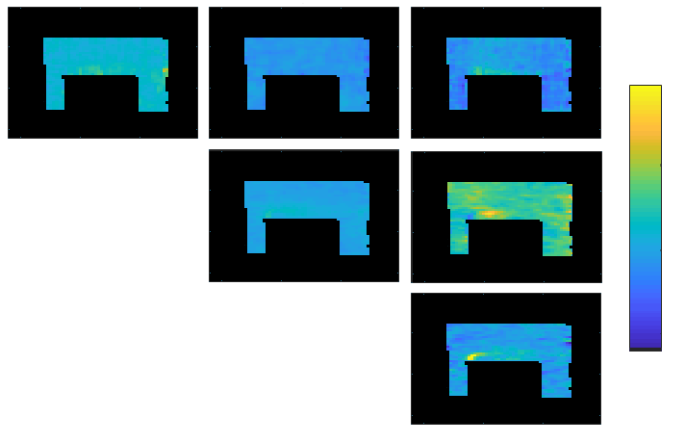
Turbulent System #2: Obstructed Pipe
0.2 m²/s
D_{xx}
D_{yx}
D_{zx}
y
D_{yy}
D_{zy}
Direction of Flow
D_{zz}
-0.1 m²/s
z

Slide 9
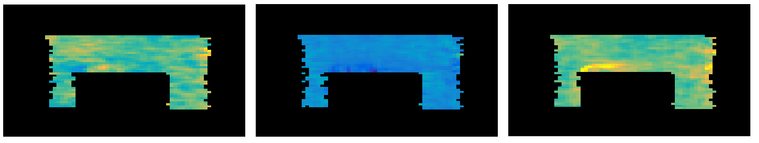
Turbulent System #2: Obstructed Pipe
D_{u}
D_{v}
D_{w}
-0.1 m²/s
0.2 m²/s
Turbulence is anisotropic!

Slide 10
Summary
MRI is a non-invasive and naturally 3D measurement tool
Motion-encoded SPRITE is a robust tool useful for measurements of fast turbulent gas flow
The phase accumulation gives us information about the time-averaged velocity field
The signal attenuation gives us information about the turbulent anisotropy

Slide 11
MERCI/THANK YOU
Further reading:
Newling, B. et al, “Velocity Imaging of Highly Turbulent Gas Flow”, Phys Rev Lett, 93 (15), 2004
Kuethe, D. O., “Measuring Distributions of Diffusivity in Turbulent Fluids with Magnetic Resonance Imaging”, Phys Rev A, 40 (8), 1989
Basser, P. et al, “MR Diffusion Tensor Spectroscopy and Imaging”, Biophysical Journal, 66 (1) , 1994

