Slide 1

Status of Higgs Portal Dark Matter
Rainer Dick
Department of Physics & Engineering Physics
Update on Higgs-nucleon coupling
Scalar Higgs portal dark matter
Vector Higgs portal dark matter
CP even fermionic Higgs portal dark matter
CP odd fermionic Higgs portal dark matter
Mixed fermionic Higgs portal dark matter
Conclusions
CAP Congress, Halifax, June 13, 2018

Slide 2
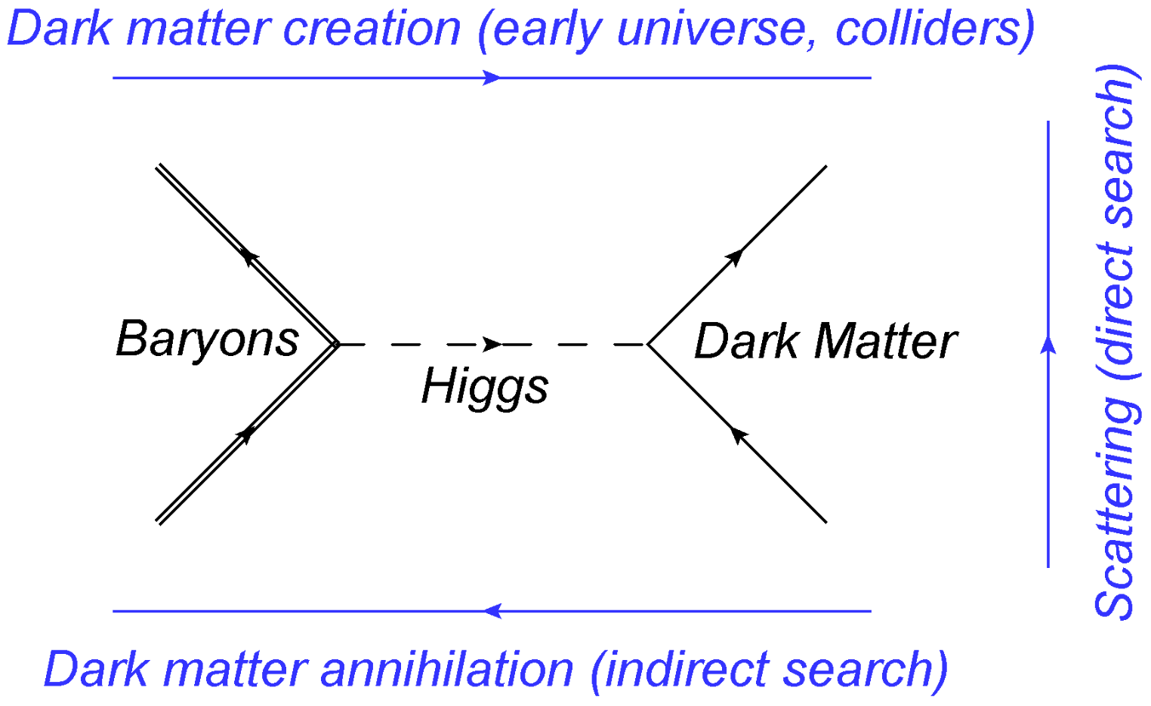
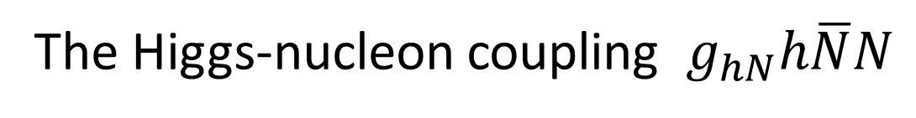
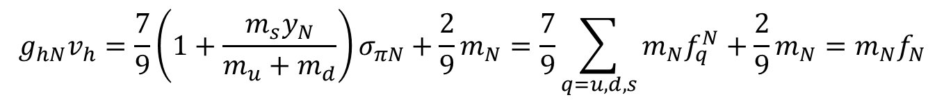
The Higgs-nucleon coupling $g_{hN}h\overline{N}N$
The Higgs-nucleon coupling is critical for Higgs portal models
Shifman, Vainshtein
& Zakharov 1978;
Ellis, Olive & Savage 2008;
Goudelis, Hermann & Stål 2013;
F.S. Sage & RD 2015;
Hoferichter et al. 2017.
$$g_{hN}v_{h}=\frac{7}{9}\left(1+\frac{m_{s}y_{N}}{m_{u}+m_{d}}\right)σ_{πN}+\frac{2}{9}m_{N}=\frac{7}{9}\sum_{q=u,d,s}{{m_{N}f}_{q}^{N}}+\frac{2}{9}m_{N}=m_{N}f_{N}$$

Slide 3
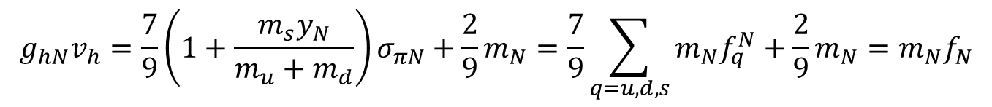
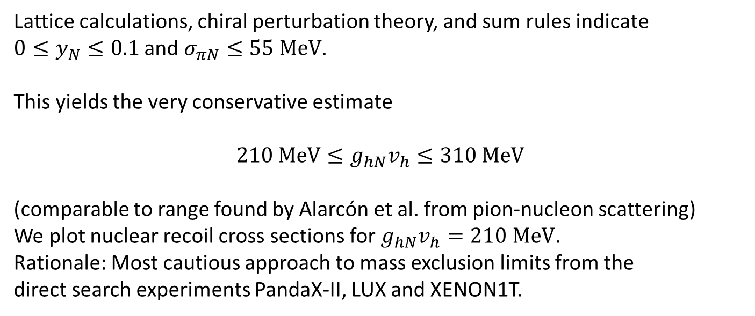
The Higgs-nucleon coupling $g_{hN}h\overline{N}N$
$$g_{hN}v_{h}=\frac{7}{9}\left(1+\frac{m_{s}y_{N}}{m_{u}+m_{d}}\right)σ_{πN}+\frac{2}{9}m_{N}=\frac{7}{9}\sum_{q=u,d,s}{{m_{N}f}_{q}^{N}}+\frac{2}{9}m_{N}=m_{N}f_{N}$$
Lattice calculations, chiral perturbation theory, and sum rules indicate
$0≤y_{N}≤0.1$ and $σ_{πN}≤55 MeV$.
This yields the very conservative estimate
$$210 MeV≤g_{hN}v_{h}≤310 MeV$$
(comparable to range found by Alarcón et al. from pion-nucleon scattering)
We plot nuclear recoil cross sections for $g_{hN}v_{h}=210 MeV$.
Rationale: Most cautious approach to mass exclusion limits from the
direct search experiments PandaX-II, LUX and XENON1T.

Slide 4
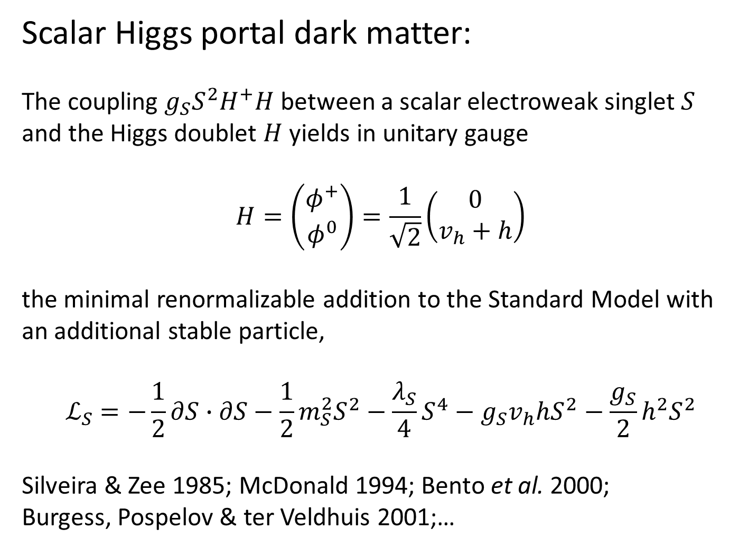
Scalar Higgs portal dark matter:
The coupling $g_{S}S^{2}H^{+}H$ between a scalar electroweak singlet $S$ and the Higgs doublet $H$ yields in unitary gauge
$$H=\left(\begin{matrix}φ^{+} \\ φ^{0}\end{matrix}\right)=\frac{1}{\sqrt{2}}\left(\begin{matrix}0 \\ v_{h}+h\end{matrix}\right)$$
the minimal renormalizable addition to the Standard Model with an additional stable particle,
$$ℒ_{S}=−\frac{1}{2}∂S∙∂S−\frac{1}{2}m_{S}^{2}S^{2}−\frac{λ_{S}}{4}S^{4}−g_{S}v_{h}hS^{2}−\frac{g_{S}}{2}h^{2}S^{2}$$
Silveira & Zee 1985; McDonald 1994; Bento et al. 2000;
Burgess, Pospelov & ter Veldhuis 2001;…

Slide 5
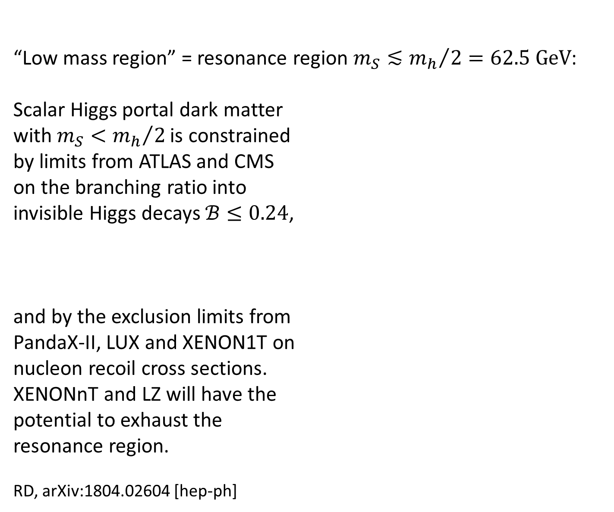
“Low mass region” = resonance region $m_{S}≲{m_{h}}/{2=62.5 GeV}$:
Scalar Higgs portal dark matter
with $m_{S}<{m_{h}}/2$ is constrained
by limits from ATLAS and CMS
on the branching ratio into
invisible Higgs decays $ℬ≤0.24$,
and by the exclusion limits from
PandaX-II, LUX and XENON1T on
nucleon recoil cross sections.
XENONnT and LZ will have the
potential to exhaust the
resonance region.
RD, arXiv:1804.02604 [hep-ph]

Slide 6
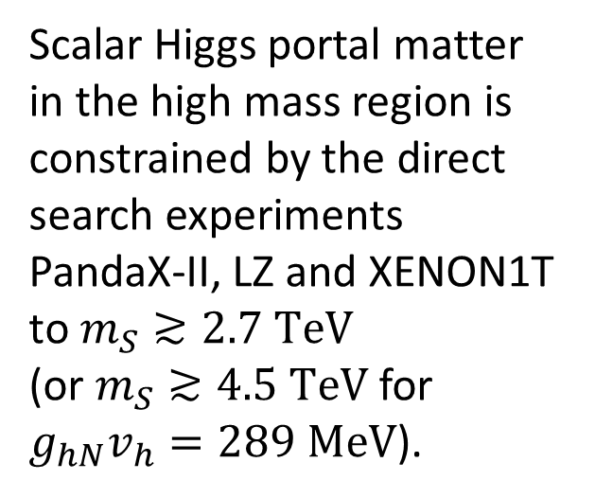
Scalar Higgs portal matter in the high mass region is constrained by the direct search experiments PandaX-II, LZ and XENON1T to $m_{S}≳2.7 TeV$
(or $m_{S}≳4.5 TeV$ for $g_{hN}v_{h}=289 MeV$).
It should be detected or ruled out by DarkSide-20k and DARWIN
arXix:1804.02604 [hep-ph]

Slide 7
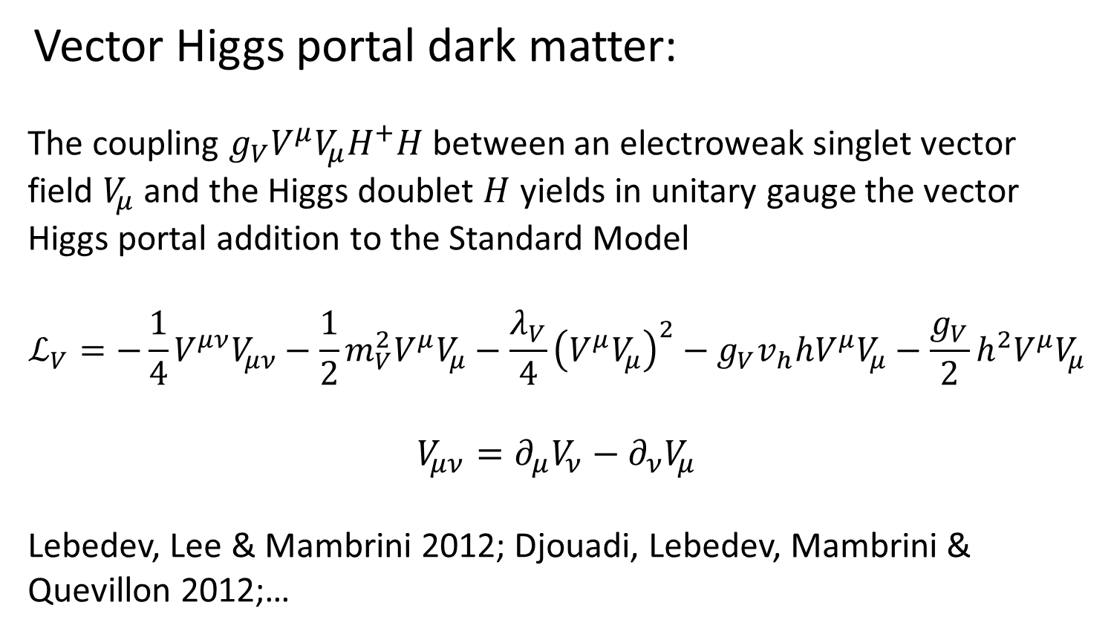
Vector Higgs portal dark matter:
The coupling $g_{V}V^{μ}V_{μ}H^{+}H$ between an electroweak singlet vector
field $V_{μ}$ and the Higgs doublet $H$ yields in unitary gauge the vector
Higgs portal addition to the Standard Model
$$ℒ_{V}=−\frac{1}{4}V^{μν}V_{μν}−\frac{1}{2}m_{V}^{2}V^{μ}V_{μ}−\frac{λ_{V}}{4}{\left(V^{μ}V_{μ}\right)}^{2}−g_{V}v_{h}hV^{μ}V_{μ}−\frac{g_{V}}{2}h^{2}V^{μ}V_{μ}$$
$$V_{μν}=∂_{μ}V_{ν}−∂_{ν}V_{μ}$$
Lebedev, Lee & Mambrini 2012; Djouadi, Lebedev, Mambrini &
Quevillon 2012;…

Slide 8
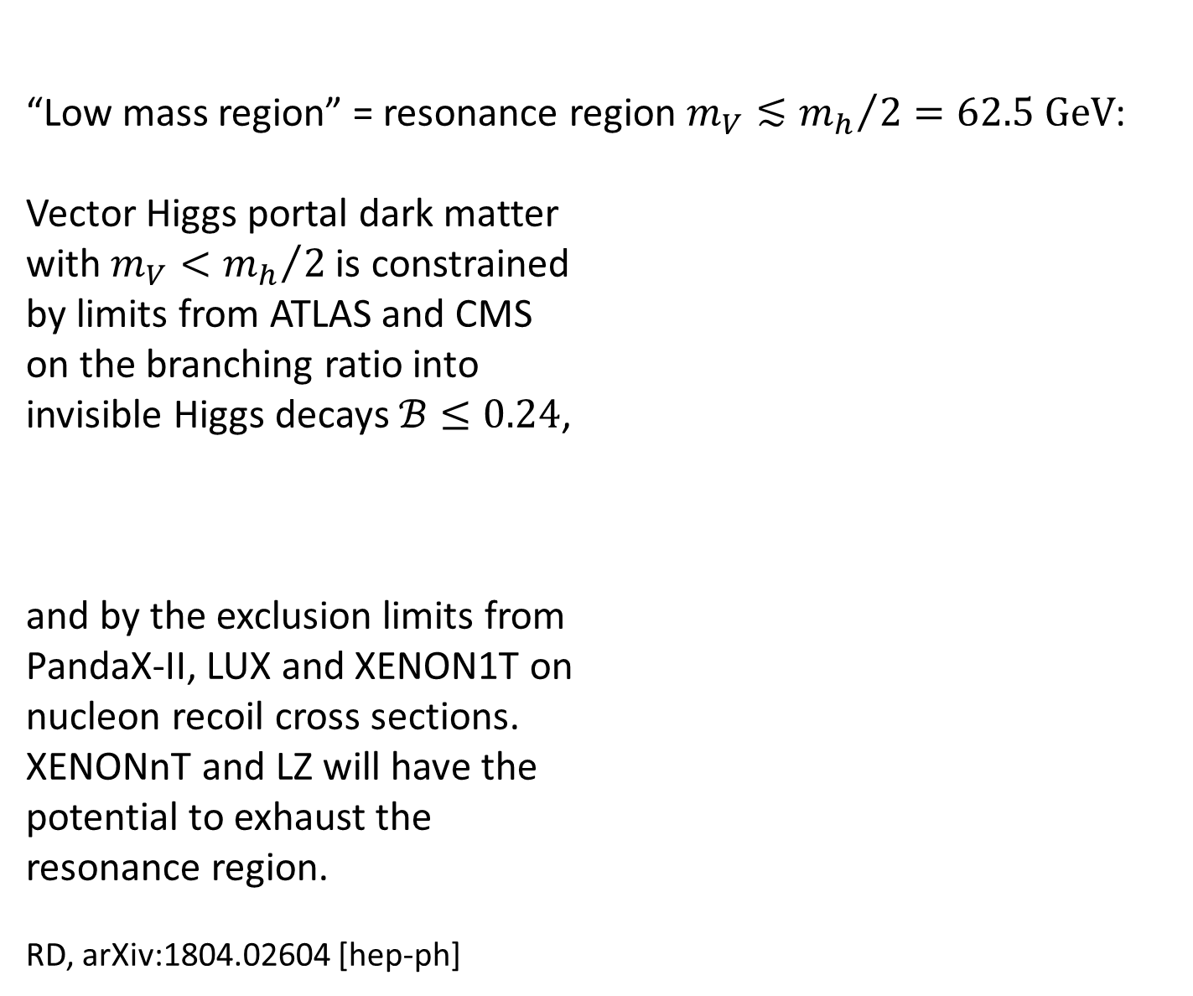
“Low mass region” = resonance region $m_{V}≲{m_{h}}/{2=62.5 GeV}$:
Vector Higgs portal dark matter
with $m_{V}<{m_{h}}/2$ is constrained
by limits from ATLAS and CMS
on the branching ratio into
invisible Higgs decays $ℬ≤0.24$,
and by the exclusion limits from
PandaX-II, LUX and XENON1T on
nucleon recoil cross sections.
XENONnT and LZ will have the
potential to exhaust the
resonance region.
RD, arXiv:1804.02604 [hep-ph]

Slide 9
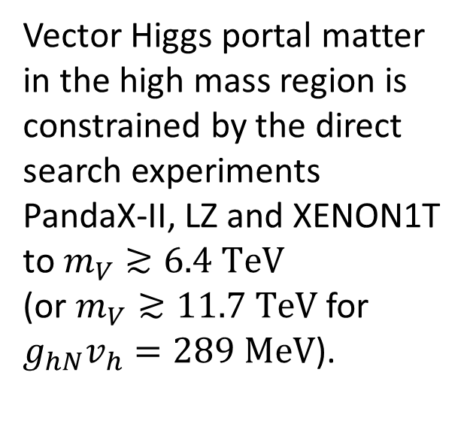
Vector Higgs portal matter in the high mass region is constrained by the direct search experiments PandaX-II, LZ and XENON1T to $m_{V}≳6.4 TeV$
(or $m_{V}≳11.7 TeV$ for $g_{hN}v_{h}=289 MeV$).
It should be detected or ruled out by DarkSide-20k and DARWIN.
arXix:1804.02604 [hep-ph]

Slide 10
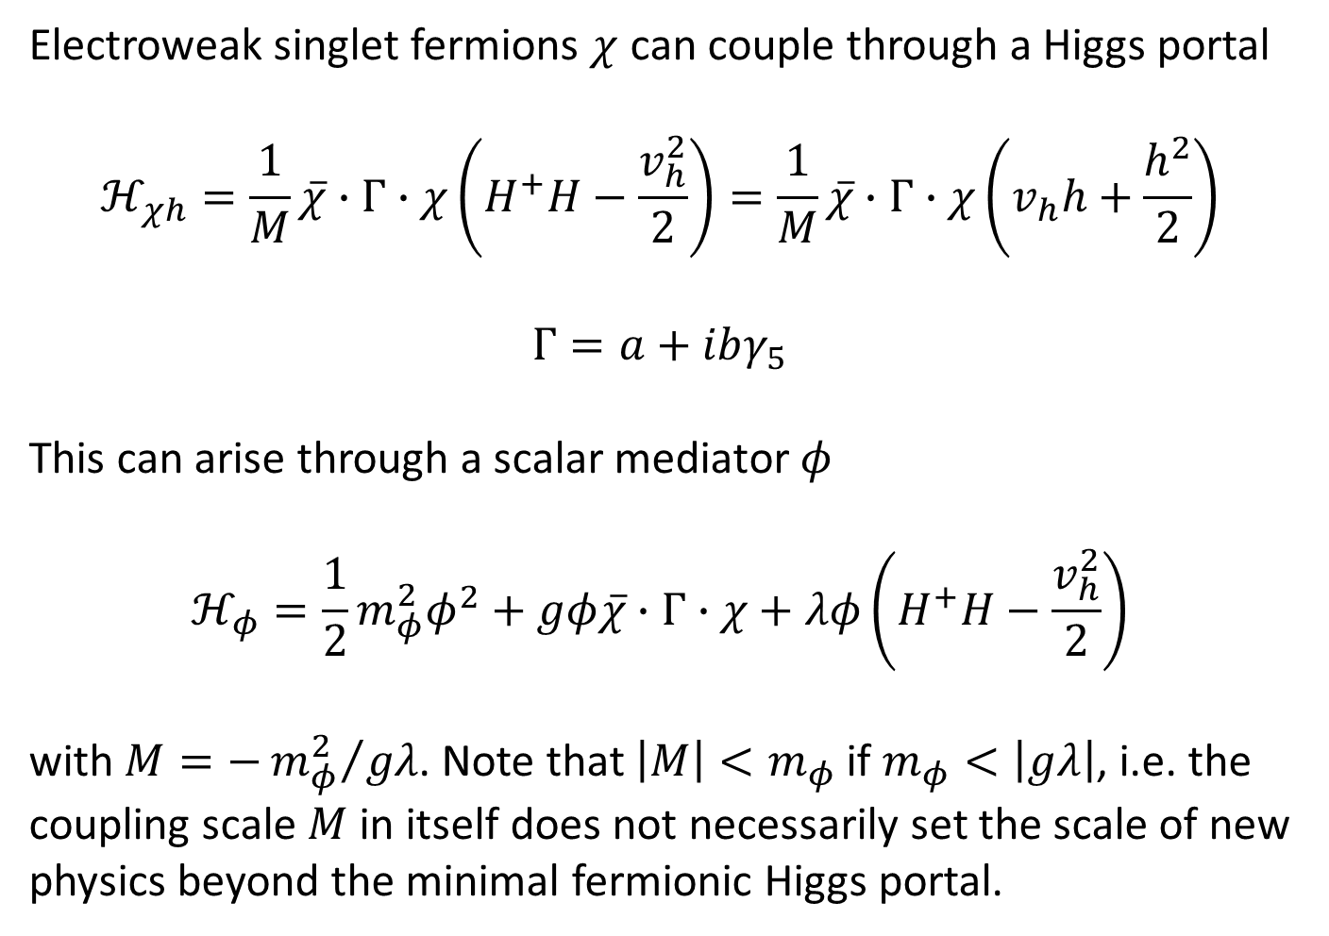
Electroweak singlet fermions $χ$ can couple through a Higgs portal
$$ℋ_{χh}=\frac{1}{M}\overline{χ}∙Γ∙χ\left(H^{+}H−\frac{v_{h}^{2}}{2}\right)=\frac{1}{M}\overline{χ}∙Γ∙χ\left(v_{h}h+\frac{h^{2}}{2}\right)$$
$$Γ=a+ibγ_{5}$$
This can arise through a scalar mediator $φ$
$$ℋ_{φ}=\frac{1}{2}m_{φ}^{2}φ^{2}+gφ\overline{χ}∙Γ∙χ+λφ\left(H^{+}H−\frac{v_{h}^{2}}{2}\right)$$
with $M=−{m_{φ}^{2}}/{gλ}$. Note that $\left|M\right|<m_{φ}$ if $m_{φ}<\left|gλ\right|$, i.e. the coupling scale $M$ in itself does not necessarily set the scale of new physics beyond the minimal fermionic Higgs portal.

Slide 11
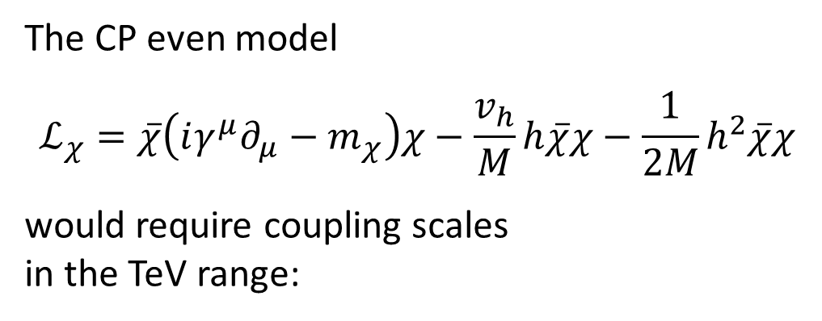
The CP even model
$$ℒ_{χ}=\overline{χ}\left(iγ^{μ}∂_{μ}−m_{χ}\right)χ−\frac{v_{h}}{M}h\overline{χ}χ−\frac{1}{2M}h^{2}\overline{χ}χ$$
would require coupling scales
in the TeV range:

Slide 12
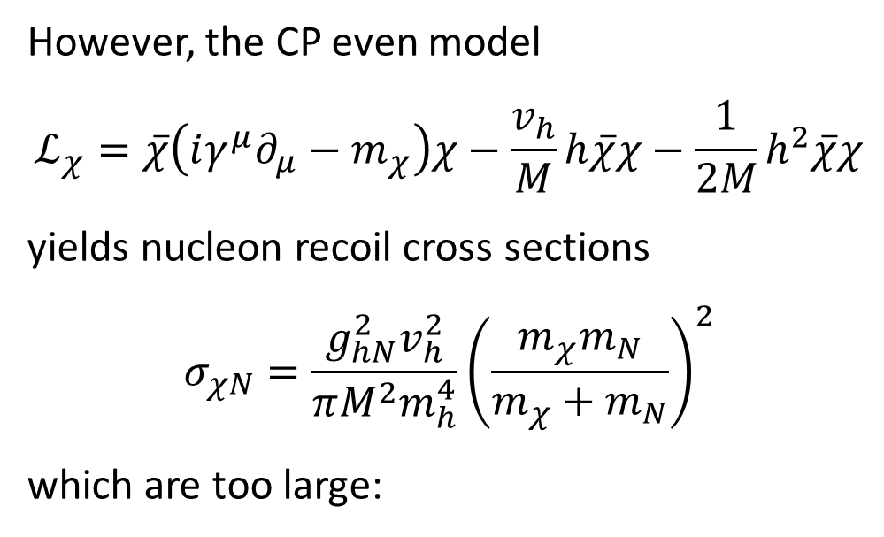
However, the CP even model
$$ℒ_{χ}=\overline{χ}\left(iγ^{μ}∂_{μ}−m_{χ}\right)χ−\frac{v_{h}}{M}h\overline{χ}χ−\frac{1}{2M}h^{2}\overline{χ}χ$$
yields nucleon recoil cross sections
$$σ_{χN}=\frac{g_{hN}^{2}v_{h}^{2}}{πM^{2}m_{h}^{4}}{\left(\frac{m_{χ}m_{N}}{m_{χ}+m_{N}}\right)}^{2}$$
which are too large:

Slide 13
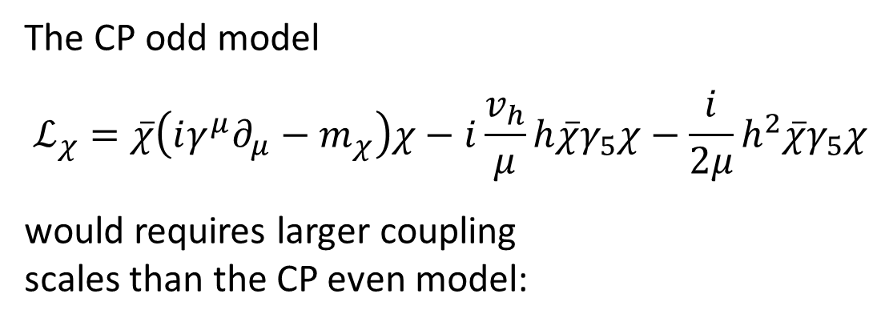
The CP odd model
$$ℒ_{χ}=\overline{χ}\left(iγ^{μ}∂_{μ}−m_{χ}\right)χ−i\frac{v_{h}}{μ}h\overline{χ}γ_{5}χ−\frac{i}{2μ}h^{2}\overline{χ}γ_{5}χ$$
would requires larger coupling scales than the CP even model:

Slide 14
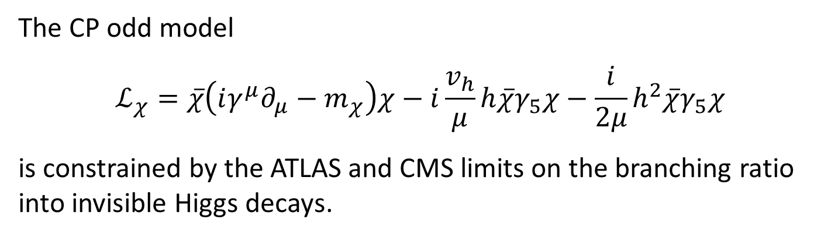
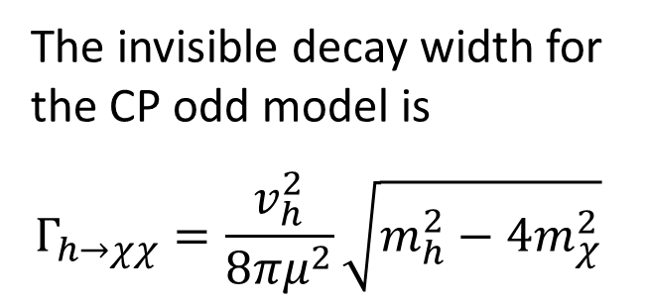
The CP odd model
$$ℒ_{χ}=\overline{χ}\left(iγ^{μ}∂_{μ}−m_{χ}\right)χ−i\frac{v_{h}}{μ}h\overline{χ}γ_{5}χ−\frac{i}{2μ}h^{2}\overline{χ}γ_{5}χ$$
is constrained by the ATLAS and CMS limits on the branching ratio into invisible Higgs decays.
The invisible decay width for the CP odd model is
$$Γ_{h→χχ}=\frac{v_{h}^{2}}{8πμ^{2}}\sqrt{m_{h}^{2}−4m_{χ}^{2}}$$

Slide 15
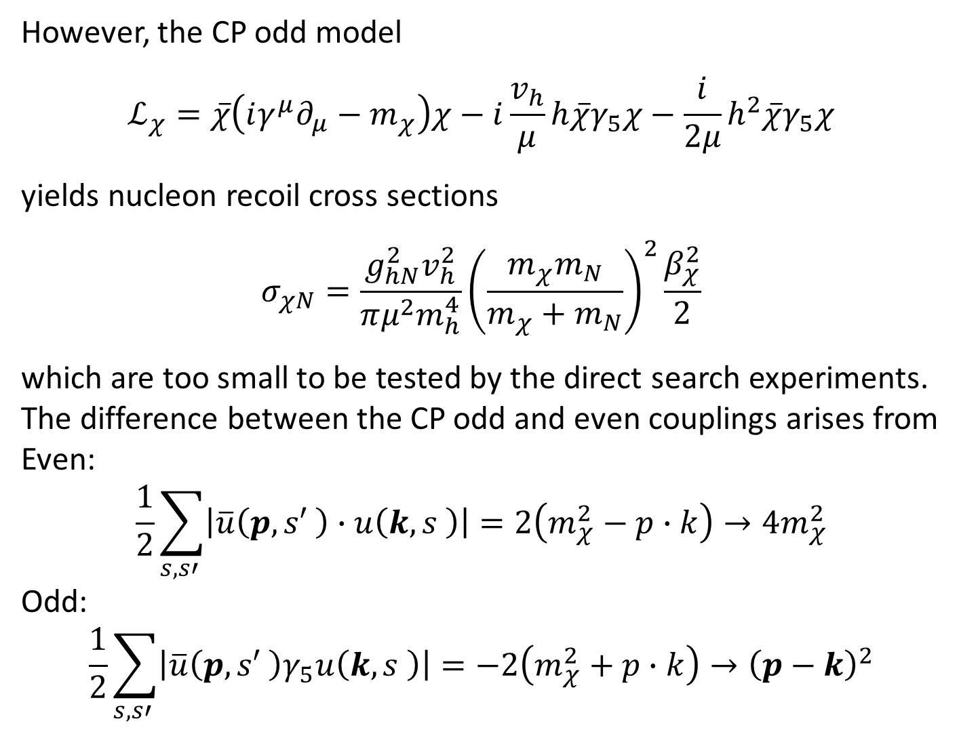
However, the CP odd model
$$ℒ_{χ}=\overline{χ}\left(iγ^{μ}∂_{μ}−m_{χ}\right)χ−i\frac{v_{h}}{μ}h\overline{χ}γ_{5}χ−\frac{i}{2μ}h^{2}\overline{χ}γ_{5}χ$$
yields nucleon recoil cross sections
$$σ_{χN}=\frac{g_{hN}^{2}v_{h}^{2}}{πμ^{2}m_{h}^{4}}{\left(\frac{m_{χ}m_{N}}{m_{χ}+m_{N}}\right)}^{2}\frac{β_{χ}^{2}}{2}$$
which are too small to be tested by the direct search experiments.
The difference between the CP odd and even couplings arises from
Even:
$$\frac{1}{2}\sum_{s,s′ }{\left|\overline{u}\left(p,s′ \right)∙u\left(k,s \right)\right|}=2\left(m_{χ}^{2}−p∙k\right)→4m_{χ}^{2}$$
Odd:
$$\frac{1}{2}\sum_{s,s′ }{\left|\overline{u}\left(p,s′ \right)γ_{5}u\left(k,s \right)\right|}=−2\left(m_{χ}^{2}+p∙k\right)→{\left(p−k\right)}^{2}$$

Slide 16
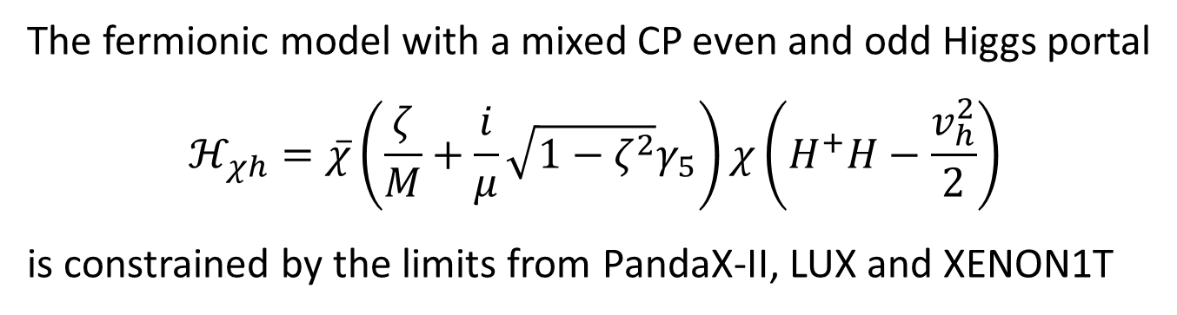
The fermionic model with a mixed CP even and odd Higgs portal
$$ℋ_{χh}=\overline{χ}\left(\frac{ζ}{M}+\frac{i}{μ}\sqrt{1−ζ^{2}}γ_{5}\right)χ\left(H^{+}H−\frac{v_{h}^{2}}{2}\right)$$
is constrained by the limits from PandaX-II, LUX and XENON1T
RD, arXiv:1804.02604 [hep-ph]. Allowed values of $ζ$ are further reduced by a factor 0.727 if $g_{hN}v_{h}=289 MeV$.

Slide 17

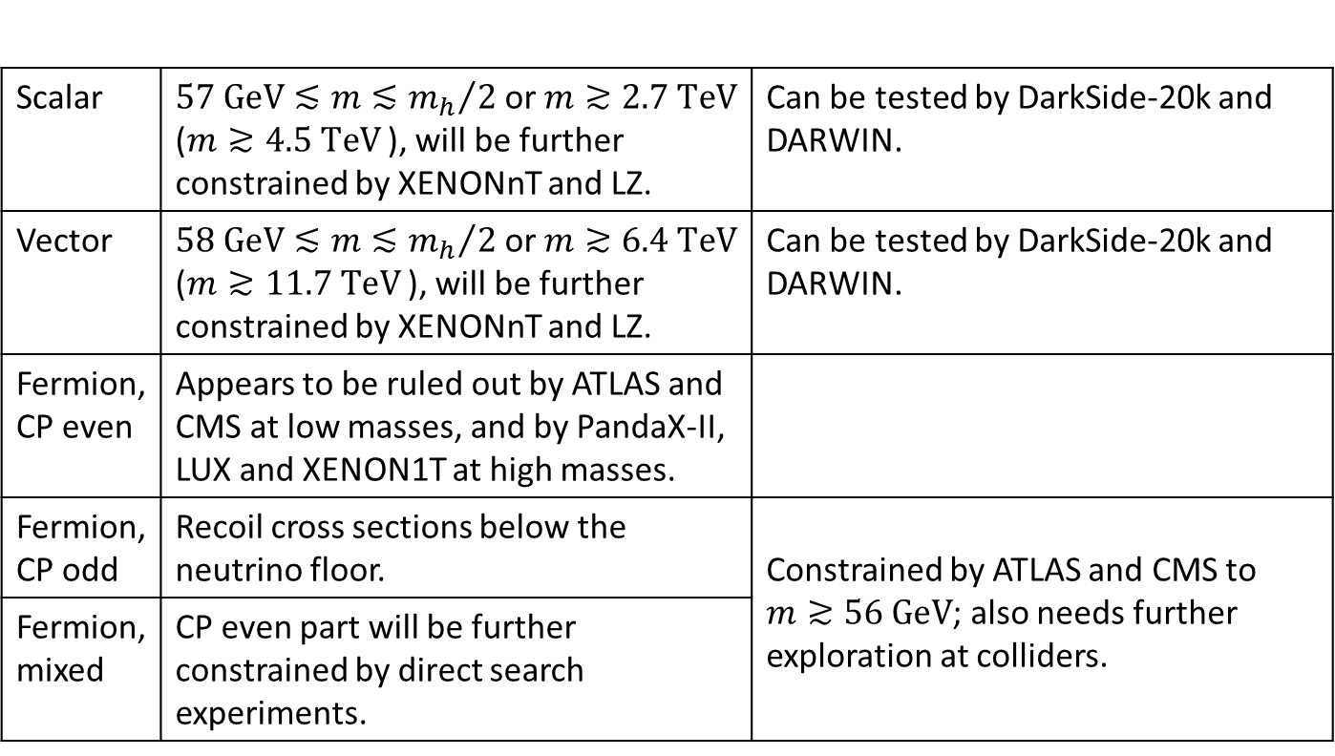
Conclusion: Status of minimal electroweak singlet Higgs portal dark matter from thermal freeze-out
Scalar | $57 GeV≲m≲{m_{h}}/2$ or $m≳2.7 TeV$ ($m≳4.5 TeV$ ), will be further constrained by XENONnT and LZ. | Can be tested by DarkSide-20k and DARWIN.
Vector | $58 GeV≲m≲{m_{h}}/2$ or $m≳6.4 TeV$ ($m≳11.7 TeV$ ), will be further constrained by XENONnT and LZ. | Can be tested by DarkSide-20k and DARWIN.
Fermion, CP even | Appears to be ruled out by ATLAS and CMS at low masses, and by PandaX-II, LUX and XENON1T at high masses.
Fermion, CP odd | Recoil cross sections below the neutrino floor. | Constrained by ATLAS and CMS to $m≳56 GeV$; also needs further exploration at colliders.
Fermion, mixed | CP even part will be further constrained by direct search experiments.

