Slide 1
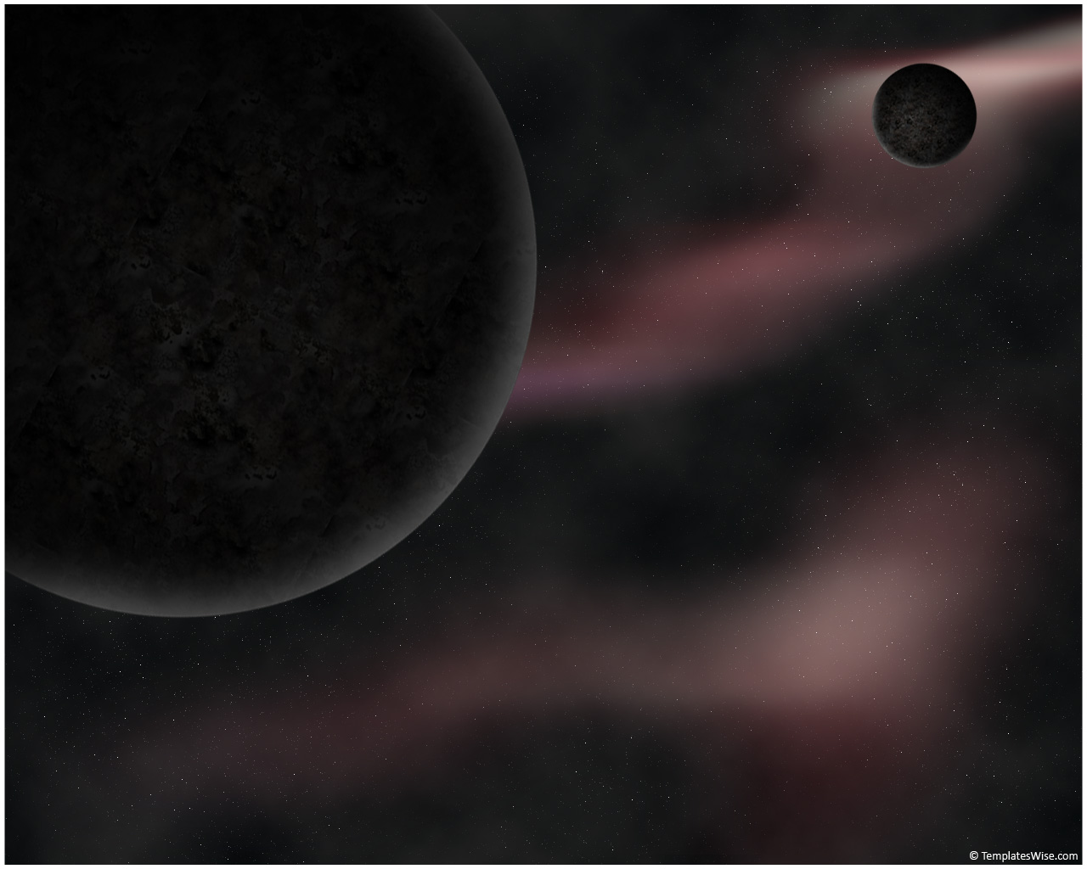
Outline
Results and Future Plans for the PICO Dark Matter Bubble Chamber
PICO superheated liquid technology
PICO Background Mitigation
Recent Results from PICO 60
Future Plans: PICO 40 → PICO 500
Tony Noble
Queen’s University

Slide 2






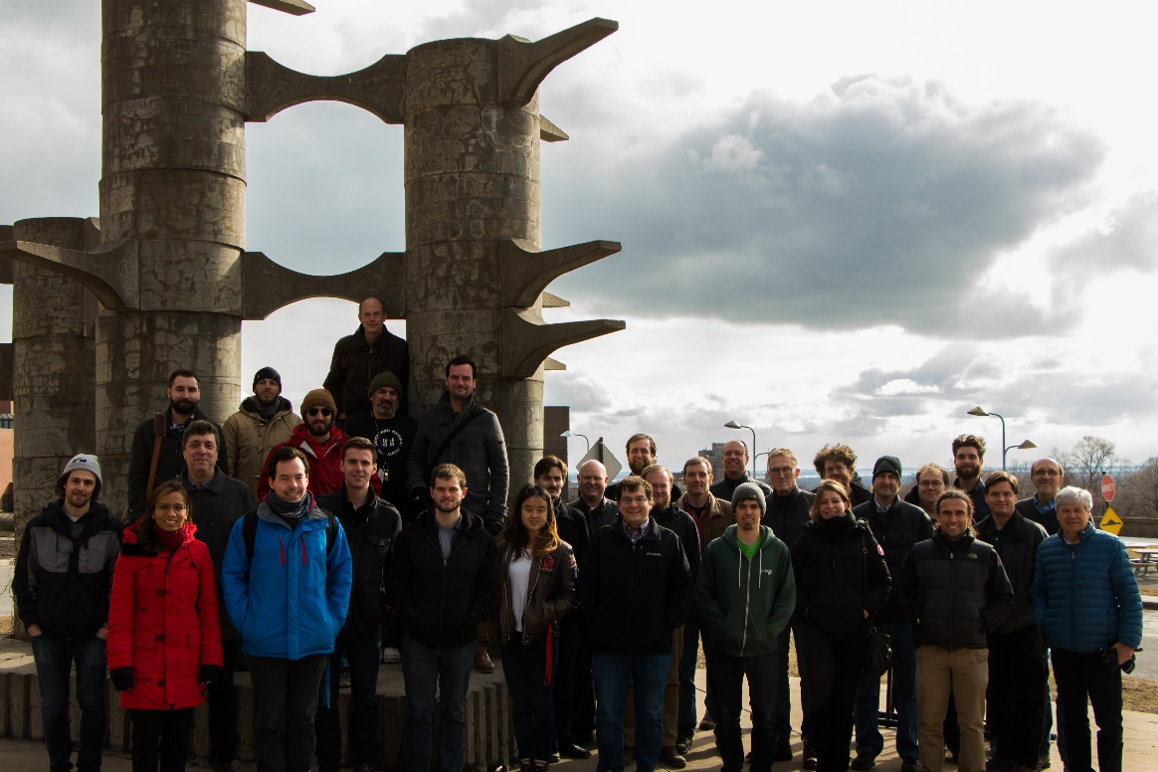













O. Harris
S. Chen, M. Laurin,
J.-P. Martin, A. Plante,
A.E. Robinson, N. Starinski, F. Tardif, D. Tiwari, V. Zacek, C. Wen Chao,
R. Filgas, I. Stekl
J.I. Collar
I. Lawson
E. Behnke, I. Levine, T. Nania
M. Ardid, M. Bou-Cabo, I. Felis
M. Das, S. Sahoo, S. Seth
M. Bressler, R. Neilson
D. Maurya, S. Priya, Y. Yan
P.S. Cooper, M. Crisler, W.H. Lippincott, A. Sonnenschein
C. Coutu, S. Fallows, C. Krauss, M.-C. Piro
D. Baxter, C.E. Dahl, M. Jin,
J. Zhang
E. Vázquez-Jáuregui
B. Broerman, G. Cao, K. Clark, G. Giroux, C. Hardy, C. Moore, A. Noble
I. Arnquist , C. Cowles, C.M. Jackson, B. Loer, K. Wierman
J. Farine, A. Le Blanc, C. Licciardi, O. Scallon, U. Wichoski

Slide 3
The Bubble Chamber Technology

Slide 4
Direct WIMP Dark Matter Detection…The challenges:
    Must detect kinetic energy of recoiling nucleus in WIMP interaction. ~(1-100 keV).
    Very low event rate expected
    ~(1 event per tonne/year)
    Need to remove ~all sources of backgrounds.

Slide 5
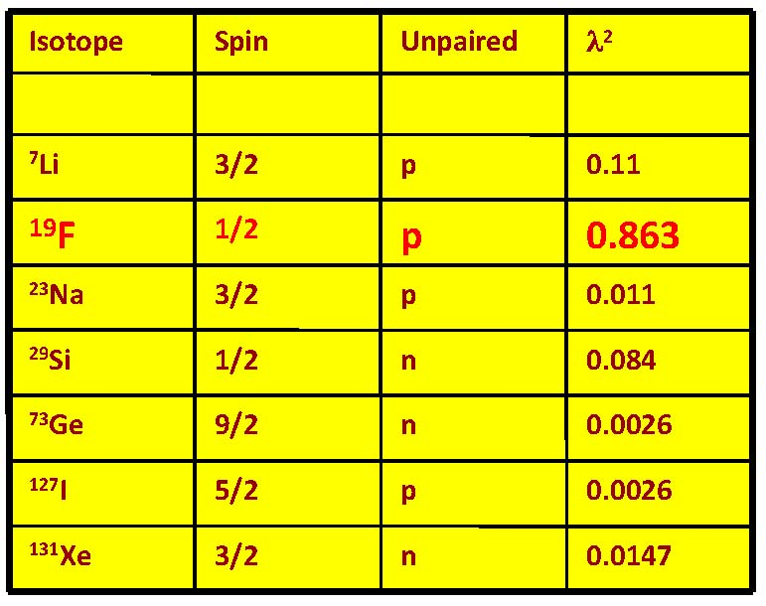
Bubble chamber fluids
Could make a dark matter bubble chamber with any liquid.
Fluorocarbons are ideal:
  Superheated fluid at room temperature and pressure.
  Not flammable.
  Low toxicity.
  Fluorine is ideal spin-dependent target.
  Fluorine can be replaced with high-mass halogen (Cl, Br, I) for improved A² enhancement.
COUPP/PICO bubble chambers have until now used CF₃I, C₃F₈ as active fluid.
PICASSO used similar C₄F₁₀
Spin-independent
Spin-dependent
Hydrogen would also be great. See Talk by Frédéric Tardif : W2-3

Slide 6
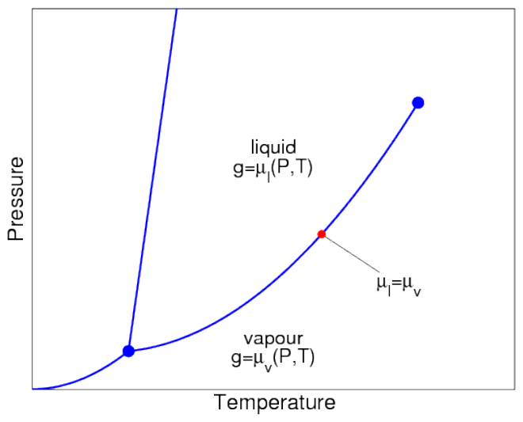
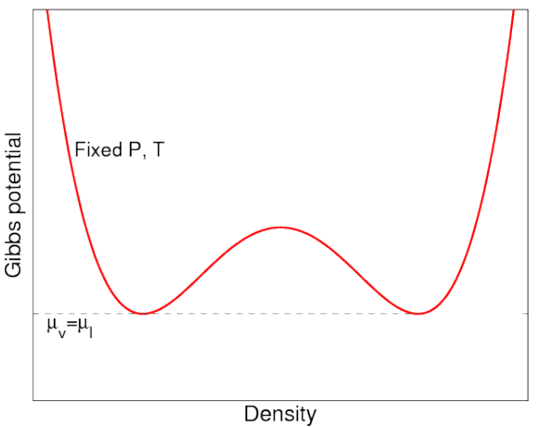
Bubble Chamber Operation
Phase diagram
Gibbs free energy
Vapour
Liquid
Gas Like
Liquid Like
When on the saturation curve, liquid and gas are in equilibrium. (Same pressure, temperature and chemical potential).
At equilibrium, the potential has two minima (one dominantly gas like and one liquid dominated)

Slide 7
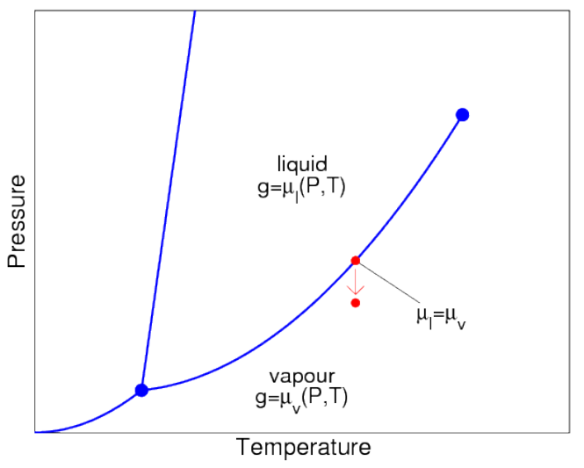
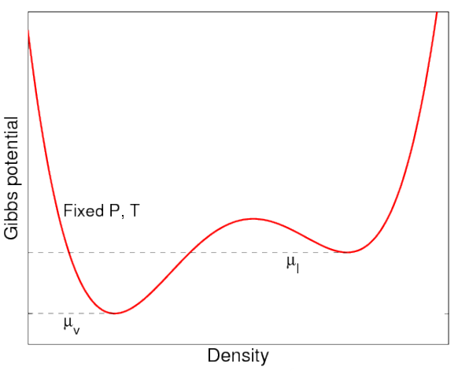
Bubble Chamber Operation
Phase diagram
Gibbs free energy
Superheated Liquid
Vapour
We now lower the pressure of the chamber carefully….starting from the pure liquid phase.
This distorts the potential, leading to a meta-stable superheated liquid state. Unless sufficient energy is added, it will stay in meta-stable state.

Slide 8
Bubble Nucleation Dynamics. What Controls Bubble Growth?
For a full description. See Talk by Alexandre Le Blanc : W1-3
A small proto-bubble is produced.
The bubble begins to expand as the vapour is produced. Outward pressure P_{b}
P_{b}
This is opposed by the external pressure of the liquid , and …
It is opposed by the surface tension at the interface.
At equilibrium:
At larger radii, diff pressure is small, bubble grows easily …. Rapid boiling
Critical radius for (unstable) equilibrium:
At smaller radii, diff pressure is large, bubble can’t grow …. Collapse

Slide 9
Particle detection with bubble chambers
A bubble chamber is filled with a superheated fluid in meta-stable state.
Energy deposition greater than E_{th} in radius less than r_{c} from particle interaction will result in expanding bubble (Seitz “Hot-Spike” Model).
A smaller or more diffuse energy deposit will create a bubble that immediately collapses.
Surface energy
Latent heat
Take away message:
To be sensitive, particle must deposit enough energy within a critical radius.

Slide 10
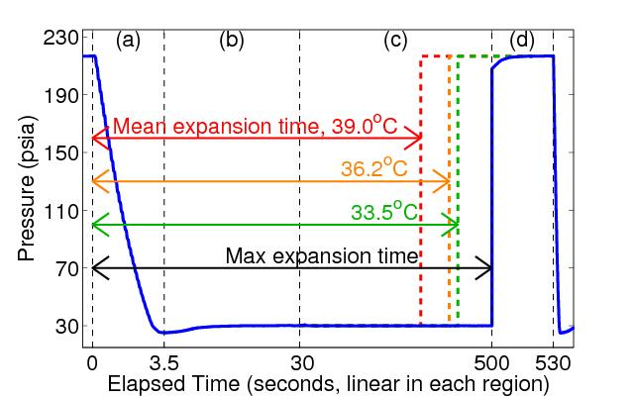
Principle of Operation: Original Bubble Chambers
Buffer fluid
(water)
Synthetic silica jar
Target fluid
(CF₃I/C₃F₈)
Hydraulic
fluid
to hydraulic controller
Lower the pressure to a superheated state.
See the bubble:
  Cameras trigger. record position, multiplicity
  Microphones record acoustic trace
  Fast pressure transducer recording.
Raise pressure to stop bubble growth (100ms), reset chamber (30sec)

Slide 11
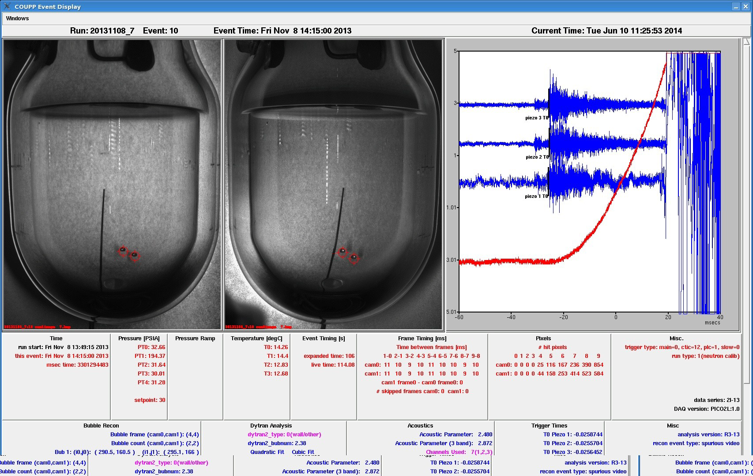
Acoustic Transducers
100fps stereo images
Fast Pressure Transducer
Screen Display during operations

Slide 12
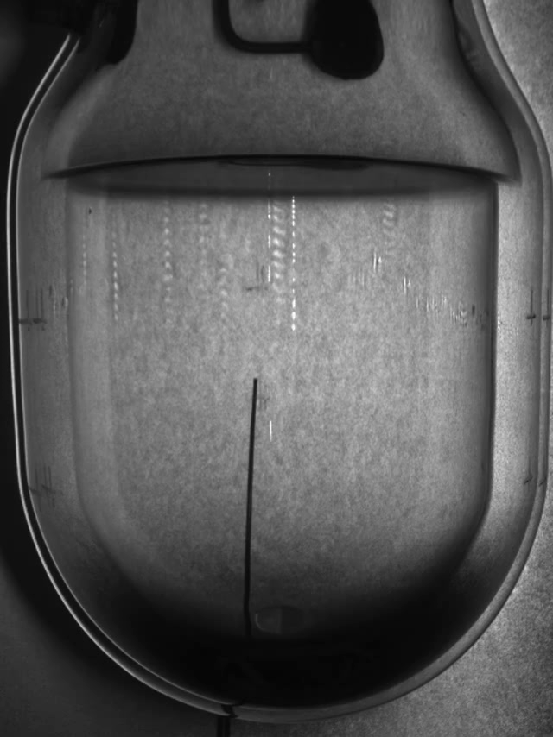
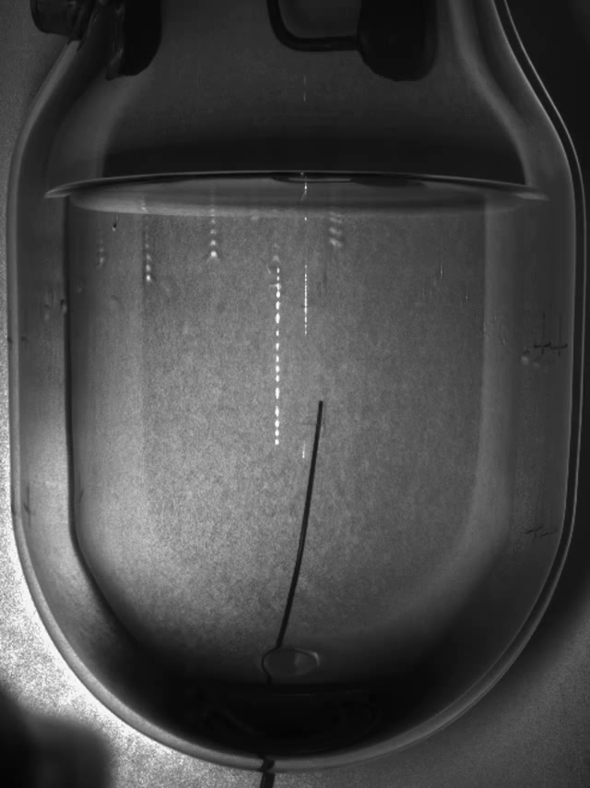
Two example events recorded
Single Bubble event
Neutron event

Slide 13
Background Mitigation:

Slide 14
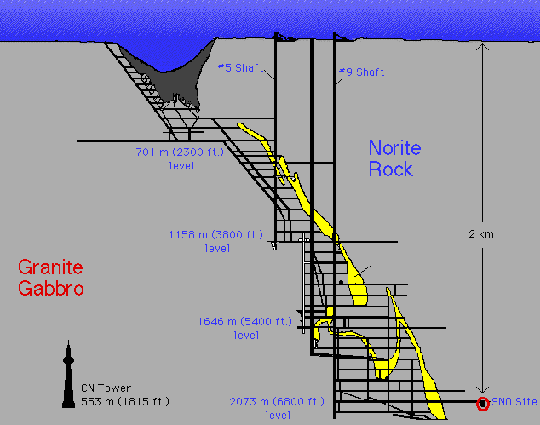
Backgrounds:
  Require very low background environment to see rare events ….
    Go deep underground to escape cosmic rays.
    Provide local shielding
    Use materials with ultra-low levels of radioactivity
    Develop particle discrimination techniques….
Neutrons
Electrons/gammas
Alpha
Neutrinos
Non-particle induced
SNOLAB, CANADA

Slide 15
Gamma/Beta Background Rejection.
C₃F₈
CF₃I
Various PICO Detectors
PICO-60
(set by adjusting T,P)
Excellent electron/gamma rejection has been demonstrated. < 10⁻¹⁰
C₃F₈ can reach lower thresholds than CF₃I for same rejection.
A lower threshold extends the sensitivity to lower mass WIMPs.

Slide 16
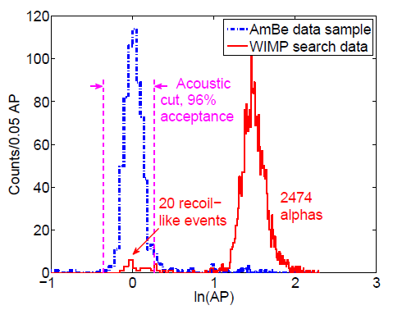
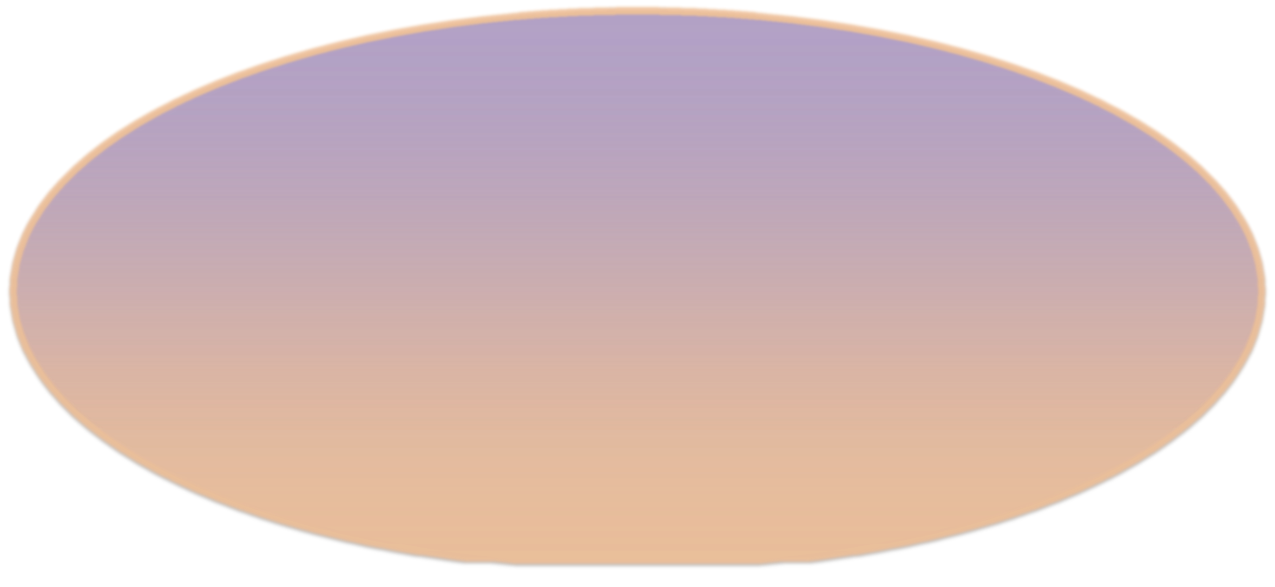
Alpha Acoustic Discrimination
Discovery by PICASSO of acoustic discrimination against alphas
  Nuclear recoils deposit their energy over tens of nanometers.
  Alphas deposit their energy over tens of microns.
In bubble chambers alphas are several times louder due to the difference in the rate of expansion and the number of protobubbles.
Observable bubble ~mm
~40 μm
~50 nm
Daughter heavy nucleus
(~100 keV)
Helium nucleus
(~5 MeV)

Slide 17
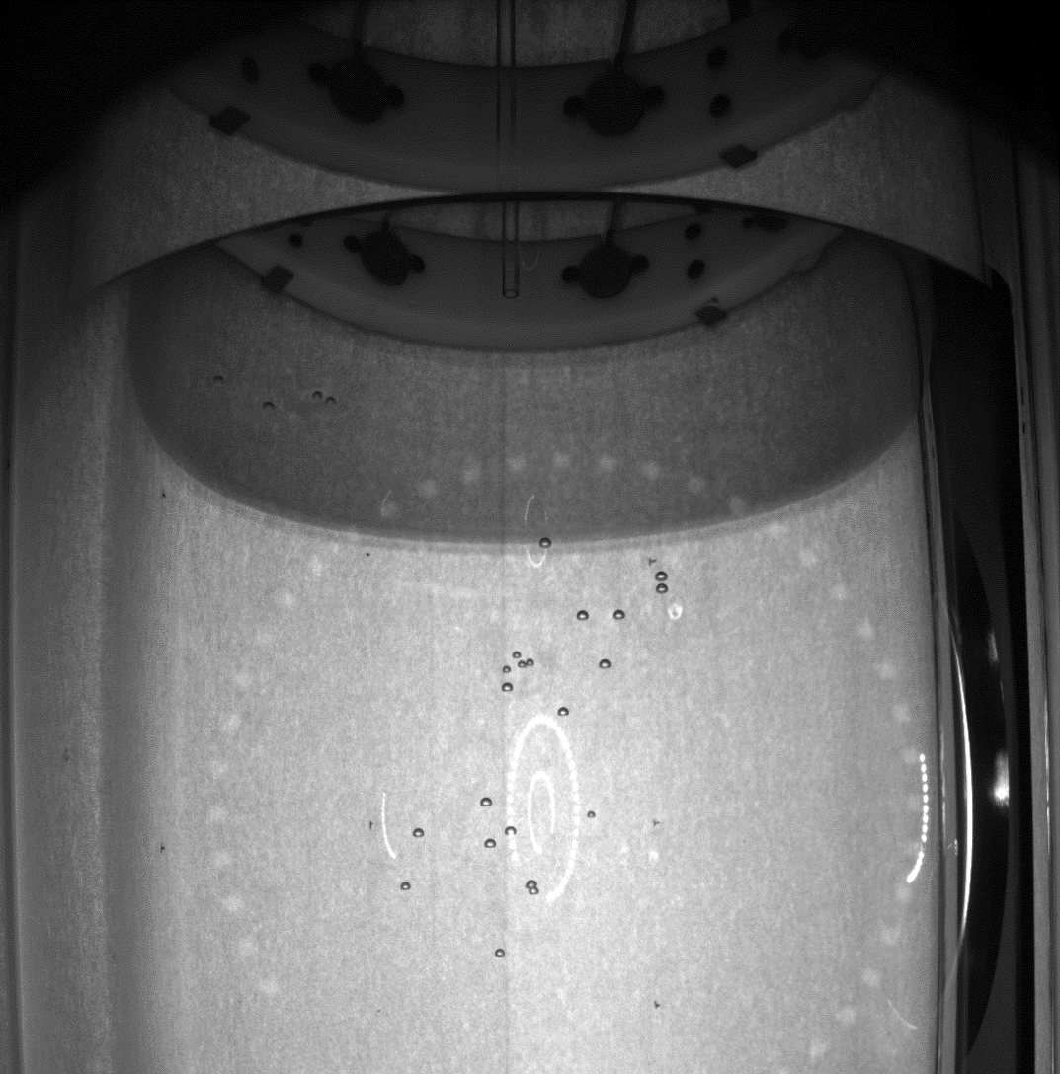
Neutron Backgrounds
Preferentially multiple-scatter
  Allows us to measure background rate directly
Simulation tells us to expect 3:1 multiples to singles ratio in PICO 60
With water tank to shield external sources, residual background dominated by detector materials
How many bubbles can you count?
Answer: 25
For exquitite details on the neutron simulation. See Talk by Arthur Plante : W2-3

Slide 18
Anomalous Background
PICO-2L Run1
  9 candidate events in 32 live-days at 3.2keV
  Inconsistent with known radioactive backgrounds AND dark matter
PICO-2L Run2
  1 candidate event in 66 live-days at 3.2keV
  Consistent with neutron expectations
Between runs, the detector was cleaned of particulate contamination
Run 1
After
C. Amole et al. Phys. Rev. D 93, 061101(R) (2016)
Between runs an enormous effort was made in how to clean detector of microscopic particulate contamination

Slide 19
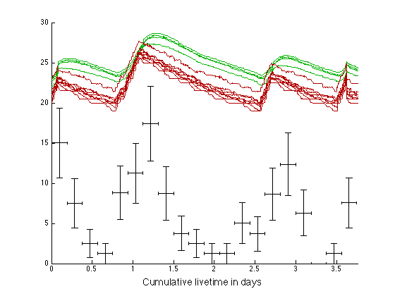
Also seen very clearly in PICO 60 with CF₃I. Some classes of events clearly correlated with the temperature of the water and glycol …. Correlation with pump, heaters, electrical noise, vibrations, convection…?
Temperature in Glycol (not to scale)
Temperature in Water (not to scale)
Anomolous-Event rate
(not to scale)

Slide 20
Anomalous Background
PICO-2L Run1
  9 candidate events in 32 live-days at 3.2keV
  Inconsistent with known radioactive backgrounds AND dark matter
PICO-2L Run2
  1 candidate event in 66 live-days at 3.2keV
  Consistent with neutron expectations
Between runs, the detector was cleaned of particulate contamination
Run 1
Run 2
C. Amole et al. Phys. Rev. D 93, 061101(R) (2016)
Hypothesis: combination of particulate matter and water leads to anomalous nucleation mechanism

Slide 21
Latest PICO Results
…. More in the pipeline, almost ready to publish

Slide 22
Brief Recap:
PICO is a merger of the original PICASSO and COUPP experiments (2014)
Since then we have been progressing with a series of world leading results in SD interactions as we resolve background issues and build larger detectors:
COUPP – 4 CF₃I (2011) Unknown background limits physics reach
PICO – 2L - 1 C₃F₈ (2014) Change fluid to type used by PICASSO
PICO – 60 - 1 CF₃I (2014) Large scale to understand background
From these, we believe backgrounds to be related to particulates at the microscopic scale. Develop procedures to improve on particulate backgrounds and lower neutron backgrounds
PICO – 2L – 2 C₃F₈ (2016) One background event (consistent with environmental neutrons)
Go big !
PICO – 60 - 2 C₃F₈ (2017) Aim for background free. Blinded data.

Slide 23
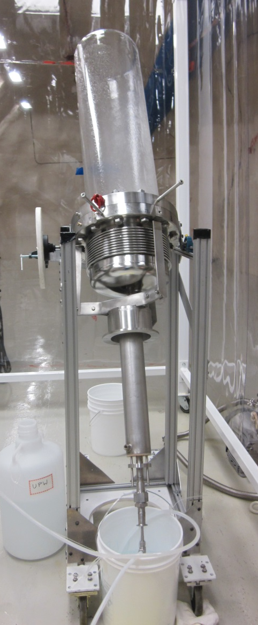
PICO-60 Cleaning
Every component touching the inner volume was cleaned according to the standard: MIL-STD-1246C level 50
Post-Filtration Particulate Size Distribution
----- Mil-Std 1246C level 100
----- Mil-Std 1246C level 50 (Goal)
----- Mil-Std 1246C level 25
* Filter Sample Normalized by Flow
<5μm
<15μm
<25μm
<50μm
<100μm
Particulate Size Bin

Slide 24
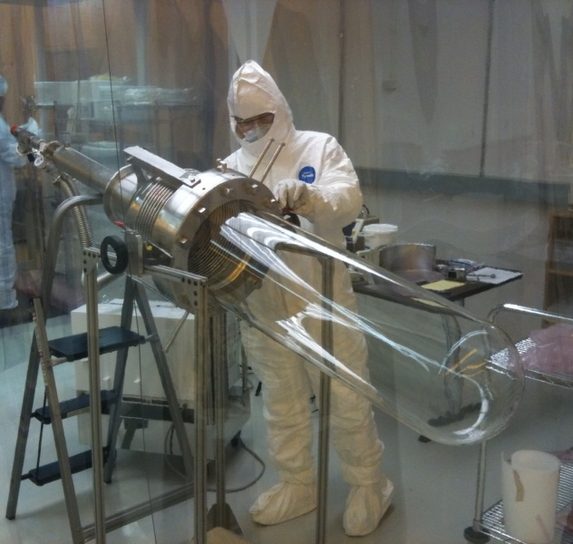
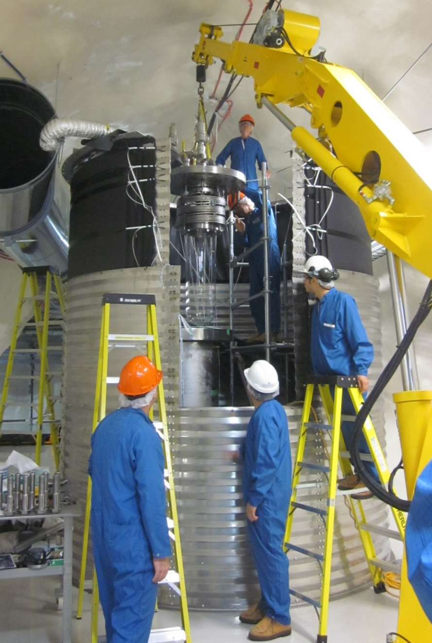
COUPP-60

Slide 25
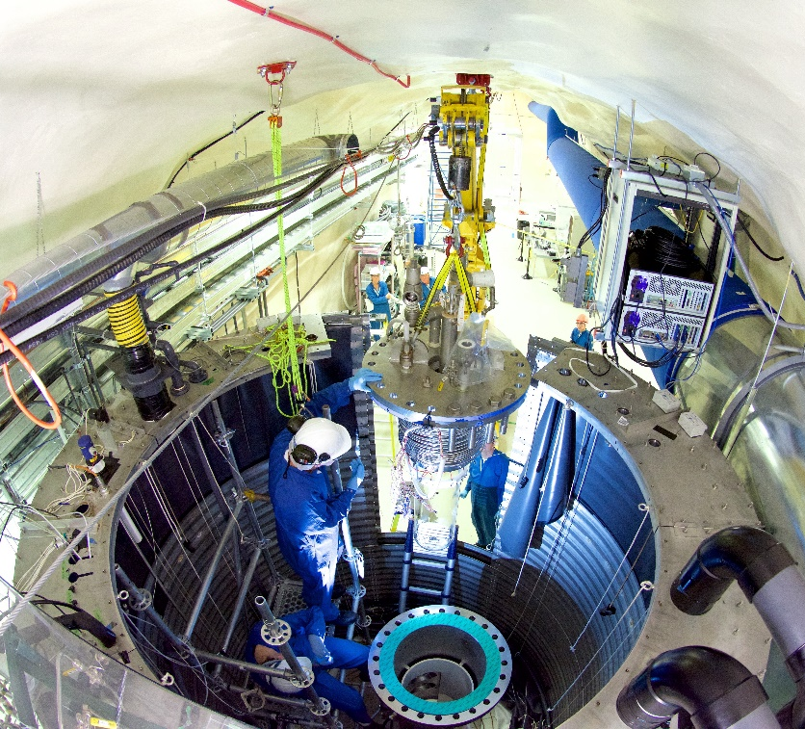
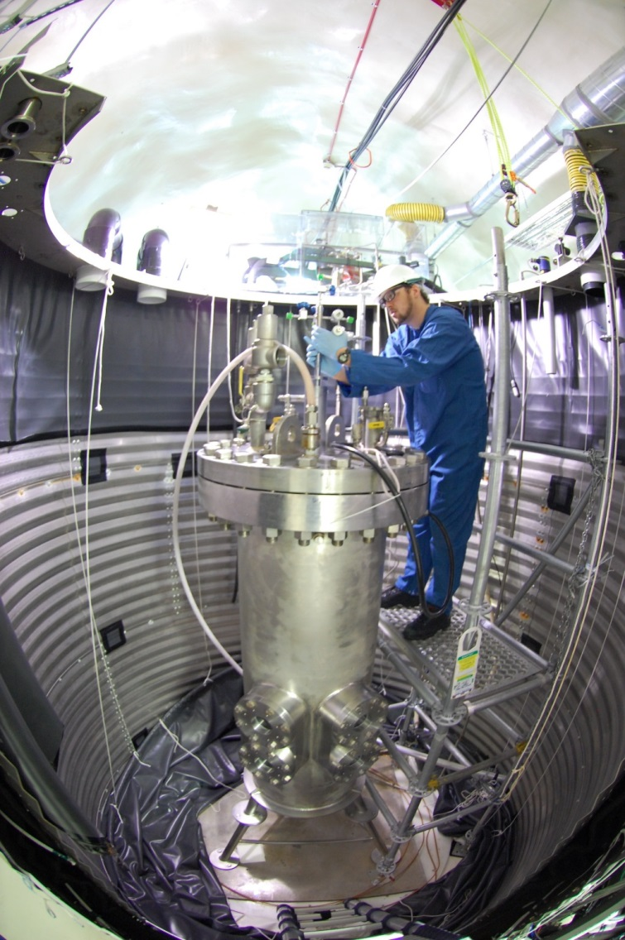
Commissioning
Filled with 40L C₃F₈ on June 30, 2016
First physics run Nov. 2016 – Jan. 2017

Slide 26
What do we measure?
Camera images (primary trigger)
  How many bubbles were there?
  What was the bubble’s position?
Temperature
Pressure (secondary trigger)
Acoustic signal
Neutron Rejection
Surface Rejection
Threshold
Determination
Alpha Rejection

Slide 27
What do we measure?
Camera images (primary trigger)
  How many bubbles were there?
  What was the bubble’s position?
Temperature
Pressure (secondary trigger)
Acoustic signal
Neutron Rejection
Surface Rejection
Threshold
Determination
Blind this information
Alpha Rejection

Slide 28
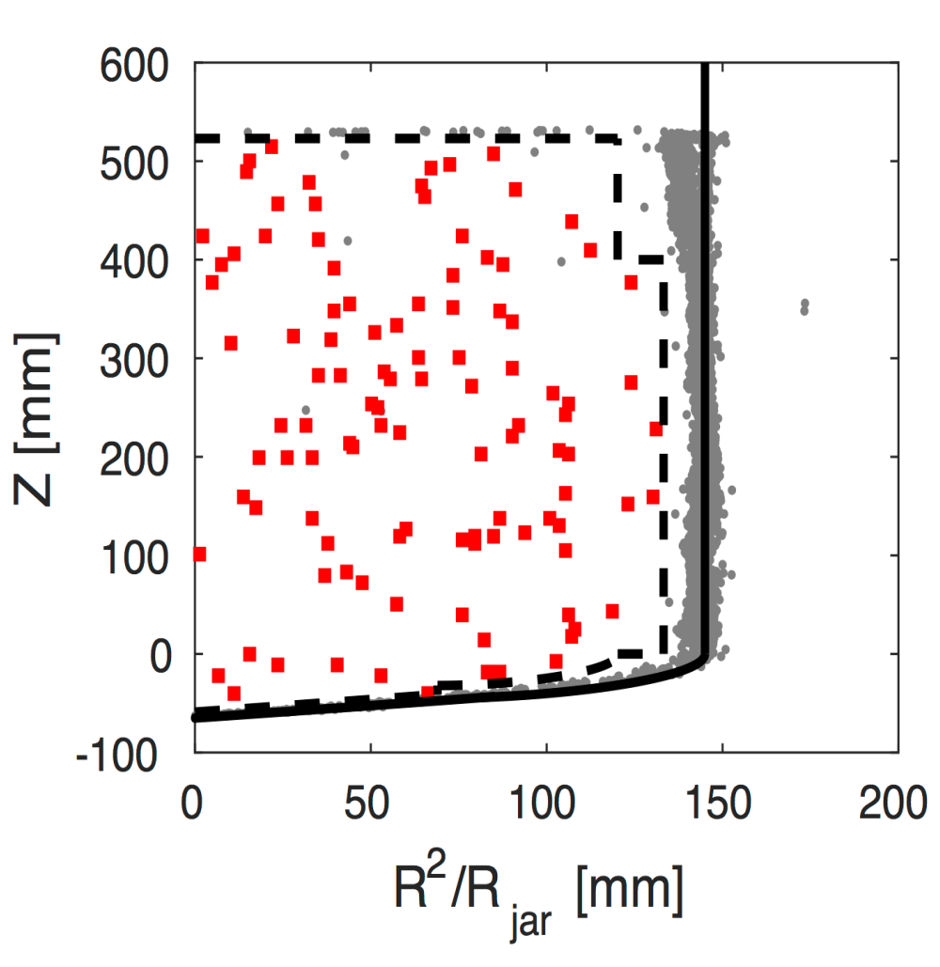
Before Opening the Box
106 bulk singles in WIMP search dataset
  Acoustics Still Blind
  Consistent with Rn decay rate in pre-WIMP search unblinded data
Neutron Background
  Not blinded to multiplicity
  3 multiple bubble events in the physics data
  Multiples to singles ratio is approximately 3:1 from calibration and simulation
Conclusion: 0-3 bulk singles would be consistent with neutrons and no anomalous background
C. Amole et al., arXiv:1702.07666

Slide 29
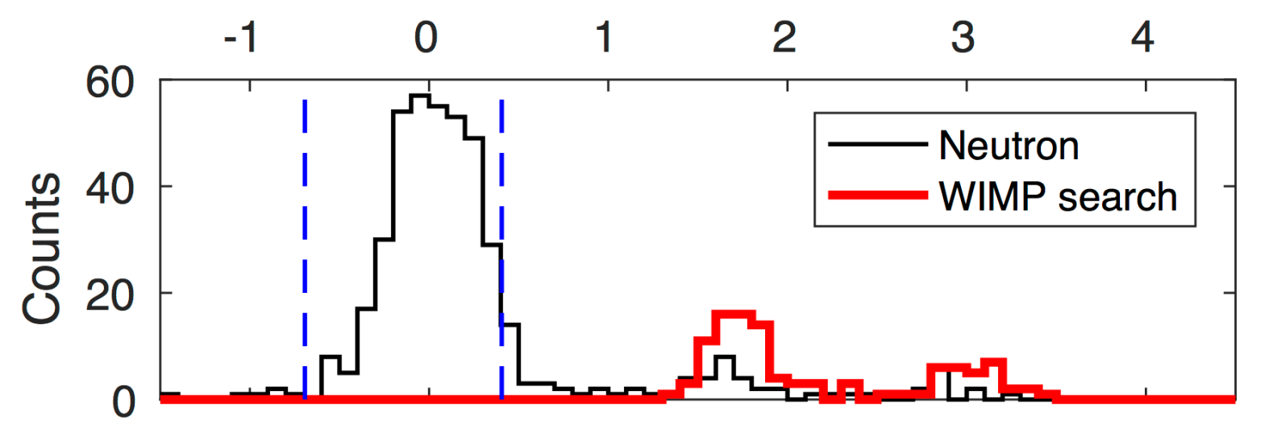
After Opening the Box
C. Amole et al., arXiv:1702.07666
No events in signal region!
Acoustic Power
Of the 106 fiducial-bulk singles, none are consistent with nuclear recoil hypothesis (all are consistent with radon chain alphas)
No background events observed !
Blind analysis

Slide 30
Spin-Dependent WIMP-Proton Coupling
Recent (2017) Limits from PICO-60
C. Amole et al., arXiv:1702.07666
PICASSO
SIMPLE
PandaX-II
PICO-2L C₃F₈
PICO-60 CF₃I
SuperK
IceCube
PICO-60 – Blind analysis, 0 events observed, x17 improvement to set world best limit on spin dependent proton coupling

Slide 31
Future Plans:
  PICO 40 …. ~ now
  PICO 500 …. ~ 2019

Slide 32
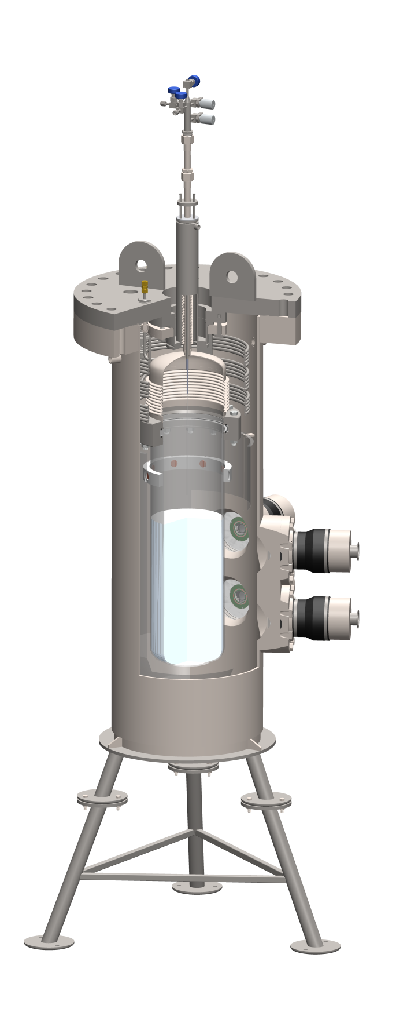
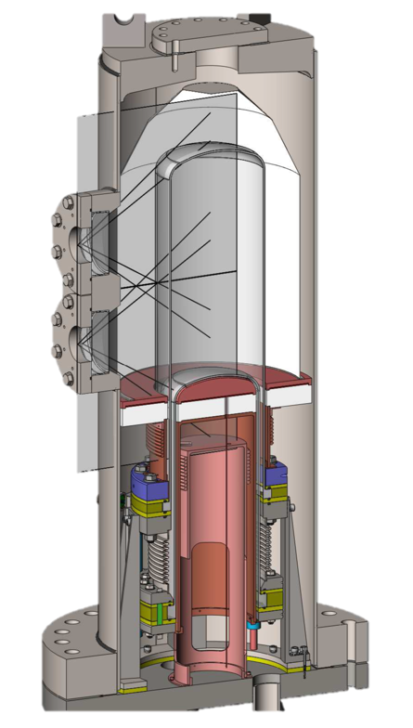
PICO-40L: Eliminate buffer fluid
Purpose of buffer liquid is to isolate the active liquid from the stainless parts
PICO-40L
Thermal Gradient
Thermal gradient can ensure that target fluid near stainless parts is not active
PICO-60

Slide 33
PICO-40L
Main Objectives
  Reduced neutron backgrounds, allowing us to push down in cross-section. We expect an order of magnitude improvement in exclusion by running for a year.
  Added stability could allow us to push down in threshold (WIMP mass) until we hit electron-recoil backgrounds.
  Ability to use new target fluids optimized for different WIMP masses
  Tests technology for future tonne scale detector: PICO 500

Slide 34
Advantages
40-liter
Superheated
Volume
15⁰C
Cold Normal
Liquid
-25⁰C
Elimination (~entirely) of anomalous backgrounds
  • Backgrounds caused by
    • Water,
    • Particulates,
    • Surface tension effects
  • Elimination of Water will break the chain
Additional technical benefits of no water buffer:
  • Can operate below ⁰C
  • Active fluid choice does not require a compatible buffer fluid
  • Full recirculation & in-place purification is technically possible

Slide 35
36-inch Diameter Pressure Vessel (much larger than before to keep neutrons at bay).
New Larger Capacity Hydraulic System
(Necessary for larger diameter pressure vessel)
New Thermal Control system
(Necessary to maintain dual temperature zones)

Slide 36
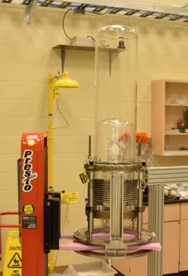
Schedule:
All significant components have been fabricated and are on site.
Installation work is underway. Expected to be complete by August
Commissioning to begin in the fall to establish running conditions, do calibrations, etc.
After initial open data set to establish good working conditions, the experiment will be blinded.
Roughly one year of exposure is planned for the moment.
Early commissioning data will be used to finalize design of PICO 500
For a full description of PICO 40. See Talk by Tristan Sullivan: R3-3

Slide 37
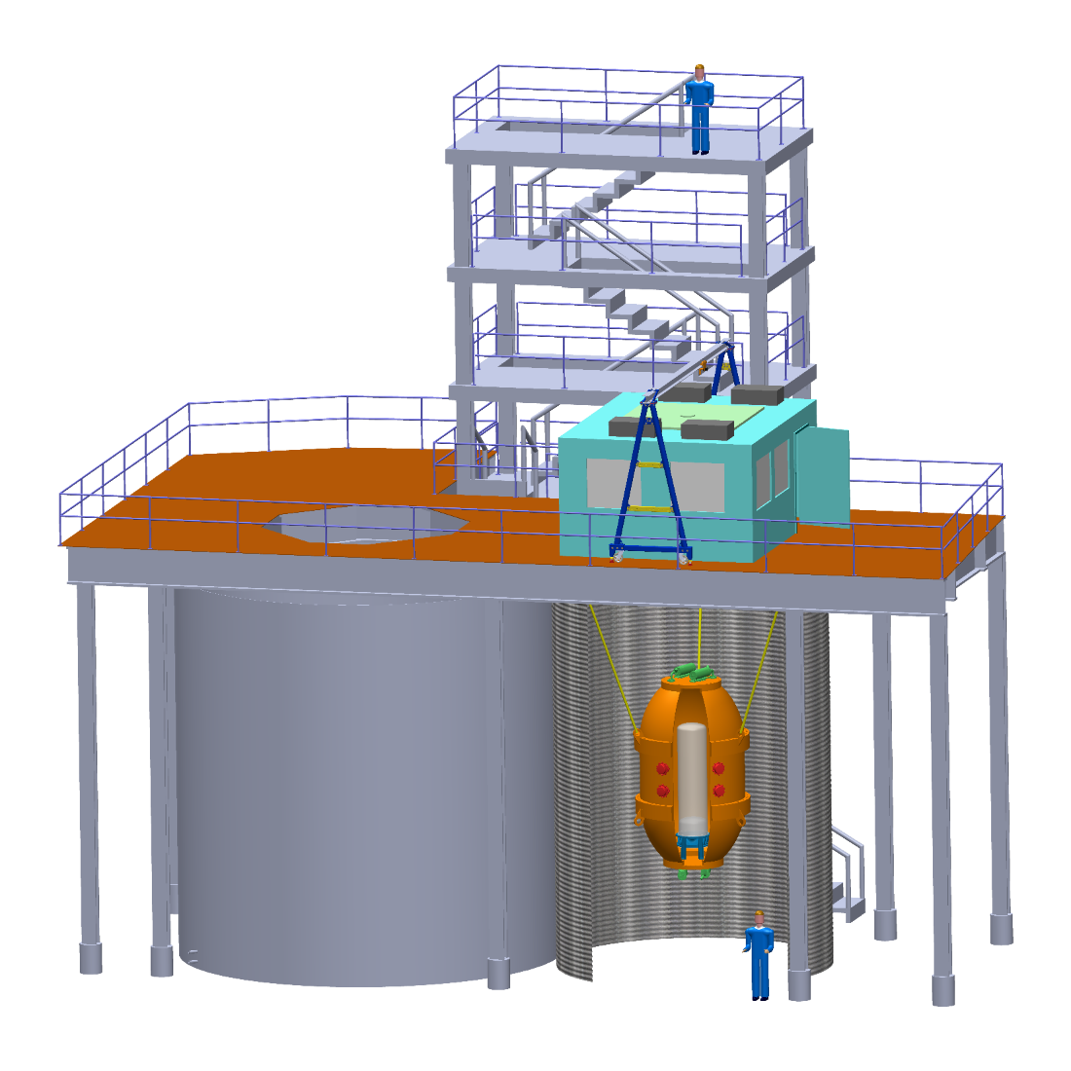
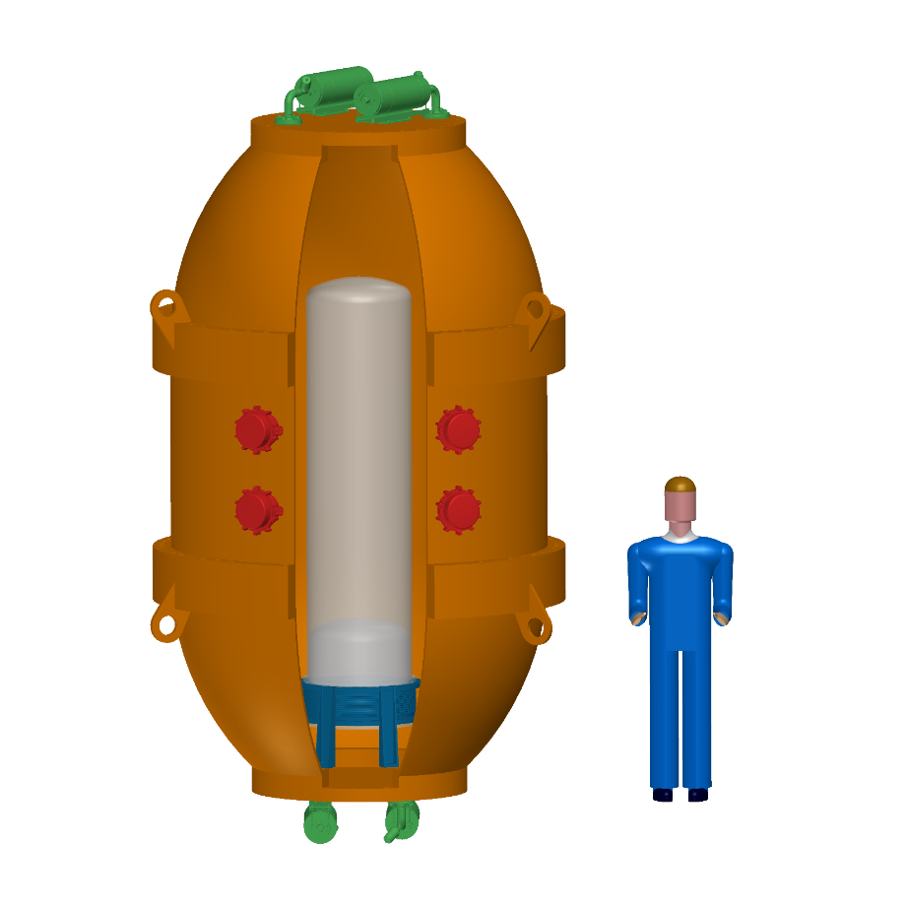
PICO-500
Engineering work ongoing as part of R&D program
Funding (~$5M CAD) has been awarded. Going through final budget finalization with agency now. Cash flow early 2018
Construction envisioned for 2019

Slide 38
Spin-Dependent Future
PICO program has significant reach. Complementary to other DM experiments with SI interactions and higher mass reach.
Lower neutrino floor opens unique phase to PICO

Slide 39
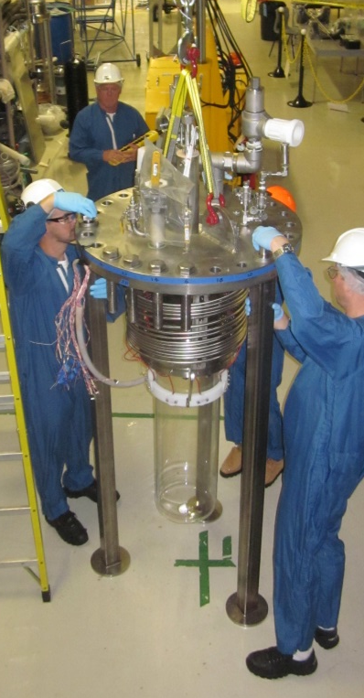
Summary
PICO bubble chambers at the 40L scale can be built background-free
PICO dominates the search for spin-dependent WIMP-proton couplings
Construction of PICO 40 is well underway
The design of PICO 500 is very advanced. Fine details of engineering design to be made based on PICO 40 experience.
C. Amole et al., arXiv:1702.07666
PICASSO
SIMPLE
PandaX-II
PICO-2L C₃F₈
PICO-60 CF₃I
SuperK
IceCube

Slide 41
Spin-independent Limits
Light nuclear targets give sensitivity to low-mass WIMPs
Unexplored phase space would be accessible with slightly reduced threshold
C. Amole et al., arXiv:1702.07666
PICO-2L C₃F₈
PICO-60 CF₃I
CDMSlite
CRESST-II
PandaX-II
LUX

Slide 42
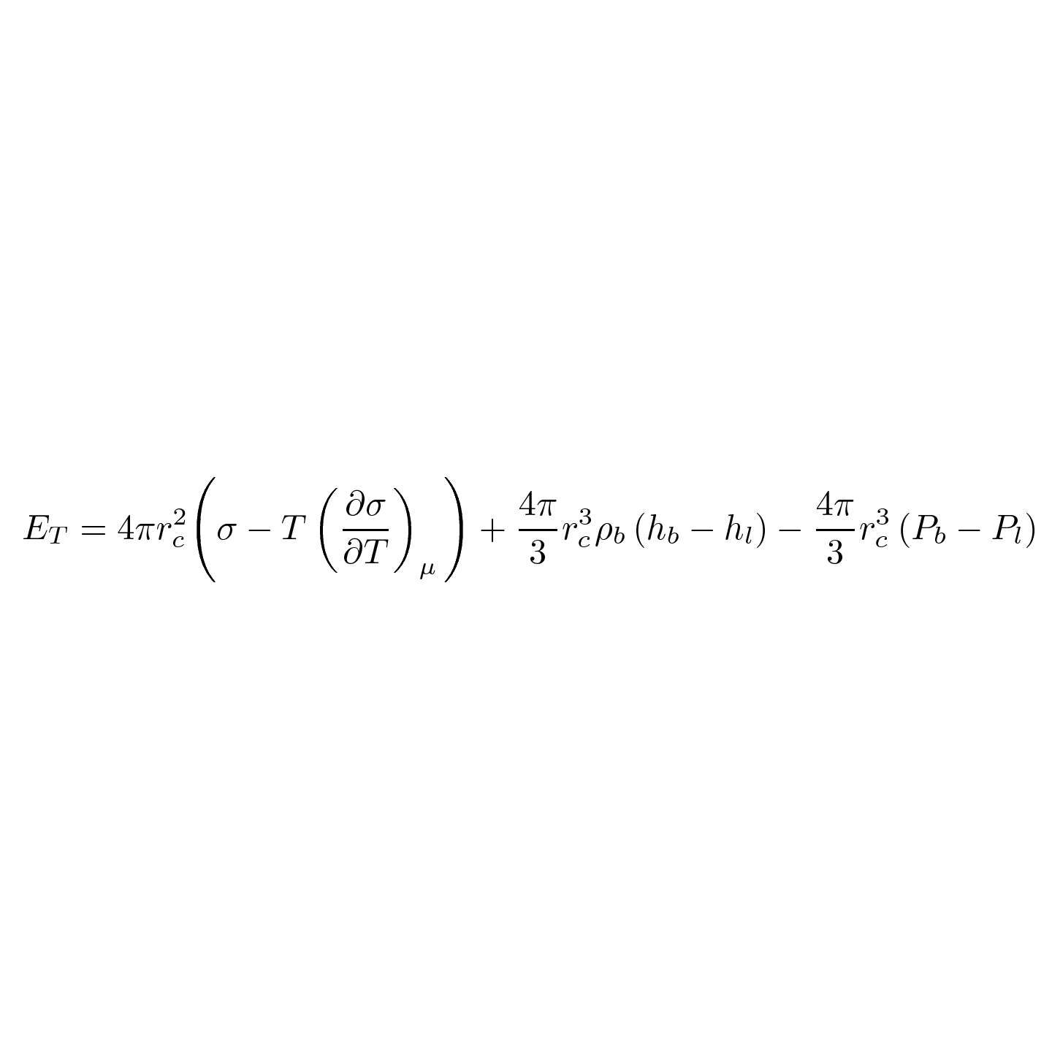
Seitz Threshold Calculation
Surface energy, Bulk energy, Reversible Work
P_{l}=35 psi,
T_{l}=15.0ºC
1.57 keV
1.95 keV
P_{b}= 77.9
psi
-0.15 keV
r_{c}= 24.1 nm
C₃F₈
= 3.37 keV

Slide 43
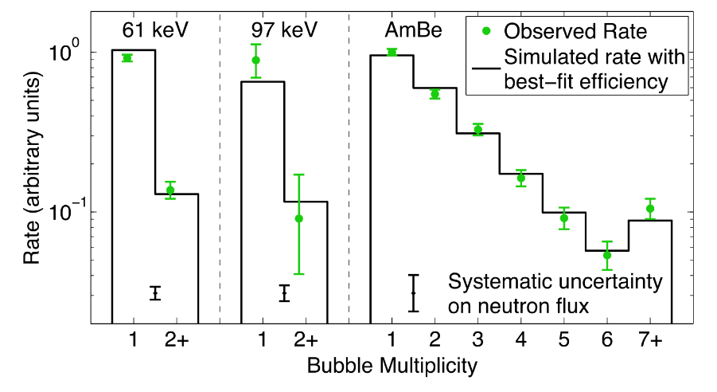
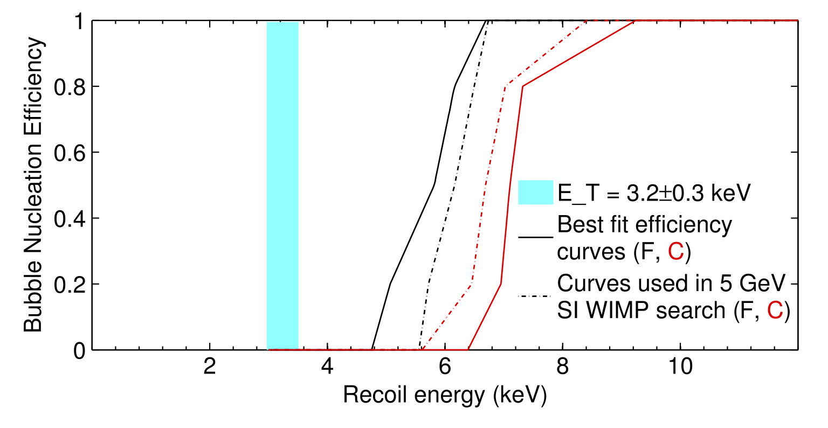
Nuclear Recoil Efficiency
Use neutrons to determine nucleation efficiency from nuclear recoils
Full paper is in preparation
Amole, C. et al. Phys. Rev. Lett. 114, 231302 (2015)

