Slide 1
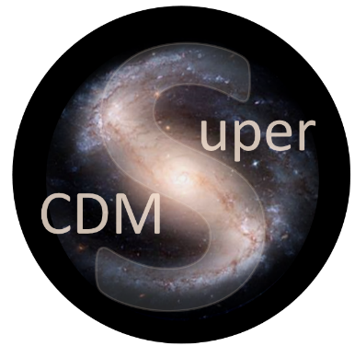


SuperCDMS
and CUTE
at SNOLAB
Wolfgang Rau
Queen’s University
for the
SuperCDMS Collaboration

Slide 2
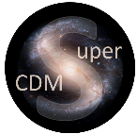
Overview
SuperCDMS
Detector technology
Detector generations
Experimental Setup
Goals for SNOLAB
Status
CUTE
Motivation
Design
Status
Analysis Projects
Detector Calibration
Backgrounds
Rare interactions
Dark Matter searches
Conclusions

Slide 3
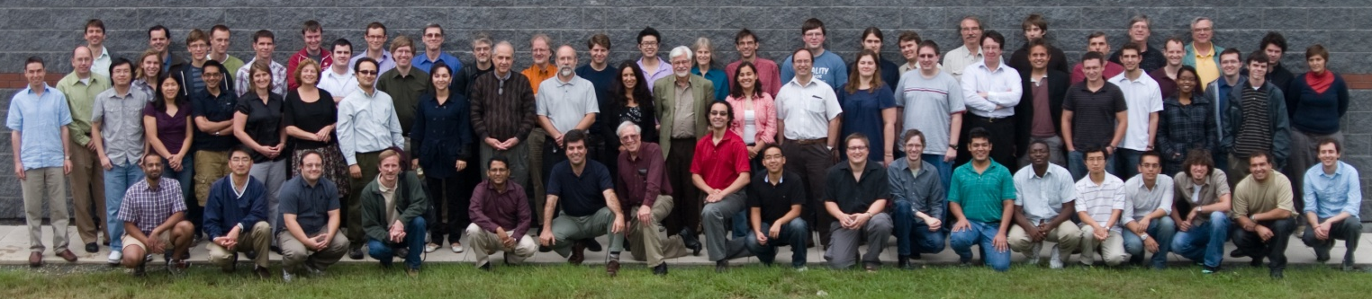
SuperCDMS
SuperCDMS Collaboration
California Institute of Technology CNRS/LPN Durham University
Fermi National Accelerator Laboratory NISER NIST Northwestern University
PNNL Queen’s University Santa Clara University SLAC/KIPA
South Dakota School of Mines & Technology SNOLAB/Laurentian University
Southern Methodist University Stanford University Texas A&M
University of British Columbia/TRIUMF University of California, Berkeley
University of Colorado Denver University of Evansville University of Florida
University of Minnesota University of South Dakota University of Toronto

Slide 4
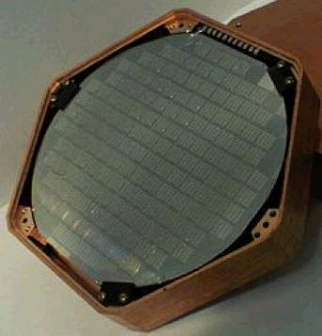
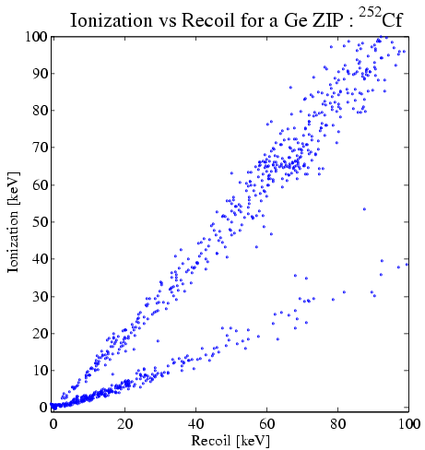
SuperCDMS
Detectors
CDMS
Super
Soudan
Neganov-Luke Effect
Semiconductor
operated at
few 10s of mK
-
In Vacuum
+
i
HV
ZIP
Electron gains kinetic energy
(E = q · V → 1 eV for 1 V potential)
-
Phonon Readout:
Tungsten TES
-
In Matter
+
Add: high voltage (~70 V)
Phonons from drifting charges
Threshold < 0.1 keV (phonon)
Add: charge readout (few V)
Background discrimination
Threshold < 10 keV
Deposited energy in crystal lattice:
Neganov-Luke phonons
∝ V, # charges
R vs T
-
+
0
0 V
remove surface
background
Electron recoils:
background
large phonon signal from
charges
–
+
Charge signal
–
0
– 70 V
Luke phonons mix charge and phonon signal → reduced discrimination
Apply high voltage → large final phonon signal, measures charge!!
ER much more amplified than NR
→ gain in threshold; dilute background from ER
< 1 background event for
whole exposure
Nuclear recoils:
signal
effective threshold:
few hundred eV (NR)
Phonon signal

Slide 5
SuperCDMS
Detectors
SuperCDMS
SNOLAB
Ge / Si
100 mm ∅ x 33 mm
Operated at 30 mK
iZIP
HV
Phonon Readout:
Tungsten TES
Add: charge readout (few V)
Background discrimination
Threshold < 1 keV
Add: high voltage (~100 V)
Phonons from drifting charges
Threshold < 0.1 keV (phonon)
R vs T
+
0
+ 50 V
remove surface
background
Electron recoils:
background
large phonon signal from
charges
–
+
Charge signal
–
0
– 50 V
< 1 background event for
whole exposure
Nuclear recoils:
signal
effective threshold: few
(or one) electron-hole pairs
Phonon signal

Slide 6
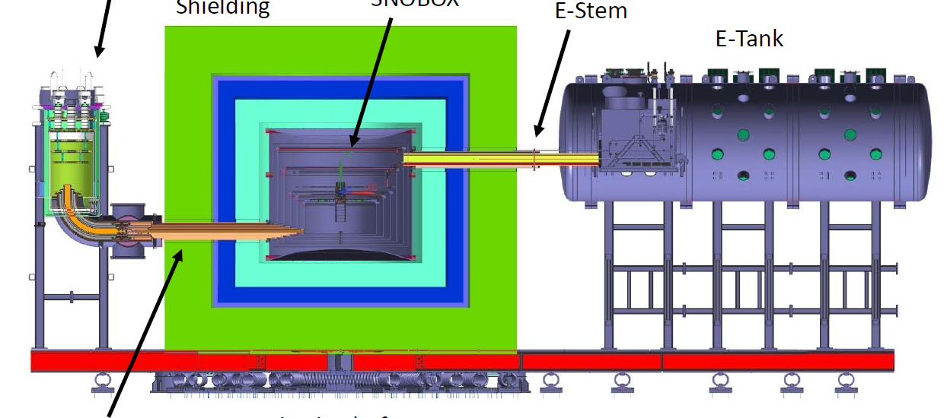
SuperCDMS
Implementation (SNOLAB setup)
Initial Payload:
2 HV towers (4 Ge/2Si)
1 Ge iZIP tower
1 Ge/Si iZIP tower (4/2)
Fridge to provide
<15 mK at the detector
Detector volume
(space for up to 31 “towers”)
6 detectors
→ 1 tower
30 cm HDPE
20 cm Pb
60 cm HDPE base / water
Signal vacuum
feedthroughs
Cold finger
Mounted on spring-loaded
platform (seismic isolation)
Additional cooling
(70 K/4 K)

Slide 7
SuperCDMS
SNOLAB
Clean
room
CUTE
Experimental area
Cryo
Backup
cooling
(ice)
Cryogenics
and radon
filter plant
Access
drift
Radon
filter

Slide 8
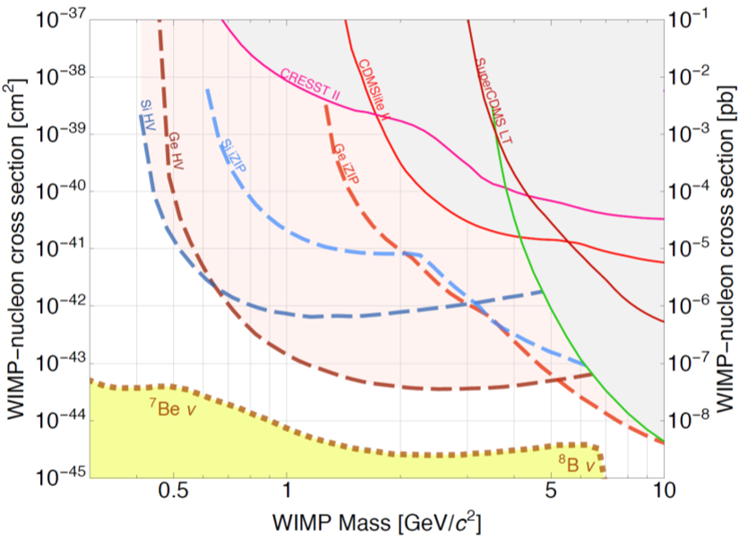
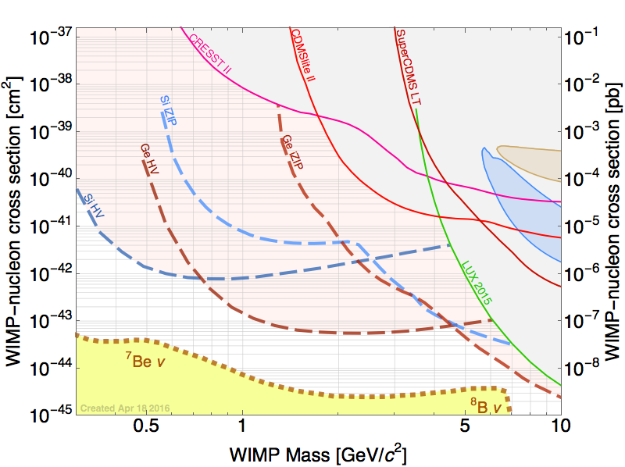
SuperCDMS
Goal
LUX 2013
Longterm goal

Slide 9
SuperCDMS
Schedule and Funding
2013
2014
2015
2016
2017
2018
2019
CFI approved
US G2 decision
CD 1
GW 2a
Main construction phase
CFI application
CD 2/3
CD 4
Start of
operation
DOE/NSF proposals
GW 1
CAP 17
Queen’s
GW 2
Funding approved (CFI: 2012, DOE/NSF: 2014)
DOE/NSF review process:
First step passed (CD 1: conceptual design review)
Next step end of 2017: technical design review/ready for construction (CD 2/3)
Reviews at SNOLAB:
passed Gateway 1 (space allocation) in fall 2015 / GW2a (early construction) in December 2016; upcoming: GW2 (construction) fall 2017
Total project costs ~$30M

Slide 10
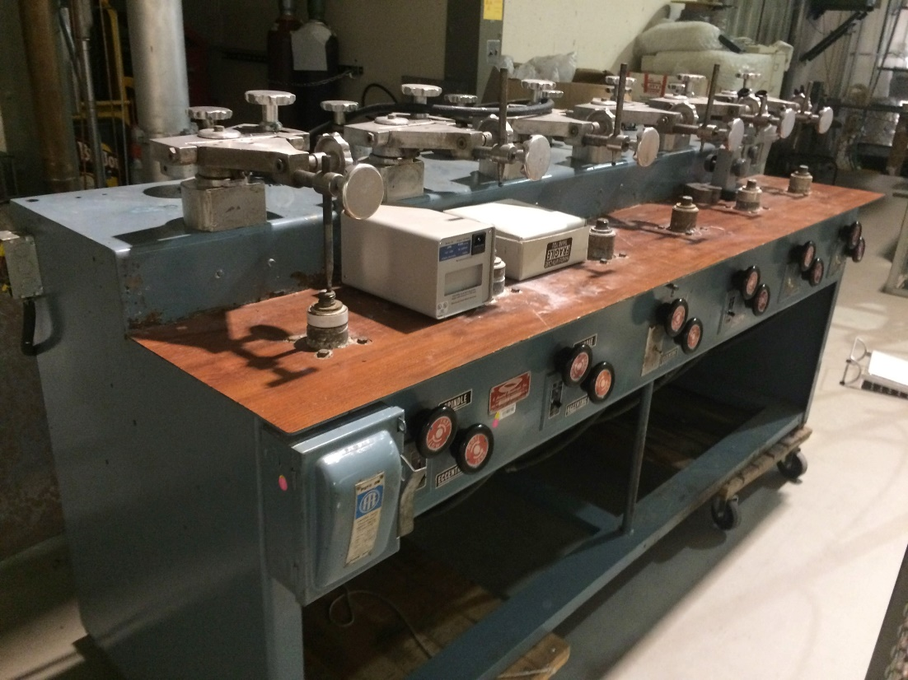
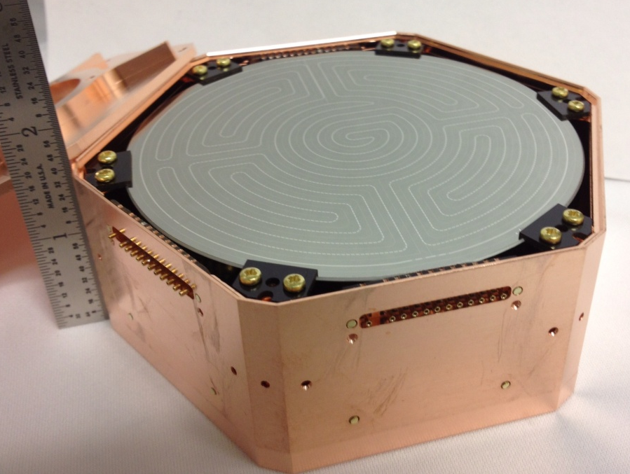
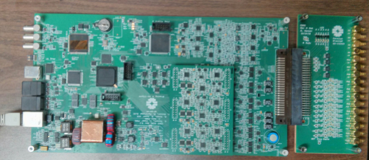
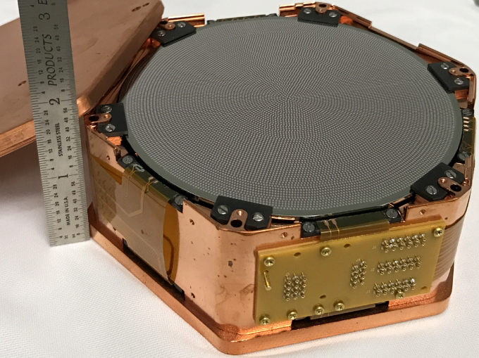
SuperCDMS
Developments (selection of activities)
Detectors: larger crystals; prototypes for both iZIP and HV detectors exist and have been tested using old electronics – good performance so far.
Detector tower (mechanical structure, wiring): design ready, mechanical prototype exists; wiring prototype exists – final version expected soon.
Readout electronics:
Preamp: thermal readout design ready; charge readout: circuits are being tested
“Warm electronics” (outside cryostat): prototype exists, tests underway
DAQ: MIDAS based, being developed at UBC with help from TRIUMF
and UofT [M. Wilson, POS-46]
Cryogenics design completed; shielding: design advanced,
Dilution refrigerator is procured
Backgrounds: extensive material screening program; tracking and
monitoring program; minimizing cosmogenic exposure for crystals;
radon filter to be installed for detector assembly cleanroom at SNOLAB.
Shielded transport container
HV
Underground polishing
HV

Slide 11

CUTE
Cryogenic Underground TEst facility (CUTE) – a Queen’s Project
Motivation
Detector performance:
Detector integrity after transportation
Background discrimination
Noise performance (impact of background)
Background studies
Confirm that screening program and
handling procedures are appropriate
Study cosmogenic backgrounds (³H, ³²Si)
Available for testing of other cryogenic detectors
for rare event searches (e.g. EURECA detectors
for integration with SuperCDMS)
Opportunity for early science! (BG O (few evt/keV/kg/d below 100 keV))
Schedule
Cryostat ordered, to arrive at Queen’s this summer
Infrastructure (water tank, platform, crane): ordered, installation starts in July
Sept/Oct: test cryostat at Queen’s; installation underground end of 2017
Commissioning: early 2018 (~2-3 years ahead of SuperCDMS)
Vibration
damping
Fridge: <10 mK
Pb
Water Shield

Slide 12
Analysis
Analysis Projects
Photo-Neutron calibration (low-energy nuclear recoil calibration); last “physics” measurement from Soudan (2015). Analysis under way (B. von Krosigk, UBC)
Backgrounds: Analysis of cosmogenic backgrounds in CDMSlite (³H and others)
Analysis in good shape; hope to publish this summer or fall (E. Fascione, Queen’s)
Rare interactions: follow-up of LIPs analysis (use CDMSlite data to improve our sensitivity for lower fractional charges?)
Annual modulation – long time coming; hopefully ready within the next 2-3 months
Standard WIMP search from SuperCDMS (full discrimination, intermediate to high mass range): not competitive with Xe for ‘vanilla WIMP’, but still important for more general models (EFT …); analysis essentially finished – publication in preparation
CDMSlite: detailed discussion of previous analysis [R. Underwood, POS-39] and incremental results (publication very soon)
Last CDMSlite data set – blinding scheme developed [X. Zhang, Thursday R3-4; 2:30], consider background modeling; analysis ongoing (W. Page, D. MacDonell, UBC)
Test sensitivity of detectors to vibrations [R. Germond, POS-33]

Slide 13
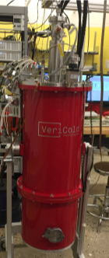
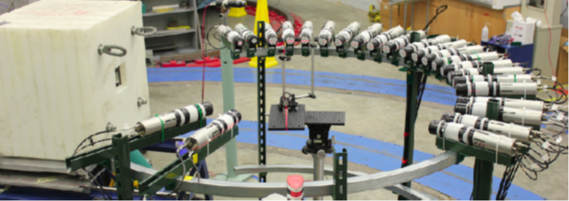
Calibration
Calibration
Energy threshold in the eV range: need new methods for low-energy calibration
Neutron activation: ⁷⁰Ge → ⁷¹Ge, EC (10.4 keV, 1.3 keV, 0.16 eV); doesn’t work for Si
Queen’s effort: use IR photons (long-term goal: single e-h pair measurement)
Low energy scale by comparison of detectors close to and far from photon source [M. Ghaith, Monday M4-3]
Low energy nuclear recoil calibration:
neutron scattering (TUNL, DD generator),
γ recoils after thermal neutron capture

Slide 14
Conclusions
SuperCDMS SNOLAB aims at detecting dark matter WIMPs
Main focus are low-mass WIMPs (< 10 GeV/c²)
Project planning well under way
Main R&D is done, full technical design close to completion
Start of operation expected in 2020
Initial payload: ~30 kg, significant push in threshold and sensitivity
Upgrades (improved HV detectors, EURECA detectors, …) will allow us to reach the neutrino floor at low mass and/or check discovery claims at high mass
CUTE: Queen’s initiative for an underground test facility, operational in early 2018
(detector performance studies, background checks, early dark matter science)
Analysis: many updates in the pipeline; small steps until new facilities come online

