Slide 1
EXO
David Sinclair
Presentation to the 2017 IPP AGM
Kingston

Slide 2
What is EXO
EXO is a program searching for neutrinoless double beta decay in Xenon
It is comprised of 3 activities
  EXO-200 – a 200 kg detector operating at WIPP in New Mexico
  nEXO – a proposed 5 tonne detector at SNOLAB
  Detector Development to extend to the Normal Hierarchy
The realization of nEXO – a major international project to be sited in Canada is the top priority of the Canadian collaboration but the other activities are very important and complementary

Slide 3
Canadian participation in EXO
Carleton – Mark Boulay, Razvan Gornea, Thomas Koffas, David Sinclair
Laurentian – Bruce Cleveland, Jacques Farine, Ubi Wichoski
McGill – Thomas Brunner (Deputy Spokesperson)
Sherbrooke – Serge Charlebois, Rejean Fontaine, Jean-Francois Pratte
TRIUMF – Jens Dilling, Reiner Kruecken, Fabrice Retiere
New collaborator since last grant
New Institution since last grant

Slide 4
EXO-200
Major successes
  First project to detect 2-neutrino beta-beta decay of Xenon
  Most precise measure of the rate for a 2 neutrino double beta decay
  First project to challenge the Heidelberg-Moscow claim of observation of 0 neutrino double beta decay
  Continues to take precision data and should produce another globally competitive result
  Strong Candian participation in operation and analysis
  Candian (Jacques Farine) chairs the Collaboration Board

Slide 5
Next Analysis for EXO-200
Caio Licciardi (EXO Post doc at Carleton) will present the first analysis of the current EXO-200 run at TAUP. Caio is the co-analysis coordinator
Main technique will be a multivariant analysis technique introduced by Thomas Koffas which forms part of the thesis of a student Warren Cree

Slide 6
nEXO
Proposal being developed for submission to the US DOE ‘down select’
Canadian leadership in light detection (Fabrice Retiere is the Manager for this activity), in Radon control (Jacques Farine is the subgroup manager) and participation in calibration and low background assay. Major role played in simulation.
Work on concepts beyond the baseline being explored as possible enhancements to sensitivity
Collaboration Board chaired by Canadian (David Sinclair)

Slide 7
nEXO
A detector to explore the inverted hierarchy region of parameter space for neutrinoless double beta decay
Based on the success of EXO-200
Modify the design to improve and optimize
Base performance predictions on a proven detector

Slide 9
EXO-200 -> nEXO : Location
EXO-200 is at WIPP
Depth is too shallow for a larger detector
Salt creeps!
Lead used for shielding
nEXO is expected to be at SNOLAB
Negligible cosmogenic production
Water shield kills local neutrons, gammas and is very pure

Slide 10
EXO-200 -> nEXO: Design Concepts
EXO-200 has two back-to-back TPCs with central cathode
nEXO has a single TPC with diameter = height
This gives best, homogeneous and shielded conditions
nEXO has much longer drift length
  EXO-200 had excellent electron lifetime (~3 ms) but nEXO must be better
  Eliminate plastics wherever possible
  (EXO-200 used SNO acrylic to support the field cage and clean Teflon as a reflector to enhance photon collection. Must find fused silica or something to replace the acrylic and eliminate the Teflon)

Slide 11
EXO-200 -> nEXO: Light Sensors
In EXO-200 LAAPDs are used for light detection.
The units we used are not available
Need high voltage (~2 kV)
Noise a problem – low gain
nEXO -
Use SiPMs and cover the barrel (4 m²)
Better light collection -> better resolution
Need SiPMs sensitive to 172 nm light (ε> 15%)
Need operation at -100°, Low dark noise, Low cross talk, etc.
This is a major area of development for Canada

Slide 12
Expected sensitivity for nEXO
Extensive and detailed Monte Carlo simulations have been made to estimate the sensitivity and discovery potential for nEXO
All activity levels are based on measurement and experience with EXO-200
Sensitivity and Discovery calculations developed in Canada

Slide 14
Expected data for 10 years
Discovery potential limit
5.5 x 10²⁷yr

Slide 17
The Canadian Program

Slide 18
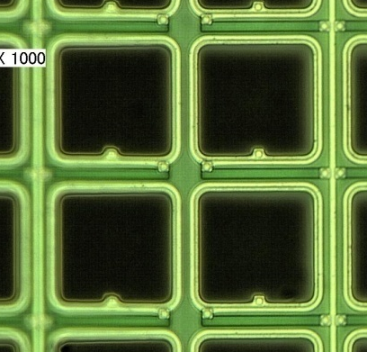
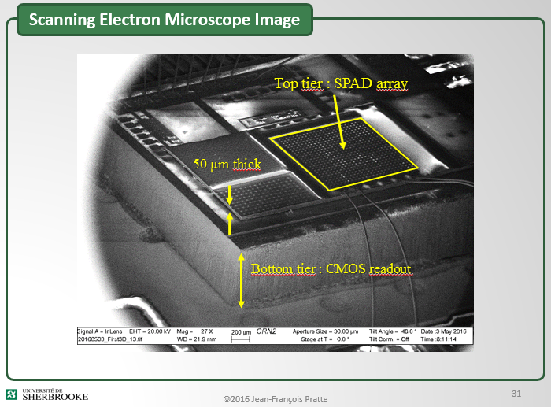
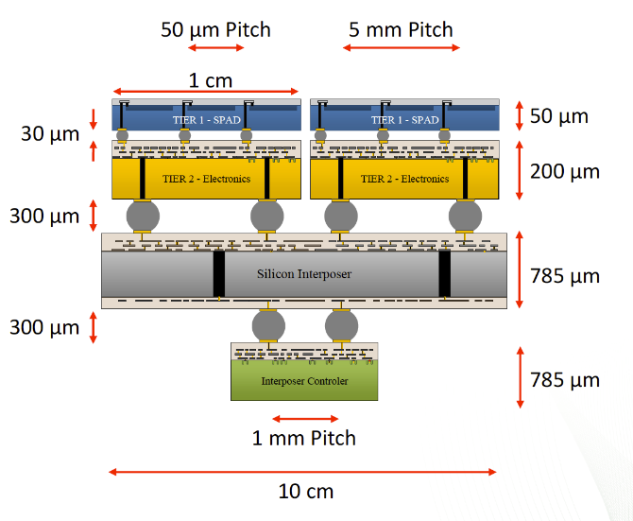
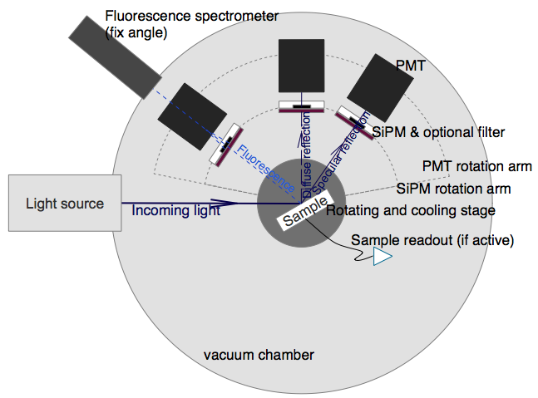
nEXO photo-detector effort
2014
2015
2016
2017
2018
2019
2020
Suitable SiPM
identified
Final spec.
for SiPM
DOE down
Select
nEXO SiPM
tech. select.
Main milestones
Analog SiPM
for nEXO (FBK, HPK)
36cm² analog SiPM
(Stanford)
3DdSiPM
for nEXO
Complete 3DdSiPM
solution
Photo-detector
Technology
First 3DdSiPM
at Sherbrooke
SiPM test setups
In vacuum at Stanford
In GN2 @ TRIUMF phase 1
SiPM test setups
In vacuum at Stanford & BNL
In LXe at Erlangen, UMass
In GN2 @ TRIUMF phase 2
SiPM efficiency/reflectivity
Setup (CFI)
Photo-detector
Characterization

Slide 19
Additional or related support for the development of nEXO photo-detectors
CRFREF
  One technician at TRIUMF working about 50% on photo-detector development for 5 to 6 years
  One research professional at U.Sherbrooke working on 3DdSiPMs development for astro-particle physics for 3.5 years.
CFI. “Facility for Development of Noble Liquid Detectors and Optical Readout for Subatomic Physics and Particle Astrophysics”
  Date: applied for Oct. 2016. Award announcement: Jun. 2017,
  PI: Mark Boulay (Carleton).
  Amount: ~2M$ for 3DdSiPM at Sherbrooke, ~1M$ for SiPM characterization at TRIUMF, ~0.5M$ for large area SiPM at McGill
DRDC 1. ”Enabling Single Photon imaging technologies for underwater arctic surveillance”
  Date: applied for February 1, 2017, award announcement?
  PI: JF Pratte, Sherbrooke
  Amount: 6M$ (no deliverable for SAP but building highly relevant expertise)
DRDC 2. “A broadband single photon detector for enhanced arctic air surveillance”
  Date: applied for February 1, 2017, award announcement?
  PI: F. Retiere, TRIUMF
  Amount: 3M$. Need DRDC1 to be viable (no deliverable for SAP but building highly relevant expertise)
NSERC CRD. “Input/Output Through Silicon Vias in CMOS”
  Date: application in 2017
  PI: S.Charlebois in partnership with Teledyne-DALSA
Partnerships with industrials (KETEK, Hamamatsu) being investigated for 3DdSiPMs

Slide 20
nEXO Photo-detector group management
Define specifications for SiPMs and passive optics (mirrored electrode)
  TRIUMF taking over simulation effort from IHEP (Eric Woolsey, graduate student)
    In FY2017 investigate interplay between SiPM efficiency and reflectivity
    Investigate electrodes made of silicon
Agree on measurement techniques for assessing specifications
Define the photo-detector architecture up to the electronics
Coordinate SiPM prototyping effort with manufacturers, including 3DdSiPM development
Organize workshops at IEEE NSS to share research effort with other collaborations (DarkSide50k, CTA, MEG,…)
Support from NSERC critical for HQP and travel

Slide 21
nEXO photo-detector characterization
Setup for measuring SiPM efficiency at 175nm and assessing nuisance parameters
  TRIUMF setup upgraded in FY2016 using NSERC and TRIUMF funds. Expected to be used until 2019
Combined efficiency/reflectivity test setup at TRIUMF requested from CFI
  Risk mitigation if CFI fails, contribute to exploitation of setups at U.Alabama and IHEP
    Need travel funds
Setup for measuring SiPM self-emission (light emitted in avalanches) at TRIUMF requested from CFI and DRDC2
  Risk mitigation if CFI and DRDC2 fails, reuse some equipment available at U.Sherbrooke
Overall setup operation and data analysis
  Maintenance and upgrade by CFREF funded technician.
  Operation and data analysis by HQPs requested from NSERC
    Currently done by 1 Italian student paid by INFN and 1 Chinese professor on sabbatical (paid by China)
    Postdoc critical for continuity between visitors, coop and graduate students

Slide 22
Large scale photo-detector plane
Scaling up from ~1cm² SiPM chips to 100cm² module and 10,000 cm² staves
  Critical effort if Canada is to build the complete photo-detector staves for nEXO
    Will likely compete with other groups for this work package
  Assembly and test equipment requested from CFI
    Risk mitigation if CFI fails: short term, collaborate with US groups, long term: apply for equipment again
Effort led by McGill
  Electrical engineering support through CFREF - CPARC
  HQP requested from NSERC: Ako Jamil (PhD) and undergraduate student (Soud Kharusi)

Slide 23
Other nEXO development
  Continuing the battle against radon ingress – monitoring and removal techniques (Laurentian)
  Calibration techniques and hardware – nEXO gains enormous advantage from self shielding but this also makes calibration with external gamma sources challenging. Simulations and new insertion hardware being developed (Laurentian)
  Explore improved spatial resolution to improve background rejection through use of 2 phase detection. Carleton funded development but now 2 students have chosen this for grad studies.

Slide 24
Development of new technologies
1) New forms of SiPM
2) Use of 2 phase detection techniques to reduce backgrounds
3) Single ion Ba tagging techniques to reduce backgrounds
Success with these technologies could lead to a concept for detection of neutrinoless double beta decay at the normal hierarchy

Slide 25
Supporting the new technologies
Funds requested from CFI for
  (a) Development of infrastructure and testing for all aspects of SiPM application to nEXO
  (b) A Cryogenics laboratory to be established at Carleton for developing next generation of cryogenic liquid detectors including 2 phase detection for double beta decay and dark matter
NSERC requests separate project request for Ba tagging development – will be submitted in Fall.

Slide 26
3DdSiPM for nEXO
Establishing 3DdSiPM production at Teledyne-DALSA and Sherbrooke
  Generic effort regardless of end project
  Fund requested from CFI and DRDC1
    Risk mitigation if CFI and DRDC1 fails, investigating partnership with established companies (Hamamatsu, KETEK) or with new venture
Tailoring photo-detector tier for nEXO (VUV sensitivity and cryogenic operation)
  Design proposed in DRDC2 compatible with VUV. Could also be tested with CFI funds
    Risk mitigation: low cost small technology demonstration test. Probably not complete sensors
  Additional support will likely be needed from NSERC RTI (FY2018, FY2019) for investigating ultra-shallow (delta) doping and VUV anti-reflective coatings
Tailoring electronics for nEXO (ultra-low power dissipation and moderate speed)
  Need CFI or DRDC funds for large production though small production possible without

Slide 27
2 Phase detection
The addition of an electroluminescence region to the nEXO detector concept, together with the use of 3D SiPM would allow much greater spatial resolution to determine the topological details of the decay events.
This should allow substantial improvement in background rejection
In early gas xenon detectors, requirement of 2 beta tracks reduced background by ~25

Slide 28
(NEXT Data)

Slide 29
Ba-tagging
Ba-tagging not part of the baseline design (reminder: baseline design means we can start building nEXO the day after the down select)
But: Ba-tagging is being developed by several groups in the nEXO collaboration (Stanford, Colorado State, U. Illinois Champaign, TRIUMF, Carleton, McGill)
Great progress has been made so far:
  Three nEXO collaboration paper on Ba-tagging (the only nEXO collaboration wide paper)
No technology identified so far that is sensitive on the 1 Ba-ion level
Canada now concentrates Ba-tagging experts with the hires of R. Gornea and T. Brunner → great potential to solve the challenges
Modest funding requested for preparatory activities
Coherent Canadian approach to tackle the challenges of Ba-tagging
→ Ba-tagging is the only way to verify that a positive 0νββ signal is indeed from a ββ decay

Slide 30

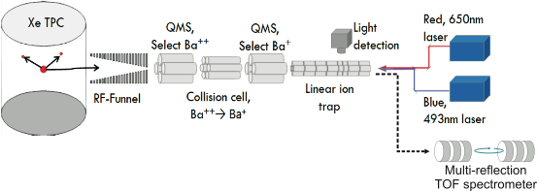
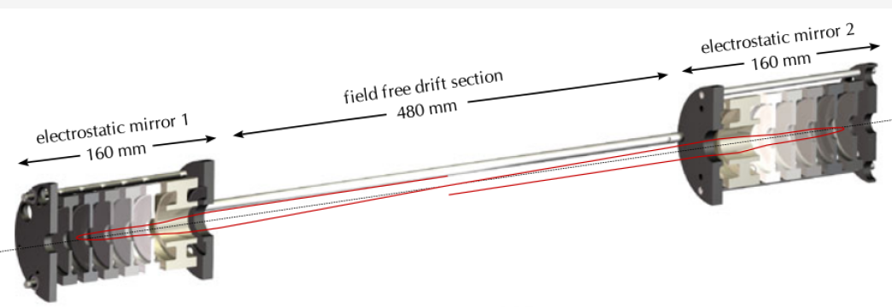


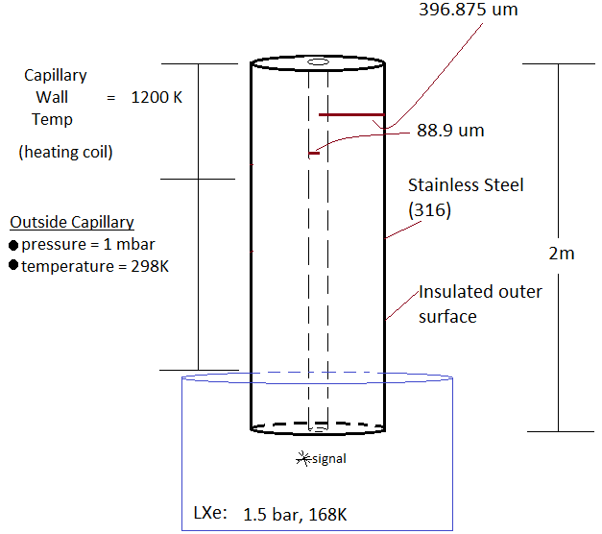
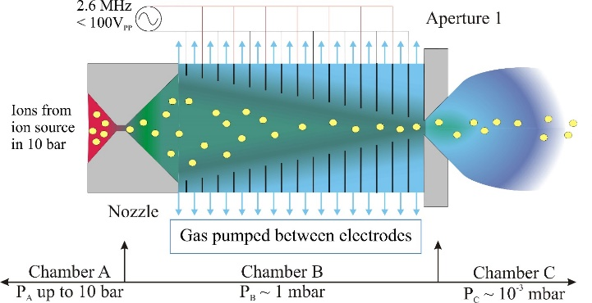
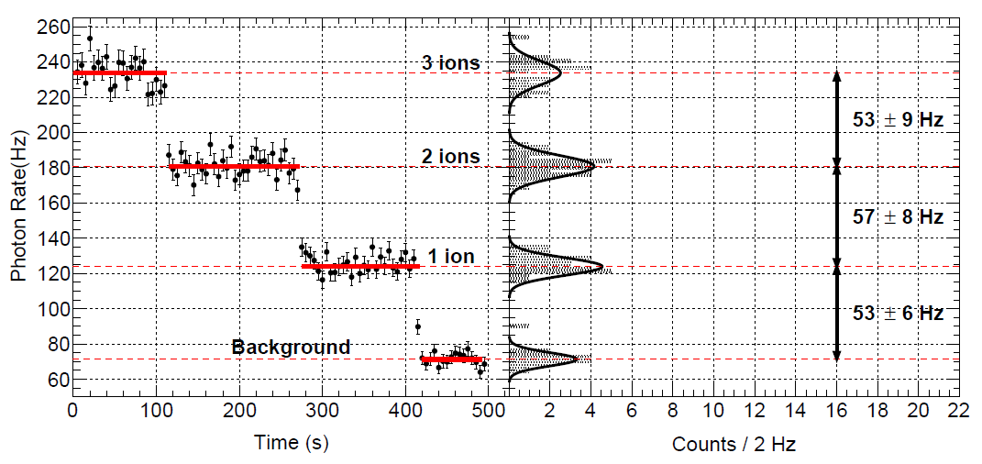
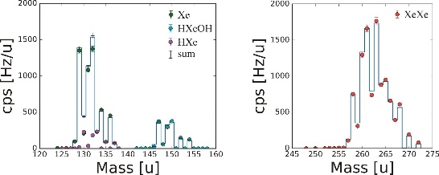
Ba-tagging – the Canadian approach
Systematic ion-extraction studies with MR TOF MS
Int. J. Mass. Spectrom. 379(2015)110
Extract Ba⁺⁽⁺⁾ from liquid Xe TPC into a Xe gas environment
Extract Ba⁺⁽⁺⁾ with a Xe gas jet into a low pressure chamber.
Identify Ba⁺⁽⁺⁾ with laser-fluorescence spectroscopy.

Slide 31
Status
Time scale for project driven by US funding decisions
‘Downselect’ always 2-3 years off
Recently R&D funding provided for preparation for Downselect
nEXO received substantial support through this process
Prospects for a major new double beta initiative look very good

