Slide 1


Probing Ultrafast Optical Demagnetization with an HHG Source
Katherine Légaré
may 30, 2017

Slide 2
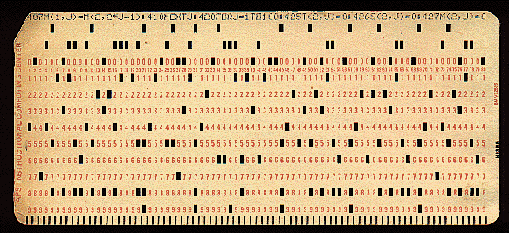
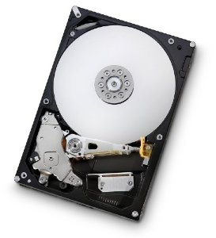
Studying Ultrafast Optical Demagnetization
Motivation
64 bytes
8 796 093 022 208 bytes
(8 TB)

Slide 3
Ultrafast Optical Demagnetization
Discovery
Article by Beaurepaire et al. in Physical Review Letters, 1996.

Slide 4
Ultrafast Optical Demagnetization
Three temperature model
Pfau, B et al. Nat. Commun. 3 (2012).
Laser pulse
Electronic
system
Spin system
Lattice
Surrounding
material

Slide 5
Magnetization Amplitude Probing Technique
MOKE (Magneto-Optic Kerr Effect)
Technique used by Beaurepaire et al.
Reflectivity measurement
Near infrared pump and probe
M
External magnetic field

Slide 6
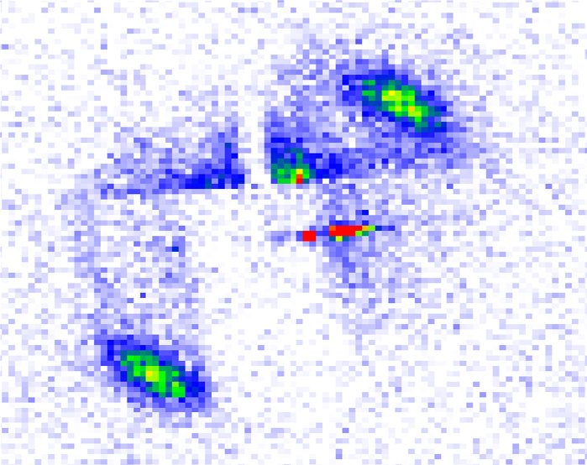


Magnetization Amplitude Probing Technique
RXMS (Resonant X-ray Magnetic Scattering)
60 eV
(20.7 nm)
$$M$$
$$f^{n}=\left(e_{s}^{∗}∙e_{i}\right)f_{c}^{n}+i\left(e_{s}^{∗}×e_{i}\right)∙M^{n}f_{m1}^{n}+(e_{s}^{∗}∙M^{n})(e_{i}∙M^{n})f_{m2}^{n}$$
$$f^{n}=\left(e_{s}^{∗}∙e_{i}\right)f_{c}^{n}+i\left(e_{s}^{∗}×e_{i}\right)∙M^{n}f_{m1}^{n}+(e_{s}^{∗}∙M^{n})(e_{i}∙M^{n})f_{m2}^{n}$$
$$I∝TM^{2}$$

Slide 7
Magnetization Amplitude Probing Technique
RXMS (Resonant X-ray Magnetic Scattering)
XUV probe – spatial resolution
No need for an external magnetic field
Holds information on the magnetic structure of the sample
Low efficiency (10⁻⁶)
Requires a specific magnetic structure
Magnetization must be out-of-plane
How to produce short XUV pulses?

Slide 8
Experimental Details
High Harmonics Generation
Three-step model, P. B. Corkum, Phys. Rev. Lett. 71, 1994 (1993)
Tunnel ionisation
Propagation
Recombination

Slide 9
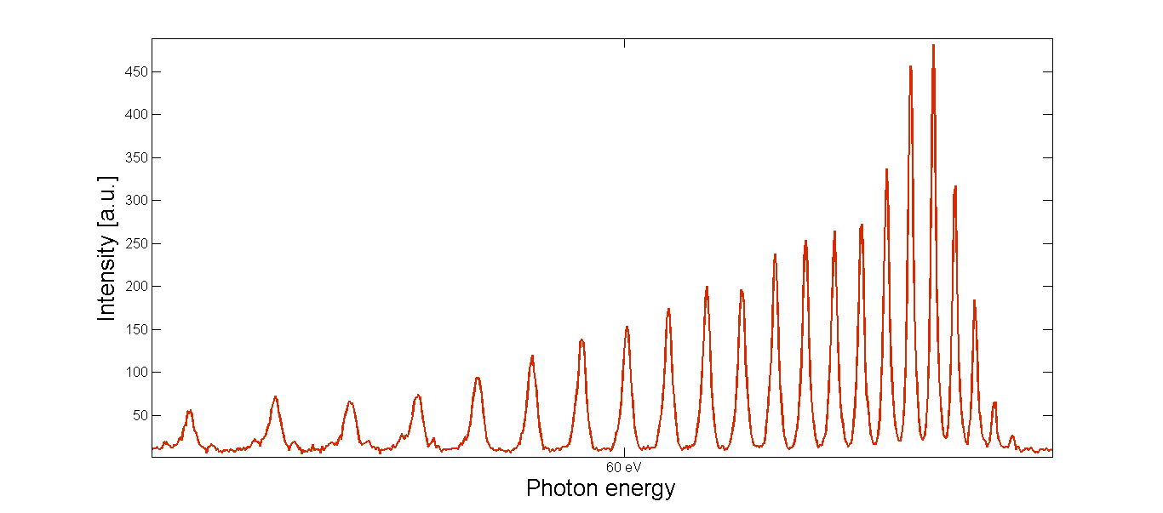
Experimental Details
High Harmonics Generation
Laser : 800 nm, 50 fs
Gas : neon

Slide 10
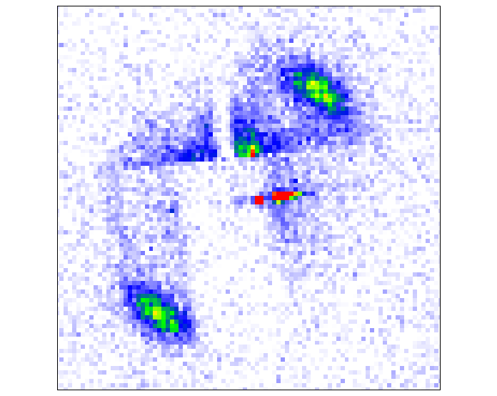

Experimental Details
Setup
Beamsplitter
Focussing mirror
Multilayer
focussing mirror
Filter
Gas cell
(HHG)
Filter
Focussing
mirror
Beamstop
Delay
line
Sample
CCD

Slide 11
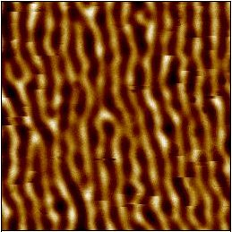
Experimental Details
Sample
Scale: 1µm
Si₃N₄(30nm) / Pt(2nm) / [Co(0.6nm) Pt(0.8nm)]₂₀ / Al(3nm)

Slide 12
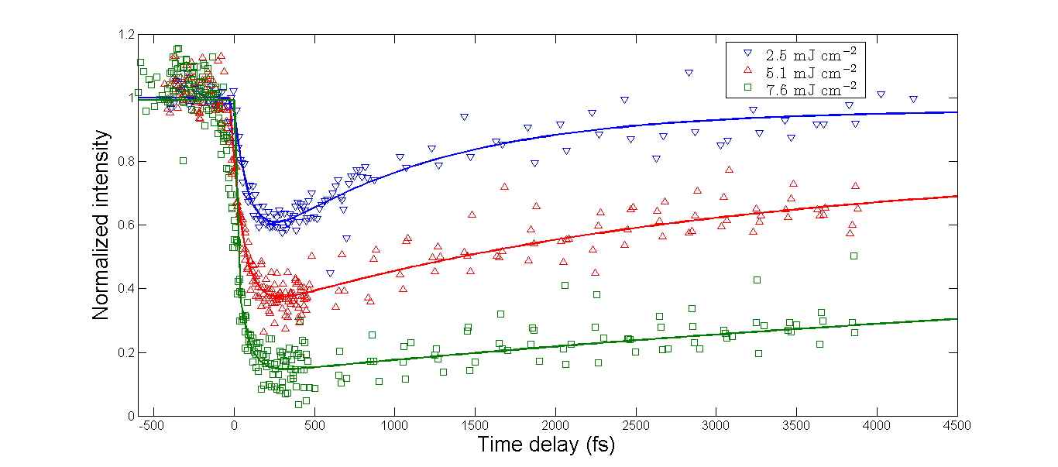
Results

Slide 13
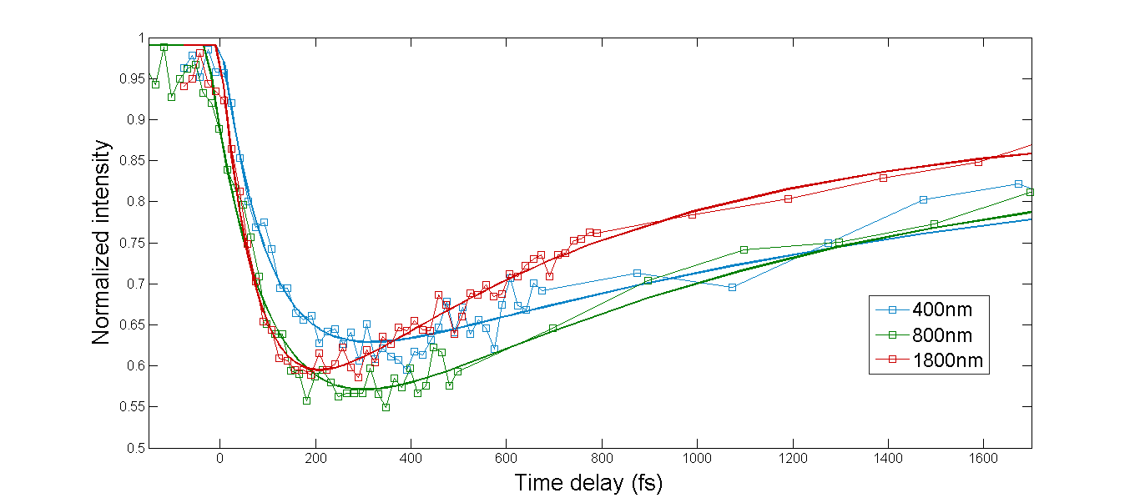
Results
Wavelength scaling

Slide 14
Conclusion and Prospects
Ultrafast optical demagnetization measurements by RXSM in ALLS laboratory
New parameters
  Wavelength
  Pulse duration
Next step
  Spatial resolution

Slide 15
Acknowledgments
Thanks to Vincent Cardin, Dr.Tadas Balciunas, Antoine Laramée
and to my supervisor, Pr. François Légaré.
Coming up
Presentation at the Frontiers in Optics 2017 conference (In revision)

