Slide 1
On the convection of ionospheric density features
John D. de Boer, Jean-Marc A. Noël (RMC Kingston) and Jean-Pierre St.-Maurice (U Sask)
CAP 2017
Notes:
I shall present what we believe is a fundamental characteristic of plasma convection, also known as ambipolar or ExB drift.
The effect is that, while ExB drift does not depend explicitly on any plasma parameters, nevertheless E will tend to become structured – at least on closed field lines – in a density-dependent way.
I’ll try to explain what we think should be observable, and also to defend the considerable number of idealisations we have to make to arrive at our results.

Slide 2
Assumptions
2-D plasma
Closed field lines
Steady state
Cold plasma
Currents don’t make significant changes in B.
Single ion species
Fully-magnetised electrons
No neutral drift (or E measured in neutral frame)
Notes:
None of these are novel assumptions. Nor do any of them wholly prevent the applicability of our results to at least some region of Earth’s ionosphere.
2-D: a flux tube must convect coherently, so we can regard the plasma as height-integrated or height-averaged
essentially we’re saying that the parallel electric field and FAC’s won’t always be that important.
Closed field lines: our effect should observable on closed FL’s – and to some degree it might even be seen on open FL’s
Steady state: Alfvén waves have had sufficient time to propagate, so the flux tube has a uniform potential.
Cold plasma: Warm plasma effects may occur overtop of or in addition to what we’ll present, but the E-field structuring we propose is a zeroth-order transport effect.
The scenarios we see will have free currents, and there could be transient FAC’s, but they will not change the magnetic field topology.
For ease of mathematical analysis: Single ion species; fully magnetised electrons; no neutral drift: measure E in frame of neutrals.

Slide 3
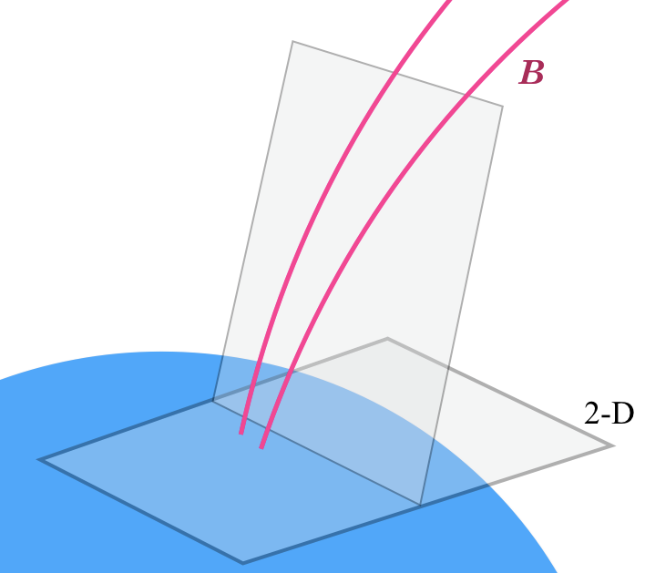
meridional plane
perpendicular plane
Notes:
Another aspect of our modeling efforts is a 2-D simulation in a meridional plane.
Originally a desire to better understand the electric potential boundary condition at the upper boundary of that model led us to the current effort.
But in this analysis we’re looking at a plane perpendicular to the magnetic field, and assuming that the parallel electric field can be neglected.
So when we talk about the E field we mean the perpendicular electric field.
The first geometry we’ll look at is a slab.

Slide 4
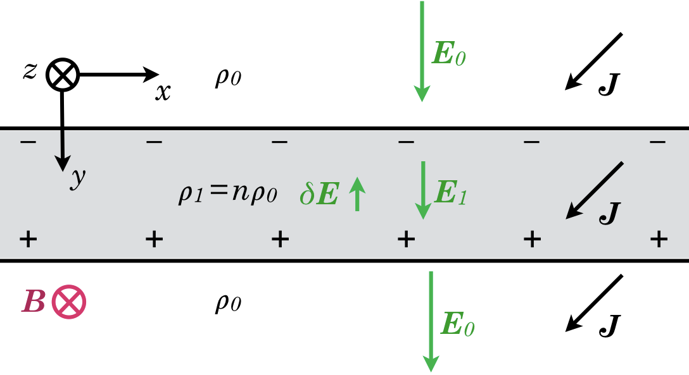
Notes:
Slab of higher plasma density in a plane parallel to B, e.g. like an L-shell
Effectively infinite in the x direction
There is an electric field, and a current is closing FAC’s that are far off in the \pm y direction.
The current density J is at an angle to the E field because of the Hall conductivity.
The plasma in the slab has a density that is a factor n higher than it is in the background, outside the slab.
If E were as strong inside the slab as outside, there would be an accumulation of free charge.
In steady state there will be a polarisation of the slab, until the point at which J is once again uniform.
A result of this geometry is that the boundary does not move. A non-moving boundary trivially gives conservation of both species.
But the significant point is that density variations create a structuring of the E field.
Is the 2-D assumption valid in the ionosphere? There may be transient FAC’s as the change in E in the E-region propagate upward, but within 1 second the F-region will have adopted the same ExB drift.

Slide 5
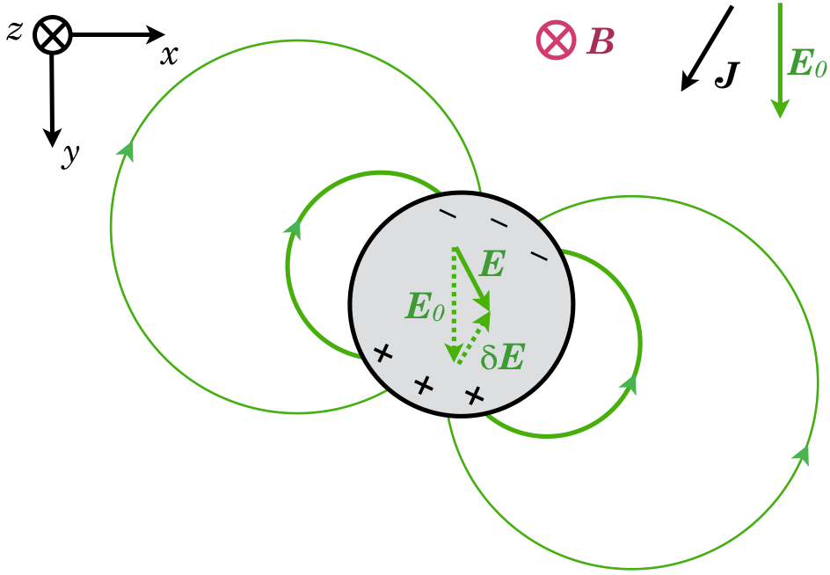
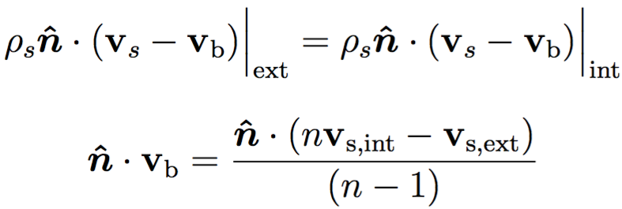
Notes:
A patch of density that is a factor n higher than the surrounding field tubes.
If E were uniform, then J would be larger inside, and charge would accumulate as a dipole.
Unlike the spherical dipole that is more familiar in space physics, a 2-D or cylindrical dipole has field lines and equipotential lines that are circular.
E remains uniform inside the circle, but the dipole is oriented toward 7 o’clock. This reduces the magnitude of E inside the patch, and also rotates it toward 5 o’clock.
This change in turn alters the exact angle at which charge accumulates. So there’s an implicit relationship between the electric field inside and charge accumulation.
But there is a unique solution for the dipole which give a divergence-free J.
Does the boundary move? [click] Let the drift speed of the boundary be v_b.
The conversation condition for each species s requires that the flux into the boundary be the same as the flux out on the other side.
rho_s is the density, v_s is the species drift, and n-cap is the outward normal.
We can rearrange to get the component of boundary drift normal to itself.

Slide 6
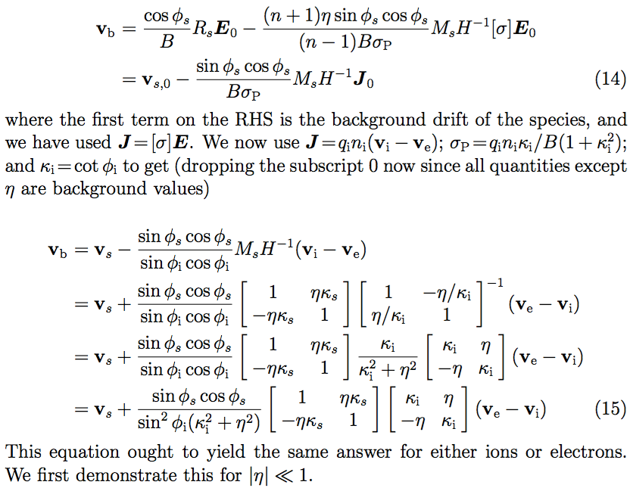
Notes:
I’m not going to talk about equations. I’ve got a draft paper if you want to see them.
But I want to show that the drift of the boundary can be determined from the conservation requirement for each species.
I only want to show these to make the point that v_b must be equal to the species drift v_s, plus a term which is proportional to the current density J, that is, to the difference between the ion and electron drift speeds.
But the factors in front of that term are species-dependent.

Slide 7
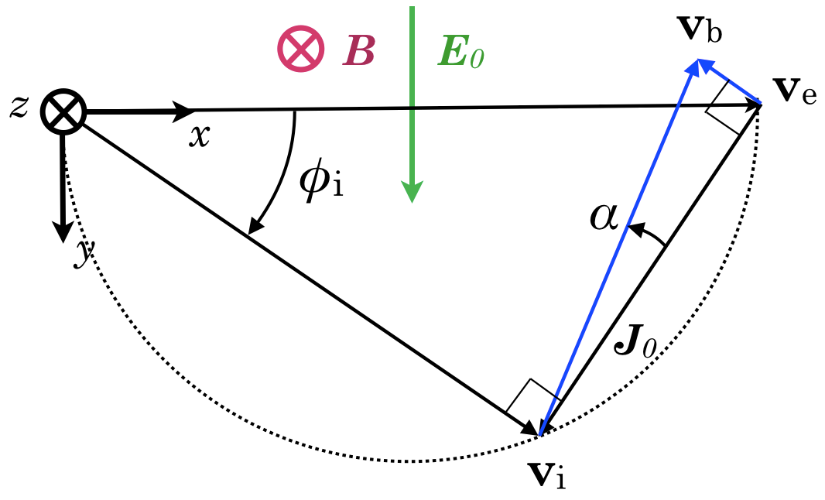
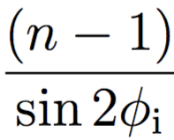

Notes:
The next three slides all show drift vectors, not patch geometry.
The black triangle shows species drift speeds in the background plasma.
The ions drift at an angle relative to ambipolar.
The cotangent of this angle phi_i is the ion magn. parameter kappa.
The conservation condition yields an expression for the dipole strength and the electric field inside the patch in steady state.
We can use either species (ions or electrons) and obtain the same v_b, and that construction is shown in blue.
In solving for v_b using the ion species, there is a term with (v_e – v_i) in it, but also a small rotation (called alpha here) proportional to (n-1). (This situation is with a patch about one-sixth denser than the background.)
Using the electron species, the term proportional to J is scaled down by the same factor alpha, but rotated by 90°.
Both species yield the same result.
For a density enhancement, the boundary of the patch drifts more slowly than the background ambipolar and (in Boreal regions) slightly leftward, that is with a small component against E.

Slide 8
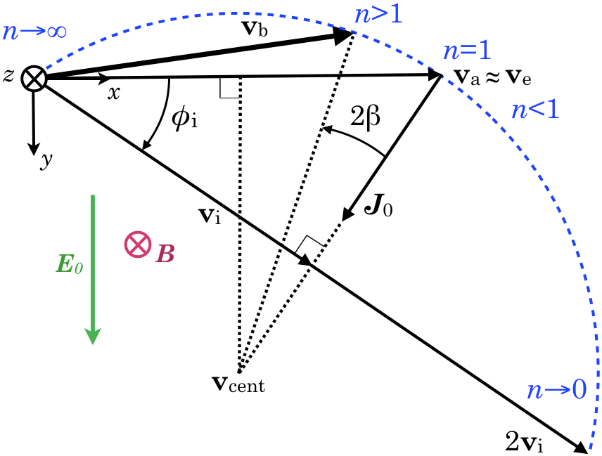
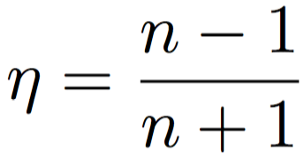

Notes:
If we throw off the small angle approximation, we can find the drift speed of a patch or depletion with any degree of enhancement.
eta is an alternate way of parameterising the relative density, equal to (n-1)/(n+1).
There are three limits that are easy to calculate:
In the limit of high density, the patch will not move.
In the limit of low density, the patch will drift at twice the ion drift speed.
And if n=1 there will be no difference from the background drift.
These three cases form an isosceles triangle. The general drift for any n turns out to be along the blue arc, centred on this speed called v_cent.
I need to point out that nothing drifts at that velocity, but all of the solutions for varying n lie along an arc around it.
The angle beta depends on the ratio of enhancement eta to the ion magnetisation kappa.
This diagramme shows results for an ion magnetisation ratio of about 0.7.

Slide 9

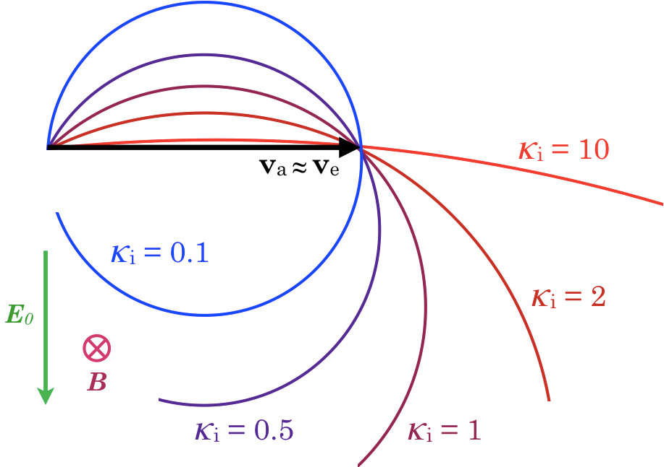
Notes:
And finally, for various values of ion magnetisation, here is what the patch drift velocity for a 2-D plasma should look like.
Each circular arc corresponds to a different ion magnetisation ratio.
A small enhancement should yield a drift near ambipolar.
Stronger patches should drift more slowly.
Deep depletions should have a component in the same sense as E, usually faster than ambipolar, but potentially slower as well.
What happens in a real ionosphere with magnetisation that changes continually with height?
For example, in a patch of twice the background density, each layer will be getting forced in a slightly different direction. [gesture]
[click] A conjecture is that the net drift of a flux tube will be a weighted average of these drifts, as determined by the ratio of height-integrated Pedersen and Hall conductivities, big Sigma_P over big Sigma_H.
Emph: so it’s really the E- and lower F-region enhancement that drives things.
And a closed flux tube has two ends in the ionosphere, so reality can be quite complicated.
That much is conjecture, but in the 2-D limit, these circular arcs are exact.
Now, we were a bit surprised by the limit of high ion magnetisation kappa, because we were expecting to see the density dependence approach zero in the case of low conductivity.

Slide 10
Removing neutral collisions
Next two figures:
Slab geometry: same result for E as before, although for different reasons.
Circular geometry: the patch (or depletion) still suffers a polarisation, but the dipole axis is exactly aligned with E. Otherwise identical results for patch drift.
Notes:
So, we also approached the problem from a non-conducting perspective. Curiously, we found the same results as the high-magnetisation limit of the conducting results (kappa \to \infty), although it comes about for completely different physical reasons.
Slab: now E will still be weaker inside. The boundary still doesn’t move. The current density J remains uniform.
Circle: There is no equivalent to the Hall conductivity, so the charge dipole is exactly at 6 o’clock, and the E field inside is parallel to the surroundings, just weaker.
Must emphasise: in the collisionless case, there is no unique steady state.

Slide 11
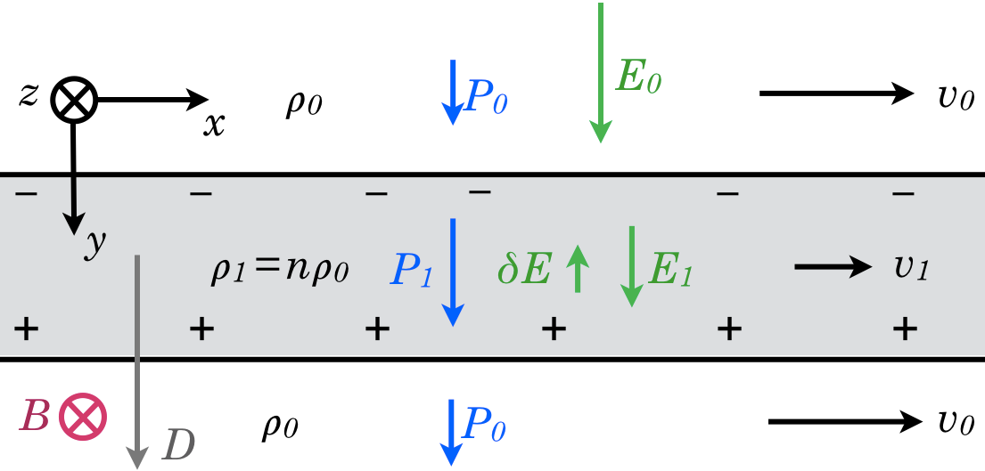
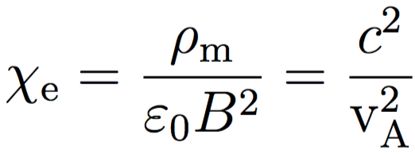
Notes:
Slab geometry: Suppose the plasma mass density is higher inside by a factor n. There is no drift initially.
Imagine that FAC’s far off in \pm y gradually build up an E field
Permittivity or Susceptibility: degree to which E is reduced inside a material
propagation speed perpendicular to B
polarisation current
particle dynamics
energy density
All lead to the same value [Click] chi_e ~ 10^4 to 10^6 for space plasmas.
An FAC couplet above and below panel generates an E field
We assume zero free charge. Therefore the difference in polarisability causes a net charge to appear on the interface.
No free currents.

Slide 12
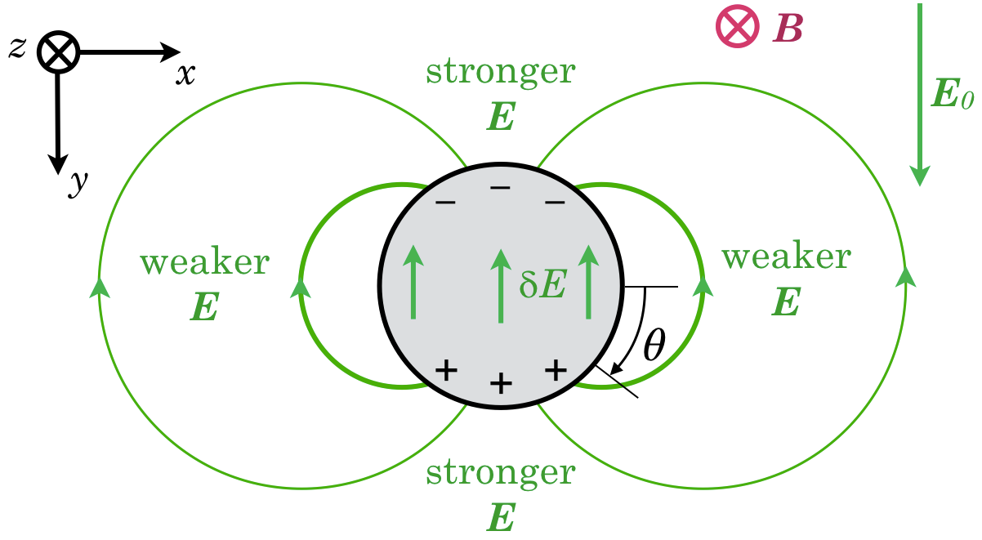
Notes:
Far-off FAC in the +/- y directions generate a “background” field which is uniform far away.
Polarisation of patch leads to a dipole of net charge.
2-D or cylindrical dipole has field lines and equipotential lines that are circular.

Slide 13
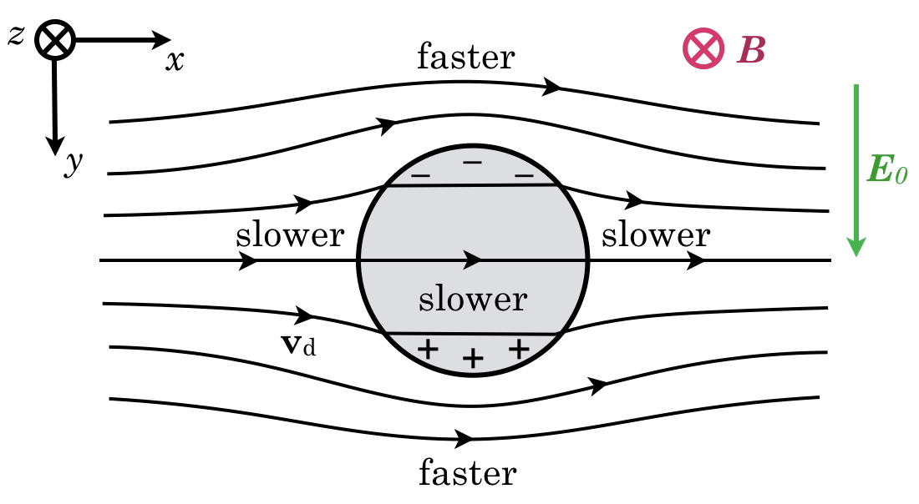
Notes:
Flow field is along equipotential lines.
How does the boundary move? Conservation of each species requires that its flux into the boundary is the same on both sides.
[click] rho_s is the density, v_s is the species drift, v_b is the boundary drift, and n-cap is the outward normal.
If we were to follow and move with the plasma inside the patch, then the boundary would not move, and the exterior flow field would be a simple diversion around the patch.

Slide 14
Conclusions
The treatment of a collisionless plasma as having an electric susceptibility yields results consistent with the κ→∞ limit of a conducting plasma.
While an open flux tube may have a uniform electric field “imposed” on it, plasma on closed flux tubes will experience a structuring of the electric field that depends on mass density features.
A non-conducting plasma can have a free-charge distribution, concomitant with an arbitrary initial 2-D flow field. But a conducting plasma has a unique steady state.
For a circular density feature, a dipolar surface charge with appropriate magnitude and orientation yields a divergence-free current field.
The boundary of a circular density feature retains a circular shape, and its electrons, although it does not “own” a particular parcel of ions.
The boundary should convect with a velocity given by the expression found – always slower than ambipolar for an enhancement and usually faster for a depletion.
Notes:
Once we’re able to publish this you’ll be able to read all of the conclusions.
The most significant one is that for the non-collisional or non-conducting case we get the same results as for the limit of high ion-magnetisation in the conducting case.

Slide 15
Questions?
Notes:
For you:
Have you seen these results presented anywhere before?
Are there any observations that support this prediction?

Slide 16
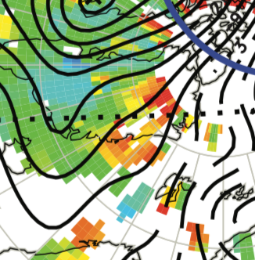
detail from Zhang et al. 2013 Fig. 2.C.

