Slide 1
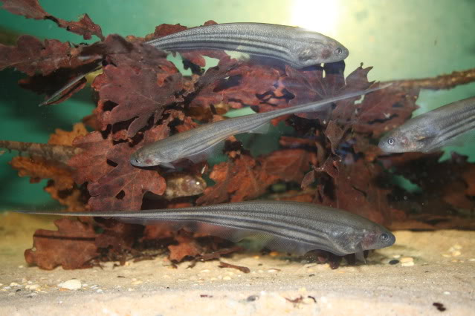
A Model for assessing ATP demands of sustained high frequency firing
Biology collaborators:
John Lewis –U Ottawa
Michael Markham –
U Oklahoma
Béla Joos, Catherine E. Morris (OHRI)
Notes:
PAGE COUVERTURE (option 1) – ÉBAUCHE (DOCUMENT NON FINALISÉ)
REMARQUE : À lire avant d’utiliser le gabarit
Les éléments suivants du gabarit ne peuvent pas être modifiés :
• En-tête institutionnel grenat (Université d’Ottawa | University of Ottawa)
• Pied de page institutionnel comprenant la bande grise et grenat ainsi que le logo
Les éléments suivants du gabarit peuvent être modifiés :
• L’adresse Web uOttawa.ca dans le pied de page peut être personnalisée afin de répondre aux besoins de l’utilisateur et le nom du document peut être inséré à la droite de l’URL si nécessaire. Vous pouvez simplement taper l’adresse Web désirée dans la boîte appropriée
• La photo ou l’image de fond peut être remplacée par celle de votre choix
COVER PAGE (option 1) – DRAFT ONLY (FILE NOT FINAL)
NOTE: Read before using template
The following elements of the template must remain untouched and cannot be modified:
• Corporate (Université d'Ottawa | University of Ottawa) garnet header
• Corporate uOttawa footer including the grey/garnet stripe and logo
The following elements of the template may be customized:
• You may include the uOttawa.ca URL of your choice in the footer, and insert the name of the document to the right of the URL, if needed
• The URL can be customized to a specific URL by following these simple steps: On the PowerPoint View tab, in the Master Views group, select Slide Master. Select the third slide on the left side panel, and type in the desired URL on the slide
• The photo or background image may be replaced by the photo or background image of your choice

Slide 2
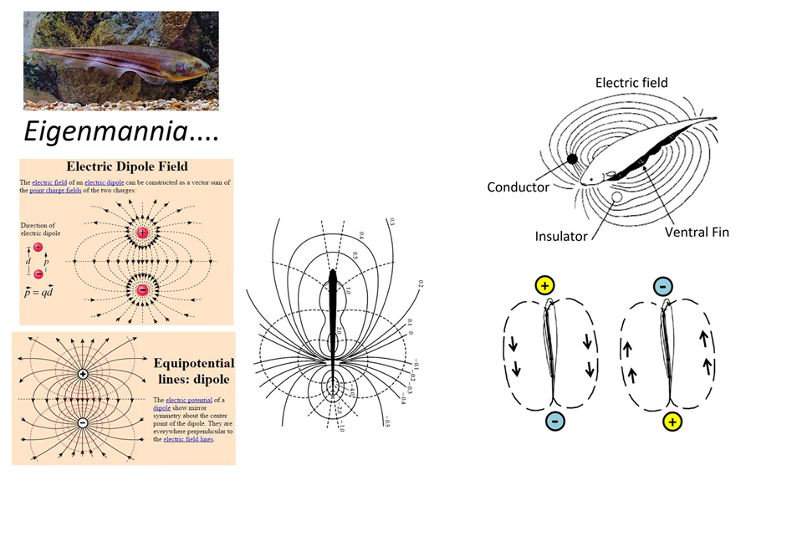
ELECTRIC ORGAN DISCHARGE (EOD)
oscillating dipole
produces electric fields whose
distortions the fish senses.
Focus? – e-discharge mechanisms
(not sensing)
Solid- equipotential
Dashed – field lines
Currents flow same pattern as
the flipping electric fields
(Ohm’s law --i.e., current flow
varies with “voltage drop”)

Slide 3

Electric eel (tetanic contracture of prey)
Stuns the fish before eating it
But our interest is in weakly electric fish which produce electric organ discharges continuously throughout their lifetime.

Slide 4
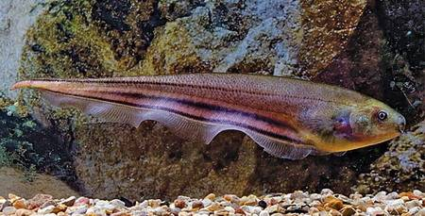
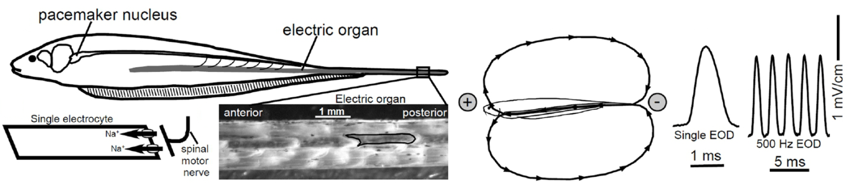
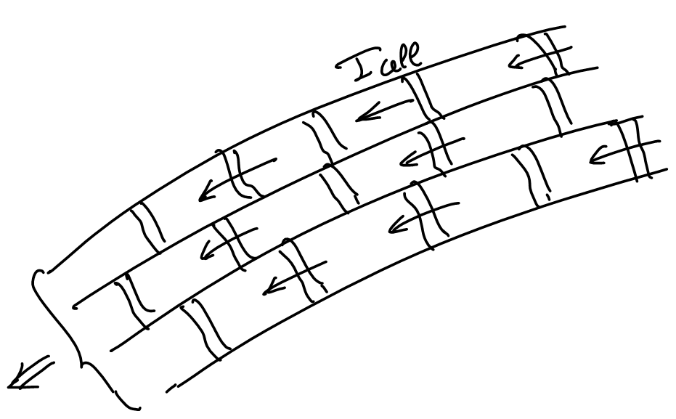

Eigenmannia -- a weakly electric fish
electric organ -- thousands of massive
(~1 mm) electrocytes
derived from fused “muscle” cells (syncytium
~30,000 nuclei)
– the EOD requires synaptic input from the
Central Nervous System pacemaker
Posterior (P): Navs and Kvs generating APs
Anterior (A):
Capacitive role
Notes:
PAGE INTÉRIEURE – ÉBAUCHE (DOCUMENT NON FINALISÉ)
REMARQUE : À lire avant d’utiliser le gabarit
Les éléments suivants du gabarit ne peuvent pas être modifiés :
• En-tête institutionnel grenat (Université d’Ottawa | University of Ottawa). Par contre, ces éléments peuvent être enlevés dans les pages intérieures dans les cas où on a besoin de plus d’espace.
• Pied de page institutionnel comprenant la bande grise et grenat ainsi que le logo. Par contre, ces éléments peuvent être enlevés dans les pages intérieures dans les cas où on a besoin de plus d’espace.
Les éléments suivants du gabarit peuvent être modifiés :
• L’adresse Web uOttawa.ca dans le pied de page peut être personnalisée afin de répondre aux besoins de l’utilisateur et le nom du document peut être inséré à la droite de l’URL si nécessaire.
• L’adresse Web qui peut être modifiée en suivant les étapes suivantes : dans le document PowerPoint, cliquez sur l’onglet View, puis sélectionnez Slide Master. Sur le menu d’affichage (à gauche), sélectionnez la troisième diapositive et inscrivez la nouvelle adresse sur celle-ci.
INSIDE PAGE – DRAFT ONLY (FILE NOT FINAL)
NOTE: Read before using template
The following elements of the template must remain untouched and cannot be modified:
• Corporate (Université d'Ottawa | University of Ottawa) garnet header. However these elements may be removed on the inside pages in cases where more space for content is required.
• Corporate uOttawa footer including the grey/garnet stripe and logo. However these elements may be removed on the inside pages in cases where more space for content is required.
The following elements of the template may be customized:
• You may include the uOttawa.ca URL of your choice in the footer, and insert the name of the document to the right of the URL, if needed.
• The URL can be customized to a specific URL by following these simple steps: On the PowerPoint View tab, in the Master Views group, select Slide Master. Select the third slide on the left side panel, and type in the desired URL on the slide.
• The photo or background image may be replaced by the photo or background image of your choice.

Slide 5
Lewis, Gilmour, Moorhead, Perry, Markham 2014
J Neurosci 34:197
Action potential energetics at the organismal level reveal a trade-off in efficiency at high firing rates.
Eigenmannia EOD – synchronous tonic APs – never stop!
major fraction of whole animal metabolism.
EOD + electric sensing: navigate, communicate, locate prey.
Jamming Avoidance Response (JAR) – CNS-controlled ∆AP frequency when a conspecific using a similar freq is nearby (average JAR: ∆ ~10 Hz – easily measurable)
whole fish respirometry (flasks) - exploit JARs to estimate ATP consumed per AP – HOW? First, measure background O₂ consumption, then “fake” a conspecific. This elicits a sustained change in AP frequency (EODs monitored throughout).

Slide 6
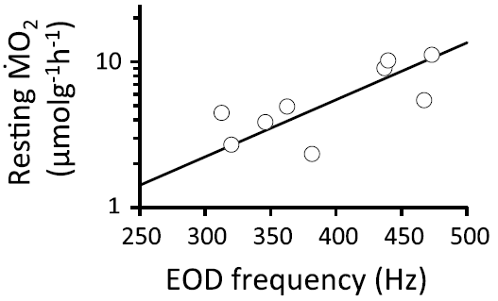
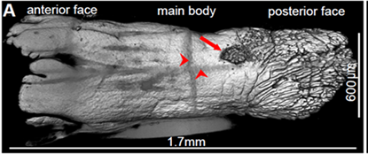
Lewis et al., 2014
Their major expt’l result:
ATP/Hz is NOT fixed
EODs cost grows exponentially with freq
--- the respirometry data
summarized by the ATP/Hz slope
(semi-log plot)
MOREOVER
– the incremental costs in ATP/Hz
determined by eliciting JARs
in 6 fish with very different baseline
EOD frequencies concurs.
SO –
tenor = cheap, soprano = “expo”-expensive
(remember … semi-log plot)
tenor ⇾ ⇾ soprano
Our aims: design the generation of action potentials (APs) by electrocytes and explain the frequency dependence of the energy requirements

Slide 7
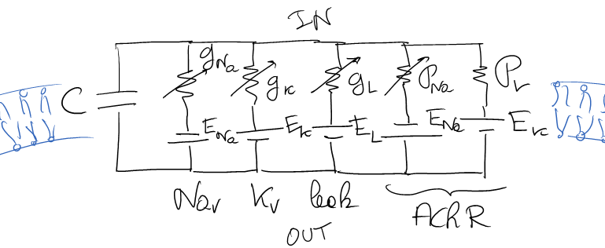
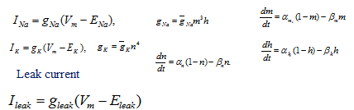
We designed a model consistent with available experimental data. Today we will focus on the posterior end which drives the electric organ discharge.
A Hodgkin Huxley type model which calculates the changes in membrane voltage as ions flow in and out of the electrocyte’s posterior face.
Each current has its own kinetics either voltage driven (Nav, Kv) or ligand driven (AChR)

Slide 8
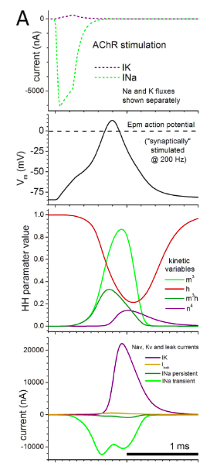
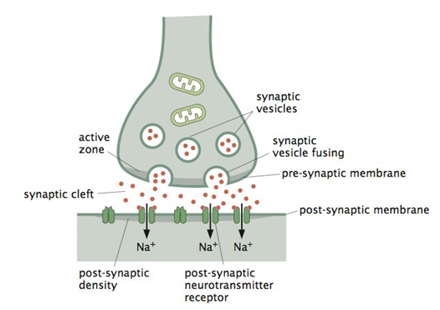
one action potential
the kinetic variables
the ion currents from voltage gated Nav and Kv channels

Slide 9
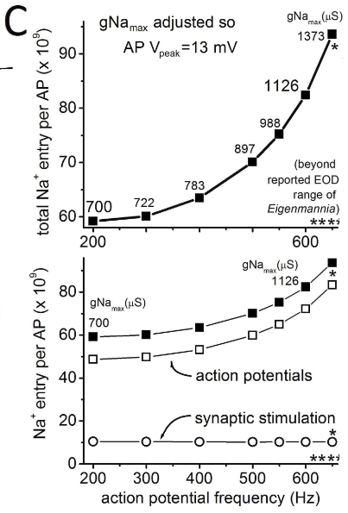
Increase in ATP measured as a Na entry* demand not exponential less than a factor 2 over the relevant range of frequencies.
It is difficult to conceive that the observed exponential increase would arise from the generation of AP
So where does it come from?
* Na⁺ has to be pumped out which requires ATP

Slide 10
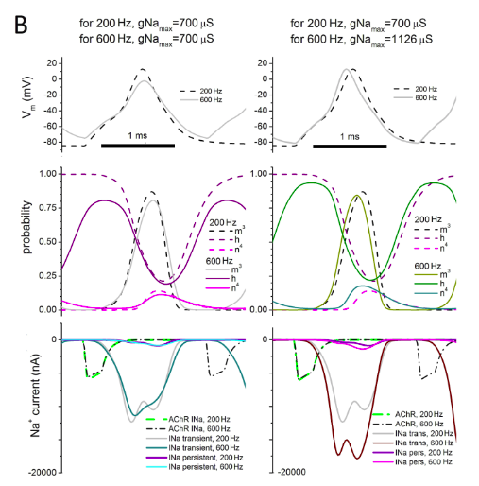
The increased demand of ATP based on Na⁺ entry is a result of overlap of action potentials

Slide 11
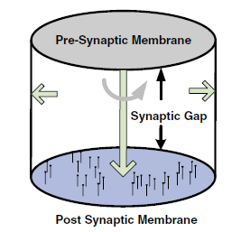
The high measured increase in cost has then to arise from increased demands related to generating high frequency stimulus
Phillips et al , Molecular Biol. of the Cell
Reaction-diffusion process where ACh released by vesicles diffuse across the gap partly intercepted by acetylcholinesterase. But others reach the posterior end of the electrocyte attaching to AChR leading to stimulating current initiating the action potential.
Khaliq et al, J. Neurosci. 2011

Slide 12
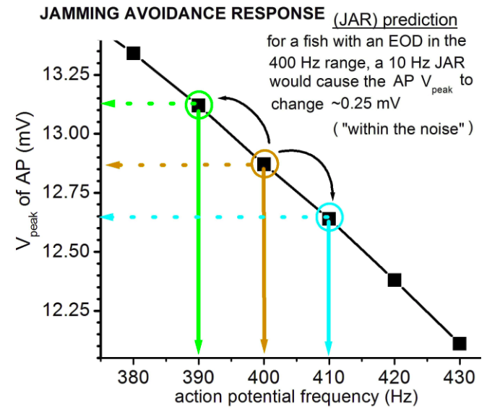
Fish shift their frequency when close to a conspecific.
We show that this could be accomplished without the need to adjust their ion conductances

Slide 13
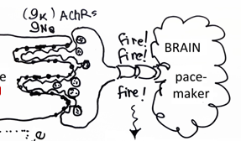
What is next?
Whole electrocyte model
Modeling the synaptic transmission: how the synapse is designed to permit firing frequencies up to 1000Hz or periods of the order of 1 ms

Slide 14
Summary
Many electric fish are capable of producing oscillating electric dipoles generated by columns of electrocytes (derived from muscle cells)
The action potentials (APs) are similar to those of neurons (Nav, Kv, and Na/K pumps) but are generated at very high frequencies (200-500Hz in Eigenmannia, but in other fish up to a 1000Hz)
The ATP cost of generating electric organ discharges increases as a power law with increased frequency contrary to the observed exponential increase indicating that the cost of providing the brain stimuli leading to the synaptic transmissions is high.
Still need the operation of the full electric organ and that of synaptic transmission

Slide 15
Eigenmannia -- a weakly electric fish
electric organ -- thousands of massive (~1 mm) electrocytes
derived from fused “muscle” cells (syncytium ~30,000 nuclei)
– the EOD requires synaptic input from the CNS pacemaker
Posterior (P): Navs and Kvs generating APs
Anterior (A):
Capacitive role
Notes:
PAGE INTÉRIEURE – ÉBAUCHE (DOCUMENT NON FINALISÉ)
REMARQUE : À lire avant d’utiliser le gabarit
Les éléments suivants du gabarit ne peuvent pas être modifiés :
• En-tête institutionnel grenat (Université d’Ottawa | University of Ottawa). Par contre, ces éléments peuvent être enlevés dans les pages intérieures dans les cas où on a besoin de plus d’espace.
• Pied de page institutionnel comprenant la bande grise et grenat ainsi que le logo. Par contre, ces éléments peuvent être enlevés dans les pages intérieures dans les cas où on a besoin de plus d’espace.
Les éléments suivants du gabarit peuvent être modifiés :
• L’adresse Web uOttawa.ca dans le pied de page peut être personnalisée afin de répondre aux besoins de l’utilisateur et le nom du document peut être inséré à la droite de l’URL si nécessaire.
• L’adresse Web qui peut être modifiée en suivant les étapes suivantes : dans le document PowerPoint, cliquez sur l’onglet View, puis sélectionnez Slide Master. Sur le menu d’affichage (à gauche), sélectionnez la troisième diapositive et inscrivez la nouvelle adresse sur celle-ci.
INSIDE PAGE – DRAFT ONLY (FILE NOT FINAL)
NOTE: Read before using template
The following elements of the template must remain untouched and cannot be modified:
• Corporate (Université d'Ottawa | University of Ottawa) garnet header. However these elements may be removed on the inside pages in cases where more space for content is required.
• Corporate uOttawa footer including the grey/garnet stripe and logo. However these elements may be removed on the inside pages in cases where more space for content is required.
The following elements of the template may be customized:
• You may include the uOttawa.ca URL of your choice in the footer, and insert the name of the document to the right of the URL, if needed.
• The URL can be customized to a specific URL by following these simple steps: On the PowerPoint View tab, in the Master Views group, select Slide Master. Select the third slide on the left side panel, and type in the desired URL on the slide.
• The photo or background image may be replaced by the photo or background image of your choice.

Slide 16
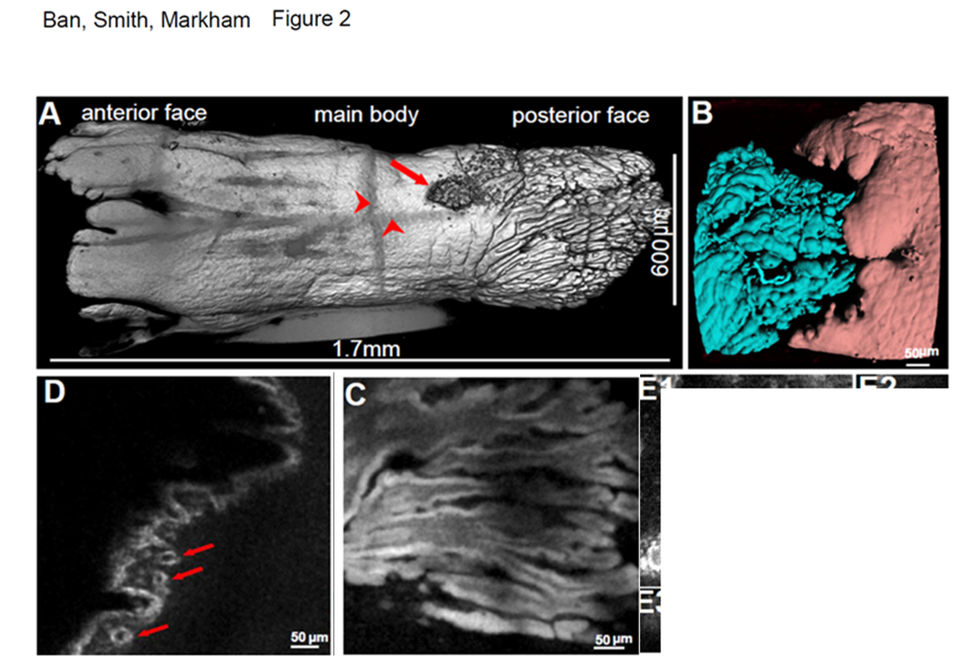
2014

Slide 17
AP generation in a single electrocyte
Anterior (A):
Capacitive role
Posterior (P): Navs and Kvs generating APs
V_{A} =potential at anterior end wrt to outside C_{A} ≈ 18nF with invag. 7.5 x larger
V_{P} =potential at posterior end wrt to outside C_{P} ≈ 48nF
Equivalent
circuit
R_{gap}= gap resistance
R_{cyt}= cytoplasma resis.
R_{cell}= R_{gap}+R_{cyt}
R_{ext}= external load
V_{A}= V₂-V₁
V_{P}= V₃-V₄

Slide 18
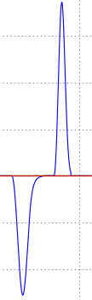
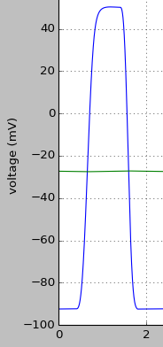
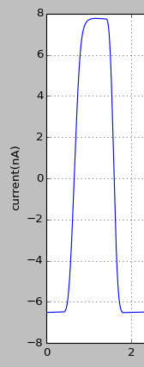
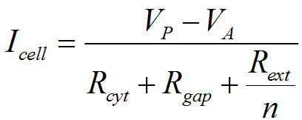
A full EOD cycle as seen from one electrocyte
(in the steady state)
500Hz spike shown
1.- Influx of Na⁺ at P (current I_{P} < 0), outflow of K⁺ (I_{P} > 0)
V_{P}
(blue)
V_{A}
_{(green)}
I_{E}
I_{P}
2.- an AP is generated at P. V_{A} stays nearly constant: successive APs have charged up the capacitive membranes at A to V_{A}.
3.- When V_{A} > V_{P} current I_{E} is head negative, then as
V_{A} < V_{P} it becomes head positive

Slide 19
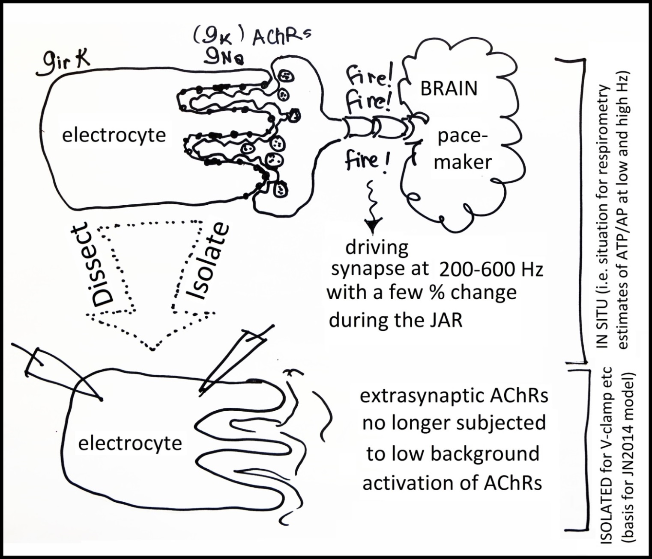

Slide 20
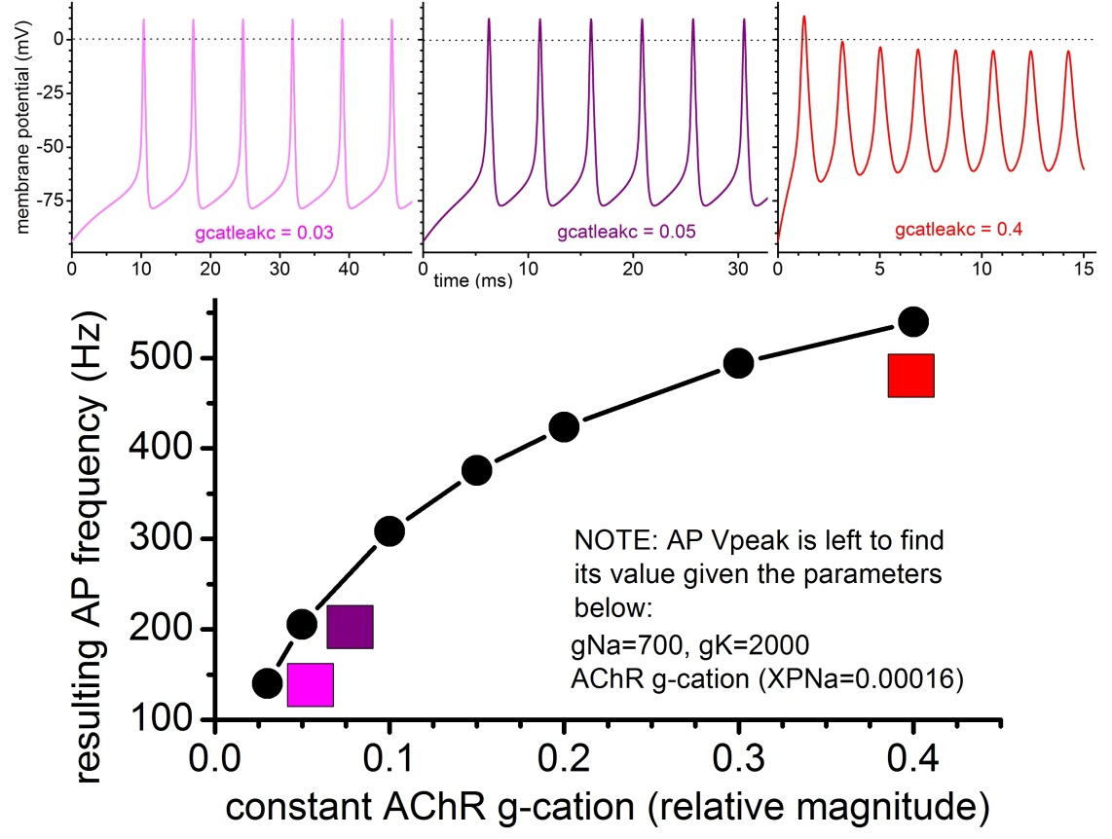
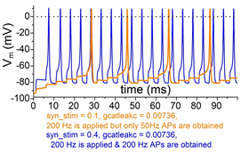
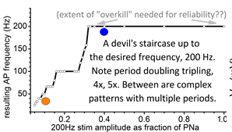
Proposed model for posterior generation of action potentials
Constant activation of AChRs
would elicit high frequency APs
over a wide Hz range(as shown), depending on [ACh].
BUT any small
∆[ACh] would cause ∆Hz & thus,
failed communication /sensing.
To ensure firing at “desired” Hz,
in spite of [ACh] vagaries, fish likely
mixes subthreshold [ACh] + pulsatile
ACh. Here (idealized case, i.e. no
[ACh] noise) desired Hz (blue) is achieved once pulsatile component
is sufficiently large.

Slide 21
Summary
Many electric fish are capable of producing oscillating electric dipoles generated by columns of electrocytes (derived from muscle cells)
The action potentials (APs) are similar to those of neurons (Nav, Kv, and Na/K pumps) but are generated at very high frequencies (200-500Hz in Eigenmannia, but in other fish up to a 1000Hz)
The ATP cost of generating electric organ discharges increases as a power law with increased frequency contrary to the observed exponential increases indicating the high cost of providing the brain stimuli ending with the synaptic transmissions.
Still need the operation of the full electric organ and that of synaptic transmission

Slide 22
