Slide 1

Detection of radiation induced changes in human lens epithelial cells using Raman spectroscopy
Harry Allen

Slide 2



Acknowledgements
Dr. Sangeeta Murugkar
Dr. Vinita Chauhan
Dr. Balazs Nyiri
Achint Kumar
Abrar Ahmad
Hamid Moradi
Chris Dedek
Carleton Biophotonics Research Group
Thank you!

Slide 3
Outline
Rationale
Objectives
Raman Scattering
Raman Spectroscopy
Procedure
Analysis Techniques
Results
Conclusions

Slide 4
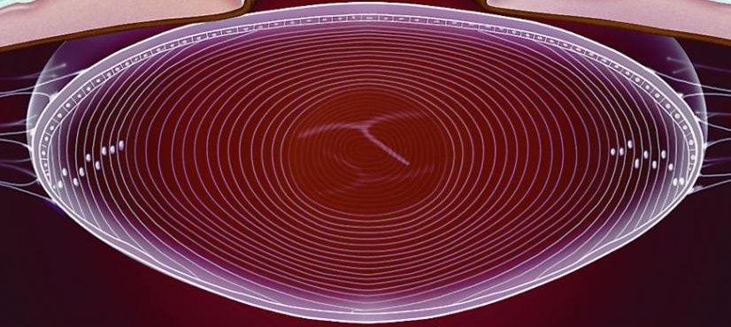
Rationale
Lens is radiosensitive
IR induces cataracts
Threshold dose was thought to be 2 Gy for detectable opacities
Recent epidemiological studies suggest 1 Gy threshold for low LET IR.
ICRP currently suggests a nominal threshold of 0.5 Gy
Increase in reported injuries due to new diagnostic procedures such as fluoroscopy
Need for sensitive assays capable of detecting minute biological changes due to low dose IR exposure
http://www.aao.org

Slide 5
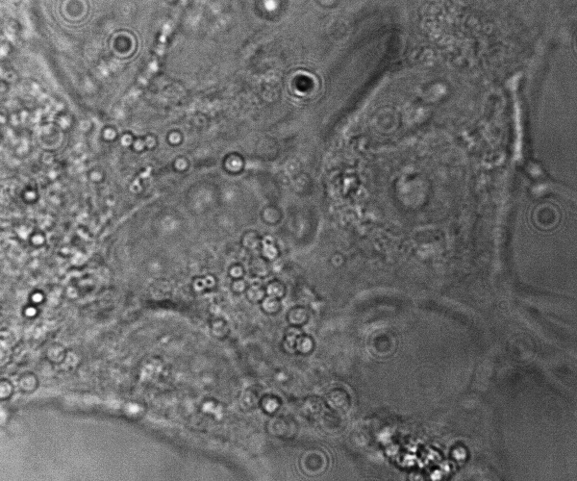
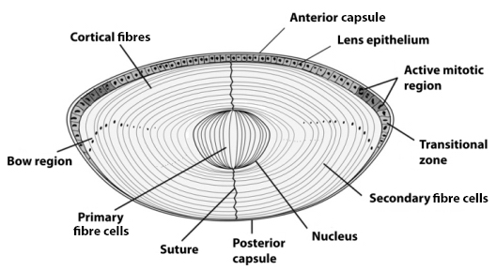
Human Lens Epithelial Cells
HLE Cells maintain homeostasis of the lens
Differentiate into lens fiber cells
http://www.abc.net.au/science/drkarl/img/4253961/lens.jpg

Slide 6
Objectives
Determine whether IR induced changes in Raman spectra of HLE cells are detectable over a range of doses
Analyse those differences, if present, to determine which biomolecules are changing in concentration
Determine whether we can discriminate between Raman spectra by dose using multivariate statistical techniques
Doses investigated:
0.01 Gy
0.05 Gy
0.25 Gy
0.5 Gy
2 Gy
5 Gy
Low dose range

Slide 7
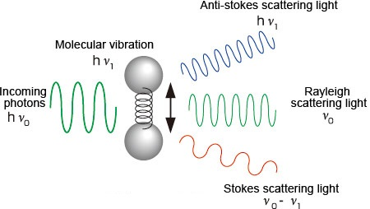

Raman Scattering
Inelastic scattering of light
Photon either loses (Stokes) or gains (anti-Stokes) energy
Molecule reciprocally gains or loses the same amount in vibrational energy
The difference in energy gives a “Raman Shift” wavenumber
http://www.hamamatsu.com
The probability of a spontaneous Stokes Raman scatter is ~10⁻⁷

Slide 8
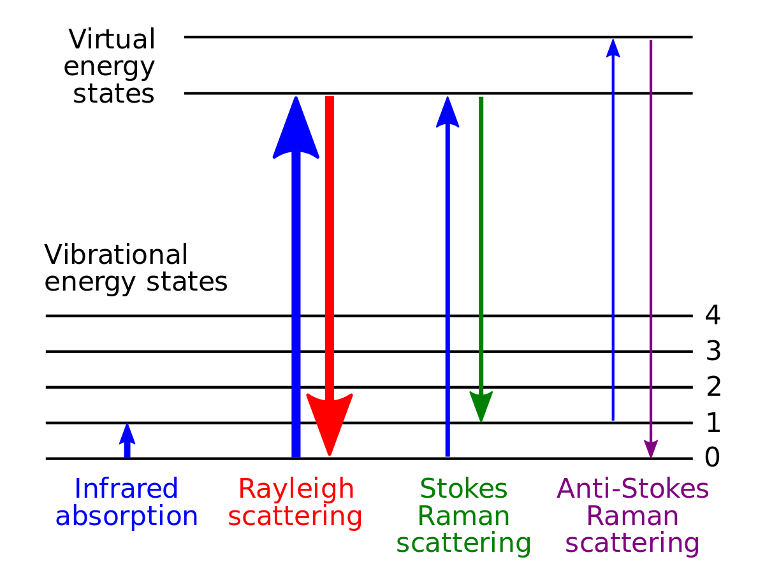
Raman Scattering
Quantum nature of a molecule limits its allowed vibrational frequencies to a discrete set characteristic of that molecule
Raman shift wavenumbers are thus characteristic of the scattering molecule
Raman scattering thus generates a “fingerprint” spectrum which can be analysed
https://en.wikipedia.org/wiki/Raman_spectroscopy

Slide 9
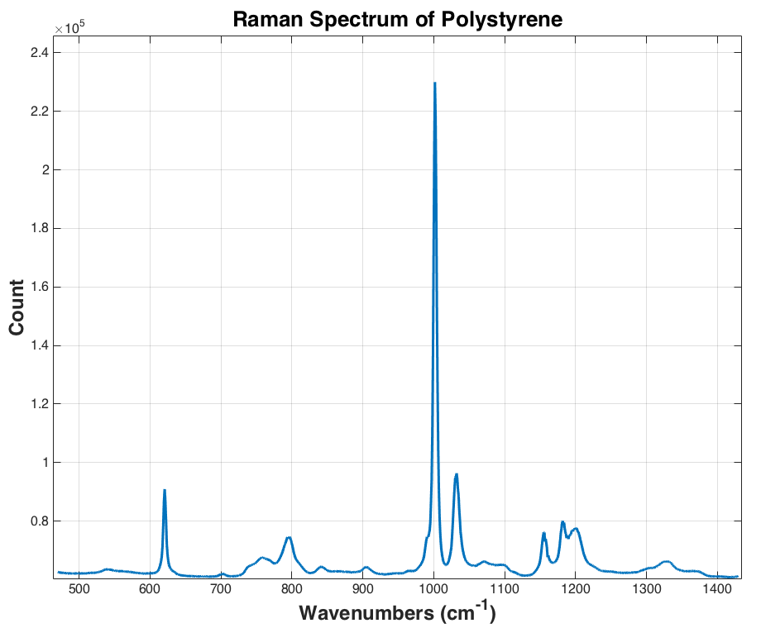
Raman Scattering
Quantum nature of a molecule limits its allowed vibrational frequencies to a discrete set characteristic of that molecule
Raman shift wavenumbers are thus characteristic of the scattering molecule
Raman scattering thus generates a “fingerprint” spectrum which can be analysed

Slide 10

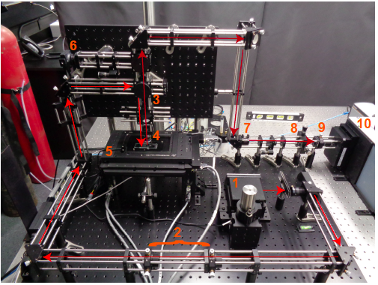
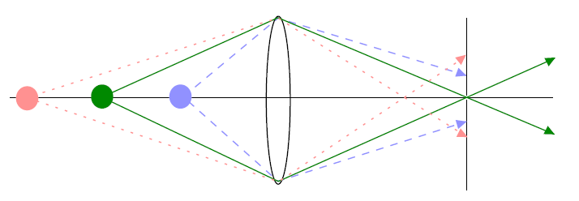
Confocal Raman Microspectroscopy
Raman scattered light transmitted
3
Rayleigh scattered light reflected
Long-pass Dichroic
Sample
http://microscopy.duke.edu/learn/introtomicroscopy/confocals.html
8 Pinhole lens Pinhole

Slide 11
Procedure
How the data was acquired

Slide 12
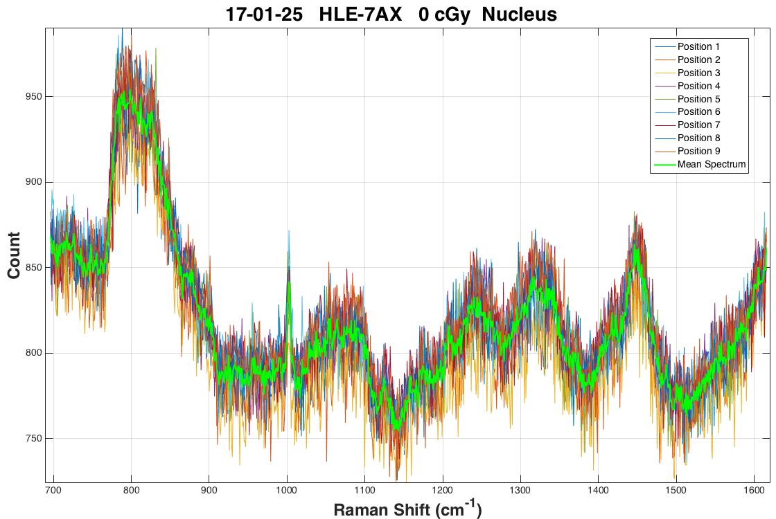
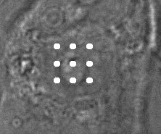
Procedure
X-Rays
7 Quartz coverslips
24 hour
Incubation
period
HLE cells grown
Irradiated
Cells Fixed
Raman Spectra Collected
Averaging + BG subtraction

Slide 13
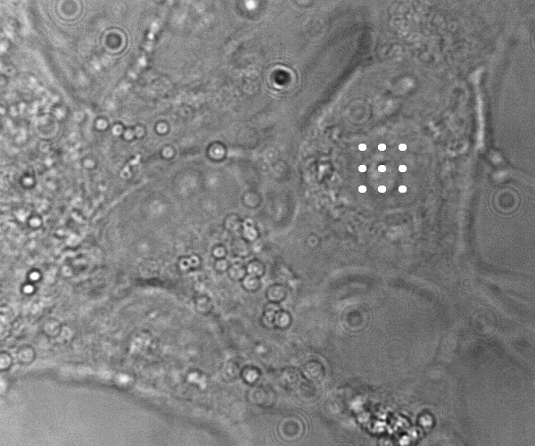
Procedure
Raman spectra recorded using the CRM, with a 785 nm laser and a 60x immersion objective
Sample coverslips with adhered cells immersed in Phosphate-buffered saline (PBS) solution
20 nucleus and 20 cytoplasm measurements taken per slip
Each measurement is the average of 9 one minute spot measurements over a 3x3 grid

Slide 14
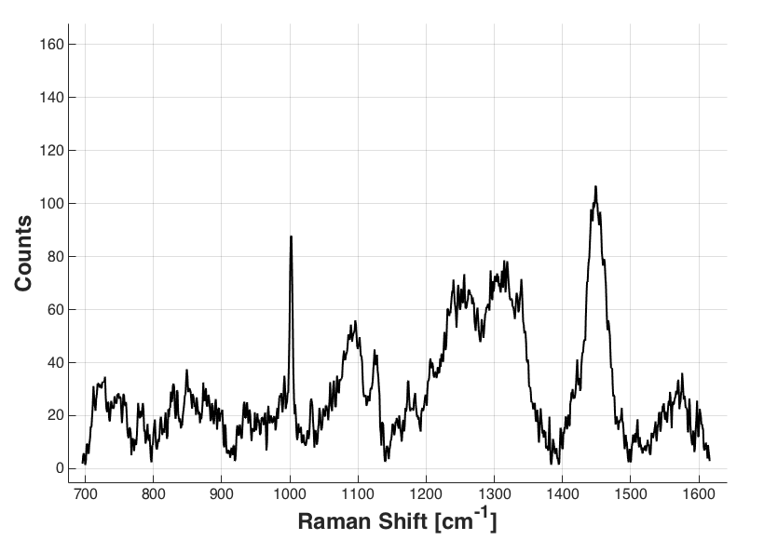
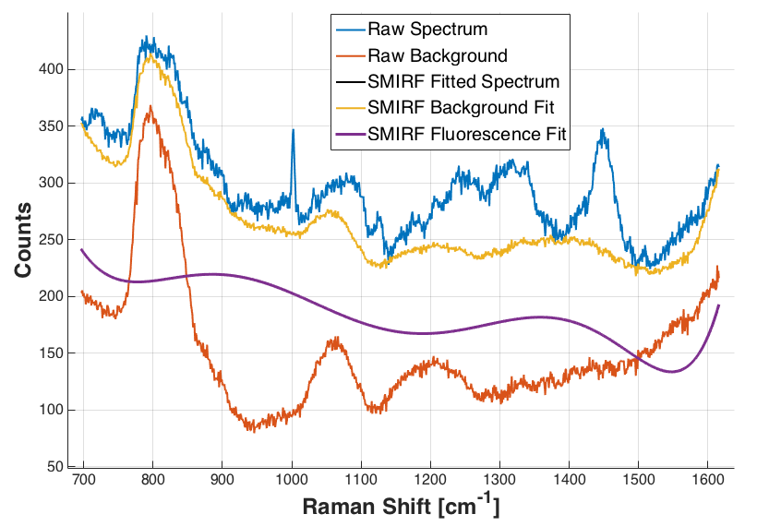
Processing Spectra
After spectrum-based method for iterative removal of fluorescence (SMIRF)

Slide 15
Data Analysis Techniques
Once we have our data, we need to analyze it
Spectral differences can be seen visually by simply plotting the mean spectra of different doses together
We also take the ratio of the area under a peak for a dose to that of the control to see how peak sizes change with respect to dose
For our classification objectives, we need to test how well we can separate measurements from the 6 doses plus control (0 Gy)
We are currently using Principal Component Analysis and Linear Discriminant Analysis to do this

Slide 16
Principal Component Analysis
Spectra have 1024 wavenumbers with a lot of correlation
PCA gives uncorrelated variables by finding the eigenvectors of the covariance matrix
Choose first N PCs, accounting for most (>95%) of the variance
Data dimensionality reduced from 1024 to less than number of measurements per dose
PC2
PC1

Slide 17
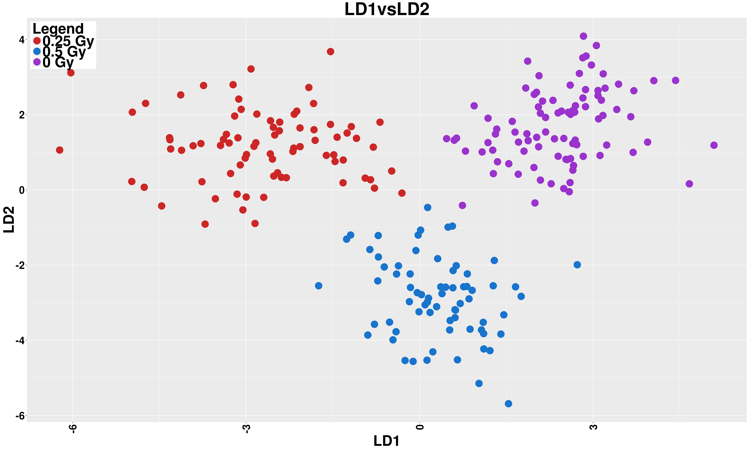
Linear Discriminant Analysis
Wish to discriminate between N classes (doses) in data
Multiclass LDA projects data onto an N-1 hyperplane, maximizing between class variance and minimizing within class variance
A distance metric is then used to determine which class mean a data point being tested is closest to in the transformed space

Slide 18
Results
Comparing mean spectra for different doses

Slide 19
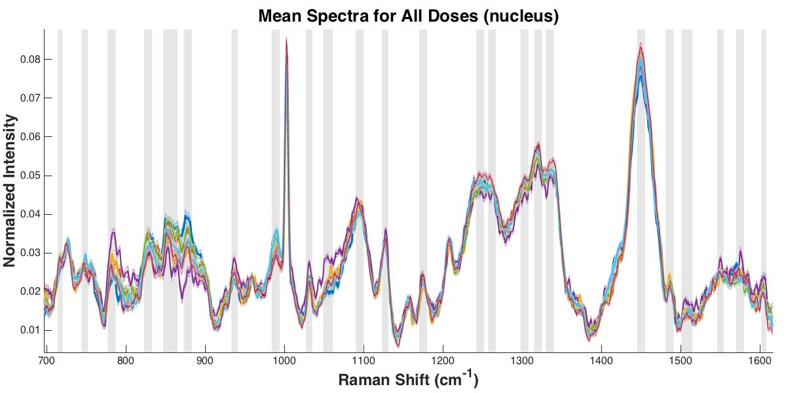
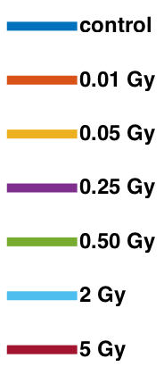
Results: Nucleus Spectra

Slide 20
Results: Nucleus Spectra

Slide 21
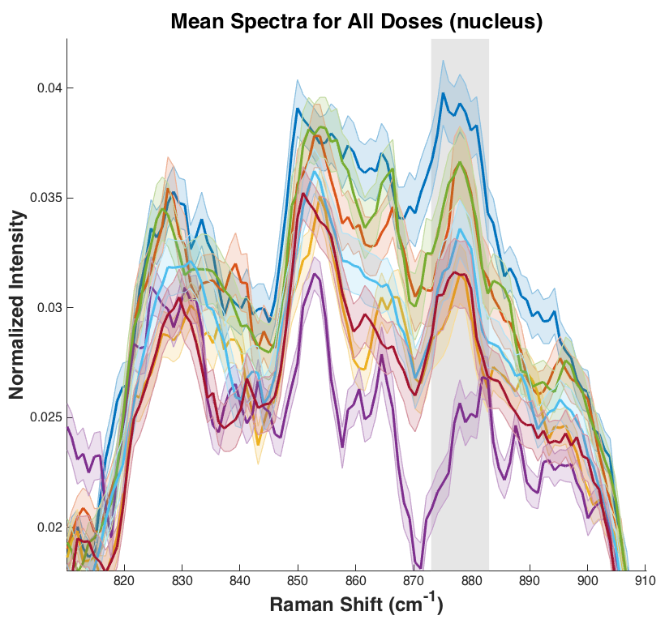
Results: Nucleus Spectra

Slide 22
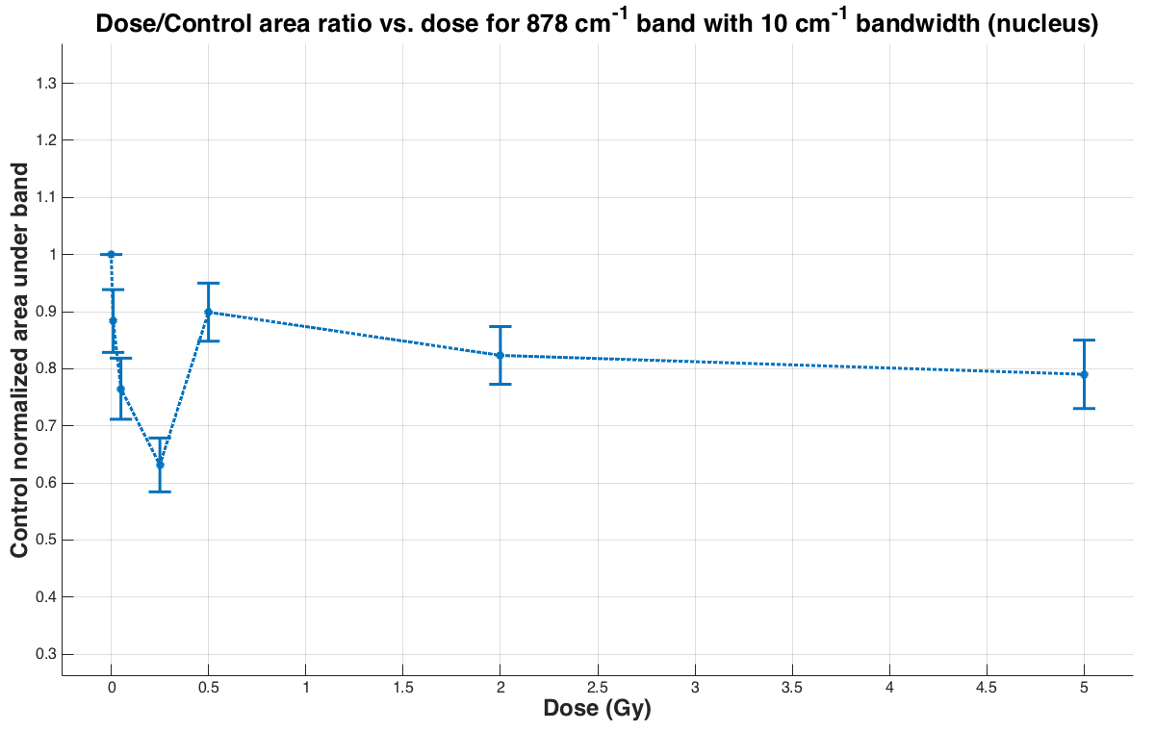
Results: Nucleus Spectra

Slide 23
Results: Nucleus Spectra

Slide 24
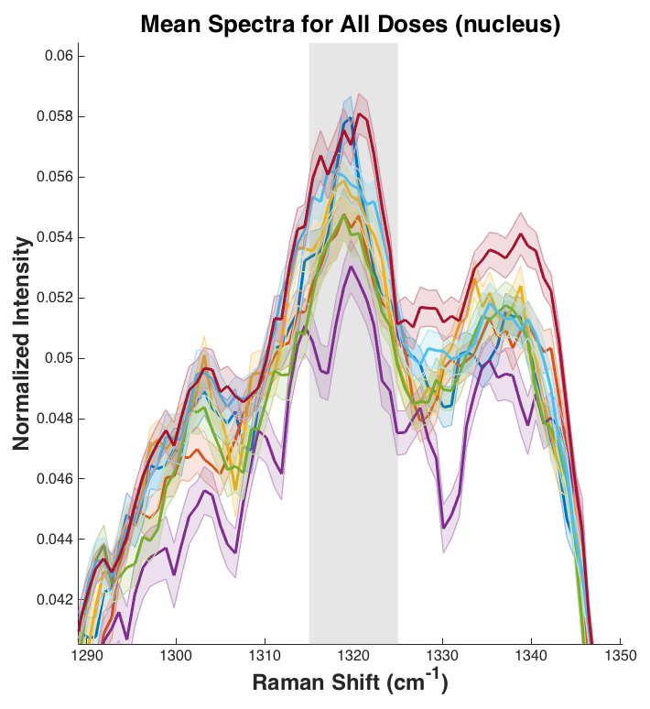
Results: Nucleus Spectra

Slide 25
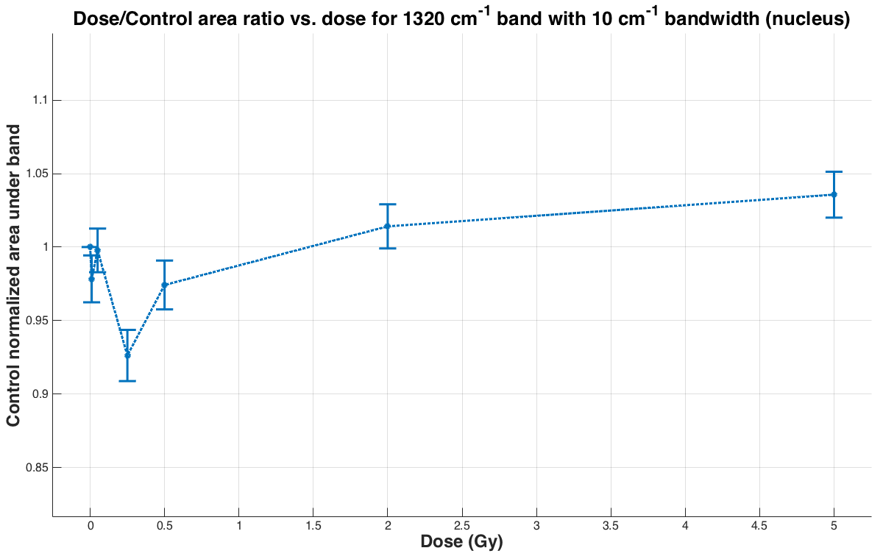
Results: Nucleus Spectra

Slide 26
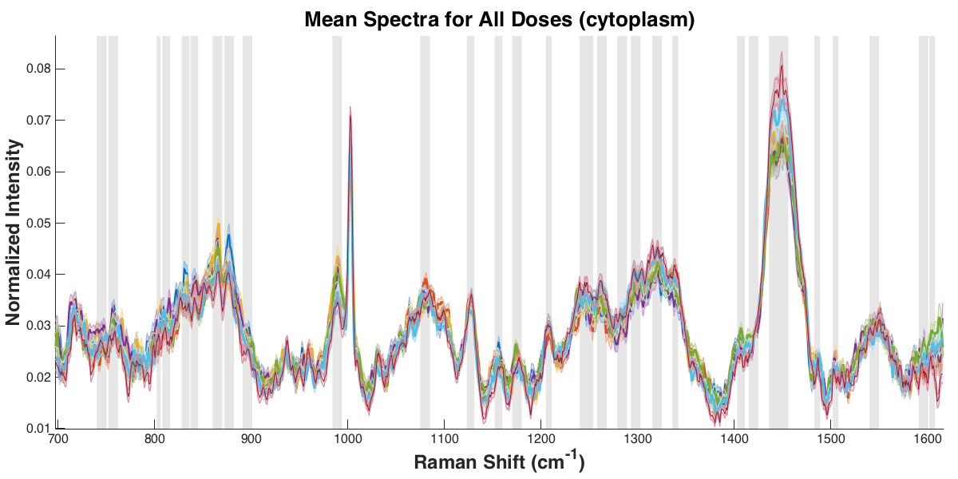
Results: Cytoplasm Spectra

Slide 27
Results: Cytoplasm Spectra

Slide 28
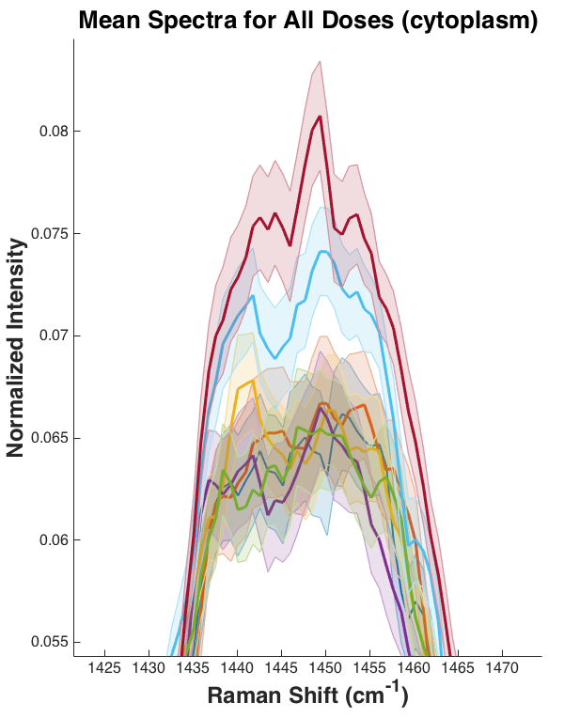
Results: Cytoplasm Spectra

Slide 29
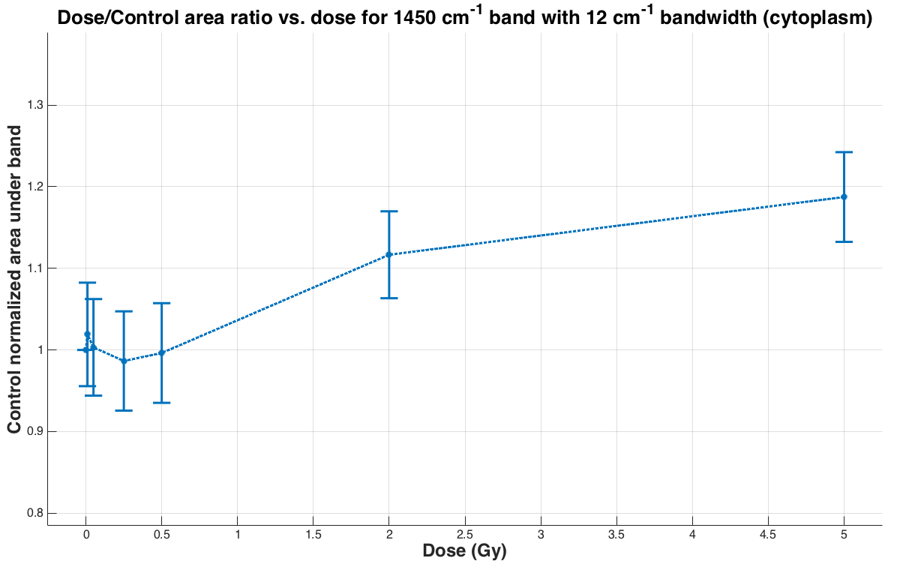
Results: Cytoplasm Spectra

Slide 30
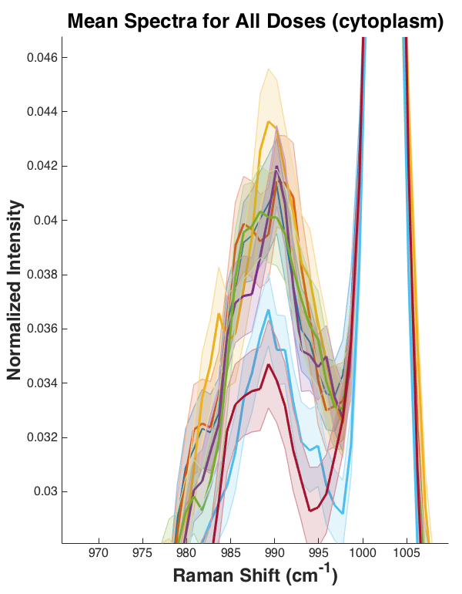
Results: Cytoplasm Spectra

Slide 31
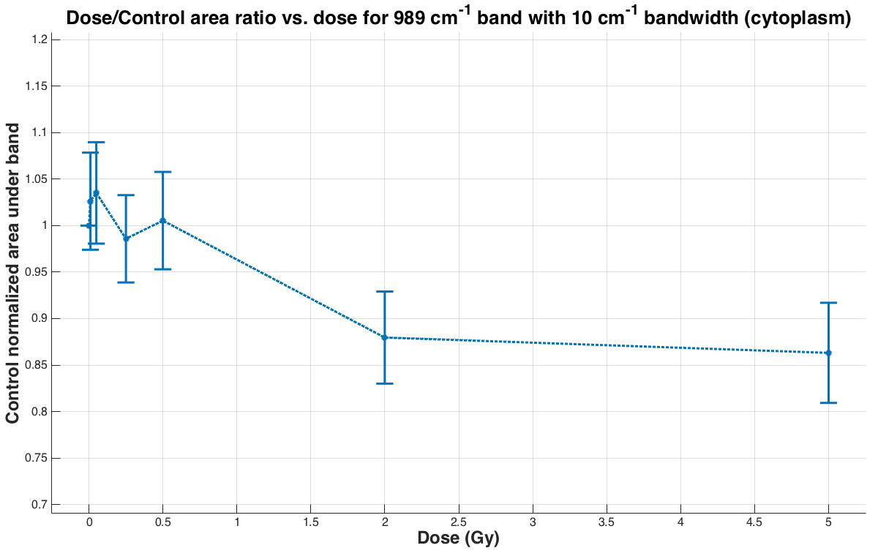
Results: Cytoplasm Spectra

Slide 32
Results
Dose discrimination using PCA-LDA

Slide 33
Results: PCA-LDA
Data for nucleus, cytoplasm analyzed separately as well as combined
For each analysis, data is randomly partitioned into ~25% test set and ~75% training set
Training set is used to find linear discriminants for classification
100 different partitions tested and an average accuracy with error is found

Slide 34
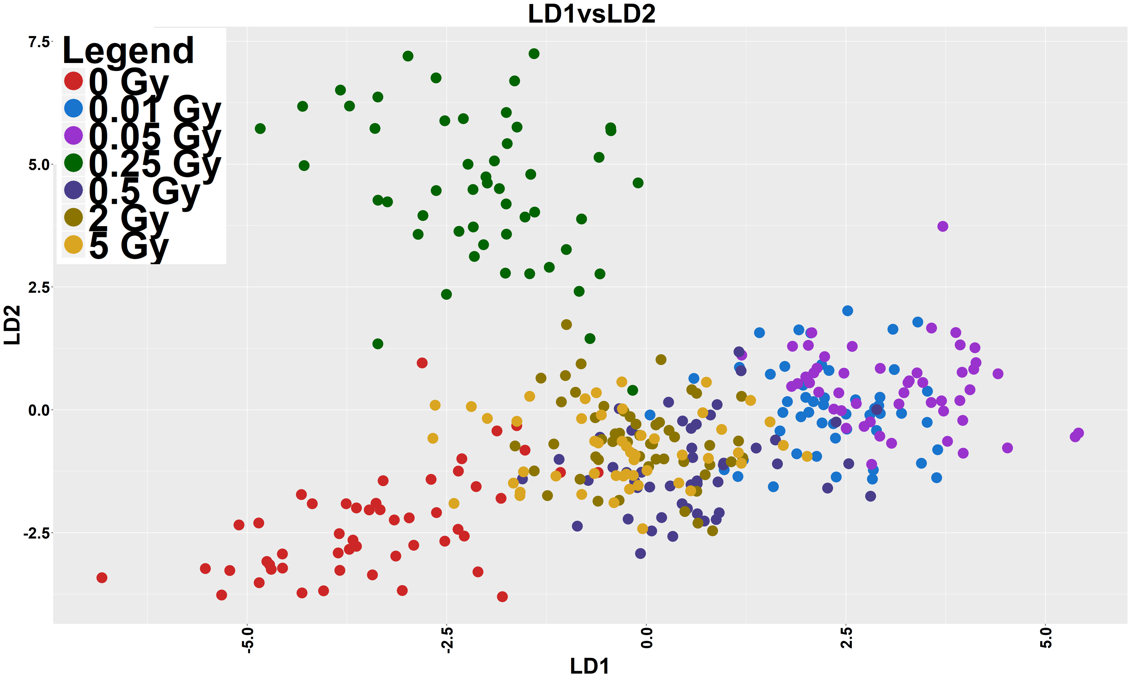
Results: PCA-LDA of Nucleus Spectra
469 nuclei measurements
50 PCs
Average test set accuracy: (92 ± 3)%
Actual Dose
Predicted Dose
 | 0 Gy | .01 Gy | .05 Gy | .25 Gy | .5 Gy | 2 Gy | 5 Gy
0 Gy | 16 | 0 | 0 | 0 | 0 | 0 | 0
.01 Gy | 0 | 16 | 0 | 0 | 0 | 0 | 0
.05 Gy | 1 | 0 | 14 | 0 | 0 | 1 | 0
.25 Gy | 0 | 0 | 0 | 14 | 0 | 1 | 1
.50 Gy | 0 | 0 | 0 | 0 | 12 | 1 | 3
2 Gy | 0 | 0 | 0 | 1 | 0 | 15 | 0
5 Gy | 0 | 0 | 0 | 0 | 0 | 0 | 16
Table 1: Nucleus Test Data Confusion Matrix

Slide 35
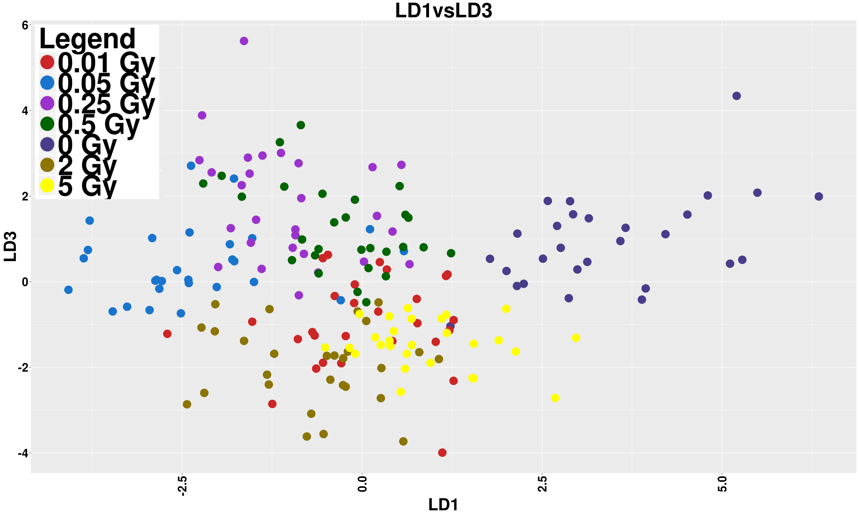
Results: PCA-LDA of Cytoplasm Spectra
259 cytoplasm measurements
30 PCs
Average test set accuracy: (90 ± 2)%
Actual Dose
Predicted Dose
 | 0 Gy | .01 Gy | .05 Gy | .25 Gy | .5 Gy | 2 Gy | 5 Gy
0 Gy | 8 | 0 | 0 | 1 | 0 | 0 | 0
.01 Gy | 0 | 8 | 1 | 0 | 0 | 0 | 0
.05 Gy | 0 | 0 | 7 | 0 | 0 | 1 | 1
.25 Gy | 0 | 0 | 0 | 9 | 0 | 0 | 0
.50 Gy | 0 | 0 | 0 | 0 | 8 | 0 | 1
2 Gy | 0 | 0 | 0 | 0 | 0 | 9 | 0
5 Gy | 0 | 0 | 0 | 0 | 0 | 1 | 8
Table 2: Cytoplasm Test Data Confusion Matrix

Slide 36
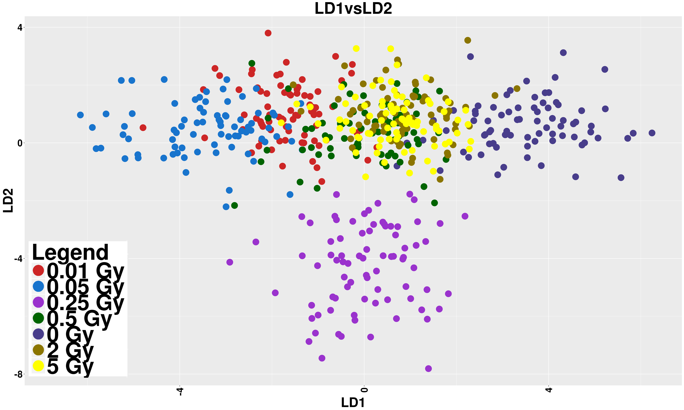
Results: PCA-LDA of all Spectra
742 combined measurements
70 PCs
Average test set accuracy: (94 ± 2)%
Actual Dose
Predicted Dose
 | 0 Gy | .01 Gy | .05 Gy | .25 Gy | .5 Gy | 2 Gy | 5 Gy
0 Gy | 26 | 0 | 0 | 0 | 0 | 0 | 0
.01 Gy | 0 | 25 | 0 | 0 | 0 | 0 | 1
.05 Gy | 0 | 0 | 25 | 0 | 0 | 0 | 1
.25 Gy | 0 | 0 | 0 | 22 | 0 | 3 | 1
.50 Gy | 0 | 0 | 0 | 0 | 22 | 2 | 2
2 Gy | 0 | 0 | 0 | 0 | 0 | 26 | 0
5 Gy | 1 | 0 | 0 | 0 | 0 | 0 | 25
Table 3: Combined Test Data Confusion Matrix

Slide 37
Summary
Spectral Differences in Raman spectra of HLE cells are visible
We can identify bands that show the largest changes, such as proteins, lipids, DNA and glutathione
Greater than 90% accuracy can be obtained using a 25% test, 75% train model of our data
Combining nucleus and cytoplasm data increases classification accuracy
Thank you for your time!

