Slide 1
Inferring sizes of compartments using oscillating gradient spin echo magnetic resonance imaging
Melanie Martin
University of Winnipeg
Sheryl Herrera and Morgan Mercredi
University of Manitoba

Slide 2
Outline
MRI
Diffusion
Restricted diffusion
A model of diffusion to infer cell sizes
Phantom data
Simulation data to reduce imaging time

Slide 3
NMR
Nuclear magnetization, M, is an ensemble effect
Angular momentum (spin) means they precess in B₀ field
ω₀ = -γB₀
B
0
M

Slide 4
Gradients for Measurement of Diffusion
If the field B is uniform then all spins have the same frequency
If B = B₀ + g•x [g = linear gradient] then spins at different positions x have different frequencies (Δω = γgx)
If spins move along x their NMR frequencies change with time

Slide 5
Measuring Diffusion Using NMR
Δ
time
apply g
➔ change phase
apply -g
➔ phase reversal

Slide 6
Diffusion Coefficient
Einstein relation
1D <(x₁-x₂)²> = 2Dt
D is characteristic of medium
Magnitude of D depends on ease of movement
D_{H2O} = 2 μm²/ms at room temperature

Slide 7
Restricted Diffusion
Diffusion time is Δ_{eff}
r
Unrestricted diffusion if <r²> >> 2D_{free}Δ_{eff}
Hindered diffusion if barriers partially permeable and/or <r²> ≈ 2D_{free}Δ_{eff}
Restricted diffusion if <r²> << 2D_{free}Δ_{eff}

Slide 8
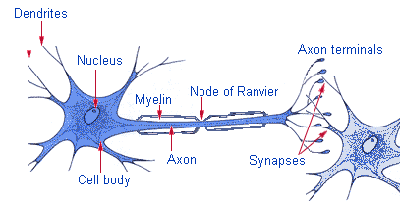
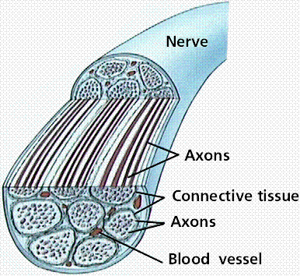
Axons
Part of neurons, or nerve cells in the brain.
Long, threadlike projections that conduct electrical impulses in nerve cells.
Transmits information to nerve cells throughout the body.
http://www.biomedresearches.com/root/pages/researches/epilepsy/structure_of_nervous_system.html

Slide 9
Biological Tissues
Free water diffuses ≈ 5 μm in 5 ms
Cells are ≈ 0.1 - 50 μm in size
Axons in mice are < 1 μm in diameter
Standard MRI requires ≈ 10 - 100 ms
Standard MRI cannot measure the transition from restricted to free diffusion
Standard MRI cannot infer cell sizes

Slide 10
Measurements at Short Δ_{eff}
Small displacements ➔ small effects
Increase sensitivity/accuracy by averaging
or...
Increase effect size by using very big g
or...
Use another method

Slide 11
Oscillating Gradient Spin Echo Sequence

Slide 12
OGSE Pulse Sequence
OGSE
Schachter et al, JMR 2000

Slide 13
Axon diameter distributions (AxCaliber)
AxCaliber is a model for estimating axon distributions using diffusion MRI
Model the signal as coming from two compartments:
  f: volume fraction of intracellular space
  D_{h}: hindered diffusion coefficient (apparent extracellular diffusion coefficient)
  D_{i} : intracellular diffusion coefficient
  w(r_{i}, θ): axon radius distribution (parameterized by θ)
  exp(-β(r_{i}, D_{i})): analytical signal from single cylinder
Extracellular signal
Intracellular signal

Slide 14
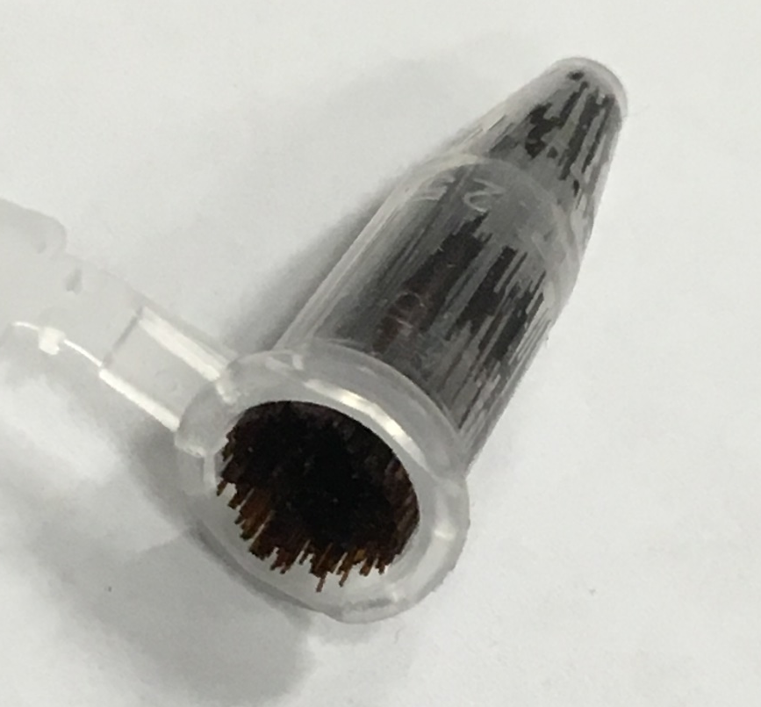
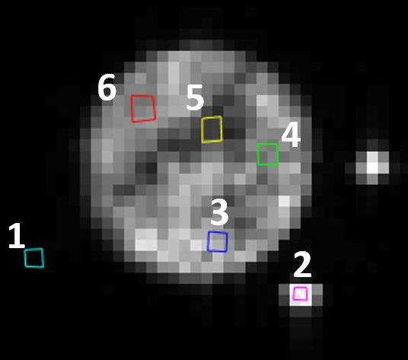
Phantom (capillary tubes)
Capillary tubing (OD ~ 150 μm , ID ~ 2 μm)
Soaked in filtered water, packed into centrifuge tubing, ~500 pcs(~2cm)
Tubing were also filled with water but the volume was not large enough to produce a measurable signal.
ROIs were created for the noise, within the centrifuge tubing, and a larger capillary tube (ID ~ 750 μm) for comparison.
noise
750 μm tube

Slide 15
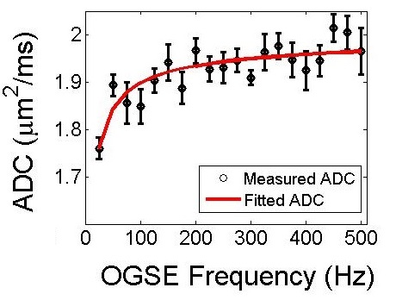
Phantom (capillary tubes)
Surface to volume ratio was found to be 0.09 ± 0.01 μm^{-1,} containing water diffusing at 2.01 ± 0.01 μm²/ms.
Corresponds to tube diameters of 180 ± 30 μm
(Assuming 80% hexagonal packing)
Actual average outer diameter ~151 μm
Plot for ROI # 4

Slide 16
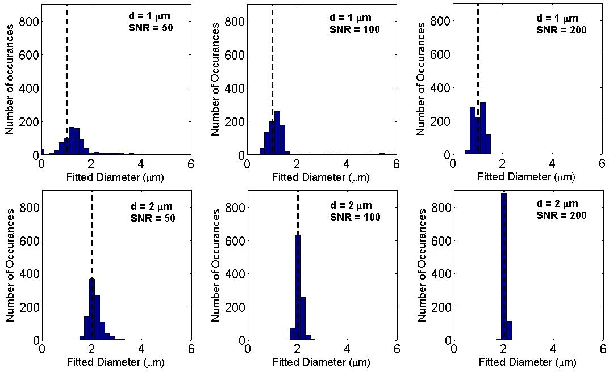
Effects of noise
To see the effects of noise on the parameter estimates, add Gaussian noise to the M_{x} and M_{y} components of the simulation results
For each realization of noise, do the fitting procedure and store the parameter estimates (repeat 1000 times)
Mercredi et al MAGMA 2017
Notes:
Can choose standard deviation on the noise

Slide 17
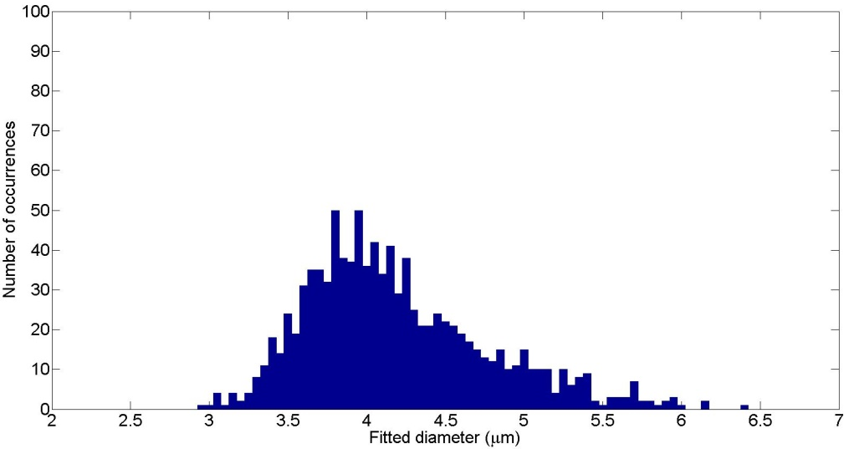
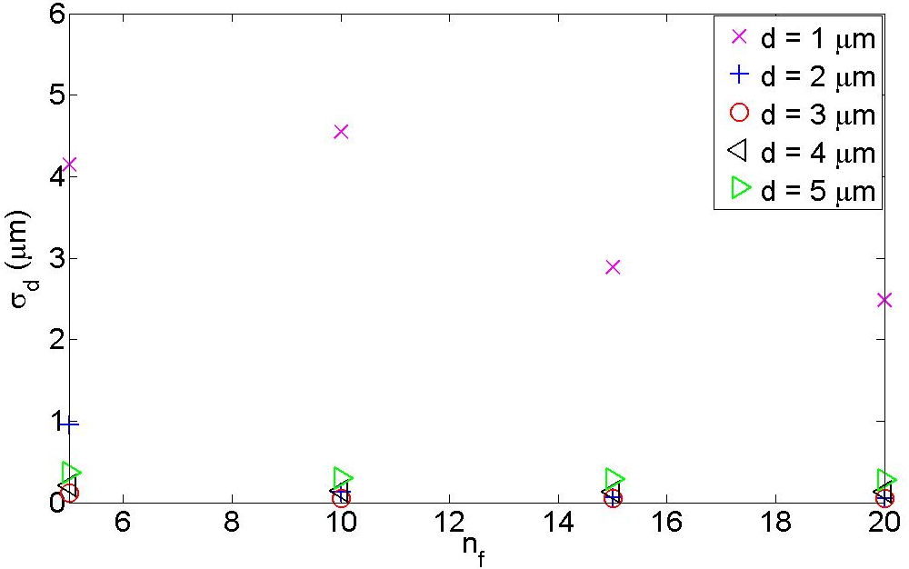
OGSE frequencies
Want to see how the fitted parameter distributions change when using smaller (or fewer) OGSE frequencies
Use n_{f} = {5, 10, 15, 20} frequencies (50 – 250, 500, 750, 1000 Hz)
For some diameters, σ_{d} change very little
μ_{d}
σ_{d}

Slide 18
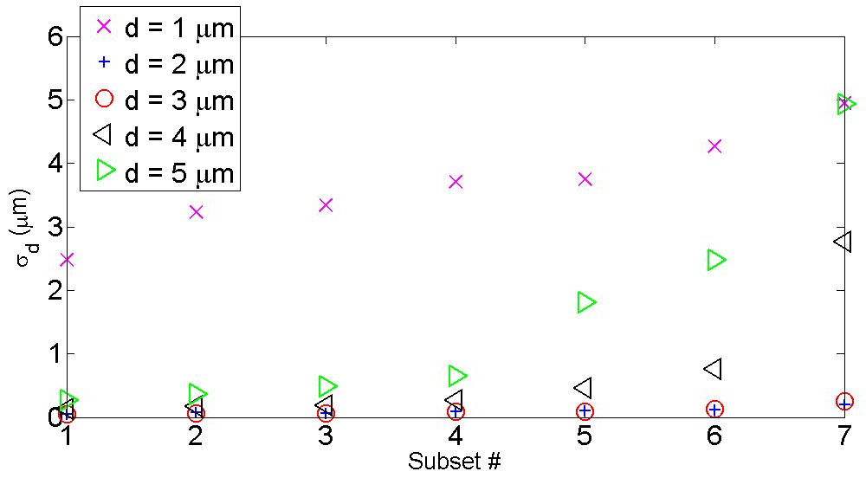
OGSE gradients
See how fitted parameter distributions change when using smaller (and fewer) gradients
G = {G₀=0, G₁,…, G_{max} = 900 mT/m}
Multiple gradients are slightly better than just two
Two gradients can be better, if the nonzero gradient is big enough
#1 | G₀, G₁, G₂, G₃, G₄
#2 | G₀, G₄
#3 | G₀, G₁, G₂, G₃
#4 | G₀, G₃
#5 | G₀, G₁, G₂
#6 | G₀, G₂
#7 | G₀, G₁
Intra-axonal simulations

Slide 19
Future studies
Finding the optimal limited range of frequencies and gradient strengths for expected diameter sizes
Finding the optimal signal-to-noise ratio for the experiments
Finding the optimal resolution for the images
Measurements on brains

Slide 20
Conclusions
MRI can infer sizes of structures by measuring water diffusion within the structures
OGSE sequences can make measurements of micron diameters in biological samples

Slide 21
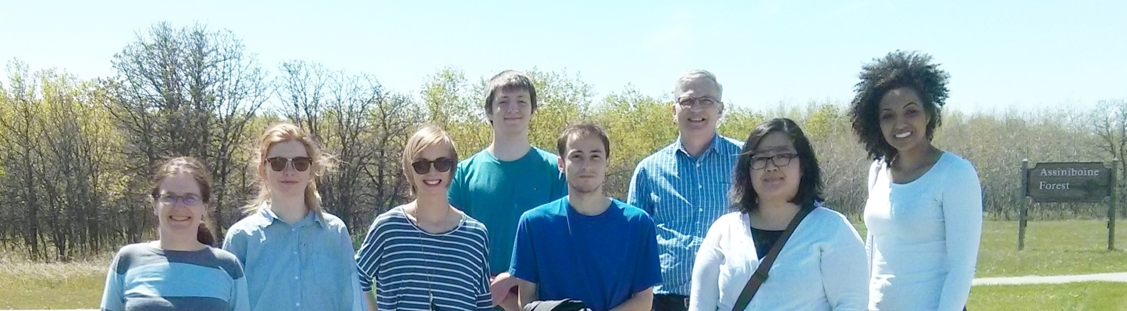
Acknowledgements
Martin Lab
Richard Buist
Sheryl Herrera
Morgan Mercredi
Trevor Vincent
Collaborator
Chris Bidinosti
Kant Matsuda

Slide 22







Acknowledgments

