Slide 1




Cryogenics based chilling, energy supply and services for deeper or hotter mines.
Daniel L. Cluff
CEO CanMIND Associates
Fellow Camborne School of Mines
www.deepmining.ca

Slide 2
Interrelations
Glencore
Funding
Engineering Critique
Real Mine Design
CanMIND Associates
Principle Investigator
Physics Engineering
Concept Development
Highview Power
Liquid Air Energy Storage
Pilot plant
5 MW plant
CEMI
Project Management
Business Acumen
Dearman Engine Co.
Engine Development
Techno-economic Analysis
In Kind Contribution
UDMN
Funding
Industry Network
Commercialisation

Slide 3
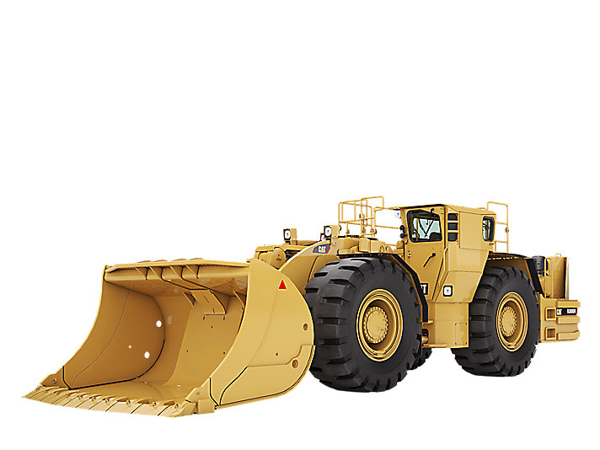
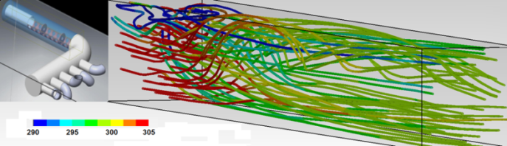
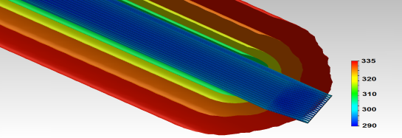
Project Elements
Large UG Equipment
Powered by Dearman Engines
UG Cryogenic
Piping and Storage
Cryogenic Chilling
CFD Modelling
Compressed Air System Design
Heat Exchanger
Receiver size
Piping
Modularity design
Rapid Response Chilling on Demand
PRU Design
5 to 10 MW_{e}

Slide 4
Why LAES
LAES technology provides plant size economy of scale
Energy storage is an emerging technological niche
The cryogenic liquids are produced on the surface in a standard cryogenic liquefaction plant.
Cryogenic liquid is piped to the depth required
  Depends on mine design decision
  Sent to a central location and chill air in downcast shaft
  Sent to individual levels to chill on demand

Slide 5
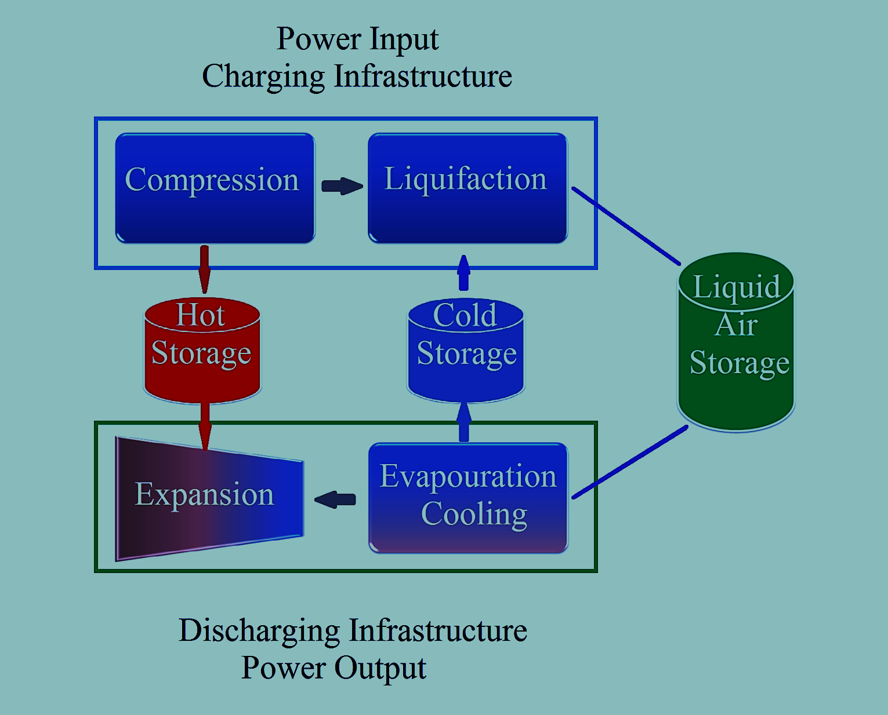
LAES Simplified Schematic
On Surface
LA to Underground
Storage
Chilling on demand
Heat air
in winter
PRU can be placed Underground
5 to 10 MW_{e}
+
Chilling

Slide 6
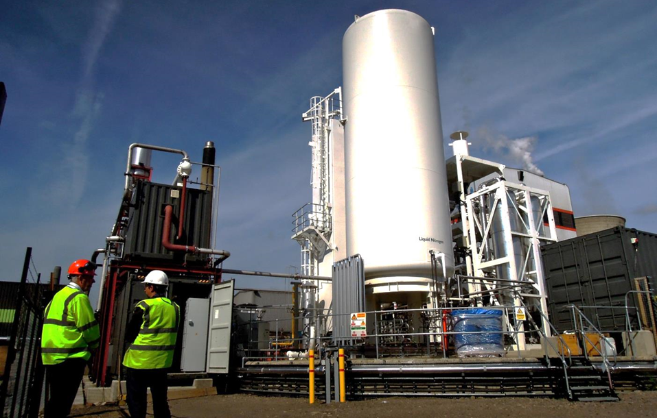
350 kW 2.5 MWH Pilot Plant
Highview Power Slough UK

Slide 7
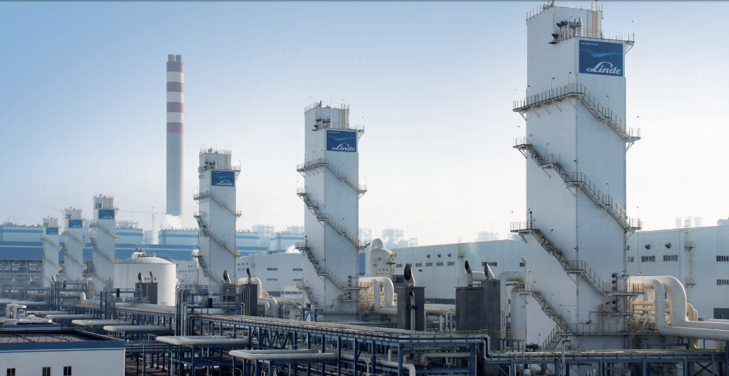
Six 3600 tpd O₂ plants in China

Slide 8
LAES Process
A Liquid Air Energy Storage (LAES) system is comprised of a charging system, an energy storage section and a discharging system.
Standard industrial air liquefaction plant
  the electrical grid or a renewable energy project supply the electrical energy.
Air drawn from the ambient environment.
  The process creates liquid air a cryogenic liquid at temperatures near -196ºC (78 K).
The liquid air is stored in a low pressure insulated tank.
  Easily accessed energy storage repository
  Low risk to the environment
When power is required
  liquid air is pumped to a high pressure and evaporated through a turbine system.
Capable of providing the pressure necessary
  to power a piston engine or turbine resulting in useful work
  to generate electricity or drive a cryogenically powered vehicle.

Slide 9
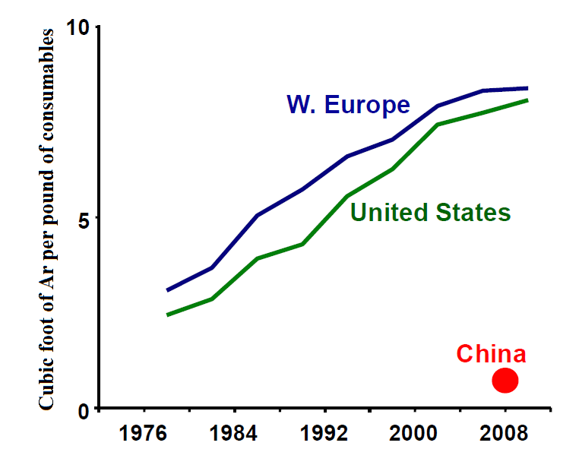
Ancillary Economics Includes Argon, Oxygen Markets Both Continue to Grow

Slide 10
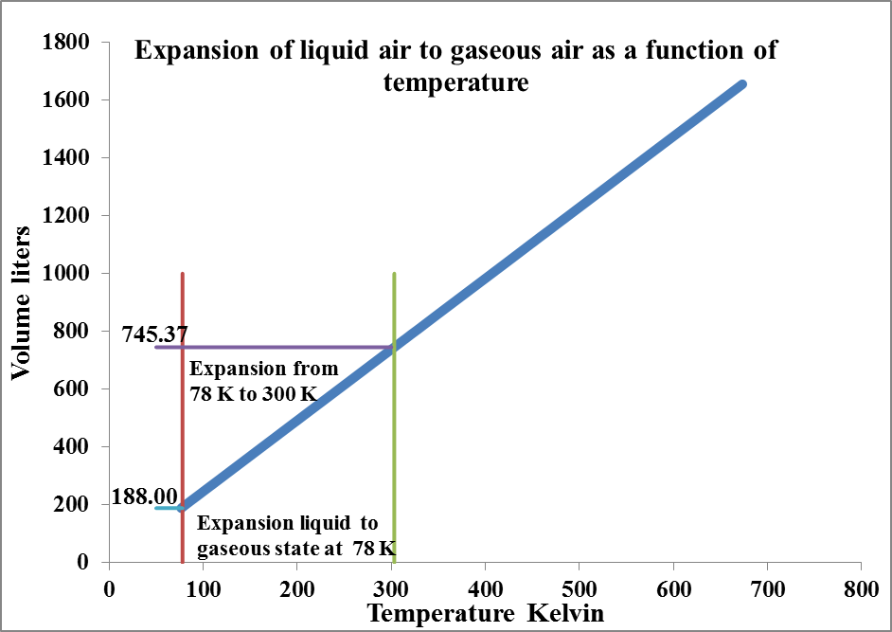
700⁺ l Gaseous Air Per 1 l Liquid Air
Change of State

Slide 11
A Basic Calculation to Illustrate the
Heat Absorbed on Change of State
The heat absorbed per kg of liquid air:
Ambient T_{a} = 29.85ºC (273.15 + 29.85 = 303K)
Cryogenic T_{c} = 78 K
Latent Heat of vaporisation L_{v} = 205 kJ/kg
Step 1: The mass “m kg” absorbs ΔQ_{L},
Becomes a gas at or near T_{c}
ΔQ_{L} = mL_{v} = (m kg)(205 kJ/kg) = (m kg)205 kJ/kg
Change of state is approximately 180l _{(gaseous) /} 1l _{(liquid)}

Slide 12
A Basic Calculation to Illustrate the Heat Absorbed on Expansion
Step 2: Very cold air (≈ 80 K) warms up to T_{a}
Expansion with heat absorbed ΔQ_{a}.
ΔT_{g} = T_{a} – T_{c} = 303 – 78 = 225 K
change in gas temperature
ΔQ_{a} = mC_{p}ΔT_{g} = (m kg)(1.005 kJ/kg-K)( 225 K) = 226.13 kJ/kg
Heat absorbed due to change in gas temperature
ΔQ_{T} = ΔQ_{L +} ΔQ_{a} = mL_{v} + mC_{p}ΔT_{g} = (m kg)(451.13) kJ/kg
Total heat absorbed due to change of state and expansion

Slide 13
For 1 MW_{r} Chilling
  So let ΔQ_{T} = 1 MJ
  The total heat absorbed by the ambient air
  The mass of liquid air required is 2.217 kg
  So a liquid flow 2.217 kg/s will provide 1 MW_{r} chilling.
  The density of liquid air is about 870 kg/m³
  So a flow of about 2.55 l _{(liquid)} provides 1MW_{r}
  Final gaseous volume 1899.42 l _{(gaseous)} or 1.9 m³

Slide 14
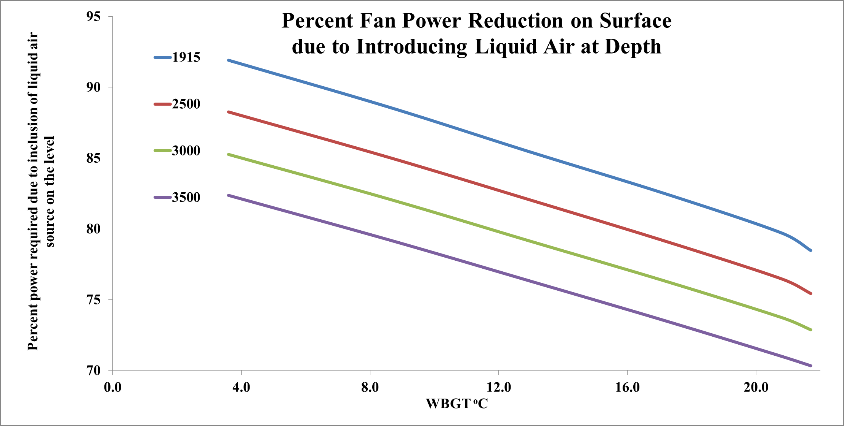

Slide 15
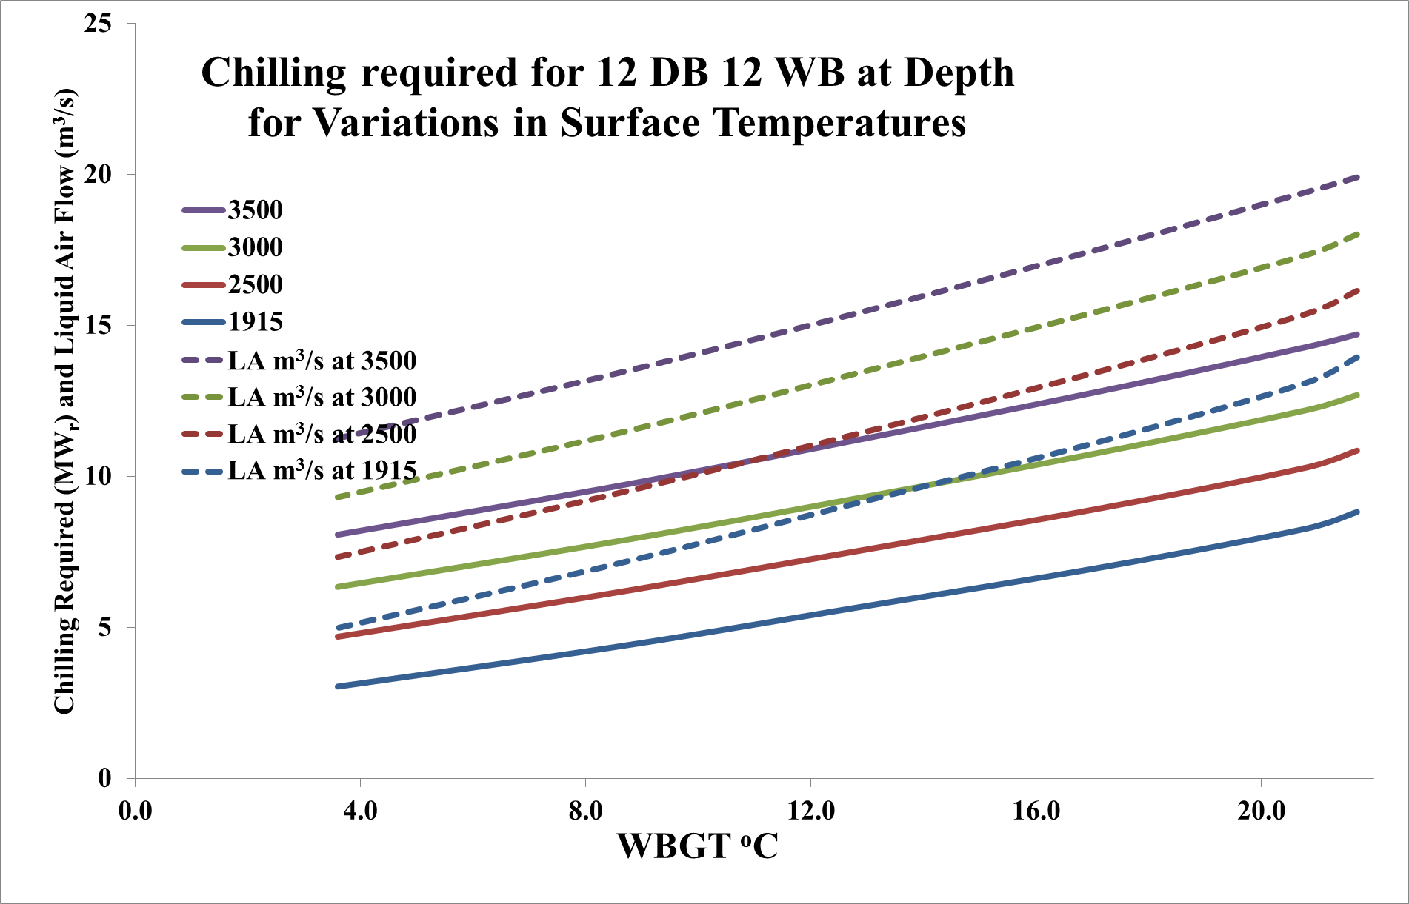

Slide 16
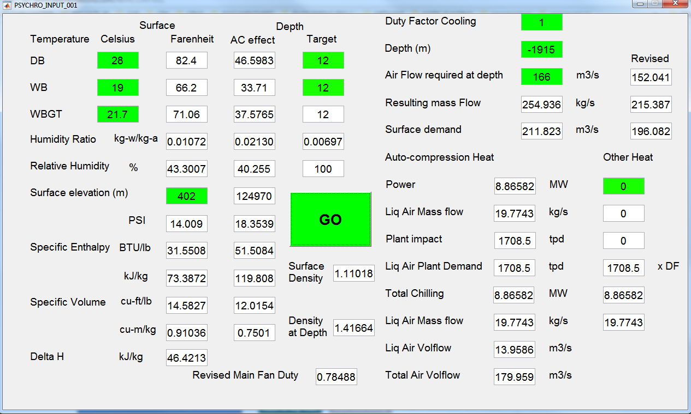
Psychrometrics to Liquid Air

Slide 17
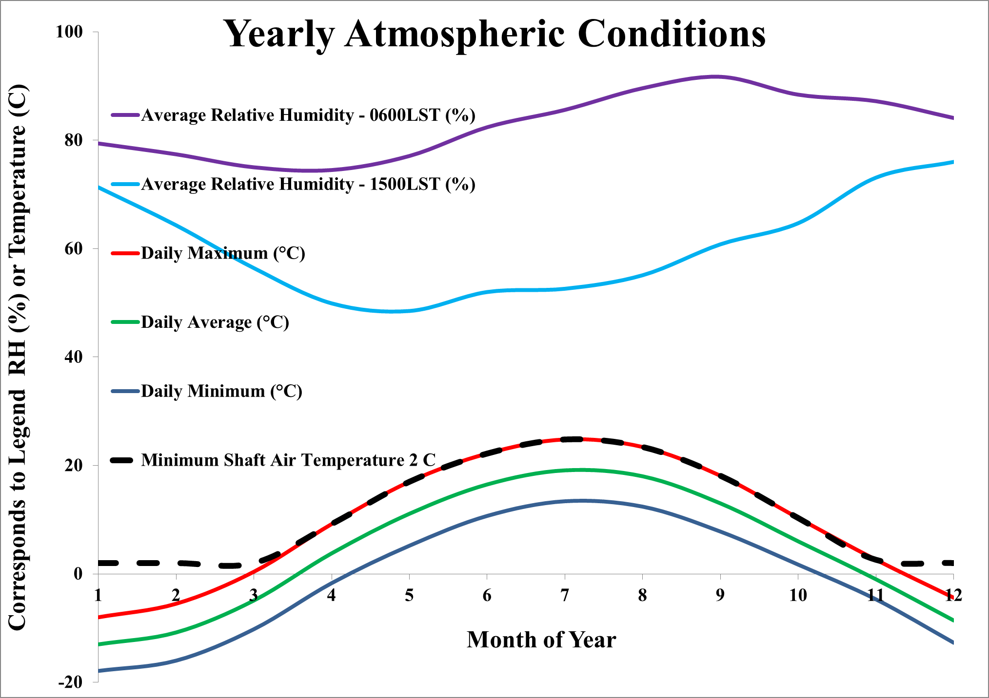
Chilling on Demand
Yearly Atmospheric Conditions Sudbury Ontario

Slide 18
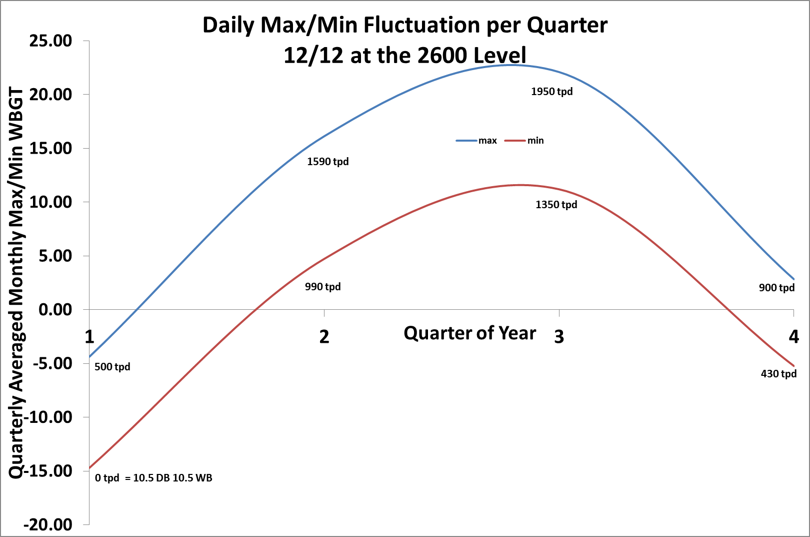

Slide 19
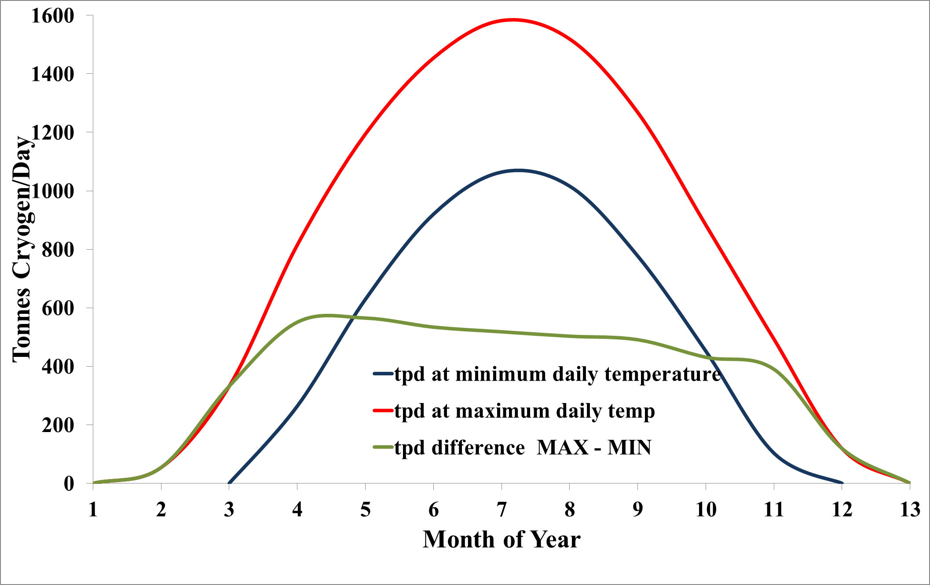
Demand for Liquid Air (tpd) to Create a 12/12 DB/WB ºC Environment at 1915 Depth
Gap between daily MAX and MIN
Allows for offsetting of LA production during cheaper electricity rates

Slide 20
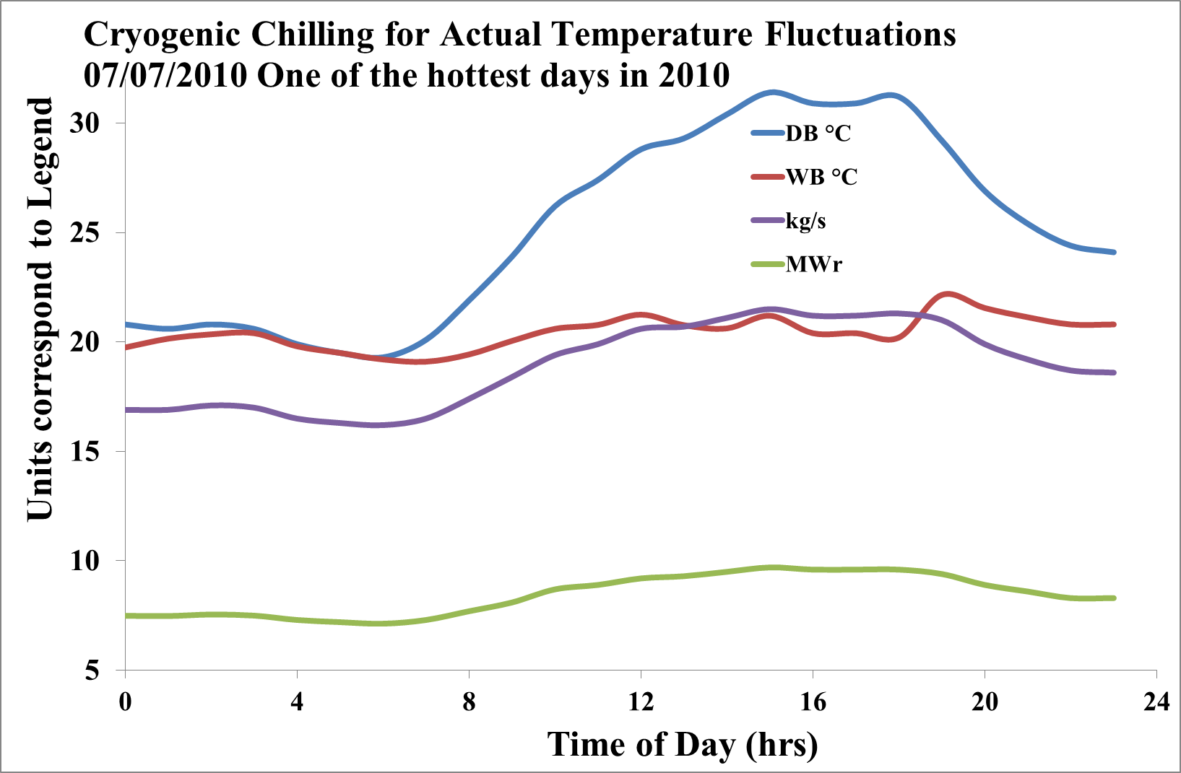

Slide 21
A 2400 tpd plant production frontier when the surplus produced over the least expensive energy cost is redistributed to the peak time cost

Slide 22
Summary of the cryogen production and power production

Slide 23
Summary of the cryogen production and power production implications for a 10 MW PRU
Plant Size tonnes | 1600 | 1800 | 2000 | 2200 | 2400 | 2500
Energy Cost | $3,170 | $2,345 | $1,520 | $775 | $787 | $781
Fan Savings | -$1,271 | -$1,271 | -$1,271 | -$1,271 | -$1,271 | -$1,271
Final Cost | $1,899 | $1,074 | $248 | -$496 | -$484 | -$490
YEAR at this rate | $693,071 | $391,886 | $90,701 | -$180,987 | -$176,752 | -$178,869
MWH paid | 218.84 | 218.84 | 218.84 | 218.91 | 219.04 | 218.98
10 MWH PRU recovered | -120.00 | -120.00 | -120.00 | -120.00 | -120.00 | -120.00
FAN MWH recovered | -10.20 | -10.20 | -10.20 | -10.20 | -10.20 | -10.20
TOTAL | 88.64 | 88.64 | 88.64 | 88.71 | 88.84 | 88.77
Tonnes produced | 1094.00 | 1094.00 | 1094.00 | 1094.33 | 1095.00 | 1094.67
Tonnes required | 1094.12 | 1094.12 | 1094.12 | 1094.12 | 1094.12 | 1094.12
Power Generation | 10 | 10 | 10 | 10 | 10 | 10
Operating Period | 12 | 12 | 12 | 12 | 12 | 12
MWH Produced | 120 | 120 | 120 | 120 | 120 | 120
Efficiency | 54.83% | 54.83% | 54.83% | 54.82% | 54.78% | 54.80%

Slide 24
Cost of Chilling When Time shifting and Using a Power Recovery Unit

Slide 25
Plant Configuration Costing
Plant Configuration | Waste heat | Standalone | Standalone | Waste heat
Liquefaction capacity (tonnes/day) | 2500 | 3000 | 2000 | 1700
Power input (MW @ charge time) | 21.4 | 25 | 16.6 | 14.3
Charge time hrs | 6 | 6 | 8 | 8
Consumed energy MWH | 128.4 | 150 | 132.8 | 114.4
Discharge time hrs @ 5 MW | 18 | 18 | 16 | 16
Energy output (MWH) | 90 | 90 | 80 | 80
Liquid air store capacity (tonnes) | 570 | 570 | 510 | 510
Round trip efficiency | 70% | 60% | 60% | 70%
CAPEX (million $) | 46 | 40 | 33 | 38
PRU (turbines/generators/grid) | 8.15 | 8.15 | 8.15 | 8.15
Storage cost | 3 | 3 | 2.7 | 2.7
Cost per kilowatt ($) | 9285 | 8098 | 6569 | 7545
Cost per kilowatt-hour ($) | 516 | 450 | 411 | 472

Slide 26
Ancillary Systems
Chilling accounts for a major share of consumption
There are a number of other services that can be implemented that provide a service while also simultaneously chilling as a side benefit.
  Compressed air
  Electricity production
  Vehicles, pumps or fans that can be driven by liquid air

Slide 27
Compressed Air
The production of compressed air exploits the liquid nature of the cryogen, which is simply squirted into a receiver tank and allowed to reach ambient temperature – quickly!

Slide 28
Compressed Air Supply
With Chilling Power
Compressed Air Consumption |  | Receiver Size | Chilling Power | kW ft³/min | Mass flow | Liq flow | Plant impact
ft³/min | m³/hr | m³ | kW |  | kg/s | l/s | tpd
500 | 850 | 1.79 | 124 | 0.248 | 0.29 | 0.33 | 25
1000 | 1699 | 3.6 | 248 | 0.248 | 0.58 | 0.67 | 50
2000 | 3398 | 7.28 | 496 | 0.248 | 1.16 | 1.33 | 100
3000 | 5097 | 11.06 | 744 | 0.248 | 1.74 | 2.00 | 150
5000 | 8495 | 18.54 | 1240 | 0.248 | 2.9 | 3.33 | 250

Slide 29
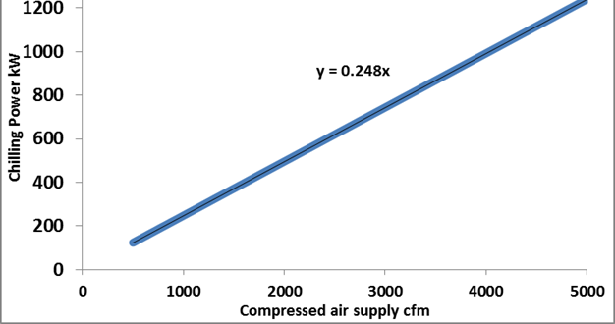
Assuming continuous demand the liquid air can be configured to provide a modular compressed air system which will simultaneously chill at the location the receiver tank is located akin to spot chilling.
Chilling Power as a function of the Compressed Air Supply

Slide 30
Recall the earlier LAES Simplified Schematic
In the schematic it was indicated that the PRU could be placed underground.
Part of the PRU process is to pump the liquid air to a pressure of about 1000 psi before evaporating and expanding through the turbomachinery.
At 2000 m the pressure is about 2500 psi
Sufficient pressure to eliminate the pumps

Slide 31
Recall the earlier discussion regarding the gap between the MAX and MIN daily temperature was about 500 tpd, Below for a 5 MW_{e} PRU
 | Waste heat | Standalone | Standalone | Waste heat
Liquefaction capacity (tonnes/day) | 2500 | 3000 | 2000 | 1700
Power input (MW @ charge time) | 21.4 | 25 | 16.6 | 14.3
Charge time hrs | 6 | 6 | 8 | 8
Consumed energy MWH | 128.4 | 150 | 132.8 | 114.4
Discharge time hrs @ 5 MW | 18 | 18 | 16 | 16
Energy output (MWH) | 90 | 90 | 80 | 80
Liquid air store capacity (tonnes) | 570 | 570 | 510 | 510
Round trip efficiency (waste heat) | 70% | 60% | 60% | 70%
CAPEX (million $) | 46 | 40 | 33 | 38
PRU (turbines/generators/grid) | 8.15 | 8.15 | 8.15 | 8.15
Storage cost | 3 | 3 | 2.7 | 2.7
Cost per kilowatt ($) | 9285 | 8098 | 6569 | 7545
Cost per kilowatt-hour ($) | 516 | 450 | 411 | 472
Typically the cold would be recycled to cold storage, but here it is absorbed by the air at depth

Slide 32
Exploitation of the Joule Thompson Effect
With 2500 psi available as a forcing pressure the Joule Thompson Effect, which is part of the liquefaction process, can be exploited to provide further chilling commonly referred to as free expansion or a throttling process.
T₂ = T₁ - U_{j}(P₁ - P₂), P₂ = 14.5 psi, T₁ = 25ºC
where U_{j} is the JT coefficient - ambient T₁ - contained P₁
For a contained pressure of 880 psi, U_{j} = 0.1815
T₂ = 298 - 0.1815(880 – 14.5) = 140.9 K =-132.05ºC

Slide 33
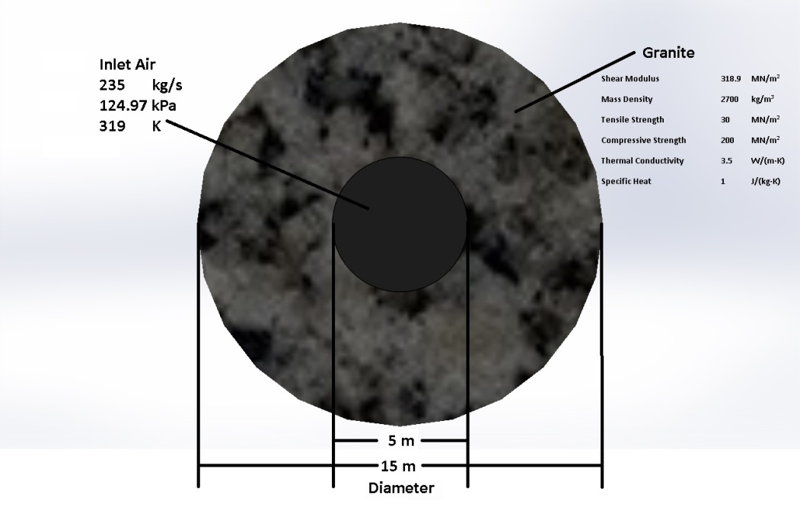
CFD Model for Chilling the Entire Airflow, Similar to a BAC

Slide 34
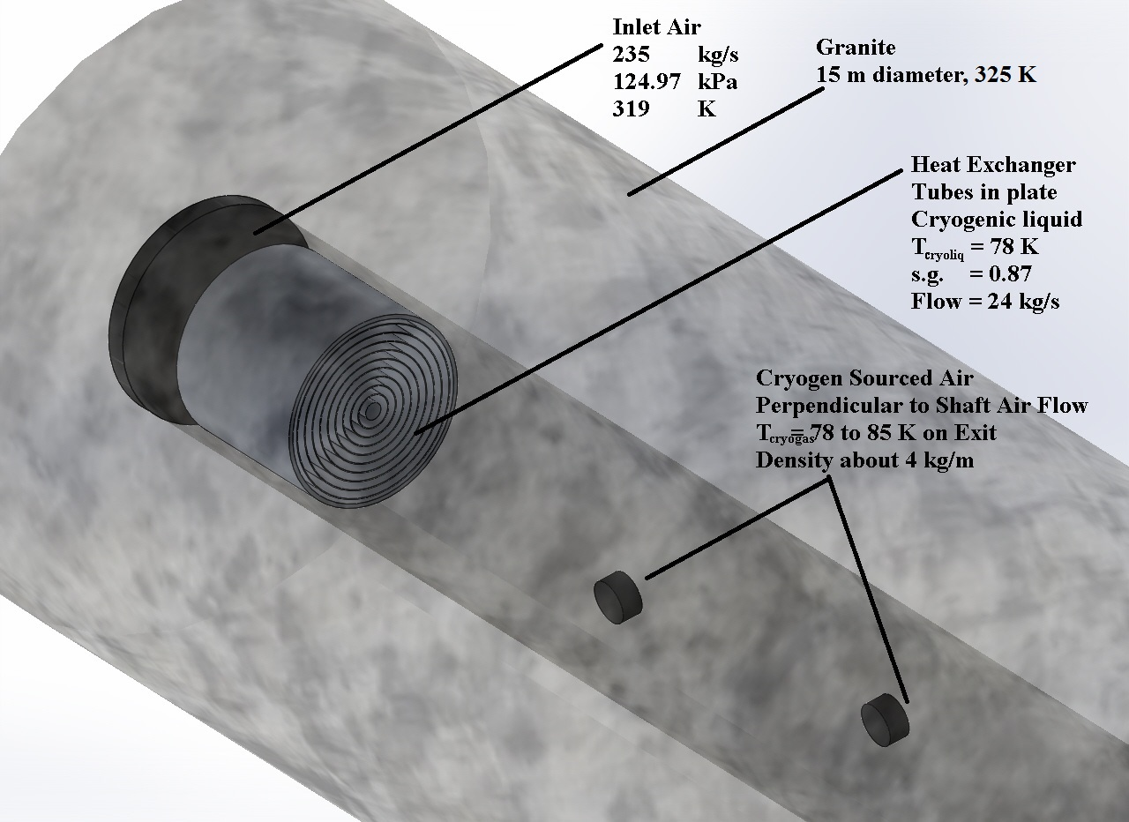
CFD Model for Chilling the Entire Airflow, Similar to a BAC

Slide 35
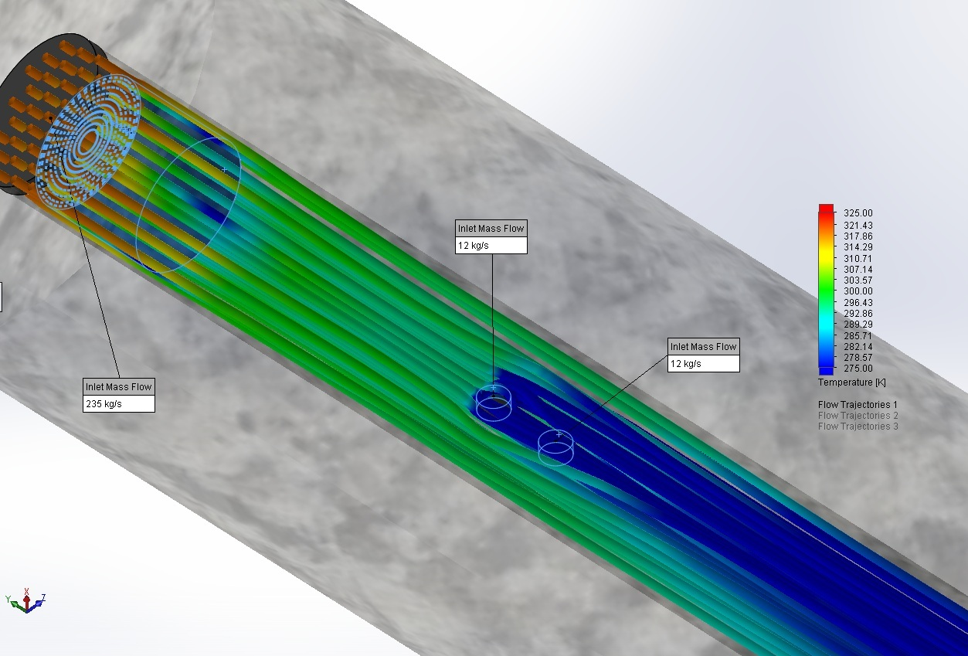
CFD Model Flow Trajectories

Slide 36
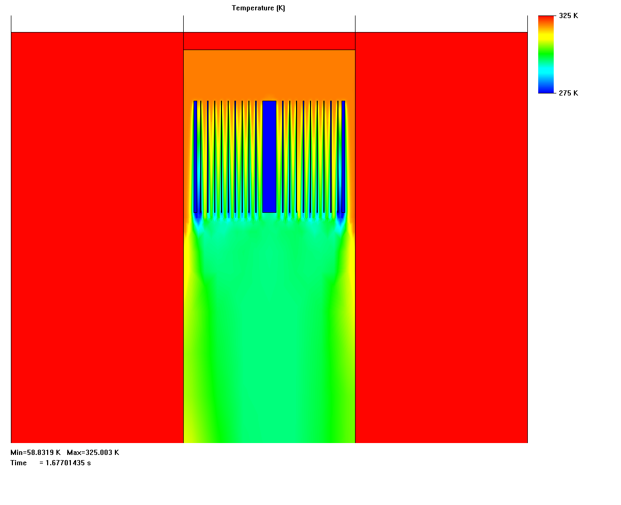
Close up View of Heat Exchanger 1.67 sec

Slide 37
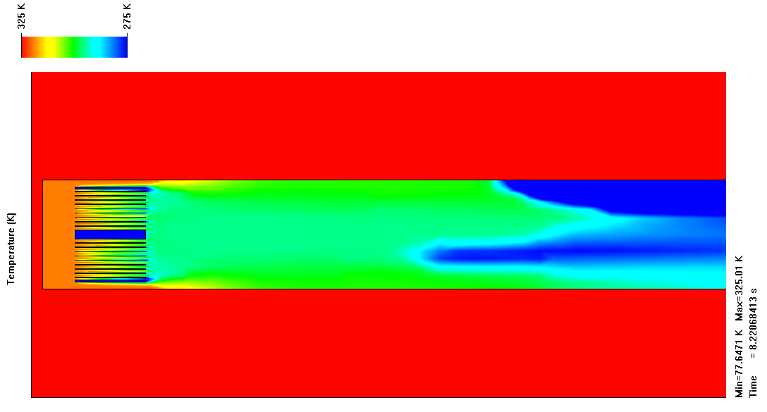
Close up View of Heat Exchanger 8.2 sec

Slide 38
Average Temperature of Air in Shaft

Slide 39
Cryogenics based chilling, energy supply and services for deeper or hotter mines.
Thank you to:
Glencore for Financial Support and Engineering Excellence.
UDMN for financial support.
CEMI for business expertise and project management
Dearman Engine Company for Cryogenics expertise and technoeconomic analysis.
Highview Power Storage for LAES expertise and technical support.
Camborne School of Mines for academic support
Dr. Daniel L. Cluff
CanMIND Associates
www.deepmining.ca

