Slide 1





Detection of Meteor Generated Shock Waves Using the Radio Signatures of Meteor Head Echoes
CAP Congress
Kingston, ON
28 May – 2 Jun, 2017
Reynold E. Silber¹, Wayne K. Hocking², Elizabeth A. Silber³, Maria Gritsevich^{4,5}
¹Department of Earth Sciences, The University of Western Ontario, Canada
²Department of Physics and Astronomy, The University of Western Ontario, Canada
³Department of Earth, Environmental and Planetary Science, Brown University, USA
⁴Department of Physics, University of Helsinki, Finland
⁵Institute of Physics and Technology, Ural Federal University, Russia

Slide 2
Outline:
Overdense meteors – fundamentals and shock waves discussion
MHE – main points
Using MHE in determination of overdense meteors shock formation altitudes
Theoretical and technical considerations
Some aspects of proposed experimental verification
Conclusion

Slide 3
Overdense Meteors
Broad term (4×10⁻³ m and up to small-sized fireballs,
q ≥ 10¹⁶ electrons m⁻¹)
Statistically small fraction of overall meteoroid influx
Initial mass loss by sputtering and evaporation by direct atm. molecules collisions
Each collision f(v_{meteor}) may release up to 500 meteoric atoms and ions → leads up to the formation of the hydrodynamic shielding (10¹ d_{meteor} – 10² d_{meteor}) (Jenniskens et al., 2000)

Slide 4
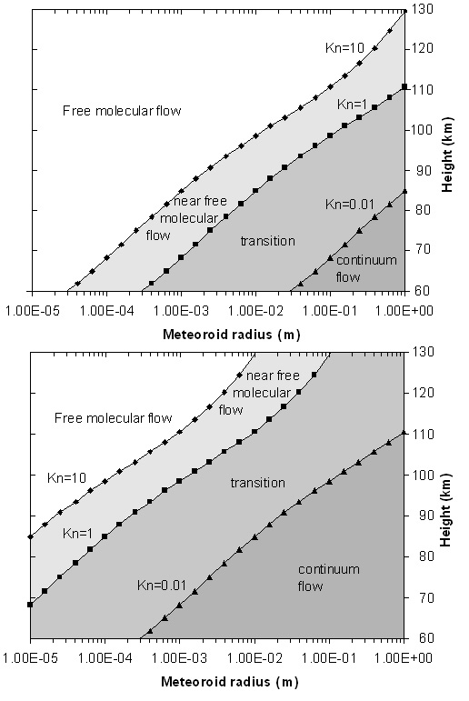
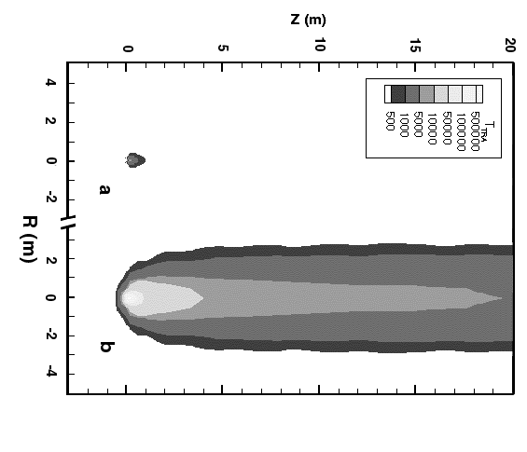
Intense ablation and evaporation driven by high kinetic T and rad. heat transfer (behind the dense shielding)
Alters the consideration of flow regime, Knudsen number and will push the continuum flow to higher altitudes
(Jenniskens et al. 2000)
Campbell-Brown & Koschny (2004)

Slide 5
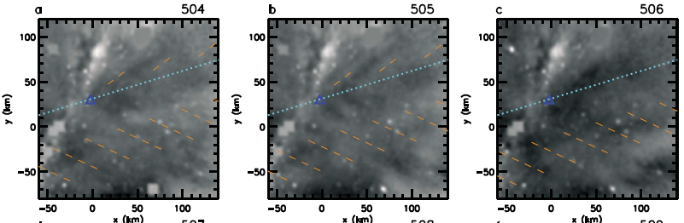
Overdense Meteor Generated Shockwaves in MLT
Ablation is instrumental for the formation of meteor shock waves (Silber et al. 2017)
Evidence for cm sized meteoroid generated shockwaves in MLT from infrasonic studies (Silber et al. 2014) and optical observations (gravity waves) (Vadas et al. 2014)
(Vadas et al. 2014)
Notes:
mm and cm sized meteoroids should not technically produce shock waves in MLT because of the high Knudsen number (rarefied regime)
Figure 4. (a–i) Masked and filtered Na airglow images for earlier times (frames #504–512). The blue dotted lines show the meteor trajectory. The blue triangles
show the assumed location of the meteor at z = 92 km. The orange-brown dashed lines show portions of the best fit plane waves, as described in the text.

Slide 6
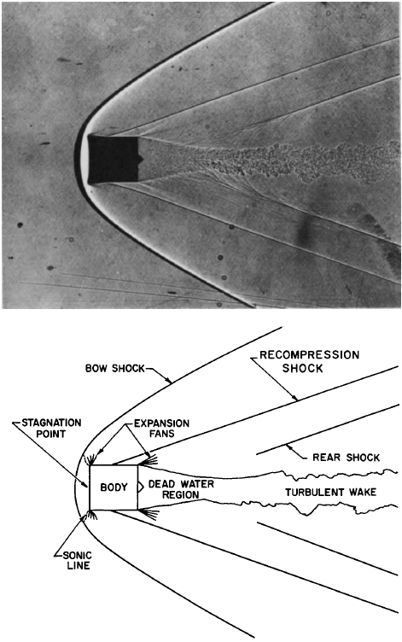
Shockwaves from Meteors
More complex than typical shockwaves produced by hypersonic entry vehicles
Occur when hydrodynamic shielding in front of meteor (vapour cap) gets compressed to such degree that v, ρ, T, gradients between the ambient atmosphere and the hydrodynamic shielding can be treated as discontinuity and obey Rankine-Hugoniot relations (Anderson 2006)
The comparative example of circular cylinder with flat face forward in air a t M = 3 . (a) Free flight shadowgraph (Ames Aeronautical Laboratory , courtesy National Advisory Committee for Aeronautics) , (b ) Sketch of flow field (Hayes and Probstein 1959).

Slide 7
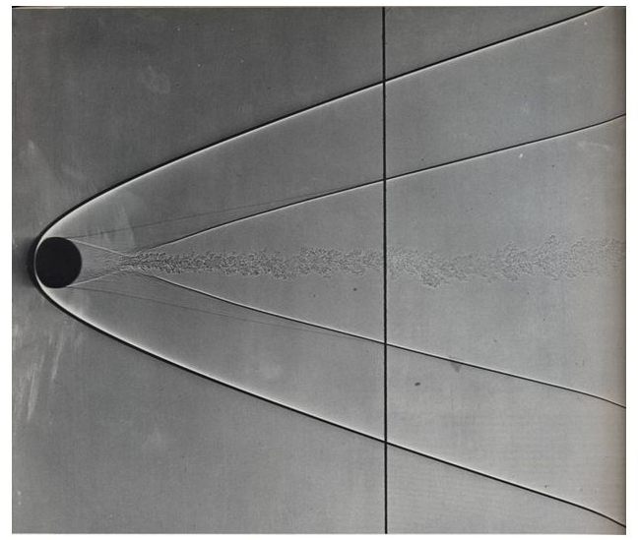
Definition: A shock wave is a discontinuous surface that connects supersonic flow with subsonic flow.
Behind the shock front, flow velocity is reduced, and P, T and entropy increases across a shock wave (Silber et al. 2017).
Shadowgraph of 5 cm sphere (M = 4) in free flight through atmospheric air shows boundary layer separation and the formation of the shockwave Credit: A.C. Charters
However we cannot directly observe the formation of overdense meteor generated shock waves, h(v, d) in the region 90 ± 5 km because:
  rapid spatial and temporal attenuation in rarefied atmosphere,
  presence of radiative phenomena
  uncertainty due to ablation-amplified hydrodynamic shielding and its dimensions
Notes:
Therefore, the flow is in nonequilibrium, and irreversible processes occur inside the shock layer

Slide 8
  Need a tool to interpret the formation of coherent flow fields (at specific altitudes) associated with the formation of the meteor generated shock waves in overdense meteors (bow shock envelope)

Slide 9
We propose that MHE may be used to determine the formation altitude of overdense meteor shock waves

Slide 10
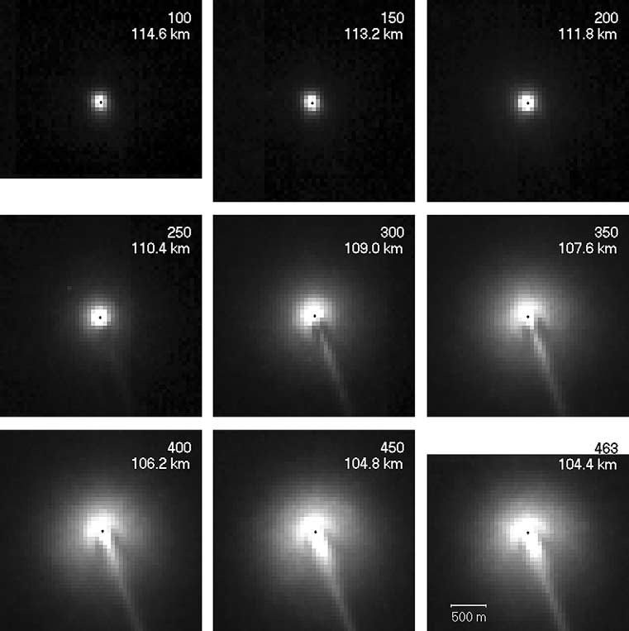
How do we define a meteor head echo (MHE)?
(Stenbaek-Nielsen and Jennniskens, 2004)
…radar detectable Doppler shifted plasma region that surrounds a meteoroid and travels at its velocity
Images show the development of the shock-like structure during Leonid entry, 115 -104 km altitudes. In this case it serves as a good visual depiction of the MHE.
Notes:
Caused by primarily high energy collisional ionization

Slide 11
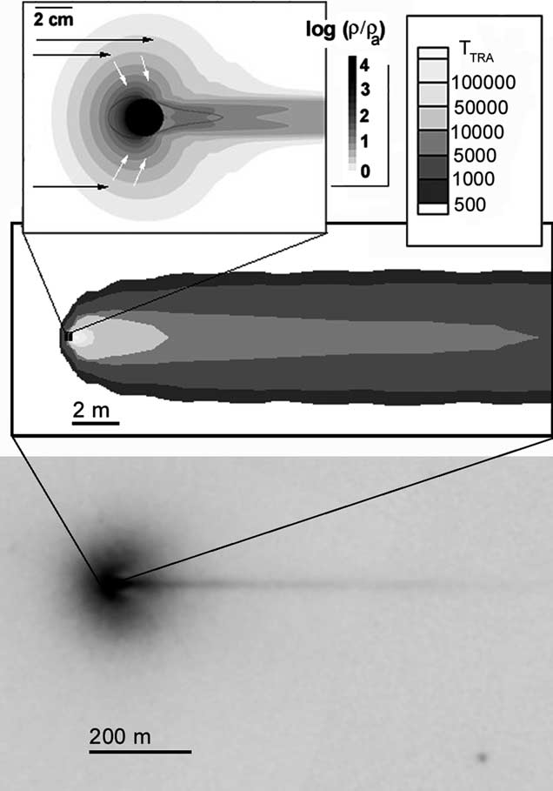
Formation of MHEs coincides with the sputtering regime (colliding atmospheric molecules directly impact the meteoroid surface) - a large number of high energy collisionally evaporated meteoric atoms are ejected – some along the axis of meteor propagation with speeds of up to 1.5v_{meteor} .
Second and third order ionizing collisions of ejected meteoric atoms form fast, scattering high energy electrons, some distance ahead of and around the meteor.
Coulombic forces ineffective in controlling the departure of high energy ballistic electrons because of the initial charge separation between ions and electrons in the low plasma density (at higher altitudes) .
Three scale-sizes of physical phenomena in the Leonid meteor images. Top section of figure shows the meteor vapor cloud calculated by Popova et al., 2000. The center section shows the meteor wake calculated by Boyd, 2000. These models do not describe the “UV-induced halo and shock-like structure” seen in the high frame rate imager (bottom). (Stenbaek-Nielsen and Jennniskens, 2004)
Notes:
In the frame of reference moving with the meteoroid, the effective mean free path of the evaporated molecules is much shorter than the mean free path of the ambient atmosphere.
For typical meteoric velocities, l_{r} is of the order of a few tens of centimeters as at 120 km altitude and about 10mm at 104 km altitude, that is, of the same order as the target sizes estimated above (Westman et al. 2004)

Slide 12
Basic Assumptions (e.g. Close et al. 2012)
MHE region hemispheric – simplifies the interpretation of RCS and the actual geometric area.
MHE plasma’s radius depends upon altitude and scales with the atmospheric mean free path and meteoroid speed
MHE plasma density - overdense
At lower altitudes, as the atmospheric mean free path decreases, so will the size of the ionized region
It is possible to relate those parameters to meteor shock wave formation
Notes:
At lower altitudes, as the atmospheric mean free path decreases, so will the size of the ionized region

Slide 13
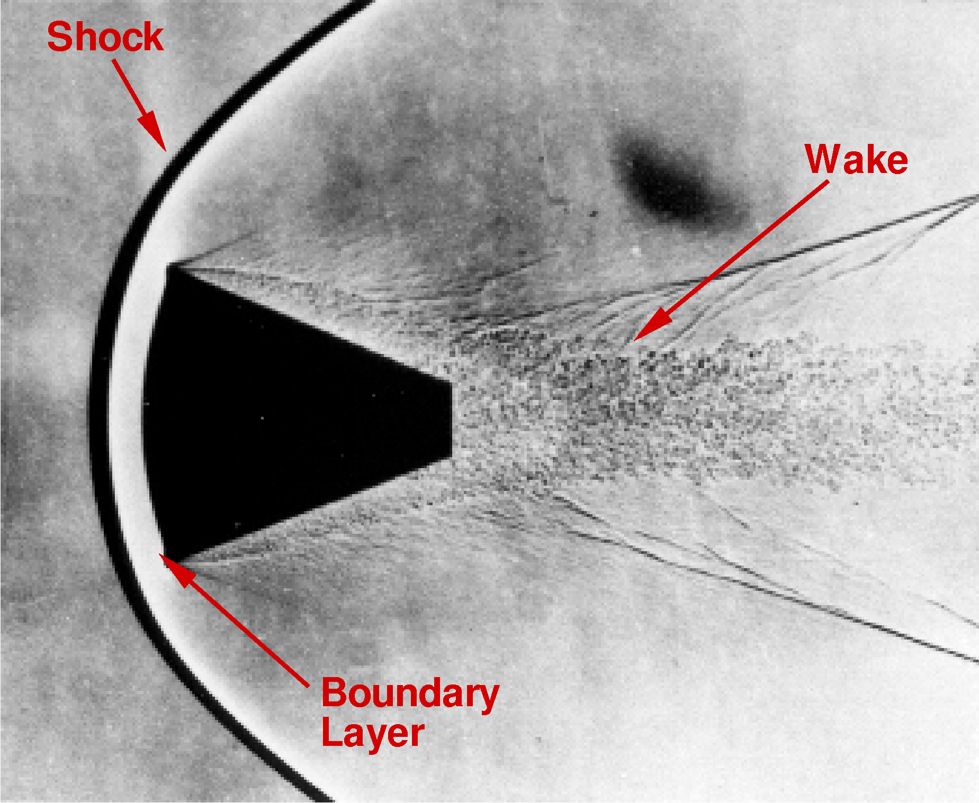
How to detect meteor shockwaves and constrain their formation altitudes?
The MHE will “terminate” (RCS falls below pre-determined dBsm threshold) upon the formation of the shock front with high (quasineutral) plasma density in strongly stratified flow fields
or because its radar RCS will be too small to detect with VHF radar
In the shock layer and in the region of high plasma density, Coulombic forces are sufficiently strong as to prevent the large scale electron scattering associated with MHEs at higher altitudes.
f(λ) and other set parameters
RCS will scale with total number of electrons (e.g. Marshall and Close 2015).
Notes:
RCS will scale with total number of electrons for plasma radii large compared to the radar wavelength and that this is also proportional to total light production (e.g. Marshall and Close 2015).

Slide 14
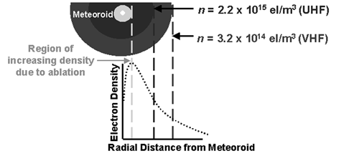
Technical Challenges and Considerations
The observed MHE target sizes strongly depends on the observing radar frequency and associated biases
Illustration of how the electron density theoretically
varies as a function of distance from the meteoroid.
The light colour center represents the meteoroid, the grey portion denotes the region where the electron density increases, and the subsequent dark rings show how the electron density decreases with radius. By assuming overdense reflection, the UHF wave (higher critical frequency) penetrates further into the meteoroid than the VHF reflection, thus explaining the lower UHF RCS (radius of head echo). (Close et al. 2002)
Target RCS fluctuations due to aspect angle, frequency, and polarization are also present.
The methodology is simplified by the assumption of hemispherical structure moving at geocentric meteor velocity
Scattering behaviour function of target circumference and radar wavelength ratio α=2πa/λ
Notes:
At UHF, the target scattering corss-section can be regarded as close to the geometrical cross section and σ=πr^2.long wavelenghts , the Mie treatment assumes a form close to the Rayleigh scattering (when the ratio is much smaller than 1)

Slide 15
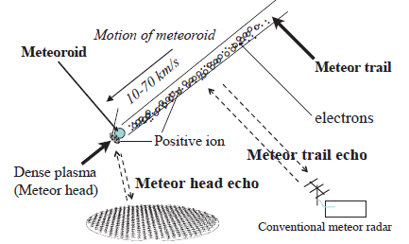
Experimental Verification
Should include simultaneous MHE and specular echo from a different and geographically separated system at VHF frequencies
(or simultaneous visual observations e.g. Michell et al. 2015).
  Exact specular electron line density necessary for exact meteor size determinations
  Actual target size may be different from RCS at different frequencies
  For a 1 m radius overdense plasma at 20 MHz, σ≈0.3 m² which increases to ~3 m² at 300 MHz (Baggaley 2002).
Abe et al. 2015
Notes:
Vhf sensitivity to larger particles than those detected by typical HPLA radars

Slide 16
Summary and Conclusions
We presented theoretical reasoning that MHE may offer valuable tool in constraining the altitudes of shock formation of mm and cm sized overdense meteors.
The full theoretical treatment is being developed, however the experimental verification is necessary

Slide 17
Thank you!
Questions?

Slide 18
Supplemental material

Slide 19
How to detect meteor shockwaves and constrain their formation altitudes? – Cont’d
Approach II: At the altitudes where the size of MHE RCS geometric areas are compatible to the ablationally augmented flow fields around a meteor (generally between 1 and 2 orders of magnitude greater than characteristic meteoroid dimensions (Boyd 2000; Popova et al. 2001), that signifies the existence of strongly stratified density gradients in the plasma layer in front of and around the meteoroid
This is a direct precursor to the shock wave formation at considered altitude (within uncertainty ± 1 km)
RCS will scale with total number of electrons for plasma radii large compared to the radar wavelength and that this is also proportional to total light production (e.g. Marshall and Close 2015).

Slide 20
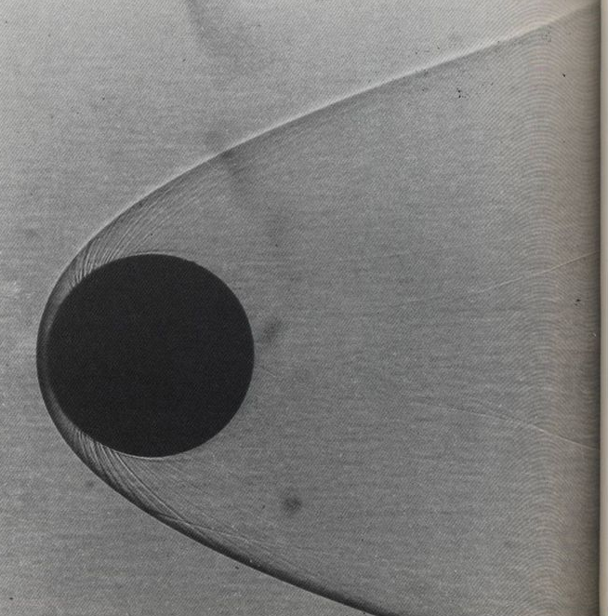
An example of sphere at M = 7.6 flying through atmospheric air. At this marginally
high Mach number the bow shock wave is forced closer to the front of the body
(bow shock envelope will approach cylindrical shape at Meteor Mach numbers).
U.S. Navy photograph from Naval Surface Weapons Center, Silver Springs, Maryland.

Slide 21
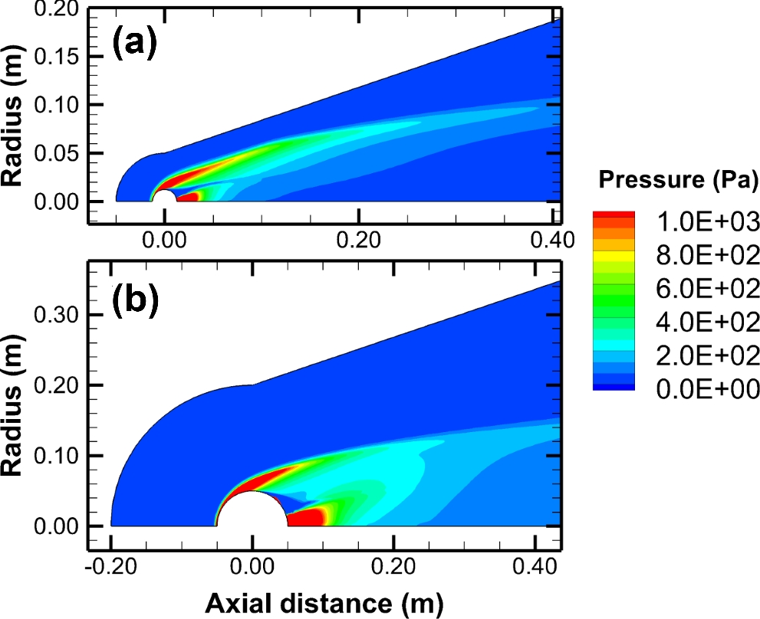

Slide 22
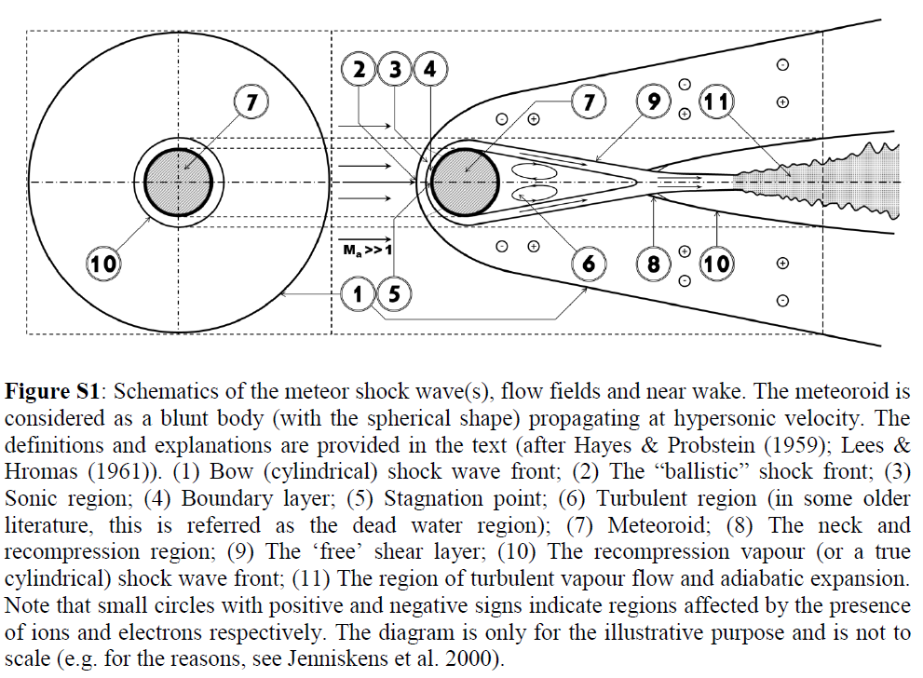

Slide 23
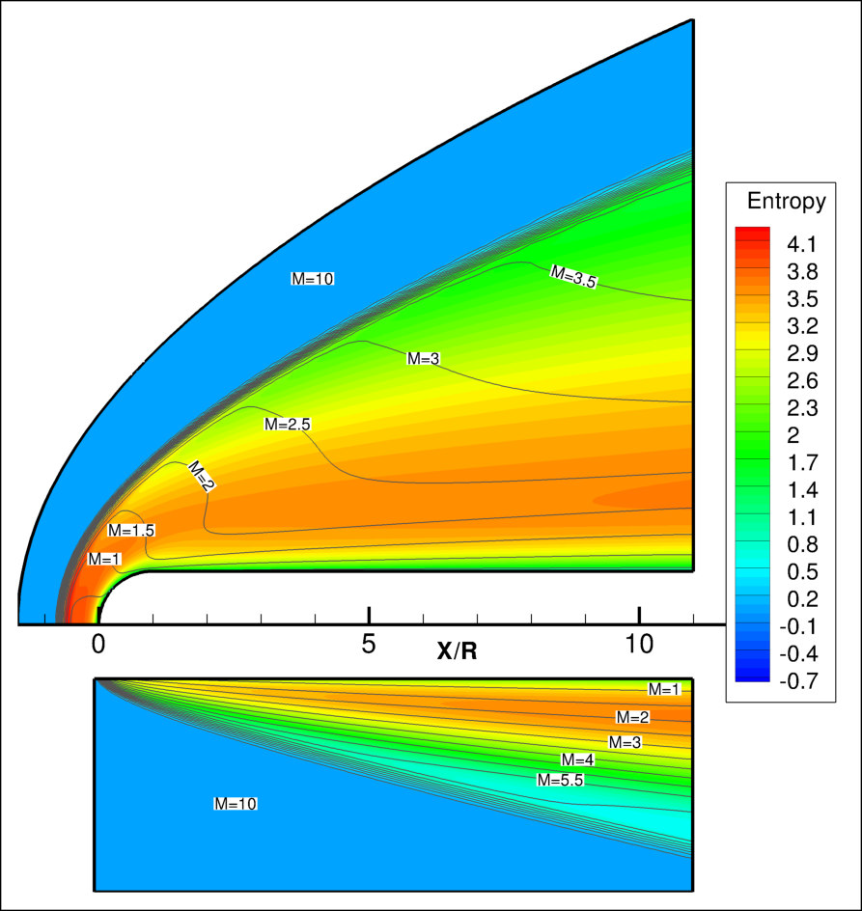
Entropy / Mach number flow fields and y-profiles of temperature and velocity for blunted and sharp plates (NS,
M=10).
“Rarefaction and Non‐equilibrium Effects in Hypersonic Flows about Leading Edges of Small Bluntness” (Ivanov et al. 2011)

Slide 24
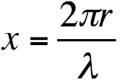


Additional Notes and Supplemental Material
• x << 1 : Rayleigh scattering
• x ~ 1 : Mie scattering
• x >>1 : Geometric scattering
HPLA UHF (930 MHz) – detection limit between 100-80 km = ~ 0.4 cm; VHF (224MHz) detection limit in the same altitude ~1.1 cm
Rayleigh
In the frame of reference moving with the meteoroid, the effective mean free path of the evaporated molecules is much shorter than l∞. They move on the average distance l_{r} before they collide with an air molecule (Bronshten, 1983):
Notes:
When r0 is small compared to the probing
wavelength, waves scattered from the front and back of a trail
add in phase and reinforce the radar return.
The source of head echo scattering remains undetermined;
a number of scattering mechanisms may play a role
in interpreting radar data and head echoes.
One possible mechanism results from
coherent returns from a volume of electrons that is small
compared with the incident radar wavelength [Mathews et
al., 1997]. Backscatter from this volume is proportional to
N² (number of electrons) according to
$$σ=4πa^{2}N^{2}$$
where a is the classical electron radius. This assumes that
the electrons scatter in-phase and that the scattered E fields
add. If a region is to contribute substantially to the RCS its
diameter must be less than λ/4; regions outside this will
tend to average to the incoherent scatter RCS
Another possibility is overdense scattering [Wannberg
et al., 1996], which occurs when the plasma frequency
exceeds the radar frequency

Slide 25



where (S/N) is the signal-to-noise ratio (SNR) of the target, R is the range, Pt is the transmitted power, and C is the system calibration constant (contains the Boltzmann constant, bandwidth, system noise temperature, antenna gain and radar wavelength).
If a possible scattering mechanism that may cause head echoes results from
coherent returns from a volume of electrons that is small compared with the incident radar wavelength [Mathews et al., 1997] then the backscatter from this volume is proportional to N² (number of electrons) according to
where a0 is the classical electron radius.
If a region is to contribute substantially to the RCS its diameter must be less than λ/4; regions outside this will tend to average to the incoherent scatter RCS
Another possibility is overdense scattering [Wannberg et al., 1996], which occurs when the plasma frequency exceeds the radar frequency where f is the incident radar frequency in Hz and n is the electron volume density incm³
The Mie series can be broken down into three regions: 1. objects that are much less than a wavelength (Rayleigh regime), 2. object sizes that are of the order
of the wavelength (resonance region), and 3. objects that are much greater than a wavelength (optical region).
In the Rayleigh regime, where 0 < ka < 1, the RCS is proportional to the square of the area of the body where k = 2p/λ, a is the Rayleigh radius of the target’s cross
section and l is the incident wavelength.

Slide 26
Simplified approach:
The plasma frequency in overdense MHE (Raleygh regime) greater than λ
At lower altitudes (below 95 km) the size of plasma region is decreasing with the decreasing atmospheric mean free path.
The RCS dependence on velocity and altitude revealed a strong correlation between the size of a head echo and the altitude, or mean free path (Close et al. 2002).
The altitude where the RCS is maximized (105 km)
Below approx. 100 km, the RCS follows the decrease in the mean free path
Determination of MHE plasma radius from RCS depends on frequency

Slide 27
Ways to interpret shock wave formation
Sudden drop in RCS (indicates formation of flow fields where electrons can not escape)
RCS corresponds to the size of the typical flow field for overdense meteors (1 – 2 orders of magnitude greater than the meteoroid characteristic dimensions).That again indicates the formation of the flow fields.
Finally, RCS disappears (while meteor is still ablating). That indeed demonstrates the formation of shock fronts and strongly density stratified flow fields. The Coulomb forces are sufficiently strong to control the departure of the energetic electrons. Moreover, large positive ion density will minimize the radar signature and RSC

Slide 28
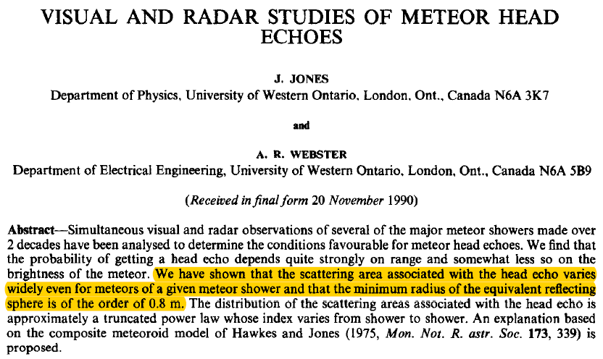

Slide 29
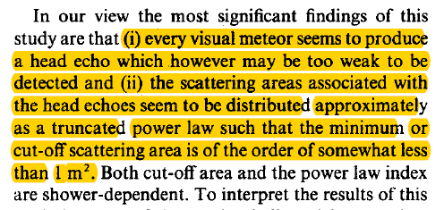
Jones and Webster, (1991)

Slide 30
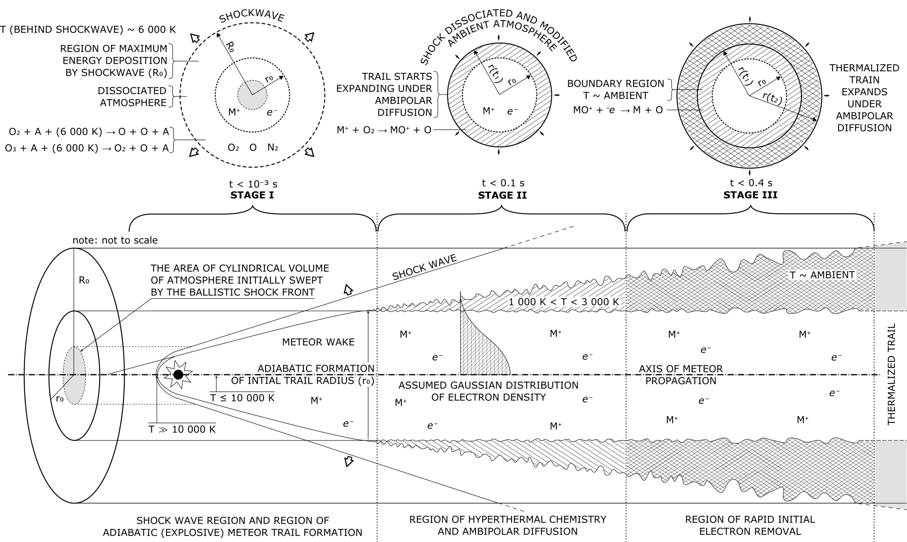

Slide 31
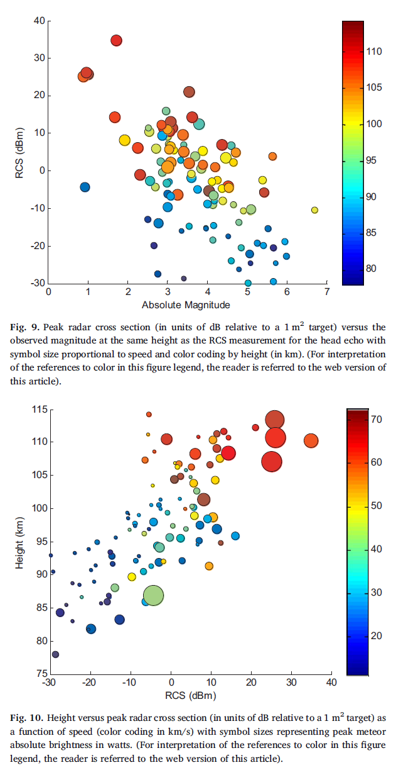

Slide 32
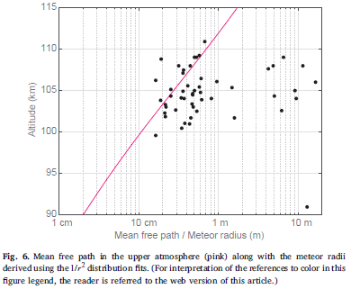

Slide 33
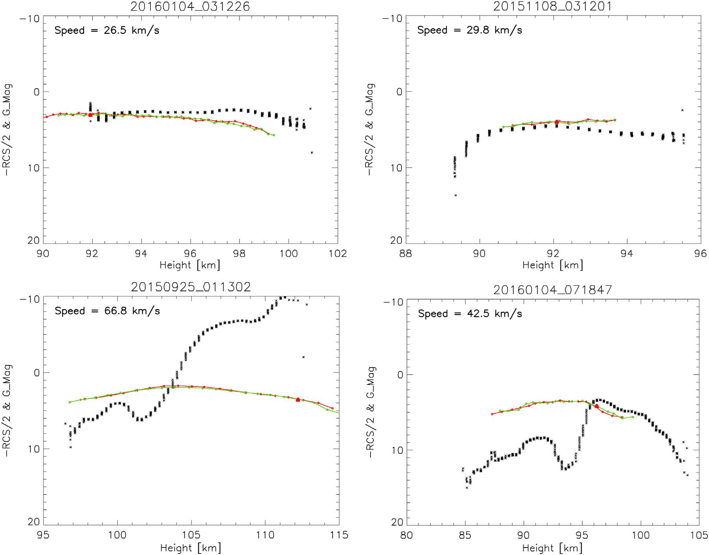
Radar cross section (in units of dB relative to a 1 m² target scaled as –RCS/2 on the y-axis so that larger RCS values are upward) shown as solid black dots versus height for four events. Also shown are the wide field (WATEC) absolute light curves in units of G-band magnitude (y-axis) from the Saura camera (red line) and Alomar (green line). The height on the optical lightcurve where the maximum RCS is reached is shown with a red triangle. The range of y-values is the same for all four events (ranging from 20 dBsm at the top to −40 dBsm at the bottom of the plot). (Brown et al. 2017)

