Slide 1



Next-generation neutrinoless double beta decay search with LXe
Razvan Gornea
Carleton University & TRIUMF
2017 CAP Congress
Kingston, May 31, 2017

Slide 2

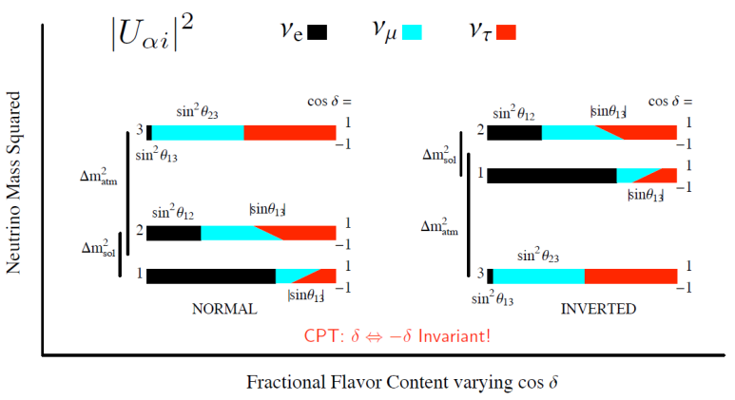
Neutrinos in the standard model
Neutrinos have non-vanishing masses
β-decay end-point
of energy spectrum
Cosmology
0νββ searches
Neutrino oscillation experiments

Slide 3
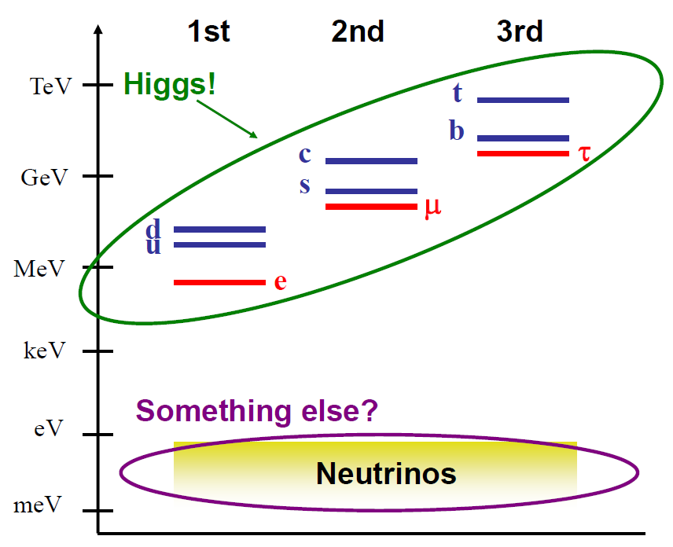
Neutrinos in the standard model
Neutrinos masses stand apart from that of the charged fermions

Slide 4
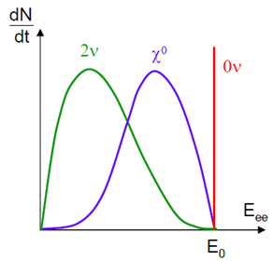
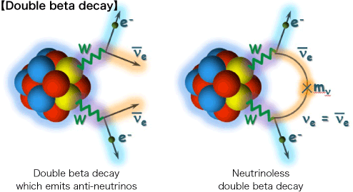
Neutrinoless double beta decay
total Lepton Number Violating process

Slide 5
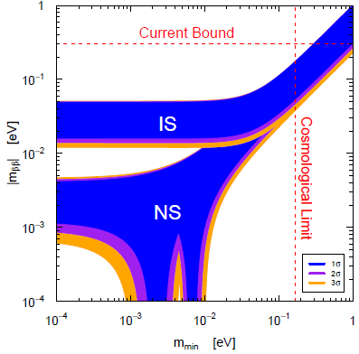
Neutrinoless double beta decay

Slide 6
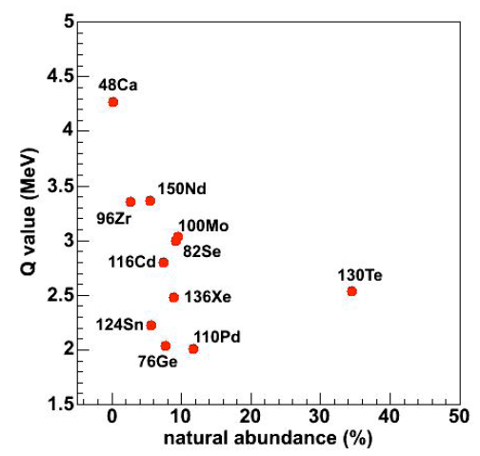
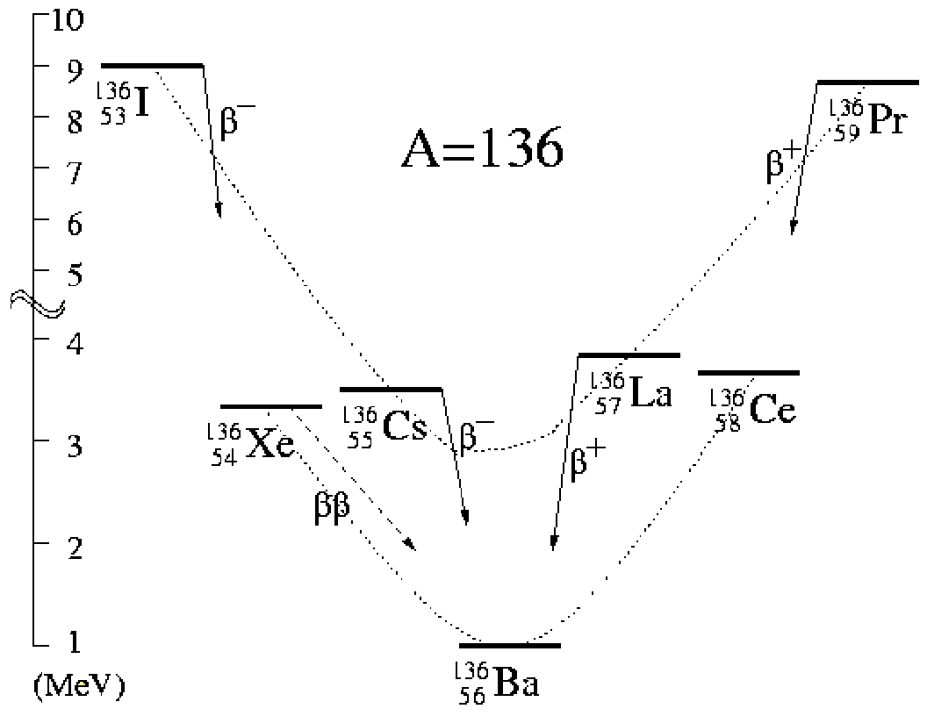
Isotope selection

Slide 7
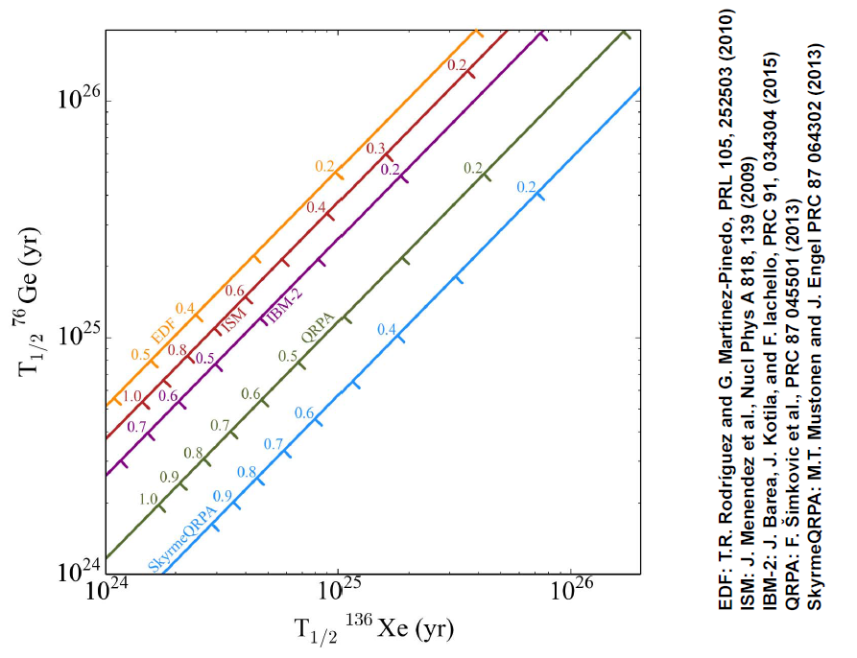
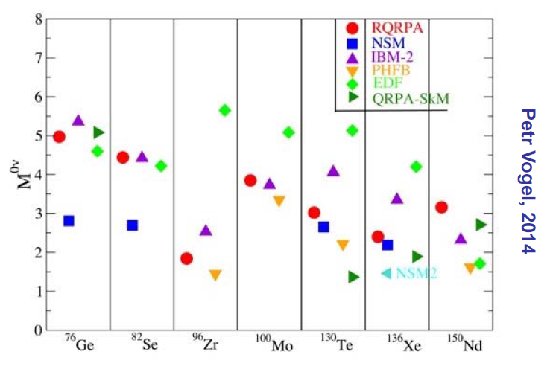
Nuclear Matrix Elements

Slide 8
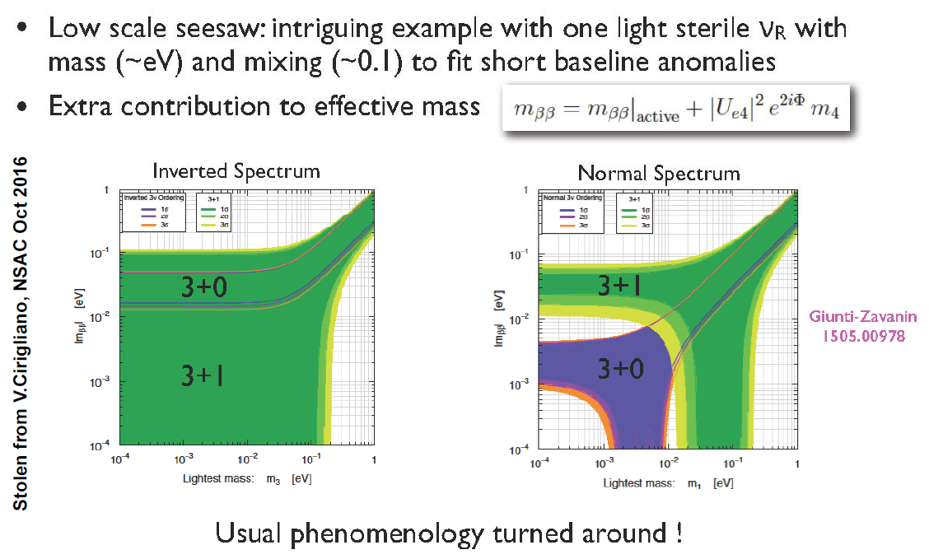
Other LNV processes

Slide 9
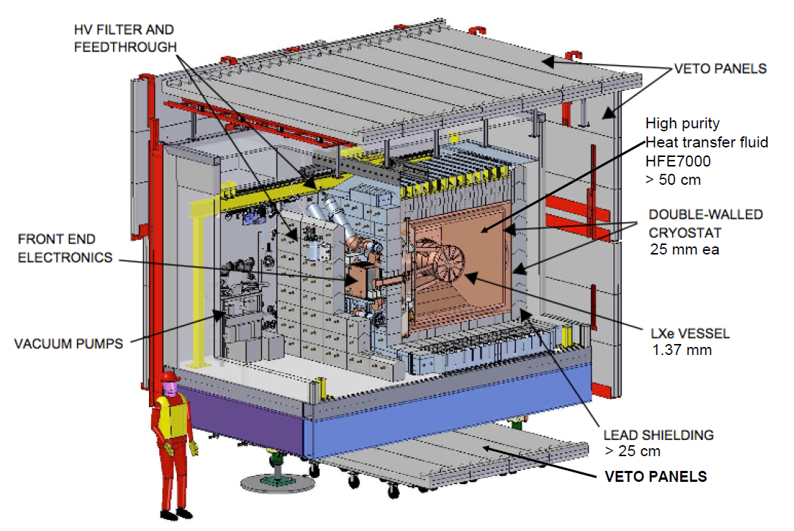
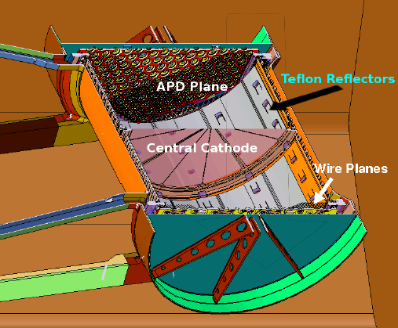
EXO-200 prototype
Ionization
Scintillation
e-
e-
e-
e-
e-
e-
e-
e-
e-
e-
e-
e-
LXe TPC with charge and scintillation light collection
e-
Charge collection
- 8kV

Slide 10
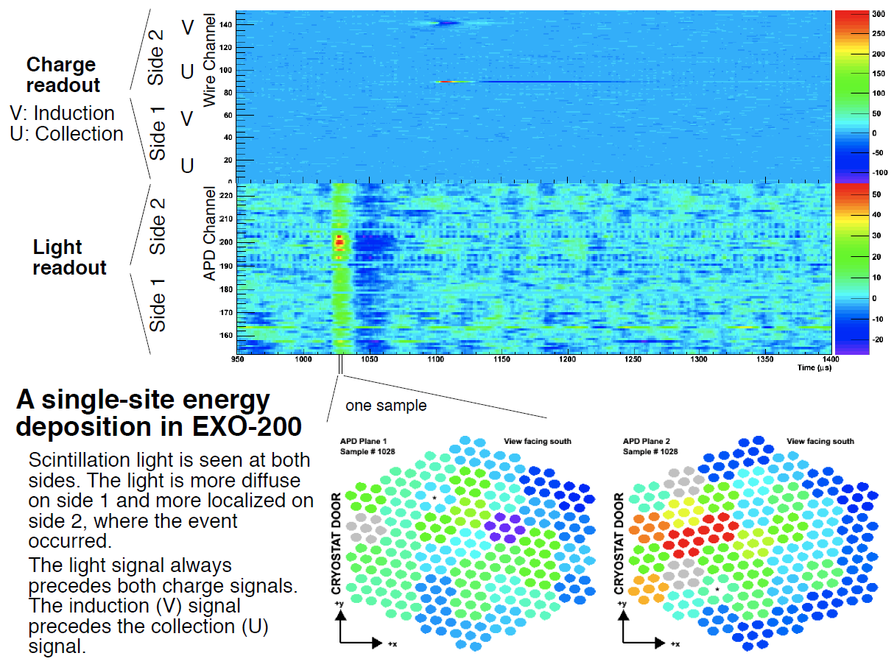
Data collection

Slide 11
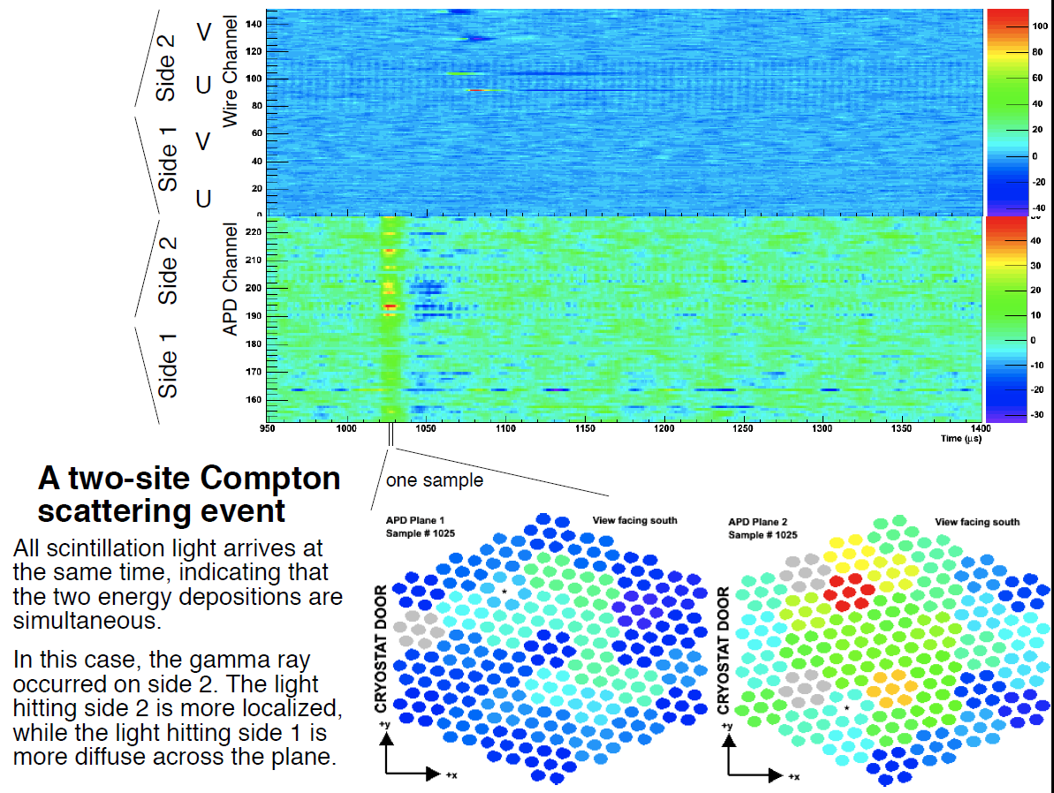
Data collection

Slide 12
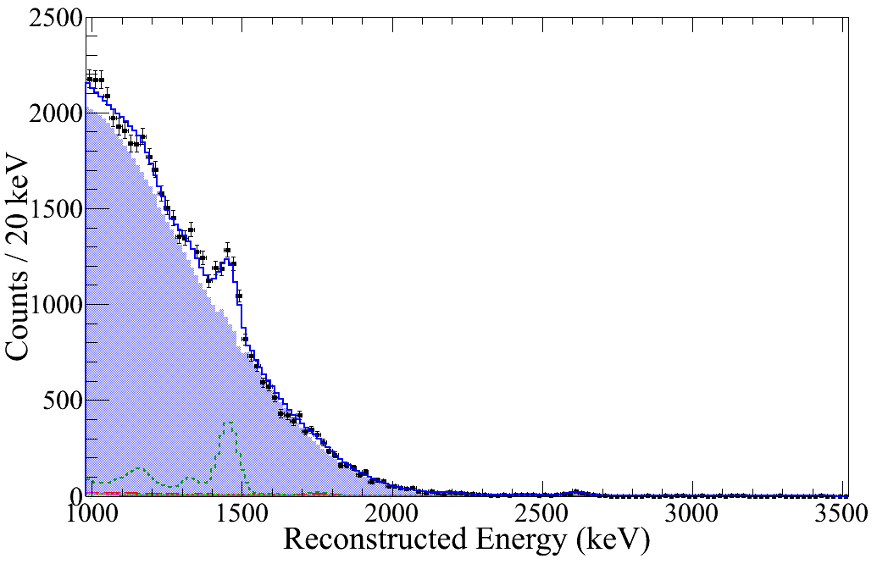
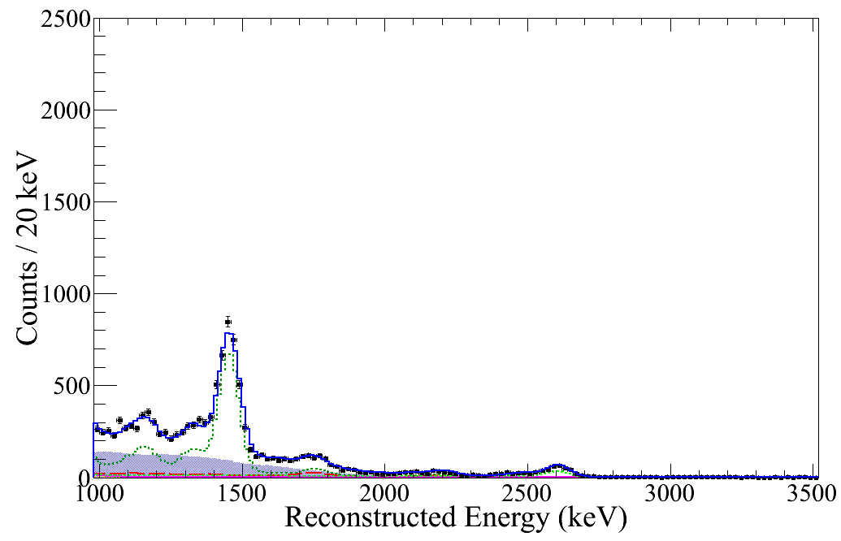
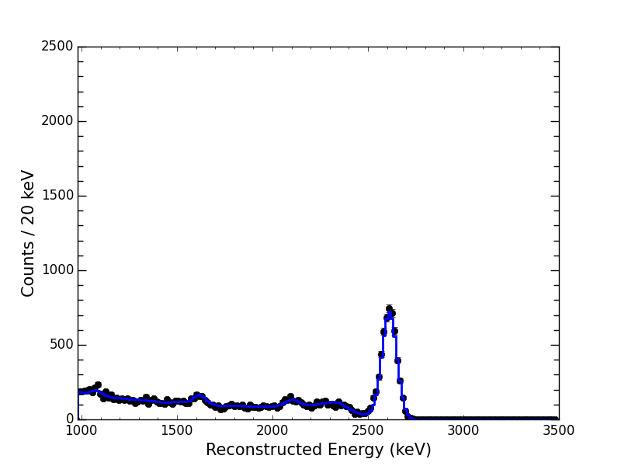
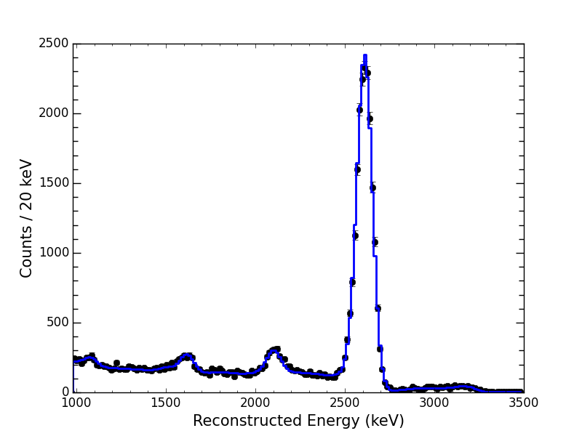
Event topology
single site events (SS)
multiple site events (MS)
Low background
data
2νββ
²²⁸Th calibration
source
γ
γ

Slide 13
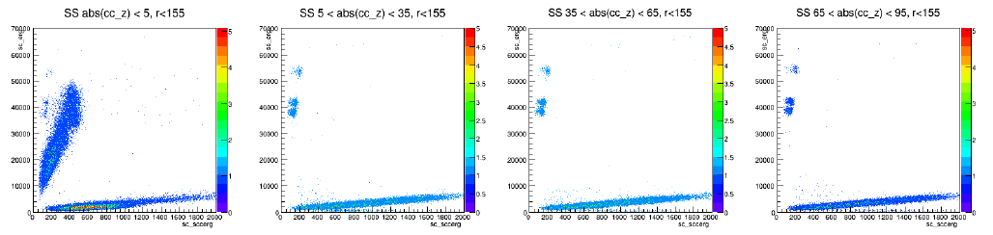
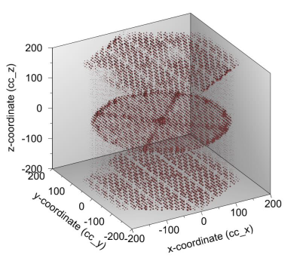
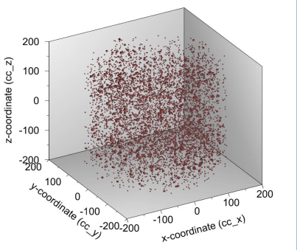
Particle ID & fiducial volume
Events from the cathode and anodes
Events from the LXe bulk

Slide 14
Energy measurement

Slide 15
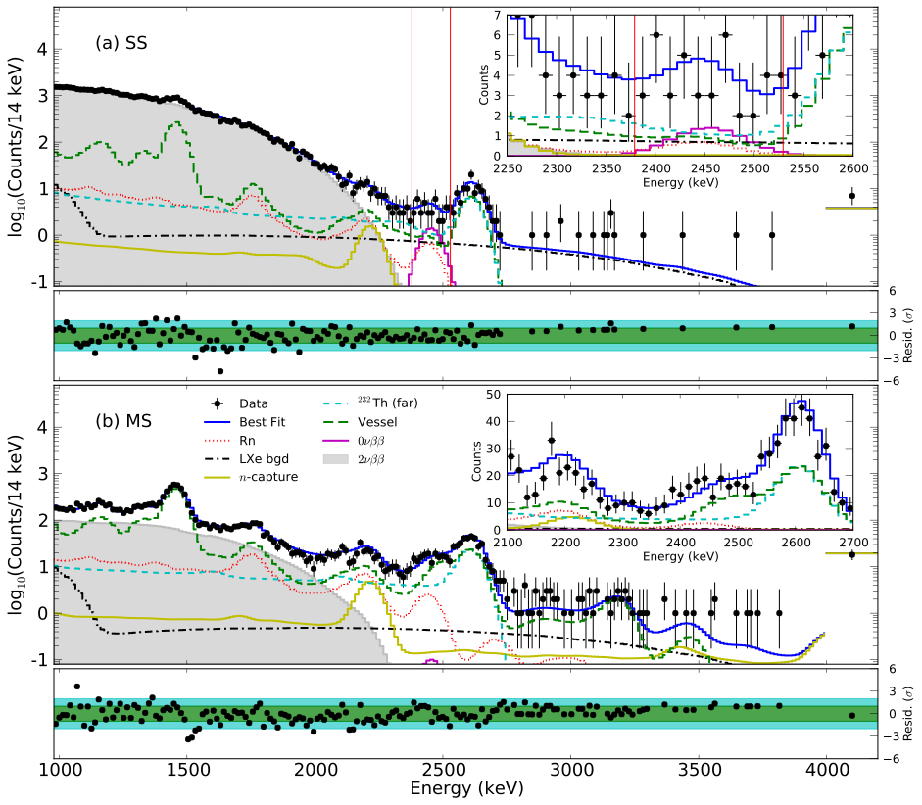
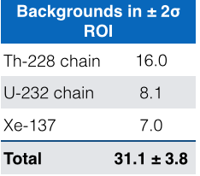
EXO-200 backgrounds
100 kg.yr exposure
0νββ ROI
The slowest process directly observed!
(1.7 ± 0.2)
keV⁻¹ ton⁻¹ yr⁻¹

Slide 16
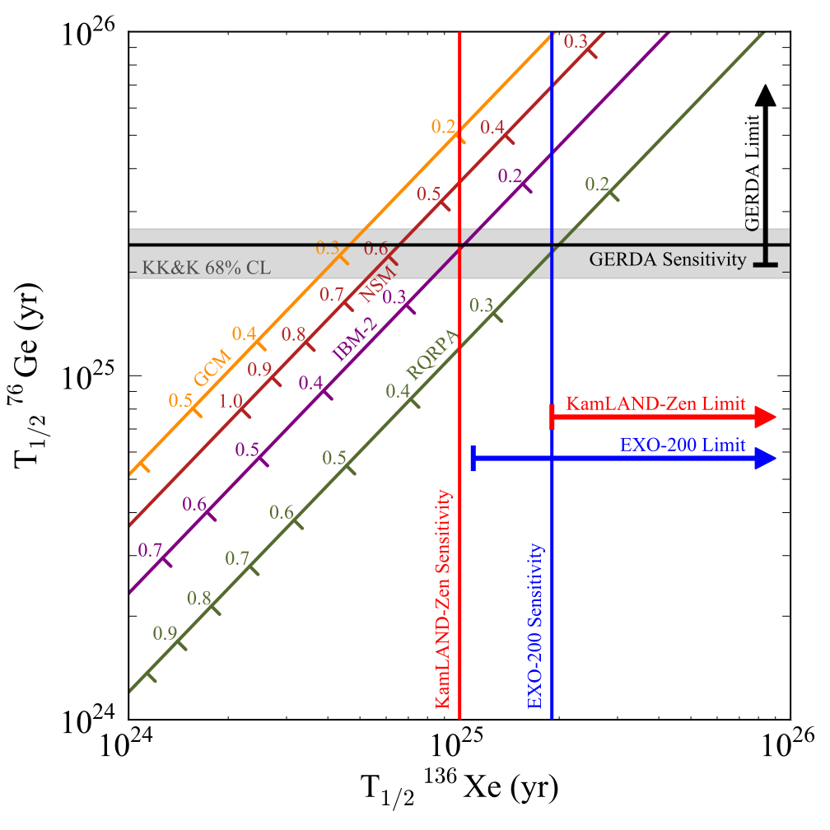
EXO-200 results
PRC 85, 034316 (2012) for phase space factors
EXO-200 published in Nature
PRL 111, 122503 (2013)
PRL 110, 062502 (2013)
Upgraded EXO-200
after 2 years run
Nature 510, 229 (2014)

Slide 17
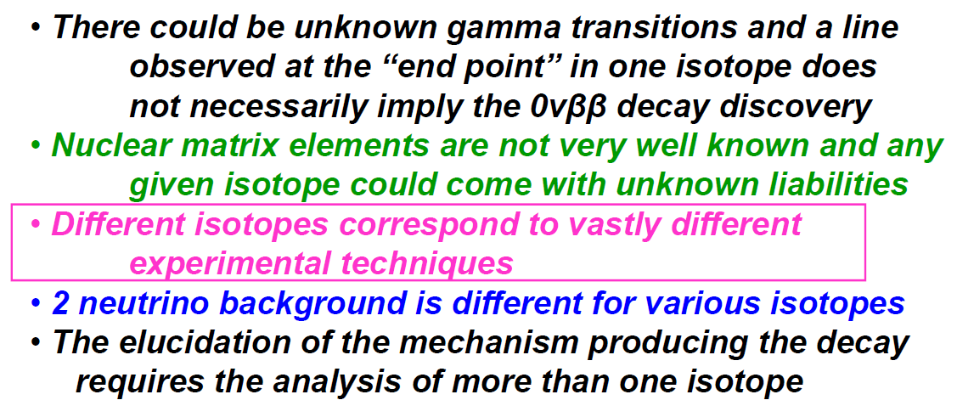
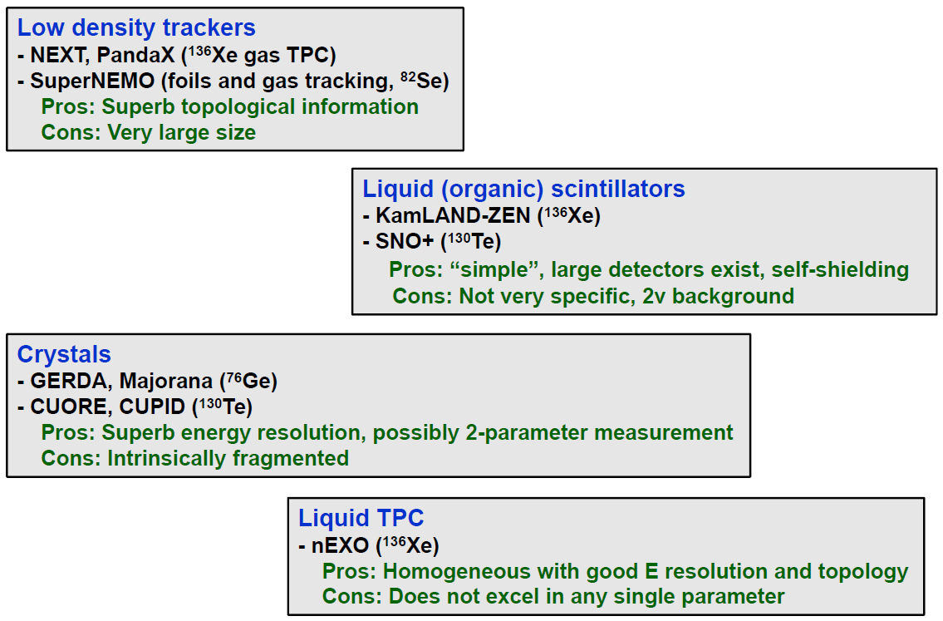
Future experiments
Arguments in favour of a rich and diversified 0νββ search program

Slide 18
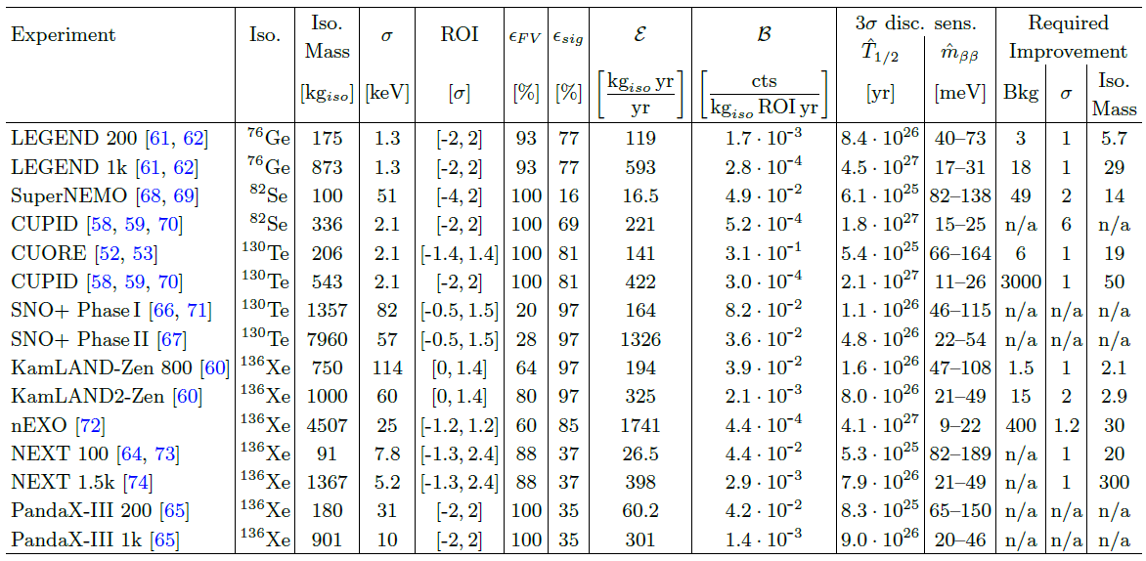
Future experiments
Agostini et al., arxiv:1705.02996 [hep-ex]

Slide 19
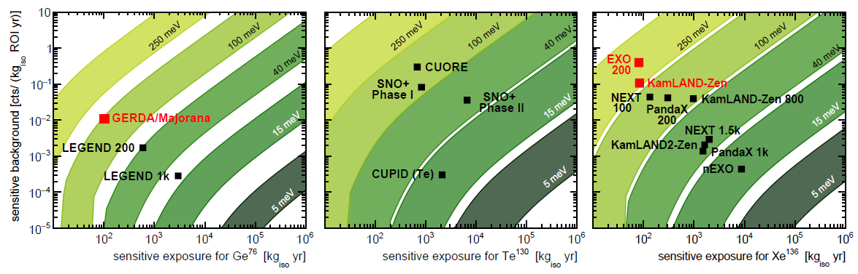
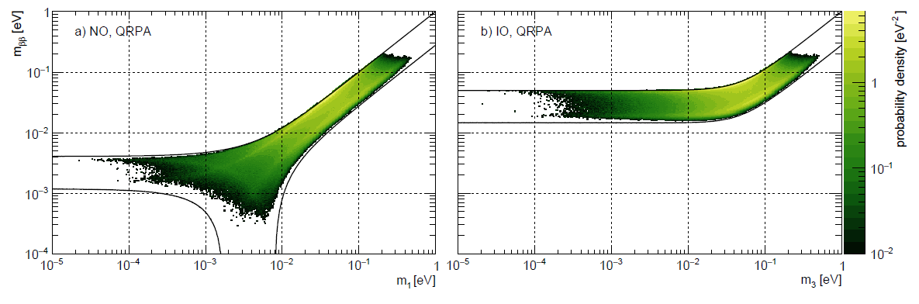
Future experiments
Agostini et al., arxiv:1705.02996 [hep-ex]

Slide 20
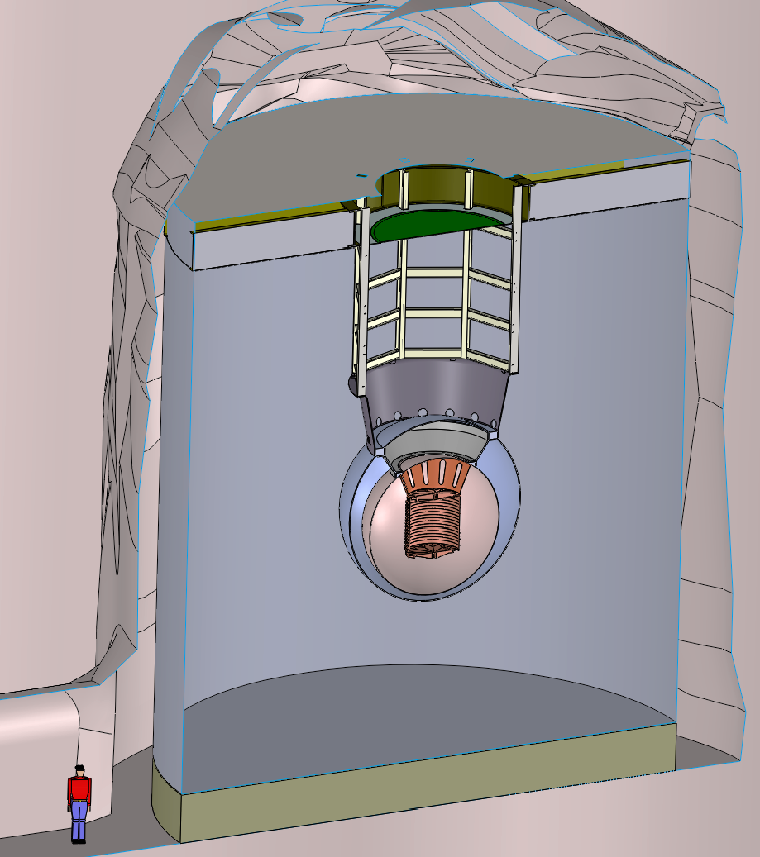
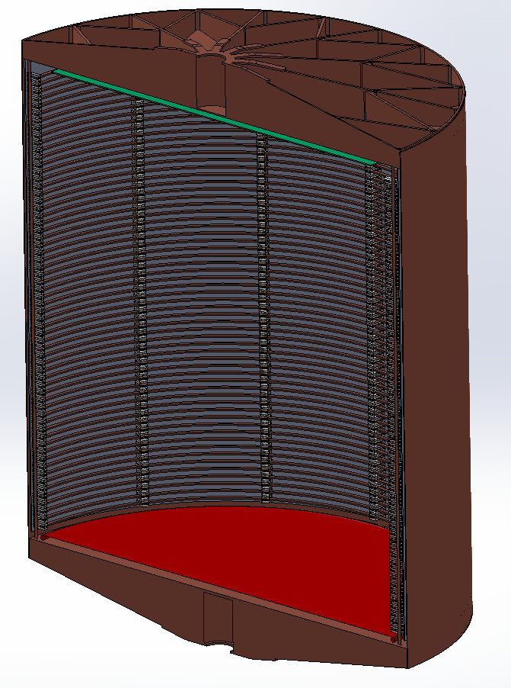
nEXO – 5 t LXe TPC
1.3 m
14 m
@ SNOLab

Slide 21
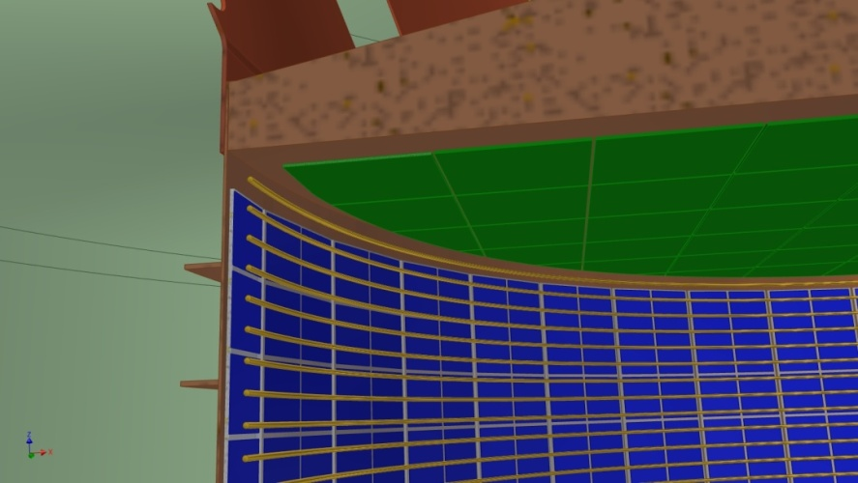
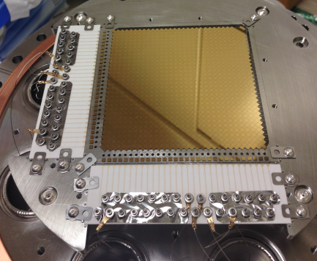
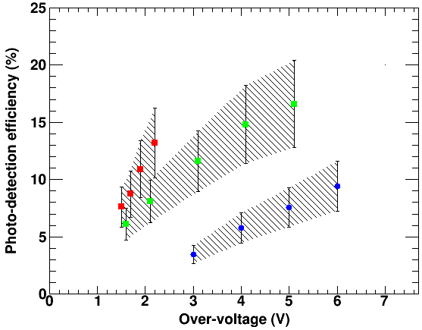
nEXO – 5 t LXe TPC
I.Ostrovskiy et al. IEEE TNS 62 (2015) 1
FBK RGB
1st gen.
Hamamatsu
FBK
1st gen.

Slide 22
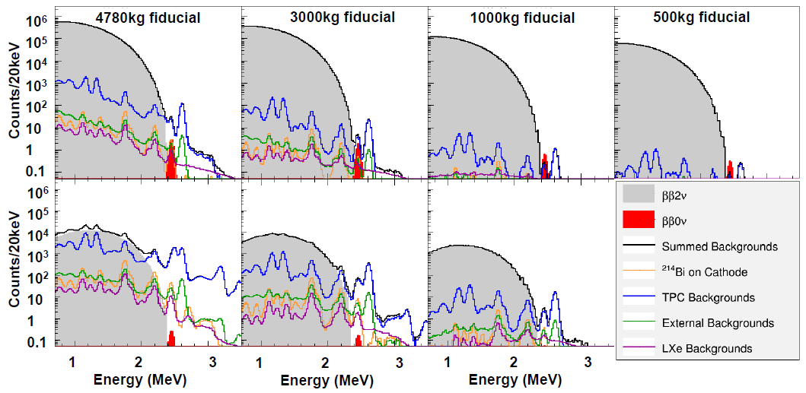
nEXO – 5 t LXe TPC
single site events (SS)
multiple site events (MS)

Slide 23
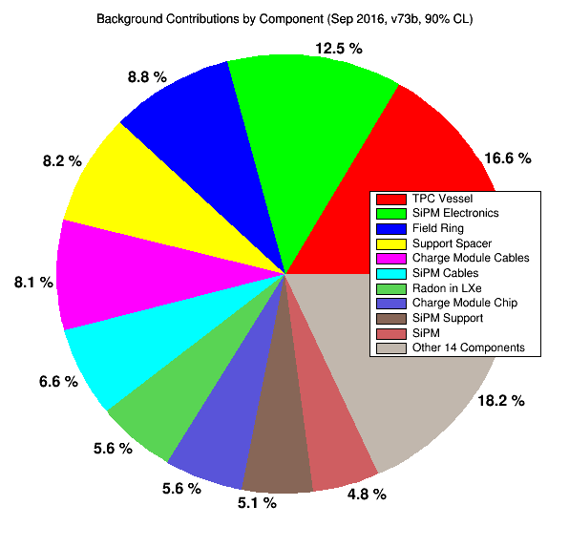
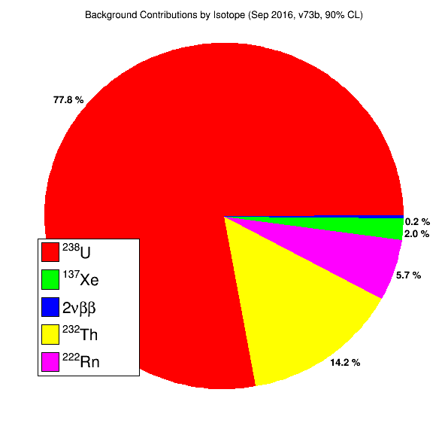
nEXO – 5 t LXe TPC
Background contributions in the ROI for the 3000 kg fiducial cut (2.1 events/year total rate)

Slide 24
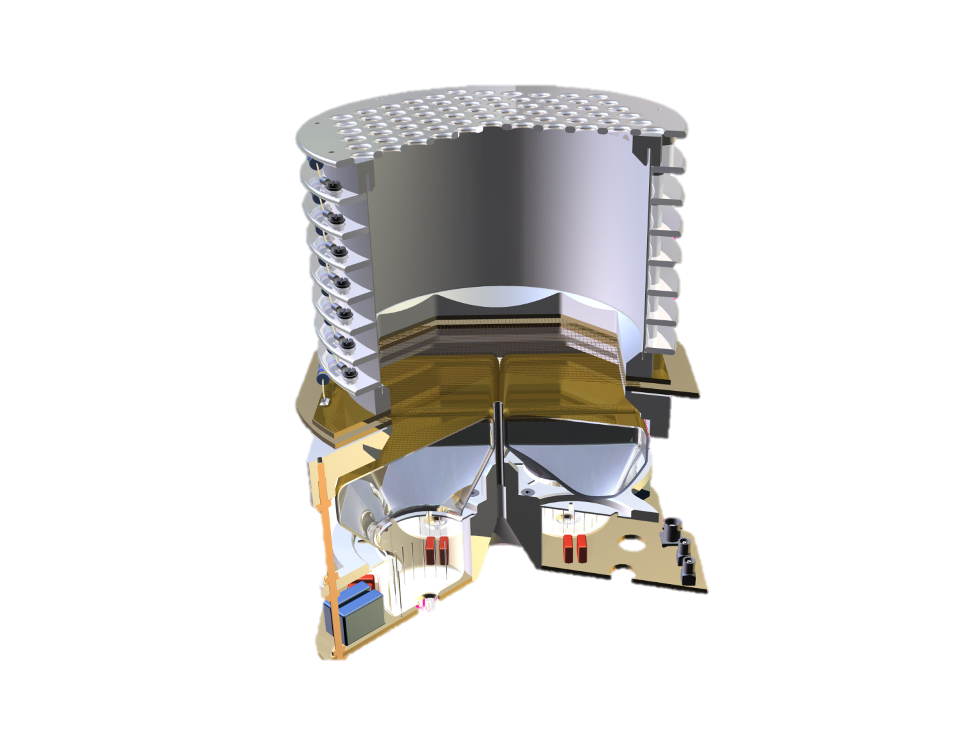
Ba ion tagging concept
Ba⁺ collection tip
Cavity ionizer
Mass filter
Quadrupole linear ion trap
e-
e-
e-
e-
e-
e-
CCD

Slide 25
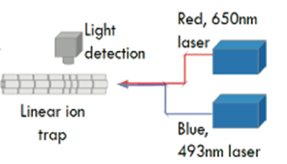
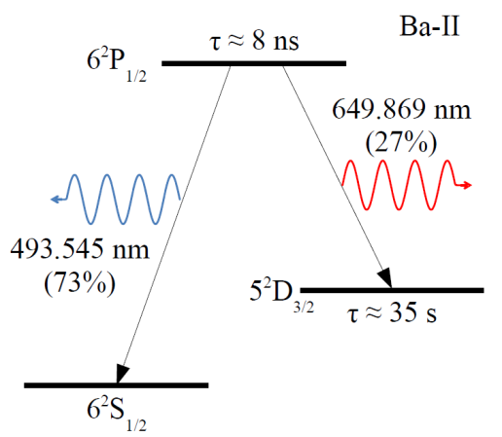
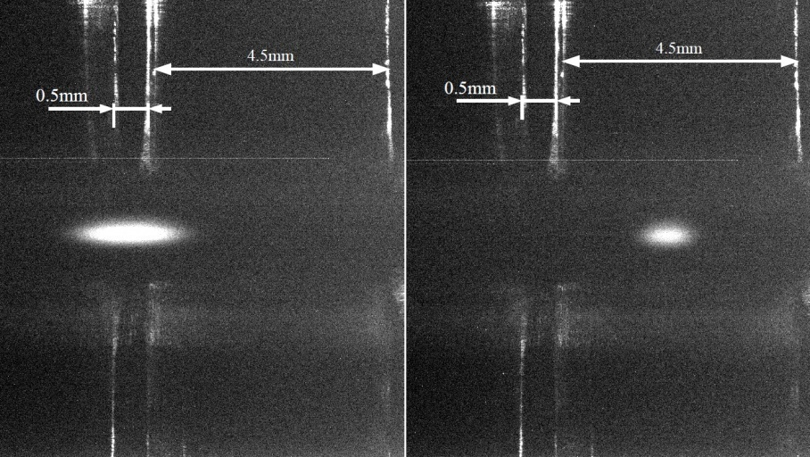
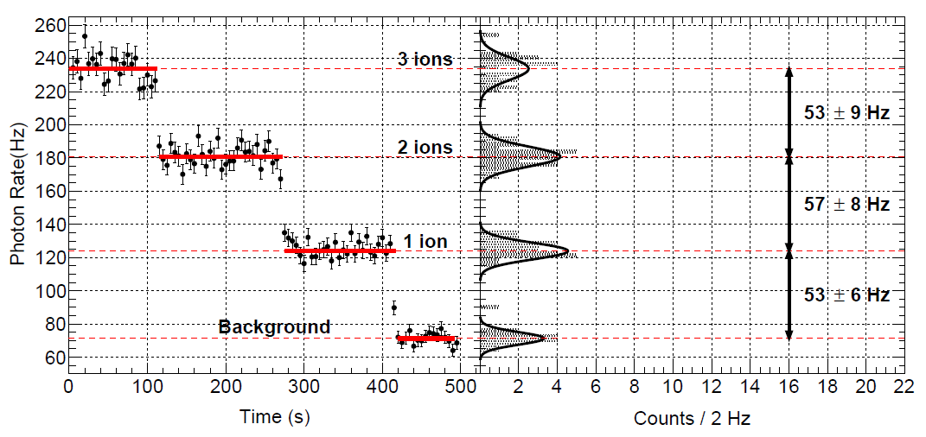
Ba ion detection
Using a relatively simple and well understood
fluorescing system
Demonstrated ion cloud imaging and accurate position control
Demonstrated single ion sensitivity using intermodulation technique (background control)

Slide 26
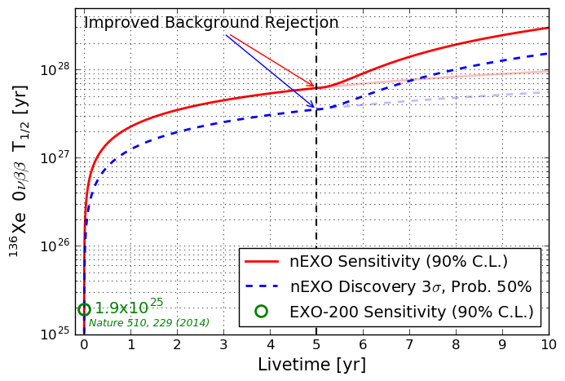
Expected performance

Slide 27
Expected performance
Improved EXO-200 after 2 years
nEXO after 5 years
nEXO + Ba tagging after 5 years

