Slide 1
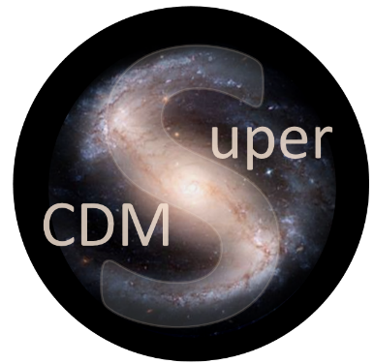


SuperCDMS
and CUTE
at SNOLAB
Wolfgang Rau
Queen’s University
for the
SuperCDMS Collaboration

Slide 2
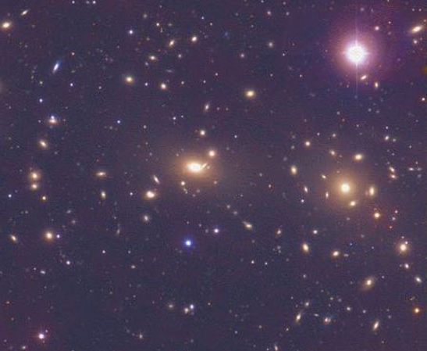
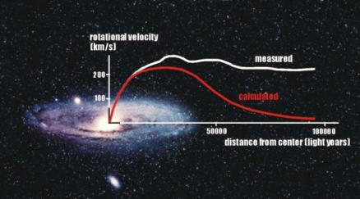
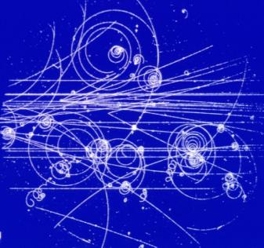
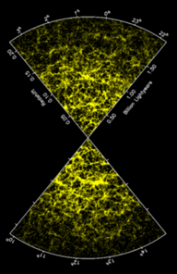
Dark Matter
Not observed in accelerator experiments:
Massive
Here, but not yet observed in nature: Weakly interacting
WIMP
Weakly Interacting Massive Particle
( )
Predicted by SUSY: Neutralino
Universal extra dimensions:
Kaluza-Klein particles
Interaction with ordinary matter:
Nuclear Recoils
(most backgrounds:
electron recoils)
Large scale
structure of the Universe:
Slowly moving (‘cold’)

Slide 3
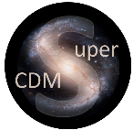
Overview
SuperCDMS
Detector technology
Detector generations
Experimental Setup
Goals for SNOLAB
Status
CUTE
Motivation
Design
Status
Analysis Projects
Detector Calibration
Backgrounds
Rare interactions
Dark Matter searches
Conclusions

Slide 4
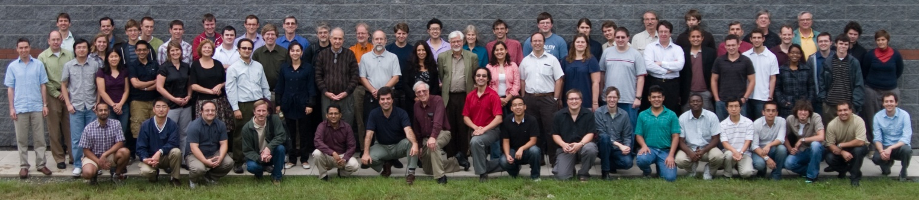
SuperCDMS
SuperCDMS Collaboration
California Institute of Technology CNRS/LPN Durham University
Fermi National Accelerator Laboratory NISER NIST Northwestern University
PNNL Queen’s University Santa Clara University SLAC/KIPA
South Dakota School of Mines & Technology SNOLAB/Laurentian University
Southern Methodist University Stanford University Texas A&M
University of British Columbia/TRIUMF University of California, Berkeley
University of Colorado Denver University of Evansville University of Florida
University of Minnesota University of South Dakota University of Toronto

Slide 5
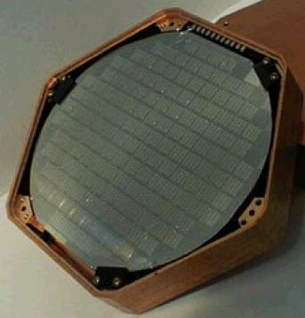
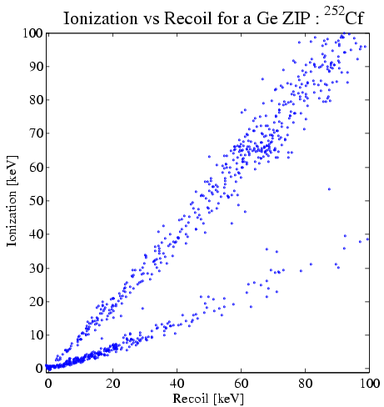
SuperCDMS
Detectors
CDMS
Super
Soudan
Neganov-Luke Effect
Semiconductor
operated at
few 10s of mK
-
In Vacuum
+
i
HV
ZIP
Electron gains kinetic energy
(E = q · V → 1 eV for 1 V potential)
-
Phonon Readout:
Tungsten TES
-
In Matter
+
Add: high voltage (~70 V)
Phonons from drifting charges
Threshold < 0.1 keV (phonon)
Add: charge readout (few V)
Background discrimination
Threshold < 10 keV
Deposited energy in crystal lattice:
Neganov-Luke phonons
∝ V, # charges
R vs T
-
+
0
0 V
remove surface
background
Electron recoils:
background
large phonon signal from
charges
–
+
Charge signal
–
0
– 70 V
Luke phonons mix charge and phonon signal → reduced discrimination
Apply high voltage → large final phonon signal, measures charge!!
ER much more amplified than NR
→ gain in threshold; dilute background from ER
< 1 background event for
whole exposure
Nuclear recoils:
signal
effective threshold:
few hundred eV (NR)
Phonon signal

Slide 6
SuperCDMS
Detectors
SuperCDMS
SNOLAB
Ge / Si
100 mm ∅ x 33 mm
Operated at 30 mK
iZIP
HV
Phonon Readout:
Tungsten TES
Add: charge readout (few V)
Background discrimination
Threshold < 1 keV
Add: high voltage (~100 V)
Phonons from drifting charges
Threshold < 0.1 keV (phonon)
R vs T
+
0
+ 50 V
remove surface
background
Electron recoils:
background
large phonon signal from
charges
–
+
Charge signal
–
0
– 50 V
< 1 background event for
whole exposure
Nuclear recoils:
signal
effective threshold: few
(or one) electron-hole pairs
Phonon signal

Slide 7
SuperCDMS
Background dilution with Luke Effect
Electron Recoil Spectrum
Nuclear Recoil Spectrum
Number of Counts
Energy

Slide 8
SuperCDMS
CDMS History
1998 - 2002
CDMS @ SUF
6 detectors
1 kg Ge (30 kgd )
σ < 3.5e-42 cm²
CDMS II @ Soudan
30 detectors
~4 kg Ge (1.1 kgy)
σ < 2e-44 cm²
SUF, 10 mwe
2003 - 2009
2009 - 2014
SuperCDMS @ Soudan
15 (bigger) detectors
~9 kg Ge (~6.5 kgy)
σ < 3e-45 cm²
Soudan, 2000 mwe
exposures are
after all cuts!
SuperCDMS @ SNOLAB
30-180 detectors
30-200 kg Ge/Si (part HV)
focus on low mass WIMPs
σ < e-43 cm² (1-10 GeV)
SNOLAB, 6000 mwe
2020

Slide 9
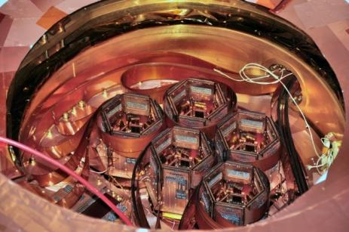
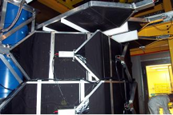
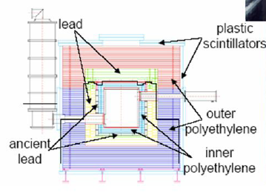
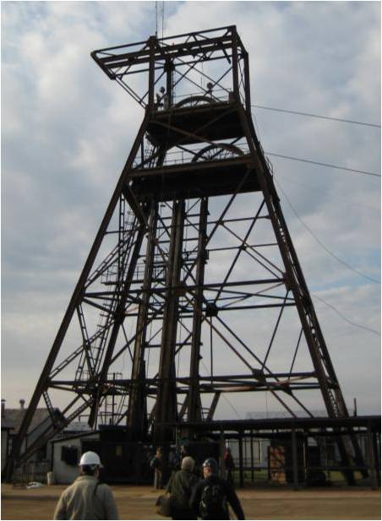
SuperCDMS
Implementation (Soudan setup)
Stack detectors (3) to mount (“tower”)
5 towers deployed in cryostat (~9 kg Ge)
Shielded with PE (for neutrons), Pb (gammas) and muon veto (cosmic radiation)
Located at Soudan Underground Lab (Minnesota) to shield from cosmic radiation (~700 m below ground)

Slide 10
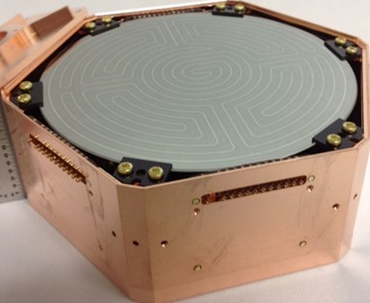
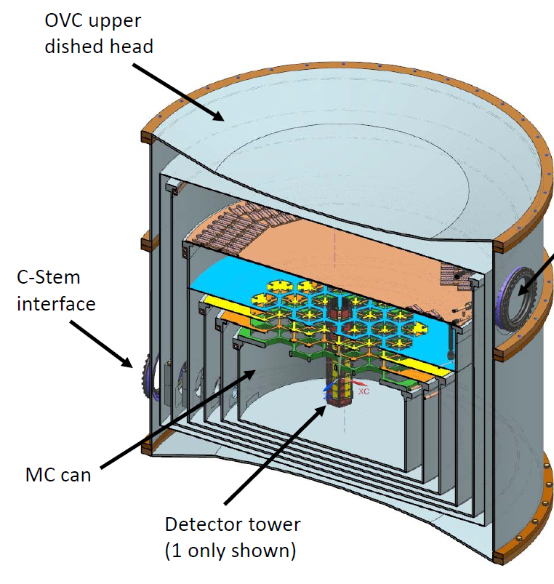
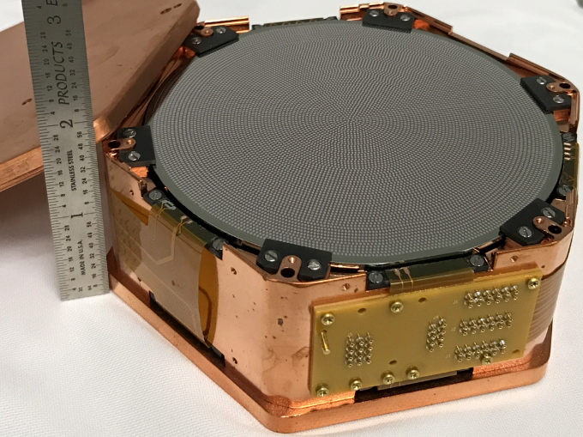
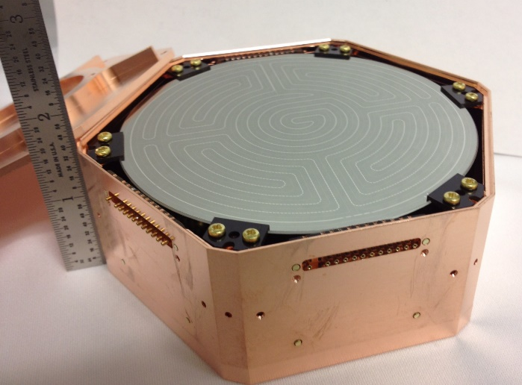

SuperCDMS
Implementation (SNOLAB setup)
6 detectors
→ 1 tower
HV
iZIP

Slide 11
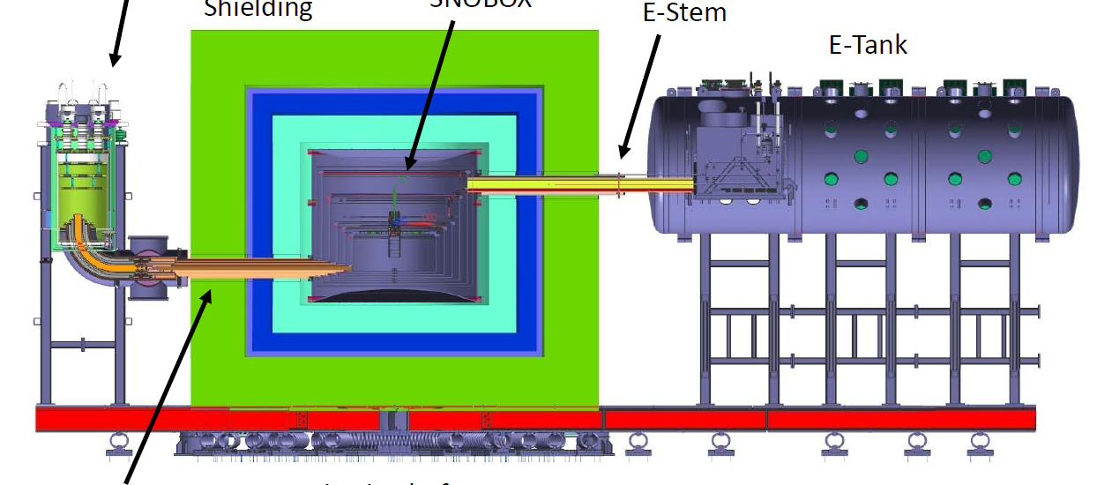
SuperCDMS
Implementation (SNOLAB setup)
Initial Payload:
2 HV towers (4 Ge/2Si)
1 Ge iZIP tower
1 Ge/Si iZIP tower (4/2)
Fridge to provide
<15 mK at the detector
Detector volume
(space for up to 31 “towers”)
6 detectors
→ 1 tower
30 cm HDPE
20 cm Pb
60 cm HDPE base / water
Signal vacuum
feedthroughs
Cold finger
Mounted on spring-loaded
platform (seismic isolation)
Additional cooling
(70 K/4 K)

Slide 12
SuperCDMS
SNOLAB
Clean
room
CUTE
Experimental area
Cryo
Backup
cooling
(ice)
Cryogenics
and radon
filter plant
Access
drift
Radon
filter

Slide 13
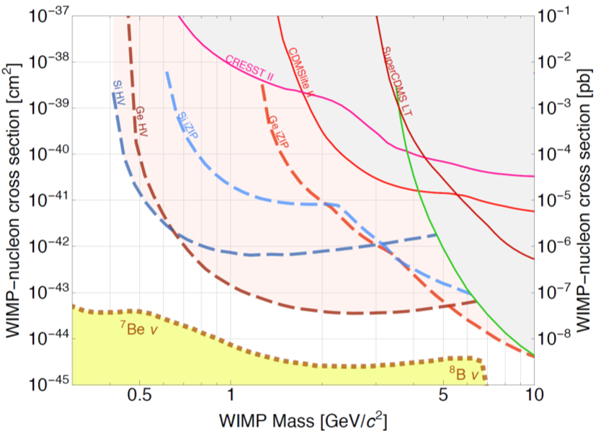
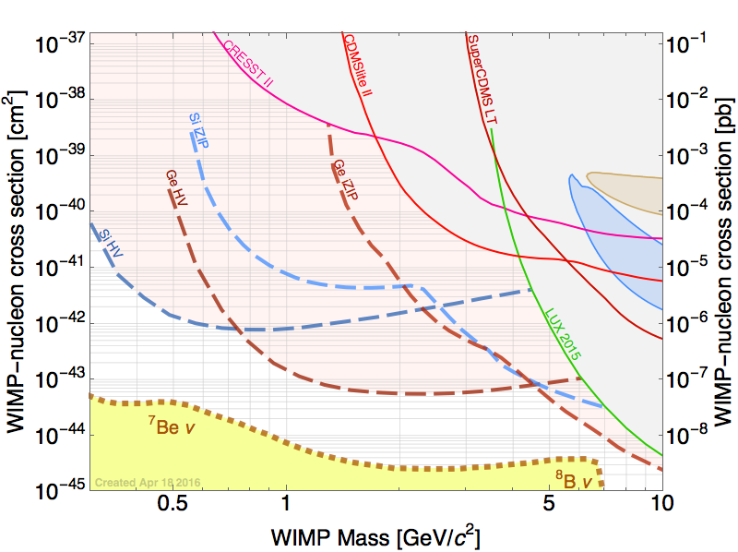
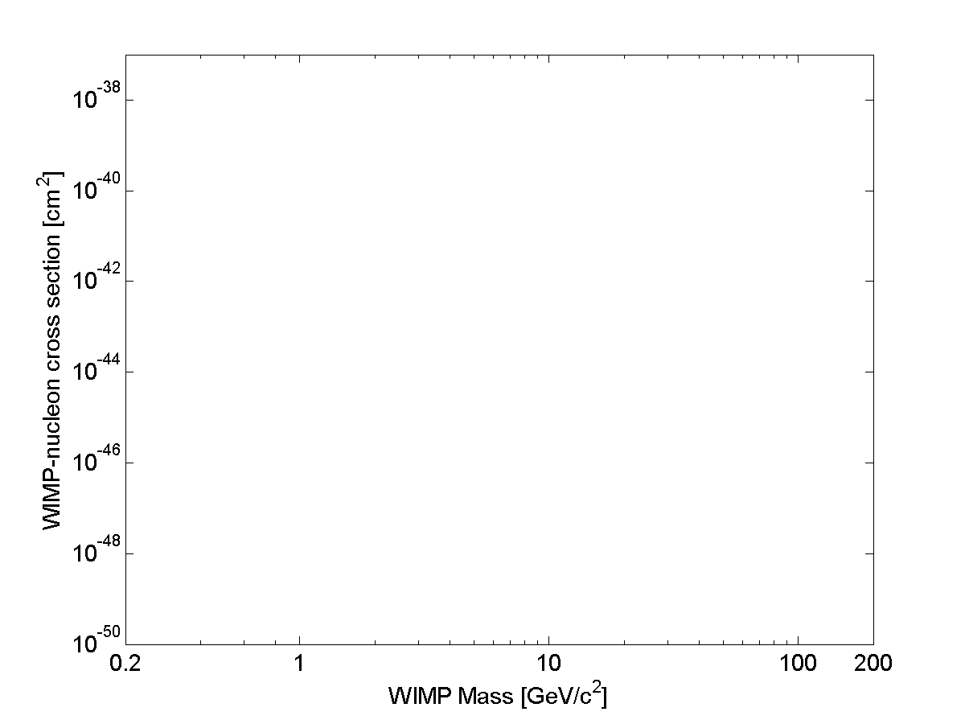
SuperCDMS
Goal
CRESST
2015
DAMIC 2016
Si iZIP
Ge iZIP
CDMSlite
2015
DAMA
Ge HV
Si HV
CDMS Si
DAMA
SuperCDMS LT 2014
CDMS II 2015
LUX 2013
Solar Neutrinos
LUX 2013
XENON1T 2017
DEAP
Longterm goal
LZ
Atmospheric Neutrinos

Slide 14
SuperCDMS
Schedule and Funding
2013
2014
2015
2016
2017
2018
2019
CFI approved
US G2 decision
CD 1
GW 2a
Main construction phase
CFI application
CD 2/3
CD 4
Start of
operation
DOE/NSF proposals
GW 1
CAP 17
Queen’s
GW 2
Funding approved (CFI: 2012, DOE/NSF: 2014)
DOE/NSF review process:
First step passed (CD 1: conceptual design review)
Next step end of 2017: technical design review/ready for construction (CD 2/3)
Reviews at SNOLAB:
passed Gateway 1 (space allocation) in fall 2015 / GW2a (early construction) in December 2016; upcoming: GW2 (construction) fall 2017
Total project costs ~$30M

Slide 15
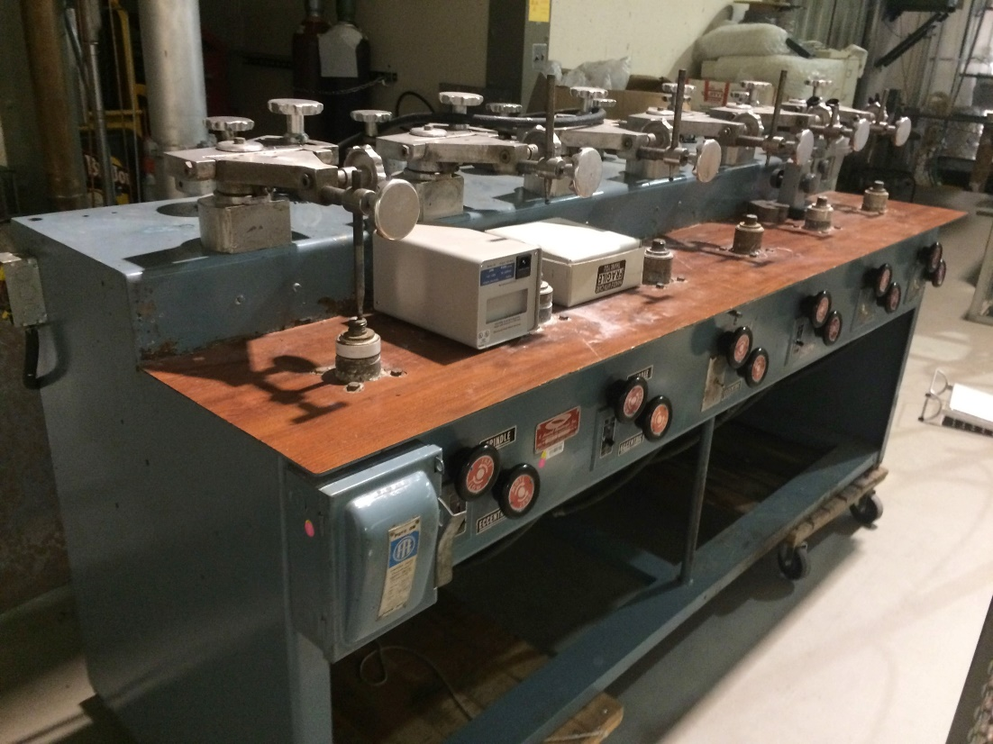

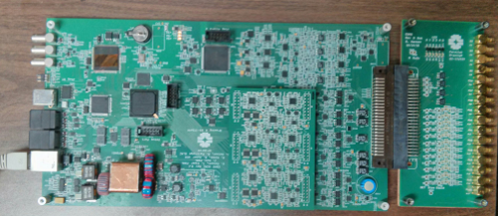
SuperCDMS
Developments (selection of activities)
Detectors: larger crystals; prototypes for both iZIP and HV detectors exist and have been tested using old electronics – good performance so far.
Detector tower (mechanical structure, wiring): design ready, mechanical prototype exists; wiring prototype exists – final version expected soon.
Readout electronics:
Preamp: thermal readout design ready; charge readout: circuits are being tested
“Warm electronics” (outside cryostat): prototype exists, tests underway
DAQ: MIDAS based, being developed at UBC with help from TRIUMF
and UofT [M. Wilson, POS-46]
Cryogenics design completed; shielding: design advanced,
Dilution refrigerator is procured
Backgrounds: extensive material screening; tracking and monitoring;
minimizing cosmogenic exposure; radon filter to be installed for
detector assembly cleanroom at SNOLAB. [S. Scorza, R1-3]
Shielded transport container
HV
Underground polishing
HV

Slide 16
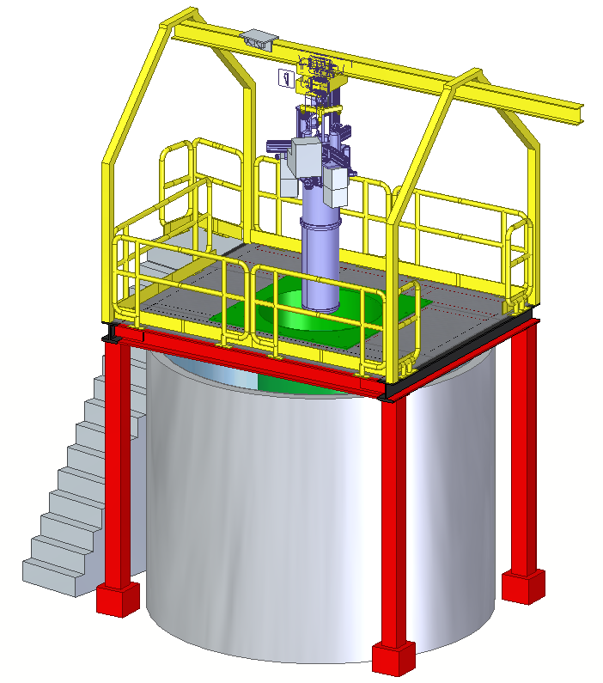

CUTE
Cryogenic Underground TEst facility (CUTE) – a Queen’s Project
Motivation
Detector performance:
Detector integrity after transportation
Background discrimination
Noise performance (impact of background)
Background studies
Confirm that screening program and
handling procedures are appropriate
Study cosmogenic backgrounds (³H, ³²Si)
Available for testing of other cryogenic detectors
for rare event searches (e.g. EURECA detectors for
integration with SuperCDMS)
Opportunity for early science! (BG O (few evt/keV/kg/d below 100 keV))
Schedule
Cryostat ordered, to arrive at Queen’s this summer
Infrastructure (water tank, platform, crane): ordered, installation starts in July
Sept/Oct: test cryostat at Queen’s; installation underground end of 2017
Commissioning: early 2018 (~2-3 years ahead of SuperCDMS)
Vibration
damping
Fridge: <10 mK
Pb
Water Shield

Slide 17
Analysis
Analysis Projects
Photo-Neutron calibration (low-energy nuclear recoil calibration); last “physics” measurement from Soudan (2015). Analysis under way (B. von Krosigk, UBC)
Backgrounds: Analysis of cosmogenic backgrounds in CDMSlite (³H and others)
Analysis in good shape; hope to publish this summer or fall (E. Fascione, Queen’s)
Rare interactions: follow-up of LIPs analysis (use CDMSlite data to improve our sensitivity for lower fractional charges?)
Annual modulation – long time coming; hopefully ready within the next 2-3 months
Standard WIMP search from SuperCDMS (full discrimination, intermediate to high mass range): not competitive with Xe for ‘vanilla WIMP’, but still important for more general models (EFT …); analysis essentially finished – publication in preparation
CDMSlite: detailed discussion of previous analysis [R. Underwood, POS-39] and incremental results (publication very soon)
Last CDMSlite data set – blinding scheme developed [X. Zhang, R3-4; 2:30 pm today], consider background modeling; analysis ongoing (W. Page, D. MacDonell, UBC)
Test sensitivity of detectors to vibrations [R. Germond, POS-33]
R & D at Queen’s: new calibration method using IR photons [M. Ghaith, M4-3]

Slide 18
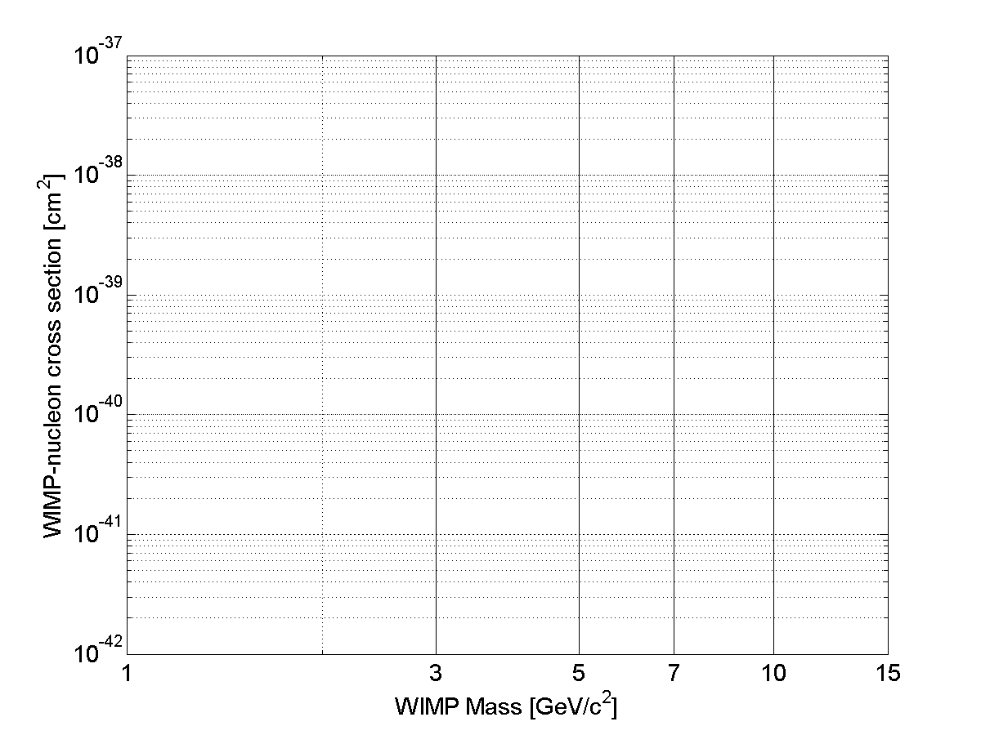
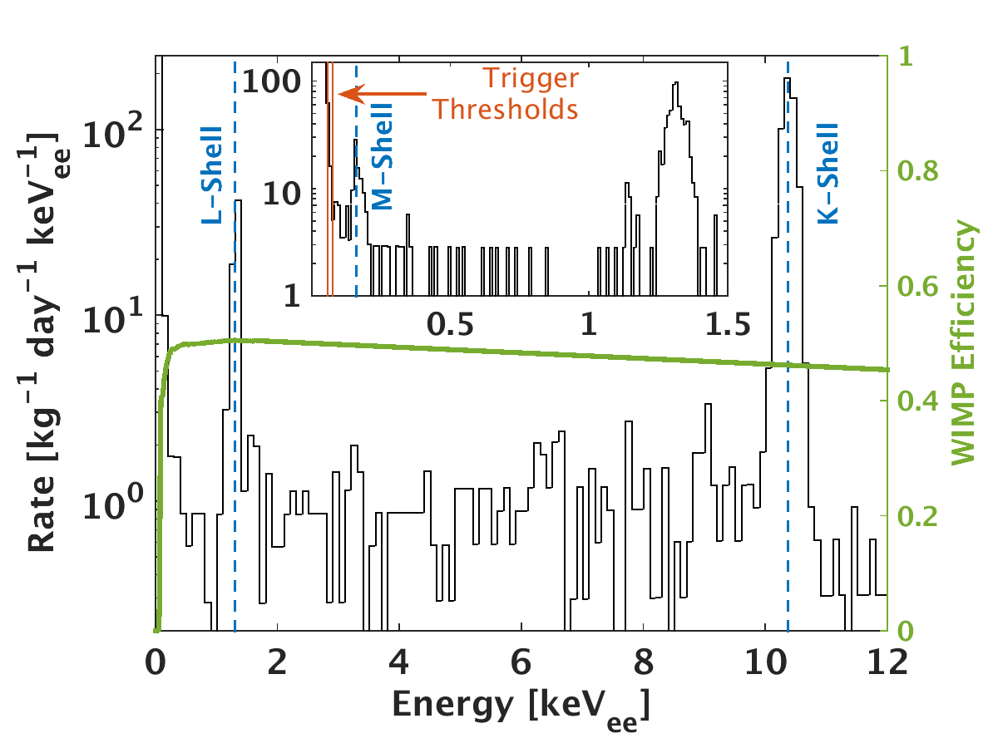
Analysis
CDMSlite
No background model
Optimum interval analysis
CDMSlite R1
SuperCDMS iZIP (LT)
Xe
CMDSlite R2
DAMIC
CRESST 2015
CDMSlite R2
CoGeNT
CDMSlite R3
Less exposure
Moderately lower threshold
Background model
CDMS Si

Slide 19
Conclusions
SuperCDMS SNOLAB aims at detecting dark matter WIMPs
Main focus are low-mass WIMPs (< 10 GeV/c²)
Project planning well under way
Main R&D is done, full technical design close to completion
Start of operation expected in 2020
Initial payload: ~30 kg, significant push in threshold and sensitivity
Upgrades (improved HV detectors, EURECA detectors, …) will allow us to reach the neutrino floor at low mass and/or check discovery claims at high mass
CUTE: Queen’s initiative for an underground test facility, operational in early 2018
(detector performance studies, background checks, early dark matter science)
Analysis: many updates in the pipeline; small steps until new facilities come online

