Slide 1
Ultracold Neutrons at TRIUMF
J. Martin
The University of Winnipeg
S. Ahmed^{3,4}, E. Altiere², T. Andalib^{3,4}, C. Bidinosti^{3,8}, J. Birchall⁴, C. Davis⁵, M. Gericke⁴,
S. Hansen-Romu^{3,4}, K. Hatanaka⁶, T. Hayamizu², B. Jamieson³, D. Jones², K. Katsika⁵, S. Kawasaki¹,
T Kikawa^{5,6,1}, A. Konaka^{5,8}, E. Korkmaz⁷ , M. Lang³, T. Lindner^{5,3}, L. Lee^{4,5}, K. Madison², J. Mammei⁴,
R. Mammei^{3,5}, J. Martin³, R. Matsumiya⁶, E. Miller², T. Momose², S. Page⁴, R. Picker^{5,9}, E. Pierre^{6,5},
W. Ramsay⁵, L. Rebenitsch^{3,4}, J. Sonier⁹, I. Tanihata⁶, W.T.H. van Oers^{4,5}, Y. Watanabe¹,
and J. Weinands²
¹KEK, Tsukuba, Ibaraki, Japan
²The University of British Columbia, Vancouver, BC, Canada
³The University of Winnipeg, Winnipeg, MB, Canada
⁴The University of Manitoba, Winnipeg, MB, Canada
⁵TRIUMF, Vancouver, BC, Canada
⁶RCNP, Osaka, Japan (Osaka University, Osaka, Japan)
⁷The University of Northern BC, Prince George, BC, Canada
⁸Osaka University, Osaka, Japan
⁹Simon Fraser University, Burnaby, BC, Canada

Slide 2
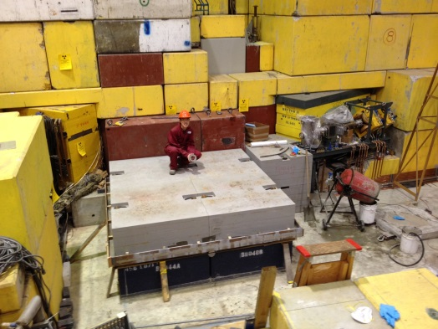
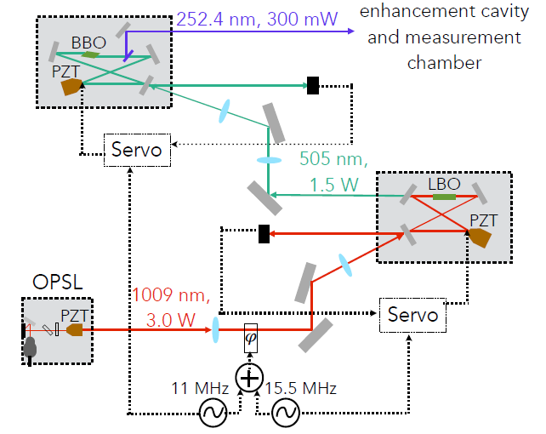
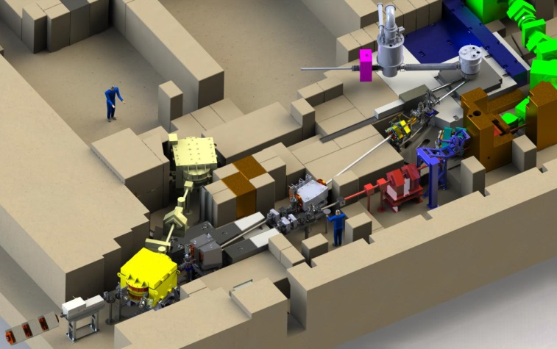
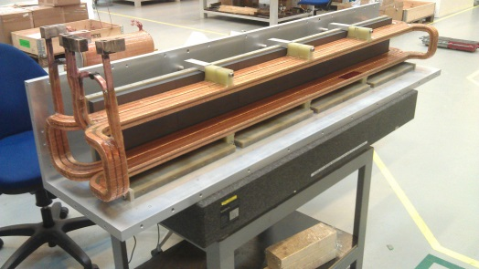
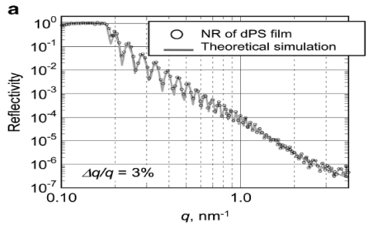
UCN/nEDM at TRIUMF
Overview:
  Spallation-driven superfluid-helium UCN source connected to room-temperature nEDM experiment.
  Goal sensitivity:
  δd_{n} ~ 10⁻²⁷ e-cm (“Phase 2”)
Recent/upcoming progress:
  Ongoing nEDM R&D: magnetic fields, comagnetometry with ¹²⁹Xe- ¹⁹⁹Hg, UCN guides, EDM cell/HV.
  Most components (incl. cold moderator cryostat from Japan) at TRIUMF and prepped.
  Superfluid cryostat by this fall.
  CFI IF proposal for UCN source upgrade and nEDM expt. in prep.
Comagnetometer laser reached
300 mW
Shielding base layer installed
UCN source
UCN guide tests @ J-PARC & PSI this summer
Kicker installed, commissioning
500 MeV
protons
Facility as expected in Sept. 2016

Slide 3
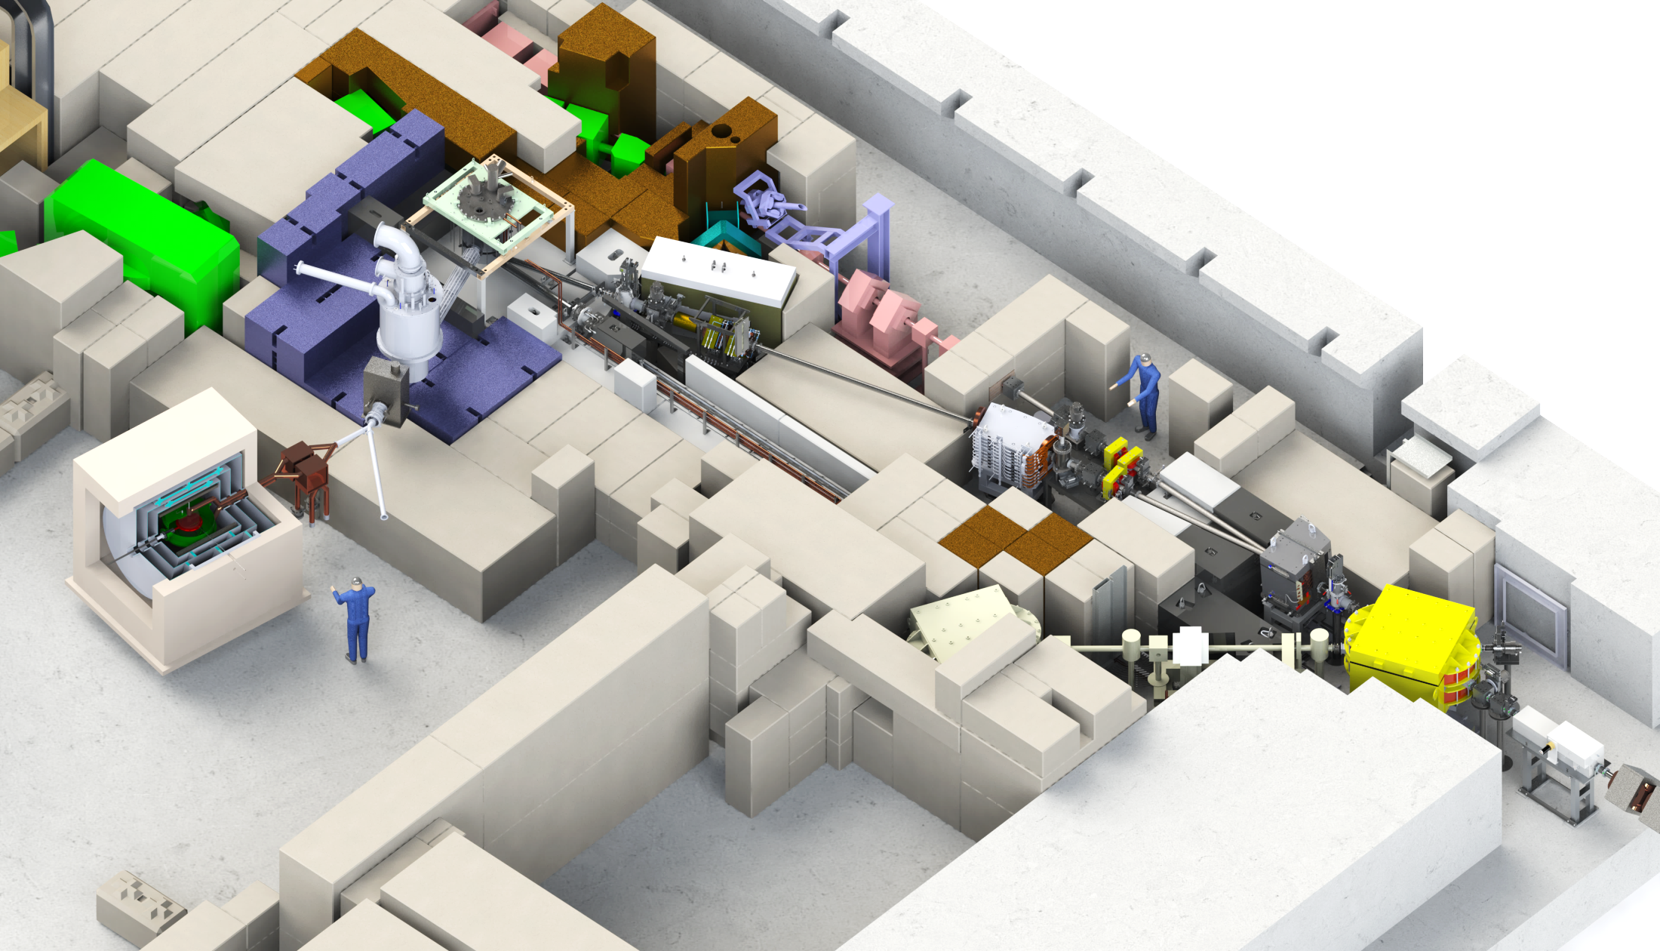

Ultra-Cold Neutrons and the Electric Dipole Moment
2016
Helium cryostat
cools He to < 1 K and neutrons to mK
2015
Quads
Diagnostics
2014
Bending dipole
deflects beam by 7° more
2014
Lambertson septum
deflects upper beam by 9° to the left into BL1U
Phase 2EDM experiment
Passive shielding
coils
EDM cell
Tungsten target + extraction system
HT SC Magnet
100% UCN polarization
2016
2016
2016
Kicker magnet
Deflects every third proton bunch upwards
Status
UCN source
    Beamline finished by May 2016
    Installation of UCN source components by end of 2016
EDM experiment
    Phase 1 coming from Japan in 2017
    Phase 2 developed in Canada (CFI proposal this year) for 2019
Phase 1: 2017
Phase 2: 2019
UCN facility in the Meson hall at TRIUMF

Slide 4
Calendar year
quarter
2015
2016
2017
2018
1 2 3 4
1 2 3 4
1 2 3 4
1 2 3 4
1
UCN
move D₂O
to TRIUMF
move He-II
to TRIUMF
@RCNP
@TRIUMF
UCN development
Safety upgrades
Beamline,target,shielding install
Source install/commission
LD₂ upgrade
EDM
@RCNP
@TRIUMF
EDM development
move to TRIUMF
EDM
install
EDM Phase 1
EDM R&D for Phase 2
EDM Phase 2

Slide 5
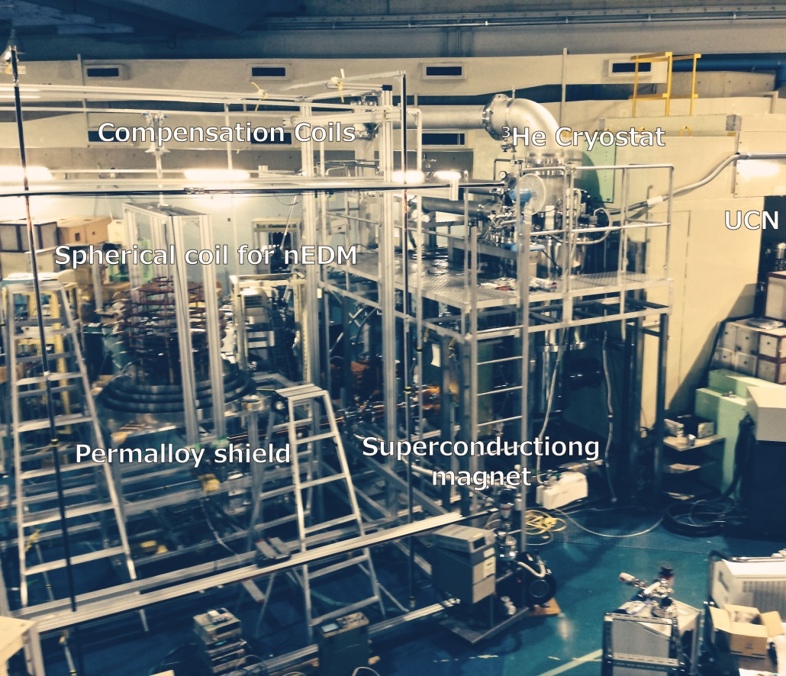
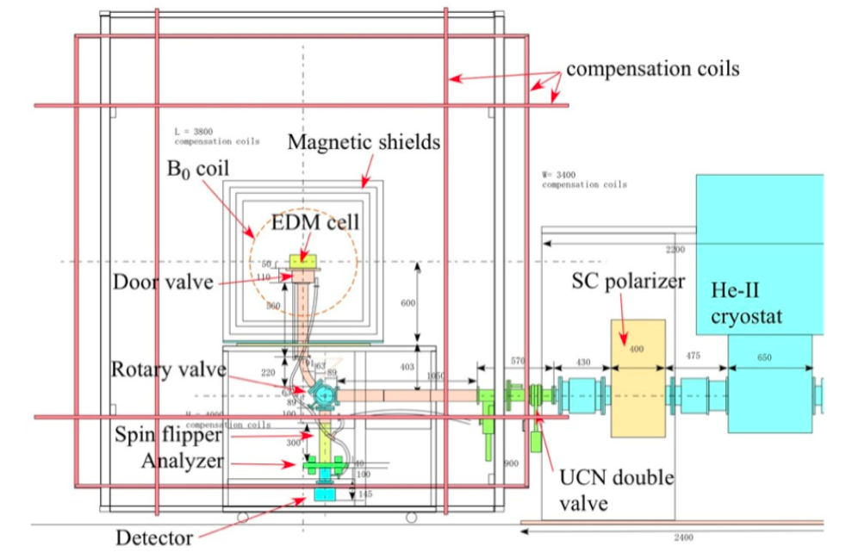
“Phase 1” – what will exist in 2017
use existing EDM Ramsey apparatus from RCNP, Osaka
exploit higher UCN density at TRIUMF (also more beamtime available)
room temperature, 1 small cell, vertical loading, spherical B₀ coil
small incremental improvements until replaced by Phase 2
  Active magnetic compensation system
  high voltage
  comagnetometer
  high-flux detector
ca 1 m
EDM Phase 1 schematic
EDM Phase 1 at RCNP

Slide 6
“Phase 2” – to implement by 2020
LD₂ moderator, to increase cold flux entering the superfluid
New high-quality UCN guides, and coating facility.
World-competitive nEDM experiment apparatus
Possibly a new superfluid helium UCN source (depends on funding)
CFI Innovation Fund application in progress. Scale $14M.

Slide 7
Updates
UCN facility construction at TRIUMF
  See also:
    L. Lee – Weds. 9:30 am – “TRIUMF UCN Facility”
    T. Kikawa – Weds. 9:45 am – “First neutron experiments at the new UCN beamline”
nEDM R&D
  See also:
    J. Martin – Thurs. – “Neutron EDM at TRIUMF”

Slide 8
UCN Facility reminder

Slide 9
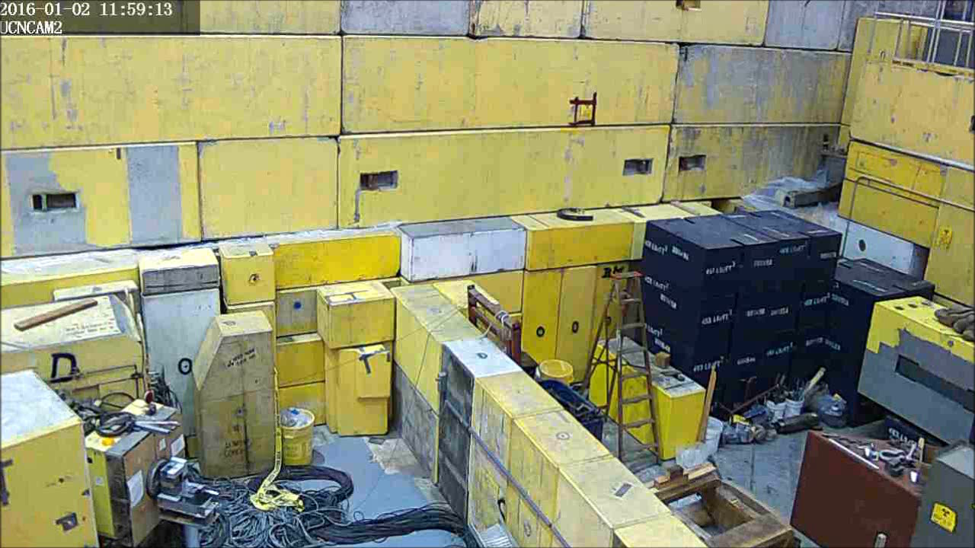
Meson Hall progress, January 3 – February 29, 2016

Slide 10
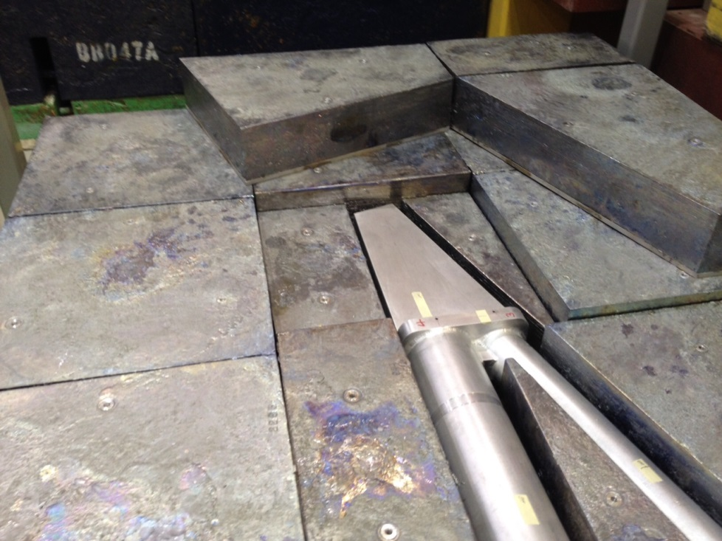
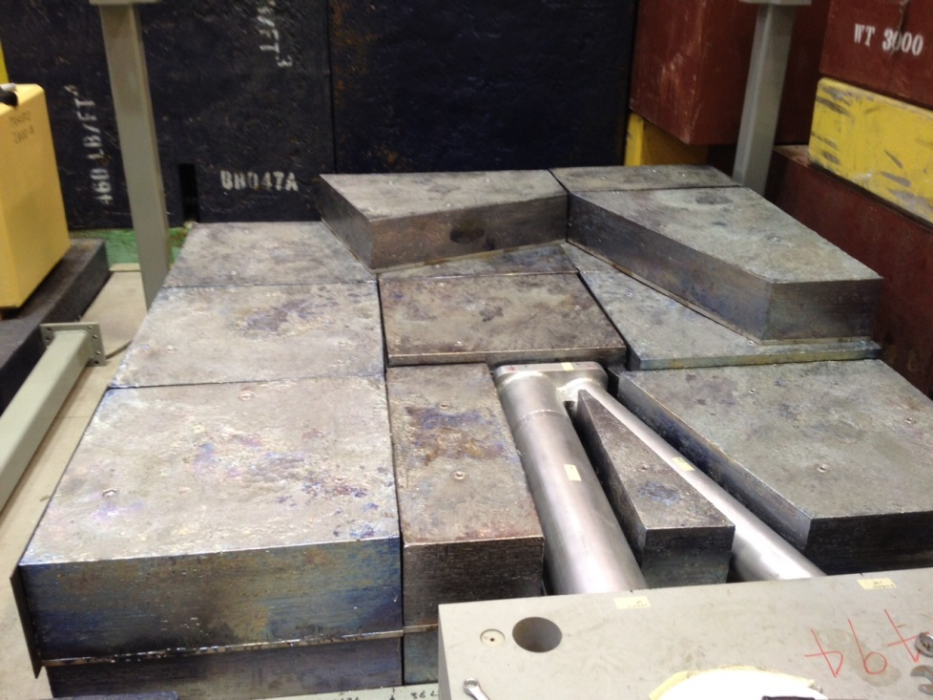
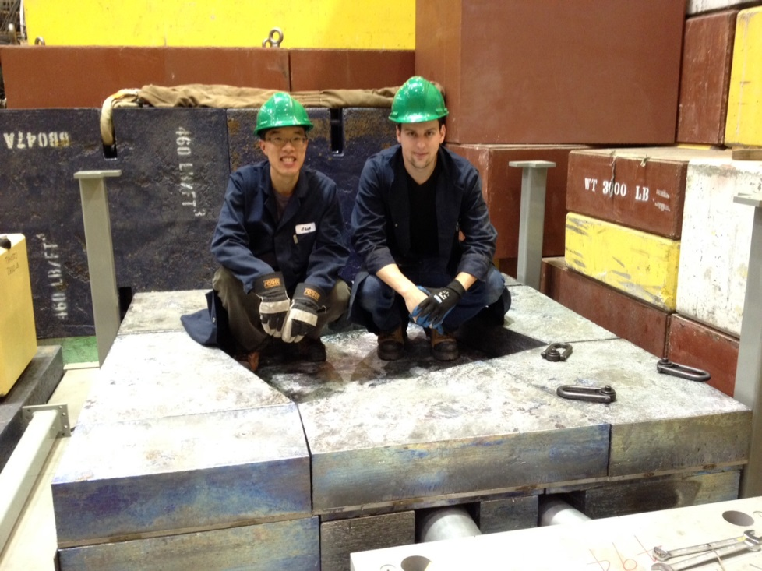
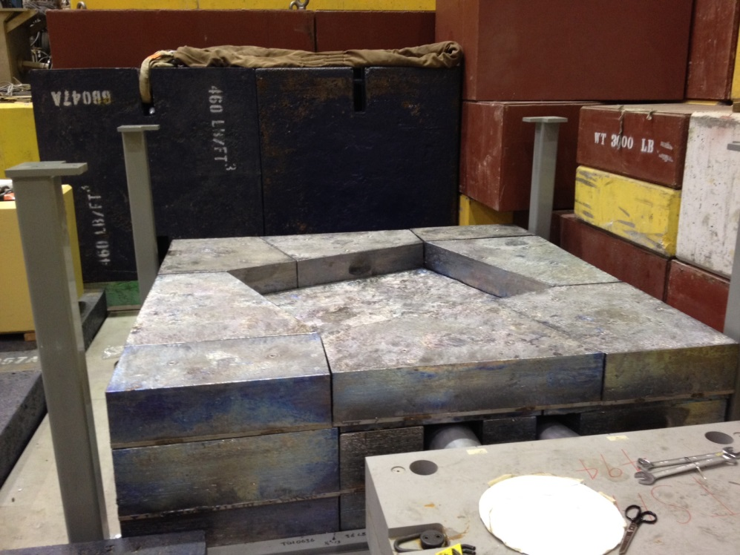
UCN Source: Pb Moderator/Reflector
Target Crypt (before covering)
Apr.25/2016
Target Crypt (partially covered)
Lead Moderator/Reflector completed

Slide 11
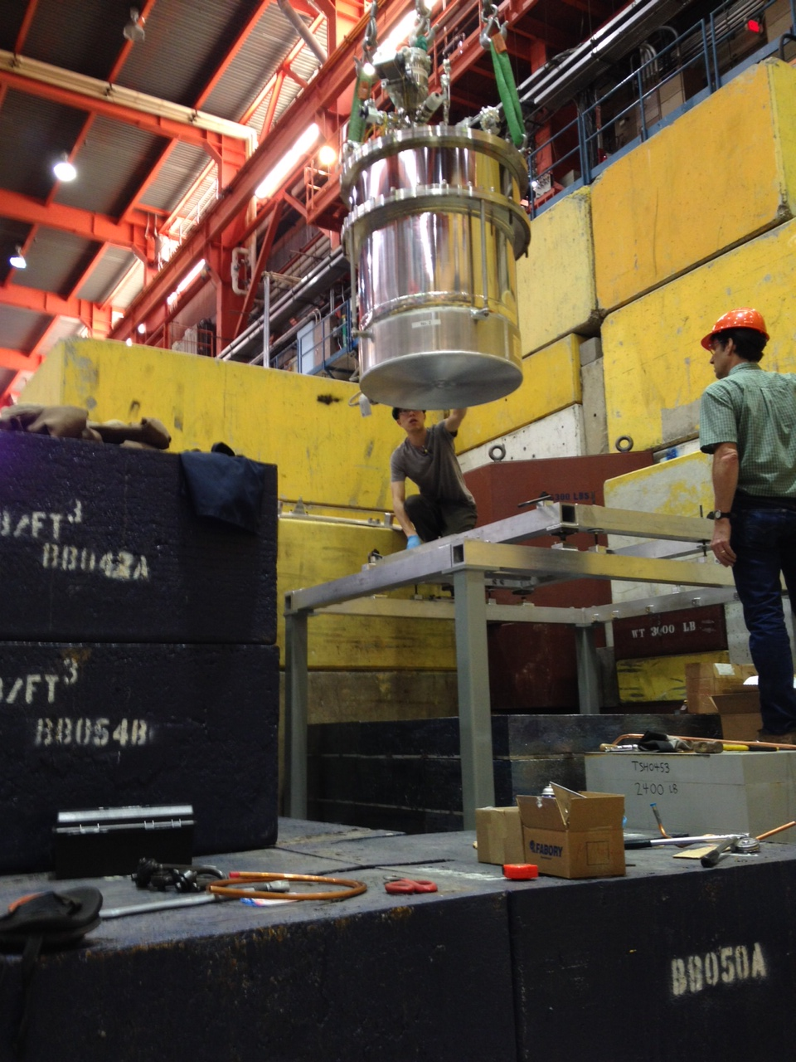
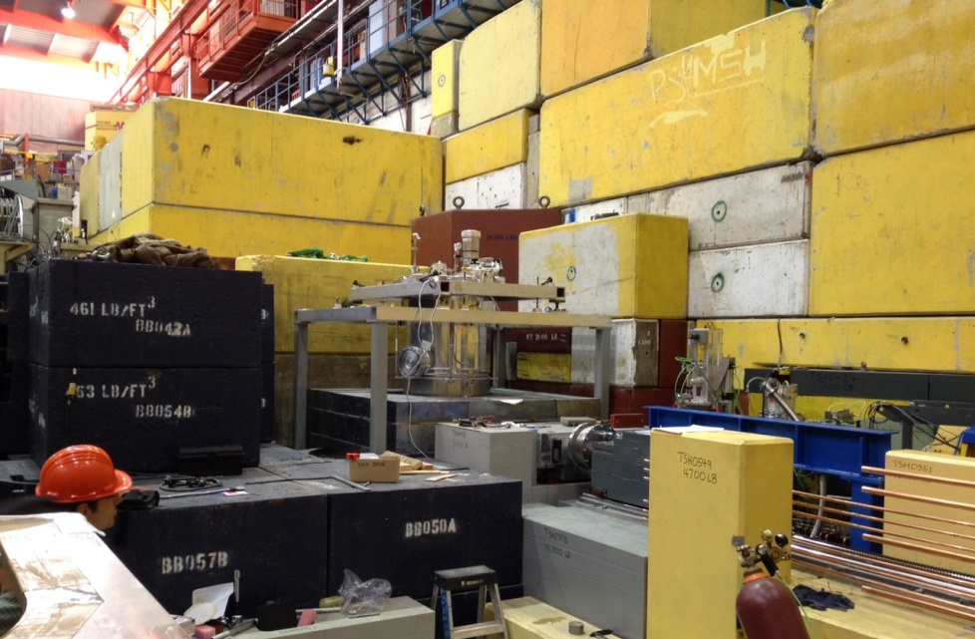
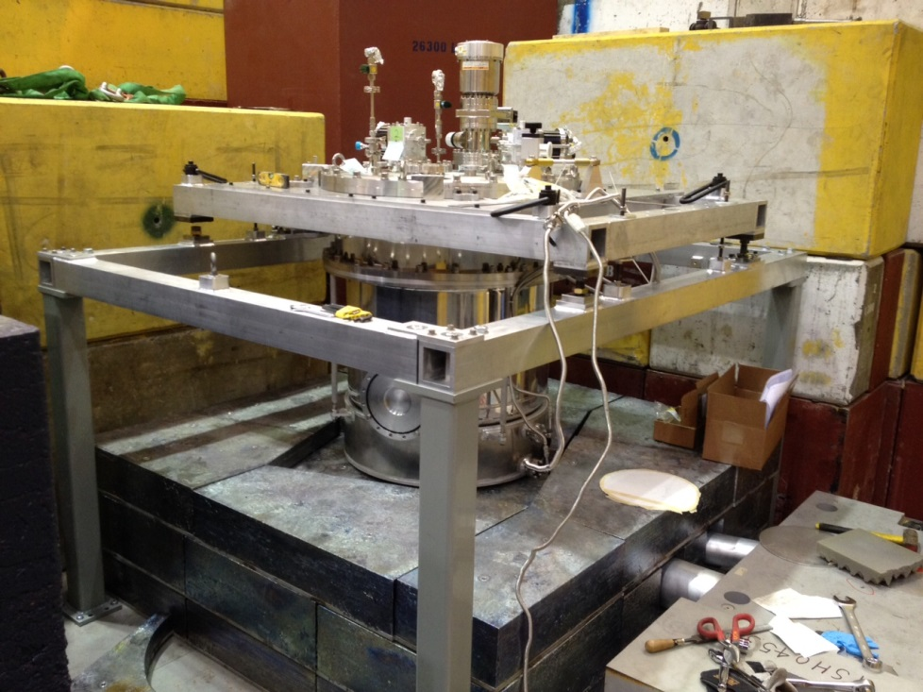
D₂O Cryostat Installation
Apr.28/2016
D₂O Cryostat installed
D₂O Cryostat being craned into support structure

Slide 12
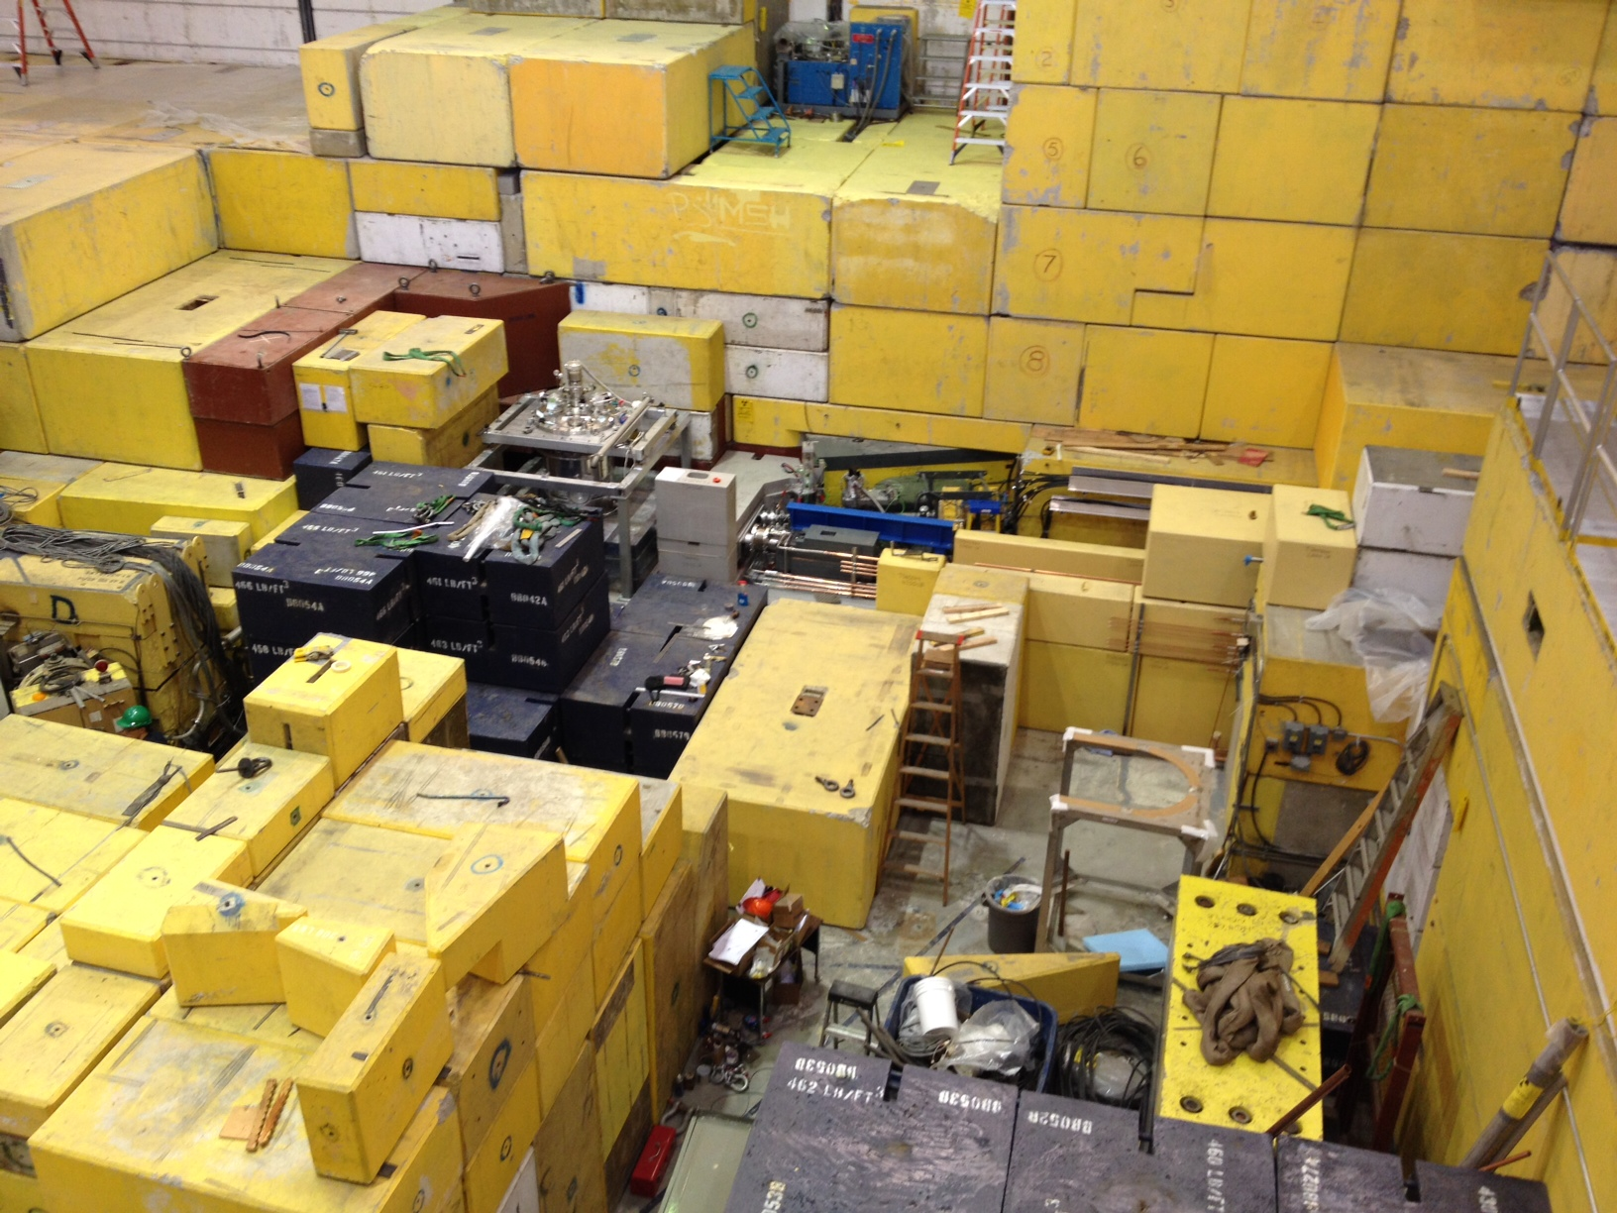
BL1U Downstream & UCN Source Front-End
12
May 2/2016
D2O Cryostat
BL1U
Downstream
Target
R/H system

Slide 13
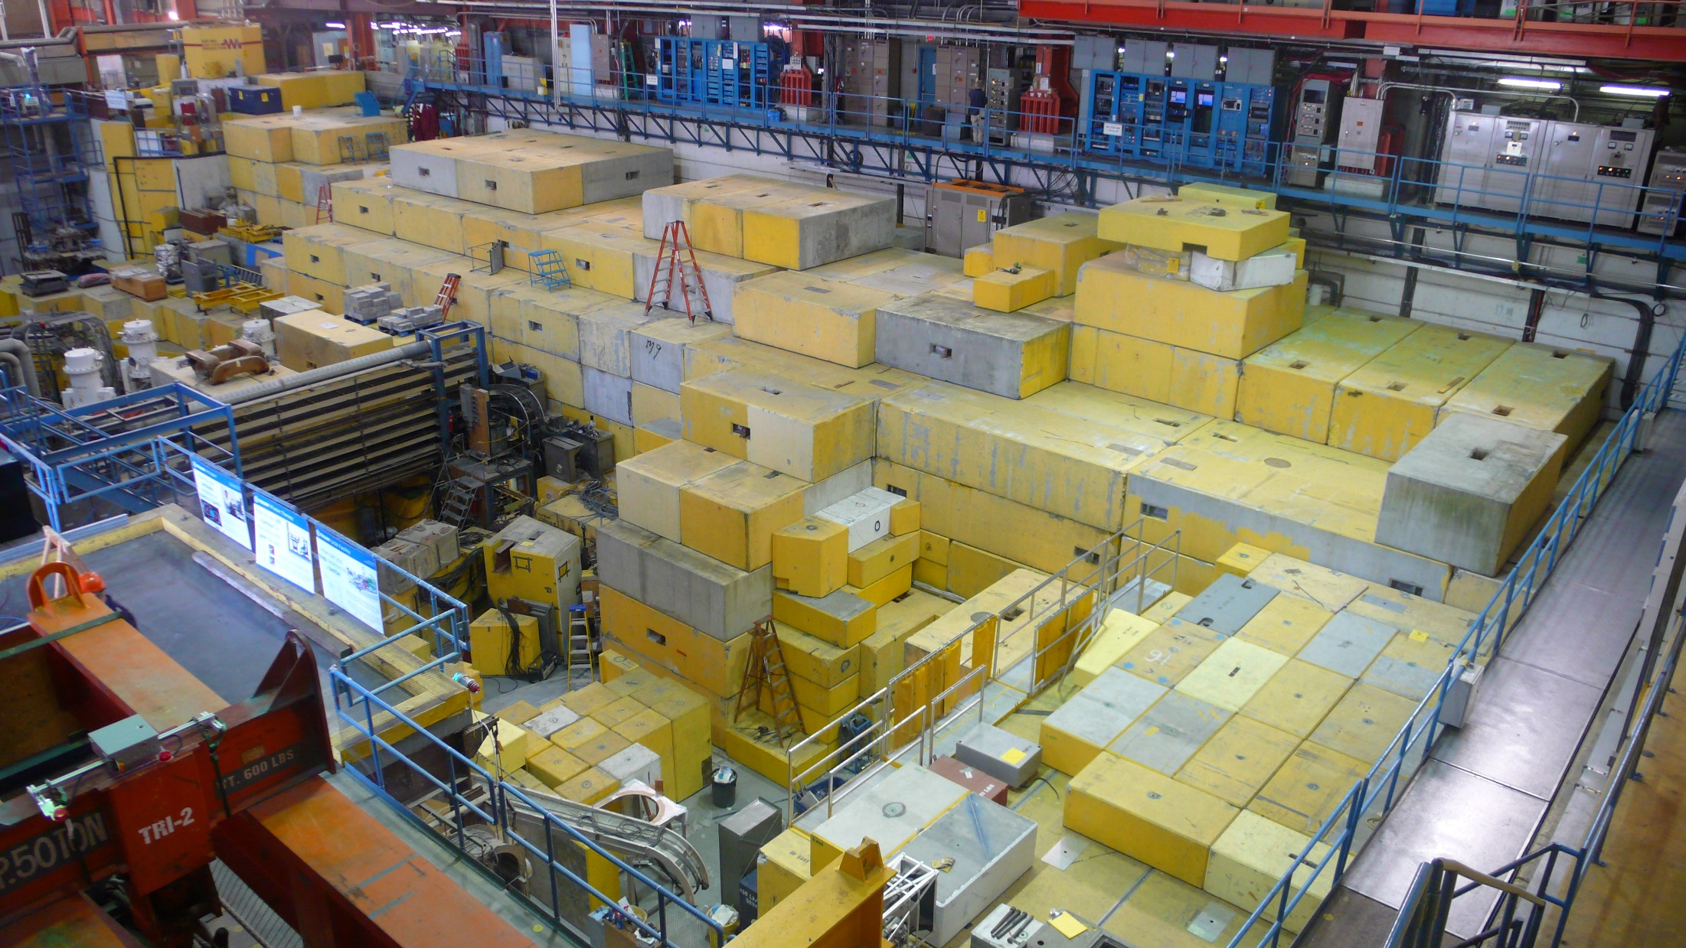
Meson Hall & UCN Facility (After Closing Up)
13
May 12/2016

Slide 14
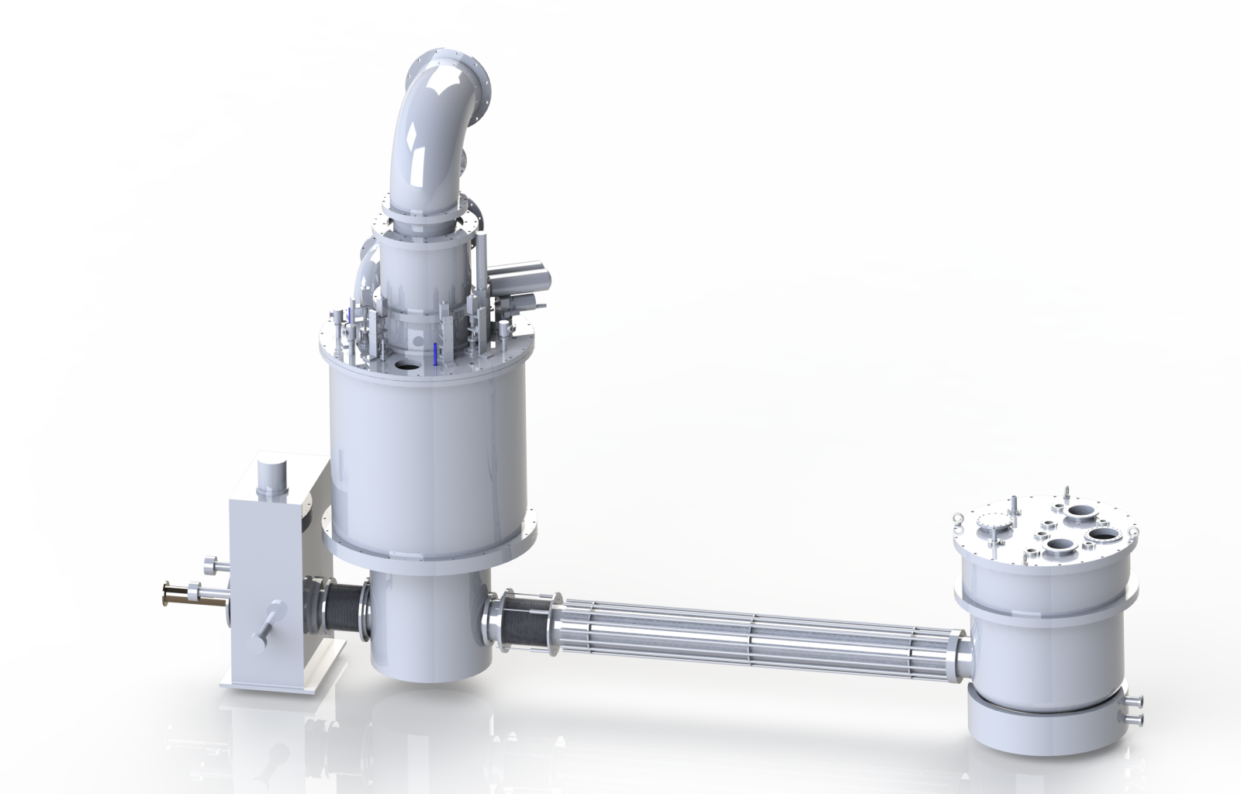
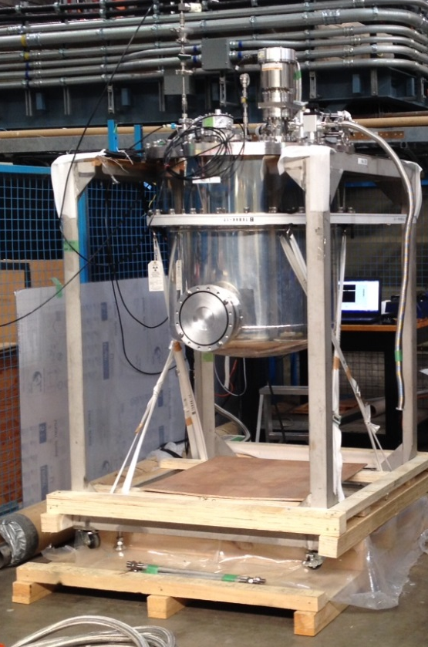
UCN Source
UCN Source (Integration):
D₂O cryostat arrived at TRIUMF (Nov. 23, 2015)
He-II cryostat modifications to meet NA safety standards (relief, venting details)
Main modifications being done in Japan
D₂O cryostat
He-II
cryostat
West loading bay
(p-Hall extension)
Superconducting
polarizer
Warm D₂O tank
D2O cryostat at TRIUMF; Vacuum tests & prep for cold tests; plan for late-March install.^{n}
1st shipment of warm (graphite) moderator arrived; 2nd shipment arrived Feb.19, 2016
Heavy water shipment in 2016
He-II Cryostat delivery to TRIUMF August 2016, First UCN late 2016.

Slide 15
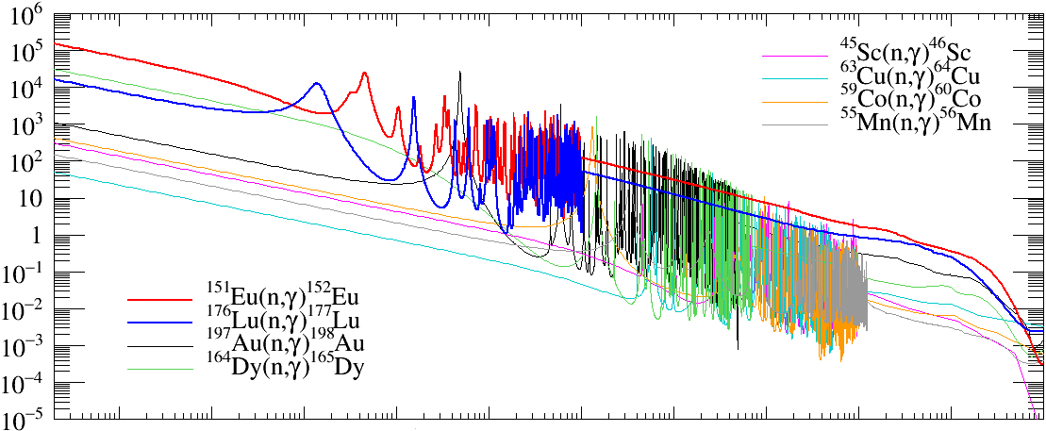
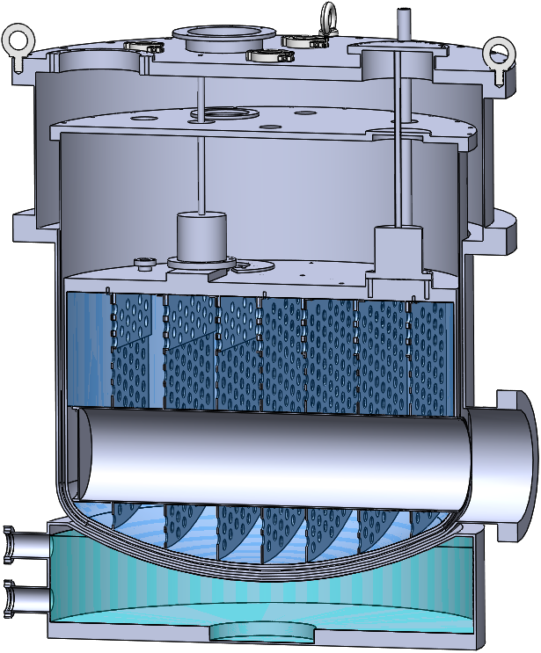
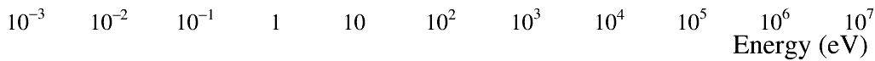
Idea to measure CN flux:
Foil Activation
T. Kikawa
Plans for startup
UCN source geometry not amenable to chopper/TOF meas’t
Activation cross section
Ice D₂O
Idea: use non-1/v foils (Eu, Lu) relative to Au, to unfold the CN flux.
Problem: activation cross-sections not well known.
Plan to measure at J-PARC
UCN bottle
Warm D₂O
Spallation target

Slide 16
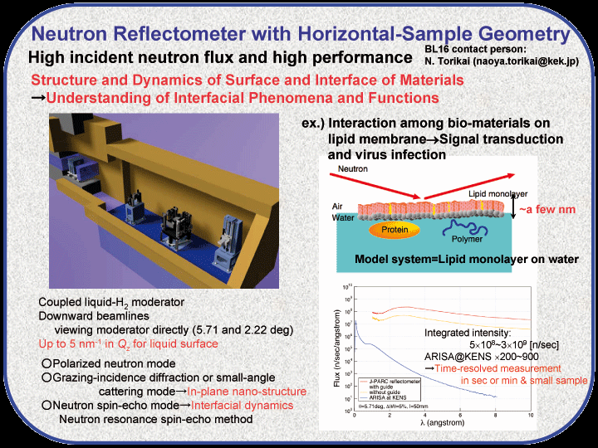
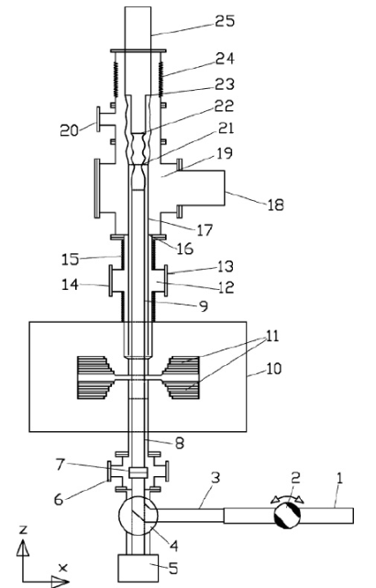
UCN Guide Production
Staged Approach:
Install current robust technology with UCN source in 2016:
  NiMo (~215 neV) coated guides (from T. Lauer) as requested in NSERC proposal.
Investigating new coating technologies in collaboration with private industry.
V_{F} measurements at JPARC (June 2016):
NiP, DLC, Ni58, and Ni
UCN Depolarization and Loss per Bounce measurements at PSI (Summer 2016): NiP, DLC
Sofia/BL 16 Instrument at JPARC
Depolarization measurement setup at PSI
Plan to create a guide coating facility at U. Winnipeg capable of producing DLC-coated guides.
Expertise of new faculty member R. Mammei (UW/TRIUMF).
UCN guide technology is a finicky business requiring pristine surfaces and coatings. Main R&D is on reproducible, robust, smooth coatings.

Slide 17
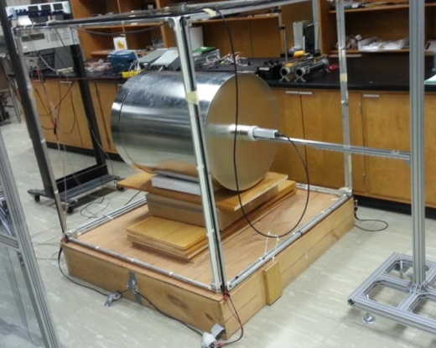
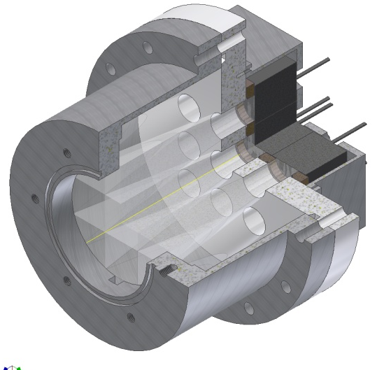



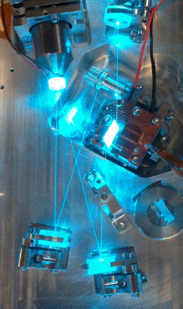
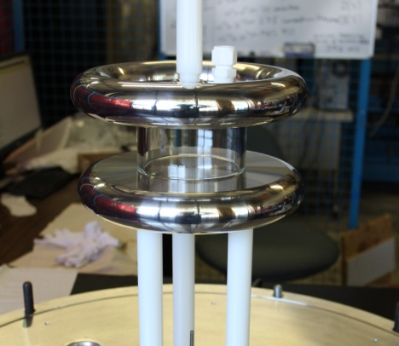


Canadian nEDM R&D
17
Magnetic environment
UCN detection
Lightguides
active shielding
passive shielding
creation of stable, homogeneous B fields
Precision atomic magnetometry and SQUIDs
Need faster detectors
Li glass scintillators + lightguide + PMTs
Test run in August 2015 at PSI
R&D towards dual detectors which count both spin states simultaneously.
Cylindrical shells of the 4 layer FM shield
  n+⁶Li→³H (2.74 MeV) +⁴He (2.05 MeV)
UCNA @ LANL
Li glass
PMTs
Dual Co-magnetometer
UCN detection scheme
Hg, Xe polarisation
laser development
2-photon transition requires development of intense CW UV lasers.
Xe EDM measurement
Electric field, UCN cell
dielectric strength of Xe at 10⁻³ mbar unknown
50x100 mm cylindrical test cell
gas breakdown studies
material studies
HV test cell
0.1 m

Slide 18
Summary
UCN source & proton beamline installation to be completed calendar 2016.
R&D progress for the nEDM experiment.
Phase 1 nEDM operating by 2017
Phase 2 aiming at 10⁻²⁷ e-cm precision, CFI IF application in prep.

