Slide 1
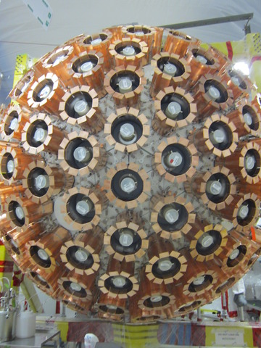
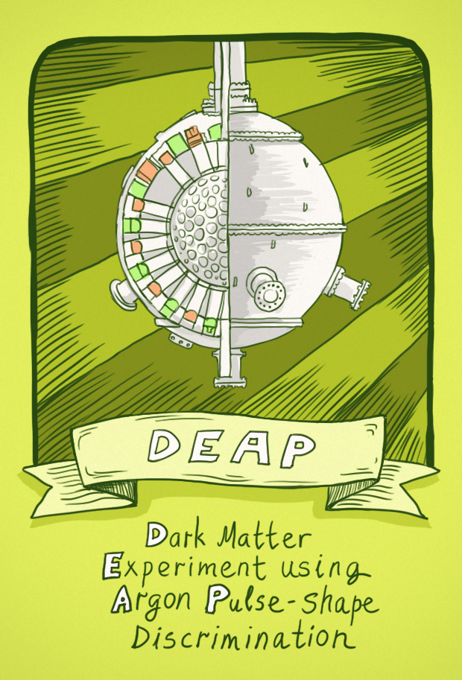
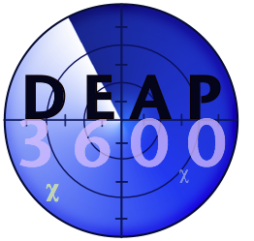
DEAP-3600 Dark Matter Search at SNOLAB
@
Mark Boulay
Carleton University
Queen’s University

Slide 2

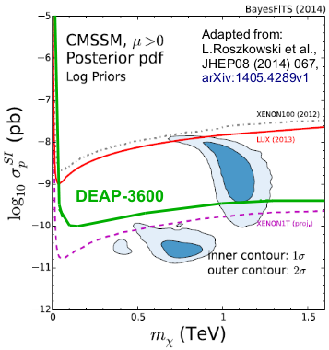
DEAP-3600 Dark Matter Search
Liquid Argon for DM (Single-phase)
Scattered nucleus detected via scintillation in LAr
Good Pulse-shape discrimination between
β/γ and nuclear recoils with scintillation
Argon is easy to purify
Very large target masses possible, no
absorption of UV scintillation photons
in argon, no pileup until beyond tonne-scale
Position reconstruction allows surface background removal, based on photon detection (~5 cm resolution allows removal
of radon daughter events from analysis)
DM Sensitivity
1 tonne fiducial mass (3.6 tonnes total) designed for < 0.2 background events/year with 60 keVr
threshold
⁴⁰Ar
χ
⁴⁰Ar
χ

Slide 3
DEAP-3600 Detector
3600 kg argon
in sealed ultraclean
Acrylic Vessel (1.7 m ID)
Vessel is “resurfaced”
in-situ to remove
deposited Rn daughters
after construction
255 Hamamatsu
R5912 HQE PMTs 8-inch
(32% QE)
50 cm light guides +
PE shielding provide neutron moderation
Steel Shell immersed in 8 m water shield at SNOLAB
v. high coverage of
light-sensors, 80%
strict radiopurity
control
3.5 meters

Slide 4










DEAP Collaboration: 65 researchers in Canada, UK, and Mexico

Slide 5
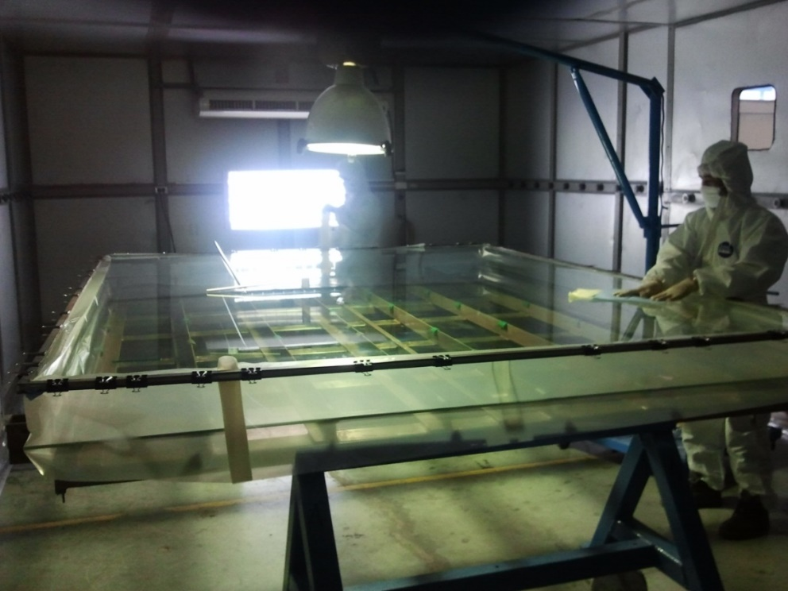
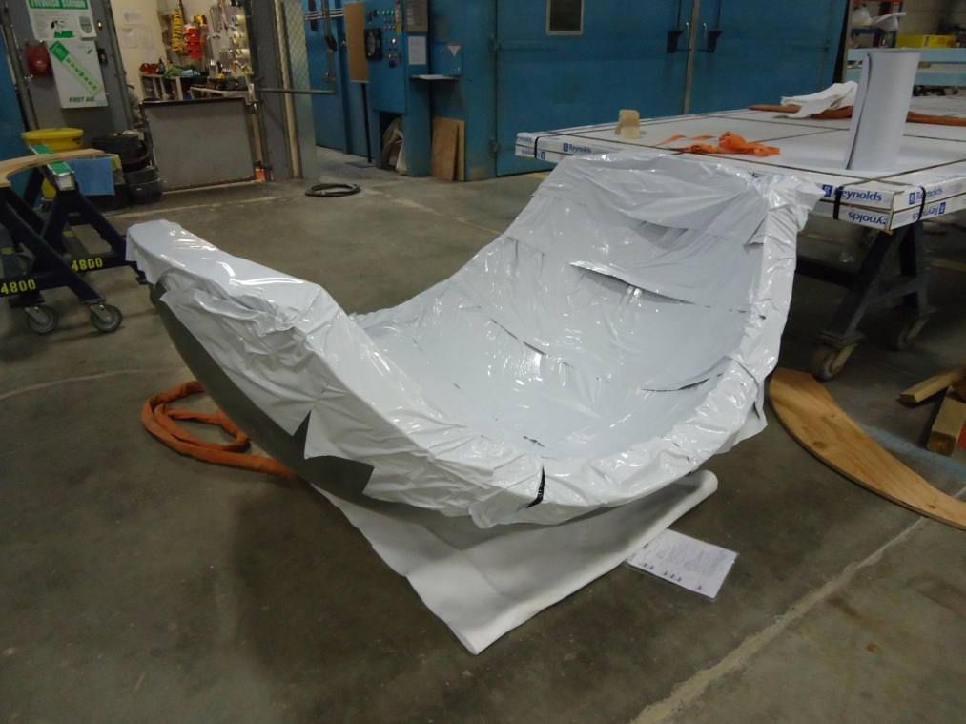
Fabrication and Assay of DEAP Acrylic
Fabrication from pure MMA monomer at RPTAsia (Thailand), strict control of radon exposure for all steps, to < 10⁻²⁰ g/g ²¹⁰Pb (RPT was fabricator of the SNO Acrylic Vessel)
Assay of production acrylic < 2.2x10⁻¹⁹ g/g ²¹⁰Pb
(Corina Nantais M.Sc. Thesis 2014, <0.2 bkg events/3 years)
Monomer cast at RPT Asia, 2010
Thermoformed Panel at RPT Colorado

Slide 6
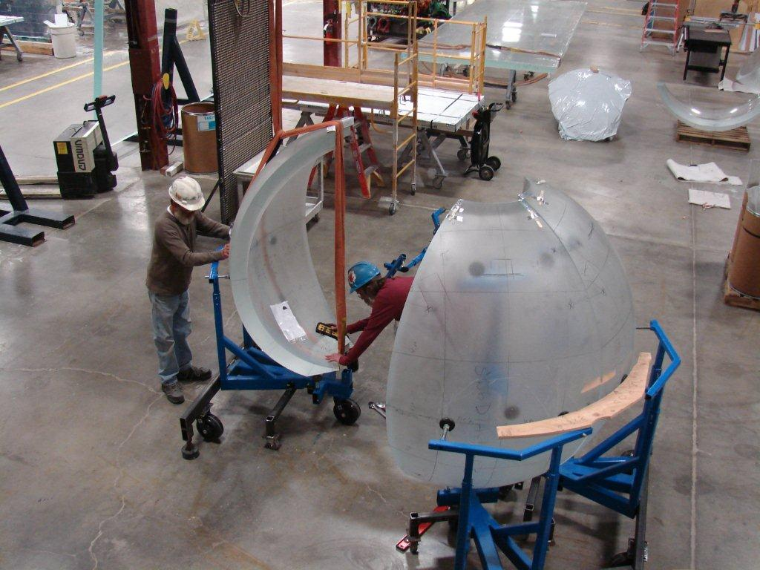
DEAP Acrylic Vessel, Panel Sections at Reynolds Polymer, Colorado

Slide 7
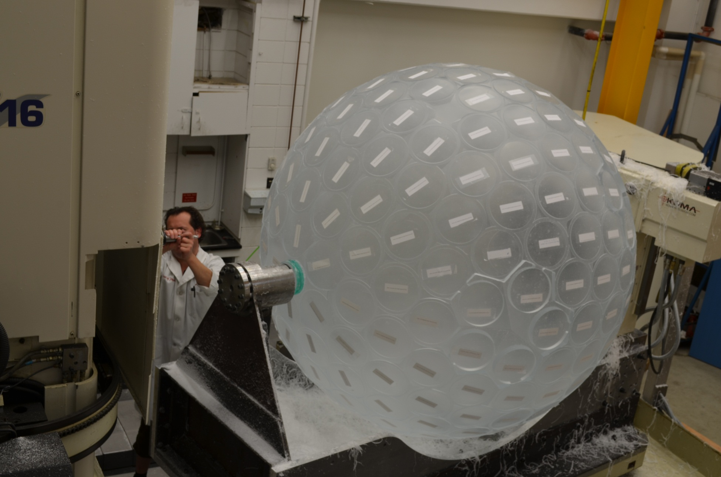
DEAP Acrylic Vessel with Light Guide “Stubs” July 2012, U Alberta

Slide 8
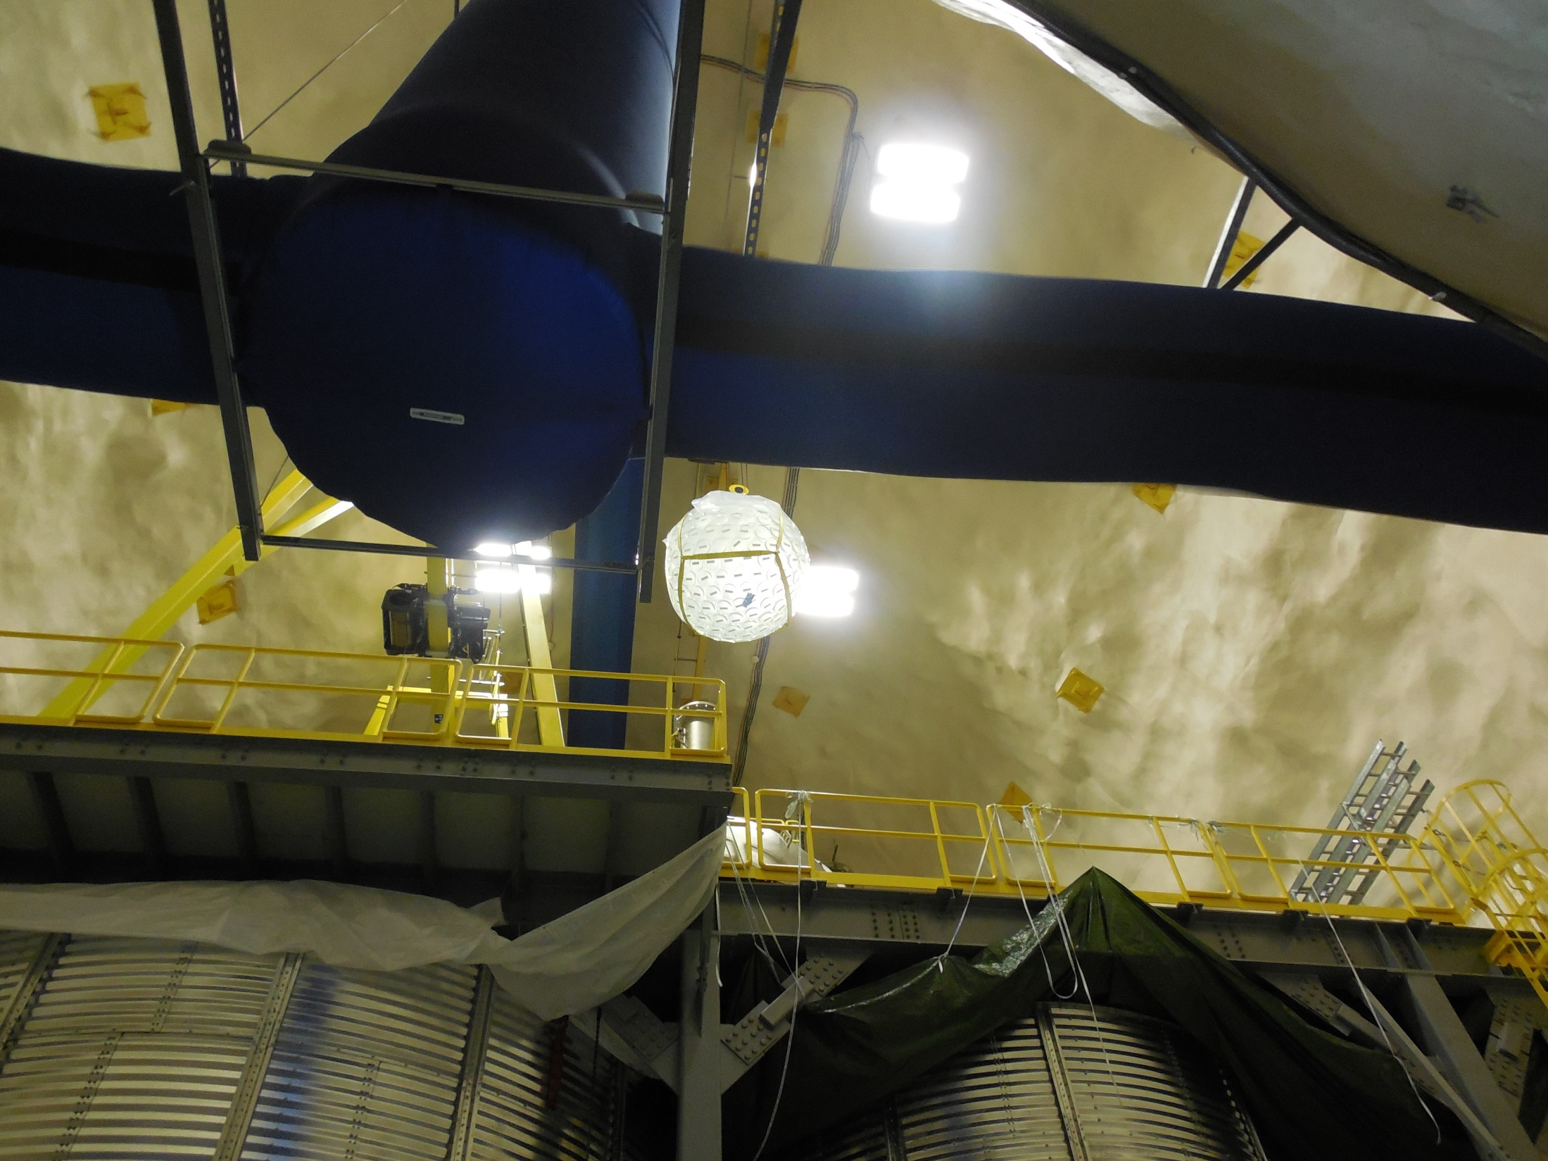

Slide 9
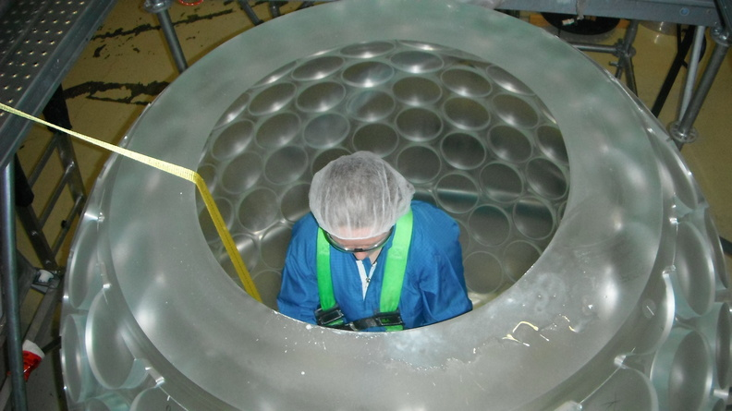

Slide 10
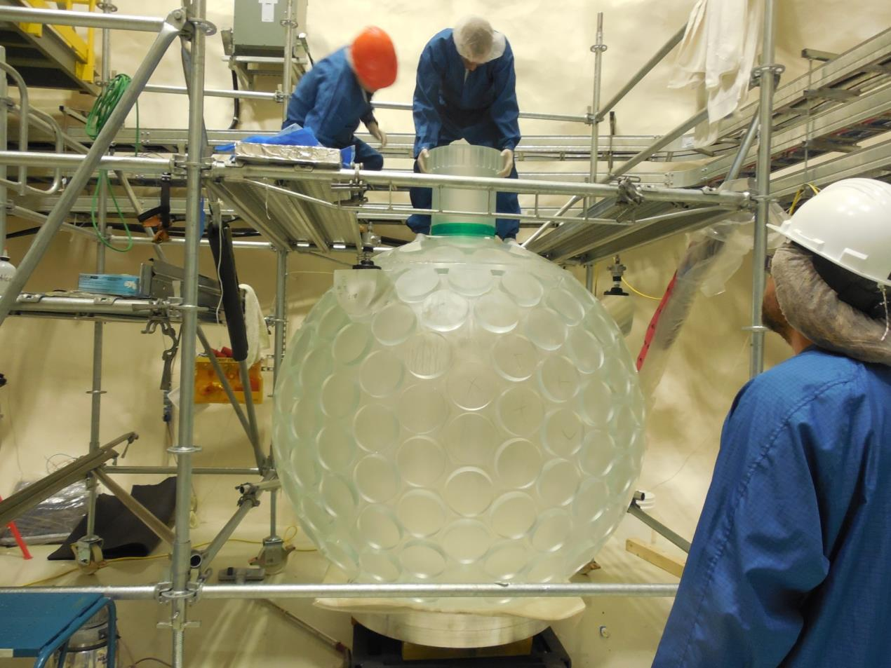
AV neck bonding underground (December 2012-January 2013)

Slide 11
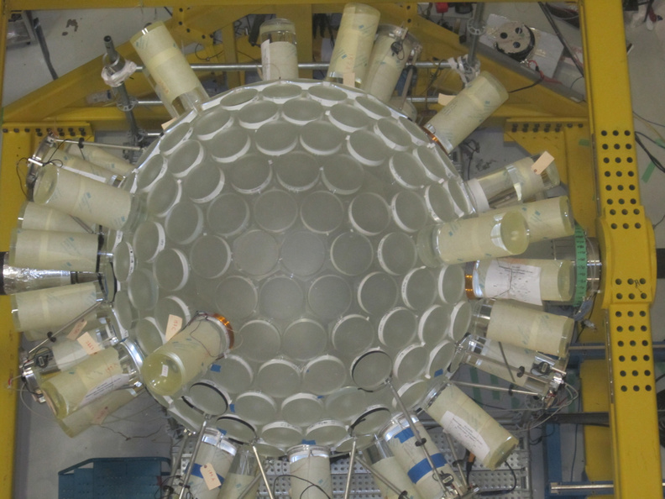
Bonding light guides to the DEAP AV, underground at SNOLAB

Slide 12
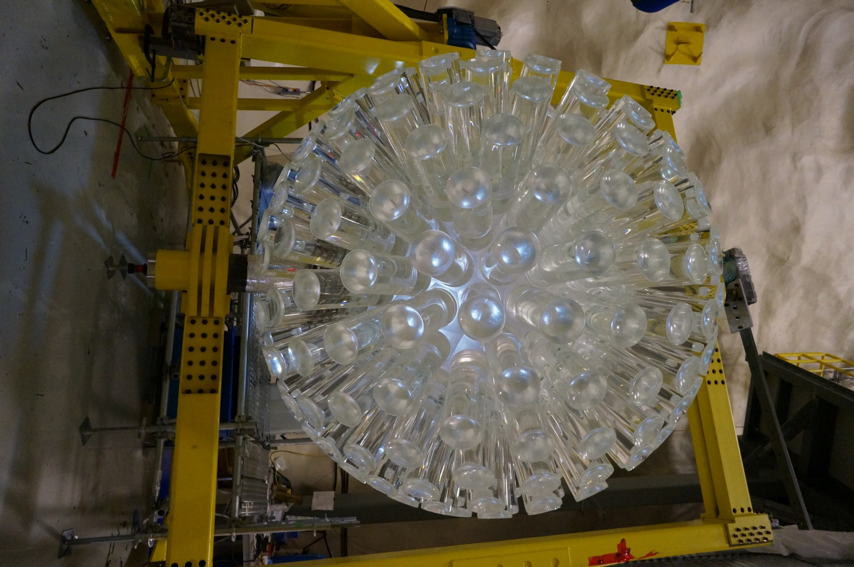
DEAP Acrylic Vessel (2013)

Slide 13
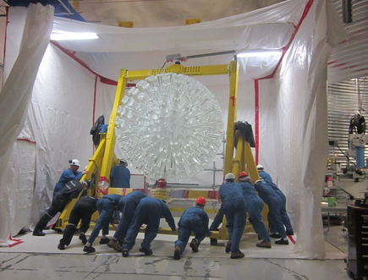
Moving the AV into assembly room

Slide 14
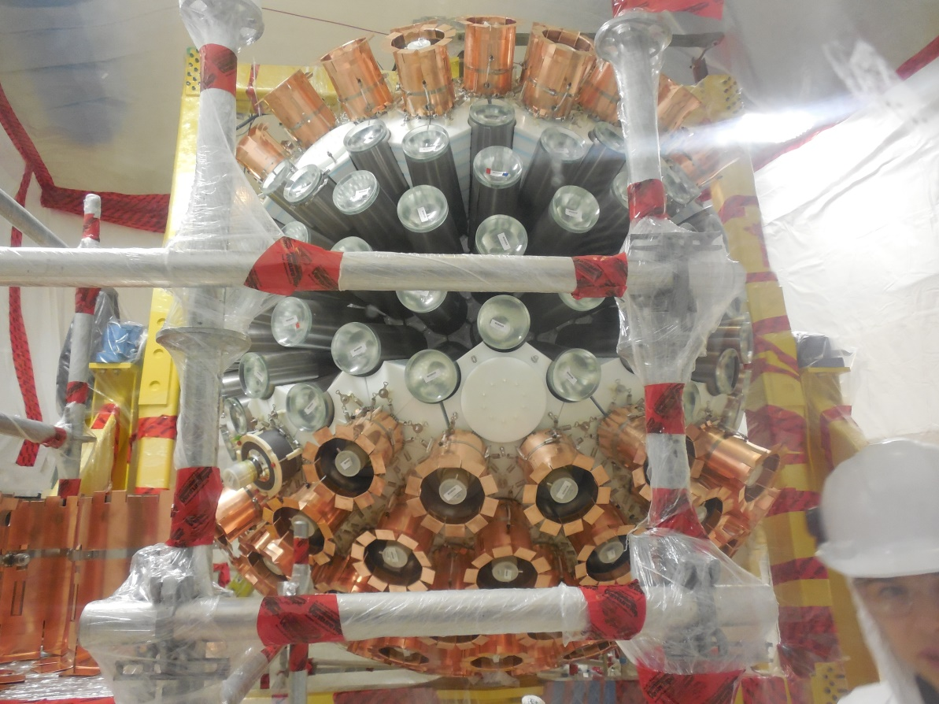
DEAP-3600 Detector Assembly
Acrylic Light Guide
Specular reflector + opaque wrap
PE neutron
shielding “blocks”
PMT with
silicone oil
coupling
2,500 person-weeks of assembly
(students, faculty, PDFs, technicians,
engineers)
Copper sleeve over PMT

Slide 15
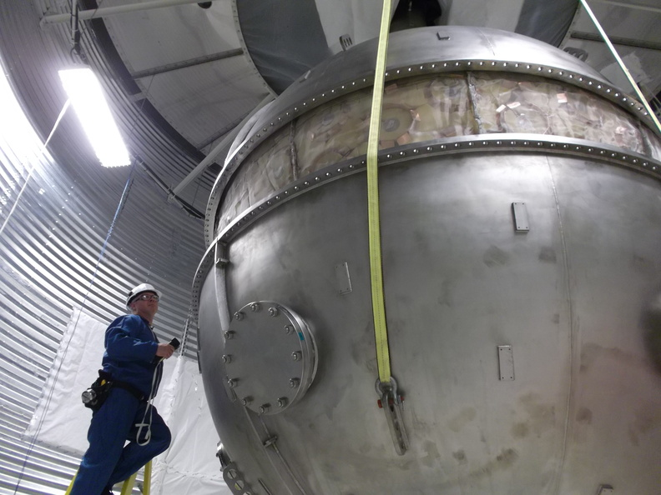

Slide 16
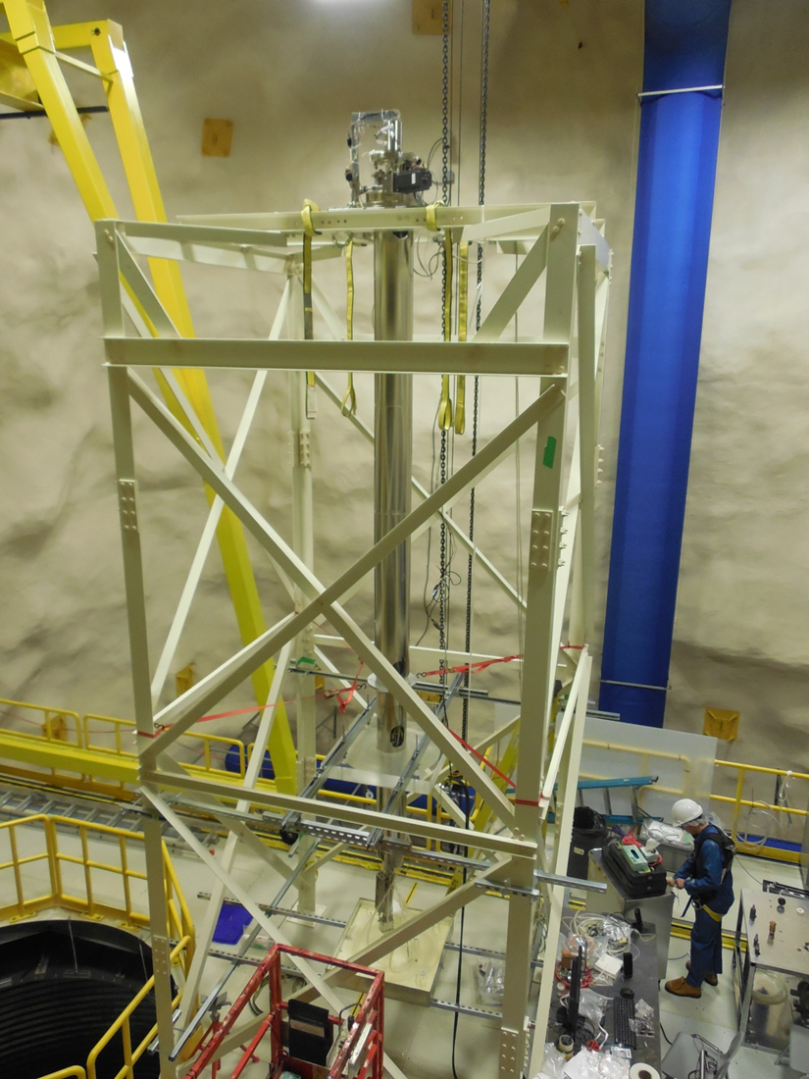
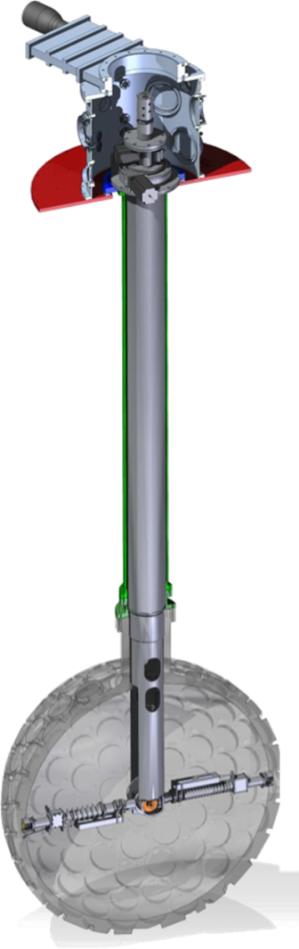
Acrylic Vessel Resurfacer
Mechanical sander to clean inner surface
Components selected for low radon emanation
Remove 0.5-mm surface in situ with N₂ purge
Cleans surface to bulk-level impurities
(order 100,000 cleaner than SNO vessel)

Slide 17
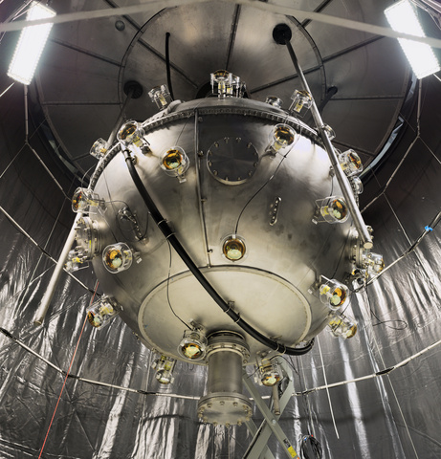
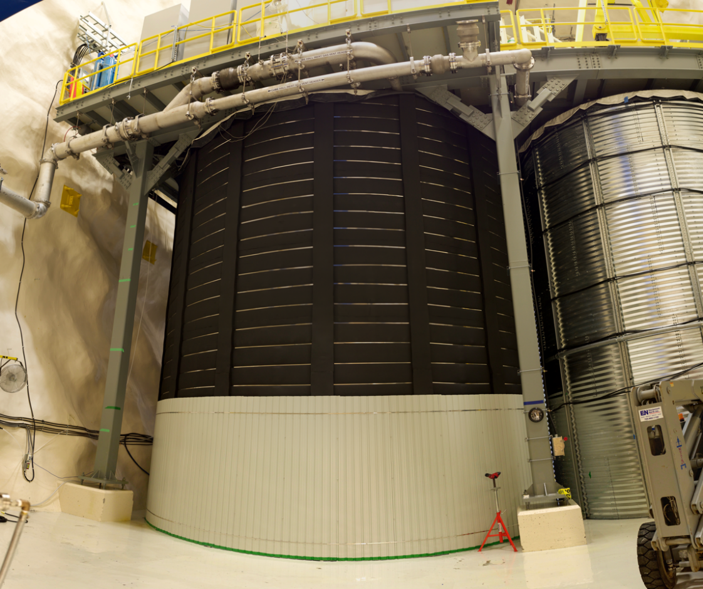
Completed Detector and Shield Tank
Completed Detector: Steel Shell, calibration tubes, muon veto in Shield Tank (fall 2015)
Shield Tank and emergency vent lines,
tank was filled with water Oct 2015

Slide 18
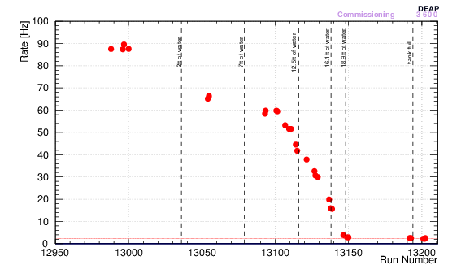
Detector event rate during shield tank water fill
Tank Full
2 feet
7 feet
16 feet
(Filled October 2015)

Slide 19
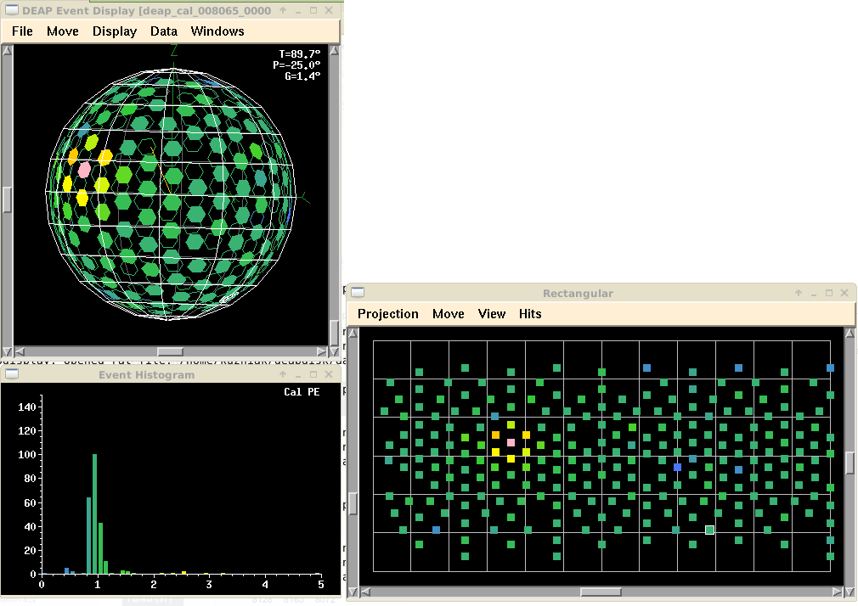
Electronics and trigger system operational
for over a year (CAEN v1720s)
Commissioning, electronics calibration
Optical calibration with internal fibers
(AARFs) and deployed diffusing laserball
source

Slide 20
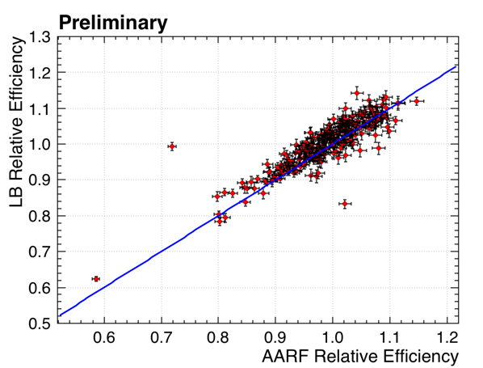
In-situ calibration of relative PMT efficiencies
(Diffusing laserball source at center)
~2% relative efficiency calibration
Internal fiber system (20 fibers into light guides)

Slide 21
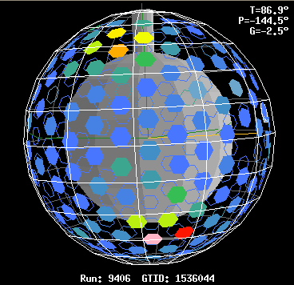
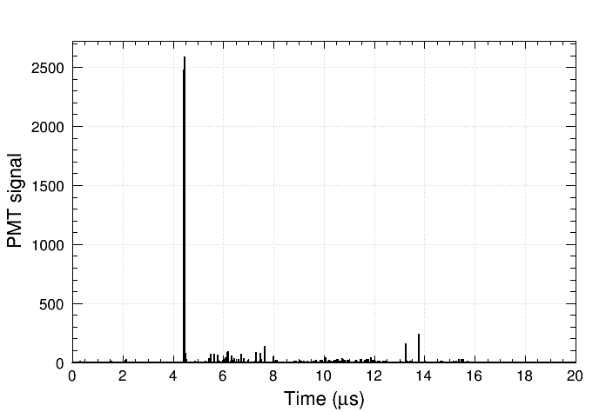
A high energy event (Commissioning running, Spring 2015)
Run: 9406 Subrun: 3 Event: 300460
High-E event rate: ~1 event/day
Expected muon rate: 1.6 muons/day
preliminary

Slide 22
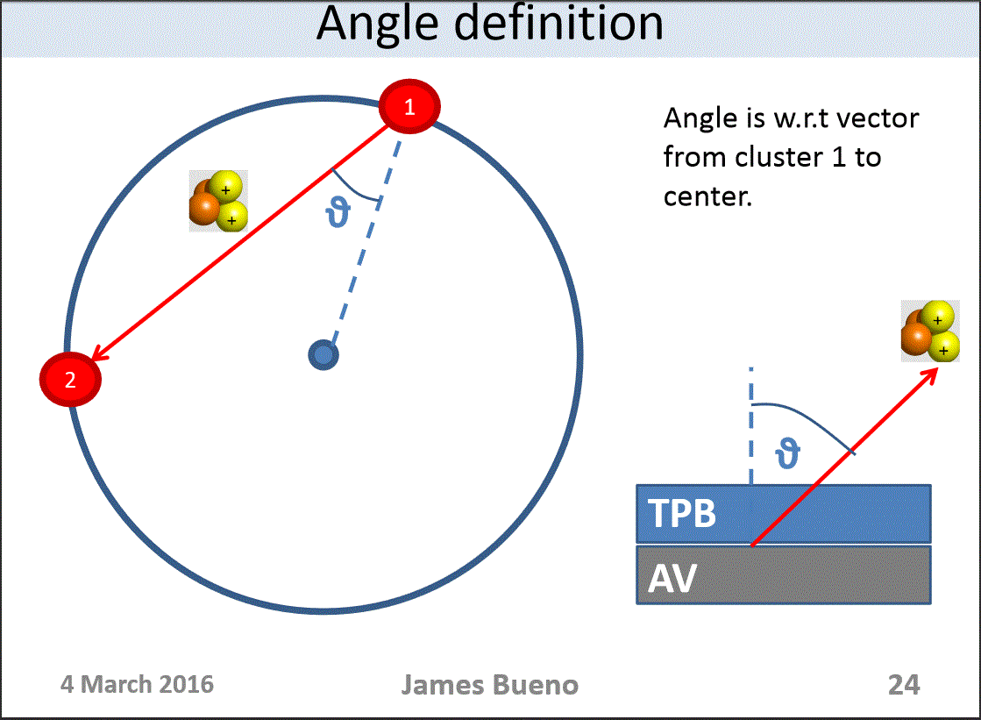
Identify alpha events from scintillation in TPB

Slide 23
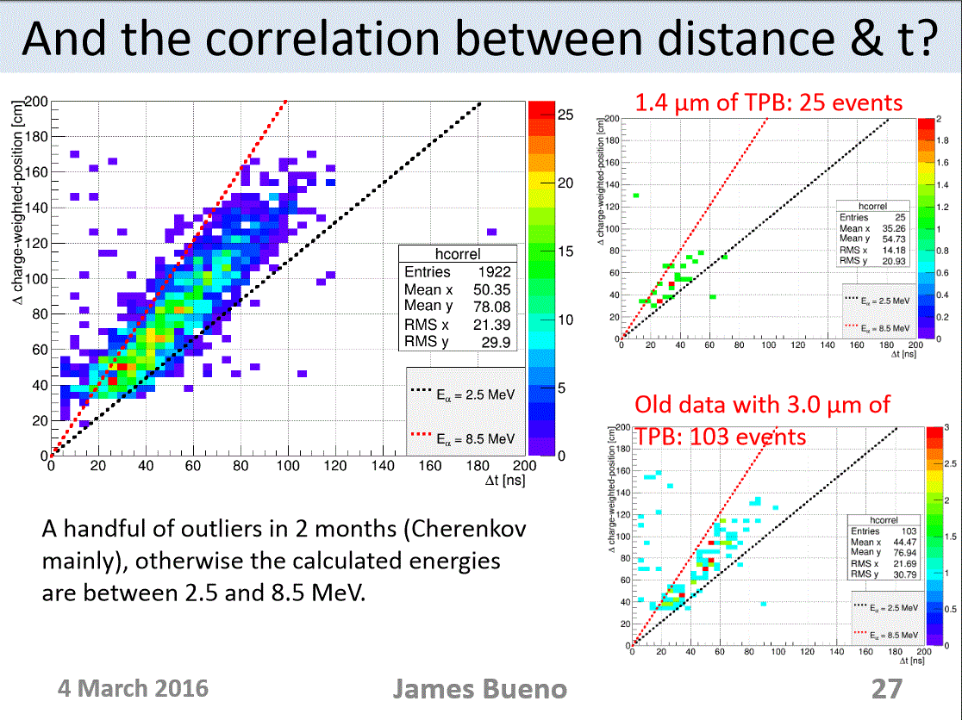
PRELIMINARY – NOT FOR DISTRIBUTION!

Slide 24
DEAP-3600 Cryogenic Systems

Slide 25
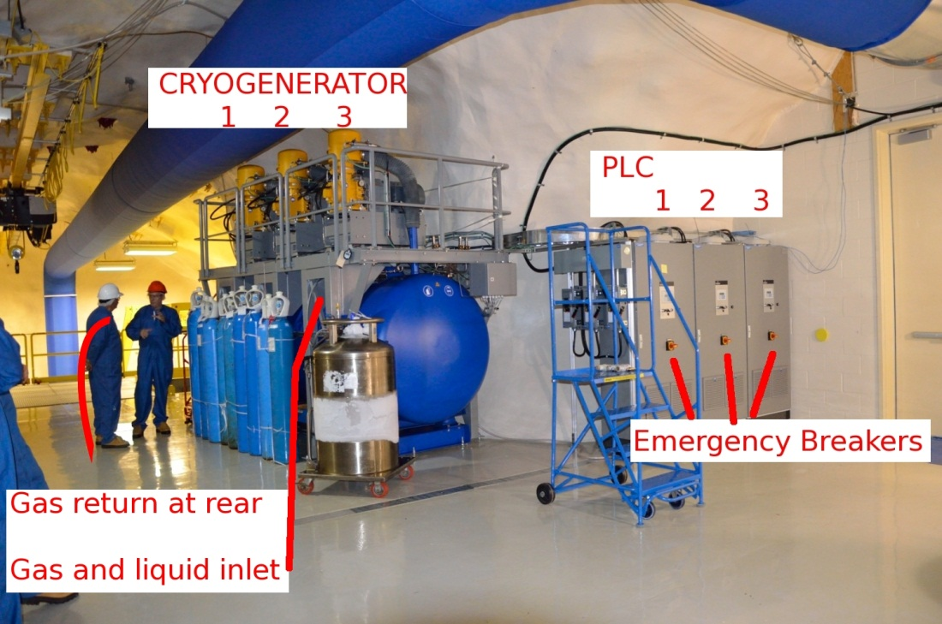
DEAP-3600 Cryocooler System Installed May 2012
3 x 1.2 kW @ 77 K
to DEAP
3500 L LN₂ dewar allows 4-day “buffer”
in cooling system

Slide 26
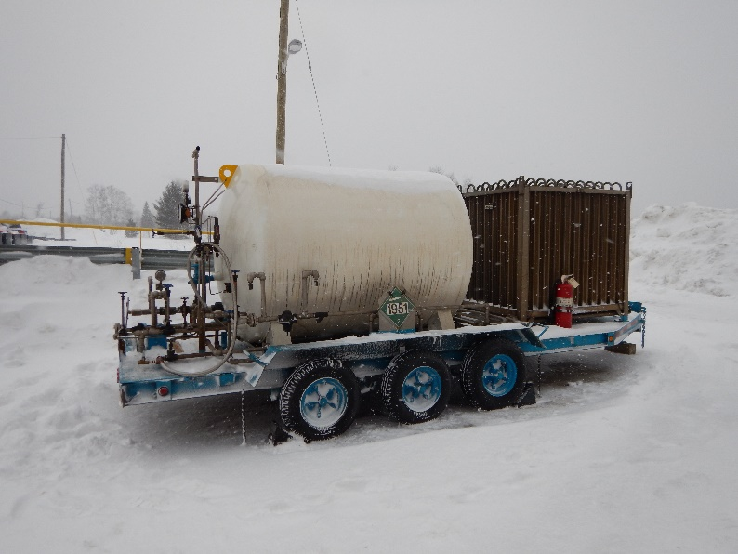
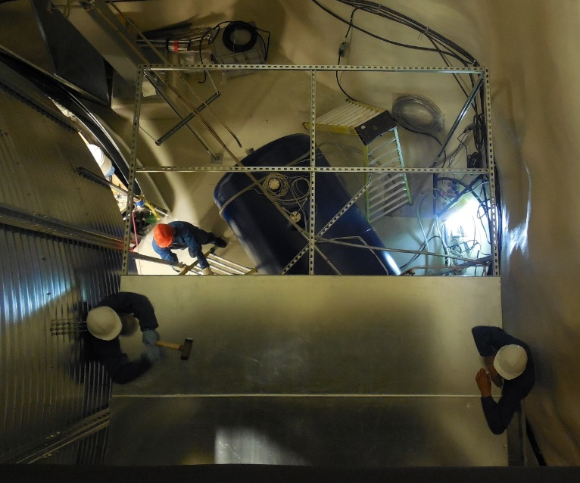
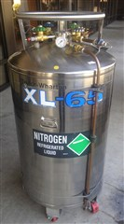
Liquid Argon Target Transfer and Storage
Bulk LAr storage on surface
2x240L
(transfer)
LN₂-cooled storage dewar
underground
Transferring underground started March 3, 2015
From RGA scans (before purification in the DEAP system):
CH₄ < 10 ppb, H₂O < 10 ppb, N₂ < 4 ppb, O₂ < 6 ppb
(<100 ppt after purification)

Slide 27
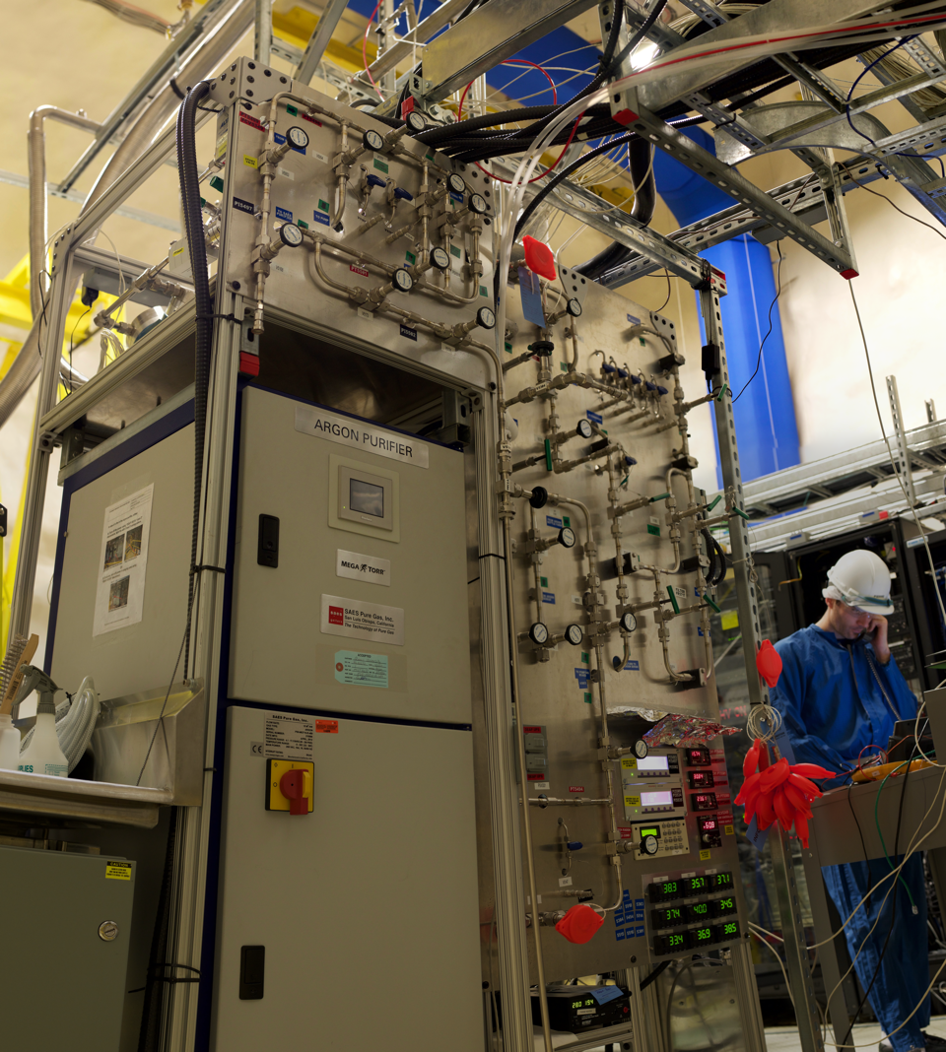
Argon Purification
Target stored as liquid,
boiled and purified
in gas phase,
then (re-)liquefied into AV
(Gettering, radon
and
particulate filtration)
AV cooldown started
Feb 2016

Slide 28
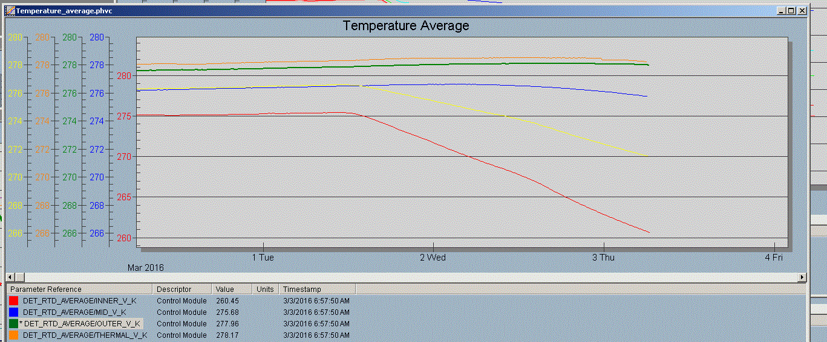

Slide 29
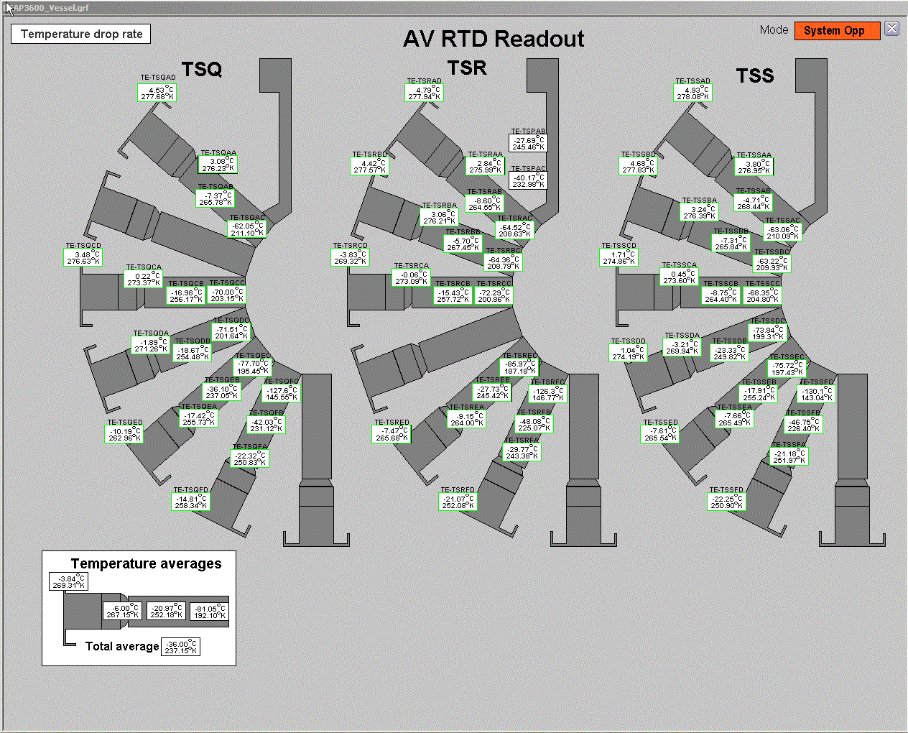

Slide 30
DEAP-3600 Analysis Groups
Working group leader | Institution | Group
Marcin Kuzniak | Carleton | Analysis Coordinator
James Bueno | Alberta | Gamma/other backgrounds
Berta Beltran | Alberta | Position reconstruction
Chris Ouellet | Carleton | Global backgrounds, Run Selection
Chris Jillings | Laurentian | PMTs
Rashid Medyev | Carleton | Efficiency/optical calibration
Tina Pollmann | Laurentian | PSD
Ben Smith | TRIUMF | Low-level calibration (electronics)
Joe Walding | RHUL | Neutron calibration
Nasim Fatemighomi | RHUL | Energy response
Eric Vazquez Jauregui | UNAM | Neutron backgrounds
Working group structure, additional students/scientists contribute to various
working groups, require additional effort on reconstruction, mu-veto calibration,
surface backgrounds, optical calibration

Slide 31
Summary
DEAP-3600: 3.6 tonnes of liquid argon (1 tonne fiducial)
>20X improvement in experimental sensitivity, excellent high WIMP mass sensitivity
(similar sensitivity to XENON-1T for high WIMP mass)
Collecting data in commissioning phase since early 2015, detector calibration and analysis well advanced
Start of detector cooldown Feb 2016, start of liquid filling June 11, 2016
Expecting first physics data summer 2016

Slide 32
END

