Slide 1
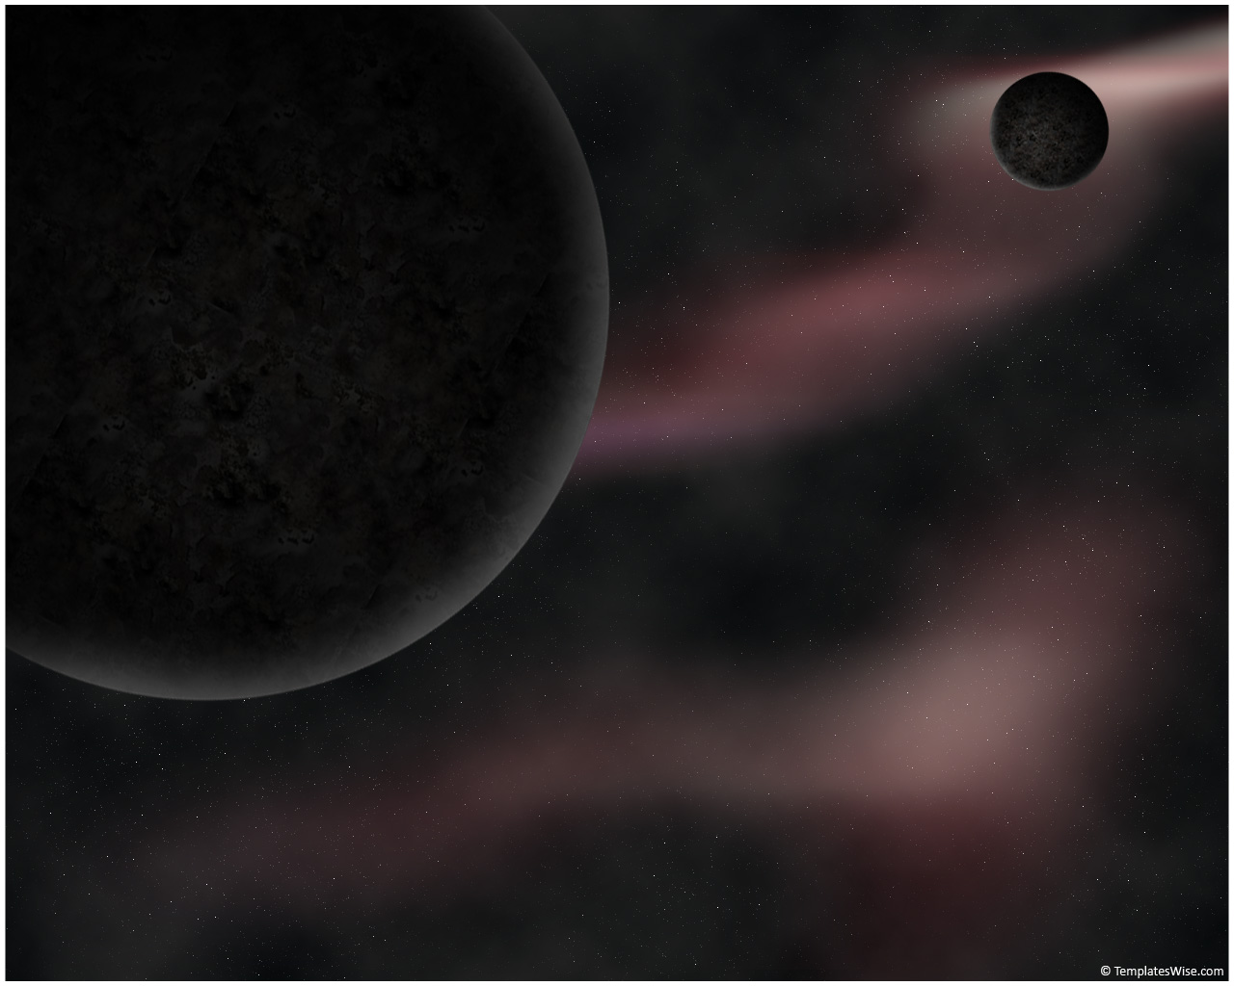
Outline
Recent Results and Future Plans for Dark Matter Searches with PICO
PICO superheated liquid technology
Recent Results:
Future Plans for PICO
Conclusions
Tony Noble
Queen’s University

Slide 2
The Objectives of the PICO Collaboration:
(Merger of PICASSO & COUPP collaborations)
  To develop the bubble chamber technology with the ultimate goal of building a tonne scale detector.
  To fully explore the Spin-Dependent sector and have particular sensitivity to low mass WIMPS
  To reach this capability with a series of detectors of increasing mass and sophistication.
PICO 2L → PICO 60 → PICO “250 L”

Slide 3
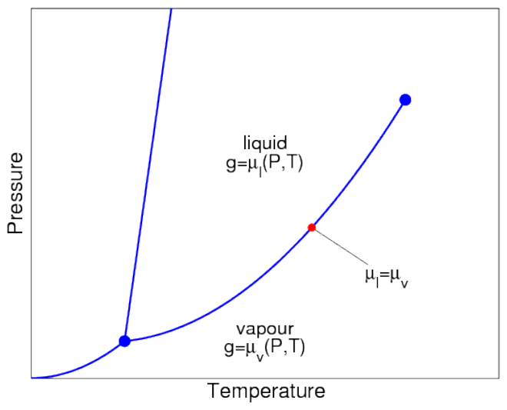
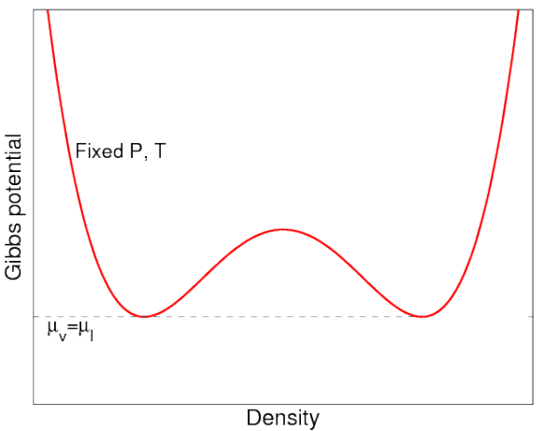
Bubble Chamber Operation
Phase diagram
Gibbs free energy
Vapour
Liquid
Gas Like
(entropy)
Liquid Like
(enthalpy)
When on the saturation curve, liquid and gas are in equilibrium. (Same pressure, temperature and chemical potential).
At equilibrium, the potential has two minima (one dominantly gas like and one liquid dominated)

Slide 4
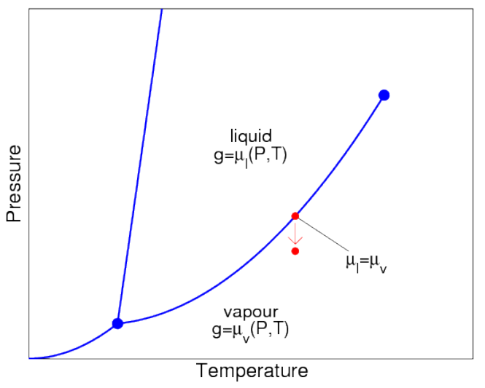
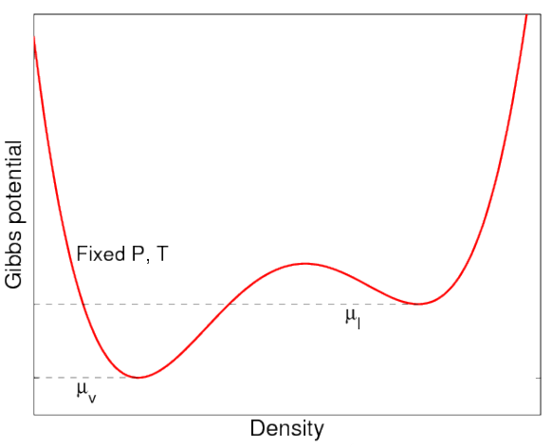
Bubble Chamber Operation
Phase diagram
Gibbs free energy
Superheated Liquid
Vapour
We now lower the pressure of the chamber carefully….starting from the pure liquid phase.
This distorts the potential, leading to a meta-stable superheated liquid state. Unless sufficient energy is added, it will stay in meta-stable state.

Slide 5
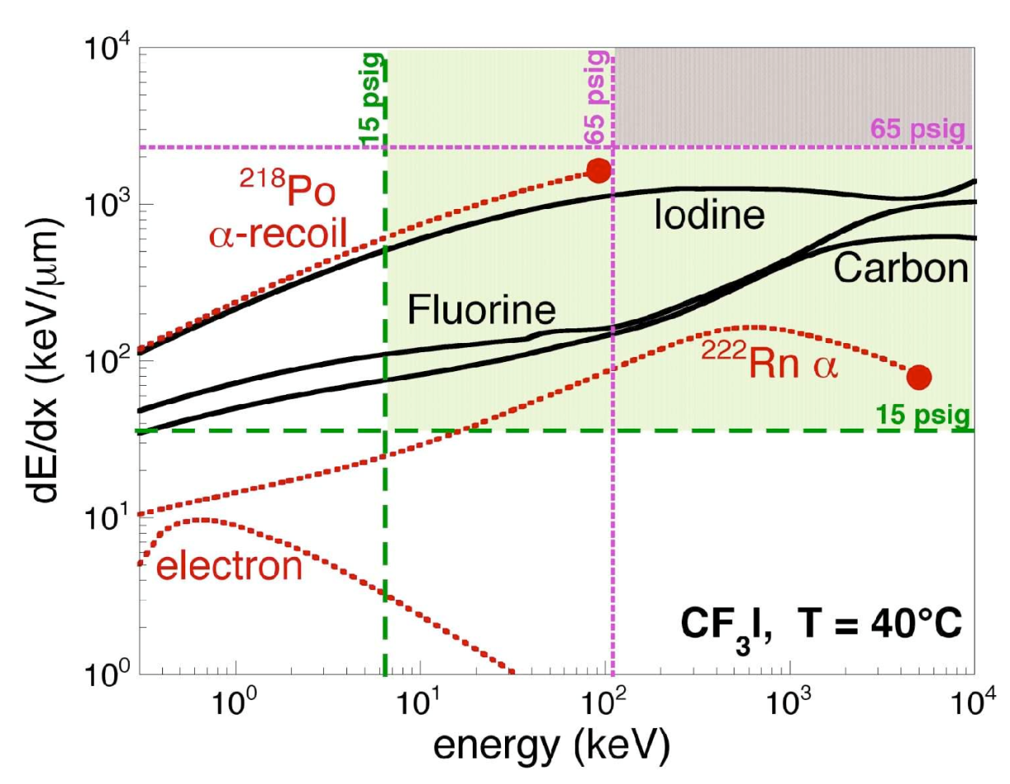
Bubble chambers as nuclear recoil detectors
Thermodynamic parameters are chosen for sensitivity to nuclear recoils but not electron recoils.
Better than 10⁻¹⁰ rejection of electron recoils (betas, gammas).
Alphas are (were) a concern because bubble chambers are threshold detectors.
Take away message:
Energy deposition depends on particle type. So can tune detector to be sensitive to certain types only. → Particle discrimination

Slide 6
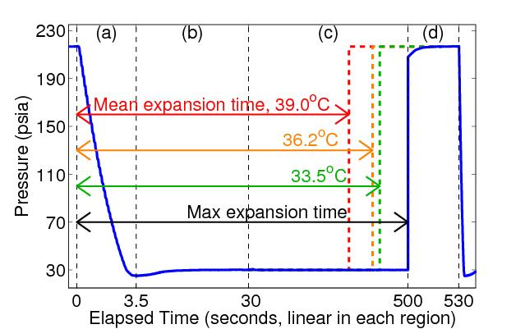
Principle of Operation: Bubble Chamber
Buffer fluid
(water)
Synthetic silica jar
Target fluid
(CF₃I/C₃F₈)
Hydraulic
fluid
to hydraulic controller
Lower the pressure to a superheated state.
See the bubble:
  Cameras trigger. record position, multiplicity
  Microphones record acoustic trace
  Fast pressure transducer recording.
Raise pressure to stop bubble growth (100ms), reset chamber (30sec)

Slide 7
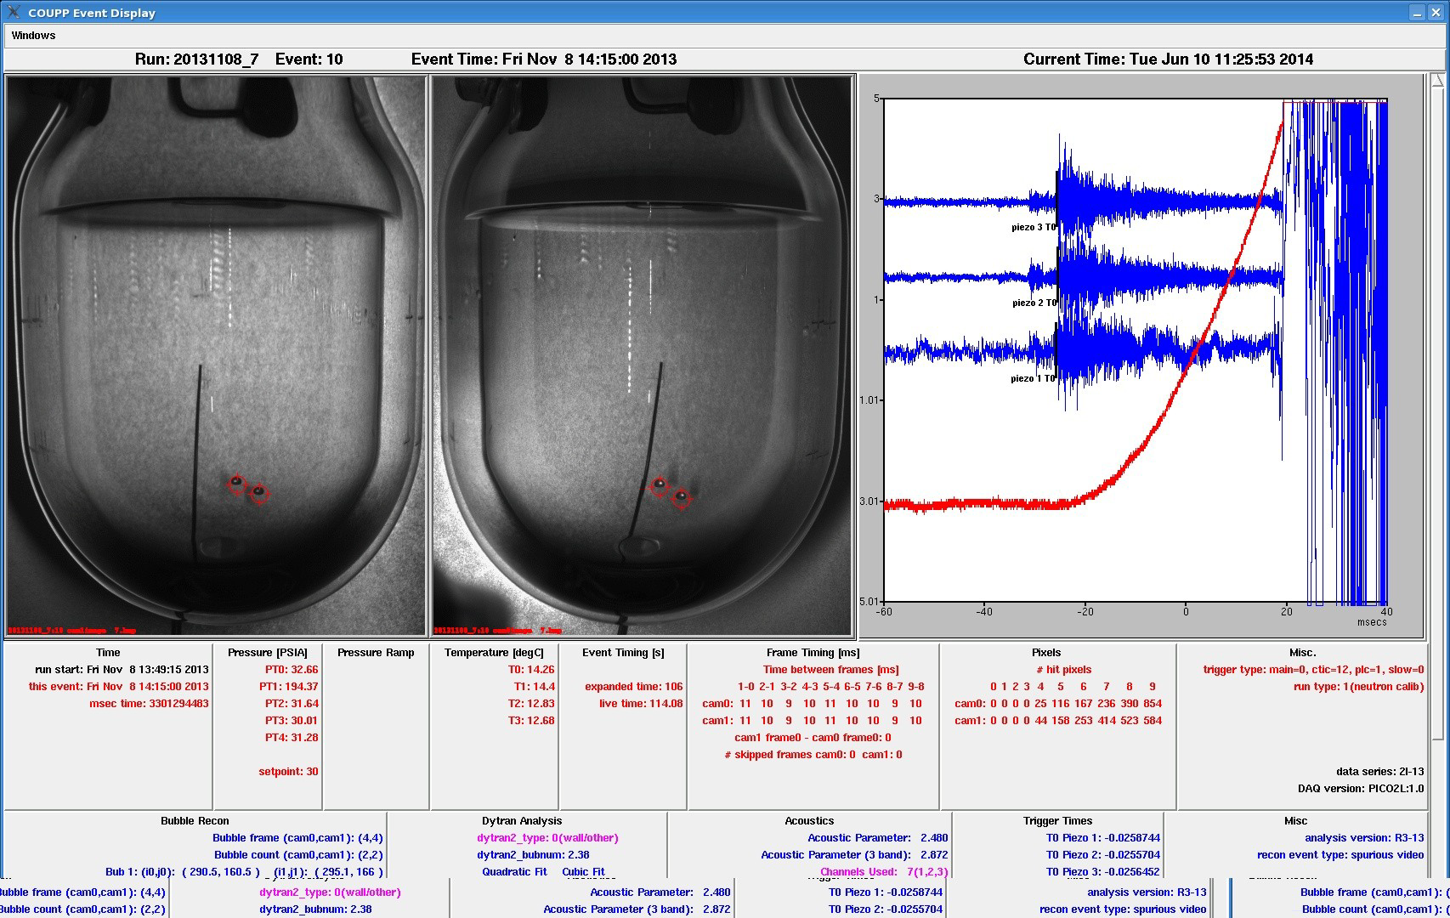
Acoustic Transducers
100fps stereo images
Fast Pressure Transducer
Screen Display during operations

Slide 8
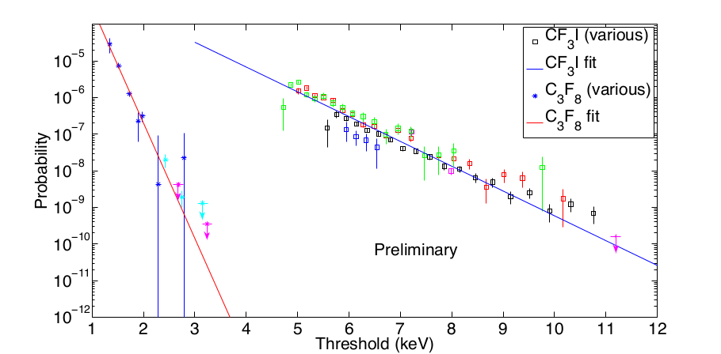
Threshold detector:
We can choose superheat parameters (T, P) so that the bubble chamber is blind to electronic recoils (10⁻¹⁰ rejection or better)
Threshold attainable with 10⁻¹⁰ gamma rejection is:
~3 keV with C₃F₈
~ 11 keV with CF₃I
CF₃I
C₃F₈
Excellent electron/gamma rejection has been demonstrated.
C₃F₈ can reach lower thresholds than CF₃I for same rejection.
A lower threshold extends the sensitivity to lower mass WIMPs.

Slide 9
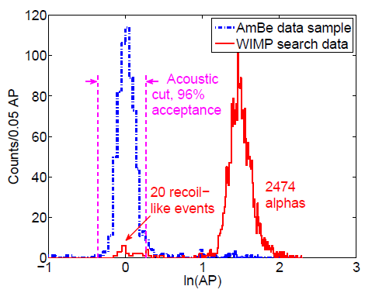
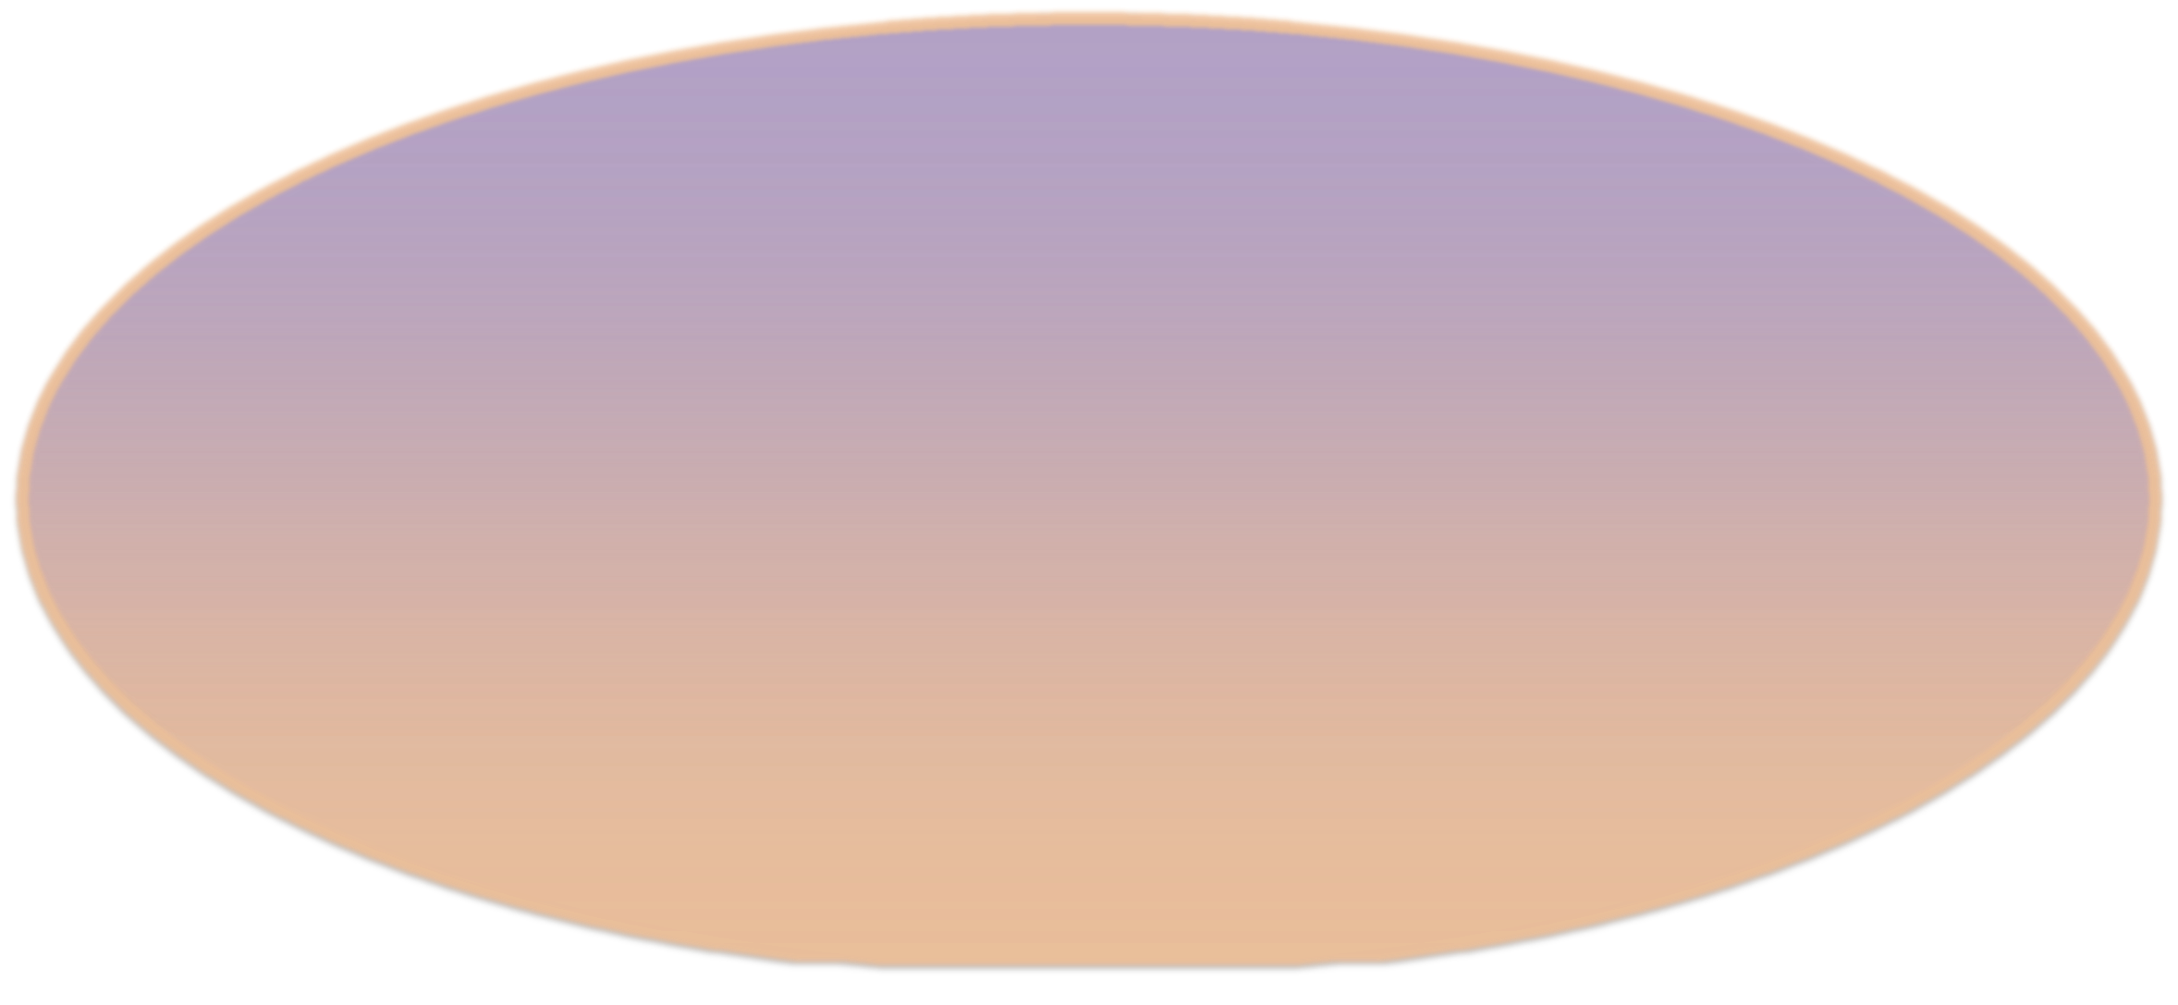
Alpha Acoustic Discrimination
Discovery by PICASSO of acoustic discrimination against alphas (Aubin et al., New J. Phys.10:103017, 2008)
  Nuclear recoils deposit their energy over tens of nanometers.
  Alphas deposit their energy over tens of microns.
In bubble chambers alphas are several times louder due to the expansion rate difference.
Observable bubble ~mm
~40 μm
~50 nm
Daughter heavy nucleus
(~100 keV)
Helium nucleus
(~5 MeV)

Slide 10
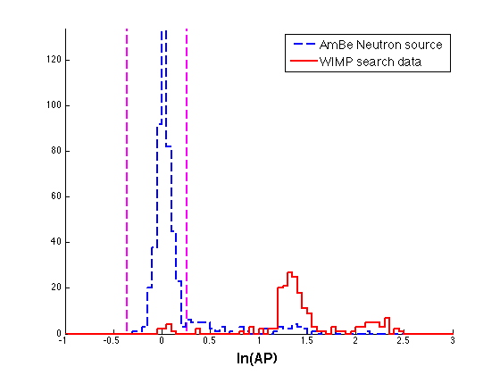
PICO-2L Analysis:
Acoustic discrimination
Acoustic cut
94%
acceptance
3 keV threshold
No multiple bubble events in the low background data
Two distinct alpha peaks, clearly separated from nuclear recoils
Timing of events in high AP peaks consistent with radon chain alphas, and indicate that the higher energy ²¹⁴Po alphas are significantly louder (a new effect not seen in CF₃I)
“Clean” alpha triplets
²²²Rn
α(5.6 MeV)
²¹⁸Po
α(6.1 MeV)
²¹⁴Po
α(7.9 MeV)
3 minutes
55 minutes

Slide 11
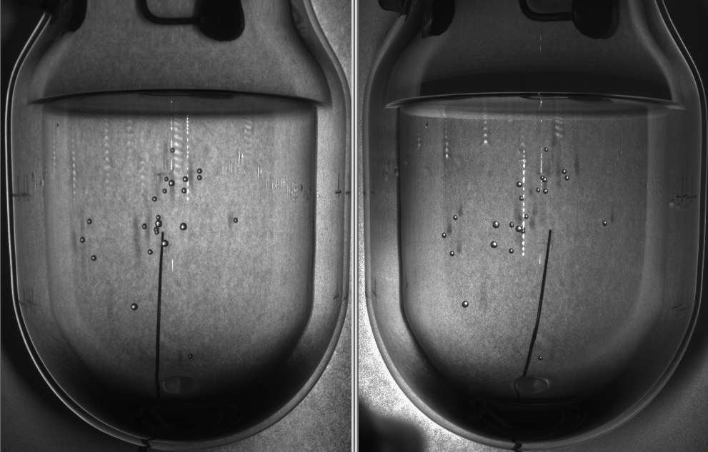
23 bubble AmBe neutron event
High multiplicity is a result of high bubble nucleation efficiency; 60% of neutron
calibration events in C₃F₈ are multiples.

Slide 12
Three recent results
  PICO-60 (experiment formerly known as COUPP-60)
  New DM results.
PICO-2L Run-1
  2015 DM result.
PICO-2L Run-2
  2016 DM result. Greatly improved. Not Background Limited.

Slide 13
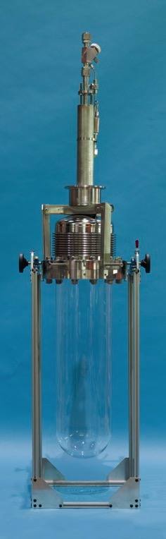
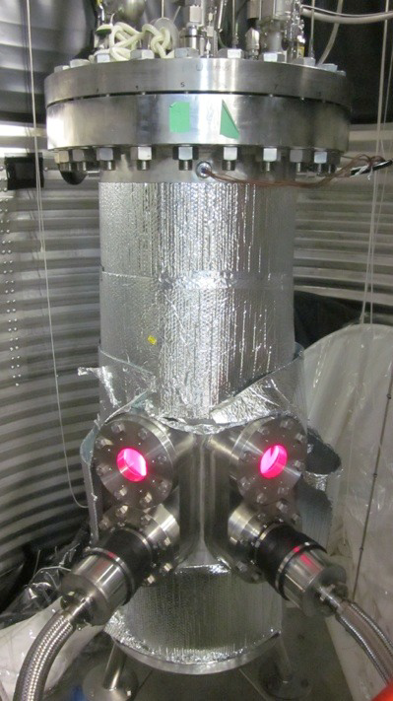
PICO-60
Filled with 36.8 kg of CF₃I.
PICO-60 Run-1: June 2013 to May 2014.
Run-2 with C₃F₈ target in 2016.

Slide 14
PICO-60 results
WIMP search data show ~2000 background events of unknown origin, with mean Acoustic Parameter (AP) slightly above nuclear recoil peak.
AP measures intensity of sound.

Slide 15
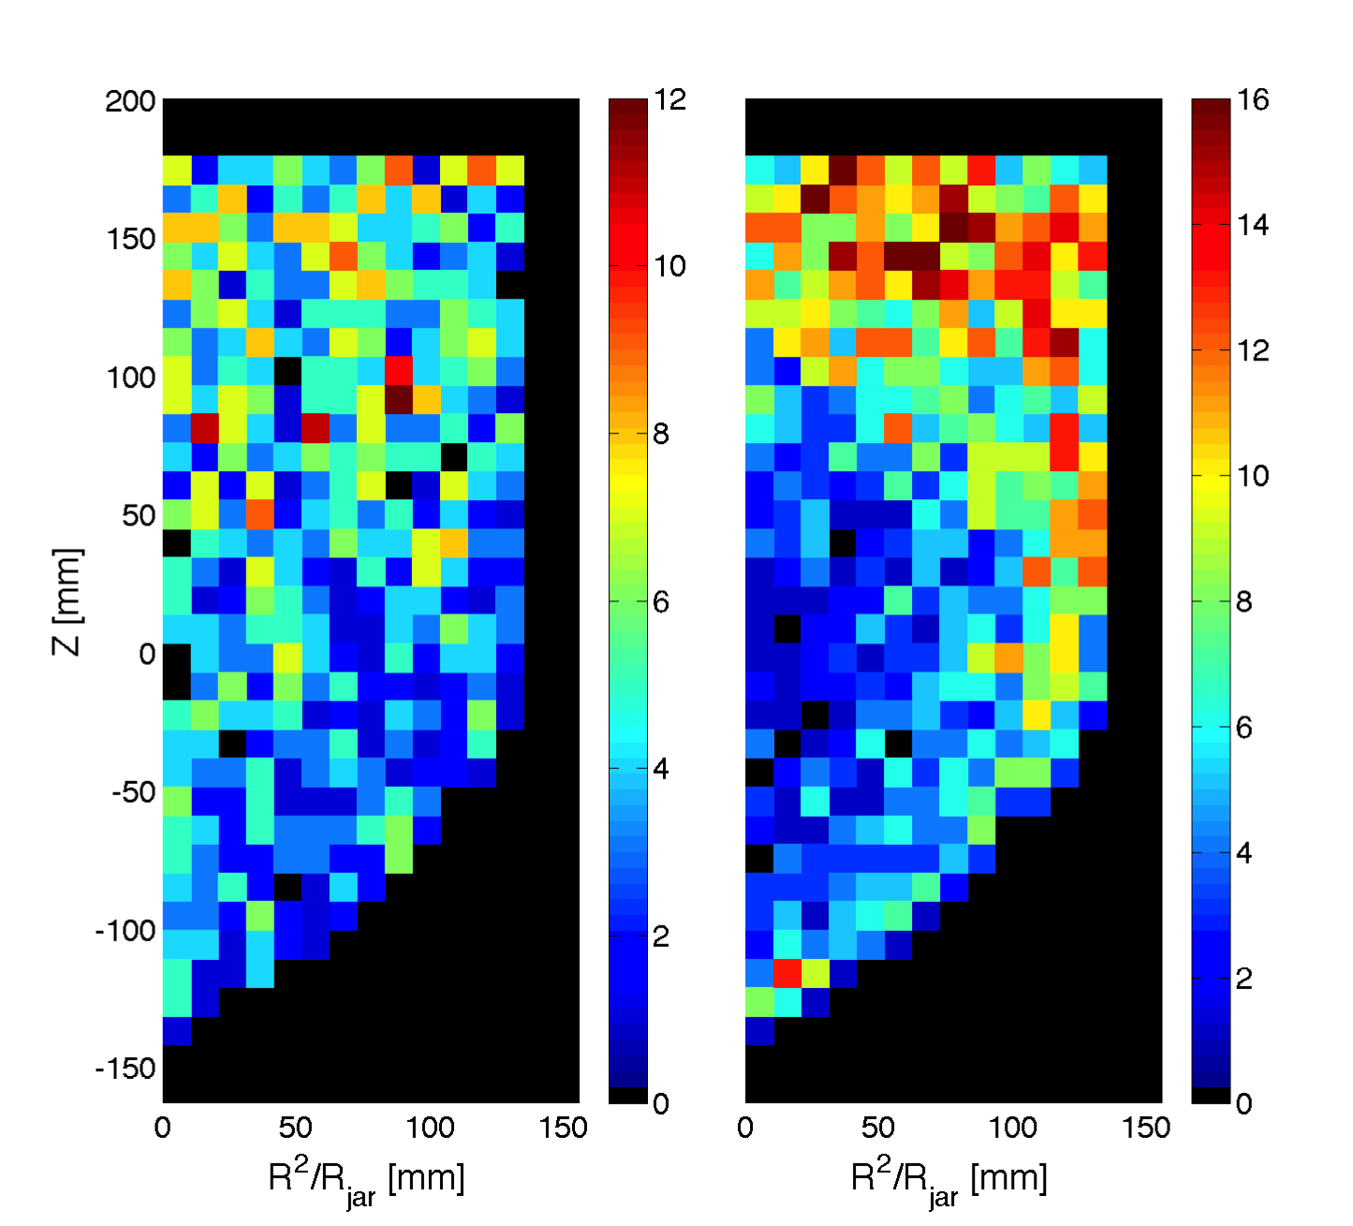
The unknown background
Alphas
Unknown background
The unknown background distributions are markedly different from alphas (and Dark Matter).

Slide 16
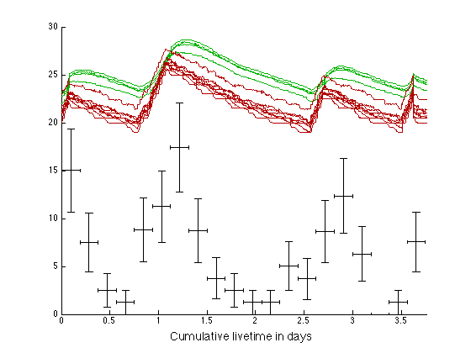
Some classes of events clearly correlated with the temperature of the water and glycol …. Correlation with pump, heaters, electrical noise, vibrations, convection…?
Temperature in Glycol (not to scale)
Temperature in Water (not to scale)
Mystery-Event rate
(not to scale)

Slide 17
PICO-60 (CF₃I) results
With CF₃I the detector is most sensitive to spin-independent interactions.
Spin-Dependent
Statistical penalty for setting cuts on data is calculated with Monte Carlo (similar to Optimum Interval method: S. Yellin, Phys.Rev. D66 (2002)
We’re currently commissioning PICO-60 for a new clean run with C₃F₈ target.
Spin-Independent

Slide 18
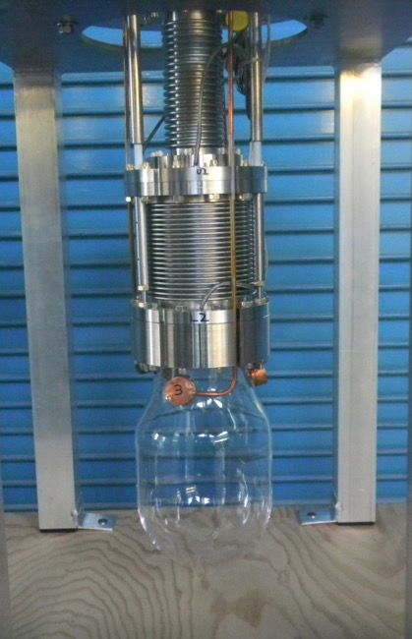
PICO-2L
Two liter active mass of C₃F₈.
Better fluorine sensitivity than CF₃I: (used by COUPP)
Twice the F density.
Lower threshold.
Improved efficiency.
More stable chemistry.
Inside water shield at SNOLAB.
Silica jar and double bellows attachment.

Slide 19
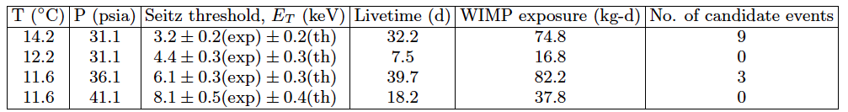
PICO-2L Run-1 results
Well above expected neutron background (<1 event at 3.2keV), and no multiple bubble events observed, so these are not neutron events.
There are timing correlations of events at 3.2keV with previous events, therefore not DM or neutrons.
We set limits by applying a timing cut with MC-derived statistical penalty, similar to PICO-60.

Slide 20
PICO-2L limits
With C₃F₈ the detector is most sensitive to spin-dependent interactions.
C. Amole et al., Phys. Rev. Lett. 114, 231302 (2015)

Slide 21
PICO-2L Run-2
Physics run June 12 – Sept 25 2015.
See talk by C. Amole for details on upgrades to remove particulate backgrounds.
Bulk event rate consistent with expected neutron background.

Slide 22
PICO-2L Run-1 vs Run-2
Run-1 3.2keV data
32 live days
Est. neutron bkgd 0.9^{+0.2}_{-0.7} events
Run-2 3.2keV data
~66 live days

Slide 23

SD Limit
C. Amole et al. Phys. Rev. D 93, 061101(R) (2016) [arXiv:1601.03729]
PICASSO
COUPP-4 (2012)
XENON100
Run 2 is NOT background limited.
Apply same mods to PICO 60 with C₃F₈ to greatly improve limits.
SIMPLE
SuperK
IceCube
CMS
Notes:
Run2 is NOT background limited and actually could detect dark matter (the floor is the limit)

Slide 24
Whither Next?
PICASSO 32 C₄F₁₀
World Best
Background Limited
COUPP 4 CF₃I
World Best
Background Limited
Merger
PICO 60 CF₃I
World Best
Background Limited
upgrade
PICO 2L Run 1 C₃F₈
World Best
Background Limited
PICO 2L Run 2 C₃F₈
World Best
“Background Free”
upgrade
PICO 60 C₃F₈
PICO RSU C₃F₈
Technology
Choice
PICO 500 C₃F₈

Slide 25
Next steps: Upgraded PICO 60
PICO-60 with C₃F₈
C₃F₈ target fluid
New vessel with fused silica flange
Active fluid recirculation with filtering
Projection assumes 6400kg-days (100 days at 40L C₃F₈), 2 background events
3.2 keV threshold

Slide 26
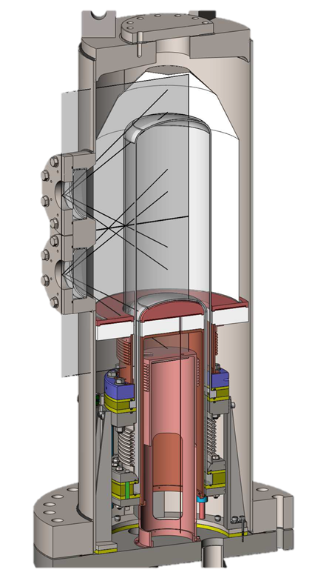
New Chamber Design “PICO 40 RSU”
Thermal Gradient
FLIP IT
“Right-side-up” bubble chamber with no buffer fluid
Stable against convection currents
Simplified fluid handling/recirculation.
Wider range of possible target fluids
No source of particulates in active region
Notes:
makes filtration way easier

Slide 27
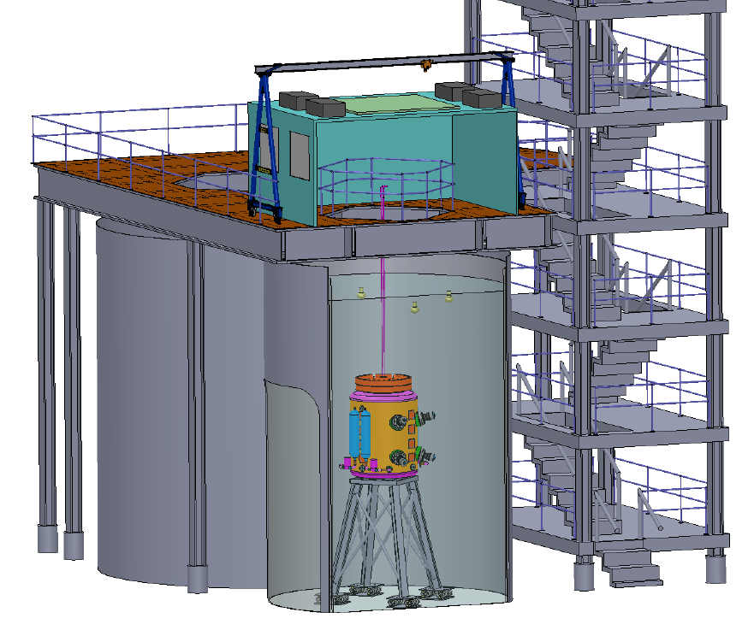
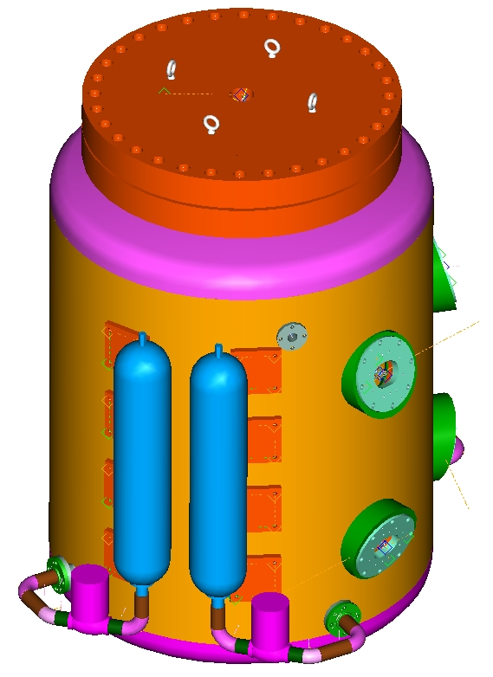
Next Generation PICO
Proposed 250-500 liter active volume bubble chamber.
Designed for CF₃I or C₃F₈ target.
CFI funding proposal being prepared.

Slide 28
Conclusions
PICO-2L and PICO-60 have produced world-leading limits on Spin-Dependent WIMP-proton interactions with different target fluids.
PICO-2L also has excellent Spin-Independent limits on low-mass (few GeV) WIMPs.
Both experiments observed a population of background events we believe is due to particulate contamination of the target fluids.
After efforts to reduce the background, Run-2 of PICO-2L now shows an a very low event rate consistent with neutron background.
PICO-60 is being commissioned for a second run with similar improvements and C₃F₈ target fluid and this is in a water tank providing better neutron shielding.
PICO-RSU is largely designed and procurement of long lead items is beginning. Operations expected to begin, without water shielding, by the end of 2016.

Slide 29



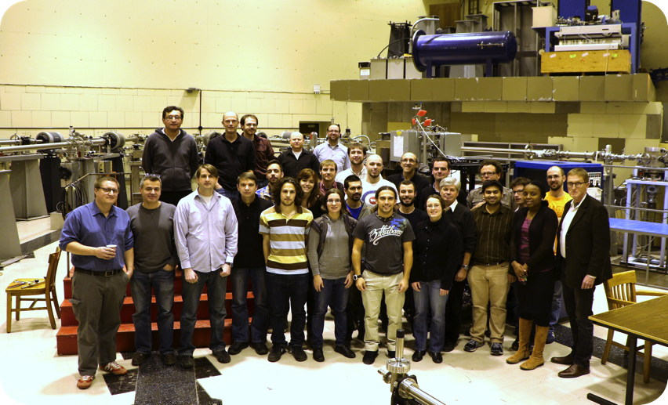















E. Vázquez-Jáuregui
I. Lawson
C. Amole, M. Besnier, G. Caria, G. Giroux, A. Kamaha, A. Noble
M. Ardid, M. Bou-Cabo, I. Felis
D.M. Asner, J. Hall
D. Baxter, C.E. Dahl, M. Jin,
J. Zhang
P. Bhattacharjee.
M. Das, S. Seth
S. Fallows, C. Krauss, P. Mitra
S.J. Brice, D. Broemmelsiek,
P.S. Cooper, M. Crisler, W.H. Lippincott, E. Ramberg, M.K. Ruschman, A. Sonnenschein
E. Behnke, H. Borsodi, O. Harris, A. LeClair, I. Levine, E. Mann, J. Wells
R. Neilson
K. Clark
R. Filgas, I. Stekl
F. Debris, M. Fines-Neuschild, C.M. Jackson, M. Lafrenière, M. Laurin, J.-P. Martin, A. Plante, N. Starinski, V. Zacek
J.I. Collar,
A.E. Robinson
J. Farine, F. Girard, A. Le Blanc, R. Podviyanuk, O. Scallon, U. Wichoski
D. Maurya, S. Priya

Slide 31
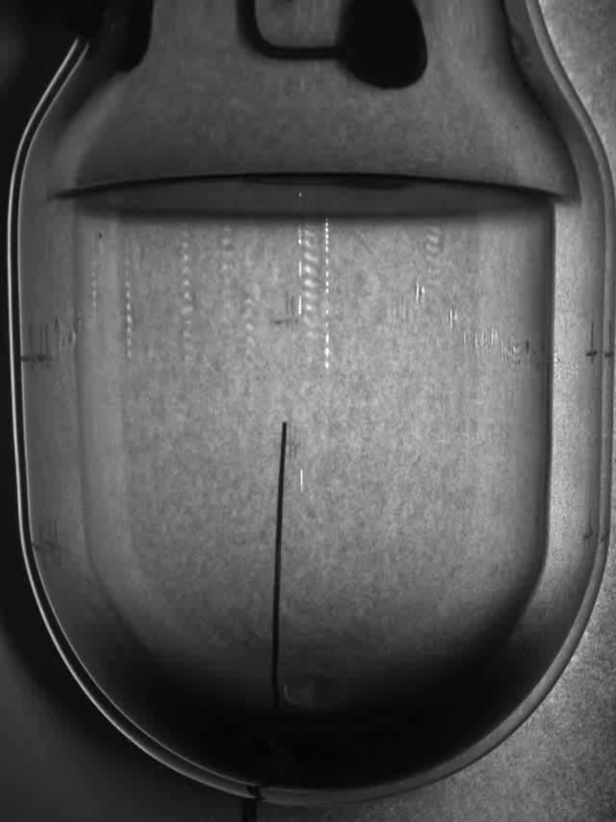
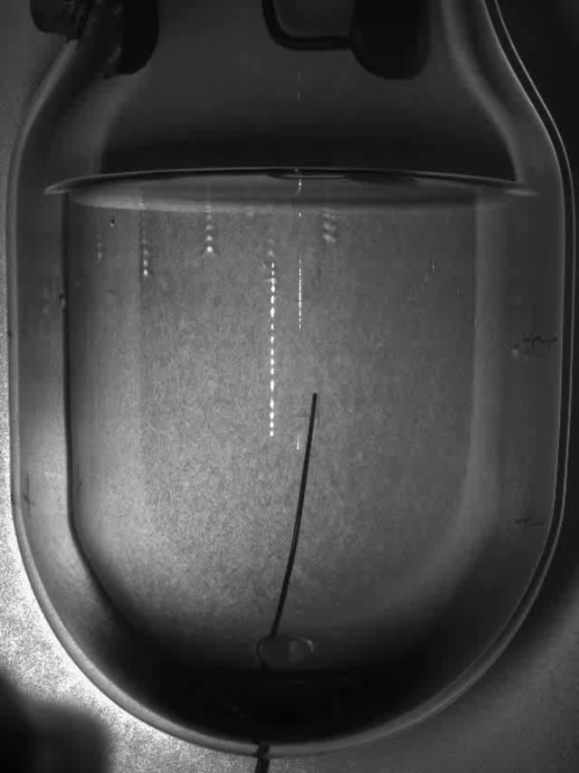
Two example events recorded
Single Bubble event
Neutron event

Slide 32
Combined PICO-60 cuts
48.2% combined efficiency, and no surviving background events

Slide 33
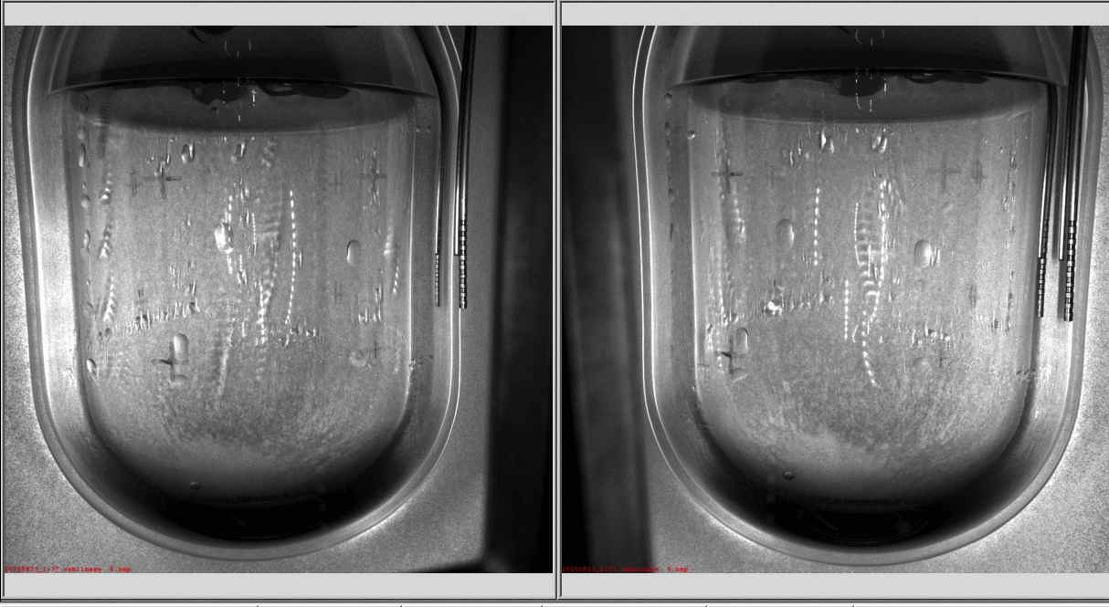
Problems with the “liquid piston”
Plagued by water droplets
“collar” activity
many wall nucleations
Chamber stabilized after
~2 months of running
Followed by stable and very quiet period of dark matter data
Activity at the vessel bottom

Slide 34
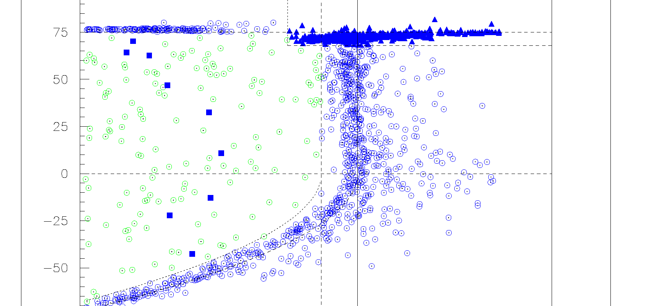
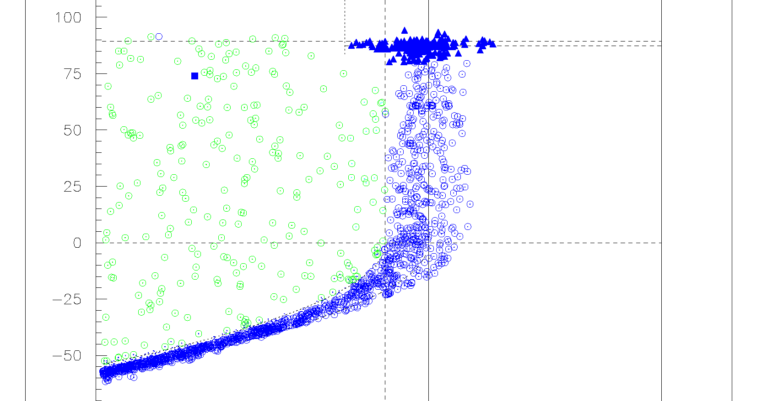
Dark Matter Backgrounds arising from particulate contamination
PICO-2L - 2013
9 low AP events
in 30 days
at 3 keV
Reduction in Surface bubbles
PICO-2L - 2015
Only 1 low AP event
in 40 days at 3 keV
44 !
66 !
Activity on the vessel walls and
collar is worse than 2013..
…but surface activity and low-AP background is gone.

Slide 35
Particulate Background Mitigation
It may ultimately not be possible to completely suppress these backgrounds in the presence of a 2-fluid interface
The fluid Interface traps particulates (and may confound attempts to at filtration…)
The fluid interface surface tension MAY ITSELF BE THE CAUSE OF THE BACKGROUND

Slide 36
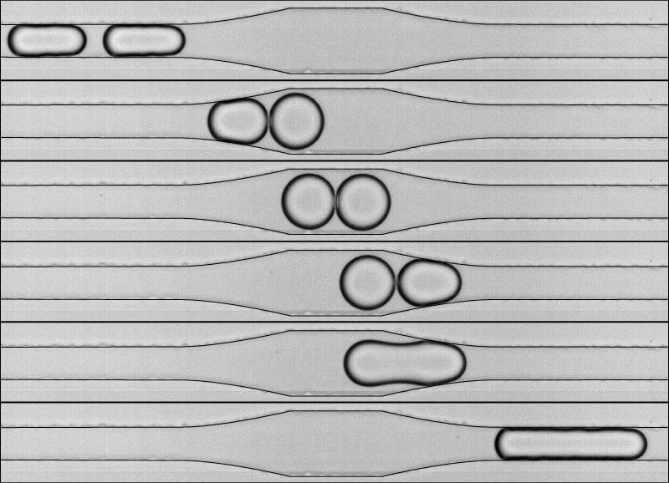
Liquid Droplet Merger (Picture is from– Int. J. Mol. Sci. 2011, 12, 2572-2597
Reprinted from Phys. Rev. Lett. 2008, 100, 024501:1-024501:4)
E_{surface} = 4πr²σ
Pressure = 2σ/r
heat capacity ΔT ~ 1/r³
acceleration ~ 1/r²
E_{release}= 0.41 x E_{surface}

Slide 37
Liquid Droplet Merger (Picture is from– Int. J. Mol. Sci. 2011, 12, 2572-2597
Reprinted from Phys. Rev. Lett. 2008, 100, 024501:1-024501:4)
Similarly for the ejection
of an irregular particle
from a droplet
The merger of
two water droplets
with size near the
Seitz Radius scale
will nucleate an
AP=1 bubble by the
release of surface tension energy

Slide 38
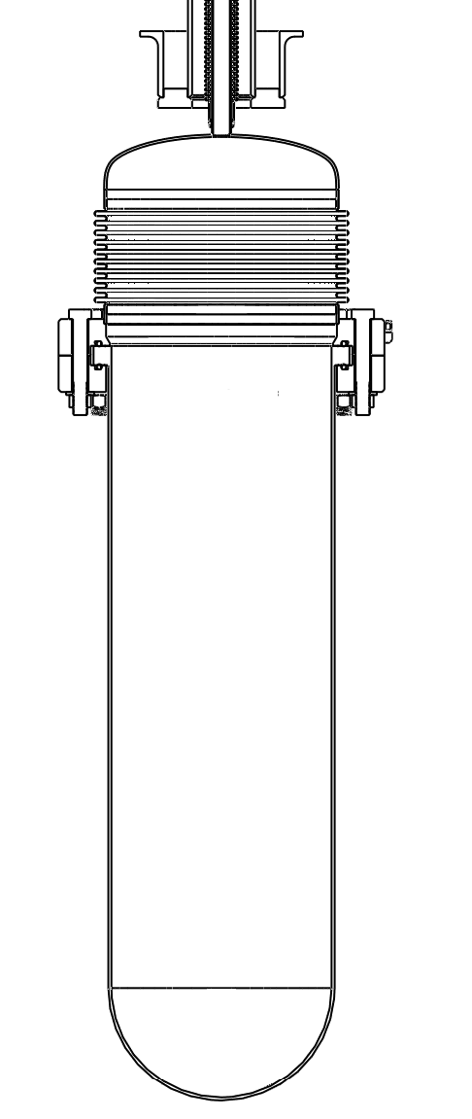
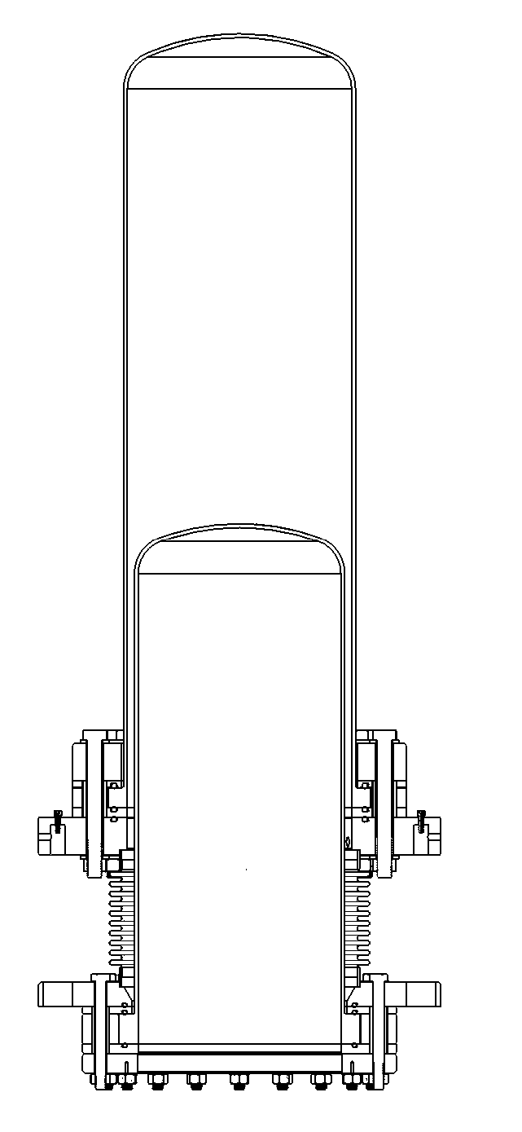
PICO-60
PICO-40L
hydraulic
Fluid
15ºC
hydraulic
Fluid
15ºC
H₂O
15 ºC
C₃F₈
15ºC
active volume
“water piston”
insulation
fused silica
piston
hydraulic
fluid
-5ºC
hydraulic
Fluid
15ºC
C₃F₈
15ºC
hydraulic
fluid
-5ºC
active volume

Slide 39
Right Side Up design virtues:
Superheated/normal transition is maintained by a thermal gradient with no buffer fluid
    No buffer fluid means no surface tension effects
    No buffer fluid means no constraint on target fluid
    Works with any refrigerant, hydrocarbon, even xenon.
Thermal gradient is naturally stable
All metals at the bottom
    Cold zone, no boiling to liberate particulate
    No convection to move particulate up
Geometry naturally lends itself to a recirculation loop

