Slide 1

Is “interactive teaching” sufficient to promote conceptual development in physics?
Paula Heron
Department of Physics
University of Washington
Seattle, USA

Slide 2
My path
Switch fields
Meet husband
Have baby
BSc & MSc
U of Ottawa
PhD
Western
Postdoc
UW
Assistant
Prof
UW
Associate
Prof
UW
Prof
UW
Condensed matter theory
Physics Education Research

Slide 3
Critical factors
Early involvement in research
  Physics is fundamentally creative
Mentors
  Denis G. Rancourt (formerly Professor of Physics, U d’Ottawa)
  Lillian C. McDermott (Professor of Physics, UW)
  Physics is a community endevour

Slide 4
Physics Education Group at UW
Faculty
  Suzanne Brahmia
  Paula Heron
  Lillian McDermott
  Peter Shaffer
Lecturers and postdocs
  Paul Emigh
  Ryan Hazelton
  Donna Messina
Physics PhD Students
  Sheh Lit Chang
  Lisa Goodhew
  Alexis Olsho
  Marshall Styczinski
  Tong Wan
  Bert Xu
Visitors
  Jerry Feldman (GWU)
  Xaoting Yue (East China Normal)

Slide 5
Physics Education Group at UW
Primary goal:
improve student learning from kindergarten through graduate school
Primary activities:
conduct basic research on student understanding
develop instructional materials for university-level courses
provide professional development for
  school teachers
  university faculty
  current and future physics education researchers

Slide 6
Current research projects
Investigating student learning of specific physics content in intro courses
  E&M, Energy, Waves, Special relativity
Investigating student learning of specific physics content in advanced courses
  E&M, Quantum Mechanics
Exploring the role of visualization and spatial reasoning abilities in student learning of physics
Examining student ability to transfer from one context to another
Assessing student reasoning ability
Helping K-12 teachers develop scientific reasoning skills

Slide 7

Physics Education Research in the US
Research universities with tenured physics faculty who do PER and where students can earn a PhD in Physics for PER
University of Washington
University of Maryland
University of Illinois
University of Colorado
University of Maine
Cornell University
The Ohio State University
Kansas State University
Michigan State University
North Carolina State Univ.
North Dakota State Univ.
Oregon State University
None of these groups would exist without the support of the
US National Science Foundation

Slide 8
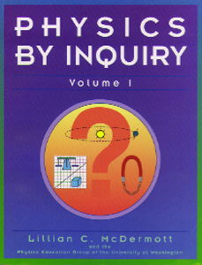
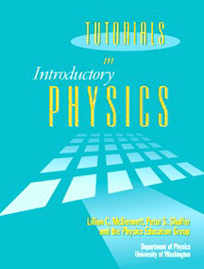
Physics Education Group at UW
Preparing primary and secondary teachers to teach physics and physical science
Physics by Inquiry
John Wiley & Sons, Inc., 1996
Improving student learning in introductory physics
Tutorials in Introductory Physics
Prentice Hall, 2002
Notes:
We have developed materials for Galilean relativity in the context of both of the curriculum development projects underway in the PEG. Physics by Inquiry is a stand-alone, laboratory based curriculum designed to prepare precollege teachers to teach physics and physical science as a process of inquiry. Tutorials in Introducotry Physics is a supplementary curriculum desinged to improve student learning in theintroducotry course.

Slide 9
Context for research
First-year course for physics and engineering students
Second-year course in “statics” for engineering majors

Slide 10
Evidence: A question on acceleration
A ball rolls up and then down an incline as shown in a strobe photo. What is the direction of the acceleration of the ball at the top of its path?
Students were given a selection
of options to choose from,
including “there is no acceleration”

Slide 11
Results before instruction
Percentage of students giving the correct answer
Heron, PhysRev PER, 2015

Slide 12
Results after instruction
Percentage of students giving the correct answer
(different classes; no student saw the question twice)
Heron, PhysRev PER, 2015

Slide 13
Summary of results
More than 10,000 students in 79 classes of different size in 38 different academic terms over a period of 13 years, that met at different times of day, used different textbooks, had different professors…
Average = 27%
St. dev. = 7%
Percentage of students giving the correct answer
Heron, PhysRev PER, 2015

Slide 14
On questions that elicit intuitive notions (e.g., about force, motion, charge, buoyancy, balancing, ...), performance is often essentially the same before and after instruction.

Slide 15
More evidence: Capacitance
a question that apparently requires more formal knowledge…
As the (oppositely charged, isolated) plates are moved closer together, does the capacitance of the arrangement increase, decrease or remain the same?
-σ₀
+σ₀
Metal plates on insulating stands

Slide 16
Results before and after instruction
-σ₀
+σ₀
% of students giving the correct answer
Heron, PhysRev PER, 2015

Slide 17
Further analysis: Multiple linear regression
20 randomly selected qualitative questions each given in many different classes (median number = 54) over a period of 13 years
Multiple linear regression with several possible explanatory variables (year since 1999, time of day, class size, whether or not instruction had already occurred…)
instruction was associated with
  a statistically significant* positive effect on 4 questions
  a statistically significant* negative effect on 2 questions
  no effect on 14 questions
Only one other variable had a systematic effect (year since 1999)
*p < 0.1
Heron, PhysRev PER, 2015

Slide 18
Even on questions for which one might expect students to have no preconceptions (e.g., capacitance, flux, phase difference), the effect of conventional instruction is often small.
Teaching by telling is ineffective
for most students.

Slide 19
So the solution is interactive teaching, right?
Maybe, sort of.

Slide 20
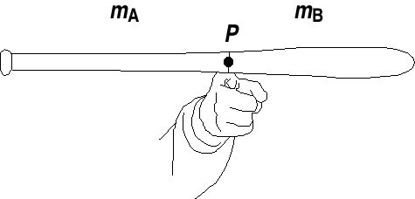
A question on balancing
A student balances a baseball bat on a finger.
Is the center of mass to the right, to the left, or at point P?
Is the mass to the left greater then, less than, or equal to the mass to the right?
Explain your reasoning.

Slide 21
Results after conventional instruction
Each diamond represents one class (> 100 students each)
5 of students
All instruction on torque, equilibrium etc., in intro physics
% of students in class answering correctly
Class label (arbitrary)
Ortiz et al, AJP, 2005

Slide 22
Hands-on, collaborative group work
Second-year engineering statics at UW
Students had a three-hour session on centroids and center of mass
  Worked in small groups
  Made predictions about the location of the center of mass
  of assorted shapes
  Checked their predictions with real apparatus
15% later answered the bat question correctly (N > 70)

Slide 23
Interactive demonstration
Introductory Physics
A demonstration based on the bat question was performed
by a professor familiar with our research
40% answered the bat question correctly several days later (N = 84)
Common incorrect response:
“m_{A} = m_{B} like Professor X showed us in class.
Also, if they weren’t equal, the bat would tip over.”

Slide 24
Interactive teaching (aka active learning, etc.)
Most (all?) demonstrably effective instructional strategies are interactive; not all interactive instructional strategies are effective
Generalizing results is difficult (if not impossible) when terms are not operationally defined
How do we know learning is “active?”
How can we tell whether students are “engaged?”

Slide 25
Decades of systematic research suggest:
knowledge is developed through construction,
not accretion or absorption.
Students have already constructed considerable knowledge by the time they reach our classrooms.
Passive listening doesn’t
foster (re)construction of existing knowledge
(for most students).

Slide 26
Implications for instruction
STYLE
CONTENT
Instruction needs to match HOW people learn
Instruction needs to match WHAT they already know
  Students must be actively engaged in learning
  Instruction needs to meet students where they are

Slide 27
Research questions
What do students “know” before instruction? How does it affect how they interpret what they hear and read? What reasoning errors do they make, and why?
What strategies are effective in helping students develop a coherent conceptual framework and the reasoning abilities for applying it?
How can these strategies be implemented within existing constraints (time, space, resources)?

Slide 28
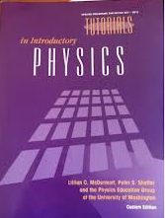
Tutorials in Introductory Physics
A set of instructional materials to supplement instruction
in large introductory courses
General goals:
Constructing concepts
Developing reasoning ability
Relating physics formalism to the real world
General instructional strategies:
Teaching is by questioning (not by telling)
Discussions among students are emphasized
Available in German, Spanish, Korean, and (soon) Finnish
Notes:
We have developed materials for Galilean relativity in the context of both of the curriculum development projects underway in the PEG. Physics by Inquiry is a stand-alone, laboratory based curriculum designed to prepare precollege teachers to teach physics and physical science as a process of inquiry. Tutorials in Introducotry Physics is a supplementary curriculum desinged to improve student learning in theintroducotry course.

Slide 29
Tutorials in Introductory Physics
Each tutorial is:
based on detailed investigation of student learning of the topics in question
developed in an iterative process that involves repeated testing at UW and other institutions
Notes:
We have developed materials for Galilean relativity in the context of both of the curriculum development projects underway in the PEG. Physics by Inquiry is a stand-alone, laboratory based curriculum designed to prepare precollege teachers to teach physics and physical science as a process of inquiry. Tutorials in Introducotry Physics is a supplementary curriculum desinged to improve student learning in theintroducotry course.

Slide 30
An example from rigid-body dynamics
Two identical pucks are on a flat, frictionless ice rink. The center of mass of each puck is marked with an ‘X.’ Forces of equal magnitude and direction are exerted on the pucks.
At the instant shown:
Is |a_{cm,1}| greater than, less than, or equal to
|a_{cm,2}|?
10% to 20% of students answer correctly

Slide 31
Interpretation
Extensive research revealed that many students assume the effect of a force on linear motion depends on where the force is exerted
Specific assumptions:
If a force is not exerted at the center of mass*, it has a diminished effect on translational motion
If the force is exerted at the edge, it contributes only to rotational motion
* i.e., the line of action passes through the center of mass

Slide 32
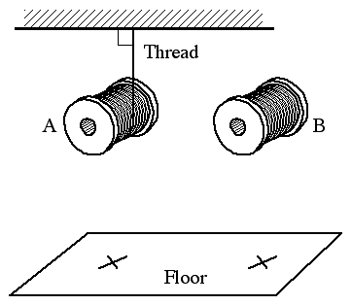
Attempts to develop a tutorial
  In early versions, students:
perform an experiment with two spools of thread: one falls freely, the other is held by an unwinding thread as it falls
observe that the freely falling one hits first
conclude (we hope) that a force exerted on the edge of an object has an effect on the center-of-mass motion

Slide 33
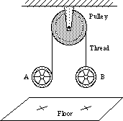
Further attempts to develop a tutorial
In later versions, students:
perform an experiment with two spools that are connected by a thread that passes over a frictionless pulley: the thread is attached to one spool at its center but is wound around the other
observe that the spools hit at the same time
conclude (we hope) that a force exerted
on the edge of an object has the same effect
on center-of-mass motion as one exerted
at the center

Slide 34
Two pucks question: Results
Percentage of students giving the correct answer
Close et al, AJP, 2013

Slide 35
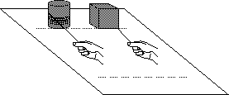
Even further attempts to develop a tutorial
In the current version, students:
consider a thought experiment about a block and a spool
discuss predictions made by three hypothetical students
consider the connected spools experiment
decide what each hypothetical student would predict about the spools
conduct the connected
spools experiment,
then revisit the block
and spool experiment

Slide 36
Two pucks question: Results
Percentage of students giving the correct answer
Close et al, AJP, 2013

Slide 37
Even research-based instruction might not be effective.
Multiple cycles of assessment and
redesign may be needed

Slide 38
Knowledge of student ideas in specific topic areas is essential for improving instruction.
Interactive instruction may be necessary,
but it is not sufficient.
Instruction should be evidence-based,
not ideology-based.

Slide 39
Physics Education Research
is not about promoting a specific teaching method
(and disparaging others).
is not about dismissing knowledge of teaching and learning based on experience.
is about promoting the view that systematically gathering and analyzing data is a good way to understand and affect complex phenomena.

Slide 40
Official Statement on PER by the APS:
In recent years, physics education research has emerged as a topic of research within physics departments. This type of research is pursued in physics departments at several leading graduate and research institutions, it has attracted funding from major governmental agencies, it is both objective and experimental, it is developing and has developed publication and dissemination mechanisms, and Ph.D. students trained in the area are recruited to establish new programs. Physics education research can and should be subject to the same criteria for evaluation (papers published, grants, etc.) as research in other fields of physics. The outcome of this research will improve the methodology of teaching and teaching evaluation.
The APS applauds and supports the acceptance in physics departments of research in physics education. Much of the work done in this field is very specific to the teaching of physics and deals with the unique needs and demands of particular physics courses and the appropriate use of technology in those courses. The successful adaptation of physics education research to improve the state of teaching in any physics department requires close contact between the physics education researchers and the more traditional researchers who are also teachers. The APS recognizes that the success and usefulness of physics education research is greatly enhanced by its presence in the physics department.

Slide 41
References
Effect of lecture instruction on student performance on qualitative questions, Heron (PhysRev PER, 2015)
Student understanding of the application of Newton's second law to rotating rigid bodies, Close, Ortiz & Heron (Am. J. Phys. 2013)
Student understanding of the equilibrium of rigid bodies, Ortiz, Heron & Shaffer (Am. J. Phys. 2005)

Slide 42


Physics Education Research in the US
Reports from the US National Academy of Sciences
Report from the
APS & AAPT
Report of the
Joint Task Force on Undergraduate Physics Programs
FREE to download from nap.gov
Coming soon

