Slide 1

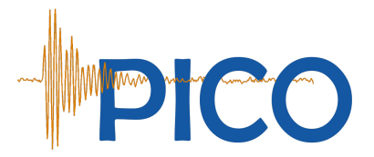


The PICO 0.1 bubble chamber calibration
Frédéric Girard
CAP congress
June 14th, 2016

Slide 2
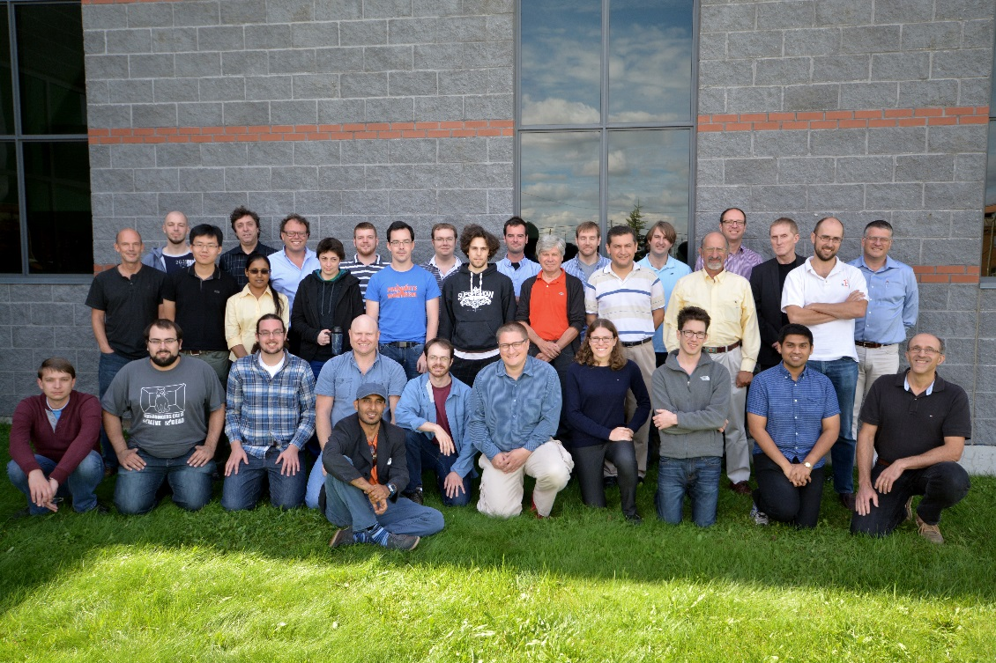
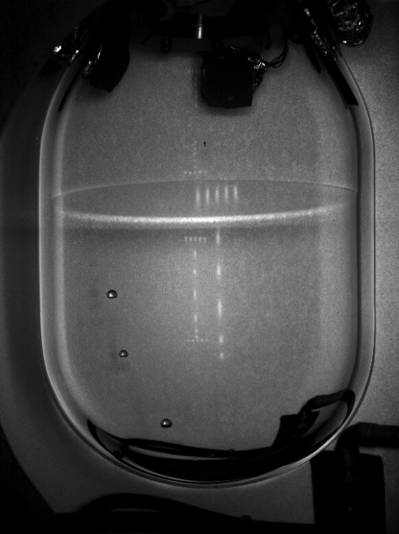
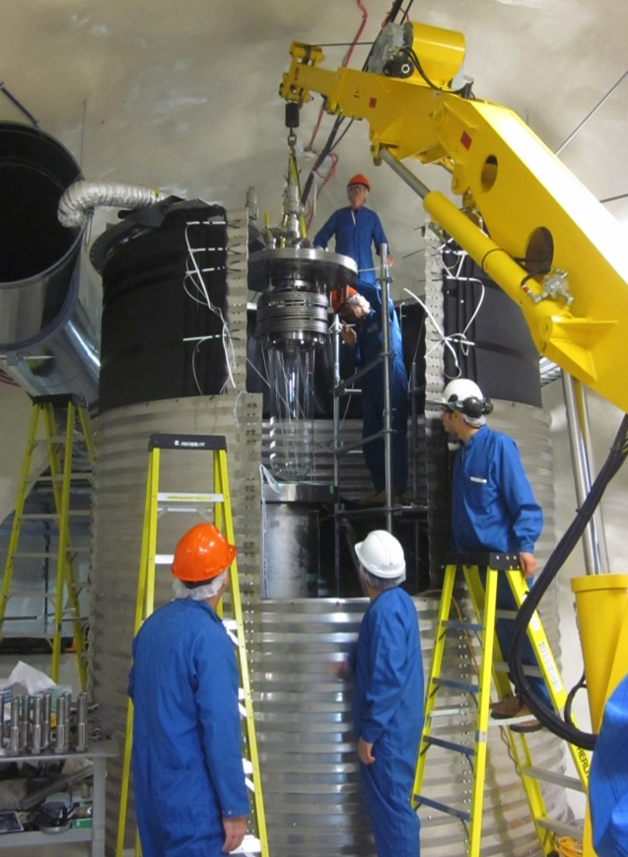
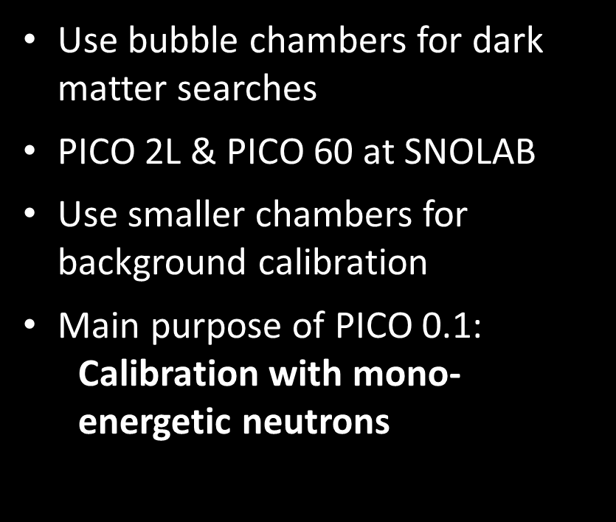
PICO collaboration
Use bubble chambers for dark matter searches
PICO 2L & PICO 60 at SNOLAB
Use smaller chambers for background calibration
Main purpose of PICO 0.1: Calibration with mono- energetic neutrons
1
Multiple bubbles in PICO 2L
PICO 60 during commissioning
Notes:
Bubble chamber -> threshold detector
PICO 2L -> World leading limit SD
Queen’s chamber for particulate and alpha calibration
PICO 0.1 -> Most stable chamber

Slide 3
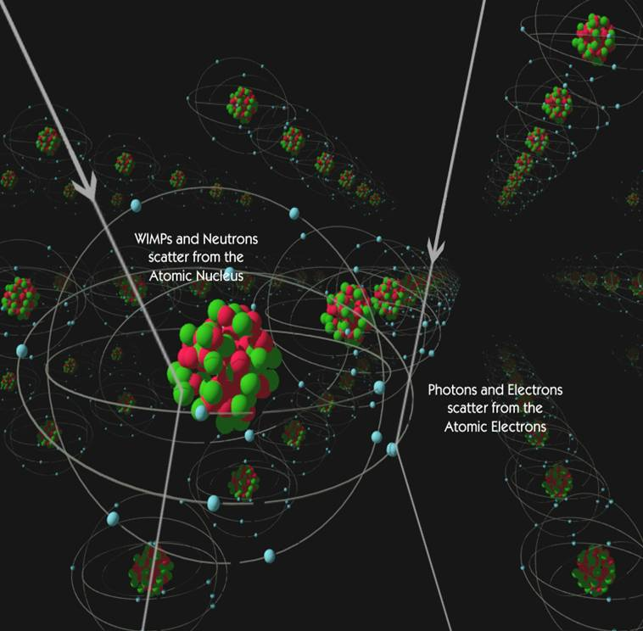
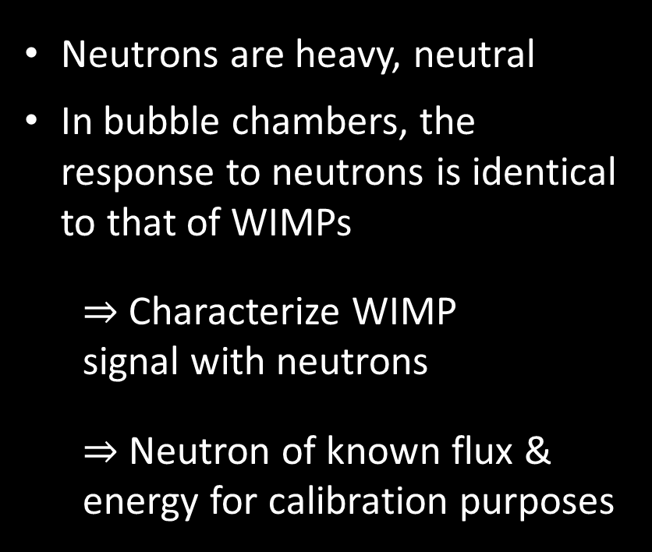
Why neutron calibration?
Neutrons are heavy, neutral
In bubble chambers, the response to neutrons is identical to that of WIMPs
Characterize WIMP signal with neutrons
Neutron of known flux & energy for calibration purposes
2
http://cdms.berkeley.edu/Education/DMpages/science/directDetection.shtml
Notes:
Neutrons won’t see electrons
-> Elastic scattering
Neutrons = major background in SNOLAB
Moderated by water, but…

Slide 4
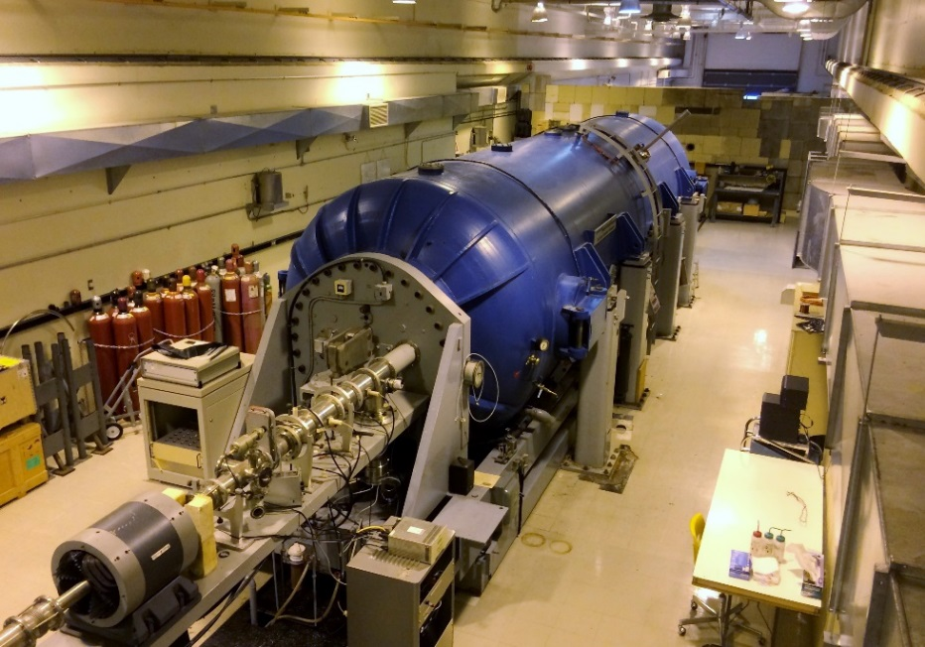
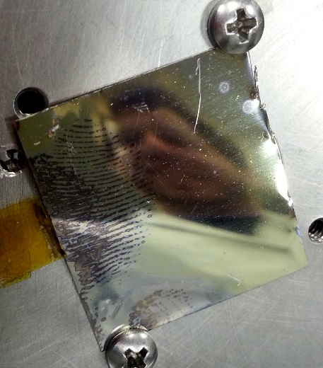
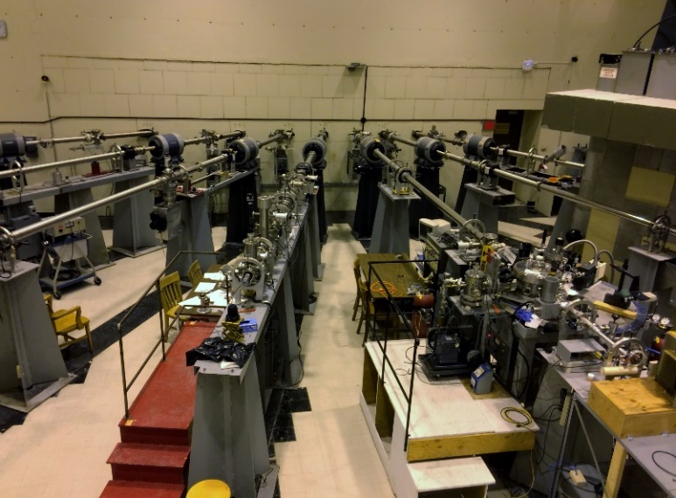
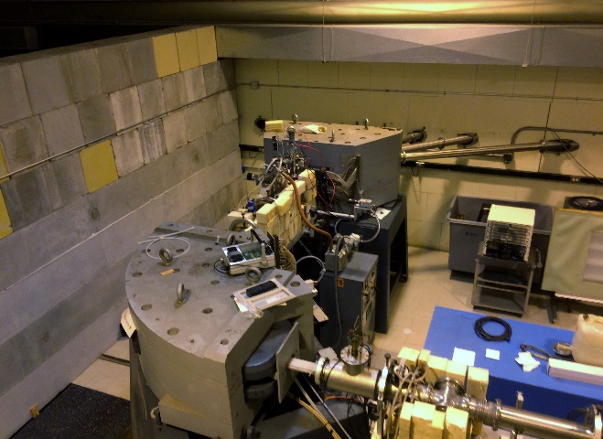

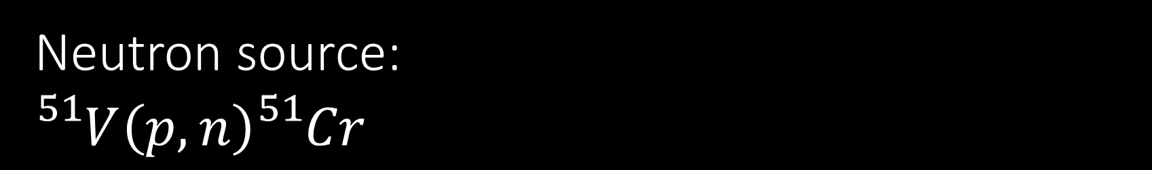
Neutron source:
$${}_{}^{51}{V\left(p,n\right){}_{}^{51}{Cr}}$$
1.6 MeV protons from Tandem Van de Graaff
$∆E_{p}=$ 0.2 keV
Use resonances in the ${}_{}^{51}V\left(p,n\right){}_{}^{51}{Cr}$ reaction
$\text{Mono}\text{−}\text{energetic} \text{neutrons}$
Vanadium Target
6 MV tandem Van de Graaff
Analysing magnet with NMR probe
Target hall
3
Notes:
Lucky to have tandem
Target thickness: 15 nm
Polished platinum substrate
Mono-energetic neutrons important because threshold detectors

Slide 5

Neutron source:
$${}_{}^{51}{V\left(p,n\right){}_{}^{51}{Cr}}$$
1.6 MeV protons from Tandem Van de Graaff
$∆E_{p}=$ 0.2 keV
Use resonances in the ${}_{}^{51}V\left(p,n\right){}_{}^{51}{Cr}$ reaction
$\text{Mono}\text{−}\text{energetic} \text{neutrons}$
Resonances in the ${}_{}^{51}V\left(p,n\right){}_{}^{51}{Cr}$ reaction
Ref.: J. H. Gibbons, R. L. Macklin, et H. W. Schmitt, ${}_{}^{51}{V\left(p,n\right){}_{}^{51}{Cr}}$ Reaction as a 5- to
120-kev Neutron Source, Phys. Rev. 100, 167 (1955).
4
Notes:
Lucky to have tandem
Target thickness: 15 nm
Polished platinum substrate
Mono-energetic neutrons important because threshold detectors

Slide 6
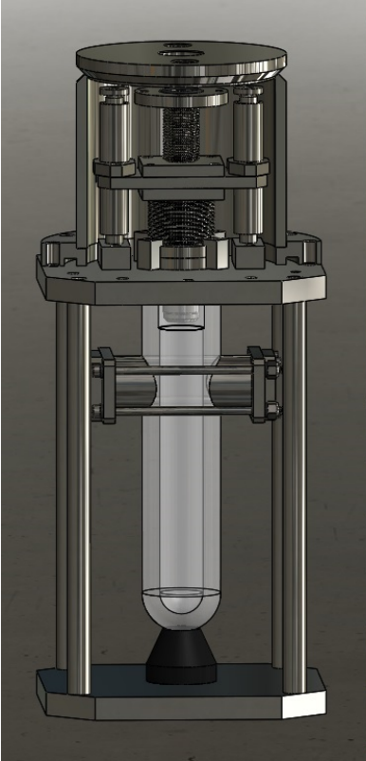
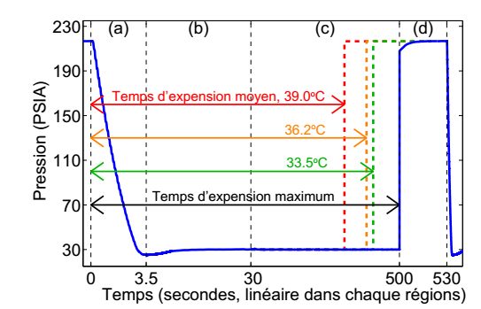
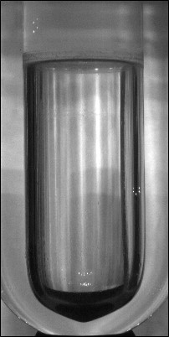

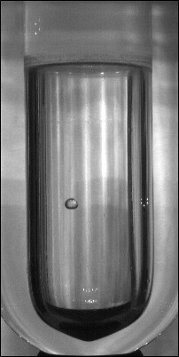
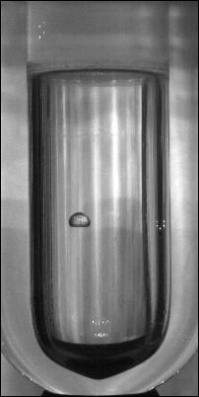


PICO 0.1
Mean expansion time, 39.0°C
Pressure (PSIA)
36.2°C
36.2°C
75 ml calibration chamber
Two piezoelectric sensors for event characterization
Inner vessel pressure transducer (Dytran) and four temperature probes for threshold determination
Two cameras at 90° for pseudo-3D imaging
Max. expansion time
Time (seconds, linear in each regions)
CAD concept of PICO 0.1
Event pressure as a function of time
5
Single bubble event in PICO 0.1. Time between frames: 13 ms
Notes:
Like PICO 2L
Two bellows
First chamber with LAB -> Cleaner?
Super stable
Start compressed 200 PSIA
Expand, active
Fast compressed

Slide 7

PICO 0.1
Mean expansion time, 39.0°C
Pressure (PSIA)
36.2°C
36.2°C
Active liquid: $C_{3}F_{8}$
First chamber filled with LAB (Linear Alkylbenzene) instead of water
Over 2 years of stable running
Max. expansion time
Time (seconds, linear in each regions)
CAD concept of PICO 0.1
Event pressure as a function of time
6
Single bubble event in PICO 0.1. Time between frames: 13 ms
Notes:
Like PICO 2L
Two bellows
First chamber with LAB -> Cleaner?
Super stable
Start compressed 200 PSIA
Expand, active
Fast compressed

Slide 8
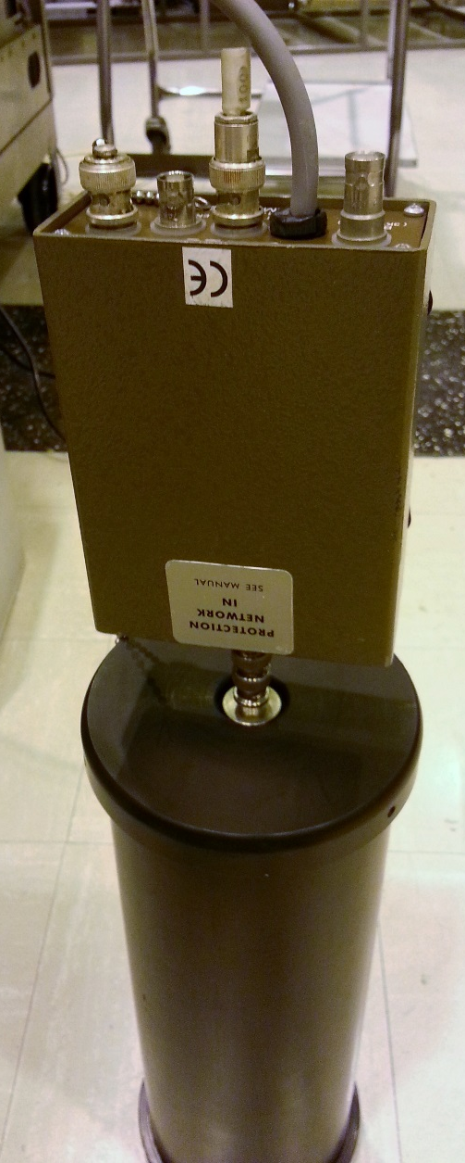
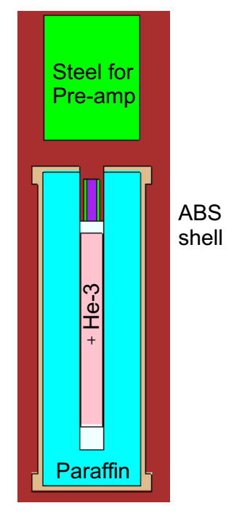
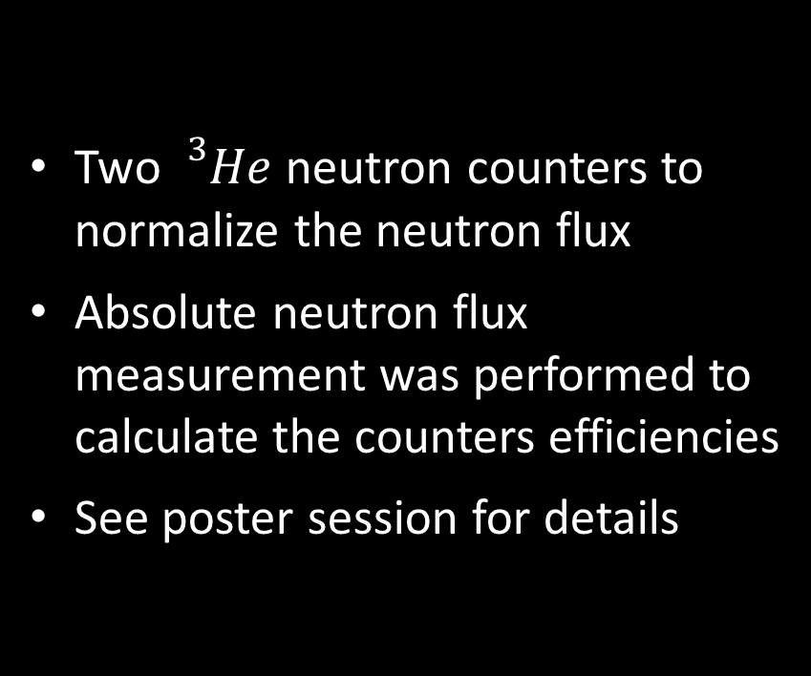
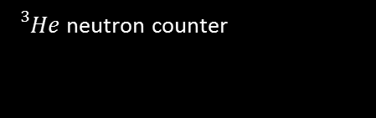
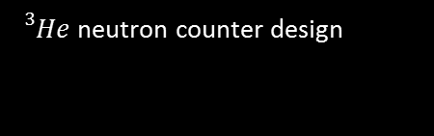
Absolute neutron flux normalization
Two ${}_{}^{3}{He}$ neutron counters to normalize the neutron flux
Absolute neutron flux measurement was performed to calculate the counters efficiencies
See poster session for details
7
${}_{}^{3}{He}$ neutron counter
${}_{}^{3}{He}$ neutron counter design
Notes:
$${}_{}^{3}{He+n_{th}→ {}_{}^{3}H+{}_{}^{1}H+760 keV}$$
Sens wire inside, see ionization from proton
Pulse = neutron

Slide 9
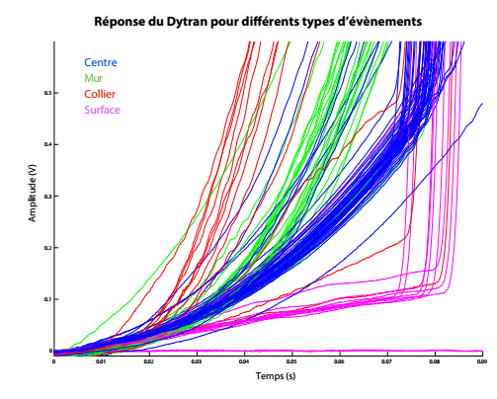
Pressure transducer signal
Dytran response for different types of events
Center
Bubbles formed in different locations expand at different rates
Signal rise time from pressure transducer informs on production sites of bubbles
Combine with acoustics to determine the multiplicity of an event
Wall
Collar
Surface
Amplitude (V)
Time (s)
Dytran analysis
8
Notes:
Surface: Less vaporisation
Wall & collar: faster mechanisim
In SNOLAB: neutron => multiple events
In small chambers: neutrons exit chamber fast
=> Monte Carlo for expected single to double

Slide 10
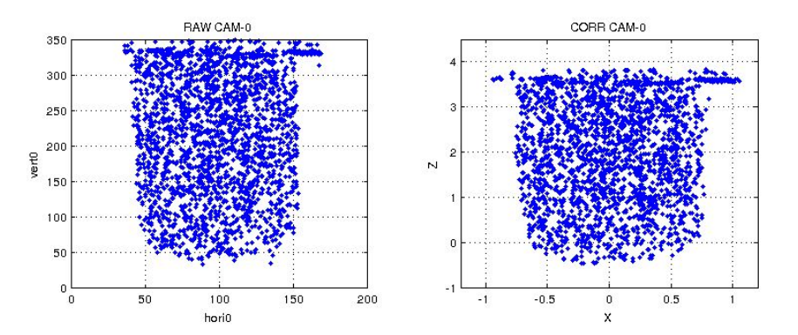
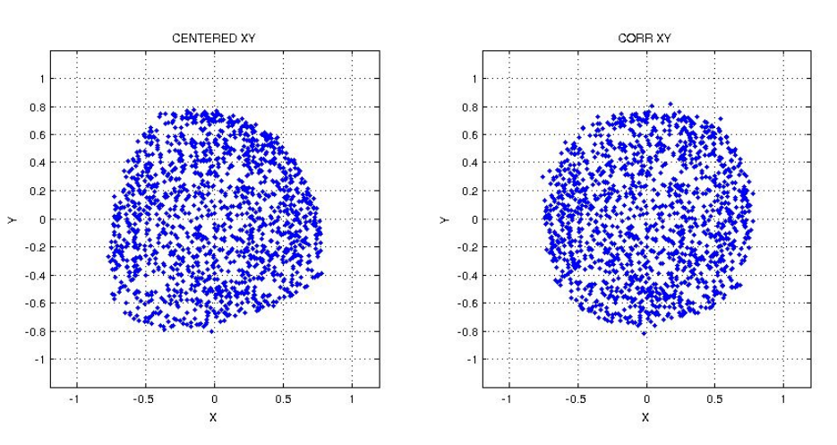
Fiducial cut
Use CCD images from the cameras to apply fiducial cut
Need to correct for refraction
Can use the Dytran analysis to exclude non-bulk events
Horizontal correction
9
X-Y correction

Slide 11
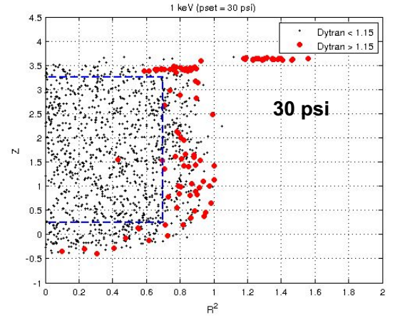
Fiducial cut
Use CCD images from the cameras to apply fiducial cut
Need to correct for refraction
Can use the Dytran analysis to exclude non-bulk events
Fiducial cut
10
Notes:
Poor optics at surface/collar

Slide 12
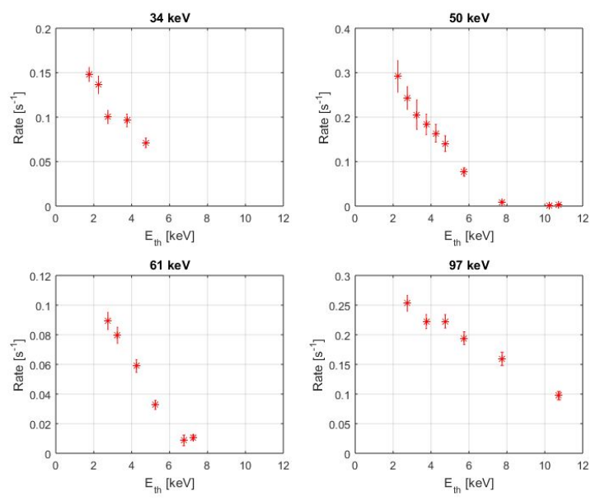


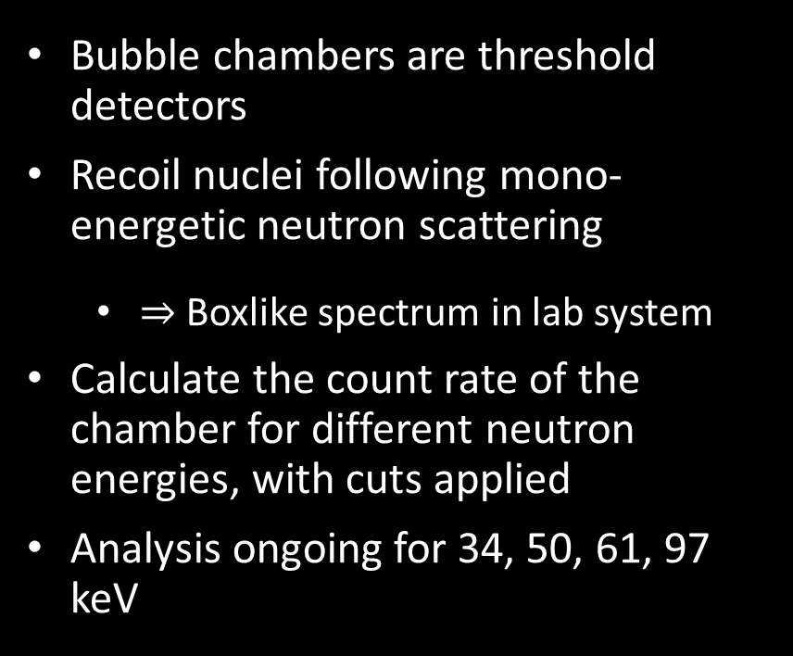



Results
1
1
Bubble chambers are threshold detectors
Recoil nuclei following mono-energetic neutron scattering
  Boxlike spectrum in lab system
Calculate the count rate of the chamber for different neutron energies, with cuts applied
Analysis ongoing for 34, 50, 61, 97 keV
0
0
$$E_{n} \left(keV\right)$$
$$E_{R} \left(keV\right)$$
Neutron energy spectrum
Recoil spectrum for mono-energetic neutrons
50 keV
1
$$Rate \left(s^{−1}\right)$$
0
$$E_{th} \left(keV\right)$$
$$E_{th} \left(keV\right)$$
11
Mono-energetic neutron response in bubble chambers
Experimental count rate for 50 keV neutrons

Slide 13
12
Notes:
Monte carlo to calculate nucleation probability

Slide 14
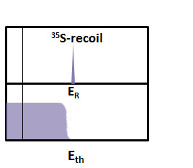
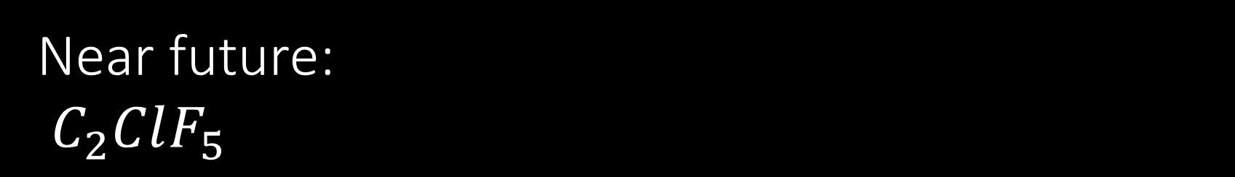

Near future:
$C_{2}ClF_{5}$
17 keV
³⁵Cl(n_{th},p)³⁵S
New Freon gas
New fill to be performed soon
Goal: Identify the 17 keV mono-energetic recoil from the ${}_{}^{35}{Cl(n_{th},p){}_{}^{35}S}$ reaction
600 keV (≤ 1keV in R_{C})
Thermal neutrons
Unique possibility to calibrate threshold curve
Determine model parameters (α, b,…), nuclear vs. electronic dE/dx
Tune Monte Carlo to data – absolute measurement possible
Thermal properties of R115 very similar to C₃F₈
 | T_{b}(ºC) | T_{c}(ºC) | ρ (20º)
C₃F₈ | -39.10 | 71.90 | 1.35
C₂ClF₅ | -39.22 | 79.95 | 1.50
13
Notes:
Exciting!
Can still see fast neutron response
But measurement far from there
First absolute calibration of threshold possible

Slide 15
Conclusion
We calibrated PICO 0.1 with mono energetic neutrons
This measurement will help characterize WIMP signal
Analysis ongoing
Threshold calibration in next months
14
Notes:
Poor optics at surface/collar

Slide 16
Thank you!

Slide 17
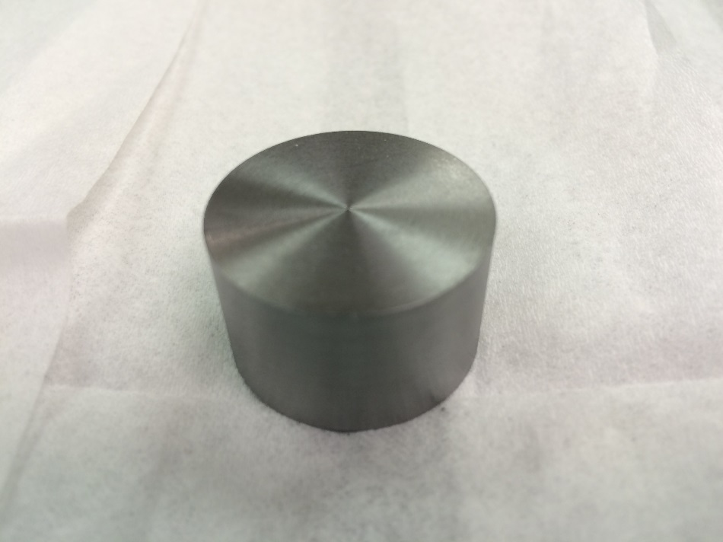
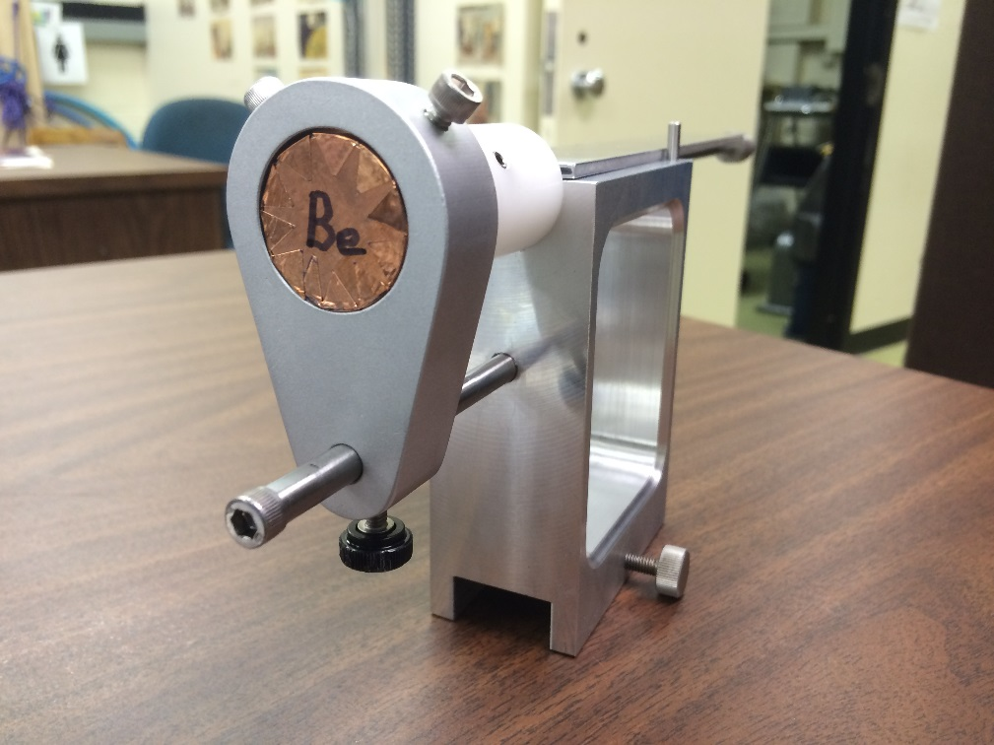

Extra slide:
SbBe neutron source
602 keV gamma from ${}_{}^{124}{Sb}$ decay
Gamma interact with ${}_{}^{9}{Be}$ to yield a 22 keV neutron
Source can be used to probe lower neutron energy
Beryllium disk
SbBe source setup

Slide 18
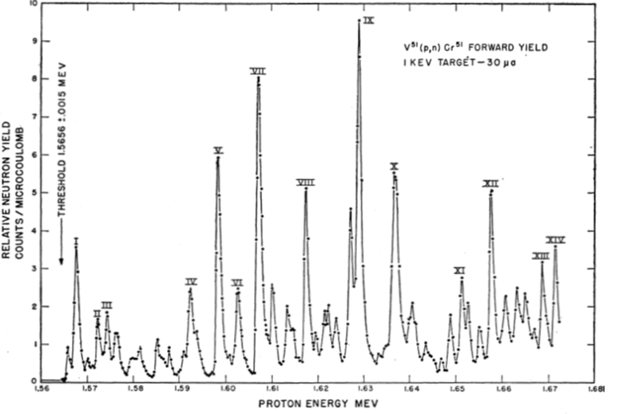
Extra slide:
Experimental neutron yield plot

Slide 19
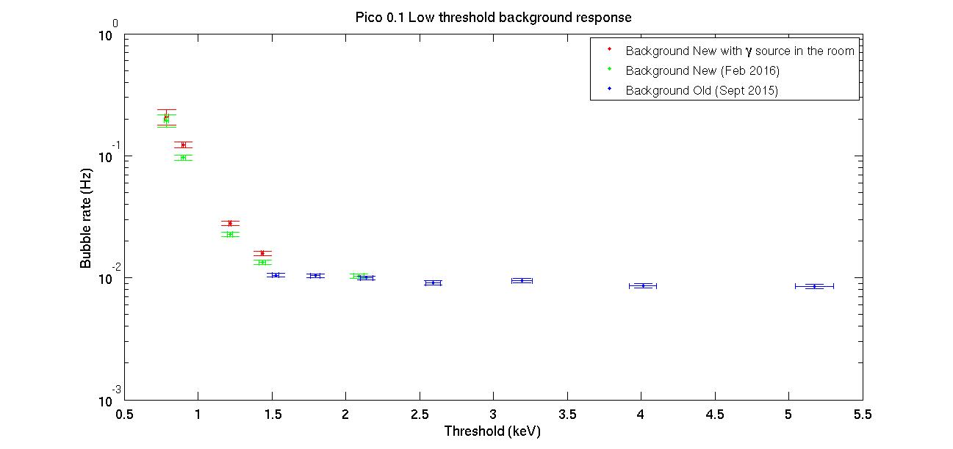
Extra slide: Low threshold measurement
Notes:
Neutron background is flat
Gamma rejection is great at threshold over 1.5 keV

Slide 20
Extra slide: Gamma rejection plot

