Slide 1

Phenomenological constraints on a Higgs-like dilaton with singlet scalar dark matter
Robyn Campbell
2016 CAP Congress
June 15th, 2016
Supervisor: Stephen Godfrey

Slide 2
Outline
Introduction to Standard Model
Motivation for New Physics
Model: HLD+SS Dark Matter
Constraints on model parameters
Summary

Slide 3

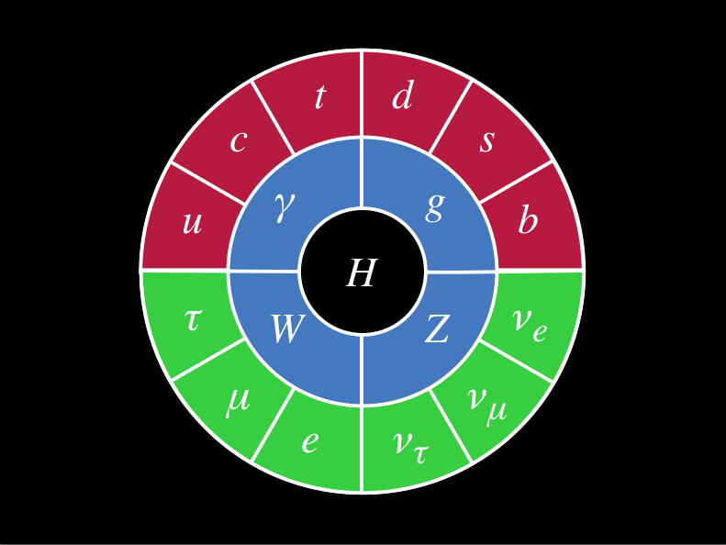
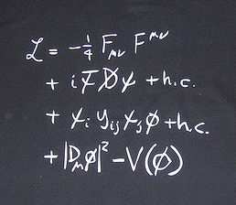
The Standard Model
describes dynamics and interactions of elementary particles
unified framework for the electromagnetic, weak, and strong interactions
while very successful, cannot be a “complete” theory
Notes:
Incr font

Slide 4
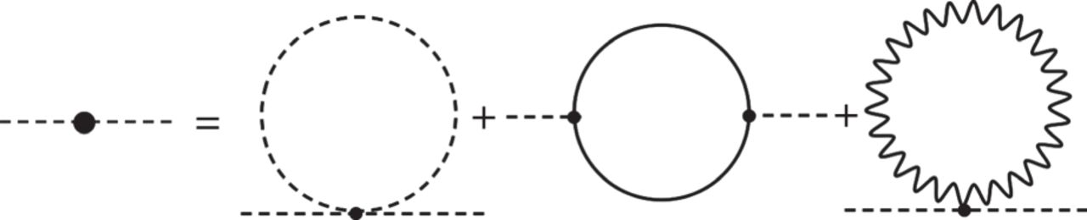
Motivation for BSM Physics
SM Higgs mechanism doesn’t explain values of parameters or quadratic divergence to loop corrections of square of Higgs mass
For corrections comparable to the order of the Higgs mass, Λ~1 TeV
Expect new physics at that scale
E
High energy EFT
Λ
Low energy EFT (i.e. SM)
Notes:
Show diagram for divergence
mPlanck
Redemy with model without a mass term in the lagrangian: scale invariant. We do end up with massive particles so scale invariance is broken at some scale

Slide 5
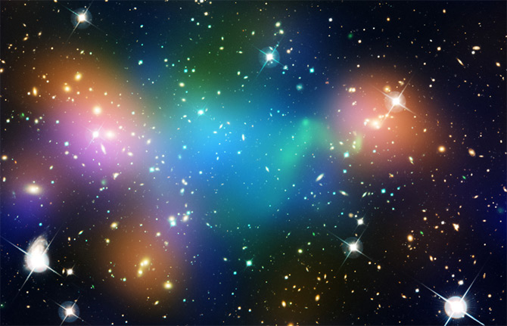
Dark Matter
Lots of evidence for the existence of DM, including galactic rotation curves, gravitational lensing, CMB…
No candidate in the Standard Model
Known: energy density, galactic velocity, neutrality, abundance, small-scale clumping
Merging galaxy cluster Abell 520 (image credit: NASA)
Notes:
Galactic rotation curves: rotational/orbital speeds of stars does not decrease with distance from galactic center
Gravitational lensing: light will bend due to the strength of a gravitational field; the mass that curves spacetime will also bend light. If there is a massive object between earth and an astronomical object, the image you receive of said astronomical object may be distorted or replicated.
Velocity dispersions: “missing matter” in elliptical galaxies, viralized up to 10 times visable radii
KNOWN:

Slide 6
Model
Introducing a theory with no mass term in the Lagrangian, has conformal invariance
Explicit breaking gives a Goldstone boson: the dilaton
Dilaton given properties of observed 125 GeV Higgs boson
Singlet serves as dark matter candidate
R. Campbell, 15/06/16
Notes:
, is classically conformally invariant
If the coupling leads to a fully conformal
If, in the theory, couplings do not run, then you will have an exact conformally invariant theory
If this symmetry is spontaneously broken, the low energy effective theory below the breaking scale contains a goldstone boson called the dilaton.
-the couplings of dilaton to SM is dictated by nonlinear realization of confoirmal symmetry below breaking scale
-the remarkable thing is this is very much like SM higgs since at classcial level the SM had an approximate conformal symmetry
Dilaton not breaking EW theory, something else is. (dilaton not doing job of the Higgs), ignore how that happens, for the time being
Effective theory of a light dilaotn

Slide 7
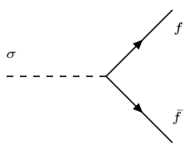
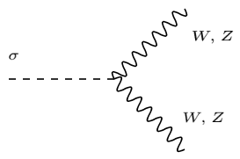
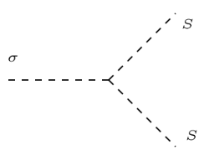



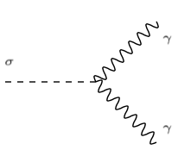
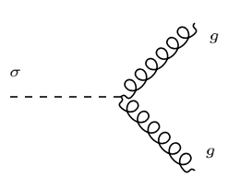
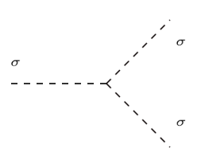



Model: Feynman Rules
Parameters: m_{S}, c_{gg}, c_{ϒϒ}, ε=v/f, λ_{p}

Slide 8
Constraining the Model
Signal strengths
Invisible width
Direct detection
Relic abundance
Notes:
How can we constrain this model?
-Higgs precision, etc
Incr font

Slide 9
Signal Strengths
Signal strengths defined as:
Minimize Χ² to constrain ε, c_{γγ,} c_{gg}
Notes:
Put expression to define- in terms of parameters of model. Move earlier
Define production and decay
Define branching ratio
Gamma_total. Give example

Slide 10
Signal Strengths
Notes:
Including DM, only include signal strength, and total width as an additional constraint, ms becomes additinoal data. 2012 result from barger. Total width changes with ms below half mass of higgs
Include other analogous plot with/without the total width.

Slide 11
Invisible Widths
Experimentally interested in branching ratio
ATLAS (arXiv:1509.00672) gives upper bound of ~0.23
Notes:
Cite ATLAS: regenerate plot
M_{s} possibly decay to Z- how to incorporate?
REMAKE INVISIBLE WIDTH PLOT- MAKE PRETTY. INCLUDE RATIOS?

Slide 12
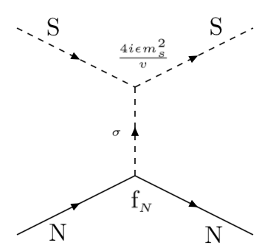
Direct Detection
σ
searches for nuclear recoils between target and new particles. m_{S} in range 10-1000 GeV/c² gives recoil in range of 1-100 keV.
Notes:
http://arxiv.org/pdf/1509.08767v1.pdf

Slide 13
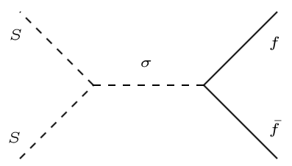
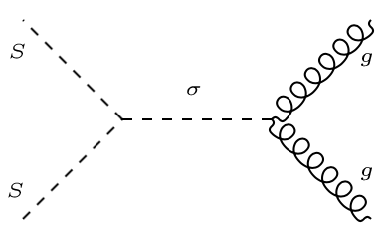
Relic Abundance
Consider all possible annihilation cross sections, i.e.:

Slide 14
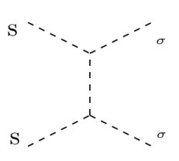
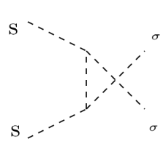
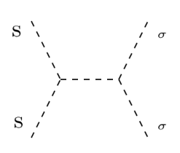
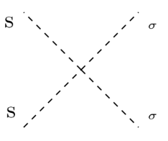
Relic Abundance
(1)
(2)
(3)

Slide 15
Relic Abundance
Clearly singlet cannot account for entire abundance
Much of this parameter space is already ruled out by direct detection constraints

Slide 16
Summary
Model is interesting for its scale invariance and dark matter candidate
Used experiment to constrain parameters of model HLD+SSDM
Looks as though dilaton lives, although in very constrained parameter space
In progress: total fit
Acknowledgements:
Stephen Godfrey*
Alejandro de la Puente*
Rouzbeh Yazdi
Alexandre Poulin
* collaborators

