Slide 1








Microstructure and hydrogen
storage properties of FeTi + x wt.% Hf alloys (x = 0, 4, 8 and 12)
By : Volatiana RAZAFINDRAMANANA
Jean-Louis BOBET and Jacques HUOT
At the 2016 CAP Congress – 15th of June 2016

Slide 2





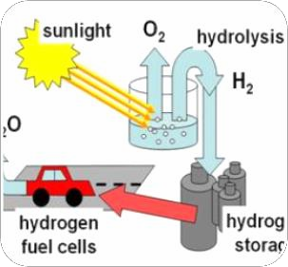


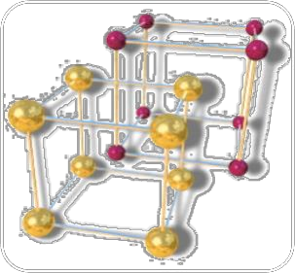


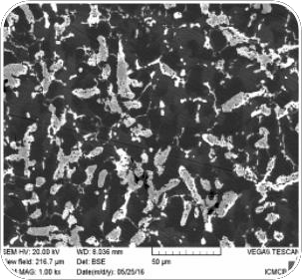




Outline
State of art
Metal Hydride
Fe-Ti-Hf system
Conclusion
1. State of art
Renewable energy
  Hydrogen
    Metal Hydride
      FeTi alloy
Fe-Ti-Hf system
  Microstructure
First hydrogenation properties
  Conclusion
    Outlook
Perspectives
2

Slide 3










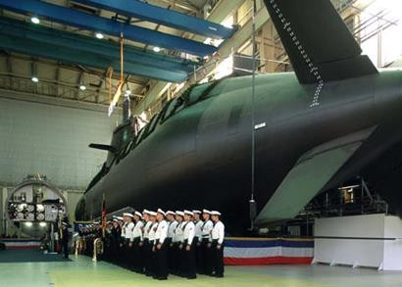
Outline
State of art
Metal Hydride
Fe-Ti-Hf system
Conclusion
Energy : big challenge of the XXI century
High population
growth
Limited reserves of fossil fuel
Renewable
energy
Reduction in emissions of greenhouse gases
Urban transport
Electronic
HYDROGEN
« Stationary » application
3

Slide 4
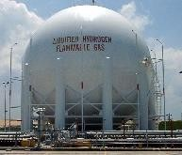



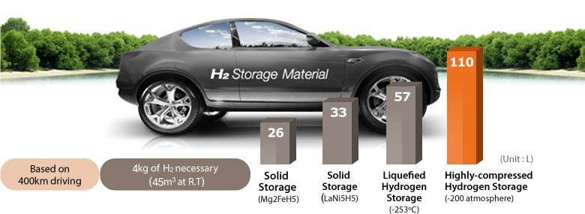
Outline
State of art Metal Hydride Fe-Ti-Hf system
Hydrogen storage
Conclusion
H₂
Hydrogen liquid
-253°C / 1 atm
Compressed 25°C / 350 to 700 atm
Metal hydride 25°C – 1 atm
Best way to store hydrogen
4

Slide 5
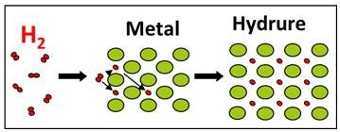
Outline
State of art
Metal Hydride
Fe-Ti-Hf system
Conclusion
Metal
Metal hydride
1
3
2
Adsorption (and dissociation) of hydrogen
Diffusion of hydrogen (absorption)
Total absorption of hydrogen in the material

Slide 6



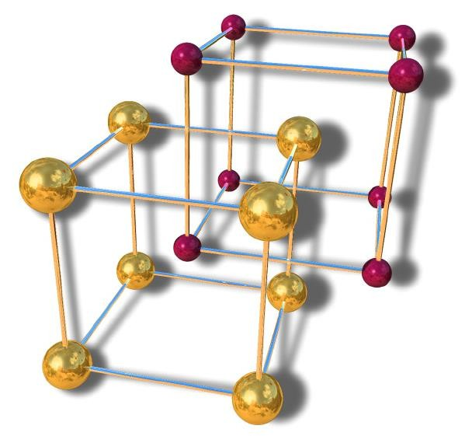





Outline
State of art
Metal Hydride
Fe-Ti-Hf system
Conclusion
FeTi alloy
Fe
Ti
Space group Pm3m

Slide 7
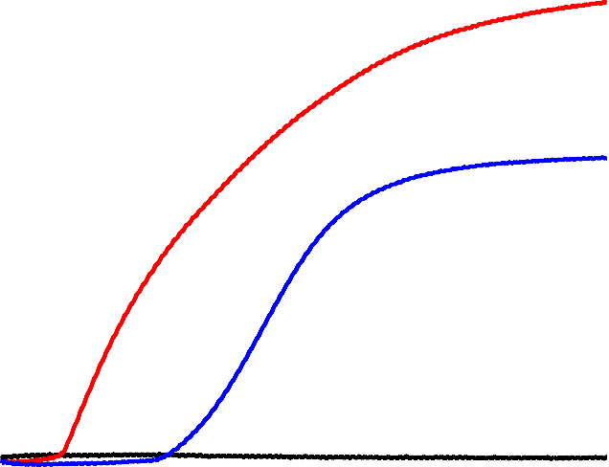
Outline
State of art Metal Hydride Fe-Ti-Hf system
Alternative process
Conclusion
Substitute Fe by Mn
Add some dopants such as :
)
l
a
t
o t
s
d
i
o p
(%
e
n
è g
ro
yd H
1,6
Hydrogen absorbed (wt.%)
FeTi+Zirconium
1,4
Zirconium (Zr),
Nickel (Ni),
Zr₇Ni_{1O},
Hafnium (Hf)
1,2
1,0
FeTi+Nickel
0,8
0,6
0,4
0,2
FeTi
0,0
0
1
2
3 4
Time (h)
5
6
7
Temps (h)
Activation curves of FeTi and FeTi doped with
Zr and Ni, at 25°C under 45 bar of H₂.

Slide 8
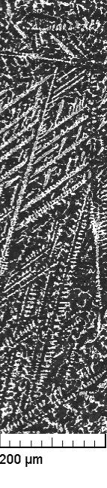
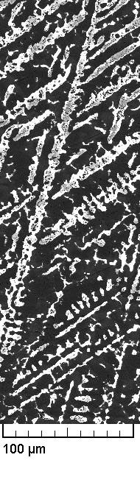
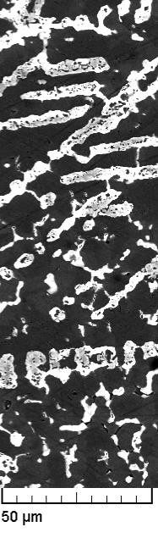
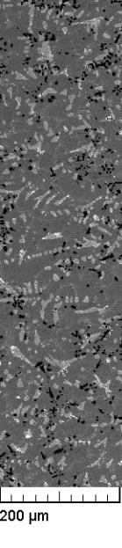
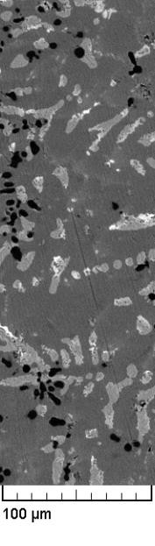
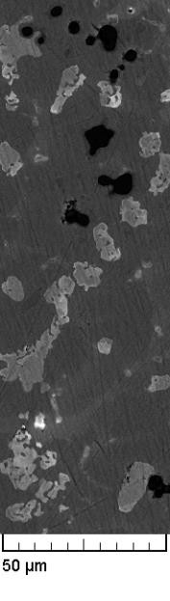
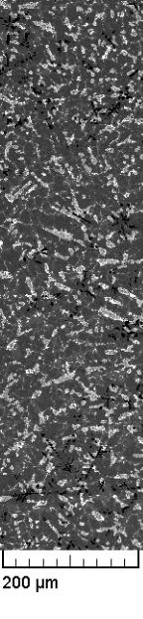
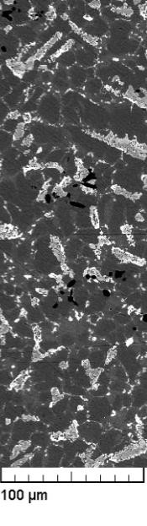
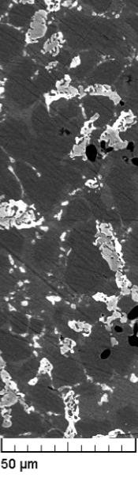
Outline
State of art Metal Hydride Fe-Ti-Hf system
Conclusion
Microstructure
FeTi + 8wt.%Hf
A
FeTi + 4wt.%Hf
FeTi + 12wt.%Hf
A
A
B
B
B
Matrix (A) + secondary phase (B)
Presence of dendritic phase

Slide 9
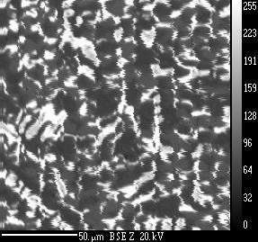
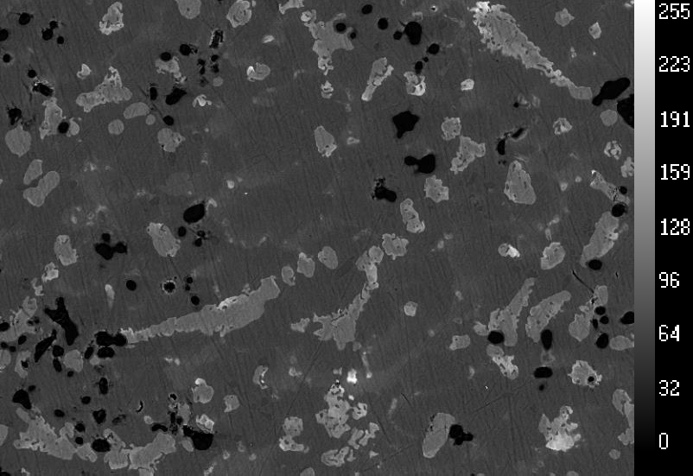
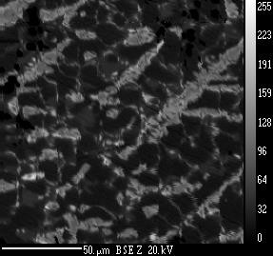
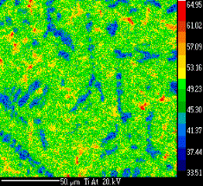
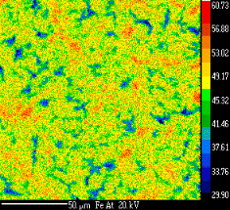
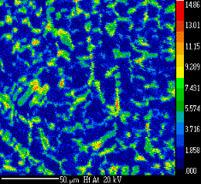
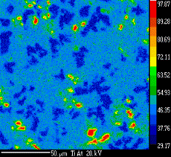
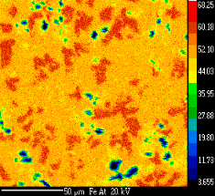
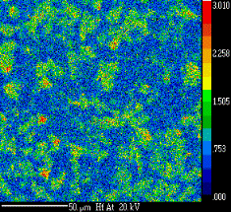
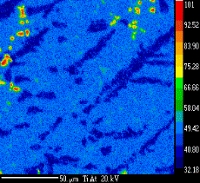
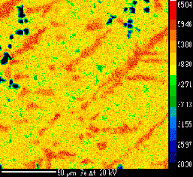
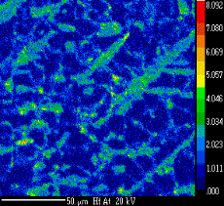
Outline
State of art Metal Hydride Fe-Ti-Hf system
Element mapping by EPMA
Conclusion
FeTi + 4wt.%Hf FeTi + 8wt.%Hf
FeTi + 12wt.%Hf
Ti
Ti
Fe
Hf
Phase Composition | FeTi + 4wt.%Hf | FeTi + 8wt.%Hf | FeTi + 12wt.%Hf
Matrix | 48.9Fe – 49.0Ti – 1,9Hf | 49,7Fe – 49,5Ti – 0,7Hf | 49.3Fe – 49.7Ti – 1.0Hf
2nd phase (1) | 53,2Fe – 40.3Ti – 6,4Hf | 58,5Fe – 39,9Ti – 1,6Hf | 56.7Fe – 40.4Ti – 2.8Hf
2nd phase (2) | 34.5Fe – 59.8Ti – 4.7Hf | - | -

Slide 10
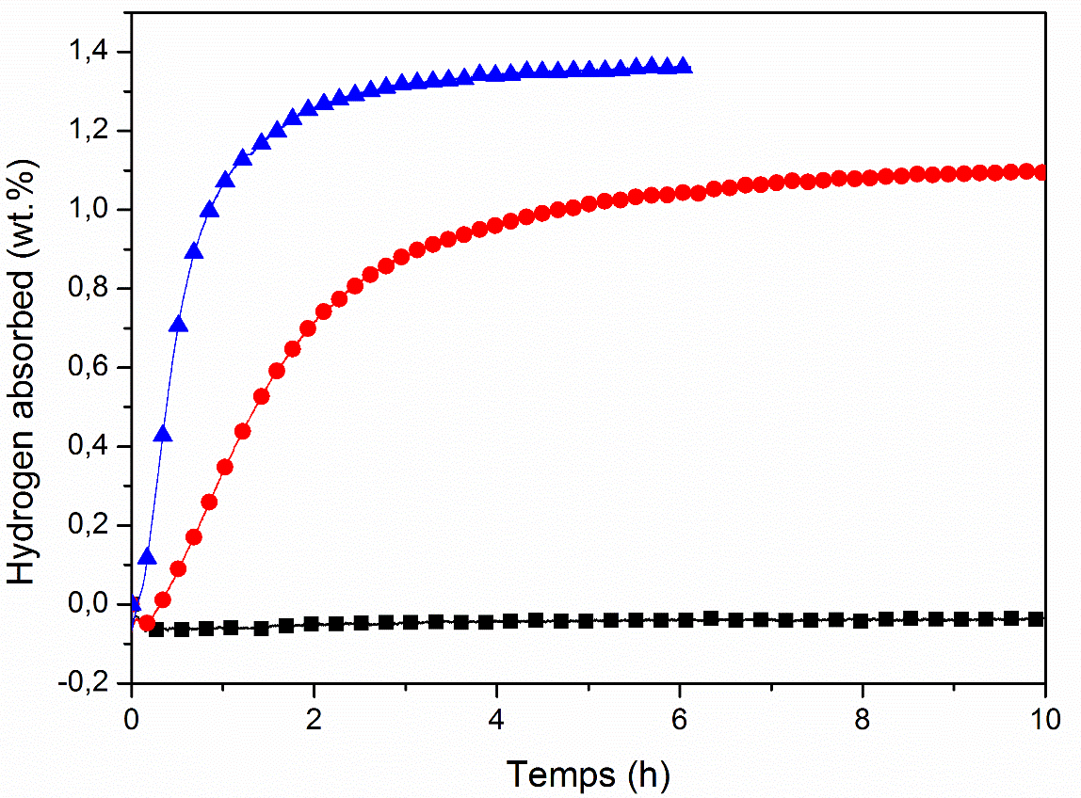
Outline
State of art Metal Hydride Fe-Ti-Hf system
Activation properties
Conclusion
FeTi + 12wt.% Hf
Need a minimum of 8wt.% of Hf to activate FeTi
FeTi + 8wt.% Hf
No incubation time
Kinetic increases with wt.% Hf
FeTi + 4wt.% Hf
% Hf | 4 | 8 | 12
% H abs. | 0 | 1.1 | 1.4
Activation curves of FeTi + x wt.%Hf
(x = 4, 8 and 12), at 25°C under 20 bar of H₂.
10

Slide 11

Outline
State of art
Metal Hydride
Fe-Ti-Hf system
Conclusion
Resume
FeTi needs a minimum of 8wt.% Hf to be activated
  Role of the Ti rich phase
FeTi alloy doped with hafnium has a good industrial base
  Low cost
  First hydrogenation at room temperature
  Fast kinetic
Perspective
Identify the 2nd phase by neutron diffraction
11

Slide 12








CAP Congress organizers J.Huot & JL.Bobet
Region Aquitaine My colleagues
Thank you for your attention
Questions ?

