Slide 1
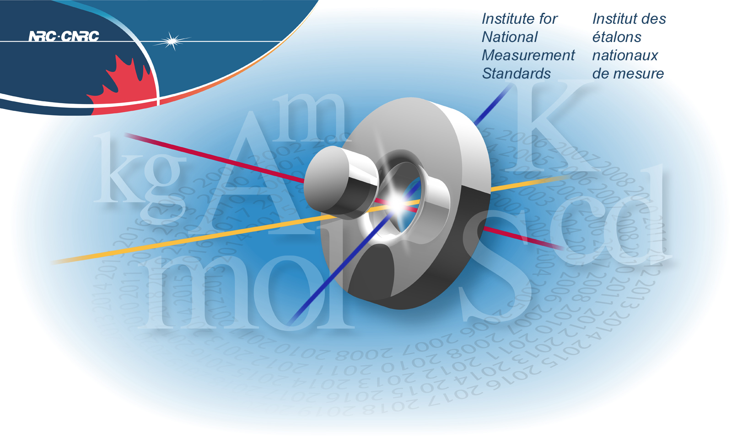


Welcome to the New Age: Realization of an Ultra-Accurate, Single Ion Clock at the Quantum Mechanical Stability Limit
Measurement Science Science et étalons
and Standards Portfolio des mesures
A.A. Madej, P. Dubé, B. Jian
June 13 , 2016
2016 CAP Congress, Ottawa, ON

Slide 2
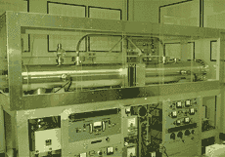
Introduction: Moving Beyond the current SI Second
Since 1967, the international definition of the second is based on the hyperfine Transition in 133Cs at 9.1 GHz.
For almost 5 decades, the various realizations of the current SI second have improved in evaluated uncertainty at a rate roughly of a factor of 10 every decade (now at the level of 1 x 10-16) .
Optical High Resolution Spectroscopy, Laser Cooling, and Trapping methods have made vast improvements in the evaluated uncertainty and stability of the probed optical transitions such that the performance of such transitions promises to outperform the current SI realizations.
That Promise is now a reality !

Slide 3

The Rapid March of Optical Frequencies to Ultra-low Uncertainty

Slide 4
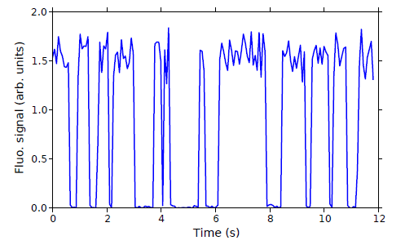
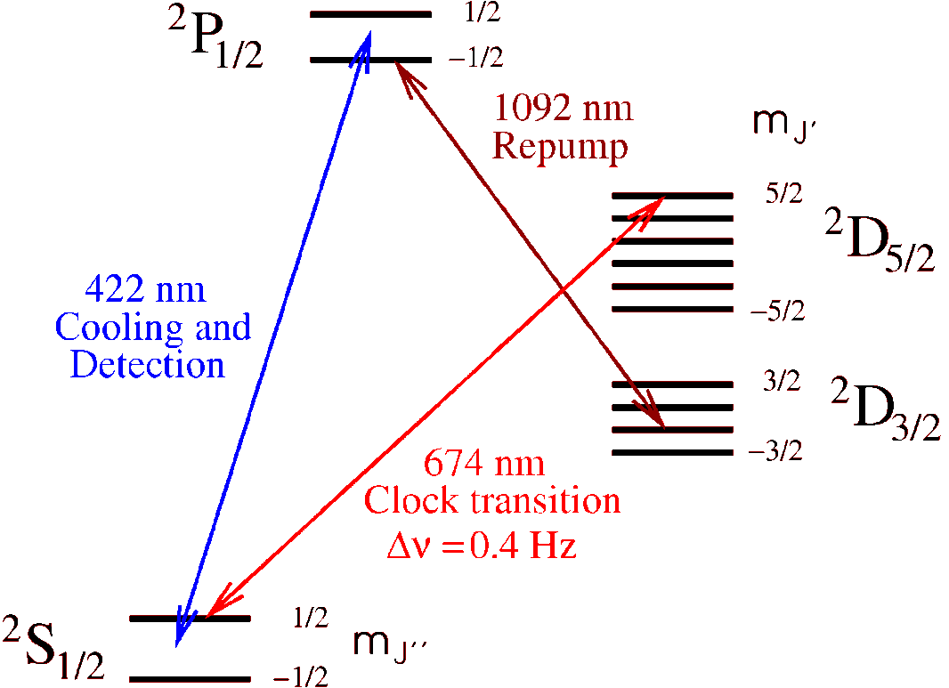
⁸⁸Sr⁺ Single Ion System
A Single Sr+ Ion is held in an Endcap Trap of 0.52mm electrode spacing and cooled to 1.8 mK.
Probing on S-D quadrupole transition (0.4Hz) using ULE cavity stabilized diode laser.
When the ion is excited in the upper D state it can be cleared following detection using 1033nm.
Recent work using circularly polarized 422 nm has achieved state preparation of the ground state before probing.

Slide 5
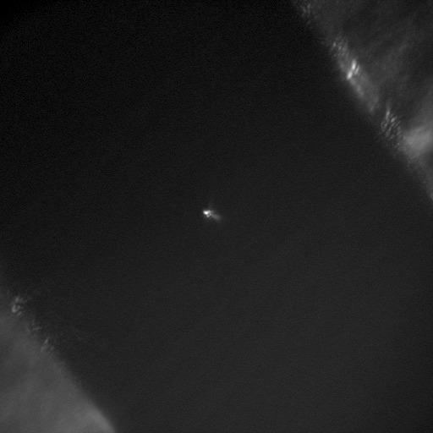
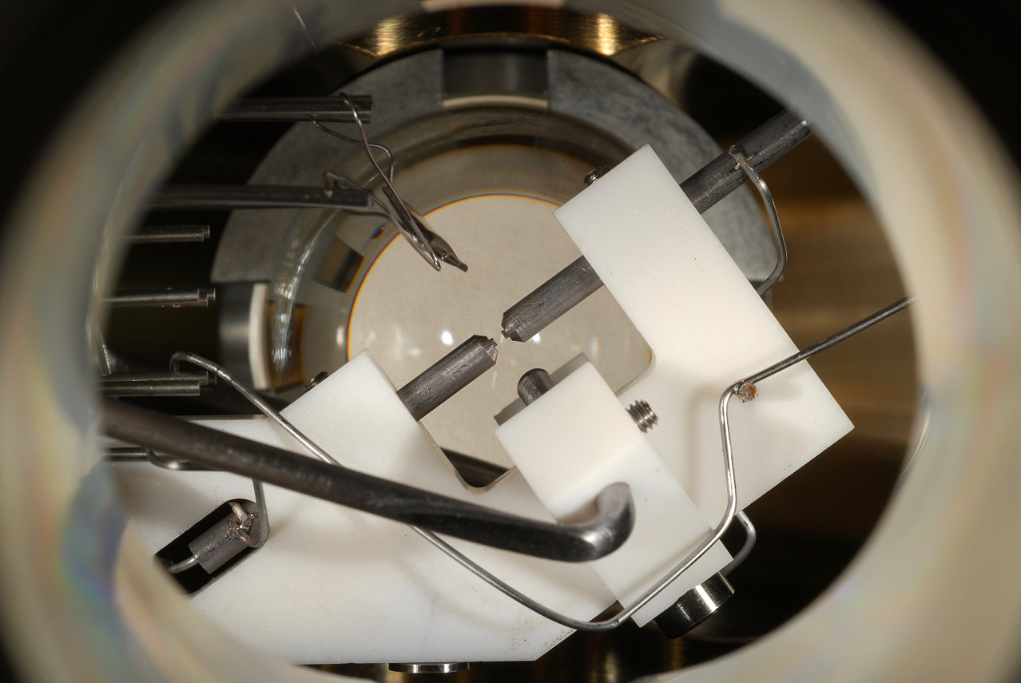

Slide 6
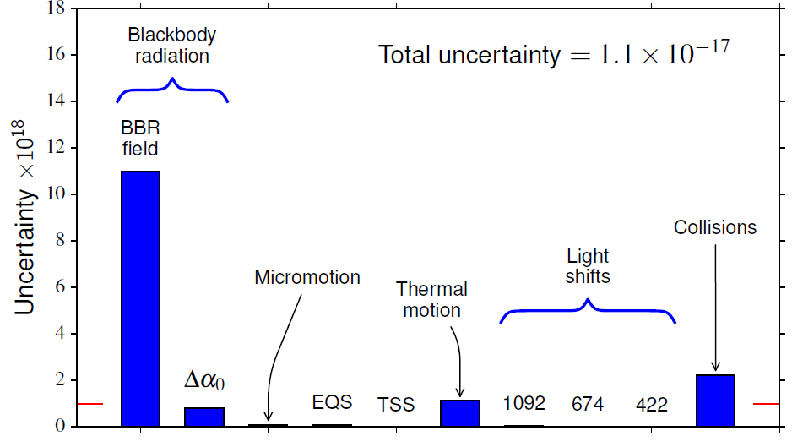
Revised Uncertainty Budget for NRC ⁸⁸Sr⁺ System
P. Dubé, A.A. Madej, M. Tibbo, and J.E. Bernard, Phys. Rev. Lett. 112, 173002 (2014).
Using our developed techniques of quadrupole shift cancellation and now, the suppression of micromotion shifts, a significant low level of uncertainty is achieved. After current evaluation, 3 X 10-18 in reach.

Slide 7
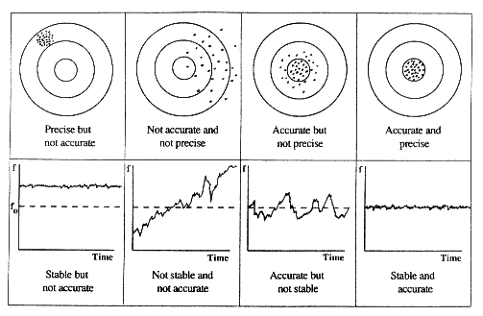
High Accuracy and Precision in Frequency References

Slide 8

The Quantum Limit of Stability for Probed Transitions
Consider excitation between two states |A⟩ and |B⟩ . In general, the state will be represented by a generalized state vector |Ψ⟩ = α |A⟩ + β |B⟩. The probability of being in the upper state is p_{B} = β². The quantum projection measurement has a variance:
(ΔP_{B})² = ⟨(P_{B} - ⟨P_{B}⟩)²⟩ = p_{B} (1 – p_{B})
This variance leads to a noise in the read out of the state depending on the relative population probability of :
Noise =
|Ψ⟩ = α |A⟩ + β |B⟩
|B⟩
|A⟩
Noise =
W.M. Itano et al., Phys. Rev. A 47, p. 3554-3570 (1993).

Slide 9

Stability in Frequency Limited by Quantum Uncertainty
X
Noise =
Stability ≈
Where T_{c} is the cycle time of the probe and τ is the averaging time at transition frequency ν_{ο}.

Slide 10
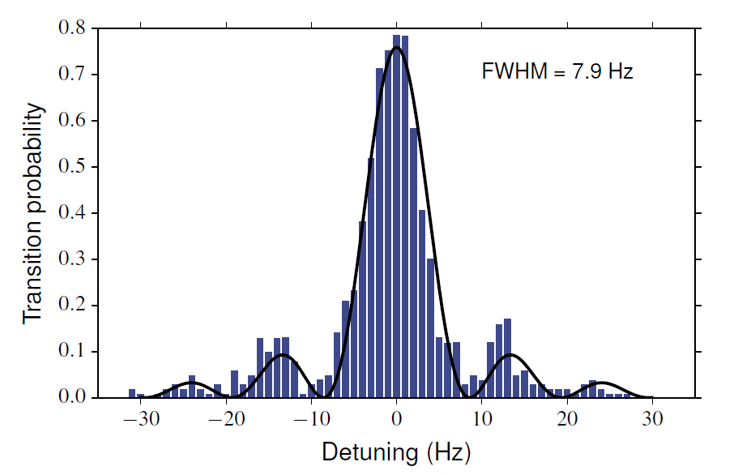
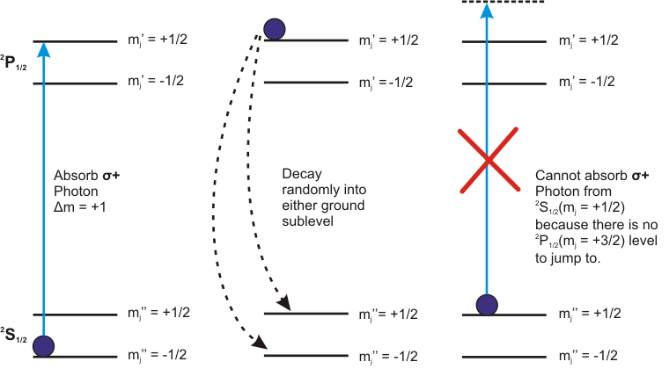
Demonstration Of Ground State Preparation
By ending the 422 nm cooling phase using circularly polarized light propagating along the quantization axis, it was possible to obtain extremely efficient preparation of the desired Zeeman sub level for probing, thus doubling the transition rate.

Slide 11
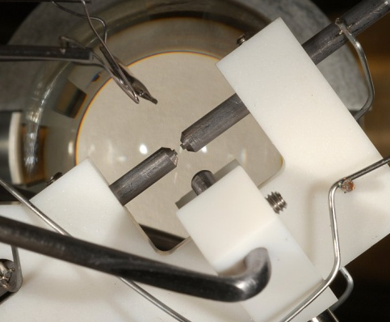
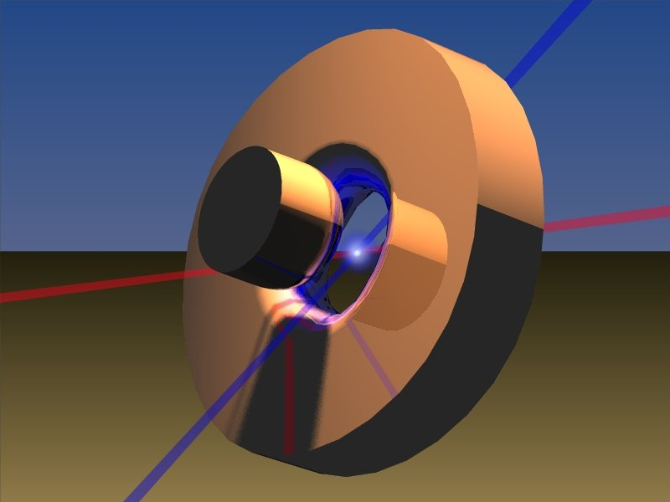
Comparison of Reference Frequency With Different Generation NRC Trap Systems
NRC Endcap Trap
NRC Paul Trap

Slide 12
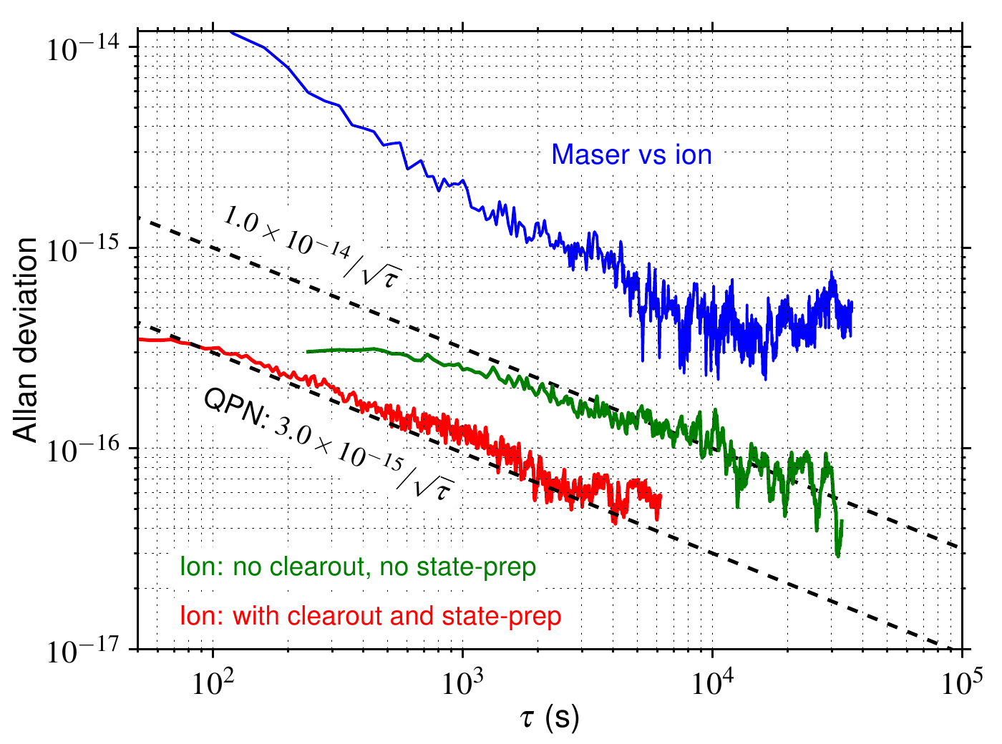
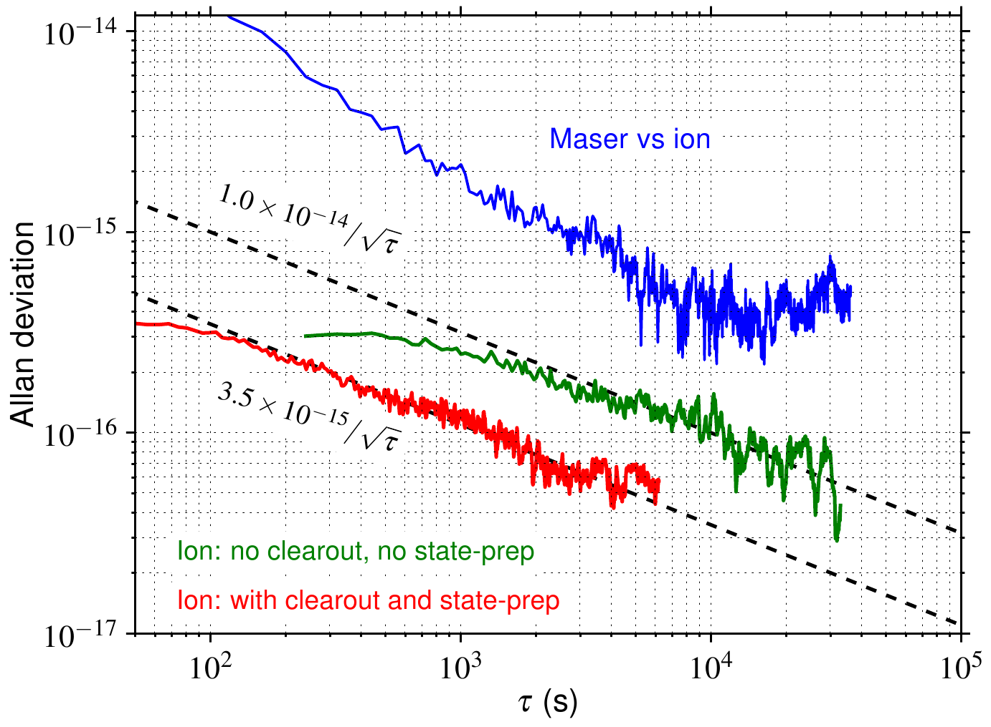
Ion Standard Approaching the Quantum Projection Noise Limit
With excitation pulses of τ=57ms duration, instabilities of (3.5×10-15)/sqrt(τ) are obtained when state preparation and D state clearout are employed.
This value is in agreement with the expected quantum projection noise limit for this pulse duration of (3.0×10-15)/sqrt(τ).
P. Dubé, A.A. Madej, A. Shiner, and B. Jian, Phys. Rev. A 92, 042119 (2015).

Slide 13
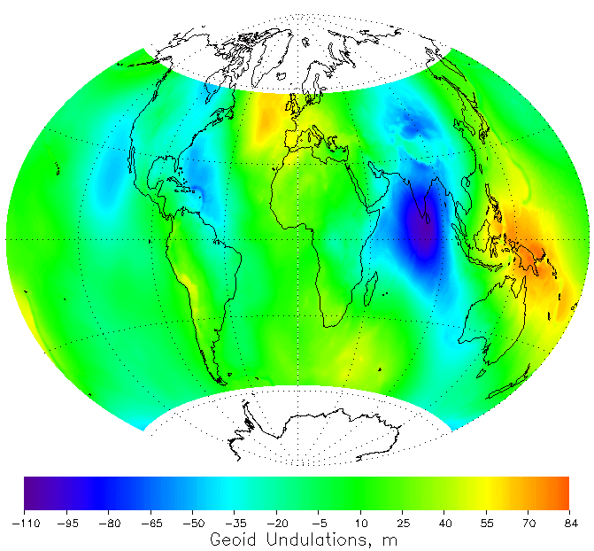
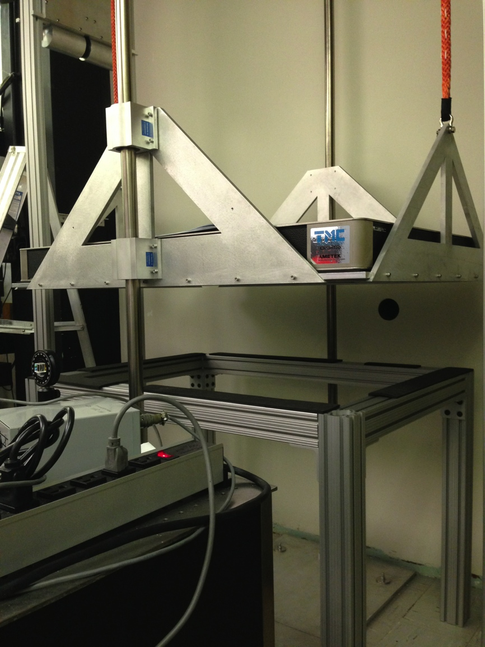
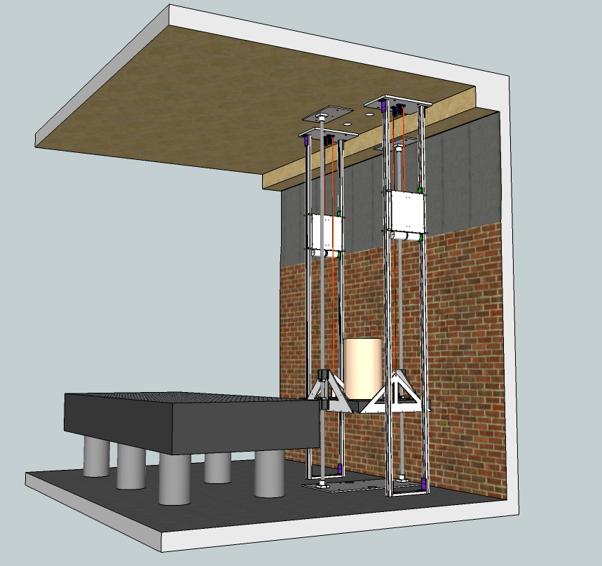
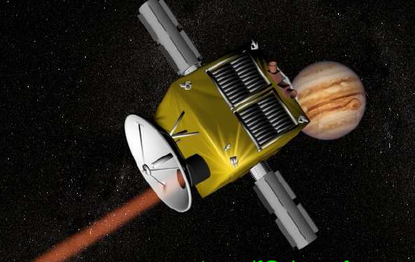
What Does the New Age promise?
Redefinition of the SI second in the coming years (2026?) and improvement in world time keeping.
Tests of Time Variation of Fundamental Constants (α(t), μ(t) )
Measurement of Gravitational Red shift at cm level and below. Improved Tests of Relativity.
Mapping of absolute gravitational potential using clocks for the study of earth’s geoid and mass distributions on the planet “Relativistic Geodesy”.
Application of new time standards to search for Relativity tests, low frequency gravitational waves, and dark mass via space probes.
New Physics?

Slide 14


Thank you
14

