Slide 1


DHCAL with Minimal Absorber: Measurements with Positrons
Benjamin Freund¹², Coralie Neubüser¹³, José Repond^{1,}
Francois Corriveau²
¹ Argonne National Laboratory
² McGill University
³ DESY
CAP 2016
12.06.16

Slide 2

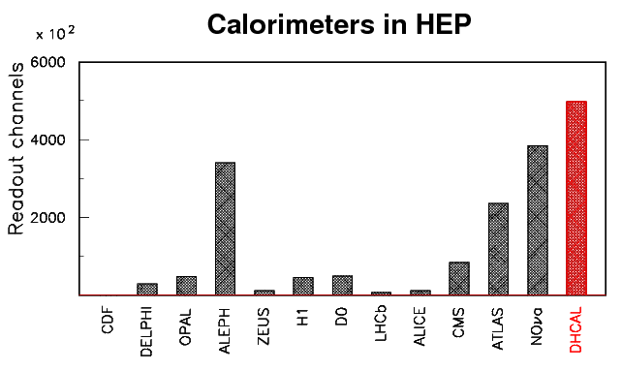
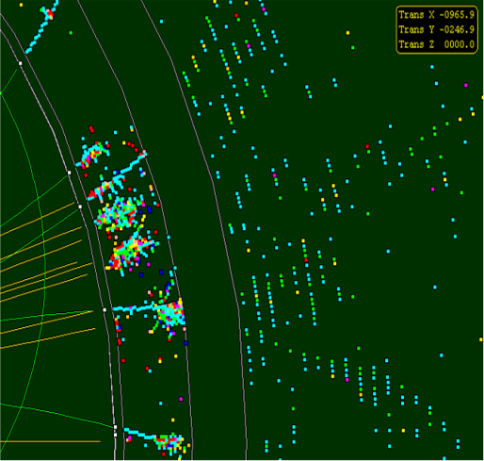
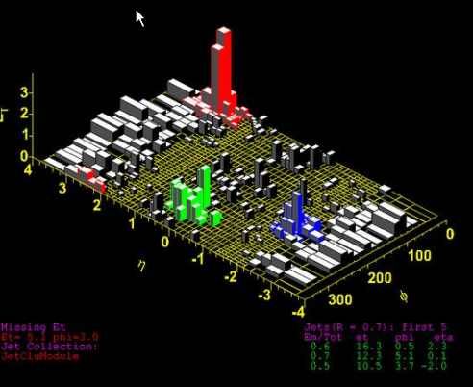
Trend in Calorimetry
Tower geometry
Energy is integrated over
large volumes into single
channels
Readout typically with
high resolution
Individual particles in a
hadronic jet not resolved
Imaging calorimetry
Large number of calorimeter
readout channels (~10⁷)
Option to minimize
resolution on individual
channels
Particles in a jet are
measured individually
E_{T}

Slide 3
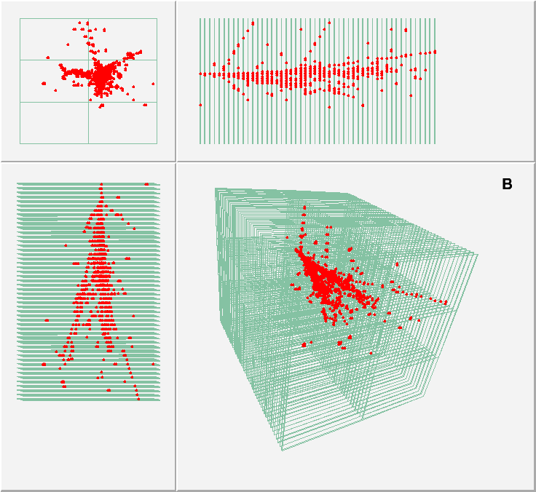
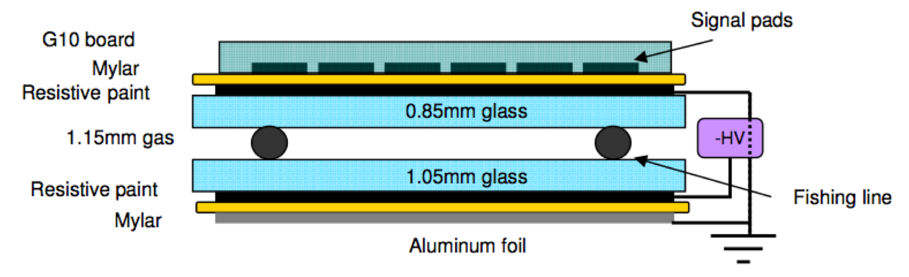
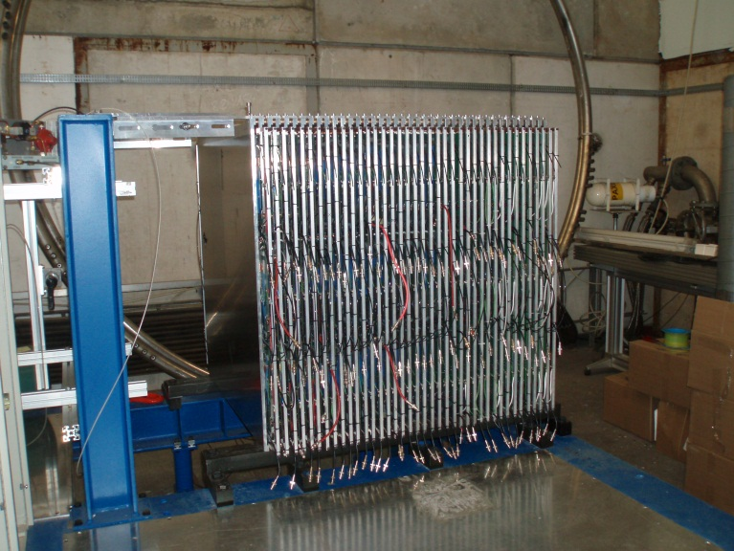
The DHCAL prototype
8 GeV e+
Description
Hadronic sampling calorimeter
Designed for future electron-positron collider (ILC)
54 active layers (~1m²)
Resistive Plate Chambers with 1 x 1 cm² pads
→ ~500,000 readout channels
Electronic readout
1 – bit (digital)
Tests at FNAL
with Iron absorber in 2010 - 2011
Tests at CERN
with Tungsten absorber 2012

Slide 4
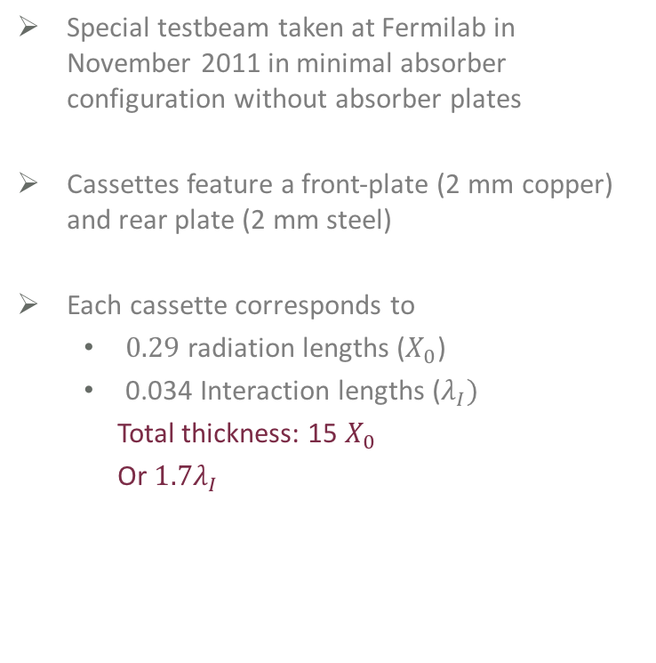
DHCAL with Minimal Absorber
Special testbeam taken at Fermilab in November 2011 in minimal absorber configuration without absorber plates
Cassettes feature a front-plate (2 mm copper) and rear plate (2 mm steel)
Each cassette corresponds to
  $0.29$ radiation lengths ($X_{0}$)
  0.034 Interaction lengths ($λ_{I})$
  Total thickness: 15 $X_{0}$
  Or $1.7λ_{I}$
  Unprecedented details of low energy electromagnetic showers!

Slide 5
Data sample collected at Fermilab
Data collected at Fermilab Test Beam Facility
Secondary beam mixture of electrons, muons and pions
Spill duration 4.0 seconds
Cerenkov counters for PID
Data collected in November 2011 has a momentum range of 1 - 10 GeV/c
Momentum [GeV/c] | Number of events
1 | 107 k
2 | 117 k
3 | 62 k
4 | 84 k
6 | 109 k
8 | 109 k
10 | 226 k
TOTAL | 814 k

Slide 6
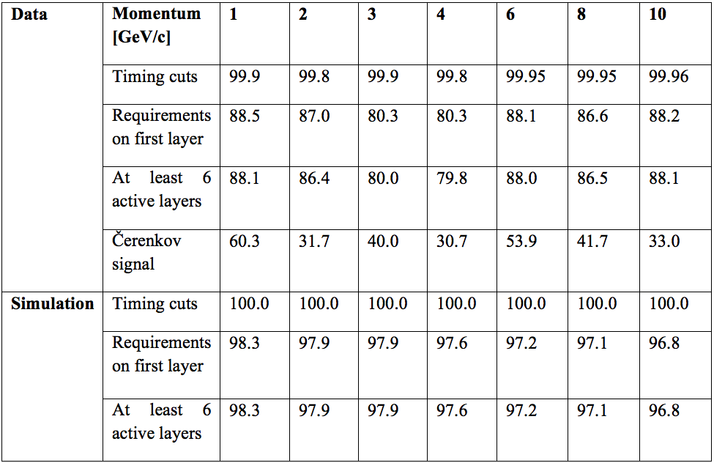
Event selection
PID provided
by Cerenkov
signal
(not simulated)
Nearly all hits
survive
selection cuts
Percentage of events surviving the various event selection criteria

Slide 7
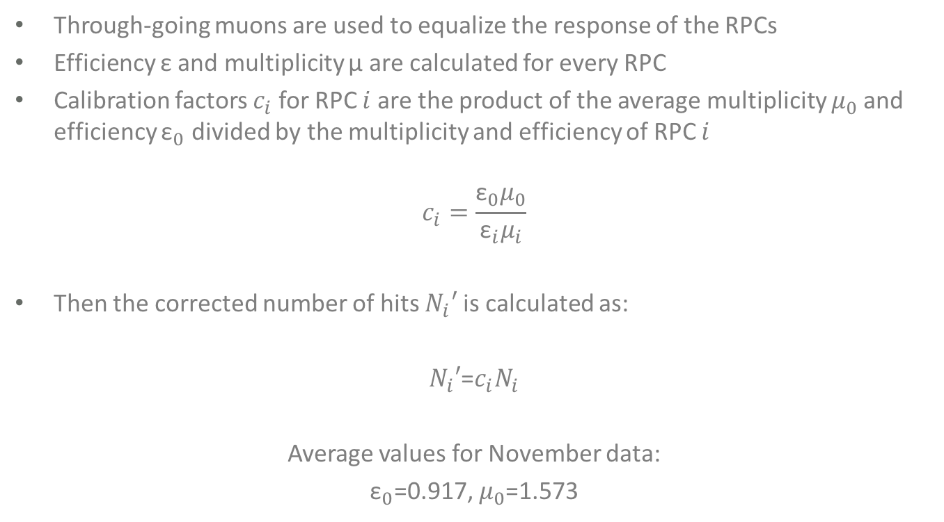
Equalization of the RPC response
Through-going muons are used to equalize the response of the RPCs
Efficiency ε and multiplicity μ are calculated for every RPC
Calibration factors $c_{i}$ for RPC $i$ are the product of the average multiplicity $μ_{0}$and efficiency ${\text{ε}}_{0}$ divided by the multiplicity and efficiency of RPC $i$
$$c_{i}=\frac{{\text{ε}}_{0}μ_{0}}{{\text{ε}}_{i}μ_{i}}$$
Then the corrected number of hits $N_{i}′$ is calculated as:
$N_{i}′$=$c_{i}N_{i}$
Average values for November data:
${\text{ε}}_{0}$=0.917, $μ_{0}$=1.573

Slide 8
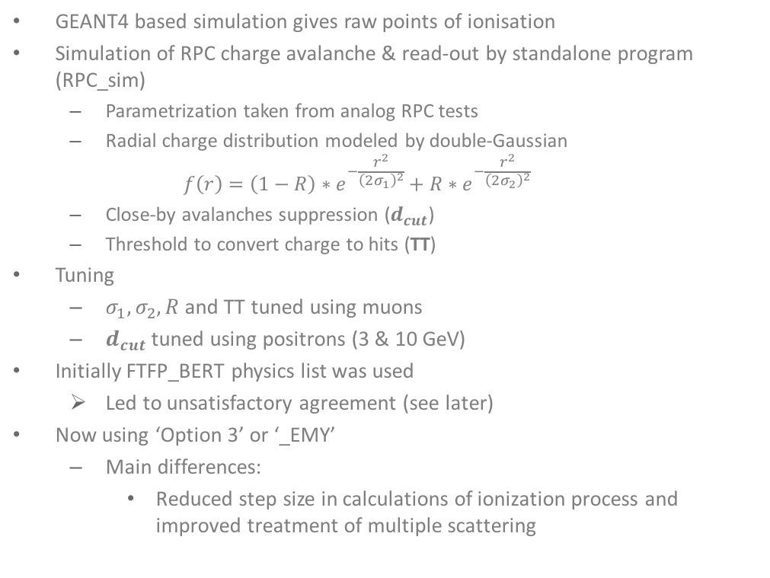
Simulation
GEANT4 based simulation gives raw points of ionisation
Simulation of RPC charge avalanche & read-out by standalone program (RPC_sim)
  Parametrization taken from analog RPC tests
  Radial charge distribution modeled by double-Gaussian
  $$f\left(r\right)=\left(1−R\right)∗e^{−\frac{r^{2}}{{\left(2σ_{1}\right)}^{2}}}+R∗e^{−\frac{r^{2}}{{\left(2σ_{2}\right)}^{2}}}$$
  Close-by avalanches suppression ($d_{cut}$)
  Threshold to convert charge to hits (TT)
Tuning
  $σ_{1},σ_{2},R$and TT tuned using muons
  $d_{cut}$ tuned using positrons (3 & 10 GeV)
Initially FTFP_BERT physics list was used
  Led to unsatisfactory agreement (see later)
Now using ‘Option 3’ or ‘_EMY’
  Main differences:
    Reduced step size in calculations of ionization process and improved treatment of multiple scattering
Charge distribution in x-y

Slide 9
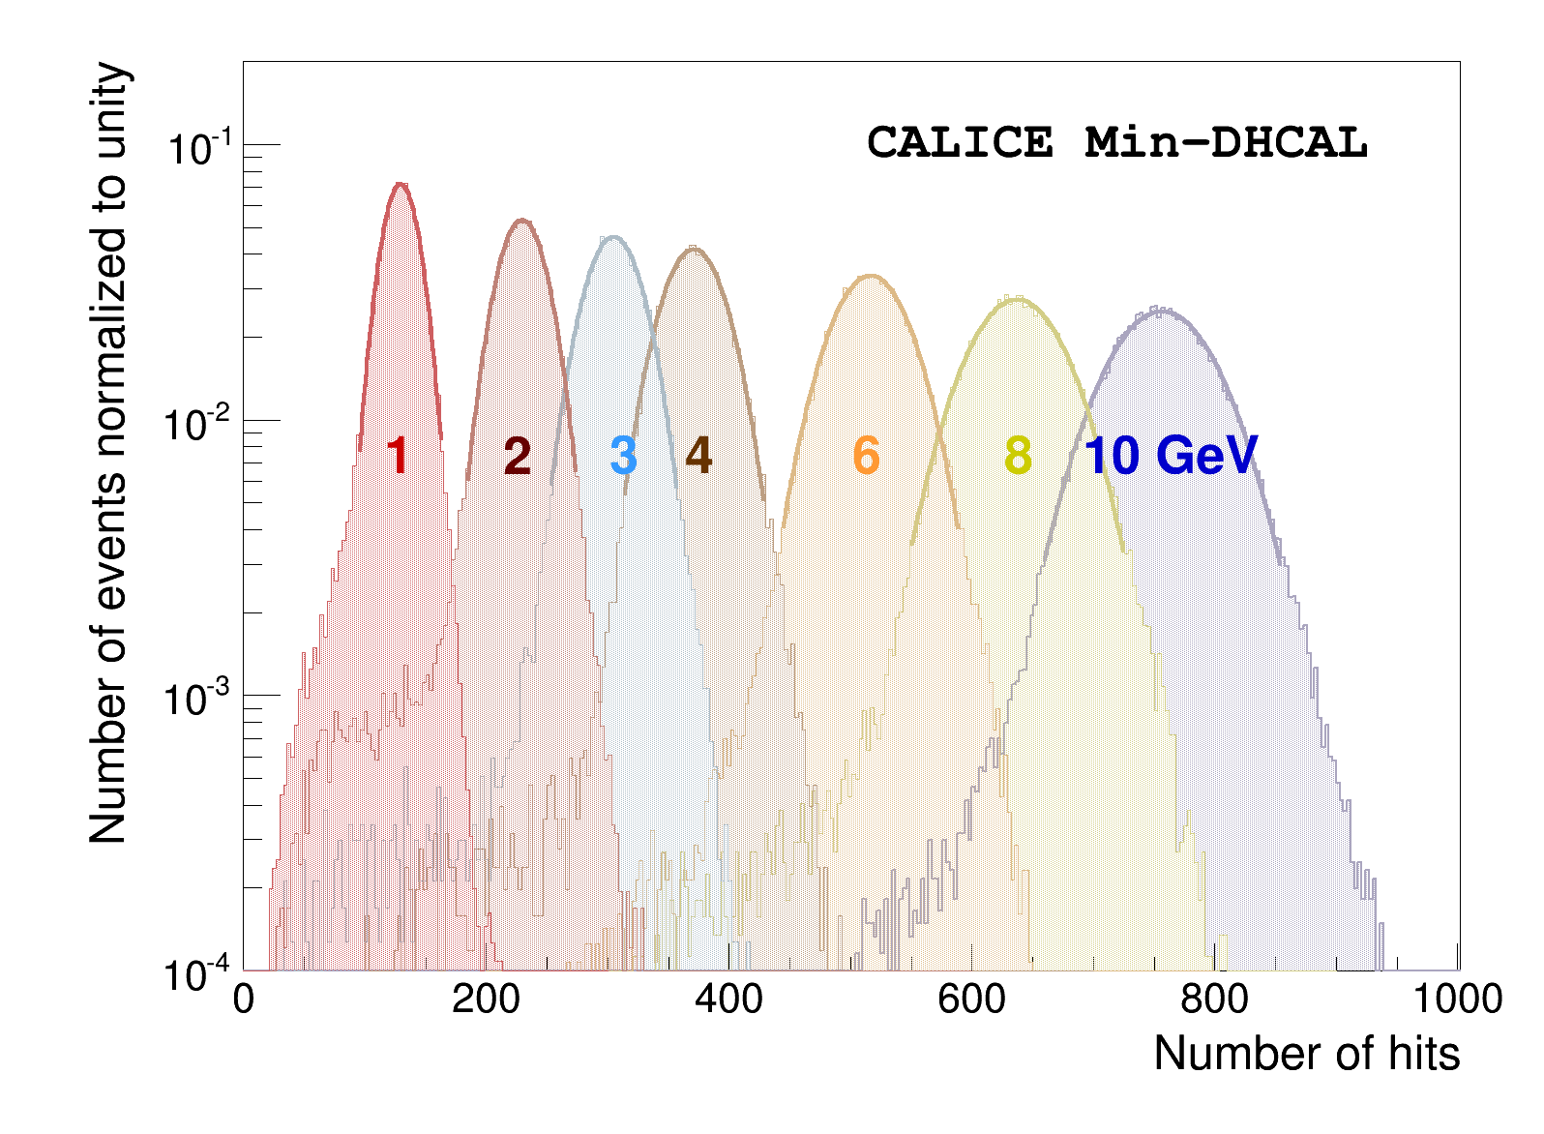
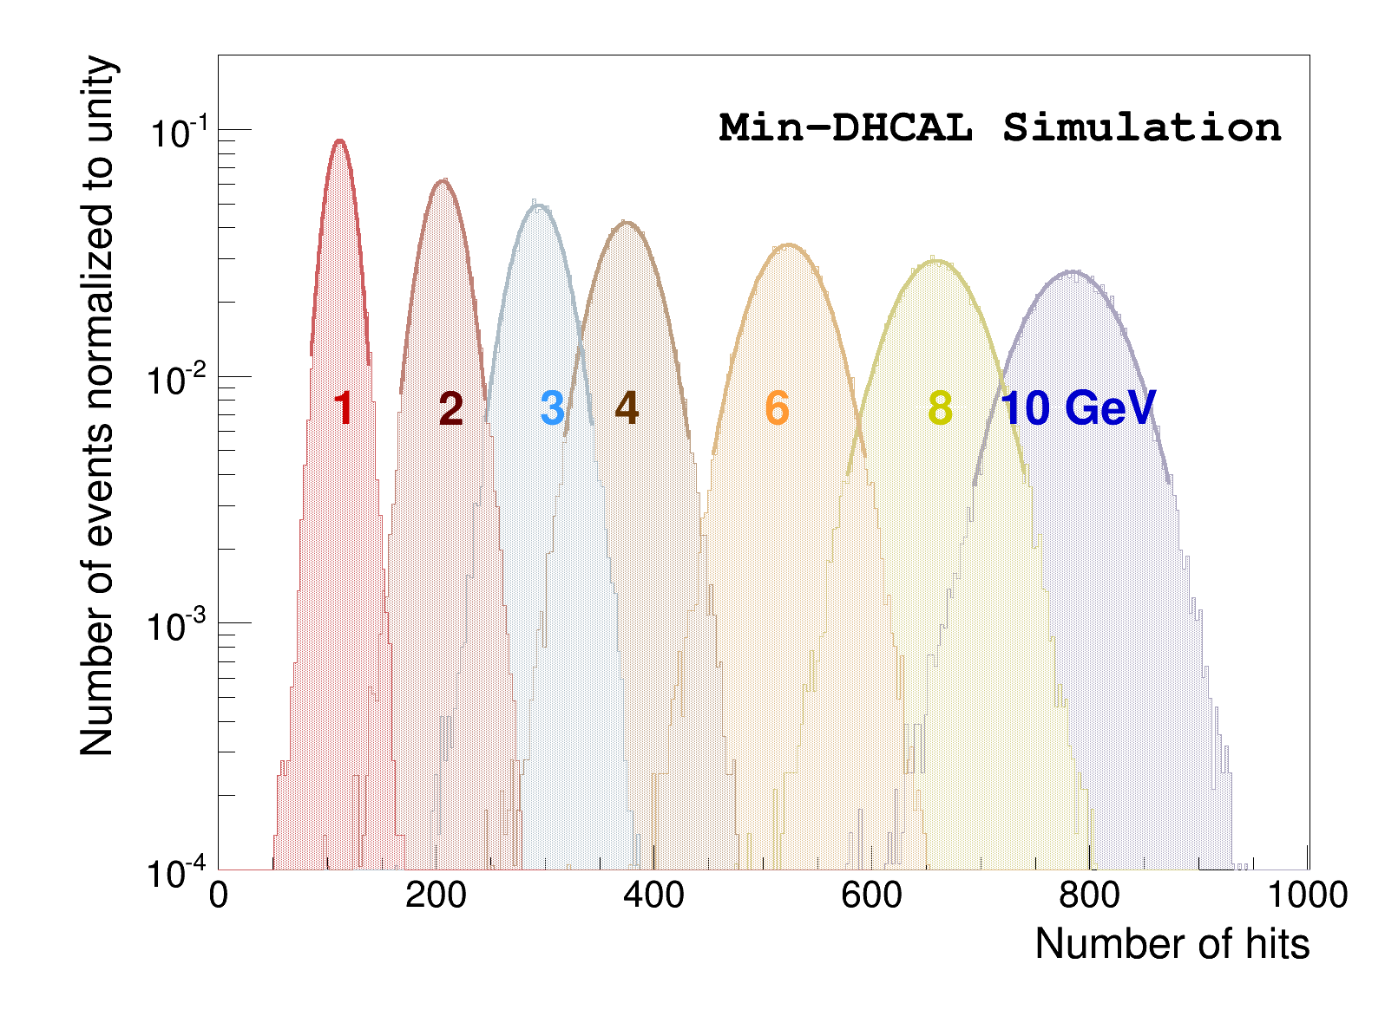
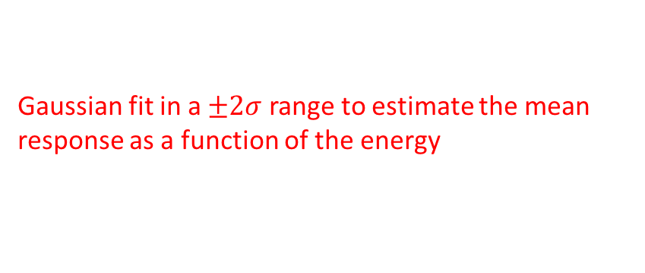
Response to positrons
Gaussian fit in a $±2σ$ range to estimate the mean response as a function of the energy
Data
Simulation (FTFP_BERT_EMY)

Slide 10
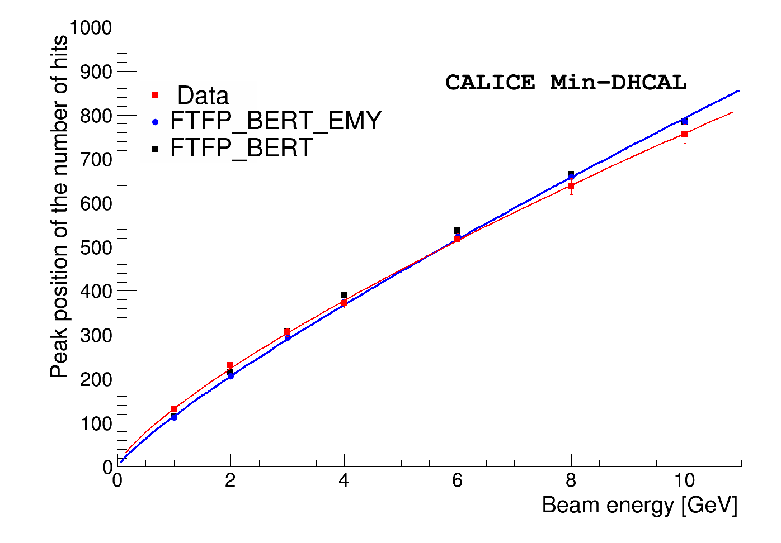
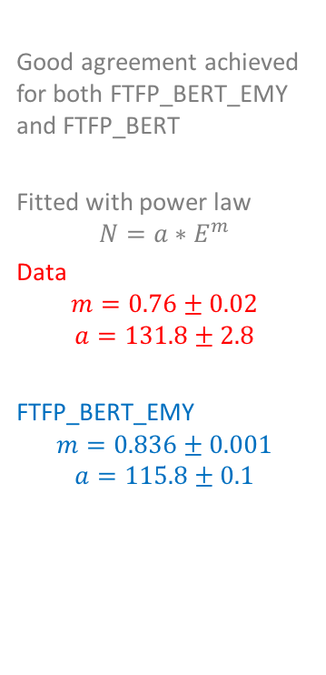
Response to positrons
Good agreement achieved for both FTFP_BERT_EMY and FTFP_BERT
Fitted with power law
$$N=a∗E^{m}$$
Data
$$m=0.76±0.02$$
$$a=131.8±2.8$$
FTFP_BERT_EMY
$$m=0.836±0.001$$
$$a=115.8±0.1$$
Saturation due to large pad size compared to the dense electromagnetic showers
Inverse fit function used to reconstruct energy

Slide 11
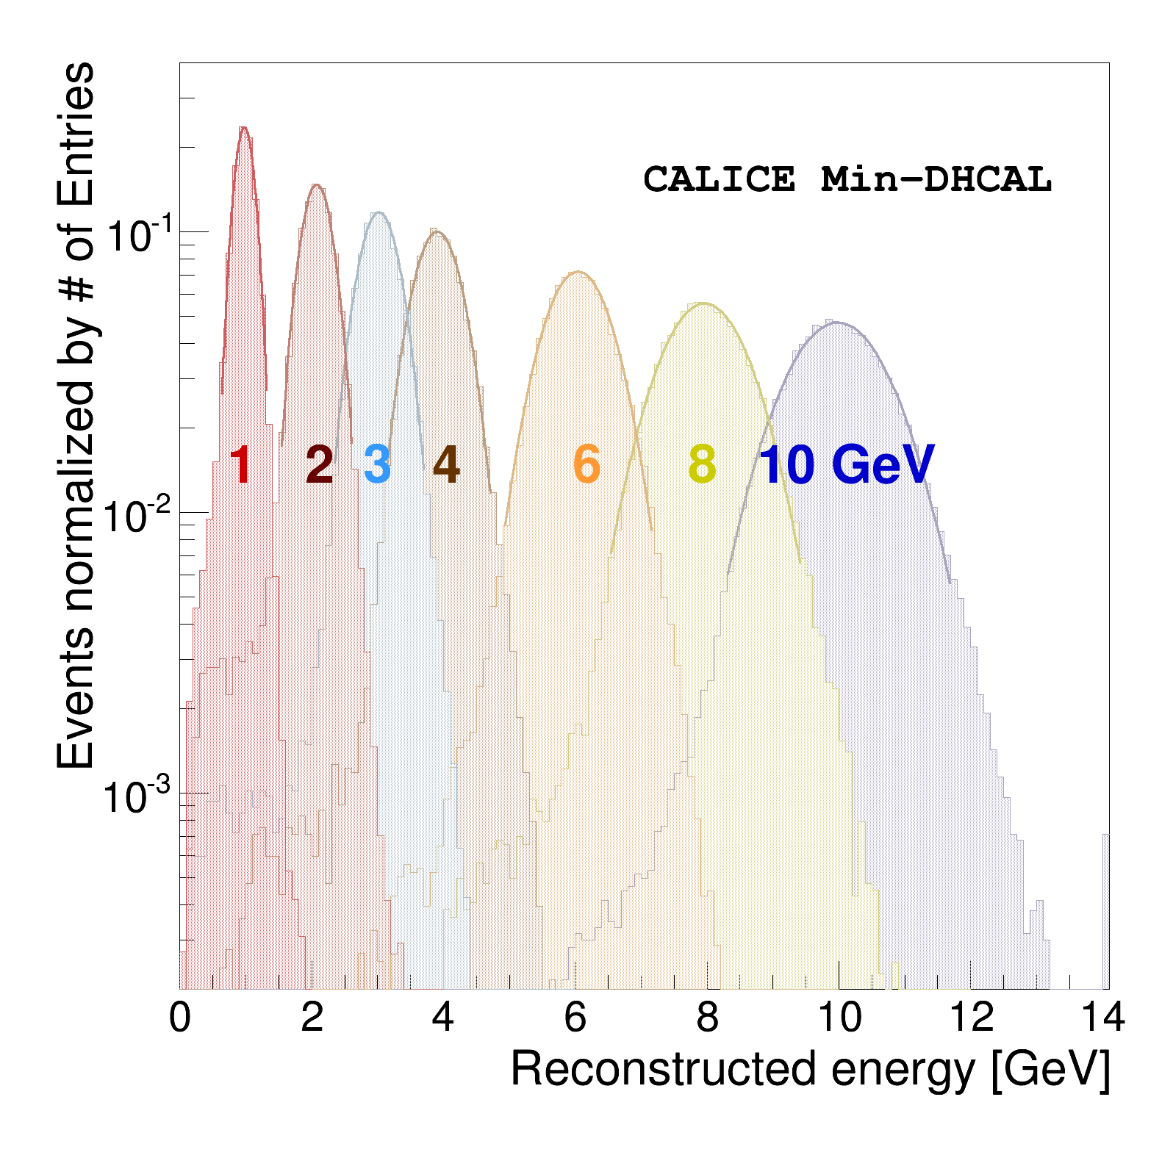
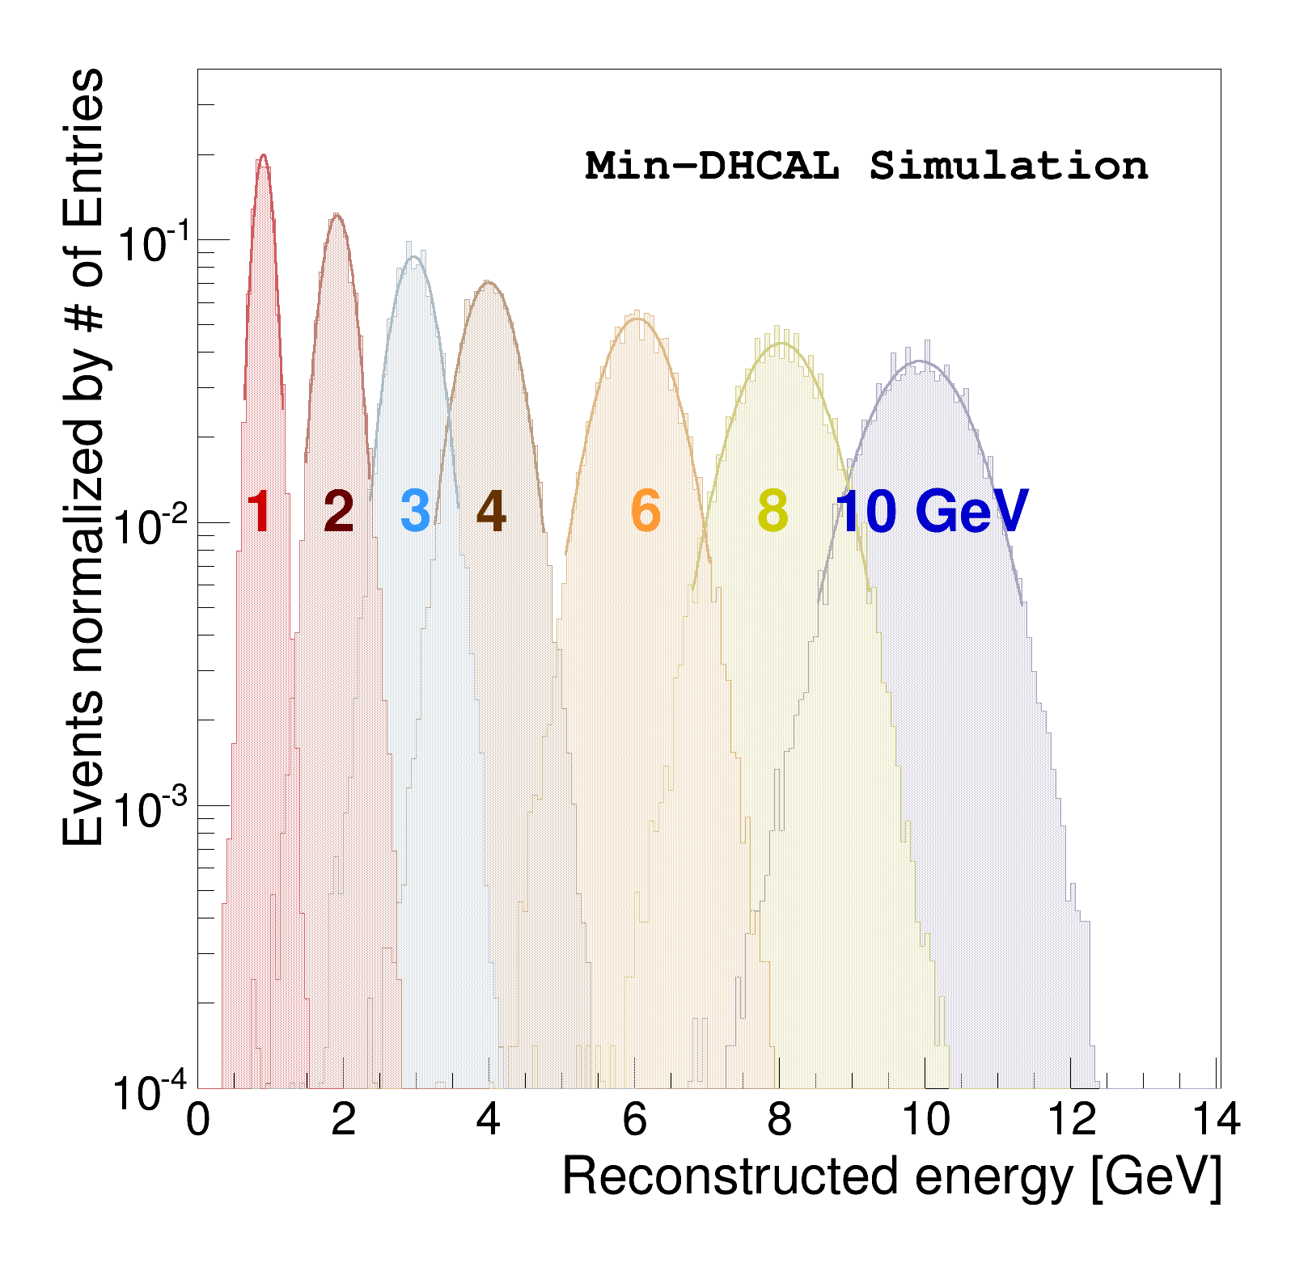

Reconstructed energy of positrons
Gaussian fit in a $±2σ$ range to estimate the resolution
Data
Simulation (FTFP_BERT_EMY)

Slide 12
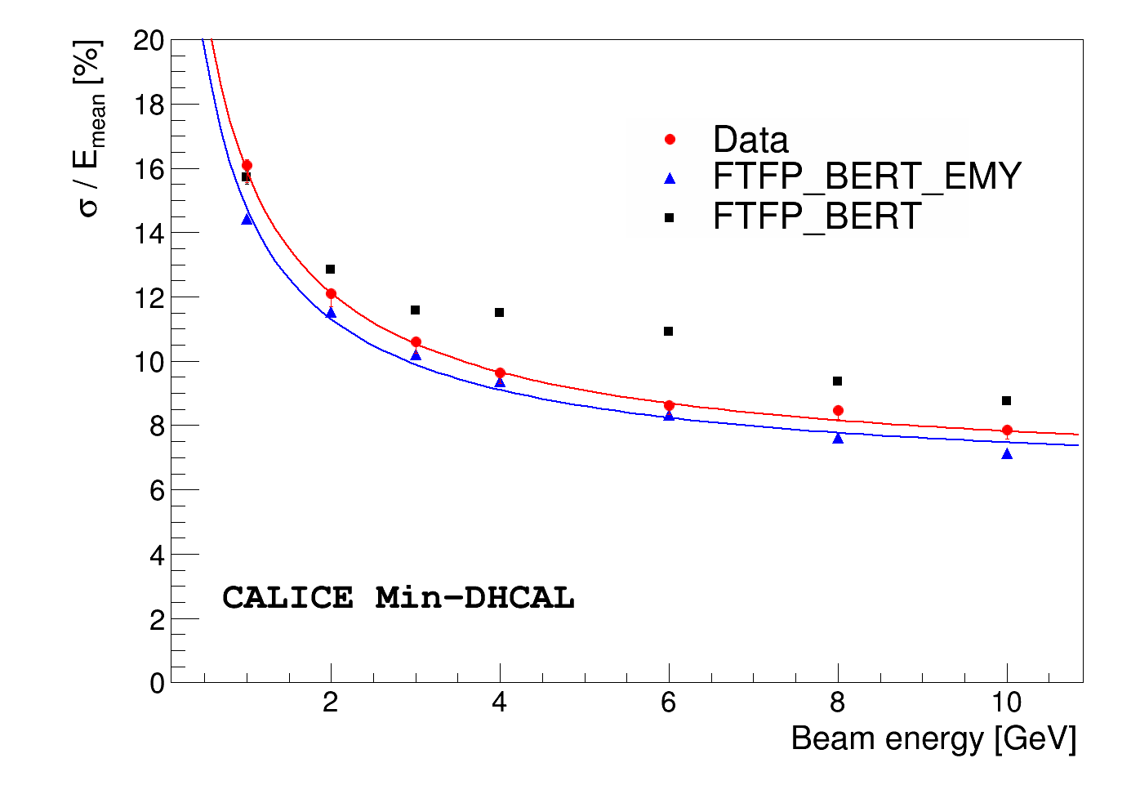
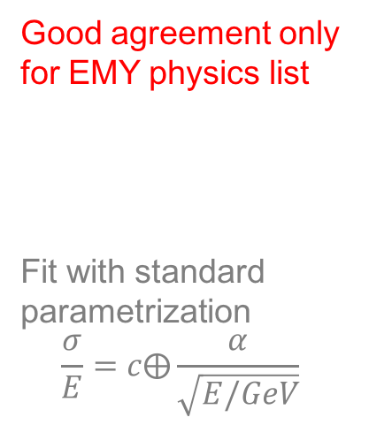
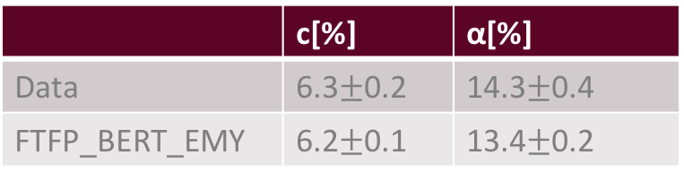
Resolution
Good agreement only for EMY physics list
Fit with standard parametrization
$$\frac{σ}{E}=c⨁\frac{α}{\sqrt{E/GeV}}$$
 | c[%] | α[%]
Data | 6.3$±$0.2 | 14.3$±$0.4
FTFP_BERT_EMY | 6.2$±$0.1 | 13.4$±$0.2

Slide 13
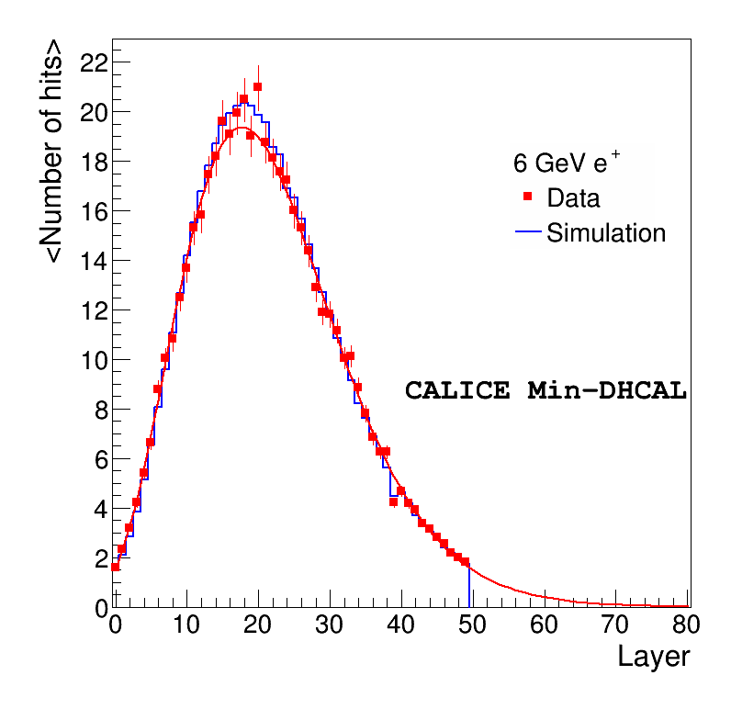
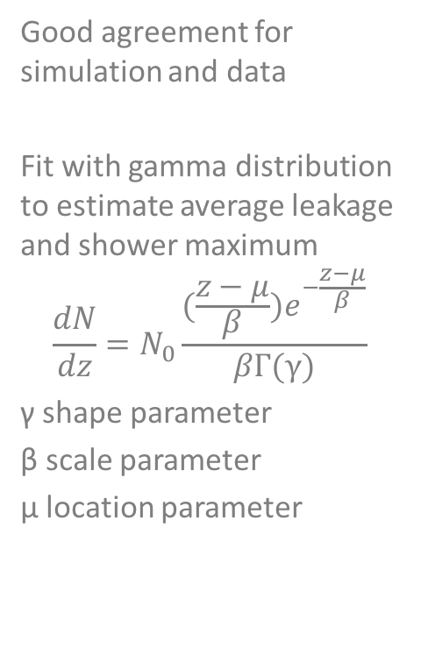

Longitudinal shower shape
Good agreement for simulation and data
Fit with gamma distribution to estimate average leakage and shower maximum
$$\frac{dN}{dz}=N_{0}\frac{(\frac{z−μ}{β})e^{−\frac{z−μ}{β}}}{βΓ(γ)}$$
γ shape parameter
β scale parameter
μ location parameter
6 GeV $e^{+}$

Slide 14
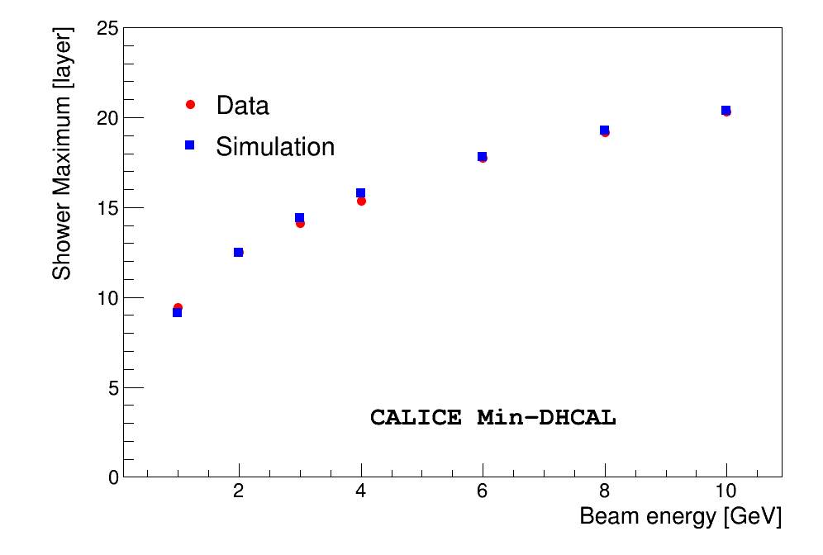
Longitudinal shower shape
Excellent agreement for shower maximum

Slide 15
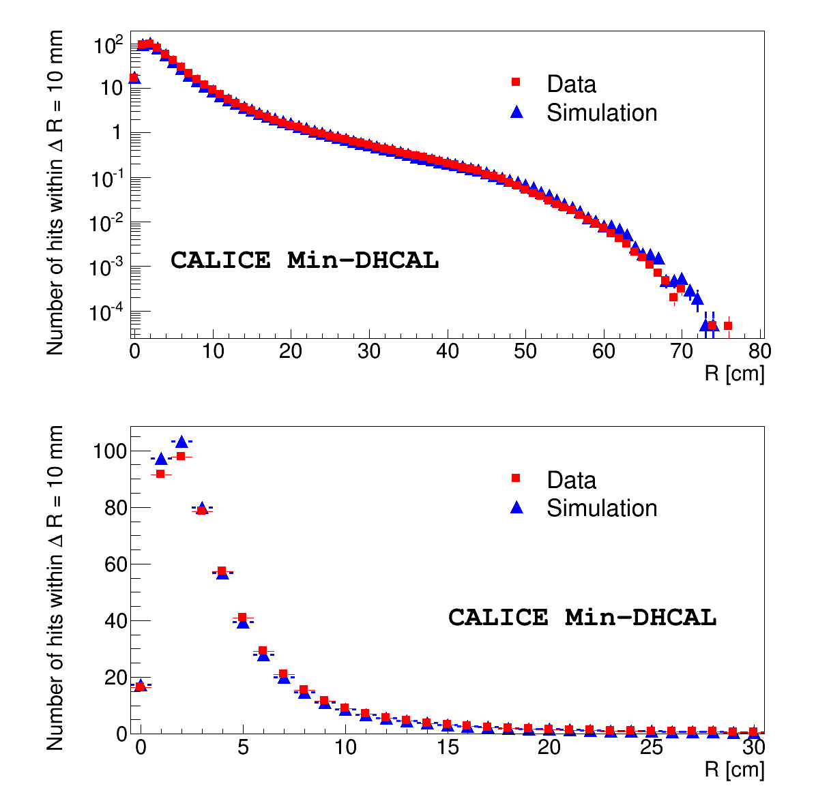
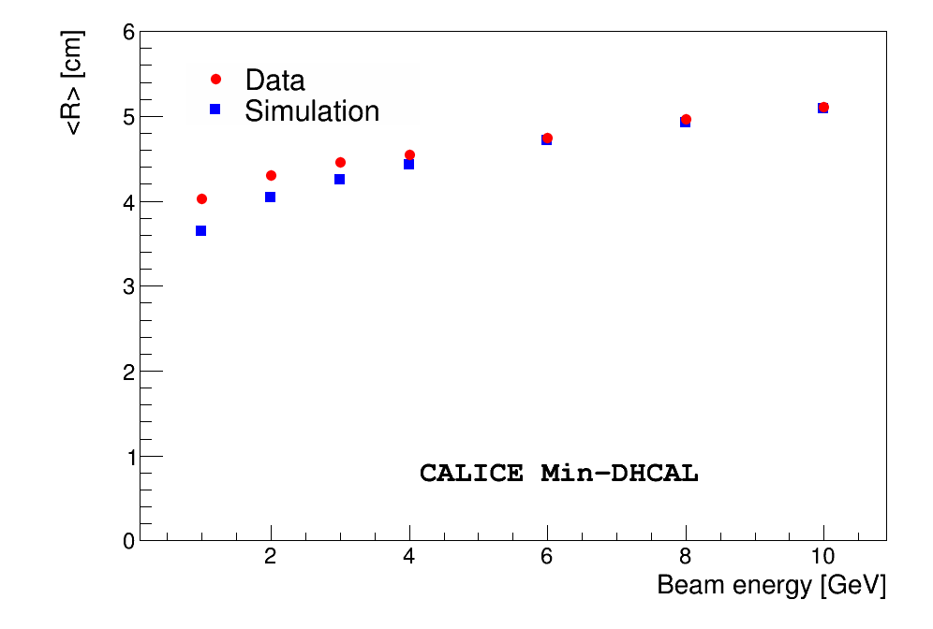

Transverse shower shape
6 GeV $e^{+}$
Hits in first 5 layer are fit to a straight line to determine shower axis
Distance R is calculated with respect to shower axis
Good agreement observed for data and simulation
Good agreement also observed for mean distance

Slide 16
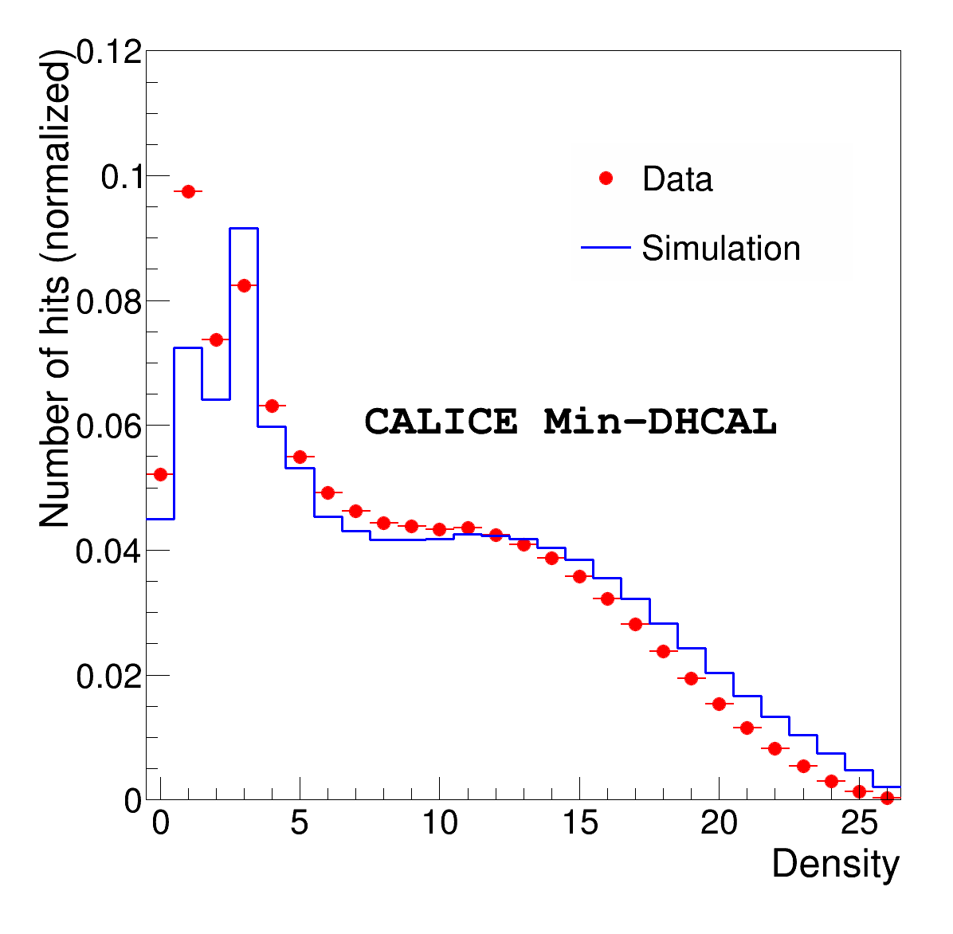
Hit density
Density is defined as number of neighbors in 3x3x3 cube around the hit (0 to 26)
Density information can be used to linearize the response

Slide 17
Conclusion
Data taken with the DHCAL with minimal absorber at Fermilab are compared to simulations
Fine segmentation allows detailed study of electromagnetic showers
Standard FTFP_BERT fails to reproduce data well
EMY option allows big improvement in the agreement
Results are published (B. Freund et al 2016 JINST 11 P05008 http://dx.doi.org/10.1088/1748-0221/11/05/P05008)
Analysis of pion data is underway

Slide 18
Thank you for your attention!

Slide 19
Backup

Slide 20
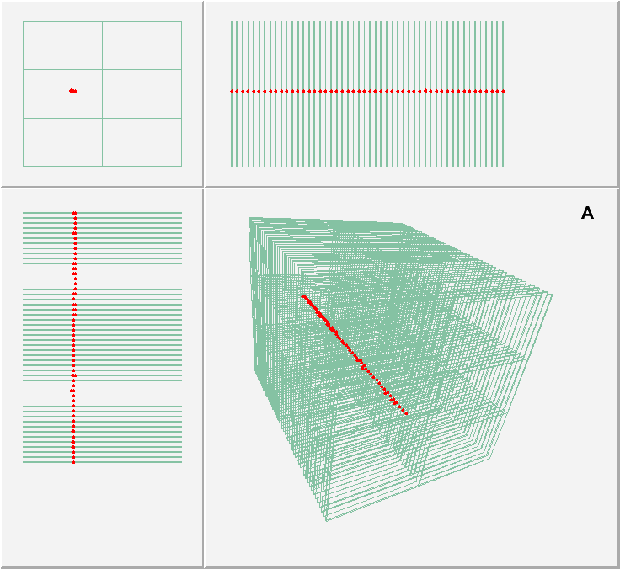
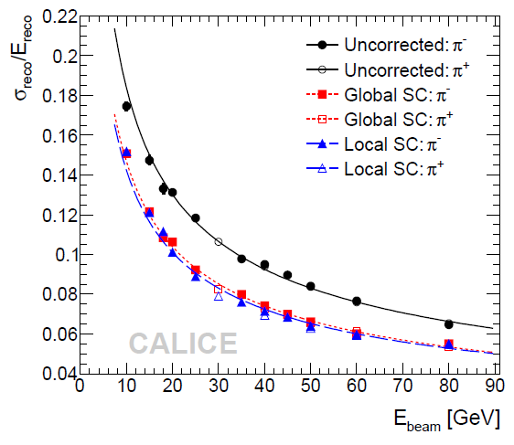
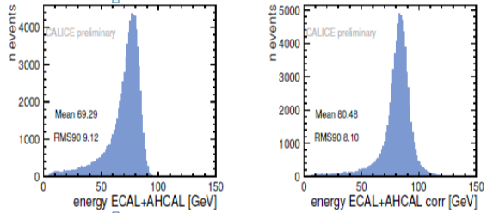
Advantages of Imaging Calorimetry
Particle ID
Electrons, muons, hadrons → (almost) trivial
Software compensation
Typical calorimeters have e/h ≠ 1
Weighting of individual sub-showers possible
→ significant improvement in σ_{E}^{had}
Leakage corrections
Use longitudinal shower information to compensate for leakage
→ significant improvement in σ_{E}^{had}
Measure momentum of charged particles exiting calorimeter
Application of Particle Flow Algorithms (PFAs)
Use PFAs to reconstruct the energy of hadronic jets

Slide 21

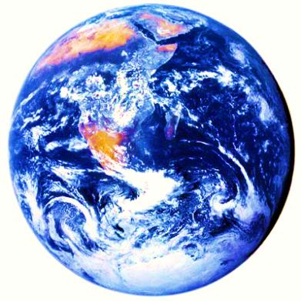
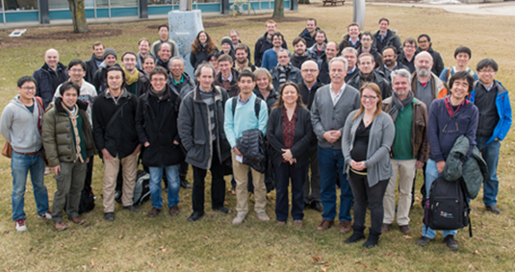
Collaboration
2nd largest R&D
collaboration in HEP
Goal
Development and study of finely segmented/imaging calorimeters
Initially focused on the ILC/CLIC needs
Now widening to include the developments of all imaging calorimeter
Large prototypes built and tested to date
Silicon-W ECAL, Scintillator-W ECAL, Scintillator-Fe/W HCAL, RPC-Fe/W HCAL,
RPC-Fe HCAL
4 continents
20 countries
60 institutes
364 physicists/
engineers

Slide 22

Systematic uncertainties
Sources of error
Equalization uncertainties (1-4 %)
Limited rate capability of RPC (only the first half second of each spill are taken for longitudinal shower profiles)
10 GeV $e^{+}$
RPC lose efficiency exponentially during spill (1-2 % effect)

Slide 23
Systematic uncertainties
Sources of error
Calibration uncertainties
Limited rate capability of RPC (only the first half second of each spill are taken for longitudinal shower profiles)
Contamination from muons and pions estimated to be less than 1%
Contamination from accidental noise hit was estimated to 0.2 hits per event in the entire stack
  Negligible, nevertheless noise events from accidental noise runs are added to simulation

Slide 24
Hit and event selection
Pads close to ground lead fire at a relatively high rate
Area of 2 x 5 cm^2 around these leads are ignored for both data and simulation (loss for simulation is negligible)
Time
Data recorded in seven time bins (100 ns)
Most hits occur in time bin 19 and 20 (bin difference to trigger)
Remove events if most hits occur outside these two time bins to reduce noise contamination & multiple particles (<1%)
Sometimes the same pad fires several times in the same event
Duplicates are assumed to be fake hits and are removed (~0.1%)
Small fraction of dead DHCAL chips (<1%)
Corresponding areas are removed in simulation
To reduce number of events with multiple particle and upstream interactions
Exactly one cluster with at most four hits is required in the first layer (10-20%)

Slide 25
Systematic uncertainties
Sources of error
Calibration uncertainties
Limited rate capability of RPC (only the first half second of each spill are taken for longitudinal shower profiles)
10 GeV $e^{+}$
Longitudinal shower profiles sensitive to this effect, applied only as positive systematic error

Slide 26

Systematic uncertainties
Sources of error
Calibration uncertainties
8 GeV $e^{+}$
Assign half the average difference between calibrated and uncalibrated data as systematic uncertainty
Error applied symmetrically in general but only downwards for resolution

Slide 27
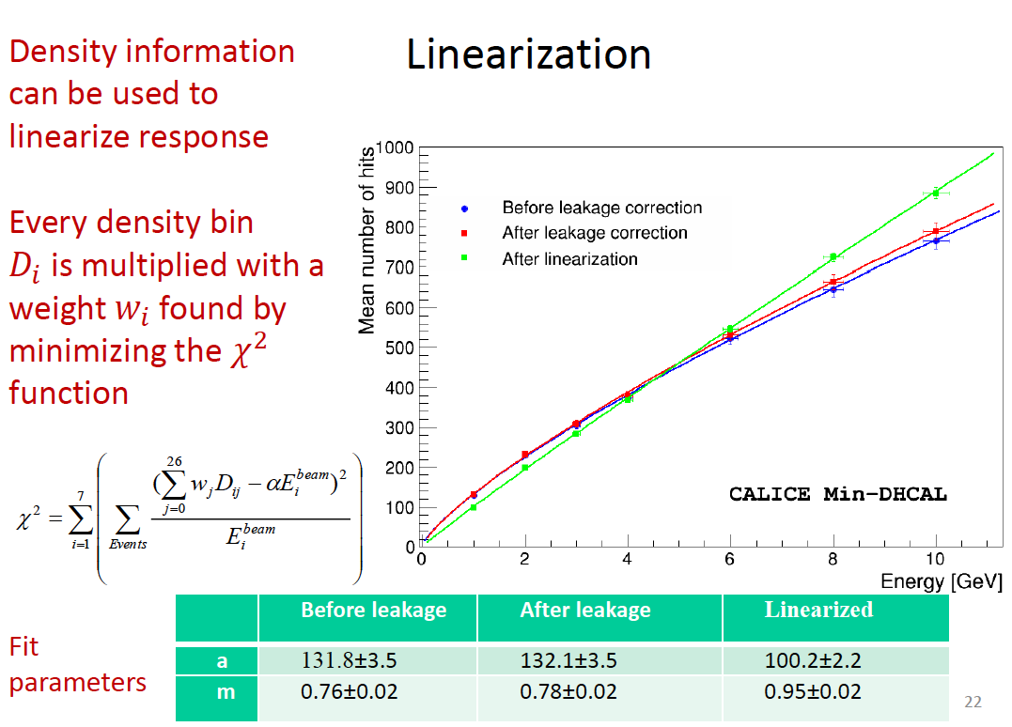

Slide 28
