Slide 1

L.Lee (Jun.15, 2016)
2016 CAP Annual Congress
The Ultra-Cold Neutron Facility
at TRIUMF
Overview and Construction Status
T. Adachi¹, E. Altiere², T. Andalib^{3,4}, C. Bidinosti³, J. Birchall⁴, C. Davis⁵,
M. Gericke⁴, S. Hansen-Romu^{3,4}, K. Hatanaka⁶, B. Jamieson³, S. Jeong¹, D. Jones²,
K. Katsika⁵, S. Kawasaki¹, T Kikawa^{5,6,1}, A. Konaka^{5,8}, E. Korkmaz⁷ , M. Lang³, T. Lindner⁵,
L. Lee^{4,5}, K. Madison², J. Mammei⁴, R. Mammei³, J.W. Martin³, R. Matsumiya⁶, E. Miller²,
T. Momose², S. Page⁴, R. Picker⁵, E. Pierre^{6,5}, W.D. Ramsay⁵, L. Rebenitsch^{3,4}, J. Sonier⁹,
I. Tanihata⁶, W.T.H. van Oers^{4,5}, Y. Watanabe¹, and J. Weinands²
¹KEK, Tsukuba, Ibaraki, Japan
²The University of British Columbia, Vancouver, BC, Canada
³The University of Winnipeg, Winnipeg, MB, Canada
⁴The University of Manitoba, Winnipeg, MB, Canada
⁵TRIUMF, Vancouver, BC, Canada
⁶RCNP, Osaka, Japan (Osaka University, Osaka, Japan)
⁷The University of Northern BC, Prince George, BC, Canada
⁸Osaka University, Osaka, Japan
⁹Simon Fraser University, Burnaby, BC, Canada

Slide 2
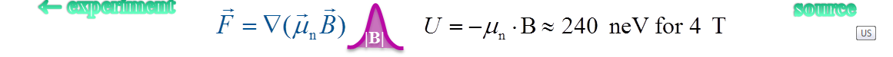
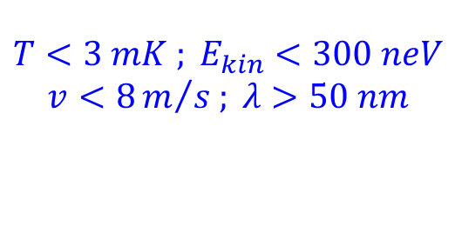
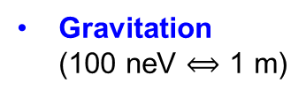
Properties of UltraCold Neutrons
2
2
$$T<3 mK ; E_{kin}<300 neV$$
$$v<8m/{s ; λ>50 nm}$$
Localize & Use in Experiments
Can be stored & manipulated using:
Strong interaction
(Fermi potential, total reflection from walls)
UCN guide
Material
wall
UCN TRANSPORT
Gravitation
(100 neV $⟺$ 1 m)
UCN constrained to h < 3 m
UCN ENERGY MANIPULATION
g
3m
Magnetic interaction
(force on magnetic moment)
polarizing magnet
low-field seeker
UCN POLARIZATION
high-field seeker
← experiment
source

Slide 3
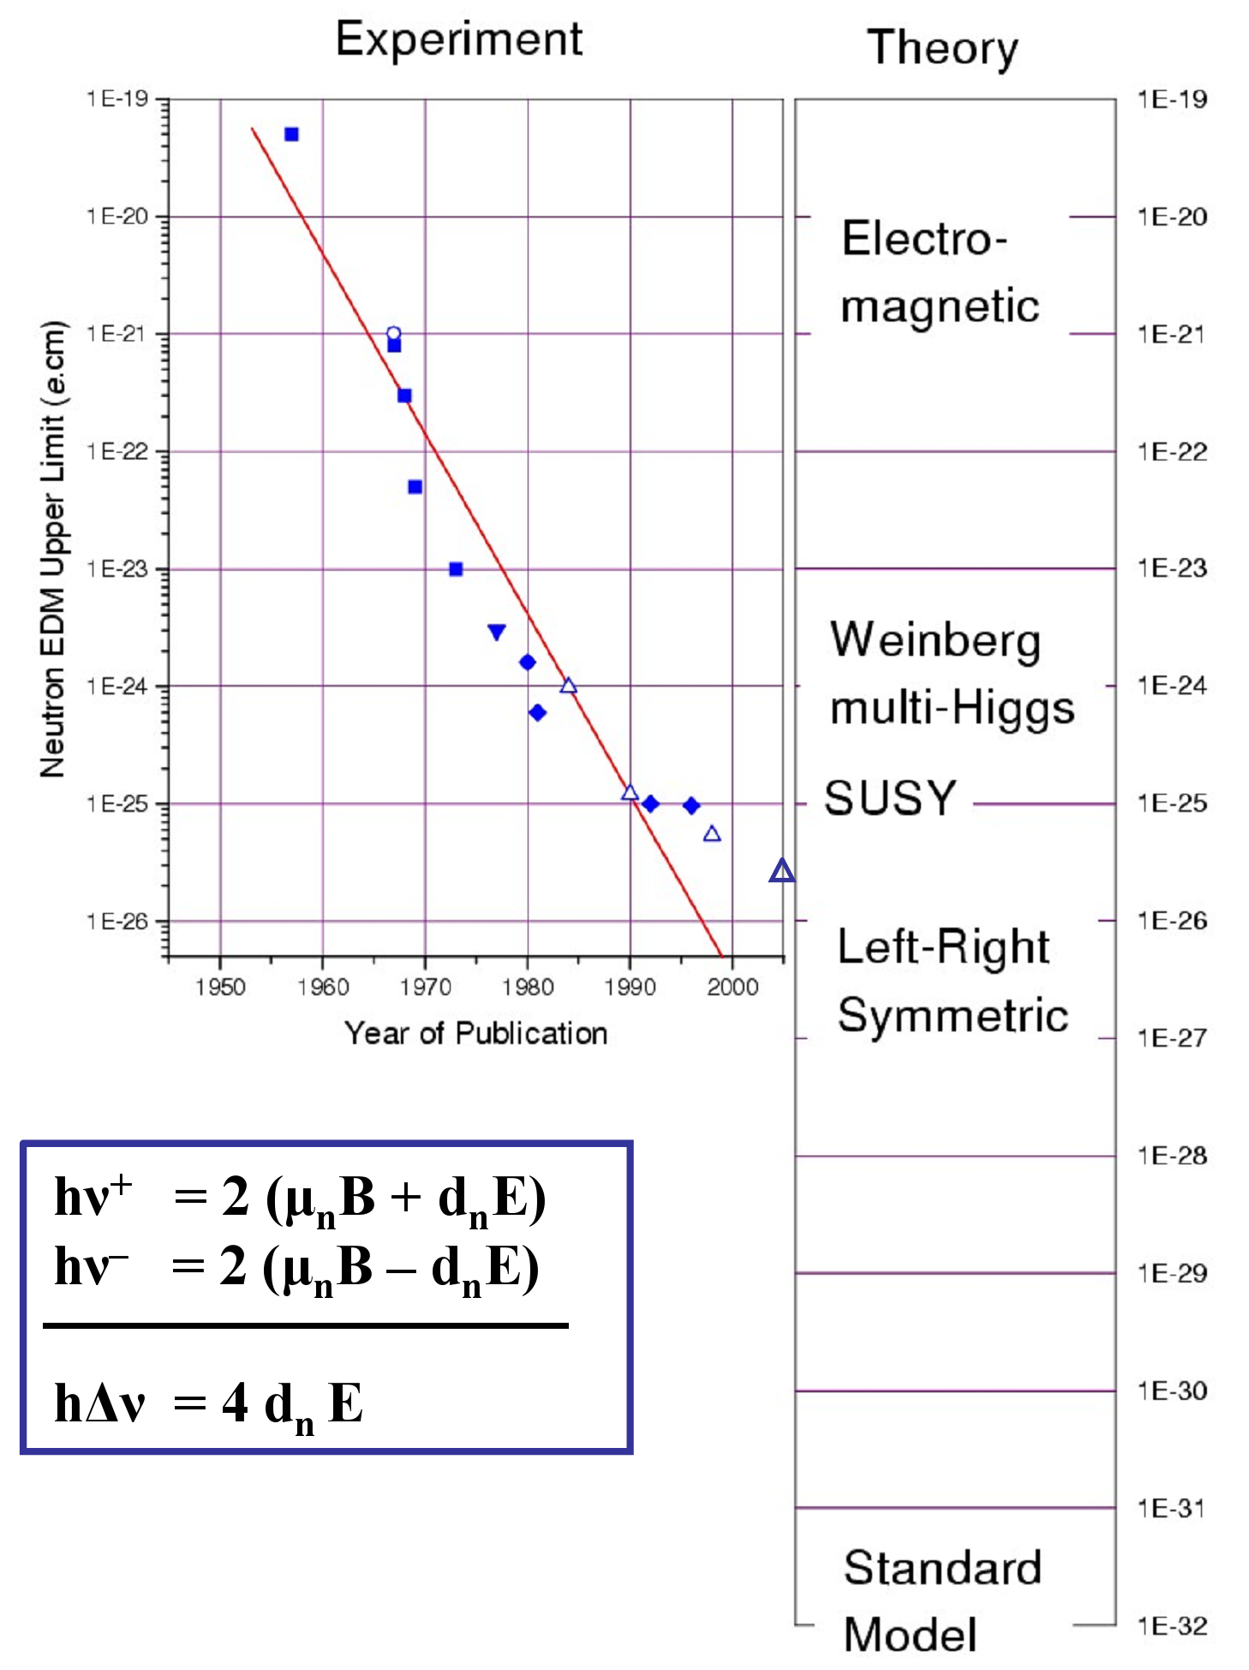
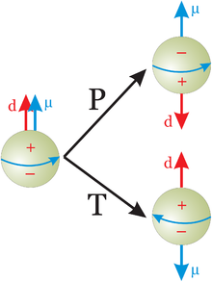
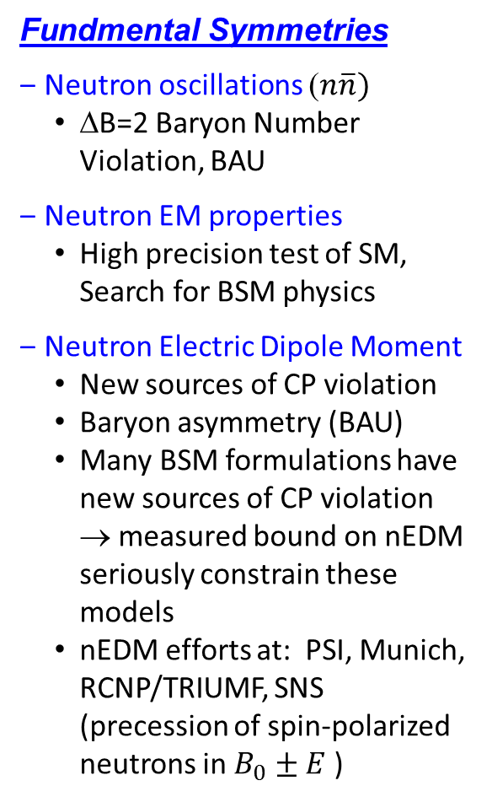

UCNs for Fundamental Physics
3
3
Fundmental Symmetries
Neutron oscillations ($n\overline{n})$
  ΔB=2 Baryon Number Violation, BAU
Neutron EM properties
  High precision test of SM, Search for BSM physics
Neutron Electric Dipole Moment
  New sources of CP violation
  Baryon asymmetry (BAU)
  Many BSM formulations have new sources of CP violation → measured bound on nEDM seriously constrain these models
  nEDM efforts at: PSI, Munich, RCNP/TRIUMF, SNS (precession of spin-polarized neutrons in $B_{0}±E$ )
Experimental limit today:
$d_{n}<2.9∙{10}^{−26}e∙cm$
Goals for next experiments:
$d_{n}<{10}^{−27(28)}e∙cm$
[ Baker, et al. Phys Rev Lett 97 (13), 2006 ]
See talk by J.W.Martin, Thur @ 13:15, R2-3

Slide 4
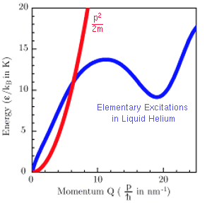
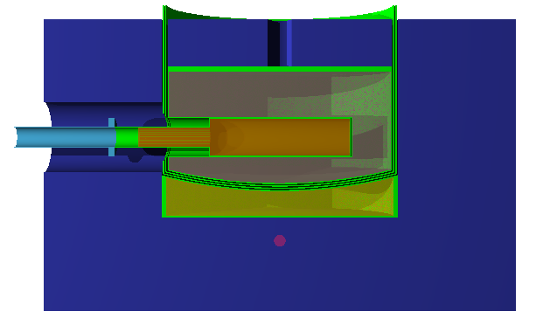
Spallation-driven Superfluid He-II UCN Source
UCN production recipe:
Cold neutron energy transferred to He-II via phonon emission
Spallation – Liberate neutrons from W target
Moderation – Thermalize, cool neutrons in D₂0 ice
Conversion – Convert cold neutrons to UCN in He-II
d
75 cm
He-II
Cryostat
D₂O Cryostat
10 K D₂O or D₂
44 cm
He-II
30 cm
Thermal, Cold &
Ultra-Cold neutrons
300 K D₂O
Graphite
MeV neutrons
W-Target
Moderators
Thermal: Graphite, 300K D₂O
Cold: 10K D₂O ice
General Layout of UCN Source at RCNP Osaka
UCN Source
Cryostats
10K D₂O Ice Cryostat (Cold Neutrons)
0.7K He-II Cryostat (Ultra-Cold Neutrons)
400 MeV protons

Slide 5
Japan-Canada UCN Project
at TRIUMF
Proton-driven Spallation Superthermal UCN Source
CFI $4.2 M awarded in 2009 (Total ∼$12 M)
MOU (KEK, RCNP, TRIUMF, U.Winnipeg) in 2011
Construction of 1st beamline component in 2012 (KEK)
First installation period in 2014 (Meson Hall)
May ’16: UCN Beamline & Source Front-end installed

Slide 6
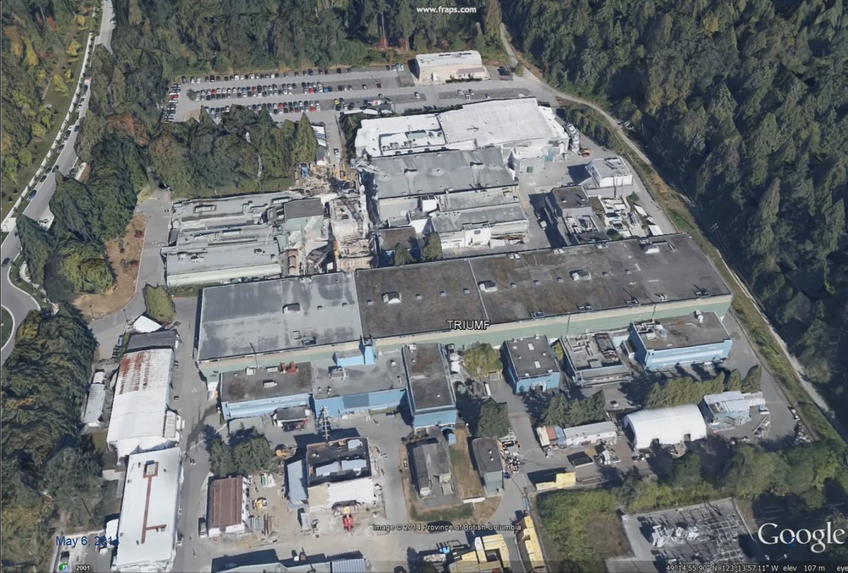

UCN’s at TRIUMF
Meson Hall
6

Slide 7
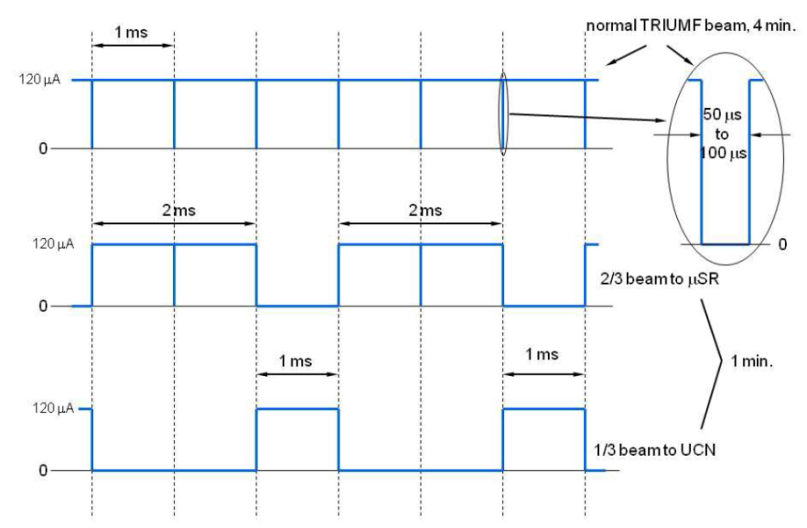
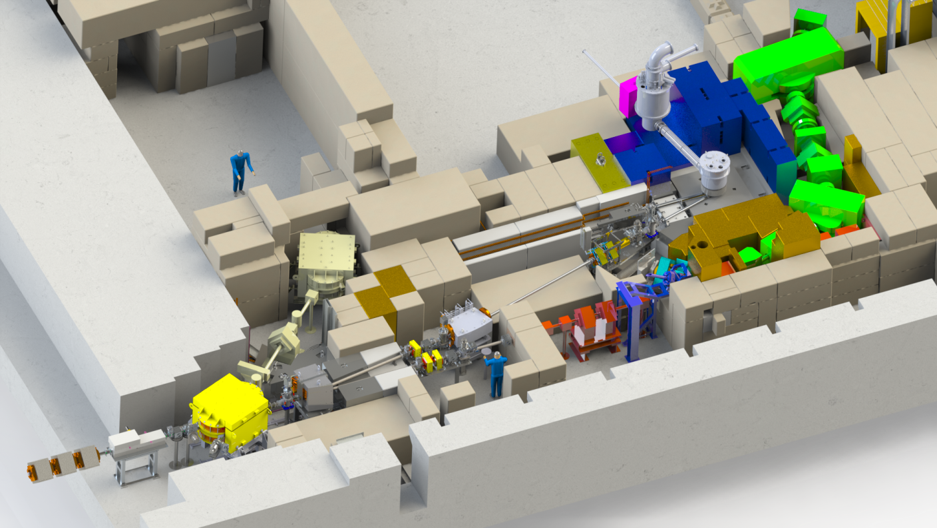
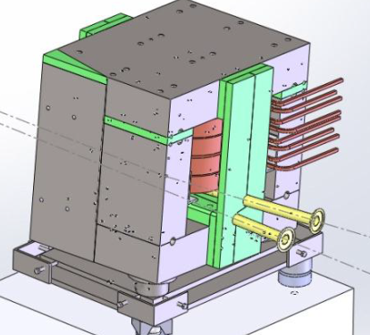
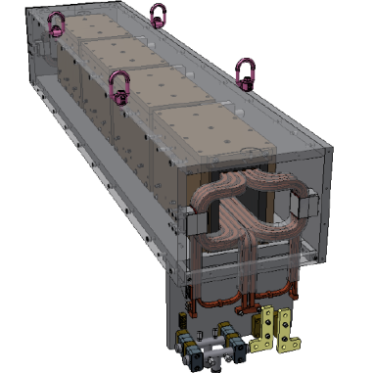
BL1U: UCN Beamline
Beam Microstructure
Floorspace
for nEDM
Experiment
Cyclotron
BL1U
Lambertson Septum
bends kicked beam 9° into 1U
unkicked beam to BL1A
BL1A
Kicker Magnet
kicks every 3rd beam bunch
BL1V: 500 MeV, 120 μA Beam

Slide 8
BL1U: UCN Beamline
Beam Microstructure
BL1U: 500 MeV, 40 μA protons, Tungsten target
Floorspace
for nEDM
Experiment
Cyclotron
BL1U
Lambertson Septum
bends kicked beam 9° into 1U
unkicked beam to BL1A
BL1A
BL1A
Kicker Magnet
kicks every 3rd beam bunch
1 min 3 min
BL1U
BL1V: 500 MeV, 120 μA Beam

Slide 9
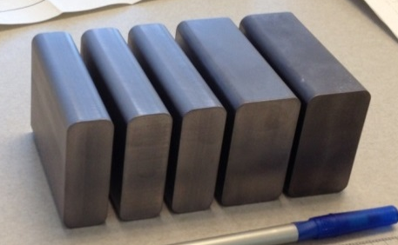
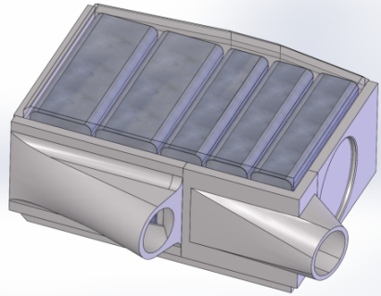
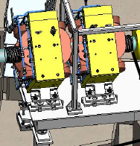
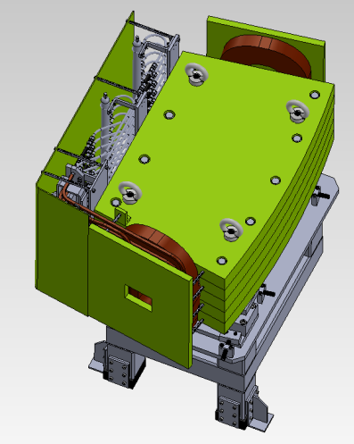
BL1U: UCN Beamline
BL1U: 500 MeV, 40 μA protons, Tungsten target
Tungsten Spallation Target
12 cm, Ta-cladded, water cooled, power: 20 kW (peak), 5 kW (avg)
SC Polarizer
UCN guide to experiments
³He/He-II Cryostat
0.7K ³He, 0.8K He-II
Ultra-Cold Neutrons
Shielding Pyramid
D₂O Cryostat
10K D₂O ice
Cold Neutrons
Quad Doublet
Set beam size at target
BL1U
Dipole Magnet
Bends beam 7° onto target
BL1A

Slide 10
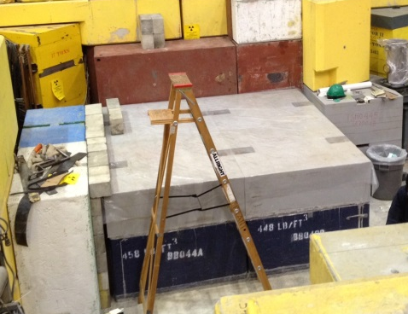
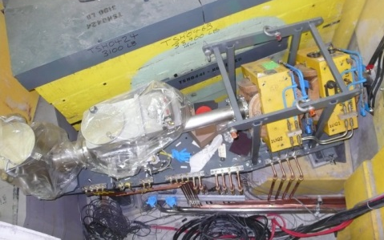
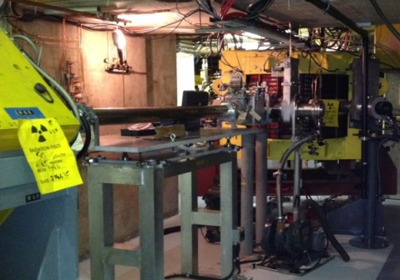
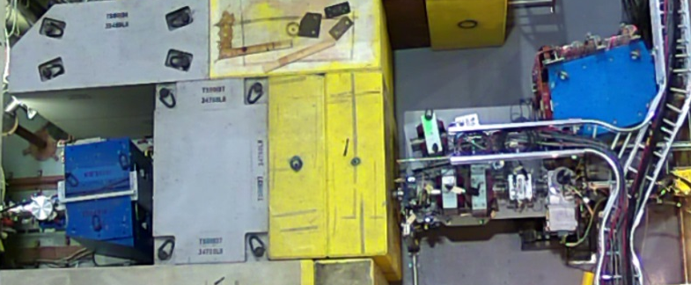
UCN Facility Installation Timeframes
Pyramid base
Floorspace
for nEDM
Experiment
UCN Source in 2016-17
D₂O cryostat (cold moderator)
He-II cryostat
D/S section
UCN
Source
Target
Target in 2016
2015
Vault Components
M13 Decommission
Quads & D/S section
Shield Pyramid Base
Quads
BL1U
Dipole
BL1A
Vault section
Septum
U/S section
Kicker
2014
Septum
Dipole & Girder
Shielding Plug
Kicker in 2016

Slide 11
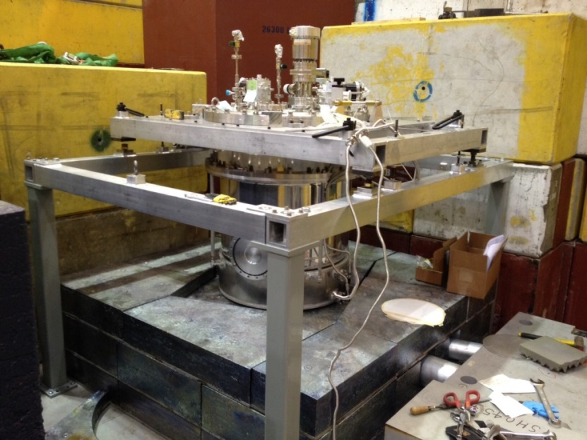
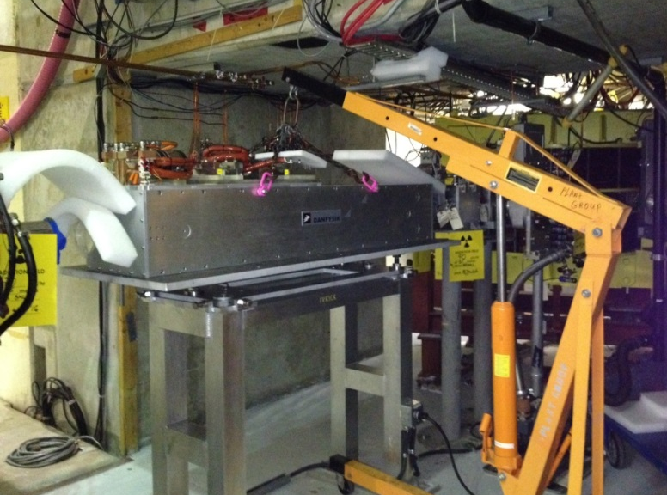
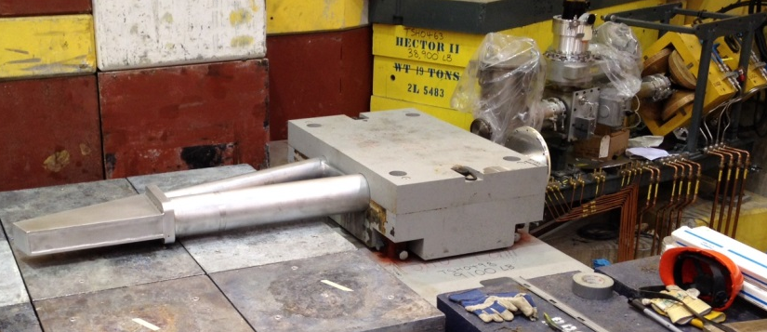
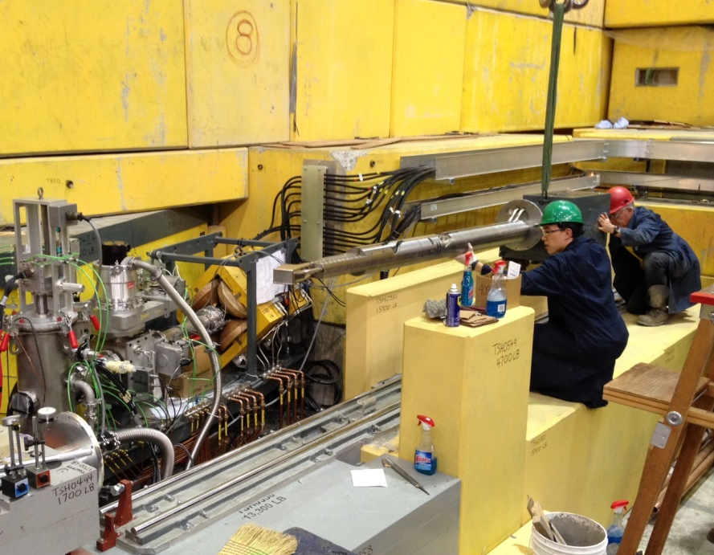
UCN Facility 2016 Installation
2016
Kicker Magnet
Target Crypt
Target & Rail System
UCN Source Front-end (CN)
Shield Pyramid
Floorspace
for nEDM
Experiment
UCN
Source
D₂O Cryostat
(UCN Source
Front-end)
Target
Quads
BL1U
Dipole
Kicker Magnet
BL1A
Target Crypt
Septum
Kicker
Water-cooled Target
& R/H Rail System

Slide 12
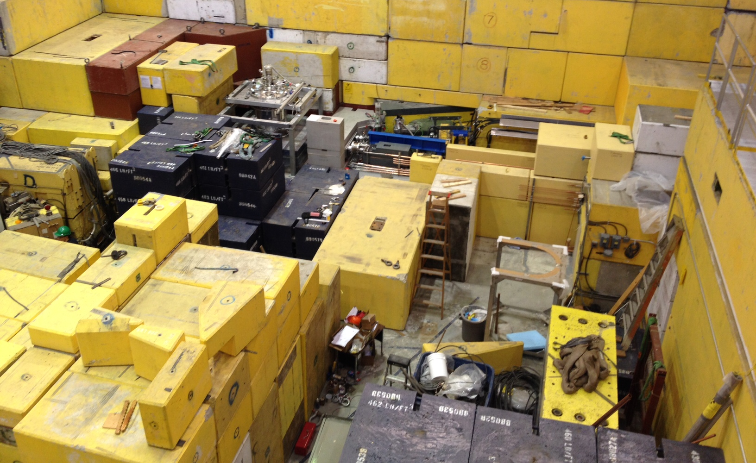
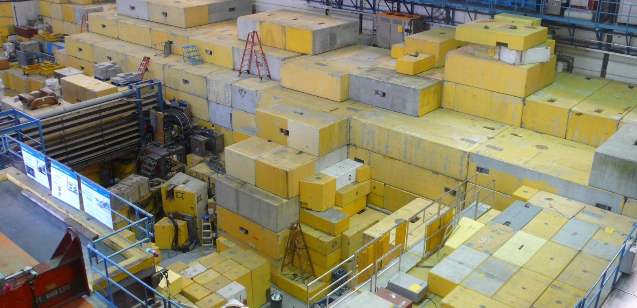
BL1U Downstream & UCN Source Front-End
12
D2O Cryostat
BL1U
Downstream
Target R/H system
May 12/2016
UCN Beamline Installed (Kicker →Target)
Source Front-End Installed (D₂O Moderator)
After closing up

Slide 13
UCN and nEDM Timeline
13
Calendar year
quarter
2015
2016
2017
2018
1 2 3 4
1 2 3 4
1 2 3 4
1 2 3 4
1
UCN
move D₂O
to TRIUMF
move He-II
to TRIUMF
@RCNP
@TRIUMF
UCN development
Safety upgrades
Beamline,target,shielding install
Source install/commission
LD₂ upgrade
EDM
Milestones: Proton Beamline (BL1U) & CN Source installed
@RCNP
@TRIUMF
EDM development
move to TRIUMF
EDM
install
EDM Phase 1
EDM R&D for Phase 2
EDM Phase 2

Slide 14
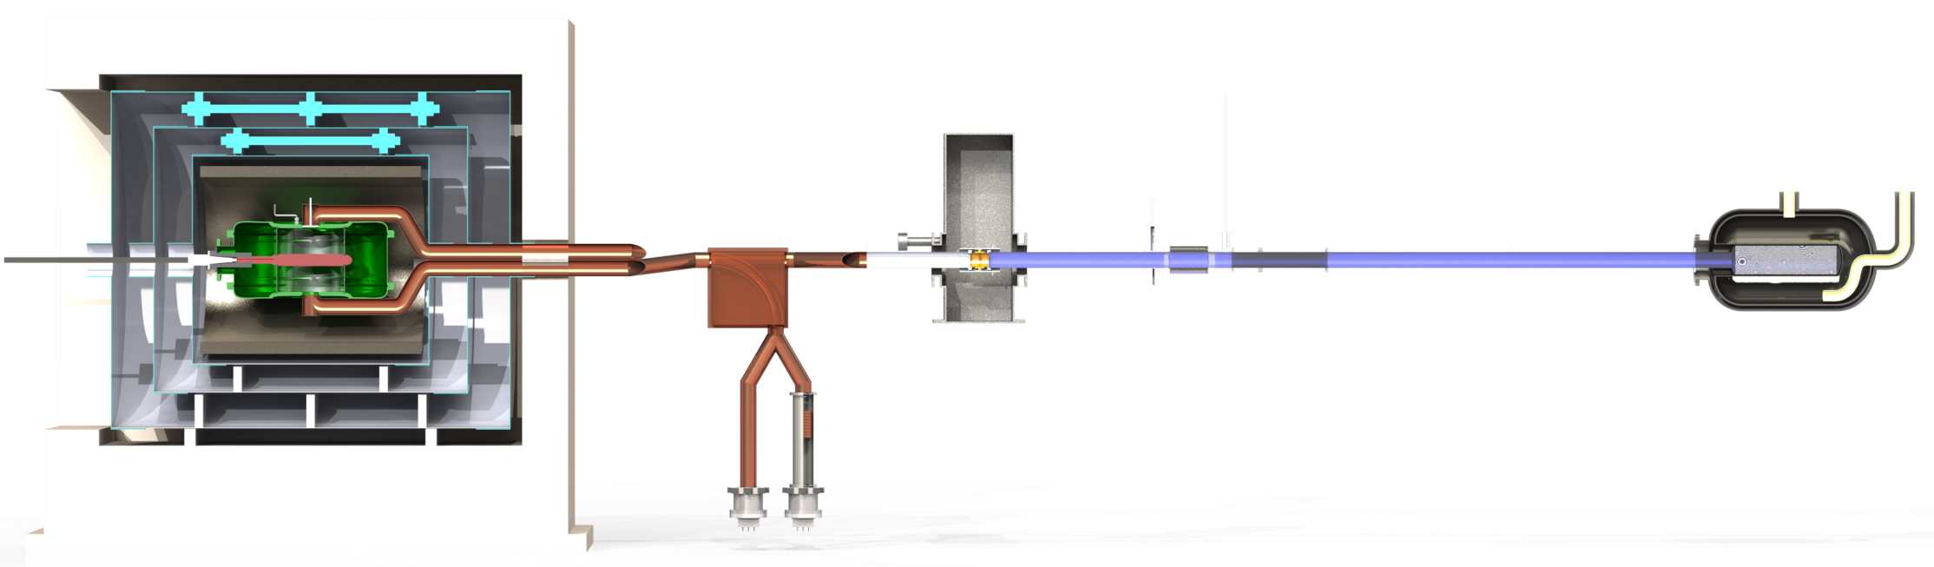
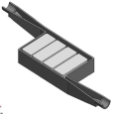

nEDM Phase 2 Strategy
Sensitivity goal: d_{n} < 10⁻²⁷ e·cm
Room temperature experiment
  Enables more rapid development
Planned improvements
  higher UCN density with LD₂ moderator
  2 cells, probably “horizontal” loading
  dual Xe/Hg comagnetometer
  improved magnetic environment
  simultaneous counting of both polarizations
Ongoing extensive R&D program
  magnetics
  UCN detector
  comagnetometer
  HV/EDM cell
  Simulations
Keep layout as flexible as possible
  to take advantage of R & D outcomes
A possible topology
magnetically shielded room
inner passive shielding
SC polarizer
moderator
cryostat
EDM cell(s)
UCN switch
He-II volume
HV feed
spin flipper/
analyzer
spallation target
protons
2.5 m
4 UCN detectors

Slide 15
Summary
UCN Facility
Proton beamline, Target, & CN Source installed on schedule
He-II Superfluid Cryostat to arrive at TRIUMF in Summer 2016
Control Hardware & Software in progress
Commission BL1U, CN and UCN source in 2016-17
  CN Source Commissioning Tests → T.Kikawa talk (next talk)
nEDM Experiment (Phase-I and Phase-II)
  Talk by J.W.Martin, Thursday at 13:15, R2-3 (Fundamental Sym. II)

Slide 16
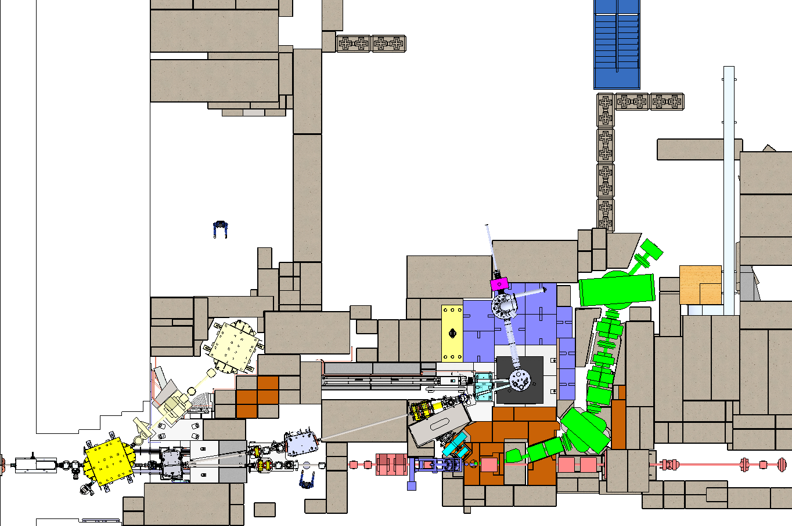
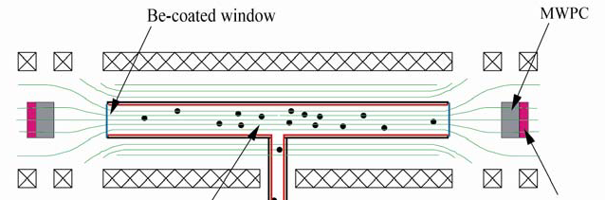
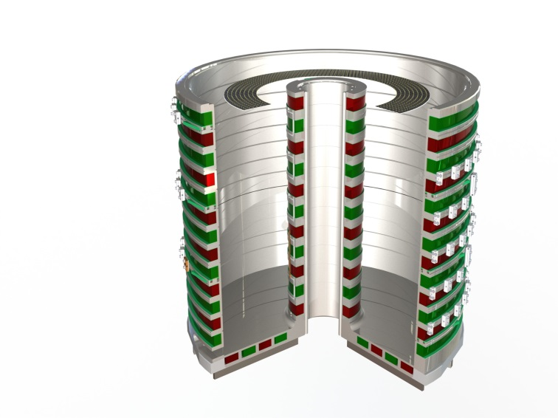
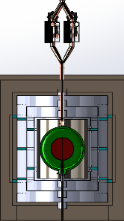
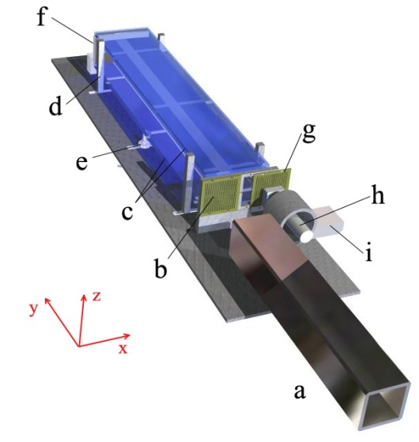
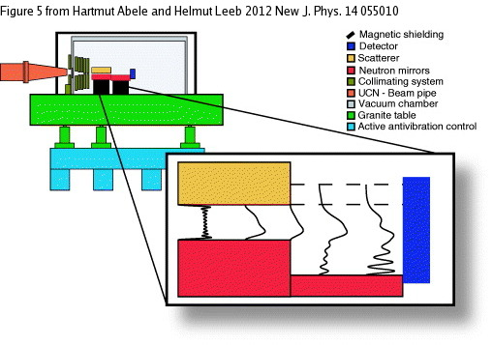
UCN Facility, nEDM & 2nd Experiment Port
Laser lab for nEDM
N
EDM space
6m x 9m
laser lab
4.5m x 5m
Neutron decay: UCNA
Second experiment port
2nd port
3m x 3m
Short term:
detector and guide development
Long term:
real user facility
Lifetime: PENeLOPE
EDM cell & magnetic shielding
UCN source
UCN Beamline
Gravity: Q-Bounce
Neutron charge
(TRIGA Mainz)
Spallation target
& moderators

Slide 17
FINIS

Slide 18
UCN Schedule Overview & He-II Cryostat
Schedule( 2010-2016 )
2016
2017
2012
2014
2015
2015
2016
2018
2011
2013
2013
2014
2017
ACTIVITY
J A J O
2012
J A J O
J A J O
J A
MESON HALL (& Vault):
J A J O
J A J O
J A J O
Cleanup M11,1A/1B roof-beam
Schedule: Source Installation
➢ Regular Shutdown (4 m)
Install D₂O cryo during S/D
➢ Post-Shutdown (4 m)
Commission beamline, CN
➢ Mini-Shutdown (Sep’16)
Vacuum D₂O to He-II
Install He-II cryo (not S/D)
Dismantle PIENU & M13-DS
Dismantle M13-US, Mod.Shld
✓
Mod. 1VQ5; Mod. Shield-Plug
Design/Fab^{r}
Core M13 I-block
BEAMLINE 1U:
Kicker
Design & Review
Order/Fabricate/Deliver
Kicker Stand & Beamtube
Design/Order
Fabr
Septum
Design & Review
Fab/Assy
Inst.
Dipole
Procure
Assy
Inst.
Beamline (incl Quads, PS,…)
Design & Review
Fabricate
Inst.
Fabricate
Inst.
UCN APPARATUS:
Shielding
Design & Review
Design/Procure
Inst.
Procure
Inst.
Spallation Target & R/H
Specify/Conceptual design
Design/Order/Fabricate
Inst.
UCN Source (D2O Cryostat)
Install/Test/Run @ RCNP
Procure
Prep
- He-II Cryostat to TRIUMF
Install/Test/Run @ RCNP
Mod/Test/Move
Inst.
COMMISSION @ TRIUMF
BL1U & Source Commissioning
p/CN/UCN
UCN
HELIUM LIQUEFIER:
Delivery of
He-II cryostat
He Liquefier System
Procure/Install
Upgrade He Liquefier System
Procure/Install
MILESTONES
Shutdown Activities
Non-Shutdown Activities
Activities Elsewhere
(KEK, RCNP, CERN, Acsion)

Slide 19
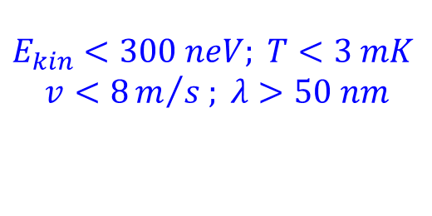
Definition of Ultra Cold Neutrons
19
19
Neutron Classification
Neutron Kinetic Energy Temperature Velocity Wavelength
Relativistic > 1 GeV 10¹³ K 0.875 c 1 fm
Fast > 1 MeV 10¹⁰ K 0.046 c 30 fm
Thermal ∼ 25 meV 300 K 2 km/s 0.2 nm
Cold < 3 meV < 35 K 760 m/s 0.5 nm
Very Cold (VCN) 0.01 – 0.8 meV 1.5 K 150 m/s 1 – 10 nm
Ultra Cold (UCN) < 300 neV < 3 mK < 8 m/s > 50 nm
UCNs:
$$E_{kin}<300 neV; T<3 mK$$
$$v<8m/{s ; λ>50 nm}$$

Slide 20

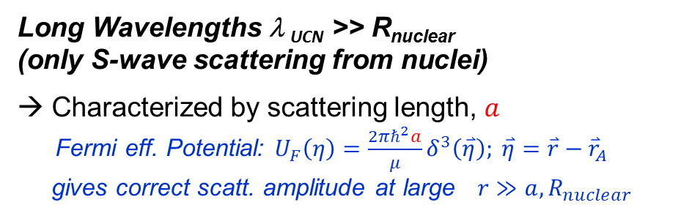

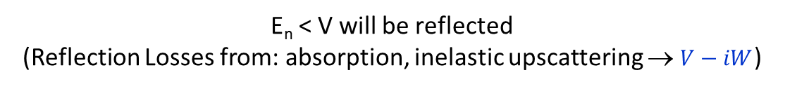
Strong Interaction and UCNs
20
20
Long Wavelengths λ _{UCN} >> R_{nuclear}
(only S-wave scattering from nuclei)
Characterized by scattering length, $a$
Fermi eff. Potential: $U_{F}\left(η\right)=\frac{2πℏ^{2}a}{μ}δ^{3}\left(\overset{⃑}{η}\right); \overset{⃑}{η}=\overset{⃑}{r}−{\overset{⃑}{r}}_{A}$
gives correct scatt. amplitude at large $r≫a, R_{nuclear}$
Fermi Potential for materials
Material V a_{coh} f_{loss}=W/V
[neV] [x10⁻¹³ cm] [x10⁻⁵ ]
--------------------------------------------------------------------------------------------------------------------------------------------------------------------------------------------
Ni⁵⁸ 335 14.4 8.6
BeO 261 13.6 1.35
Ni 252 10.6 12.5
Be 252 7.75 0.5^{(300K)}
0.08^{(100K)}
DLC 220-270
NiMo⁽⁸⁵⁻¹⁵⁾ 227
Fe 210 9.7 8.5
S.S. 183
C 180 6.6 0.6
Cu 170 7.6 15.5
Teflon 123 17.6
Al 54 3.45 2.25
PE (CH₂)_{n} -8.7 -0.84
H₂O -14.7 -1.68
Coherent scattering from a collection of nuclei
Step-function pseudo (Fermi) potential $∝a$
Effective Int.^{n}
with any
given material
$$V= \frac{2πℏ^{2}}{m_{n}}Na$$
V
x
E_{n} < V will be reflected
(Reflection Losses from: absorption, inelastic upscattering → $V−iW$)
Coated materials (pipes, bottles) to transport & store UCNs

Slide 21
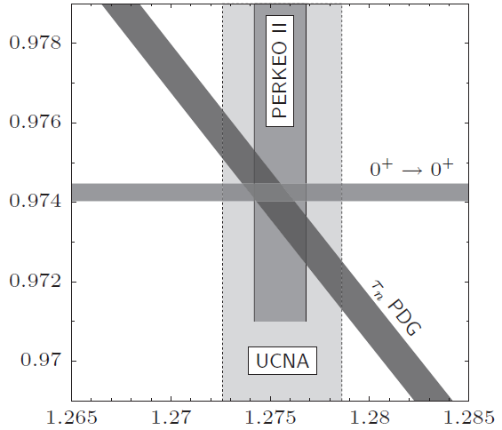
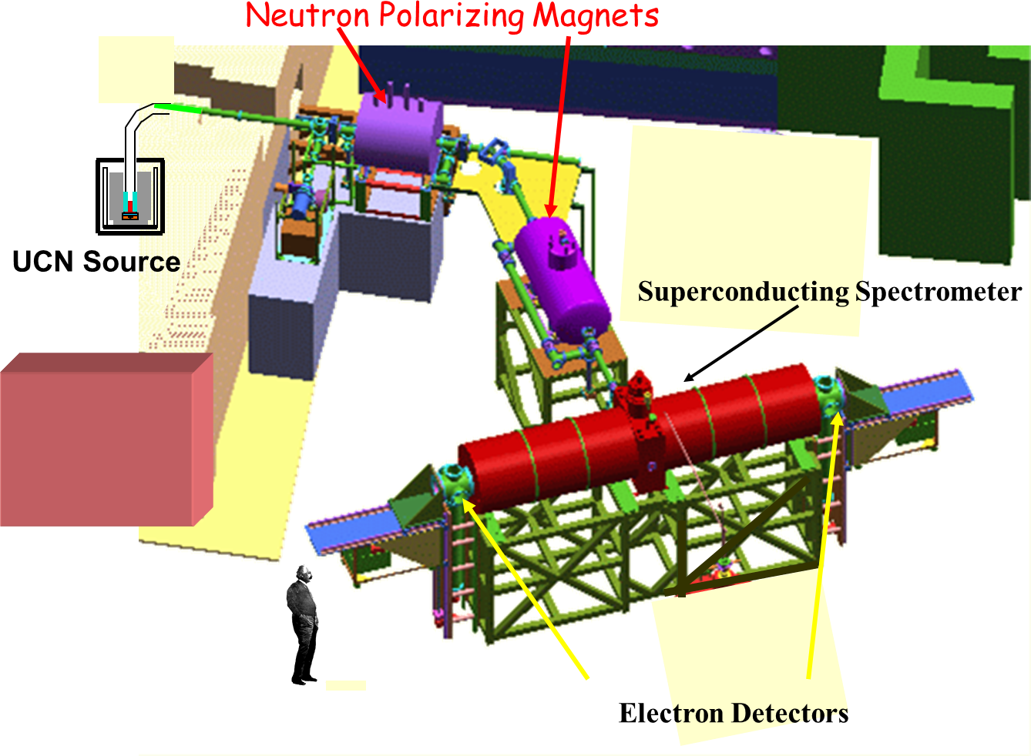
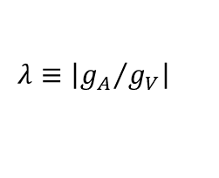




UCNs for Fundamental Physics
21
21
UCN key features: (a)“Readily” stored with interaction times ∼ τ_{n} ; (b) Can be spin-polarized.
Neutron β decay
Studies:
  CKM unitarity (V_{ud})
  Weak Couplings: λ(g_{A}/g_{V}), g_{S}, g_{T}
  BSM, right-handed couplings (V-A vs V+A)
  He/H ratios in early universe, BBN uncertainties (in τ_{n})
Neutron Lifetime τ_{n}
  New initiatives: Makes use of magnetic, magneto-gravitational traps (PENeLOPE, UCNτ)
Neutron β decay angular corr.^{n}
  A coeff. (UCNA)
$(n→p+e^{−}+\overline{ν_{e}}$ )
$$τ_{n}=\frac{4908.7 ±1.9 s}{{\left|V_{ud}\right|}^{2} (1+3λ^{2})}$$
$$V_{ud}$$
$$A=\frac{−2λ(λ+1)}{1+3λ^{2}}$$
$$λ≡\left|{g_{A}}/{g_{V}}\right|$$
Lifetime: PENeLOPE
Neutron decay: UCNA

Slide 22
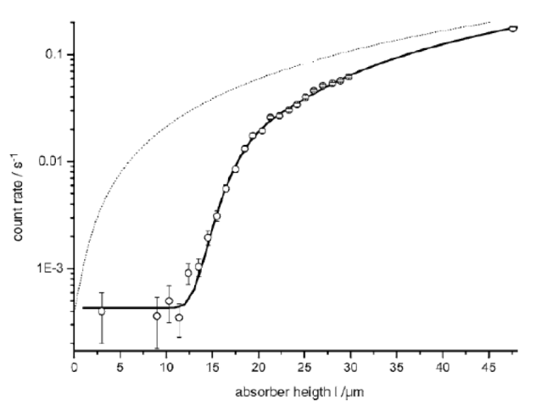
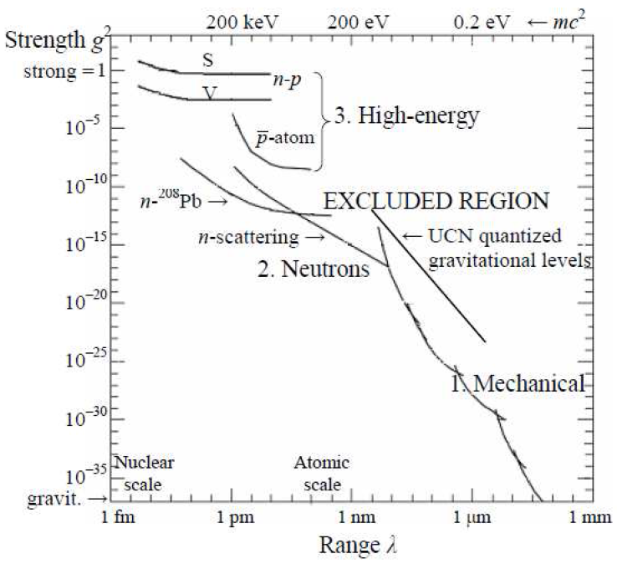
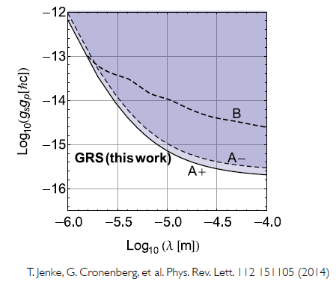
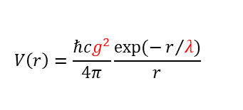
UCNs for Fundamental Physics
22
22
UCN as quantum bouncing balls
Gravity Tests with UCNs
Studies of:
  Gravitational quantum levels
  Extra dimensions (μm scale)
  Neutron constraints on new forces (strength, range) & dark matter candidates, axion models
  Neutron mass
Q-Bounce, GRANIT
  UCN mirror below and absorber (or scatterer) above
  Quantized gravitational levels observed
  Transitions induced (vibrating mirrors, magnetic fields)
Classical
expectation
Count rate s⁻¹
data +
quantum fit
Absorber height (μm)
Gravity: Q-Bounce
Strength & Range of new Forces
Dubbers and Schmidt, arXiv:1105.3694 (2011)
Limits on axion-like
particles
$$V\left(r\right)=\frac{ℏcg^{2}}{4π}\frac{exp⁡(−r/{λ)}}{r}$$

