Slide 1
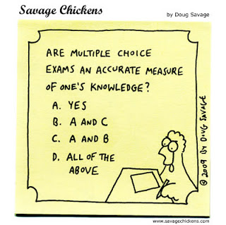
Integrated Testlets: Multiple-Choice Testing 2.0
Aaron Slepkov and Ralph Shiell
Department of Physics and Astronomy, Trent University

Slide 2
Context and Roadmap
Context:
The choice between using Oral, Constructed-Response (CR), and Multiple-Choice (MC) testing in physics examinations stems from a balance of economics and ethos.
Traditionally, multiple-choice testing has been reviled in pedagogical circles in physics, where constructed response testing is seen as a “gold standard” of sorts.
Economics are driving the adoption of multiple-choice. We are working on reconciling our ethos towards this format by exploring MC structures that are more valid in physics education.

Slide 3
Context and Roadmap
Roadmap:
Why we test
How we test
The present clash between reliability and validity
Integrated Testlets: A new multiple choice framework
      What are they?
      How do they work?
      Key attributes, validated
      How are they currently used?

Slide 4
Main uses of formal assessments
Foremost:
Determine student rankings for scholarships and/or future placements
Incentivize pre-test study (“The Stick”)
Inform students about how much they’ve learned
Secondary:
Inform instructor about their success in the transfer of knowledge
Allow opportunity for assessing meta-cognition for students (“Checkpoint”)
Tertiary (and oft ignored):
Provide leaning opportunities (i.e. formative testing)
Certify the scope and rigour of the course itself (for comparisons)
Implicitely inform students of learning objectives (post-hoc)?

Slide 5
Reliability vs. Validity
Reliability: * How accurate is the measurement?
* How repeatable or representative is it?
Validity: * How “appropriate” is the test?
* How aligned is it with our learning/testing goals?
* What does our test tell the student about our learning goals?
The medium is the message!

Slide 6
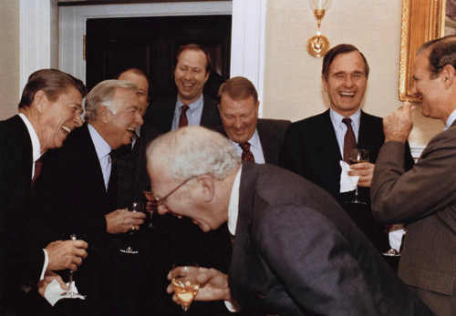
AND THEN I SAID
the final exam will be MULTIPLE CHOICE!

Slide 7
Reliability vs. Validity
The dominant antagonism between “constructed response” and “multiple choice” testing
CR: Problem solving, concept integration, idea synthesis…these are the things we WANT to test for in a VALID exam
MC: Maximizing the number of questions + objective scoring…these are the things we WANT in a RELIABLE exam.
CR: Valid but can be unreliable (and expensive!!!)
MC: Can be very reliable but smacks of invalidity

Slide 8
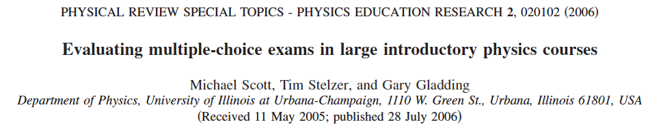
Reliability vs. Validity
CR: Valid but can be unreliable (and expensive!!!)
MC: Can be very reliable but smacks of invalidity
Large physics classrooms → Economics force us to adopt MC testing
MC testing in physics has been shown to be reliable, and a ‘tolerable’ alternative to CR.

Slide 9
Constructed-Response
Pros:
  Flexible in construction and grading
  Assess broadly across cognitive/knowledge domains
  “Honest” (?!) assessment tool
  Allows for partial credit (but a few dead mice…)
Cons:
  Time-consuming and expensive to score
  Grading/scoring less reliable; sometimes biased
Multiple-Choice
Pros:
  Easy to grade (fast and reliable)
  Inexpensive to grade
  Reliable (many items; good coverage)
Cons:
  Poorly aligned with course objectives? (i.e. overly rely on superficial knowledge)
  Partial credit is uncommon
  Potential for “guessing” repugnant to some

Slide 10
Constructed-Response
Pros:
  Flexible in construction and grading
  Assess broadly across cognitive/knowledge domains
  “Honest” (?!) assessment tool
  Allows for partial credit (but a few dead mice…)
Cons:
  Time-consuming and expensive to score
  Grading/scoring less reliable; sometimes biased
Multiple-Choice
Pros:
  Easy to grade (fast and reliable)
  Inexpensive to grade
  Reliable (many items; good coverage)
Cons:
  Poorly aligned with course objectives? (i.e. overly rely on factual knowledge)
  Partial credit is unavailable
  Potential for “guessing” repugnant to some

Slide 11
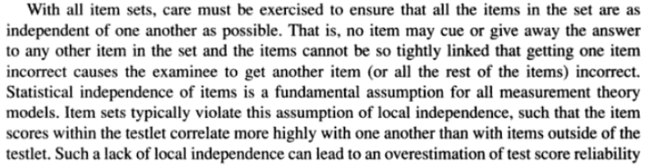
traditional testlets
Testlets are ‘context-dependent item sets’:
A group of MC items that share a common stem and mine a topic
By keeping a common stem, reading time is reduced and so students engage better with a set of questions
Item independence→ a cornerstone of traditional testlet theory:
Downing and Haladnaya, Handbook of Test Development, 2006

Slide 12
traditional testlets
Item independence avoids double-jeopardy for students
Reading comprehension modules are archetypical testlets
Main advantage of traditional testlets:
By mining a given scenario for a set of questions, both reading time and cognitive load are reduced.
→ allows for more “items” and increased reliability.

Slide 13
Integrated Testlets
Our teaching objectives involve developing knowledge and skills beyond the factual and the categorizable
want to assess deeper knowledge, understanding, and abilities.
We developed answer-until-correct integrated testlets:
Context-dependent item sets with items purposefully interrelated so knowing the answers for certain items is helpful or required to answer subsequent items.
Various levels of item integration can be used, including stand-alone items.

Slide 14
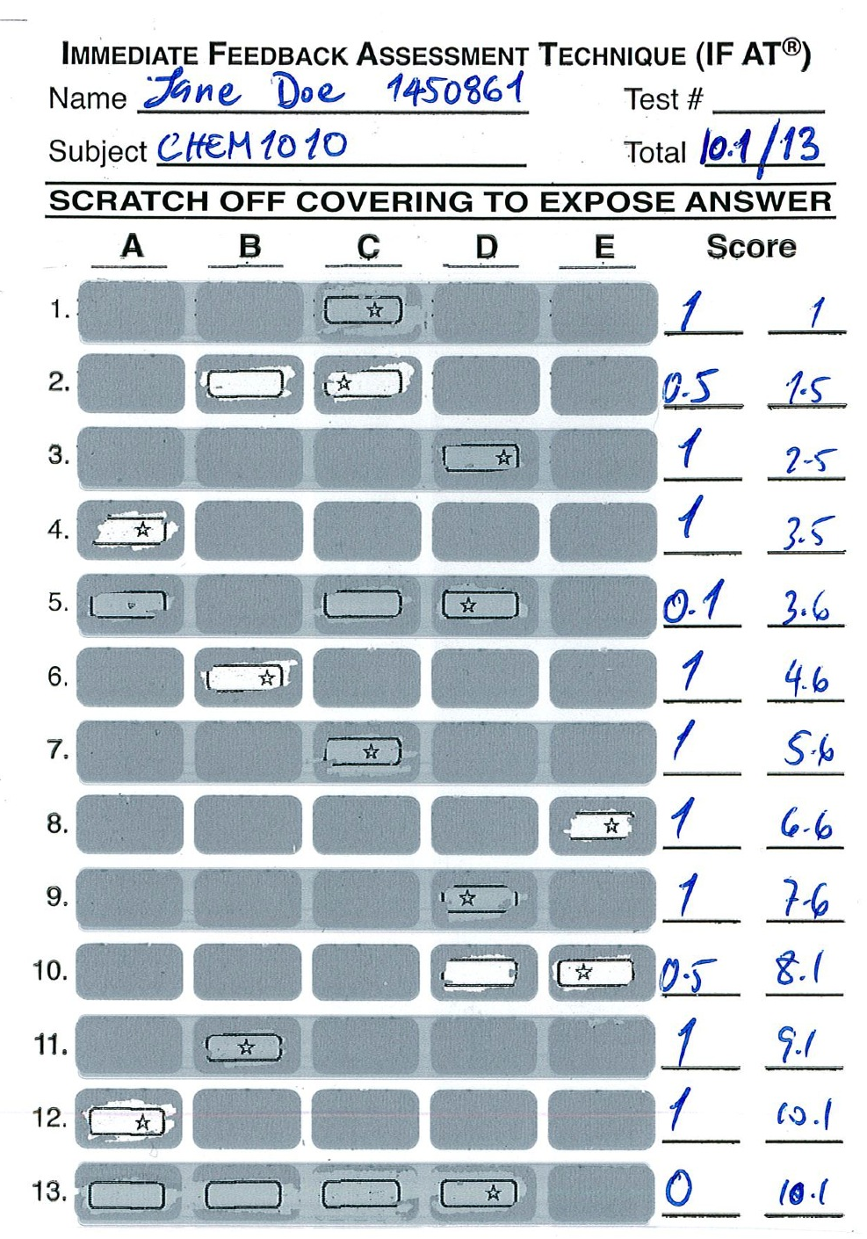
Integrated testlets
For offline implementation we use commercially available Immediate Feedback Assessment Technique (IF-AT) cards⁽¹⁾:
Boxes are coated like a scratch-and-win lottery ticket
A star is within the keyed-response box, with distractor boxes being blank
The student continues answering until the star is found
The student scores their own card, and leaves the exam with knowledge of their score
Students prefer the IF-AT to Scantron by a substantial margin*
⁽¹⁾ Available from Epstein Enterprises
* D. DiBattista, et al., Teach. High. Educ. 9, 17-28 (2004)

Slide 15
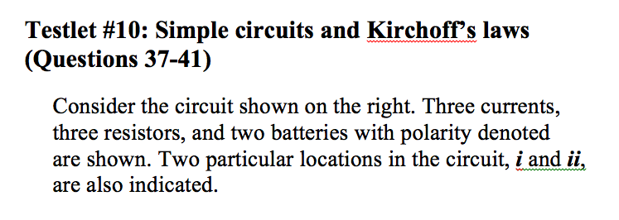
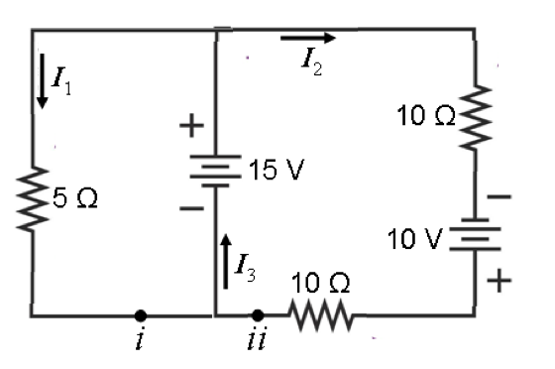
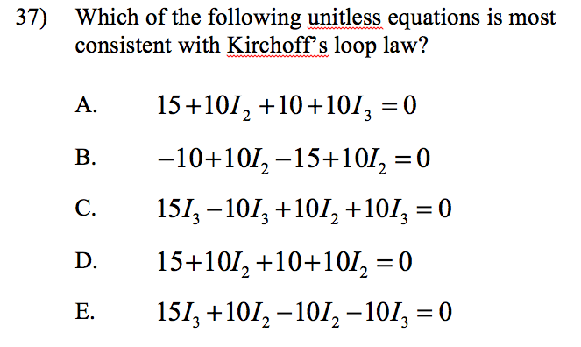
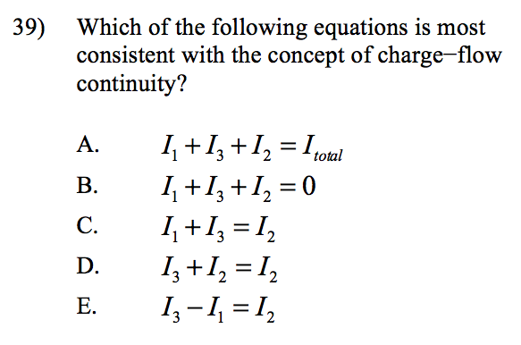
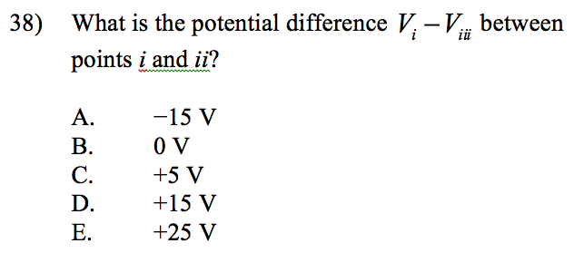
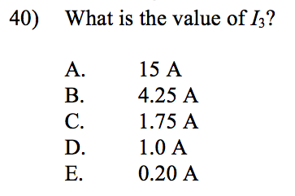
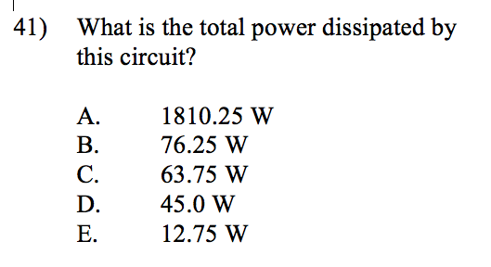
A. D. Slepkov, Am. J. Phys. 81, 782 (2013)

Slide 16

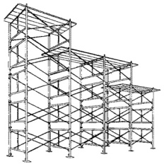

integrated testlets (ITs)
Item-by-item confirmatory/corrective feedback provides learning opportunities as well as summative assessment.
Partial-credit schemes allow for a fair and reliable MC test, at lower costs.
By integrating items, a ‘scaffolding’ can be built within the test. This allows for ascension of a mountain of knowledge.
Q6
desired knowledge assessment
Q5
climbing the mountain of learning (ITs)
vs.
surveying the perimeter
(typical MC test)
Q4
examinee
Q3
Q13
Q2
Q11
Q5
Q1
Q7
Q9
Q3

Slide 17
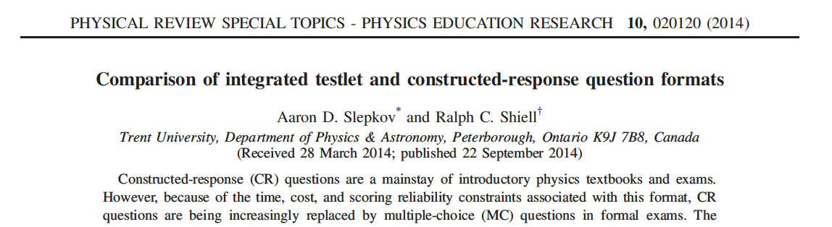
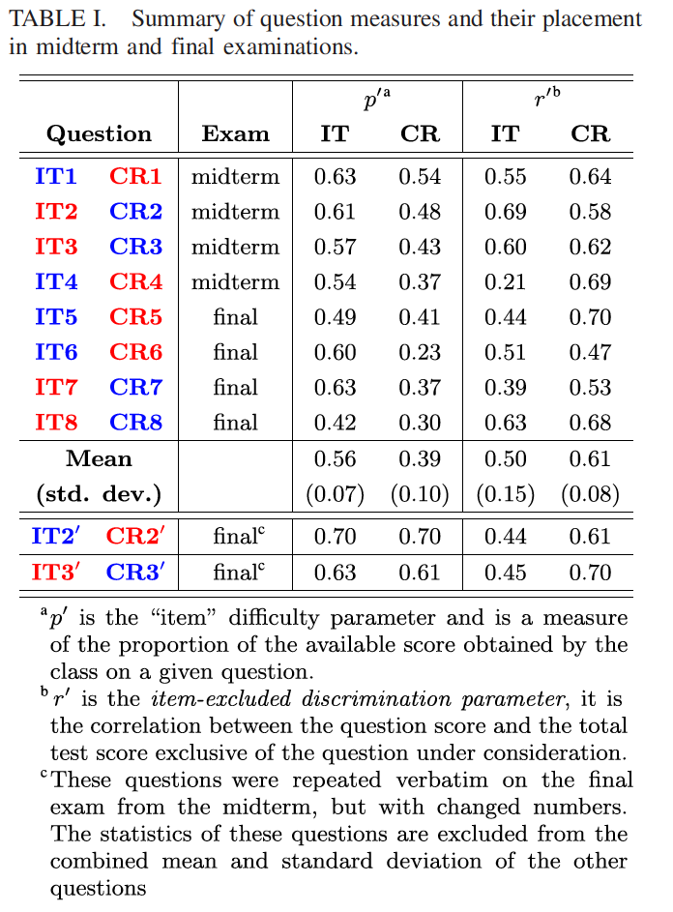
N~150 student study
ITs prove less “difficult” than CR
(mean score is 17%_{p} higher)
ITs prove less discriminating than CR (but are still very discriminating)

Slide 18
Availability of partial credit (2nd response) makes test a better measurement tool!
In all IF-AT studies (many using ITs), the test proves more discriminating and reliable with partial credit than without
Partial credit is not random; not grade “inflation”
A. D. Slepkov, A. T. K. Godfrey, Submitted to Appl. Meas. Educ., 2016.

Slide 19
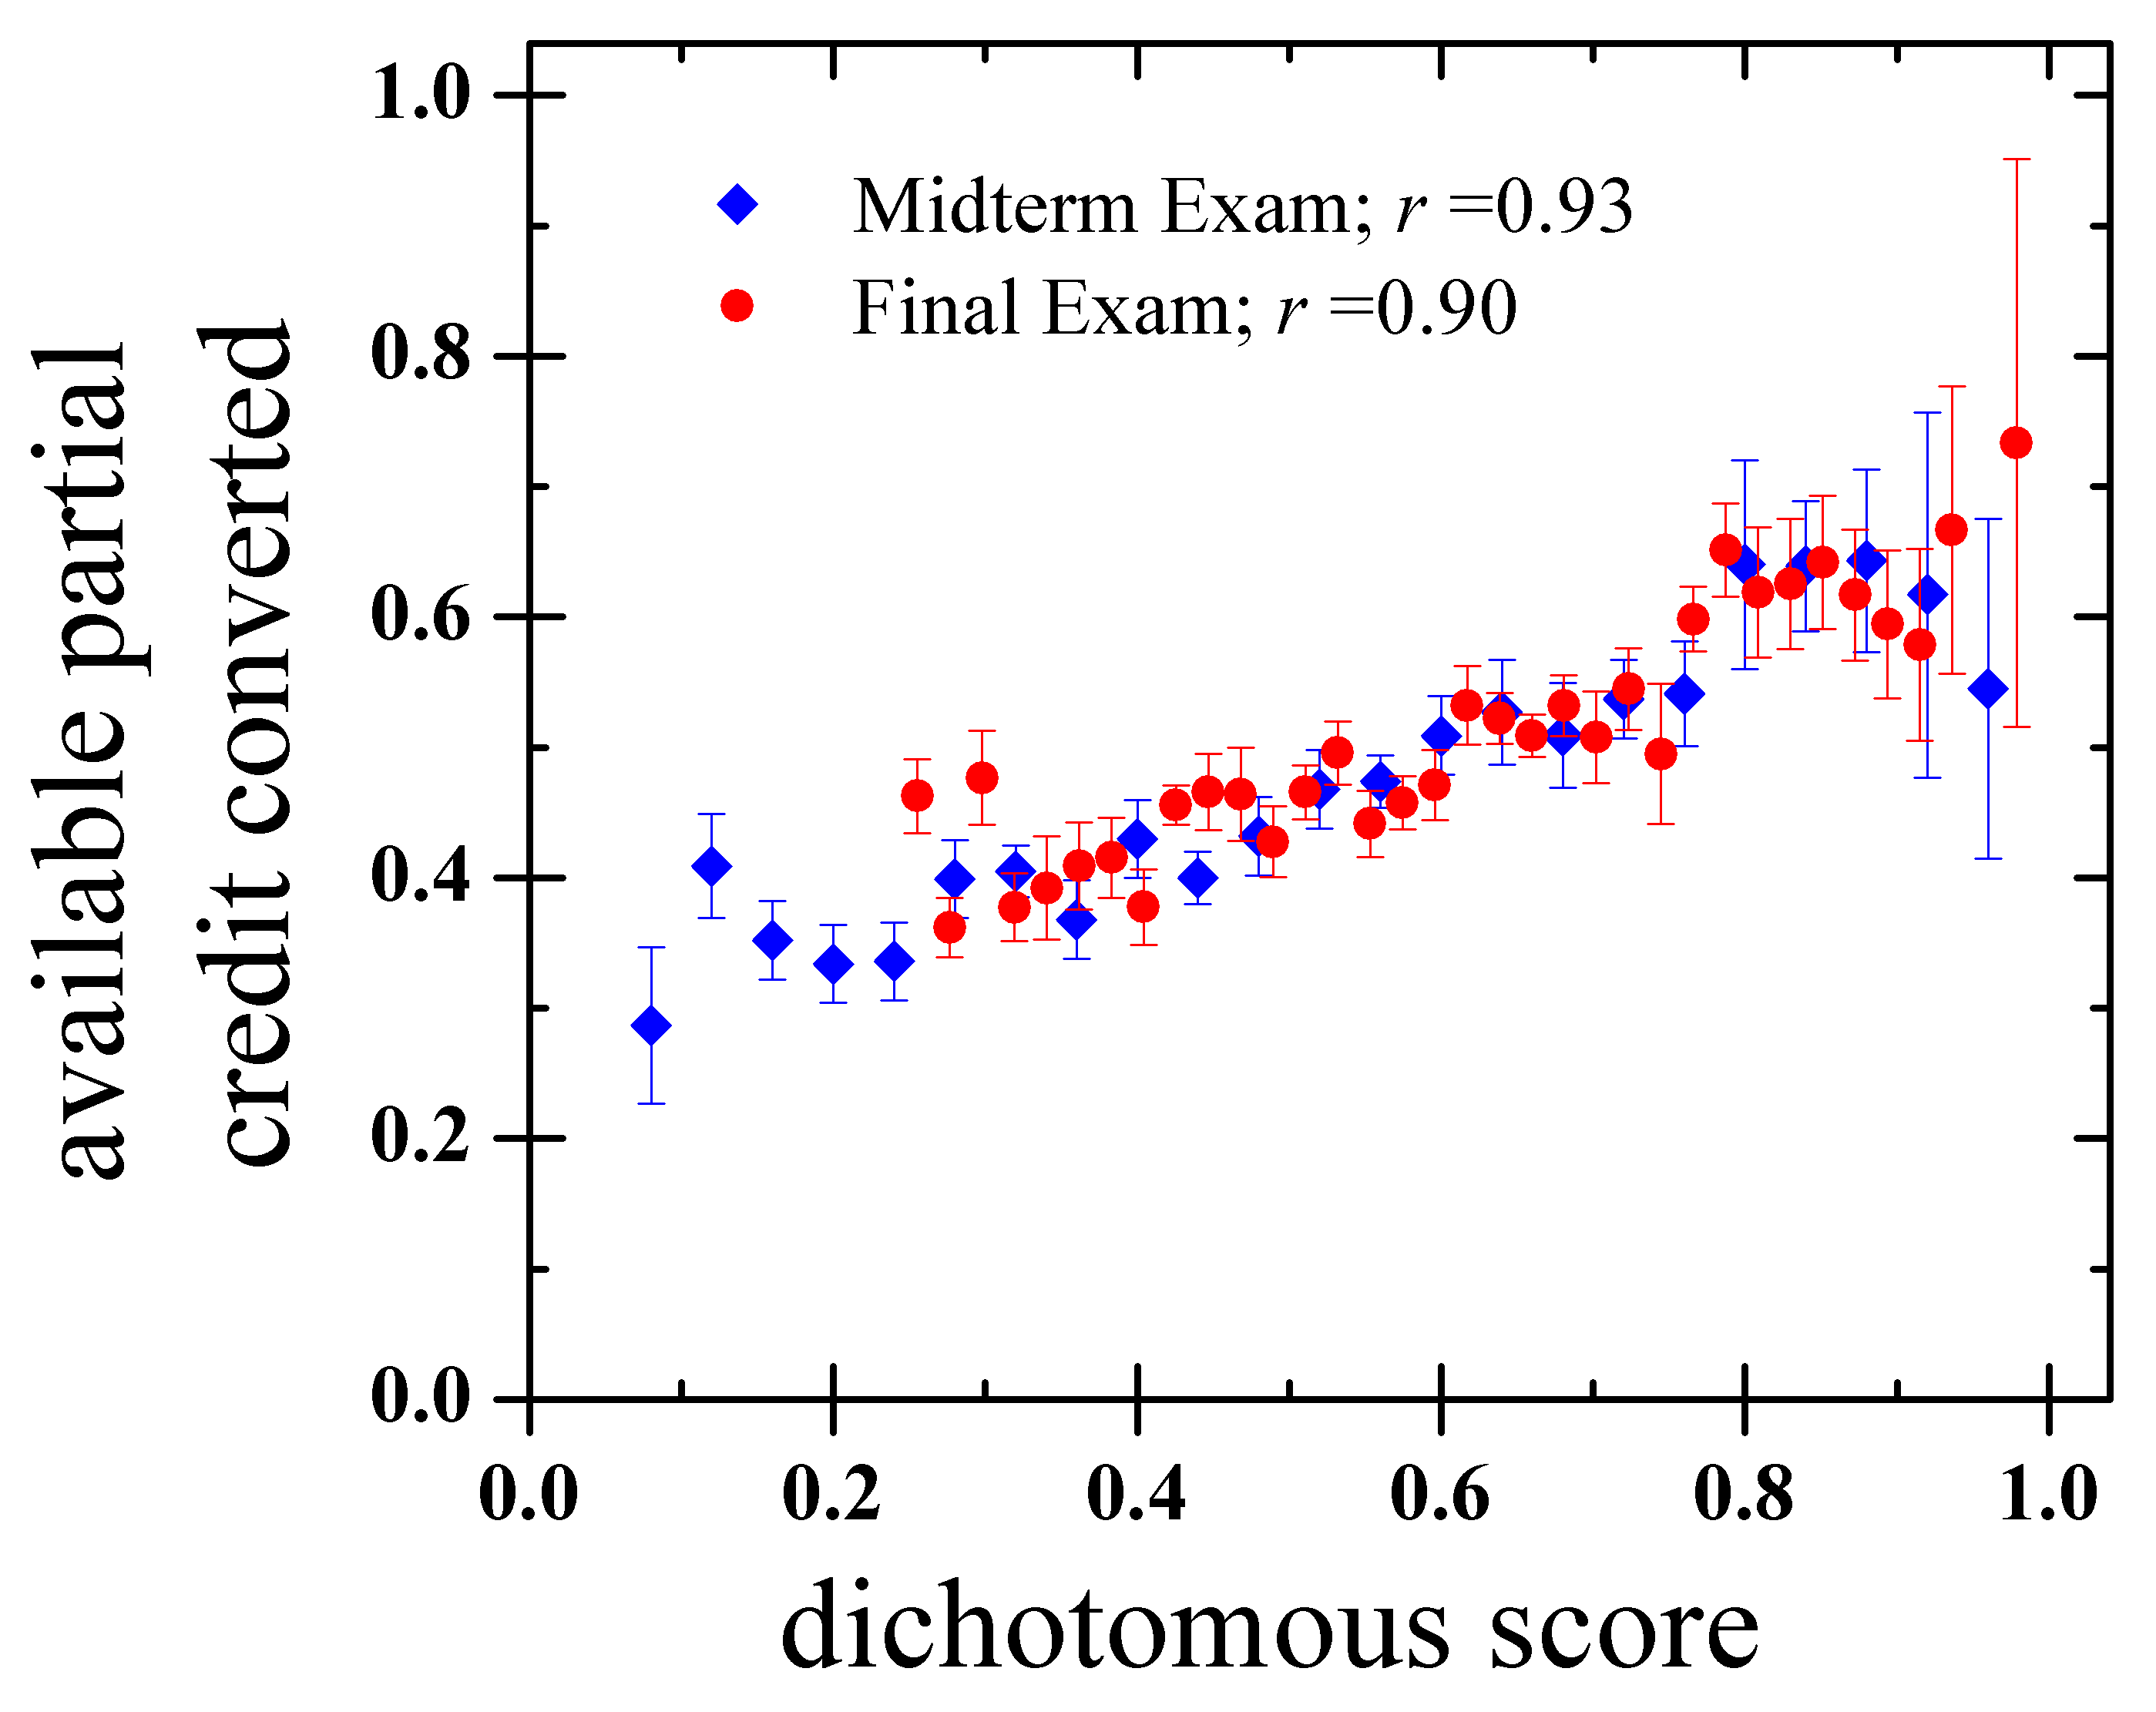
IF-AT and partial credit
Intro Chemistry II
~450 students
Partial credit is seen to be granted in a discriminating manner
→ Students with more knowledge are more likely to earn partial credit when available to them
A. D. Slepkov, A. J. Vreugdenhill, and R. Shiell, Submitted to J. Chem. Ed, 2016.

Slide 20
What do we know about Integrated Testlets?
They allow for testing of complex integrated ideas like CR
They are reliable like MC
They allow for simple and valid partial credit schemes
They are applicable to many disciplines, but are particularly useful in STEM disciplines
Students spend less time on them than on CR
Their use reinforces the course’s learning objectives
They cost 2X as much as Scantron®, but 5% as much as CR
Students prefer this testing format (even top students!)

Slide 21
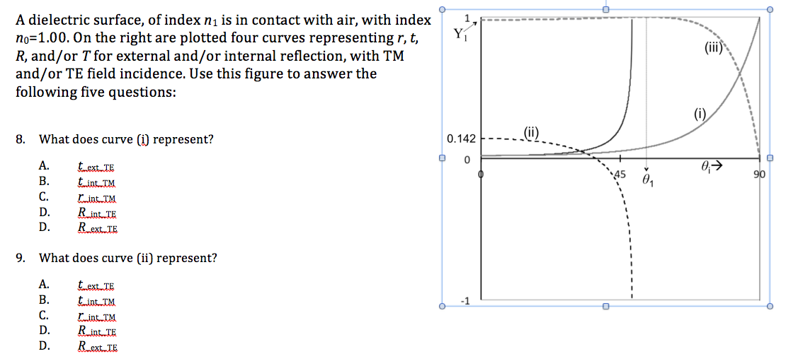

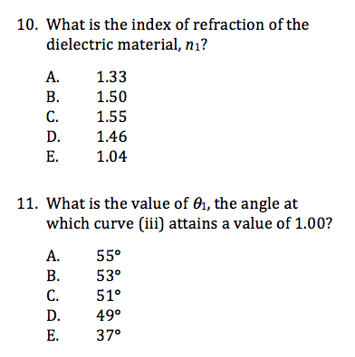
Senior Physics:
Optics

Slide 22
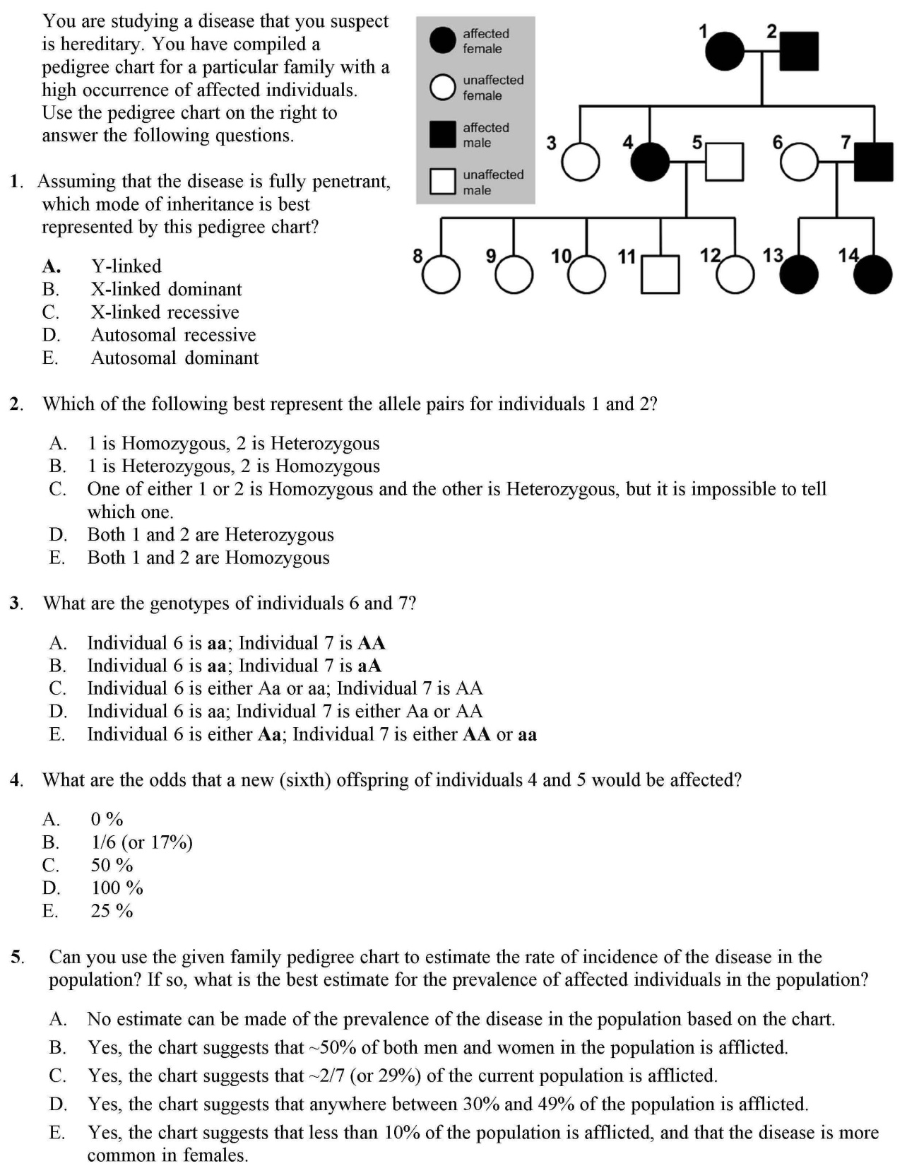
Biology/Genetics

Slide 23
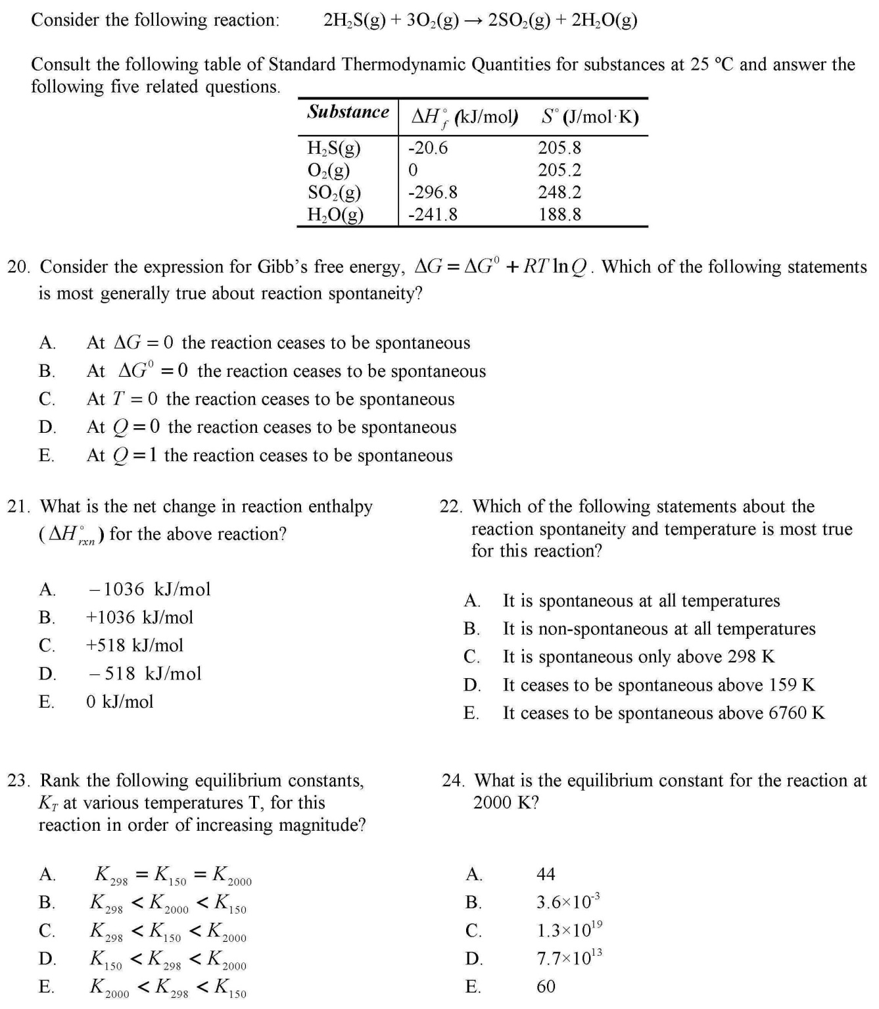
Chemistry

Slide 24
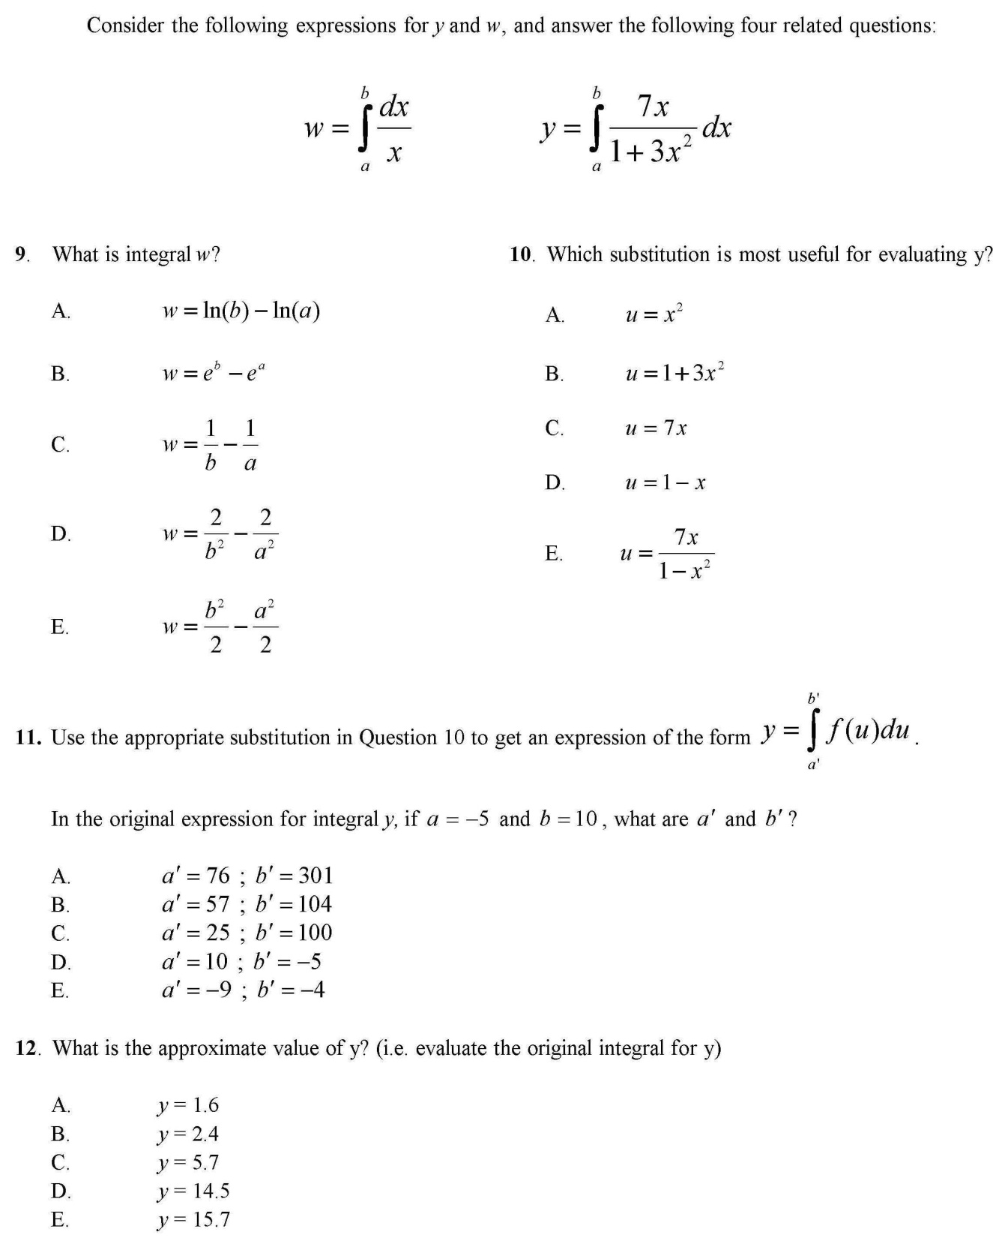
Calculus

Slide 25
What don’t we know about Integrated Testlets?
[i.e. current & future research]
How well do they model the problem-solving of CR?
Can they ever access the “synthesis” domain of CR?
How much faster are they completed than CR?
Does the grade distribution indeed better reflect the distribution of knowledge of the class?
How well do they transfer to online deployment?
What do they offer in a collaborative testing environment?

Slide 26
Usage at Trent and Beyond
ITs have been used in EVERY introductory physics exam at Trent U since 2011. (5 instructors; 15 courses)
Used in 2014 Intro Chemistry Exams
Used at Queen’s this past term! (James Stotz, 2nd year Eng.Phys course)
Students love the IF-AT (the tool), but many confuse it with the IT (the approach).

Slide 27
“I love the fact that you can walk away with knowing what your mark on the final exam is and not have to wait … to see your mark. Knowing the right answer after you made a mistake, definitely does stay in ones memory for a long time.” [formative assessment qualities]
“This was a great technique! It is very similar to the style of the …iclicker questions. If you are incorrect you are given a chance to rethink the question and try to better understand it. I think this is a great technique and very helpful in better understanding the material.” [Helps engaging with the problem]
“IT WAS AWESOME! Yes. It was cool that i got the second chance and even if i got that wrong i knew the answer to the question and i feel like it helped me learn better” [formative assessment qualities]
“It's great knowing how you're doing as you're going through a test. And also, if you make a mistake in the previous question, it helps you to correct yourself before attempting subsequent questions, which is very helpful.” [Already presuming knowledge integration]

Slide 28
“It is good for allowing for questions that can build on themselves… I liked the fact that it helped to build confidence, in that you knew that you were right and there wasn't that niggling self doubt that always makes you change your answers at the last minute to something silly.” [Already presuming knowledge integration]
“Yes I like this, immediate feedback helps me to better figure out other related questions.” [Already presuming knowledge integration]
“Knowing your mark as you leave the test is great having the feedback during the test is better.”
“I would recommend it to be used in other courses. I found that, knowing I would see whether my answer was correct or not, made me focus more on the question and less likely to guess if I was presented with a question that I did not immediately understand. [Helps engaging with the question]

Slide 29

Students can overcome poor teaching; they cannot overcome poor testing!
—David DiBattista

Slide 30



Questions & Comments?
Photo: Ben vanVeen

Slide 32
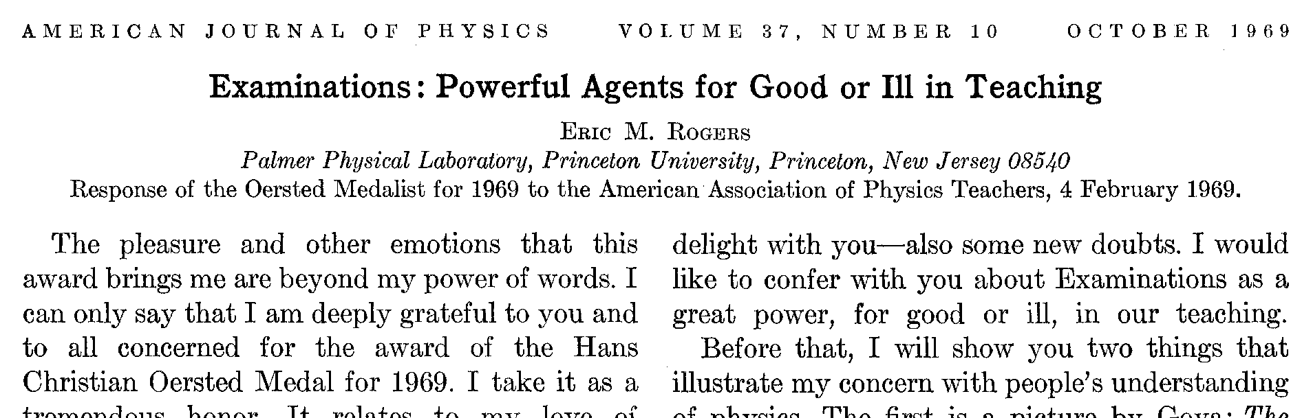
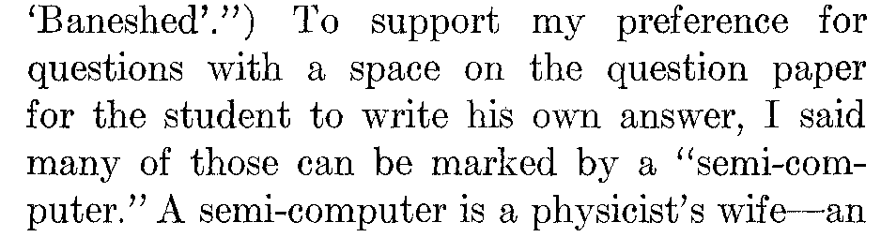
This article contains:
-great ideas
&
-sexism of all kinds
-physics chauvinism
-dead animal jokes
-Catholic jokes
“
”

Slide 33
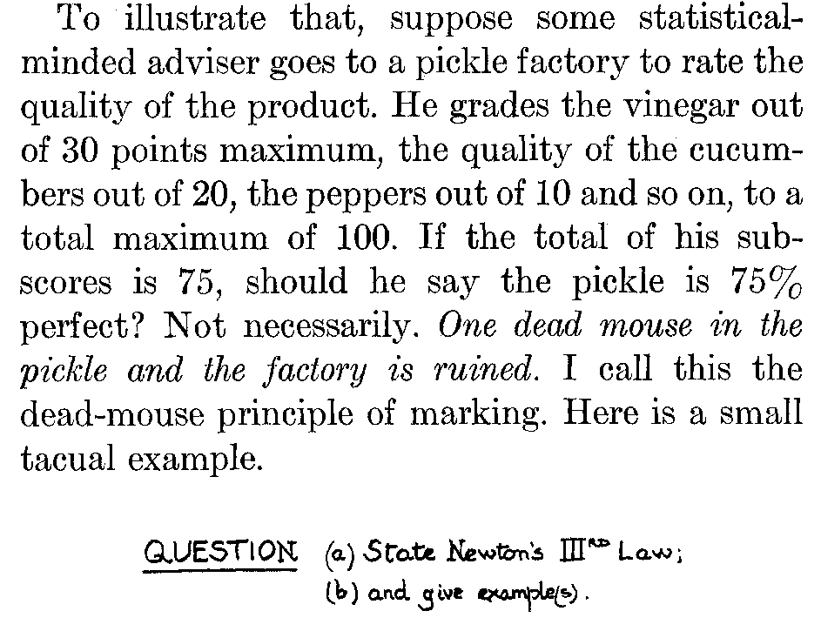
The “Dead Mouse Principle”

Slide 34
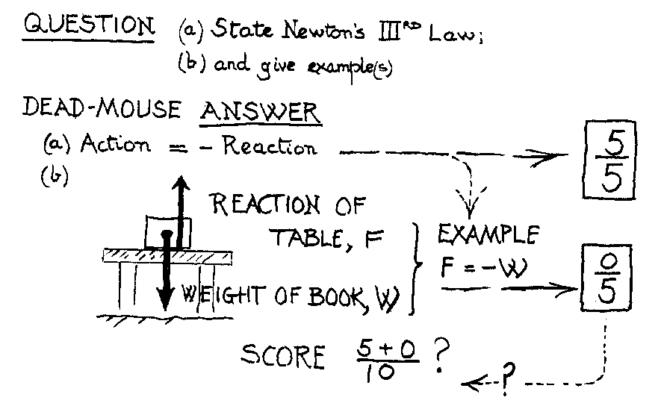

Slide 35
As a multiple-choice question
Friction, F_{b-t}
N
Which force pair best represents Newton’s 3rd Law?
W and N
W and G_{e-b}
N and F_{b-t}
N and G_{e-b}
F_{b-t} and W
Grav. pull of
book on earth,
G_{e-b}
earth

Slide 36
The Dead Mouse principle is actually, a cautionary tale about the dangers of rubrics.
How do we reliably assess partial knowledge? [ESPECIALLY when the solution is partially correct yet wholly incorrect?!]
We would like a way to give credit only for completely correct answers
We’ll come back to this later

Slide 37
The integrated testlet (IT) ethos
climbing the mountain of learning (ITs)
vs.
surveying the perimeter
(typical MC test)
ITs are designed to align our assessments with course learning objectives

Slide 38
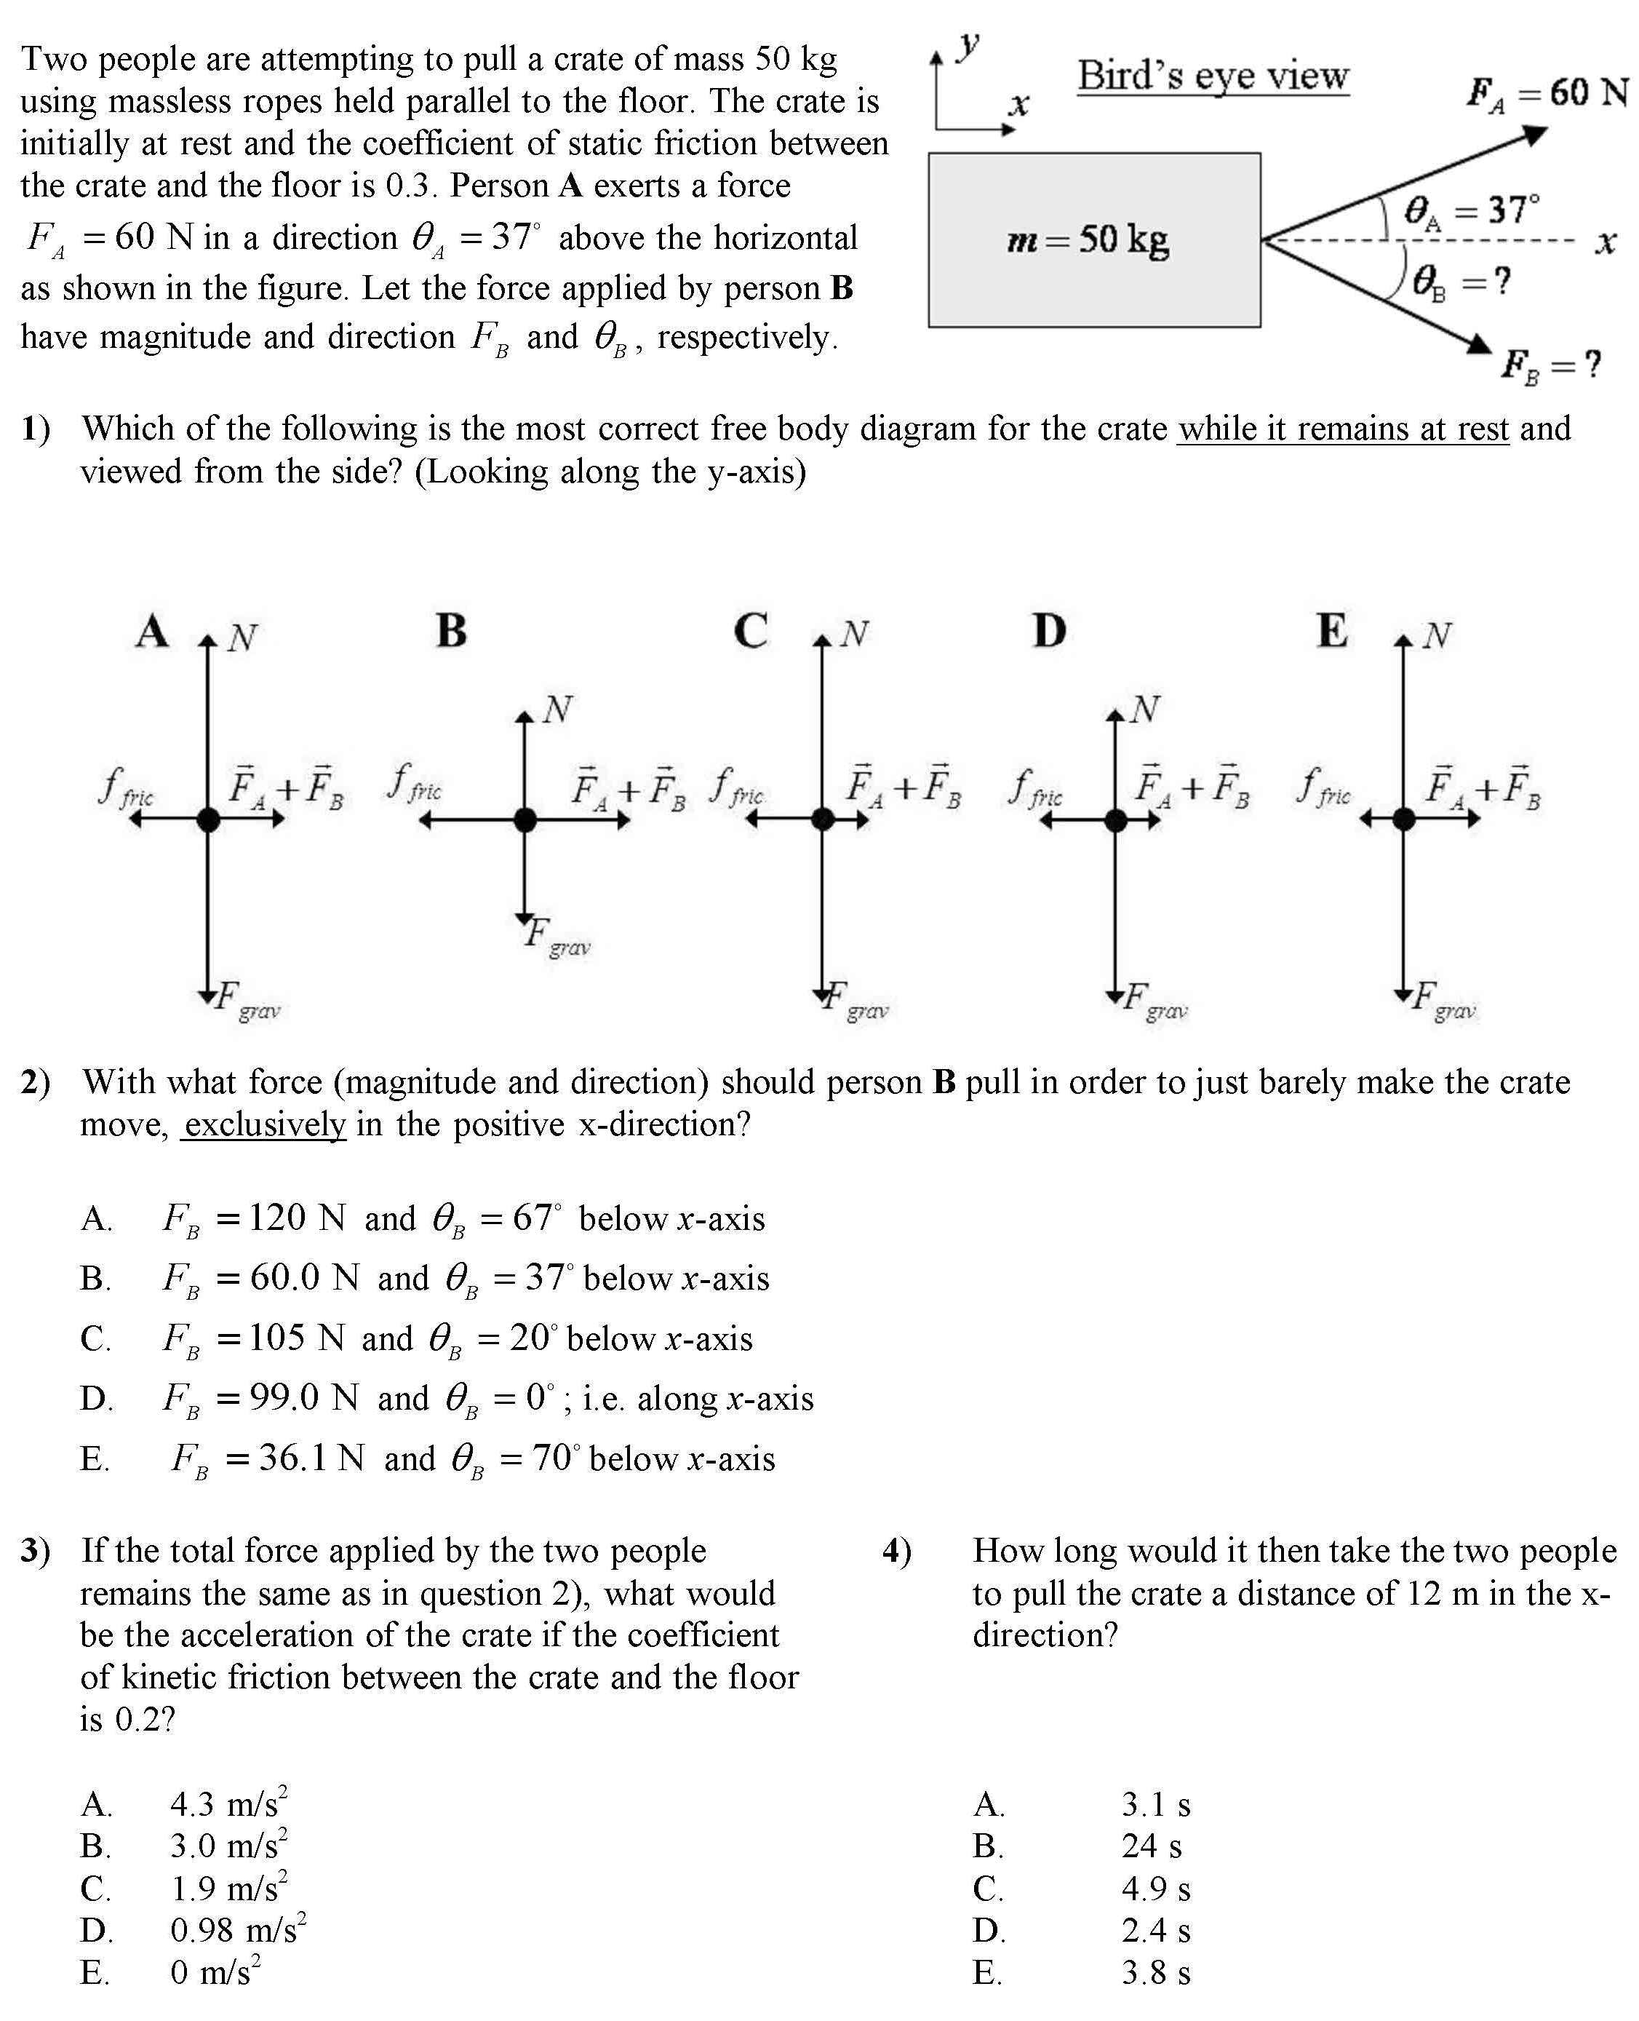

Slide 39
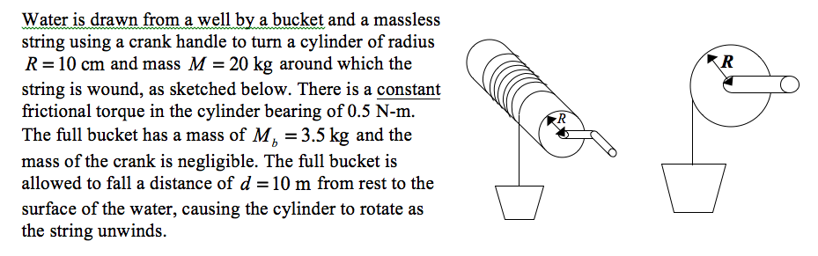
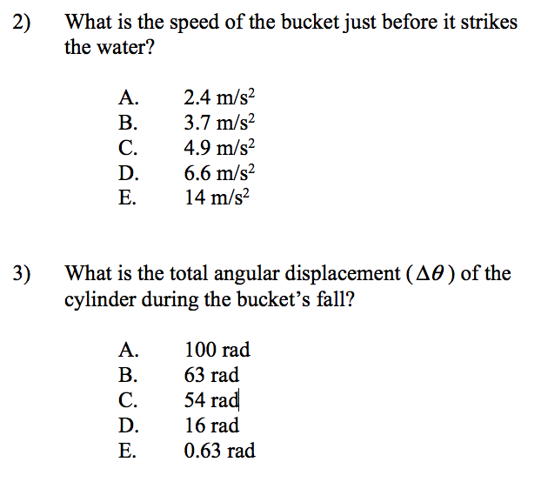
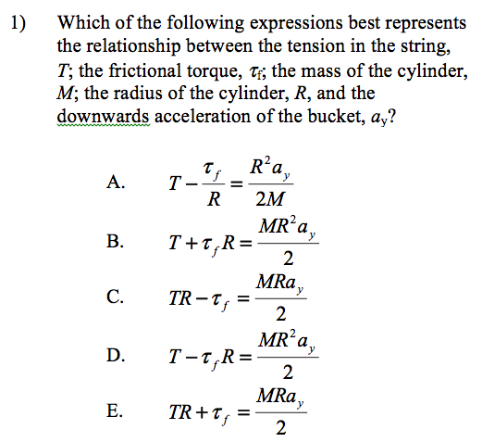
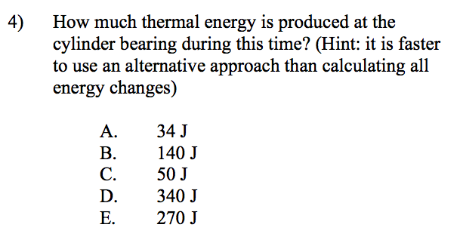

Slide 40
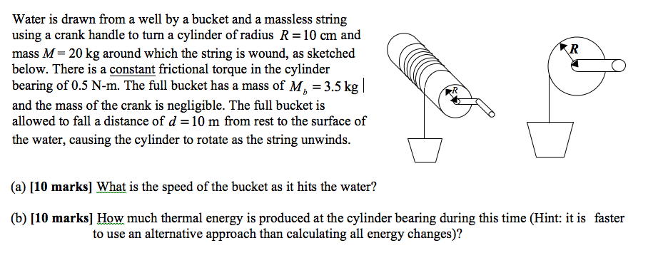
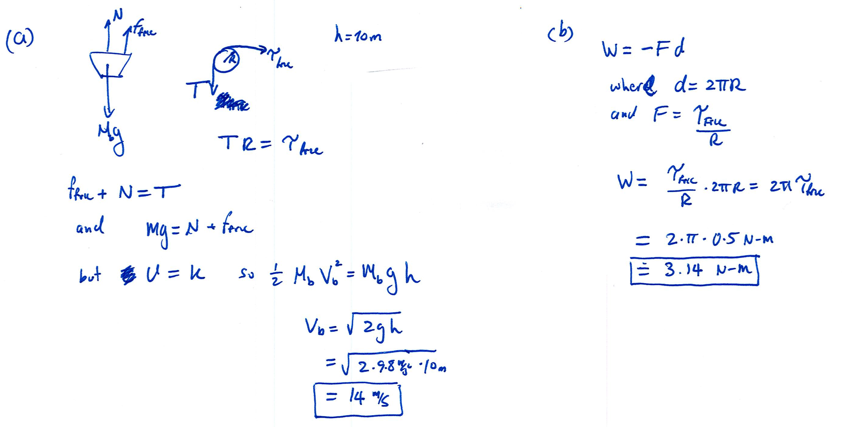


Slide 41
The Dead Mouse Principle:
How do we reliably assess partial knowledge? [ESPECIALLY when the solution is partially correct yet wholly incorrect?!]
Would like a way to give credit only for completely correct answers
With the answer-until-correct scheme, all marks are given for entirely correct responses → No dead mice!

Slide 42
N~150 student study
ITs prove less “difficult” than CR
(mean score is 17%_{p} higher)
ITs prove less discriminating than CR (but are still very discriminating)

Slide 43
out of 700 “answers” in the study:
9% of CR and 9% of IT scores were 100% ✔
0.3 % of IT scores = 0%
but
3.0 % of CR scores = 0%
Some students can’t begin a CR question, does that mean that they don’t know anything relevant?
-How much do you reward drivel?

Slide 44
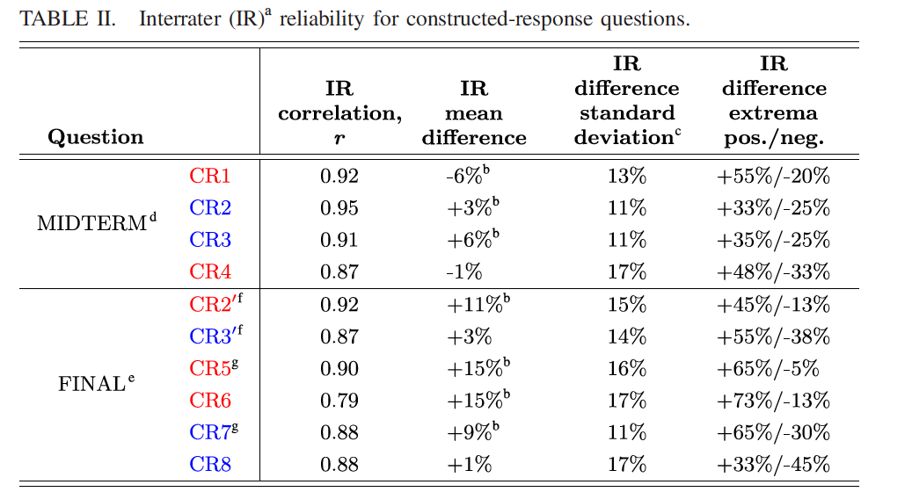
Inter-rater Reliability:
Whether scored by professors or by students, there can be significant variability in the scoring of any given question
Rubrics do not solve the problem. (dead mouse issues)
The silent taboo of constructed response (hear/see no evil!)

Slide 45
“I personally strongly prefer IFAT over constructed response. I would be very happy with a 100% IFAT tests. I have done 100% IFAT tests before in PHYS 1060H and much preferred them. I prefer IFAT because I find when I am doing a constructed response question, I spend too much time thinking about what I need to write down on my exam sheet (all the assumptions and rationale that are taking place in my head). I find this a major burden in an exam …[because] you have to come up with a way to explain this fact on paper…[while] this fact is only one small part of the problem you are solving. I find that I end up wasting time on little parts of the problem clearly stating my rationale, which reduces the amount of time I spend actually thinking about the underlying physics... I also like IFAT because I can solve questions in fractions of the amount of time (I spent just over 1 hour on 20 IFAT questions and the other 2 hours on 3 constructed response questions). I think that you can test far more material in a given amount of time through IFAT questions than through constructed response questions. I understand that generating a coherent solution that any physicist can read and understand is a very important skill to have, but I do not think that the high-stress exam environment is an ideal medium to test this skill.”
“I think that the cons (scratching the wrong box… [and] stressing about an error) are outweighed by the pros (testing more material, allowing part marks for limited understanding, allowing multi-step problems).”

