Slide 1


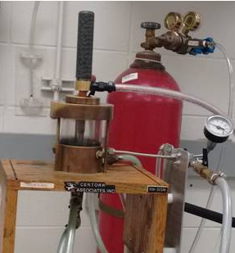
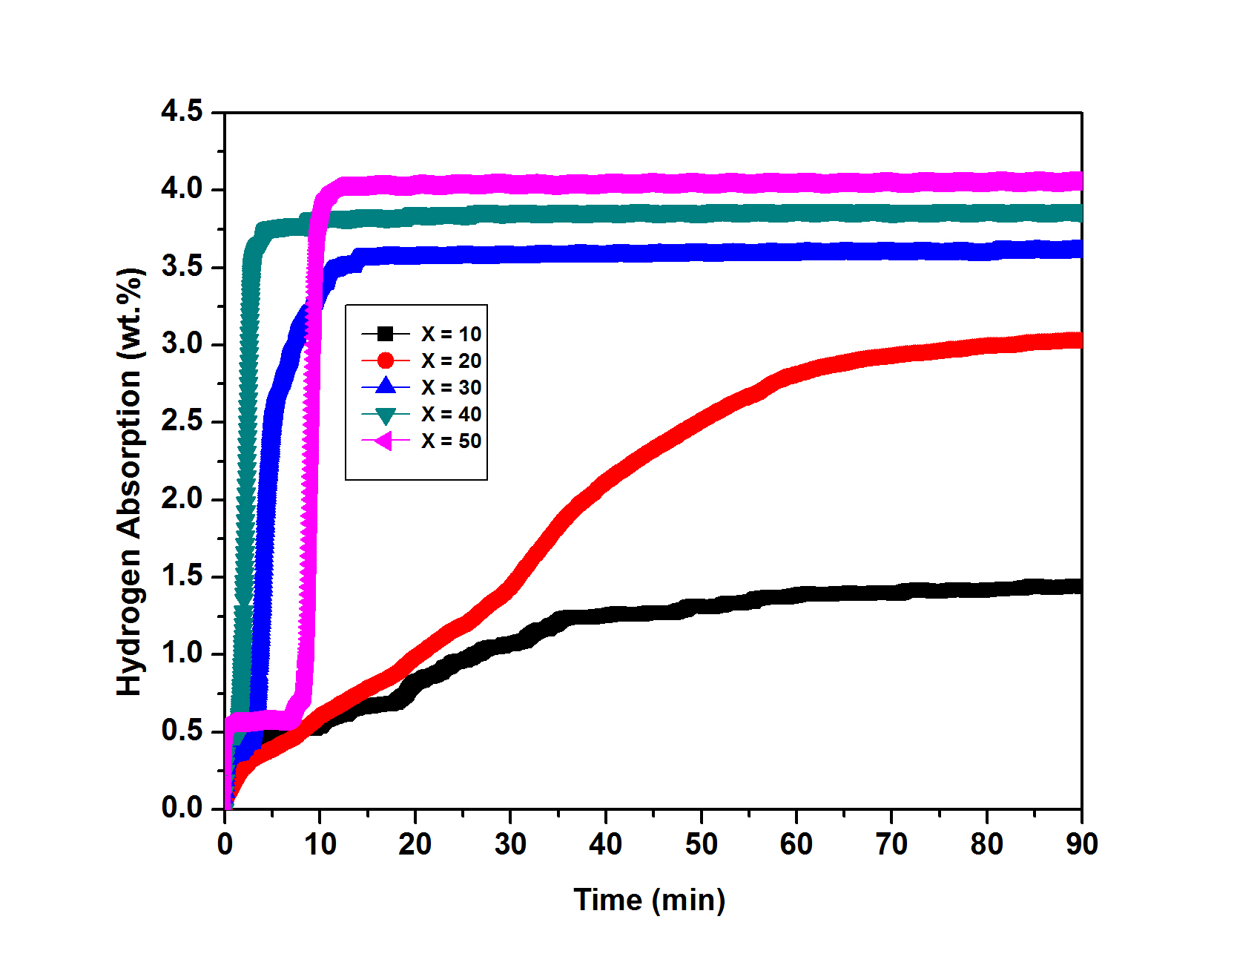
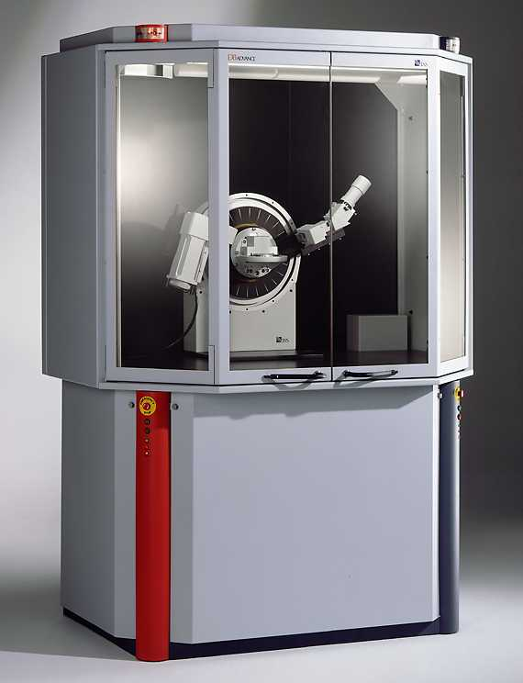
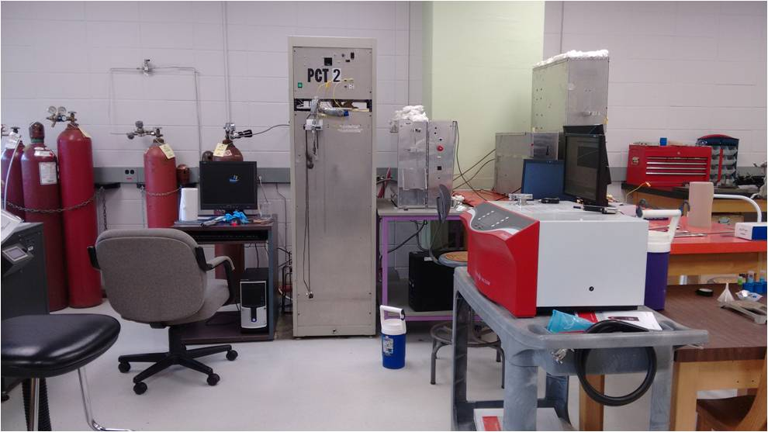
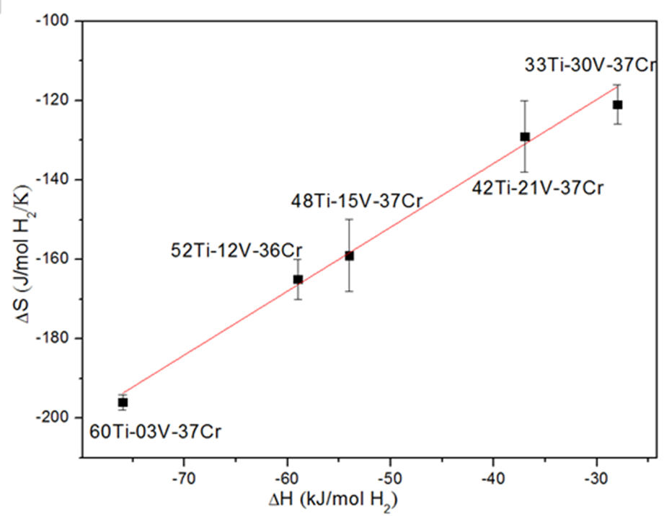
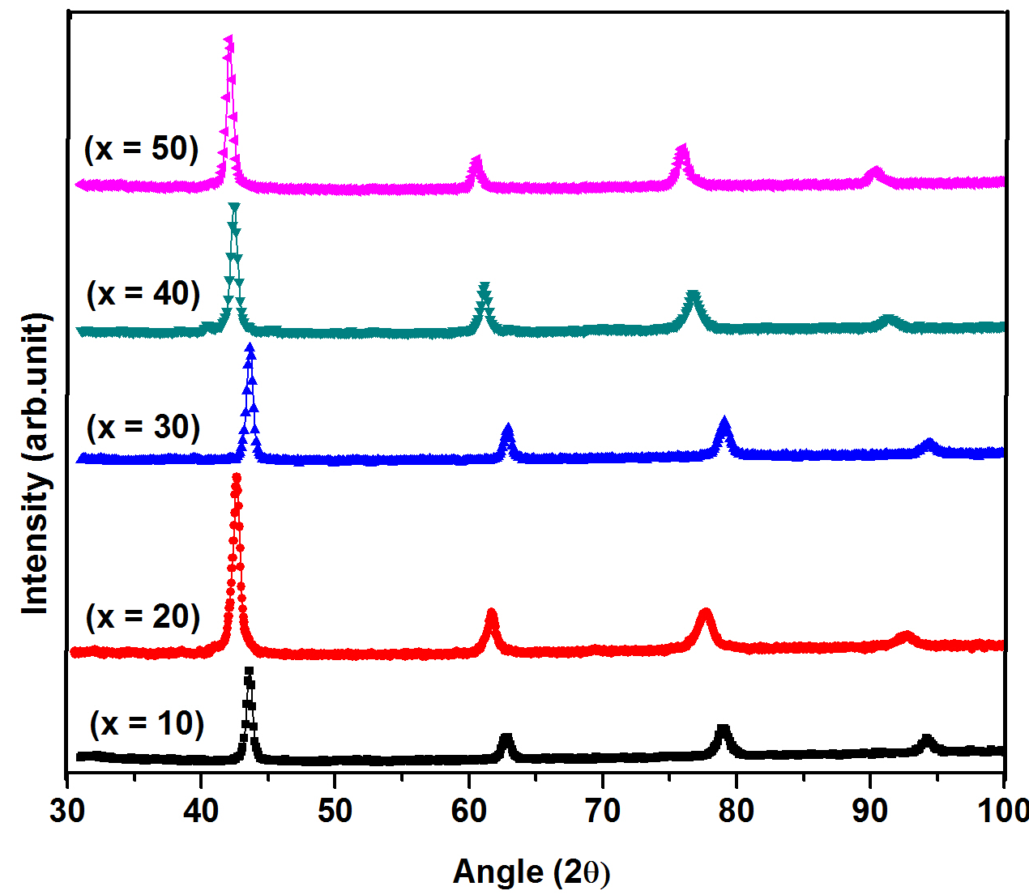

Investigation of Entropy- Enthalpy Compensation effect in the Ti-V-Cr System.
Viney Dixit ª , Thomas Bibienne ª, Jacques Huot ª
ª Université du Québec à Trois-Rivières – Institut de Recherche sur l’hydrogène - 3351, boul. des Forges, C.P. 500, Trois-Rivières (Québec) G9A 5H7.
ABSTRACT
METHODOLOGY
First Hydrogenation
Selected composition of Ti_{x}V_{70-x}Cr₃₀ (x = 10, 20, 30, 40, 50) alloys doped with 4 wt.% of Zr₇Ni₁₀ have been synthesized by arc melting. Crystal structure was characterized by X-ray diffraction pattern. Hydrogen storage properties were investigated using a Sievert- type apparatus. We found a strong discrepancy in the first hydrogenation curves of these samples. Maximum hydrogenation capacity was measured to be 4.0 wt.% for the Ti₅₀V₂₀Cr₃₀ alloy.
1. Material synthesis
2. Crystal structure
The crystal structure was studied by X-Ray diffraction (XRD).
3. First hydrogenation properties
Capacity of hydrogen absorption was determined with a Sievert-type apparatus.
All samples were synthesized by arc melting.
INTRODUCTION
Titanium-based alloys with a solid solutions Body Centered Cubic (BCC) crystal structure are well known to be good hydrogen storage materials because of their high volumetric hydrogen storage capacity.
We have recently found that in Ti-V-Cr system, the enthalpy of hydrogenation is linearly related to the entropy change^{1,2,3} which is represented by the Fig.1. This is the so-called enthalpy-entropy compensation. The aim of the present work is to investigate the entropy-enthalpy compensation effect by varying the elemental concentration of the Ti-V-Cr system.
RESULTS
Fig. 3: First hydrogenation at 24°C and under 20 bar hydrogen pressure. As-cast samples: Ti_{x}V_{70-x}Cr₃₀ (x = 10, 20, 30, 40, 50) + 4 wt.% of Zr₇Ni₁₀.
Crystal Structure
x = 50 has the highest capacity and an incubation time of less than 8 minutes.
For x = 20, no incubation time but capacity is lowered.
Sample x = 10 has shown low storage capacity.
All samples have the BCC structure. Small peaks may indicate the
Presence of a secondary phase.
Crystal parameters of as cast samples are shown in Table. 1.
CONCLUSION
Five different compositions of Ti-V-Cr were investigated.
All samples have the same crystal structure (BCC solid solution).
Large discrepancies in the first hydrogenation behaviour are observed.
Fast kinetics of first hydrogenation may be explained by the presence of a secondary phase.
Microstructure and thermodynamic parameters are now being investigated.
Fig. 2: X-Ray diffraction patterns of as-cast Ti_{x}V_{70-x}Cr₃₀ (x = 10, 20, 30, 40, 50) samples .
Table.1
REFERENCES
Alloy | Lattice Parameter (Å) | Crystallite Size (nm) | Microstrain (%)
Ti₁₀V₆₀Cr₃₀ | 3.000(2) | 18 (1) | 0.43(9)
Ti₂₀V₅₀Cr₃₀ | 3.023(1) | 12.5 (3) | 0.62(4)
Ti₃₀V₄₀Cr₃₀ | 2.999(1) | 16(1) | 0.38(9)
Ti₄₀V₃₀Cr₃₀ | 3.069(1) | 14.4(8) | 0.47(9)
Ti₅₀V₂₀Cr₃₀ | 3.102(1) | 15.6(6) | 0.46(6)
[1] Bibienne T and Huot J. Journal of Alloys and Compounds, 607 (2014) 251– 257.
[2] ] Bibienne T and Huot J. Journal of Alloys and Compounds, 620 (2015) 101-108
[3] Bibienne T and Huot J. To be published.
Fig.1:Enthalpy-Entropy plot of Ti-V-Cr system
OBJECTIVES
Synthesis and structural characterization of the system Ti_{x}V_{70-x}Cr₃₀ (x = 10, 20, 30, 40, 50).
Hydrogenation studies of these materials.
Verify the Entropy-Enthalpy relationship and find the mechanism
ACKNOWLEDGMENT
V. Dixit would like to thank to Canadian Queen Elizabeth II Diamond Jubilee Scholarships for a Ph.D. fellowship.

