Slide 1
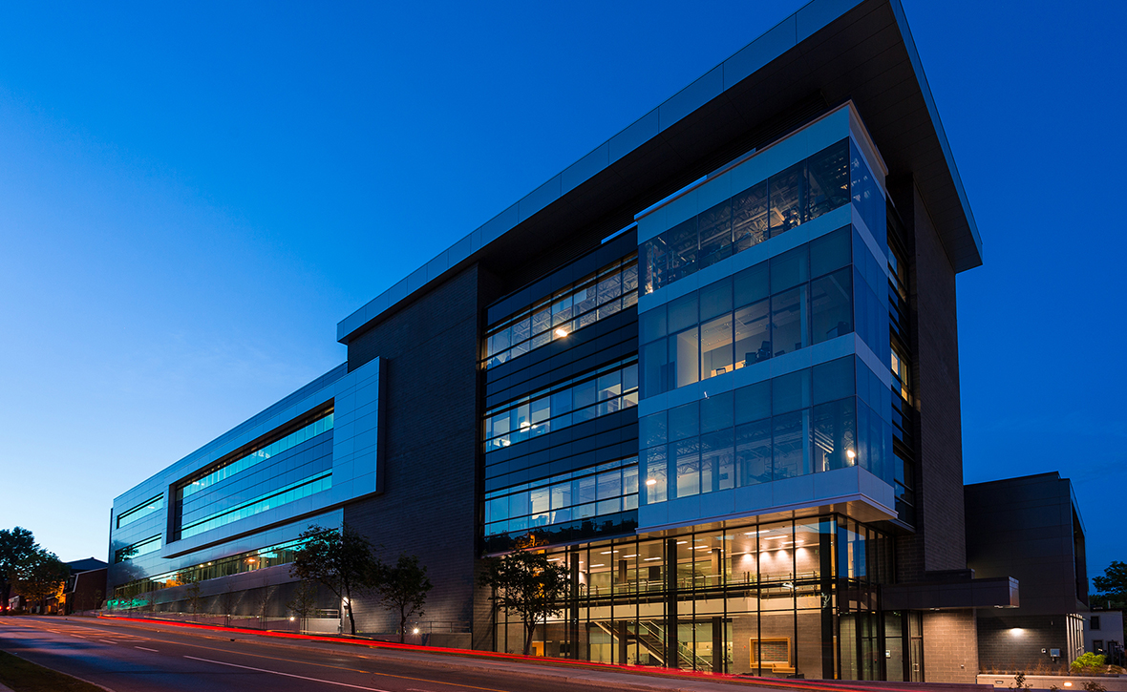


All-Optical Fresnel Zone Plate for High Harmonic Generation
1
Zhengyan Li, Graham Brown, Dong Hyuk Ko, Fanqi Kong, Ladan Arissan, Paul Corkum
Department of Physics, University of Ottawa,
National Research Council, Canada

Slide 2
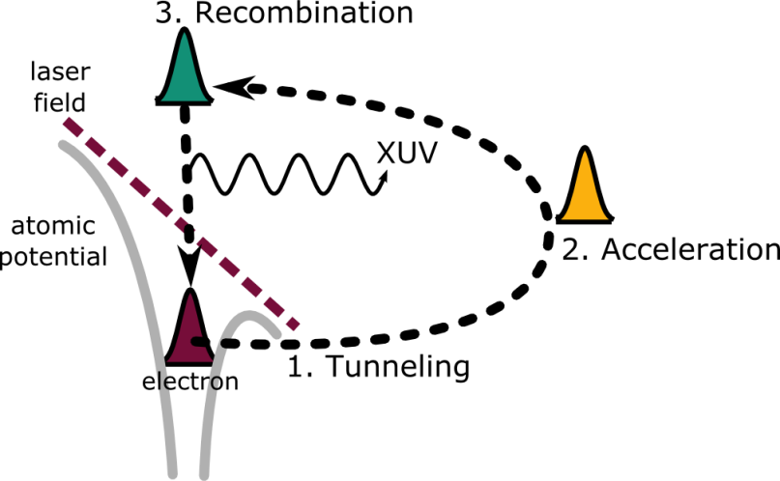
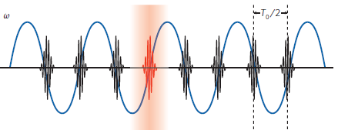
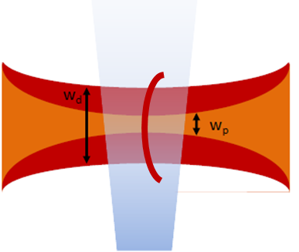
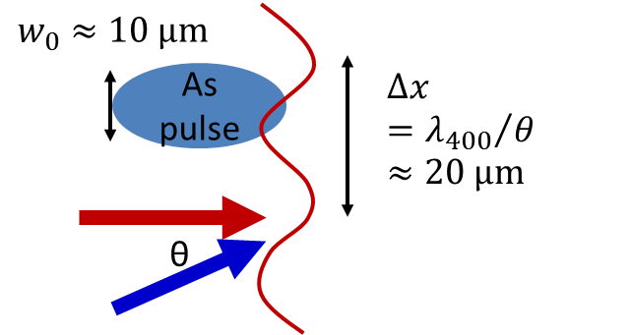
Introduction: all-optical control of HHG or atto-pulse wave front for pulse measurement
P. Corkum, Phys. Rev. Lett. 71, 1994 (1993).
A transverse modulation on fundamental wave front leads to HHG wave front changes!
Optical wedge
K.T. Kim, et al., Nat. Phys. 9, 159-163 (2013)
Optical lens
N. Dudovich, et al., Phys. Rev. A 80, 011806(R) (2009)

Slide 3
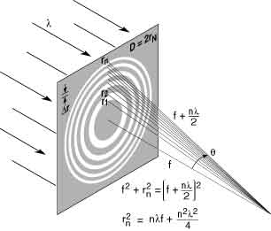
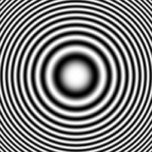
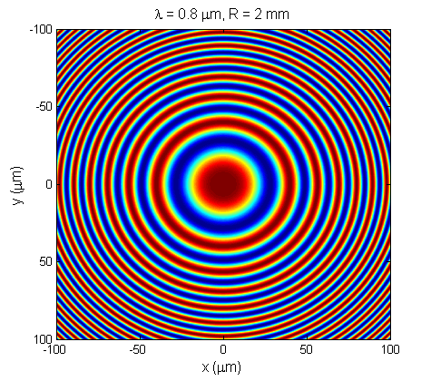
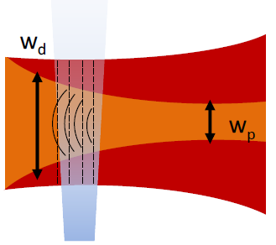
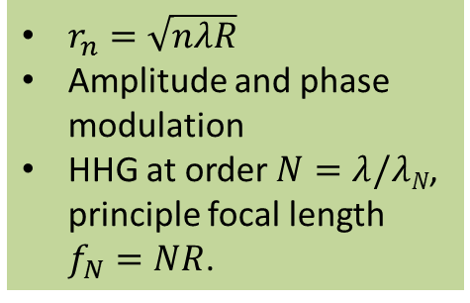
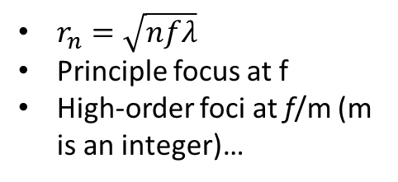
Generating Fresnel zone plate by interfering a driving beam and a perturbing beam
Fresnel zone plate?
$r_{n}=\sqrt{nfλ}$
Principle focus at f
High-order foci at f/m (m is an integer)…
All-optical generation
$r_{n}=\sqrt{nλR}$
Amplitude and phase modulation
HHG at order $N=λ/λN$, principle focal length $f_{N}=NR$.
R

Slide 4
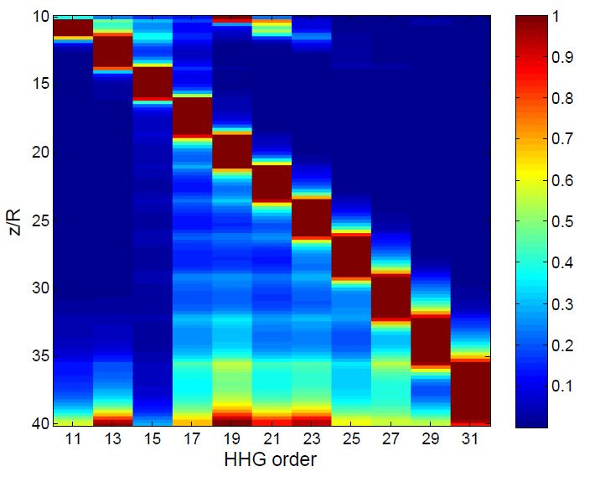
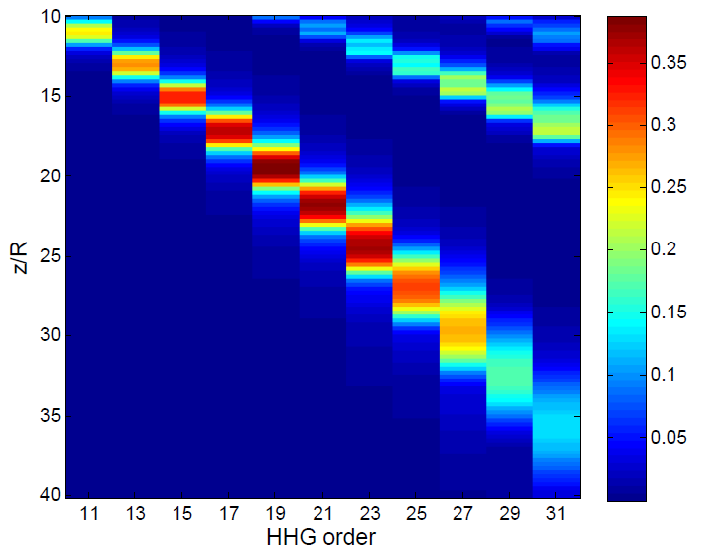
Application: zone plate as monochromator to select a single order HHG with moderate loss
z
Normalized spectrum after aperture
f ~ 2m
10 um aperture
Energy transmission efficiency
Quasi-monochromatic beam at a single HHG order is selected.
>30% transmission efficiency for selected order HHG.

Slide 5
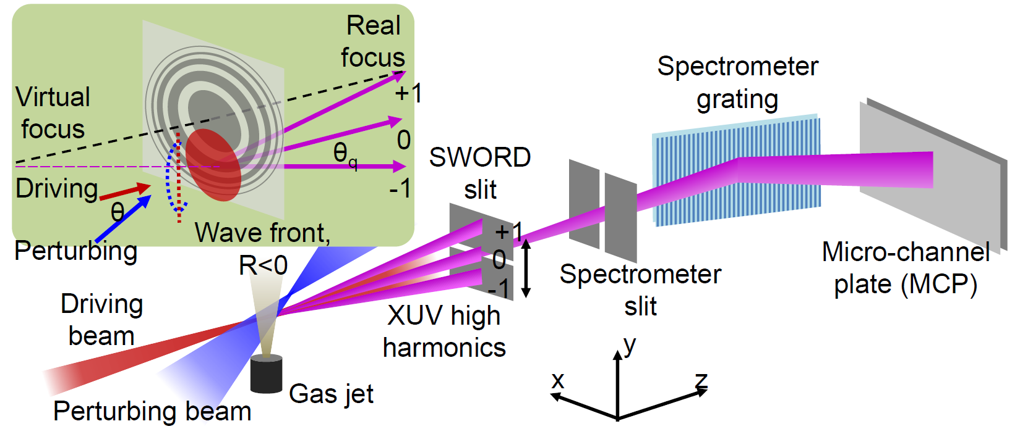
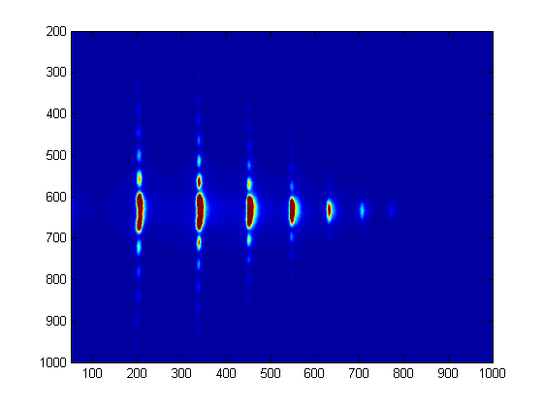
Experimental Setup
SWORD measurement (Spectral Wavefront Optical Reconstruction by Diffraction)
E. Frumker et al., Opt. Lett. 34, 3026-3028 (2009)
θ
Far field diffraction
y_{i}
θ
L=105 cm
H17
H19
H21

Slide 6
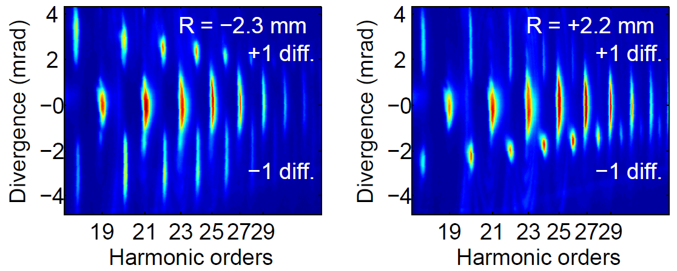
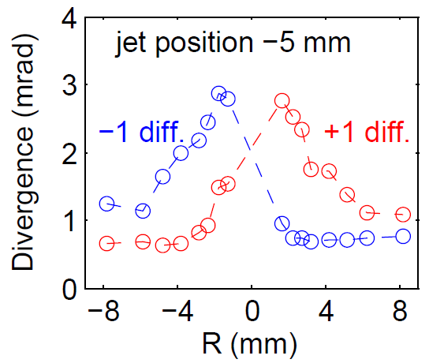
Far-field divergence measurements of even orders (without the SWORD slit)
R
The zone plate effect becomes more significant as |R| gets smaller.
Focused XUV beam is collimated, and compensates divergence due to the driving beam intensity gradient.

Slide 7
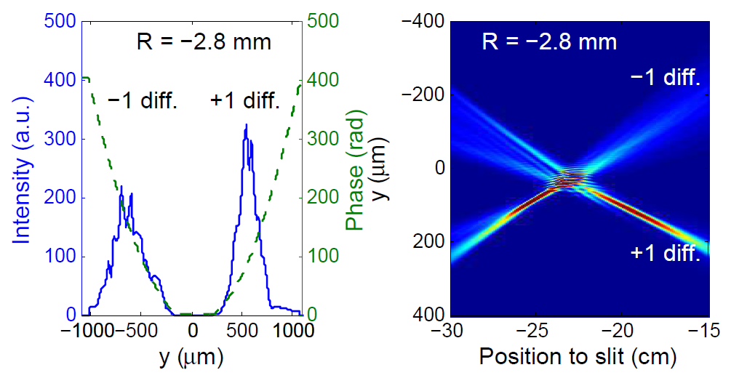
Zone plate foci characterization using SWORD
Amplitude (blue) and phase (green) at SWORD slit
Reconstruction of transverse intensity v.s. slit position y
23 cm to the SWORD slit

Slide 8

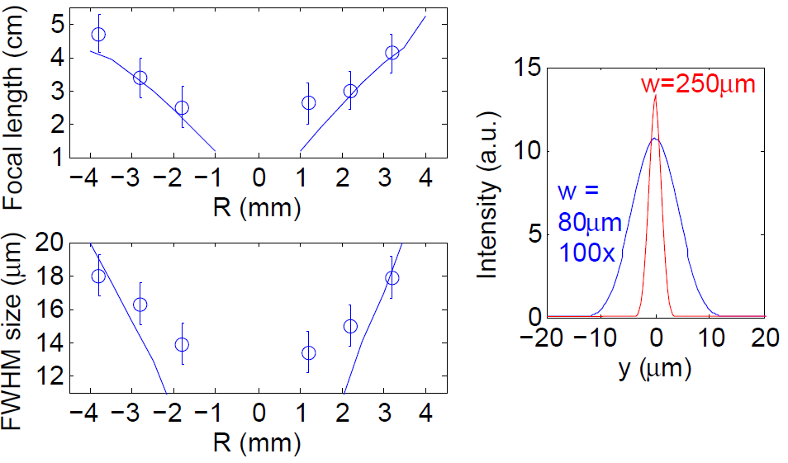
Flexible tuning of zone plate focal length and size
Larger driving beam size, shorter perturbative wavelength can lead to smaller focal size
H22 real focal length
H22 real focal size

Slide 9
Summary
All-optical Fresnel zone plate for high harmonic XUV
  Modulating the high harmonic wavefront by interfering a loosely focused driving beam and a tightly focused perturbing beam with curved wavefront.
Characterization of high-harmonic zone plate foci
  Real foci are centimeters after the gas jet, and the size is micrometers.
  Intensity enhancement is around 10 times, which may be used for femtosecond XUV pump-XUV probe experiments.
The zone plate is flexible and tunable
  Tuning parameters: control beam focal geometry (e.g. R) and perturbative wavelength.
  High order of zone plate foci is available by increasing perturbative intensity.
The concept of coherent wavefront control for other all-optical XUV optics
Applications such as XUV monochromator

Slide 10
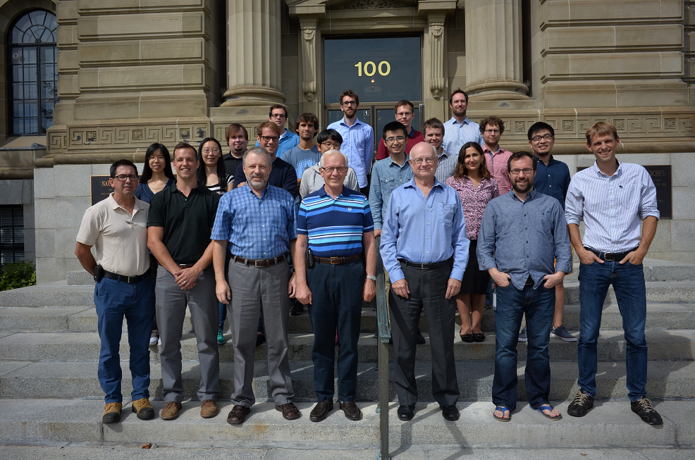
Acknowledgement
Thank you for your attention!

