Slide 1
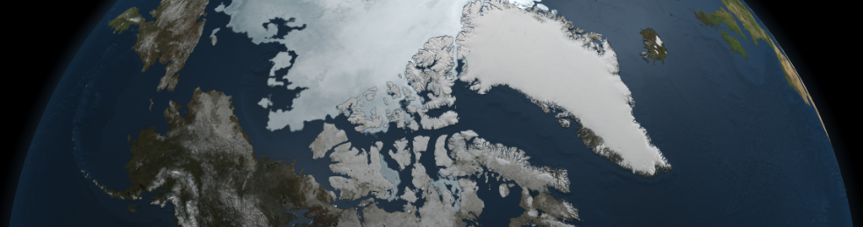
Carbon Monoxide and Ozone measurements in the Canadian High Arctic
using infrared emission spectroscopy
Tran, Sophie¹ , Z. Mariani², E. Lutsch¹, S. Conway¹, M. Palm³, P. Rowe⁴, G. Manney⁵, L. Millan⁶ and K. Strong¹
    ¹ Department of Physics, University of Toronto, Toronto, ON, Canada
    ² Cloud Physics and Severe Weather Section, Environment and Climate Change Canada, Toronto, ON, Canada
    ³ Institute of Environmental Physics, University of Bremen, Germany
    ⁴ Department of Geography, University of Idaho, Moscow, ID, USA
    ⁵ Department of Physics, New Mexico Institute of Mining and Technology, Socorro, NW, USA
    ⁶ NASA Jet Propulsion Laboratory, Pasadena, CA, USA
Eureka, NU
Image: https://nsidc.org/icelights/files/2010/11/arctic_ams.jpg

Slide 2
Outline
Context and motivation
Instrument and measurement site
Results for:
  Carbon Monoxide
  Ozone
Conclusions

Slide 3
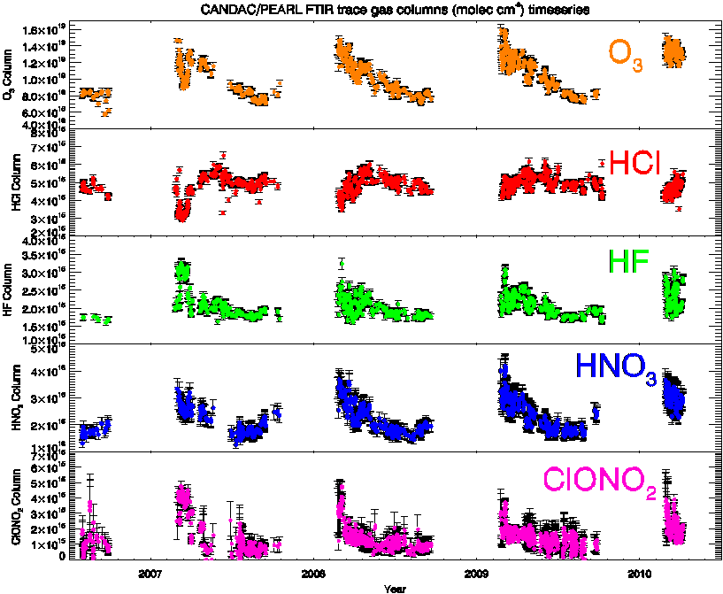

Context and motivation
Rapid climate change in the Arctic → importance to improve our knowledge about processes driving these changes, including the atmospheric composition.
High Arctic → prolonged periods of total darkness in the winter and continuous daylight in the summer.
Polar night
To monitor and measure atmospheric composition, ground-based stations are equipped with Fourier Transform Spectrometers (FTS). However, most of them use the Sun as a light source… which leads to a measurement gap during polar night.
FTIR measurements from 2007 to 2010
at Eureka (80°N), Nunavut, Canada.
(Courtesy of Rodica Lindenmaier)

Slide 4
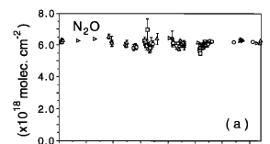
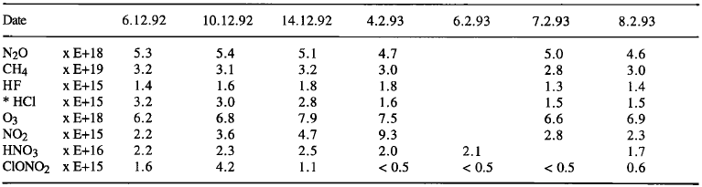
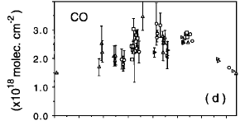

Context and motivation
During December 1992 and February 1993, Notholt at al. performed the first FTIR measurements to utilize the moon as the infrared source during the polar night at Ny Alesund, Spitsbergen (78.9°N, 11.9°E) to obtain the column densities of several trace gases.
Zenith column densities (mol cm⁻²):
Measurements were taken for about a week around full moon.
(Notholt et al., 1993)
They could also monitor the seasonal cycles of certain trace gases →
However, the measurements depend on the moon’s phases and more than half of the polar night can not be documented.
(Notholt et al., 1997)

Slide 5
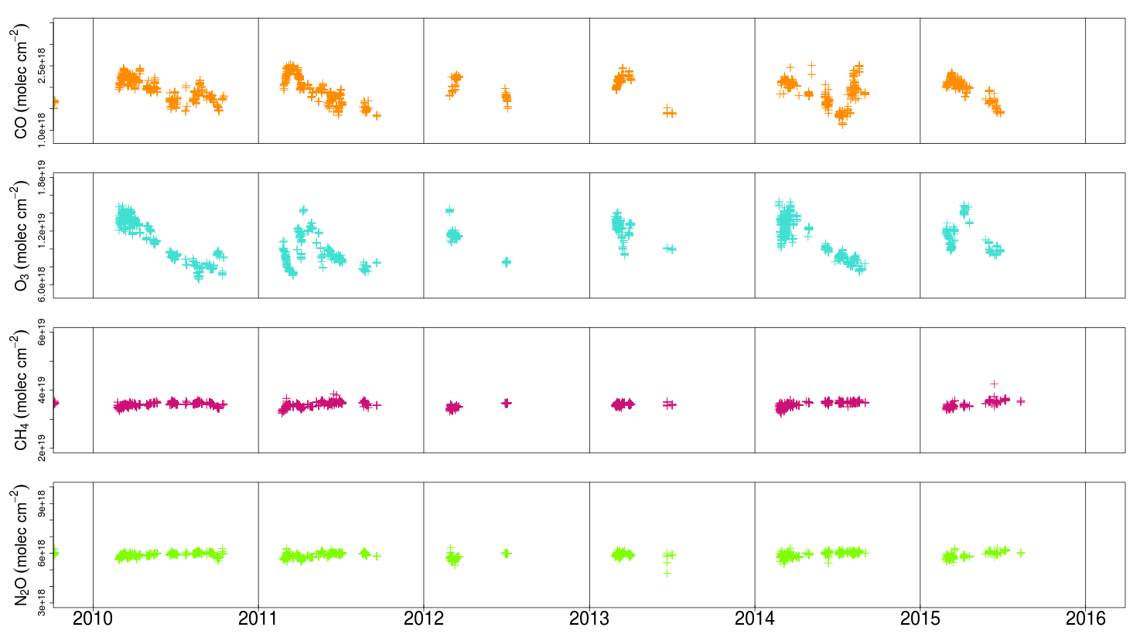
Context and motivation
In addition to documenting the atmospheric composition during the polar night, it’s also important to have good data coverage during the rest of the year.
Example of trace gas total columns measured by the 125HR from 2010 to 2015:
measurement gaps are due to polar night, weather, reduced on-site operations, instrument issues
CO
O₃
CH₄
N₂O
Need to have complementary measurements to assure the best data coverage through the year

Slide 6
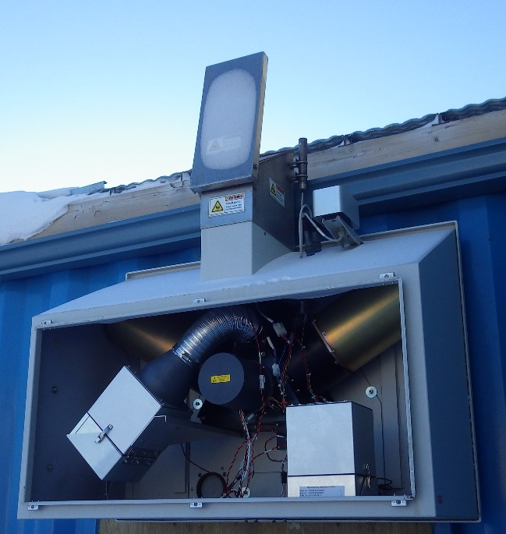
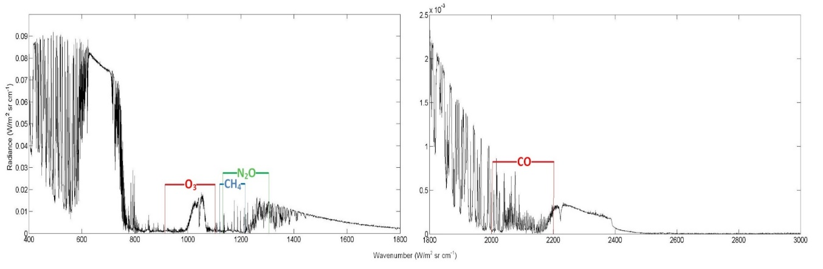
Infrared emission spectroscopy
E-AERI = Extended-range Atmospheric Emitted Radiance Interferometer
Infrared Fourier Transform Spectrometer (FTS) with 1cm⁻¹ resolution
Measurements of accurately calibrated downwelling infrared thermal emission from the atmosphere
Extended wavelength range covers 400-3000 cm⁻¹ (3-25 µm) to investigate the IR surface cooling in the Arctic
High sensitivity to tropospheric trace gases
Measurements are independent of sunlight
Retrievals of trace gas column densities
Retrieval windows
    Using new SFIT4 retrieval algorithm
    (before: SFIT2 v393_MP Emission Add-on)
Can currently retrieve CO, CH_{4,} N₂O, and O₃

Slide 7
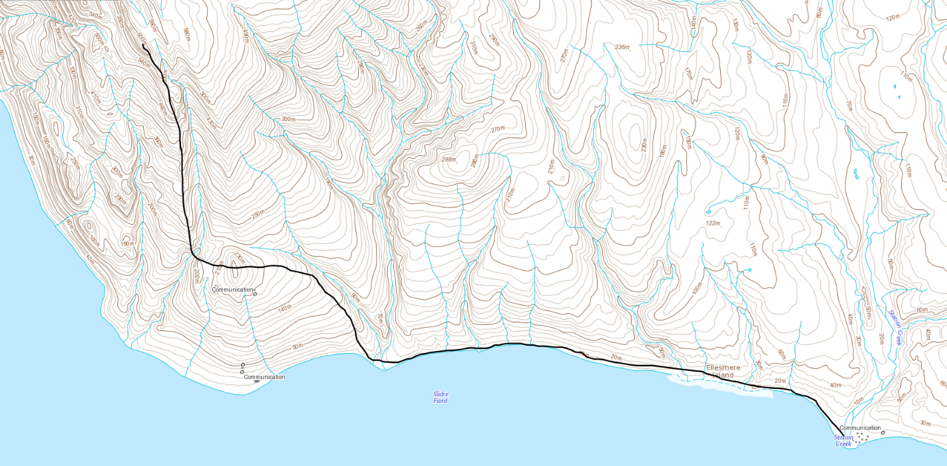
Measurement sites
PEARL - Ridge Lab
PEARL = Polar Environment Atmospheric Research Laboratory in Eureka, Nunavut
(80.05°N, 86.42°W)
Ridge Lab
PEARL - 0PAL
610 m
Instruments:
E-AERI from Oct 2008 to Sept 2009
125HR Bruker from 2006 to 2015
altitude
Instruments:
P-AERI from 2006 to Feb 2009
E-AERI from 2011 to 2015
0PAL
10 m

Slide 8
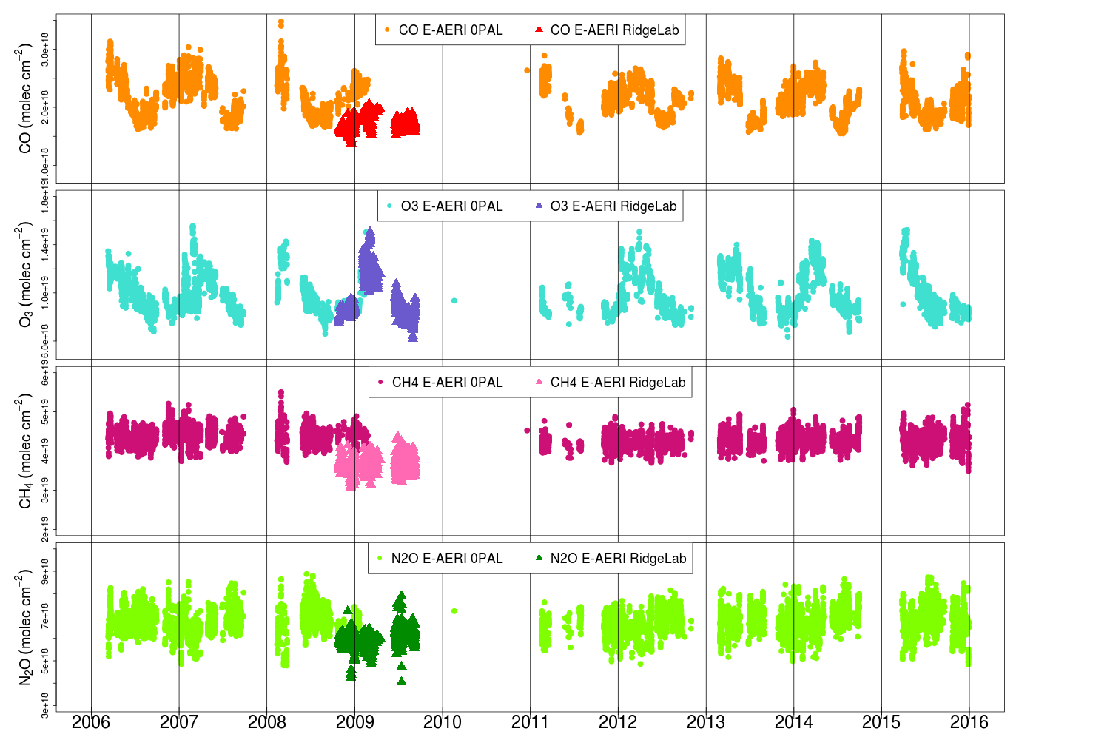
Timeseries of column densities for several trace gases
Gaps in the dataset are due to cloudy days, no data recorded or no convergence in the retrieval
Time series combining two datasets:
  P-AERI: 2006 to 2009
  E-AERI: 2008 to 2015
Measurements of trace gas even during the polar night
CO
O₃
CH₄
N₂O

Slide 9
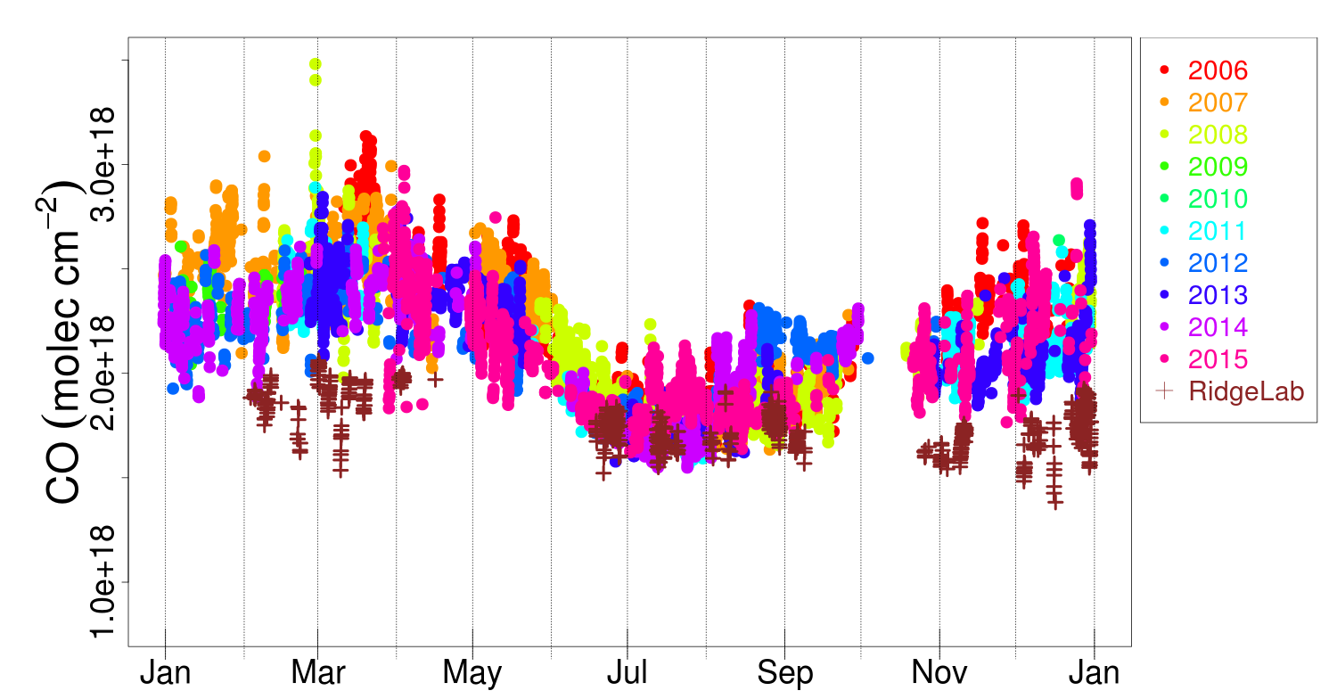
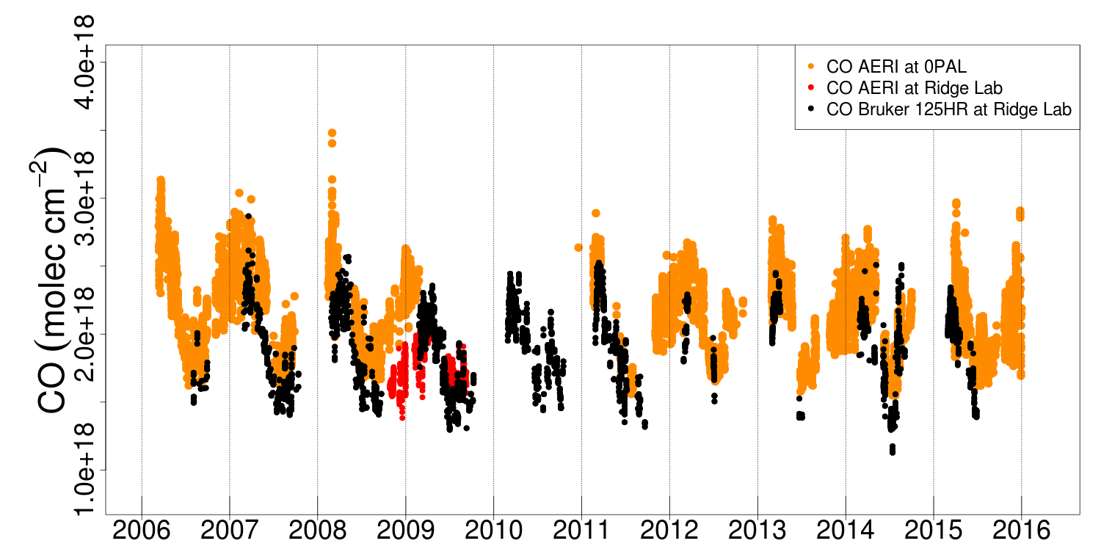
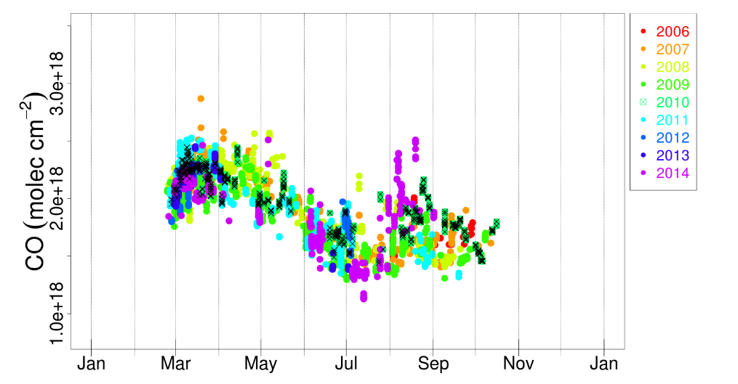
Carbon monoxide
AERI
125HR
Clear seasonal cycle of CO
Identification of CO enhancements periods

Slide 10
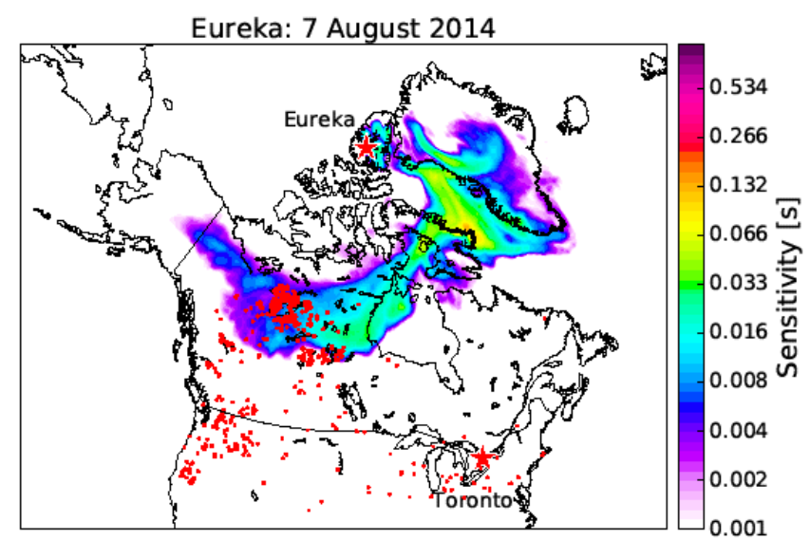
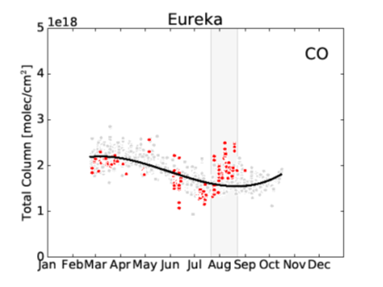
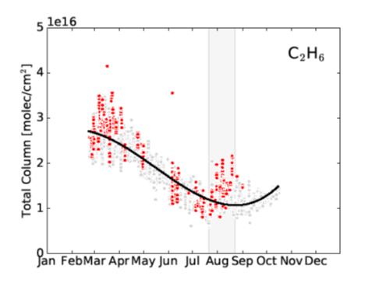
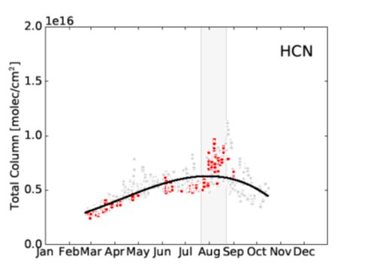
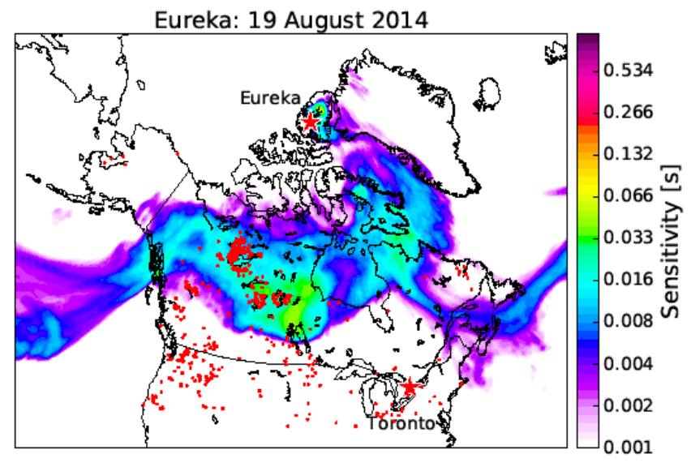
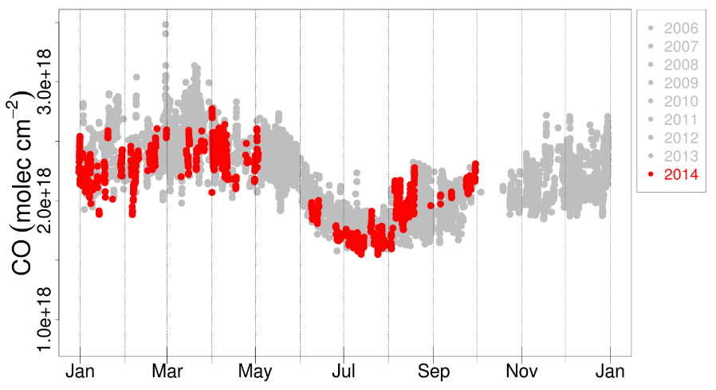
Carbon monoxide
Biomass burning event in 2014
125HR data: courtesy from E. Lutsch (paper in preparation)
125HR
125HR
125HR
CO AERI
→ Two main biomass burning events occurred in August 2014, also observed by the AERI instrument
(Flexpart model)

Slide 11
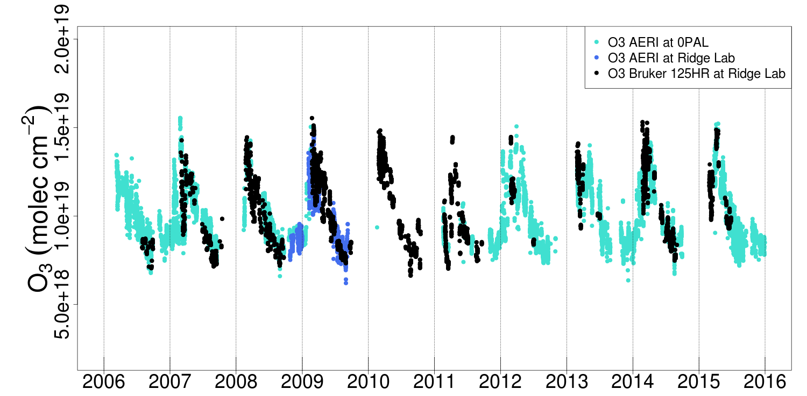
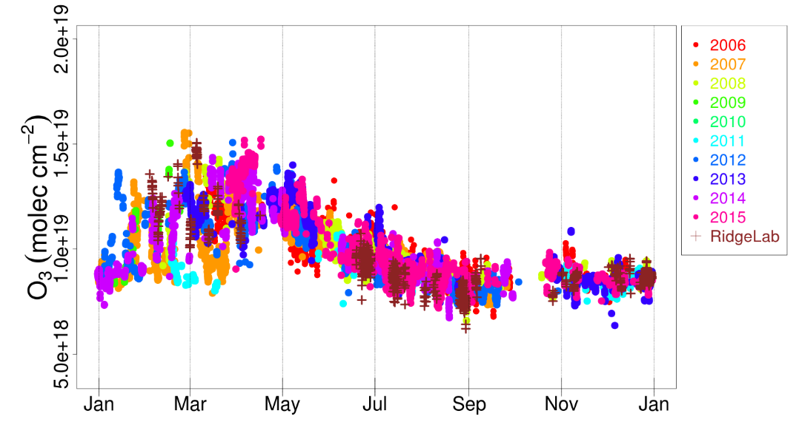
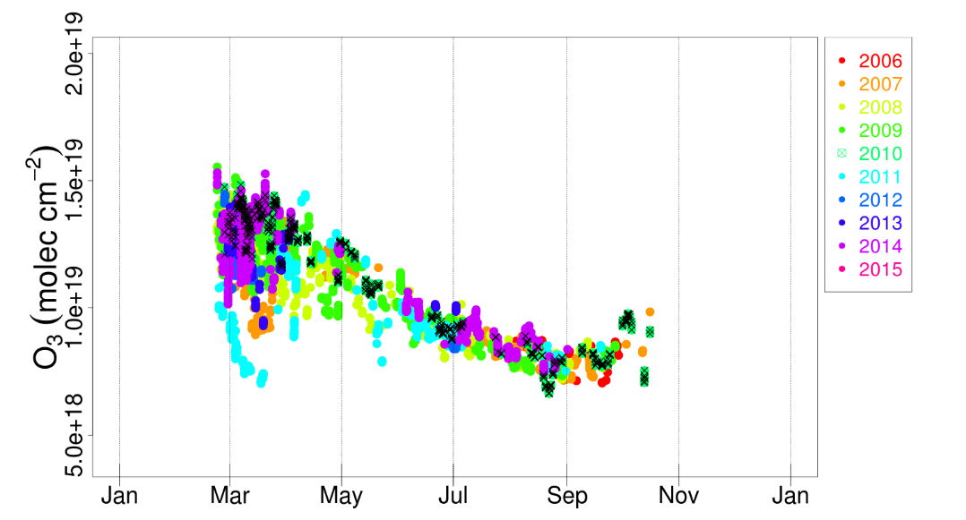
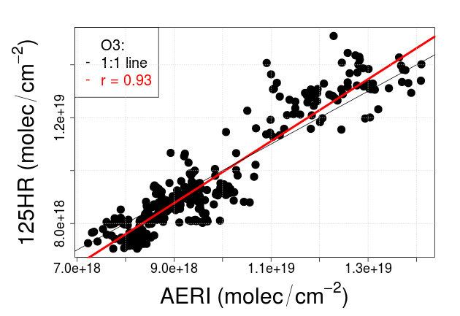
Ozone
AERI
125HR
Clear seasonal cycle of ozone
Good correlation between AERI and 125HR
Ozone depletion events in 2007 and 2011 are recorded on both datasets
Ozone enhancement event in winter

Slide 12
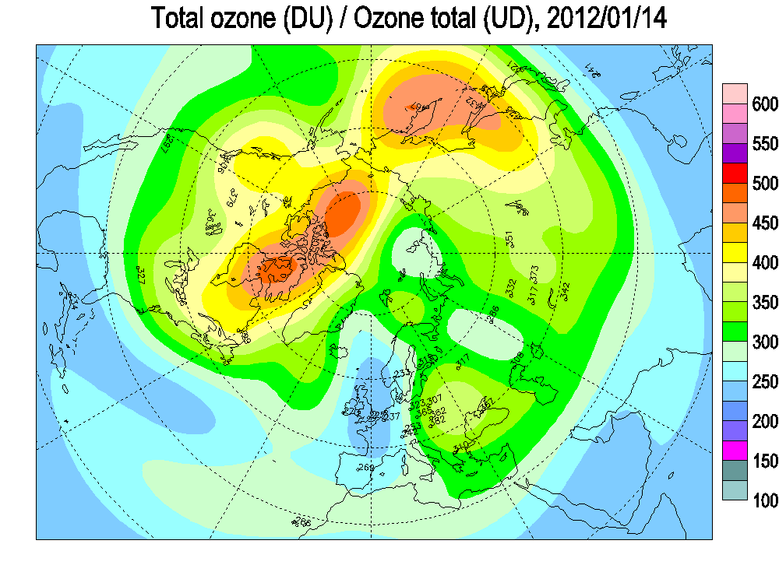
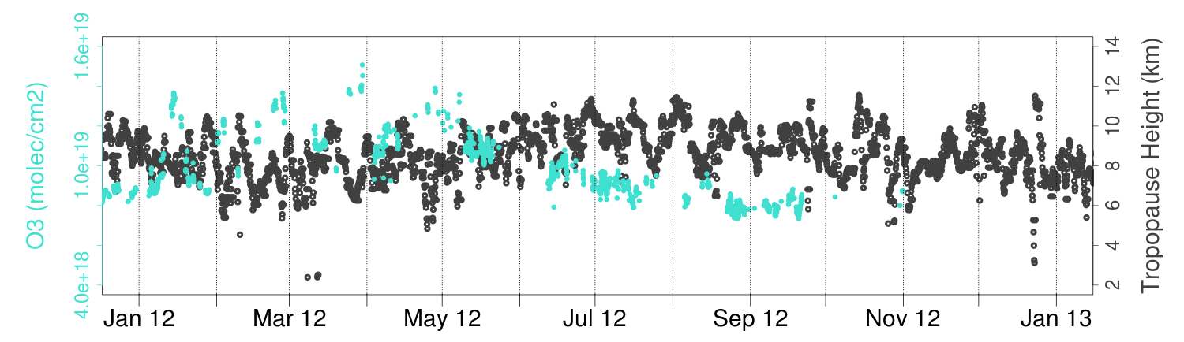
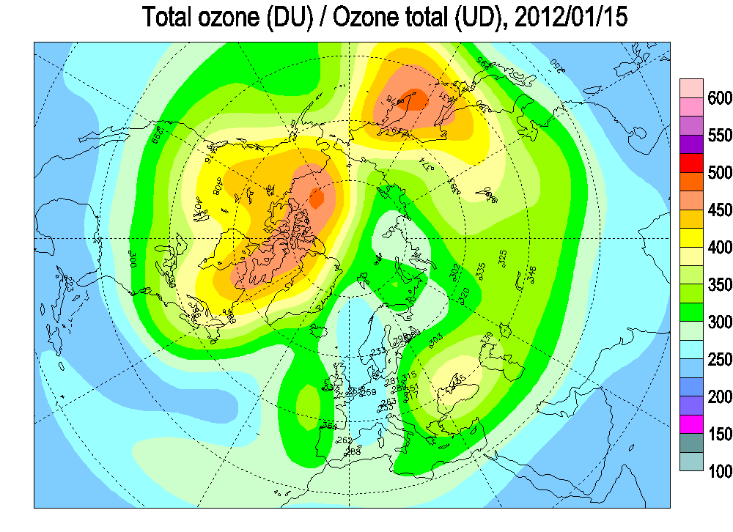
Tropopause height
Anti-correlation between the tropopause height and ozone total columns
Combined with high ozone amount in the atmosphere on January 14-15 (2012)
Exceptional ozone enhancement event during the polar night at Eureka in 2012
Source ozone maps: Environment Canada

Slide 13
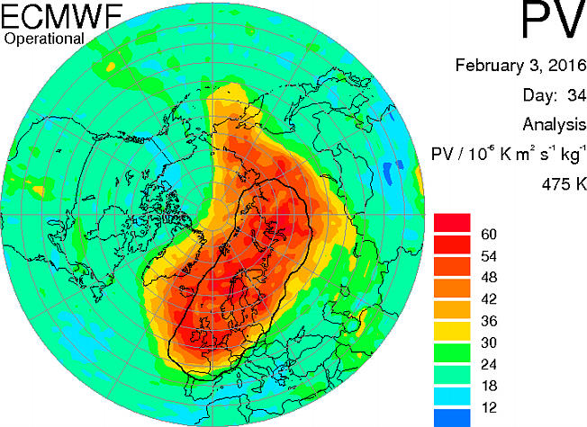
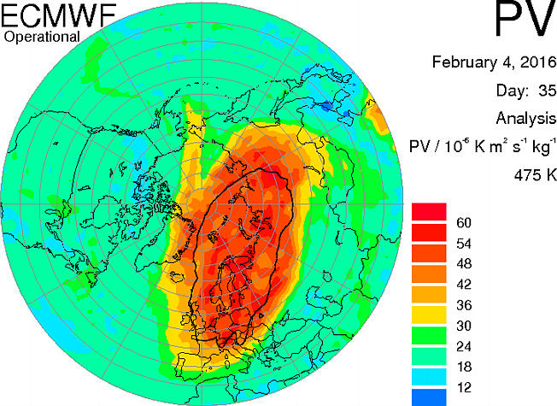
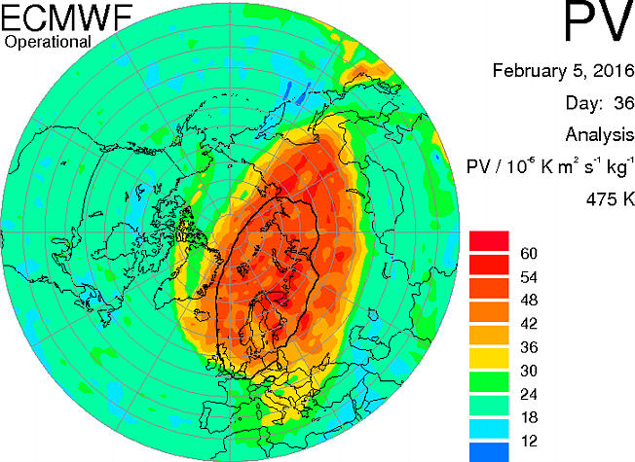
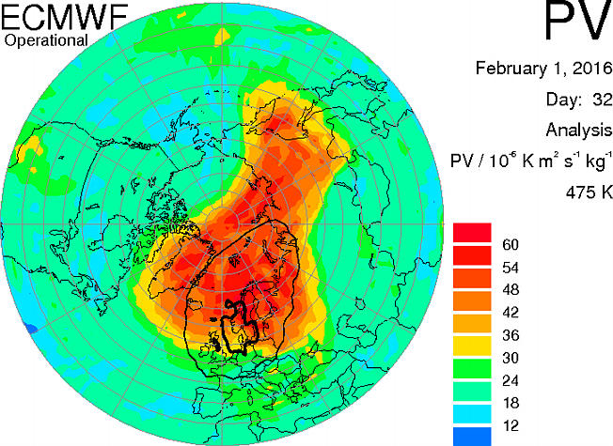
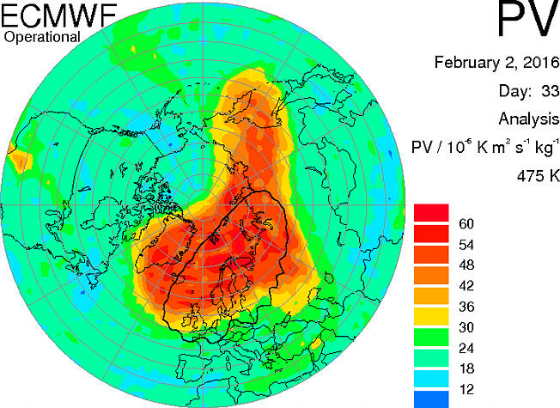
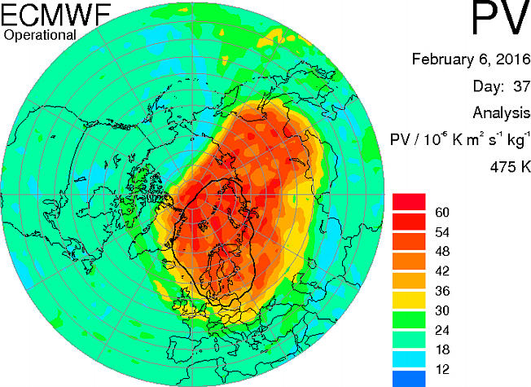
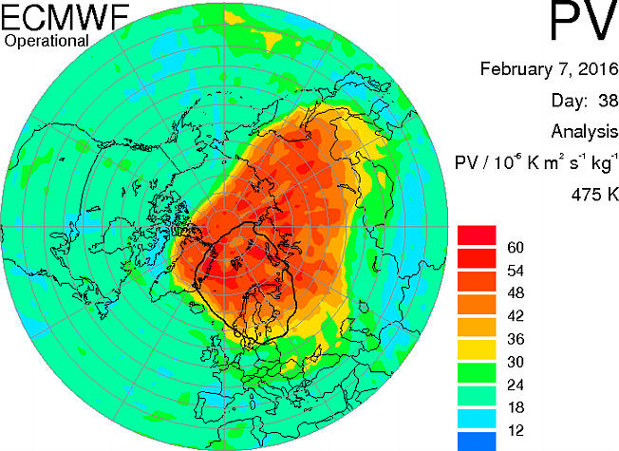
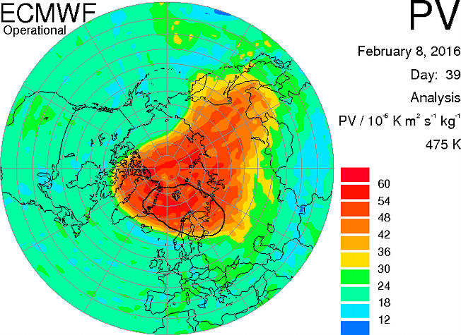
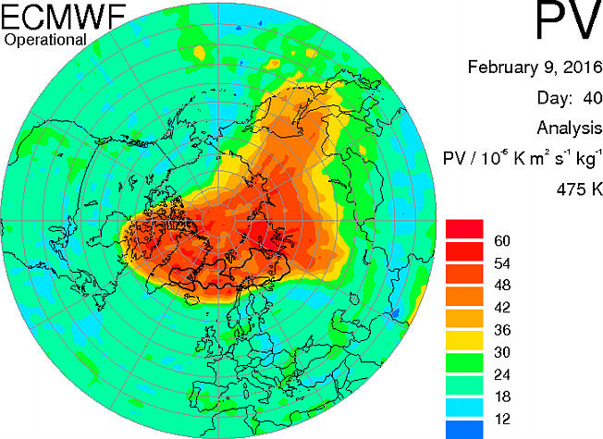
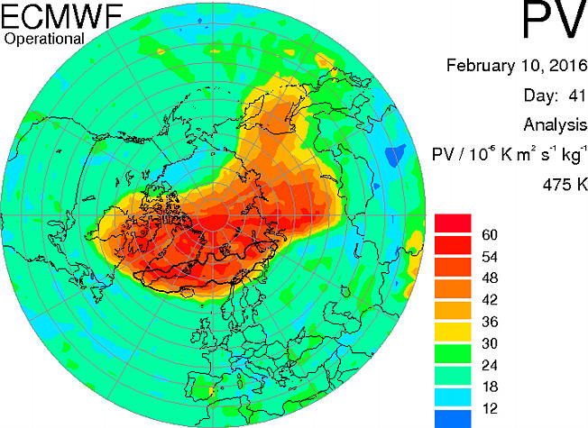
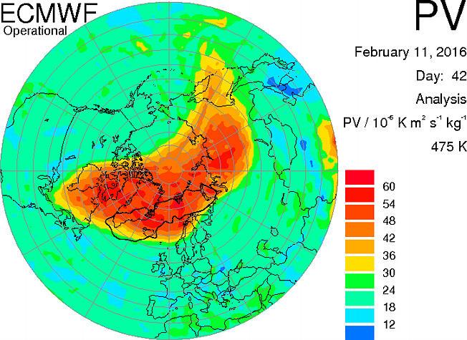
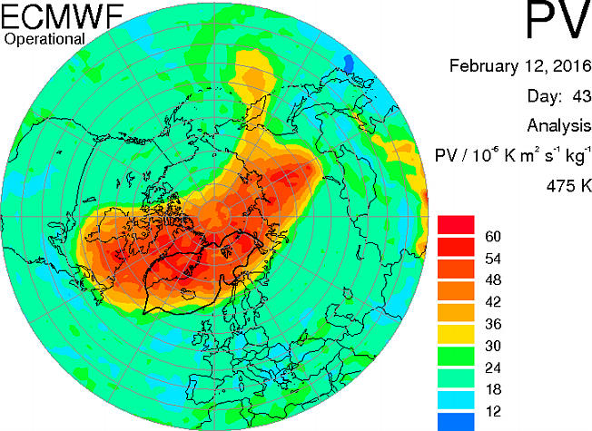
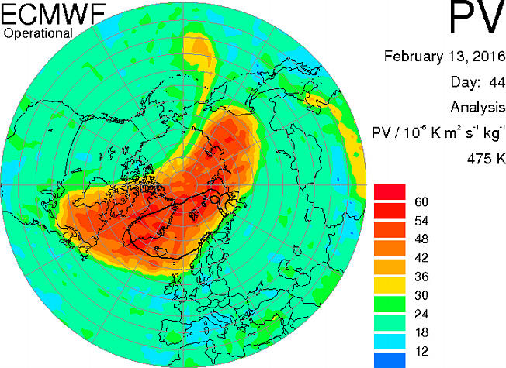
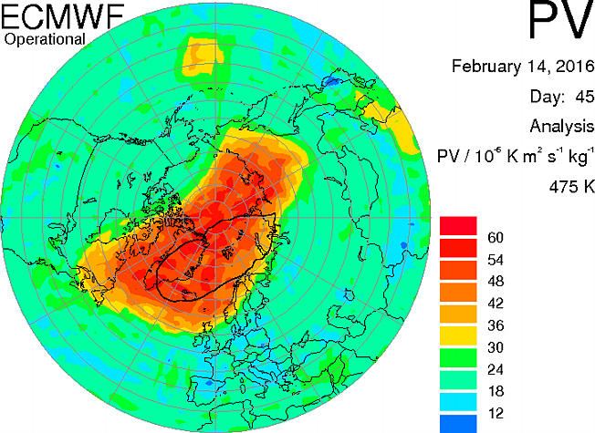
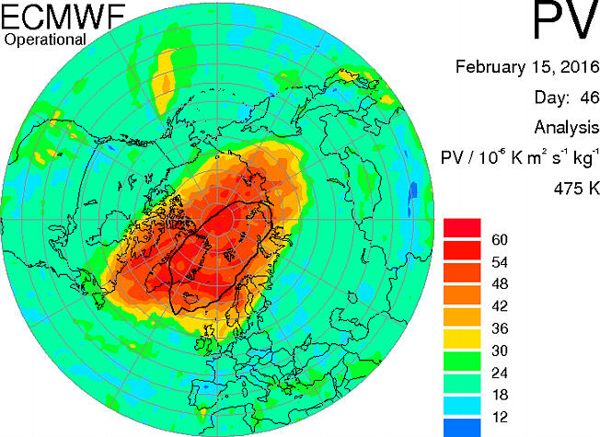
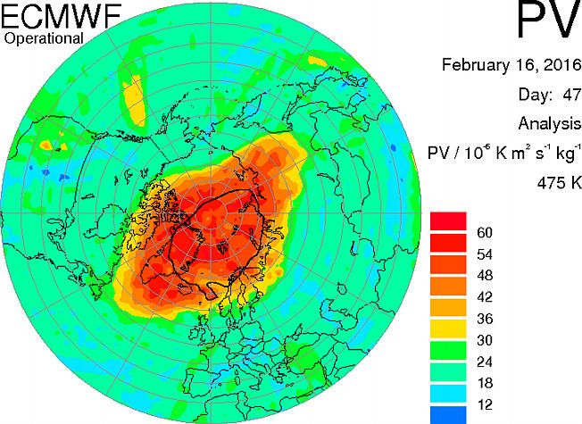
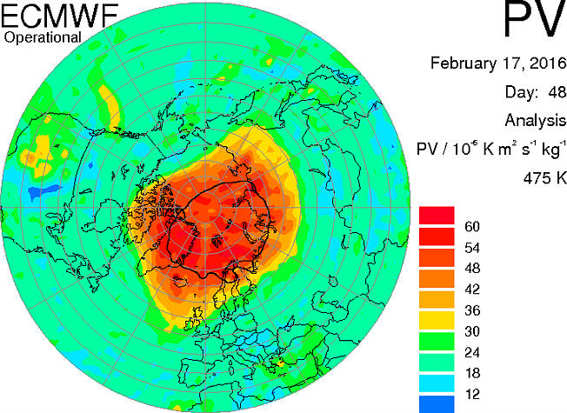
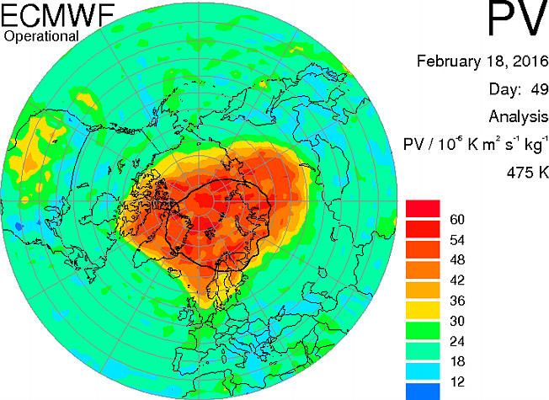

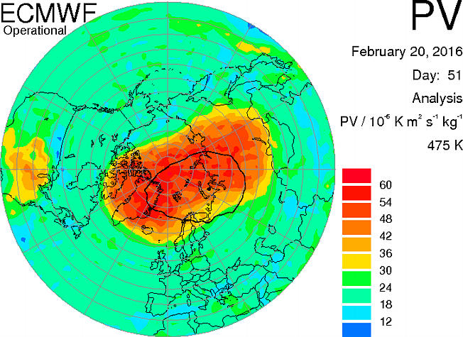
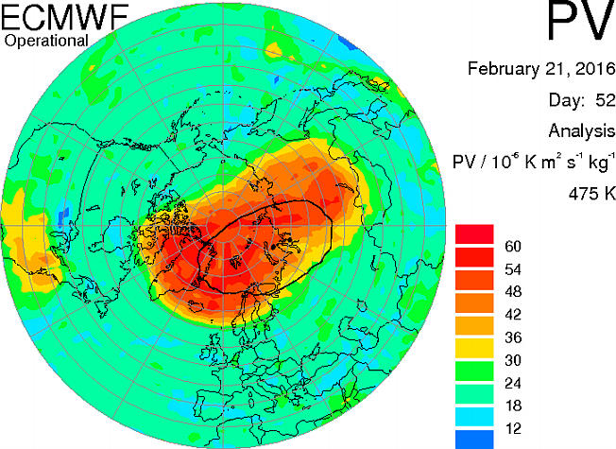
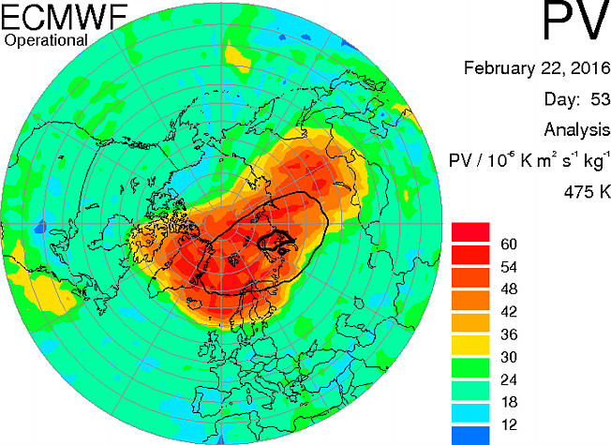
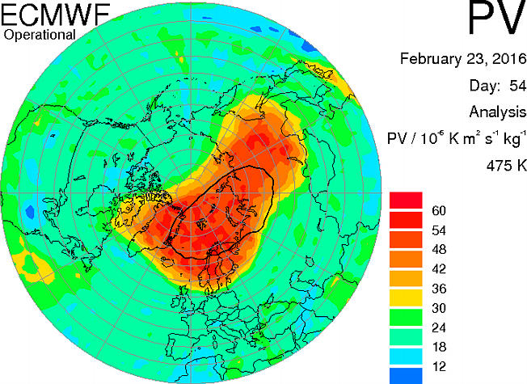
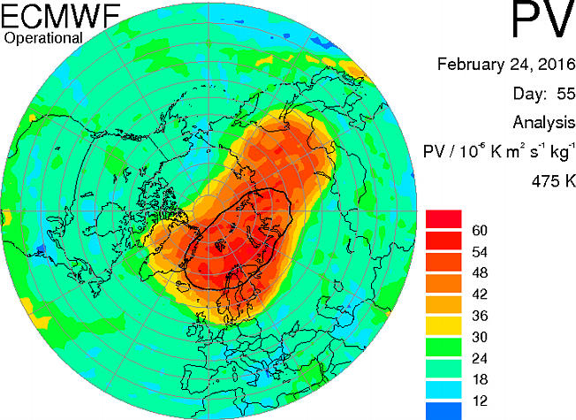
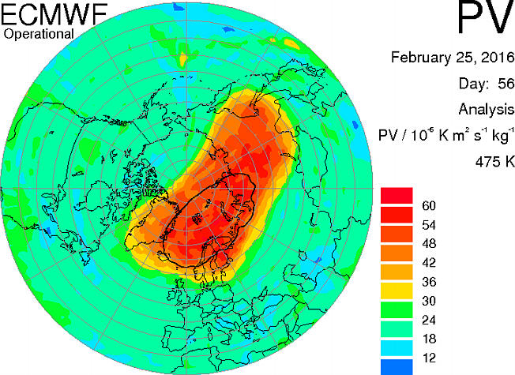








Ozone depletion
Ozone depletion events identified in 2007 and 2011 at Eureka
(Rösevall et al., 2007 ; Kuttippurath et al., 2009; Manney et al., 2011; Lindenmaier et al., 2012)
Ozone depletion event occurred from February 7 to February 22, 2016
→ During the polar night

Slide 14
Conclusions
Use of infrared emission spectroscopy to document the polar night atmospheric trace gas composition and is a great complement to the solar-viewing instruments
Clear seasonal cycle of CO and ozone with maximum column densities in winter-early spring due to the absence of photochemical destruction
Identification of carbon monoxide enhancements due to biomass burning plumes reaching PEARL in the summer
Observation of stratospheric influence on ozone column densities in January 2012 in the Arctic even though the tropopause height seems to drive the ozone amount measured by the AERI
Ozone depletion can be monitored using ground-based instrument during the winter

Slide 15
Acknowledgements
CANDAC and PEARL are supported by:
  ARIF, AIF/NSRIT, CFCAS, CFI, CSA, EC, GOC-IPY, NSERC, OIT, ORF, INAC, and PCSP
Logistical and operational support at Eureka:
  CANDAC operators
  Team at the EC Weather Station
  PEARL site manager Pierre Fogal
  CANDAC/PEARL PI James R. Drummond
  CANDAC data manager Yan Tsehtik
Canadian Arctic ACE Validation Campaigns supported by:
  CSA, EC, NSERC, and NSTP
  PI Kaley Walker
Special thanks to Pierre Fogal, Paul Loewen, Mike Maurice, Peter McGovern and Kaley Walker for assistance with ACE Validation Campaigns.

