Slide 1
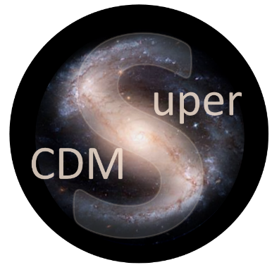


SuperCDMS and CUTE at SNOLAB
Wolfgang Rau
Queen’s University
for the
SuperCDMS Collaboration

Slide 2
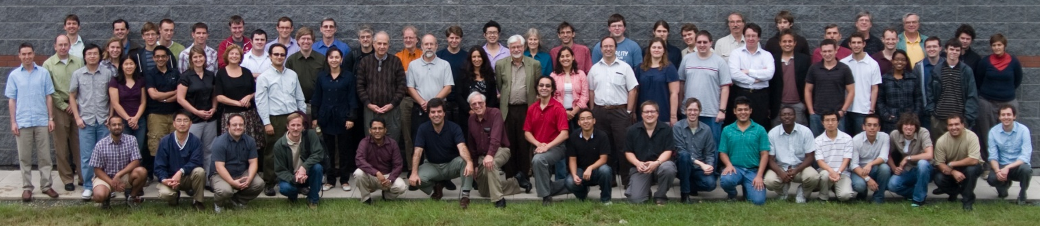

SuperCDMS Collaboration
California Institute of Technology CNRS/LPN Durham University
Fermi National Accelerator Laboratory NISER NIST Northwestern University
PNNL Queen’s University Santa Clara University SLAC/KIPA
South Dakota School of Mines & Technology Southern Methodist University
Stanford University Texas A&M University of British Columbia
University of California, Berkeley University of Colorado Denver
University of Evansville University of Florida
University of Minnesota University of South Dakota University of Toronto

Slide 3
Overview
SuperCDMS
Detectors
Readout and DAQ
Experimental Setup
Goals
CUTE
Motivation
Design
Status
Project Status
Funding
Review Process
Schedule
Development
Conclusions

Slide 4
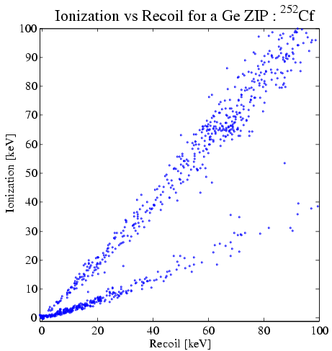
SuperCDMS
Detectors
Ge / Si
100 mm ∅ x 33 mm
Operated at 30 mK
iZIP
HV
Phonon Readout:
Tungsten TES
Add: charge readout (few V)
Background discrimination
Threshold < 1 keV
Add: high voltage (~100 V)
Phonons from drifting charges
Threshold < 0.1 keV (phonon)
R vs T
+
0
+ 50 V
remove surface
background
Electron recoils:
background
large phonon signal from
charges
–
+
Charge signal
–
0
– 50 V
< 1 background event for
whole exposure
Nuclear recoils:
signal
effective threshold: one
(or few) electron-hole pairs
Phonon signal

Slide 5
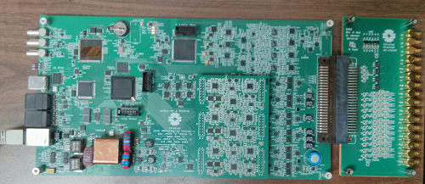
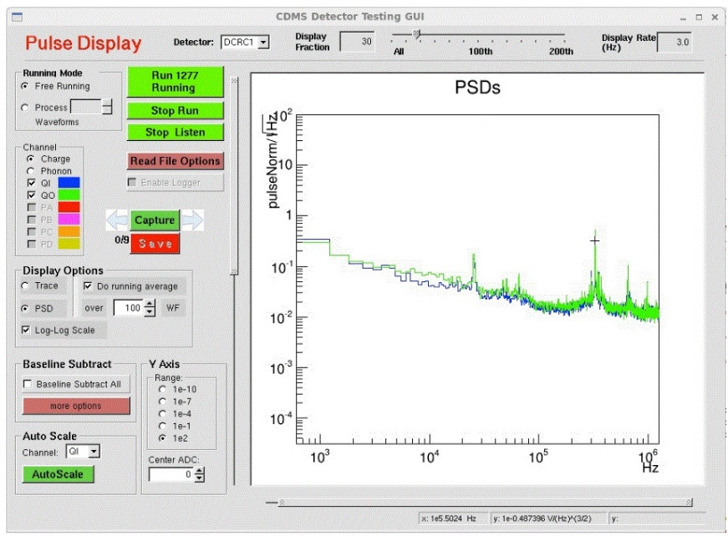
SuperCDMS
DAQ
Lead institution: UBC, with assistance from Toronto, the TRIUMF DAQ group, and several US institutions
Goal: design a deadtime-free DAQ system for new SuperCDMS electronics, including:
Optimal filtering of noise in trigger
Integrated data quality system
Integrated environmental monitoring
Fully usable and tested at SuperCDMS test facilities (Queen’s, CUTE, SLAC, UMN, Berkeley)
Built on MIDAS DAQ system
New prototype SNOLAB readout card, and noise measurements from prototype DAQ (May 2016)

Slide 6
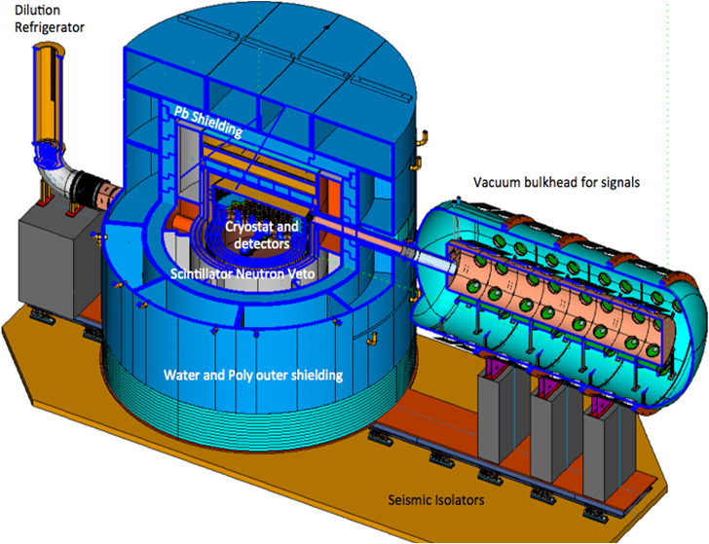
SuperCDMS
Setup
6 detectors
→ 1 tower
Gamma shield (Pb)
Fridge to provide
<15 mK at the detector
1 HV tower (4 Ge/2Si)
3 Ge iZIP towers
1 Si iZIP tower
(space for up to 31 towers)
Inner neutron
shield (PE)
Outer
neutron shield
(PE and water)
Mounted on spring-
loaded platform
(earthquake)
Signal vacuum
feedthroughs

Slide 7
SuperCDMS
SNOLAB
Radon
filter
Access
drift
Cryogenics
and radon
filter plant
Cryo
Experimental area
Clean
room
DAQ
CUTE

Slide 8
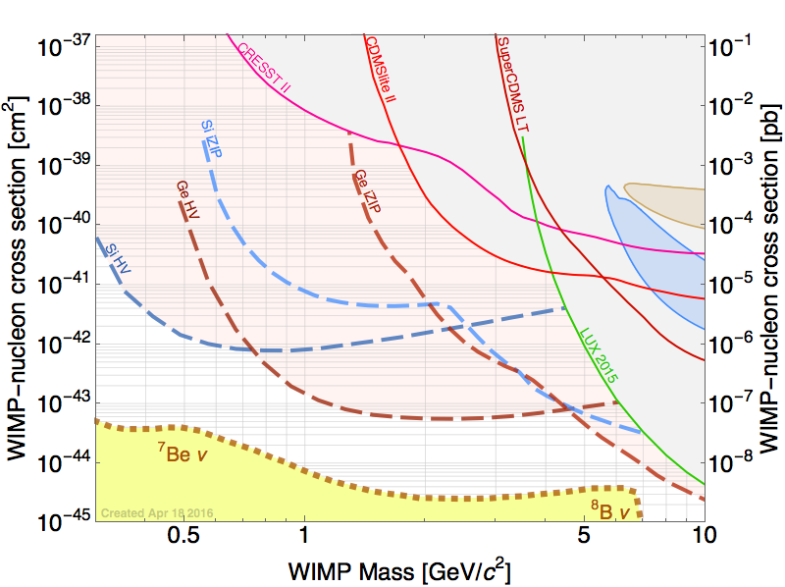
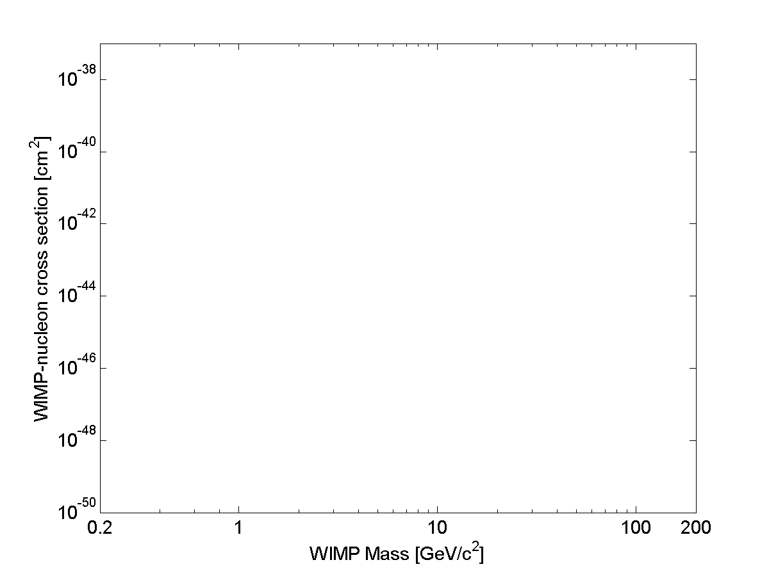
SuperCDMS
Goal
CRESST
2015
DAMIC 2012
Si iZIP
Ge iZIP
DAMA
CDMSlite
2015
Ge HV
CDMS Si
Si HV
DAMA
SuperCDMS LT 2014
CDMS II 2015
Solar Neutrinos
LUX 2013
DEAP
LZ
Atmospheric Neutrinos

Slide 9
Project Status
Schedule and Funding
2013
2014
2015
2016
2017
2018
2019
CFI approved
US G2 decision
CD 1
GW 2
Main construction phase
CFI application
CD 3
CD 4
Start of
operation
DOE/NSF proposals
GW 1
CD 2
CAP 16
Ottawa
Funding approved (CFI: 2012, DOE/NSF: 2014)
DOE/NSF review process:
First step passed (CD 1: conceptual design review)
Next step in spring 2017: technical design review (CD 2)
Reviews at SNOLAB:
passed Gateway 1 (space allocation) in fall 2015;
GW2 (begin of construction) in December 2016
Total project costs ~$30M

Slide 10
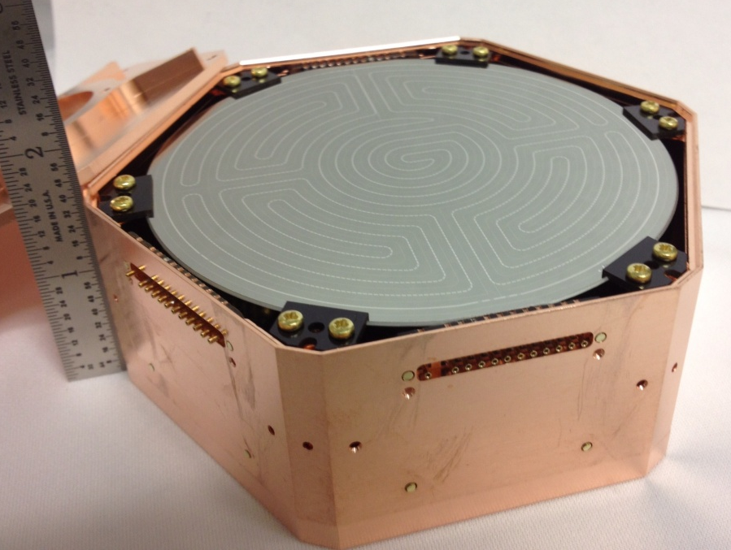

Project Status
Development
Detectors: larger crystals; iZIP: design ready, prototypes exist and have been tested; HV detectors: close to final design, first test anticipated later this year
Detector tower (mechanical structure, wiring): design ready, mechanical prototype exists; some delay for wiring prototype; first thermal tests later this year
Readout electronics:
Preamp: thermal readout design ready; charge readout: circuits are being tested
“Warm electronics” (outside cryostat): prototype exists, tests underway
DAQ: MIDAS based, being developed at UBC with help from TRIUMF
(version for detector test facilities already in use)
Cryogenics and shielding: design advanced, but not ready yet
Procurement of dilution refrigerator under way
Backgrounds: devised extensive material screening program; tracking and monitoring program being developed; radon filter to be installed for
detector assembly cleanroom at SNOLAB.

Slide 11

CUTE
Cryogenic Underground TEst facility (CUTE)
→ Xiaohe Zhang, PPD Poster #88 (19:02)
Motivation
Detector performance:
Detector integrity after transportation
Background discrimination
Noise performance (impact of background)
Background studies
Confirm that screening program
and handling procedures are appropriate
Study cosmogenic backgrounds (³H, ³²Si)
Test EURECA detectors in a SuperCDMS
environment (possibly join forces)
Schedule
Cryostat design ready; order imminent
Infrastructure (water tank, cleanroom, services): in 2016
Feb 2017: test at Queen’s; late spring installation underground
Commissioning: early summer 2017 (~2-3 years ahead of SuperCDMS)
Cleanroom
Vibration
damping
Fridge: <10 mK
Pb
Water Shield

Slide 12
Conclusions
SuperCDMS SNOLAB aims at detecting dark matter WIMPs
Main focus are low-mass WIMPs (< 10 GeV/c²)
Project planning well under way
Main R&D is done, full technical design expected for spring 2017
Start of operation expected in 2020
Upgrades (improved HV detectors, EURECA detectors, …) will allow us to reach the neutrino floor at low mass and/or check discovery claims at high mass
CUTE: Queen’s initiative for an underground test facility, operational in about a year
→ See poster: Xiaohe Zhang, 1307 (19:02).

