Slide 1



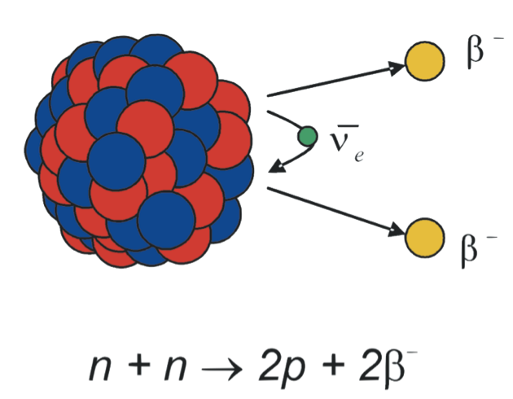
Ba-ion extraction and identification from high pressure Xenon gas for nEXO
Yang Lan for the nEXO collaboration
CAP2016-June 13th, 2016
TRIUMF/
Department of Physics & Astronomy
University of British Columbia
¹³⁶Ba

Slide 2
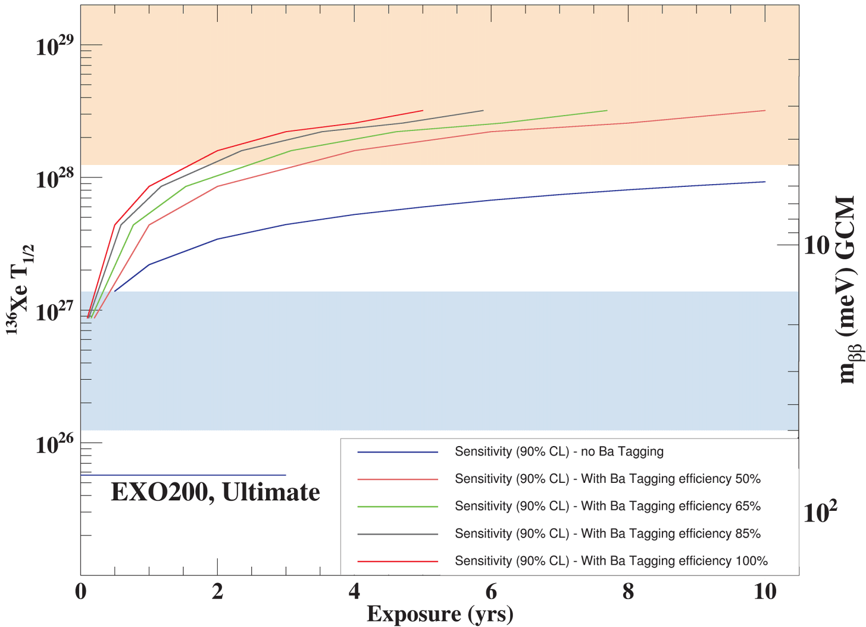


EXO 0νββ sensitivity
nEXO:
5 tons of liquid xenon
Enriched to 90%
of Xe-136
Sensitivity X 2
100% ba-tagging
50% ba-tagging
=80 ton xenon!
No ba-tagging
or, 160 years ☹
Without Ba-tagging:
With 100% Ba-tagging:

Slide 3

Ba-tagging
Ba-tagging concept in xenon gas
1. Locate the event in TPC
2. Get the Ba-ion
      Ion extraction
3. Identification (tagging)
      Laser spectroscopy
      TOF Mass spectrometry
Scintillation
Cathode
e-
e-
e-
e-
e-
e-
e-
e-
e-
Ionization
e-
e-
e-
e-
Gaseous TPC
Ba?

Slide 4
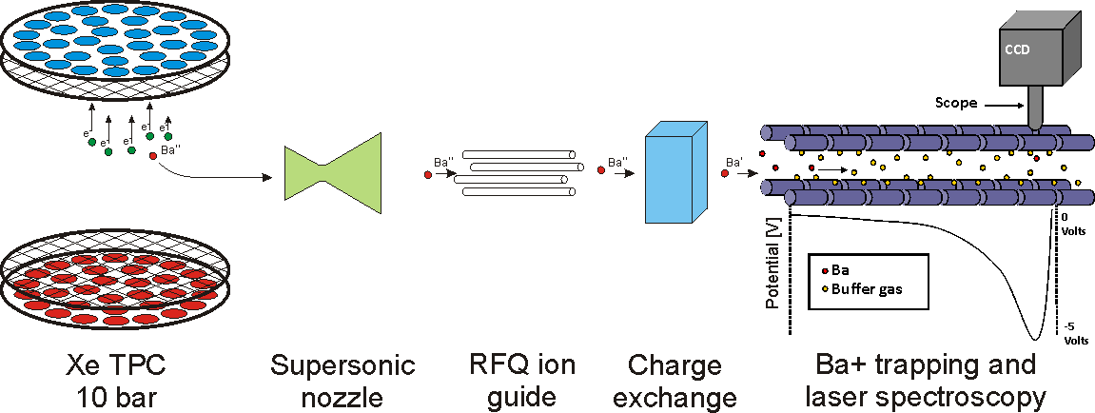
Ba-tagging
Ba-tagging for a gaseous Xenon
  Extract Ba-ions from high pressure xenon gas (RF funnel)
  Ba-ions identification
    Linear Paul trap (TRIUMF) – laser spectroscopy (Carleton)
    MR-TOF-MS (McGill) – mass spectrometry
Stanford’s prototype
Goal: 10⁻⁶ mbar

Slide 5
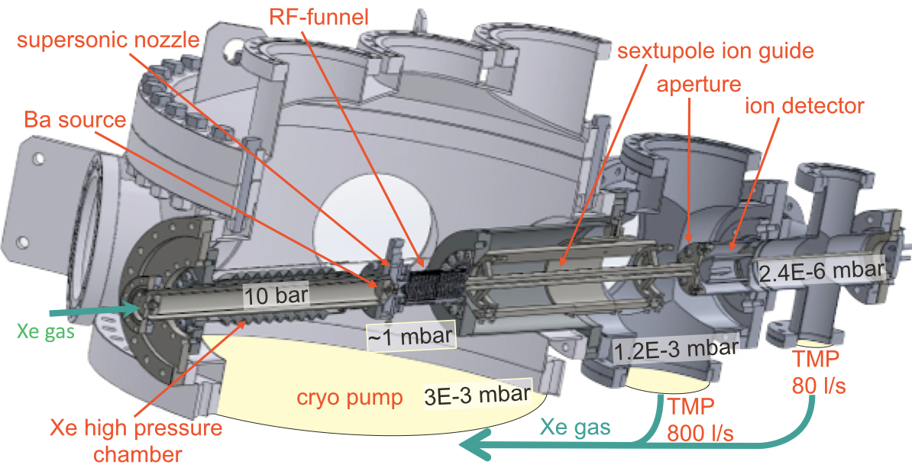
Ion-extraction
Challenges:
      Extract ions from up to 10 bar to vacuum
      Close to 100% extraction efficiency
Stanford’s prototype developed by T. Brunner and D. Fudenberg (moving to McGill)
International Journal of Mass Spectrometry 379, 110 (2015)

Slide 6
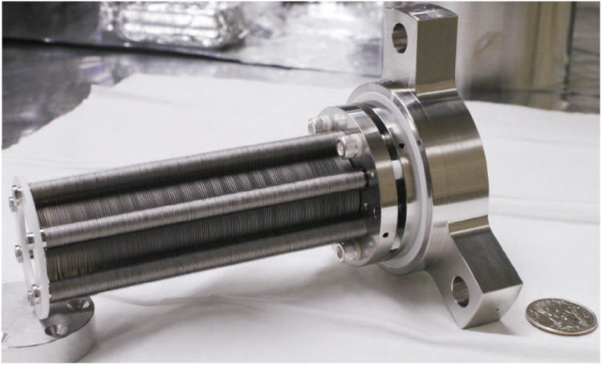
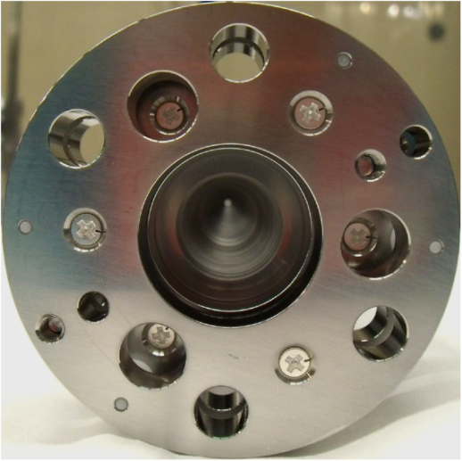
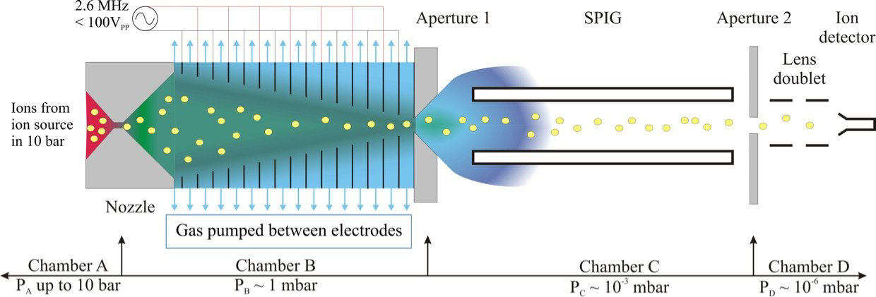
Ba-tagging in gas Xenon
Ion extraction from high pressure
T. Brunner et al.,IJMS 379, 110 (2015)

Slide 7
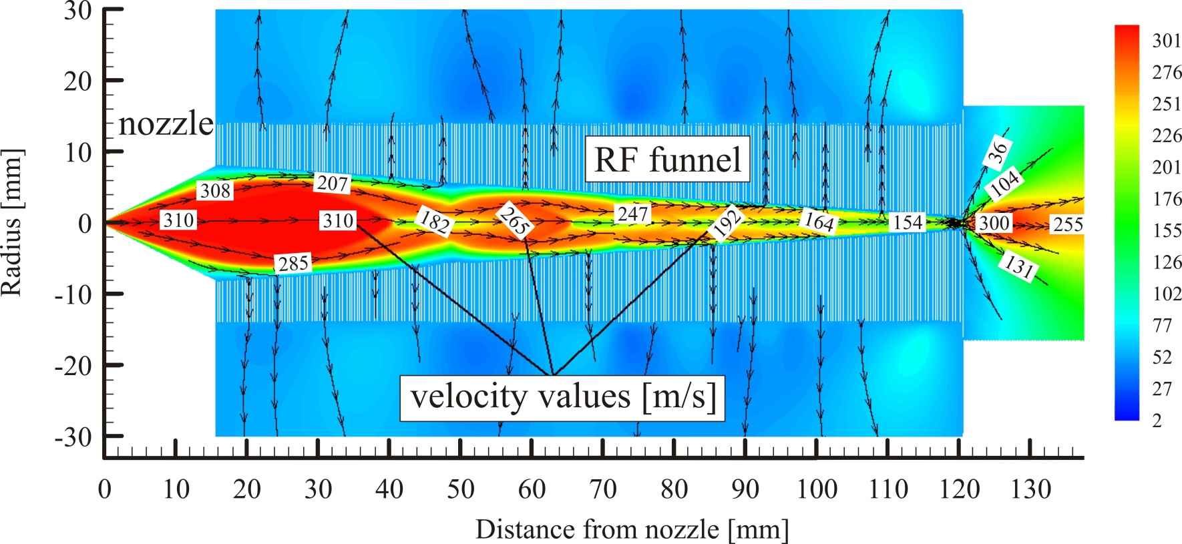
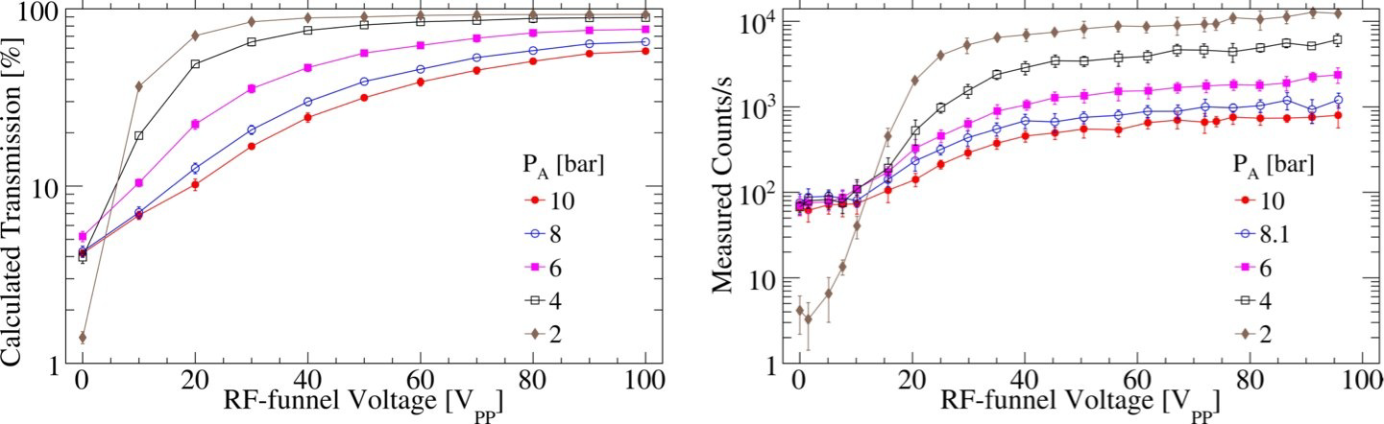
RF-funnel
Gas dynamic calculations
Ion transmission efficiency
T. Brunner et al.,IJMS 379, 110 (2015)

Slide 8
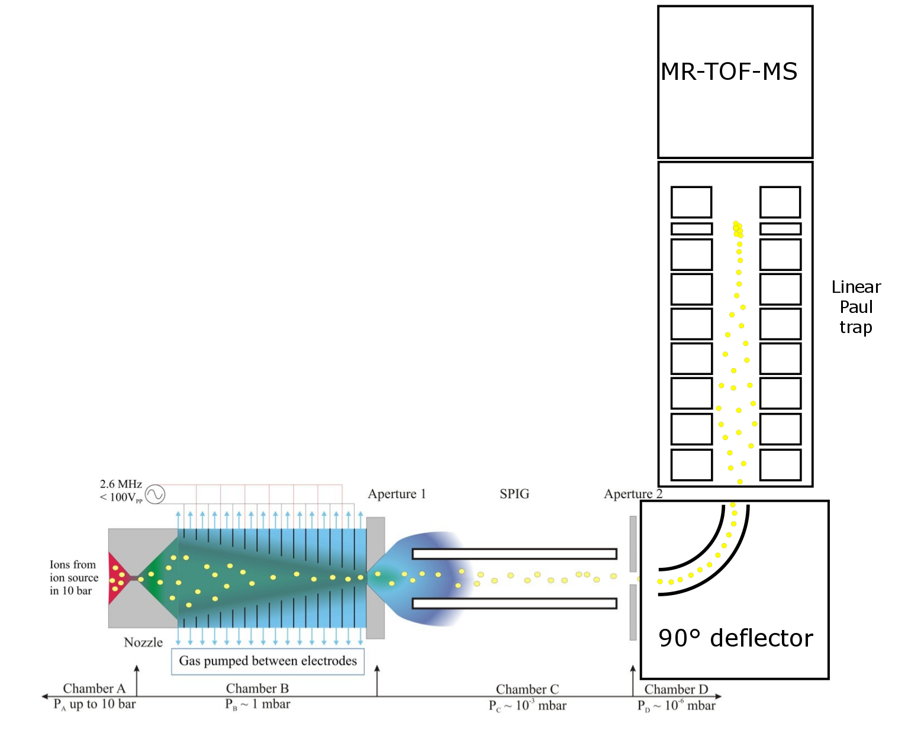
Linear Paul trap
Purpose
  Cool and store Ba-ions from RF-funnel
  Laser spectroscopy for Ba-ion identification
  Bunch the ions for an MR-TOF mass spectrometer
Challenges:
  Close 100% ion transmission efficiency
  Open geometry for florescence light collection

Slide 9
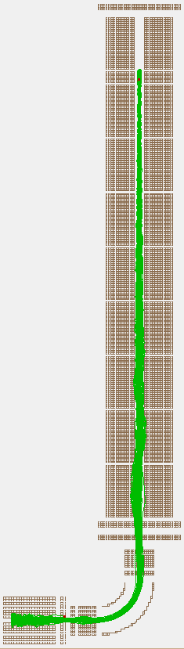
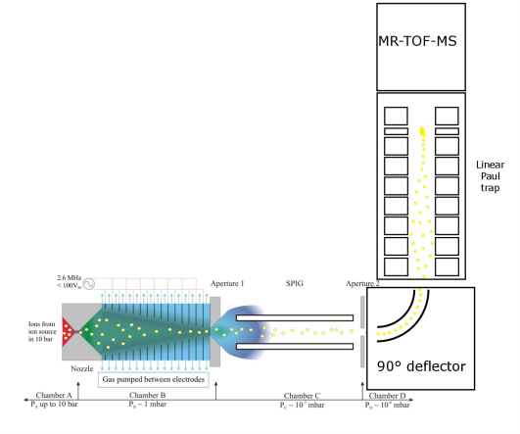
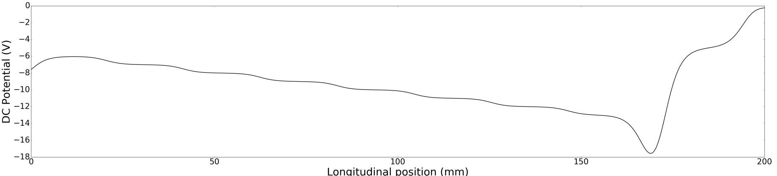
Linear Paul trap design at TRIUMF
Segmented design: 3D trapping region
Filled with Helium gas (~6 Pa)
  A 90° deflector to prevent He gas back flow
SIMION simulation: ion trapping, cooling
RF voltage: 166 V (1.1 MHz)
Trapping region

Slide 10
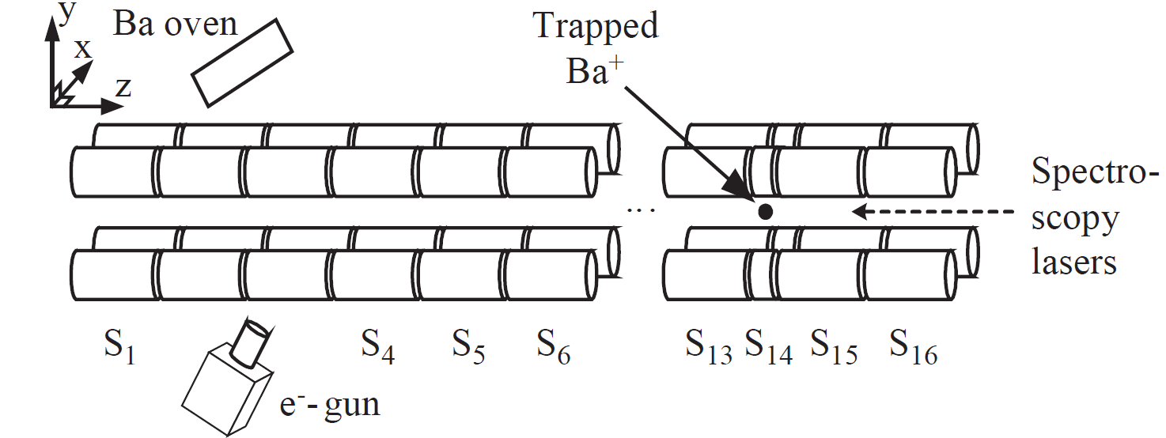
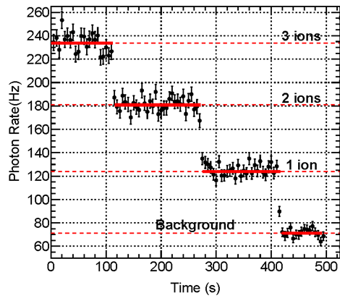
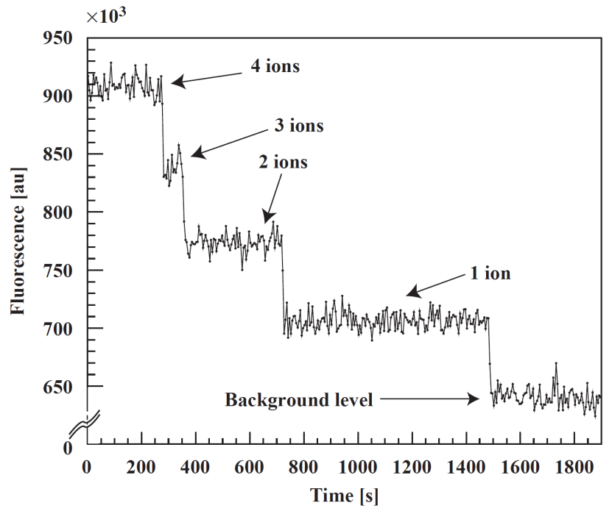
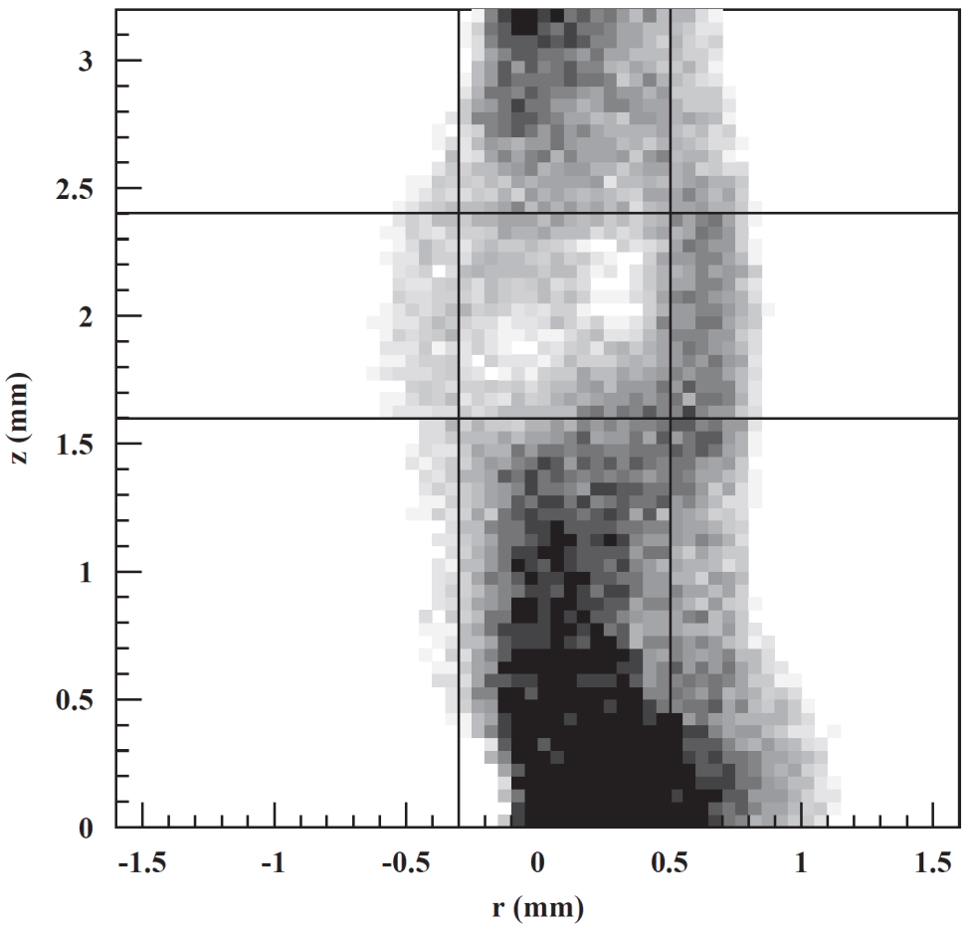
Laser fluorescence spectroscopy
Initial study at Stanford (~2007), now at Carleton University
Light scattered from electrodes
B. Flatt, et. al., Nucl. Instr. and Meth. A 578 , 399 (2007)
R. Killick, MSc thesis (2015)

Slide 11
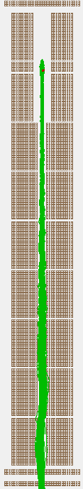
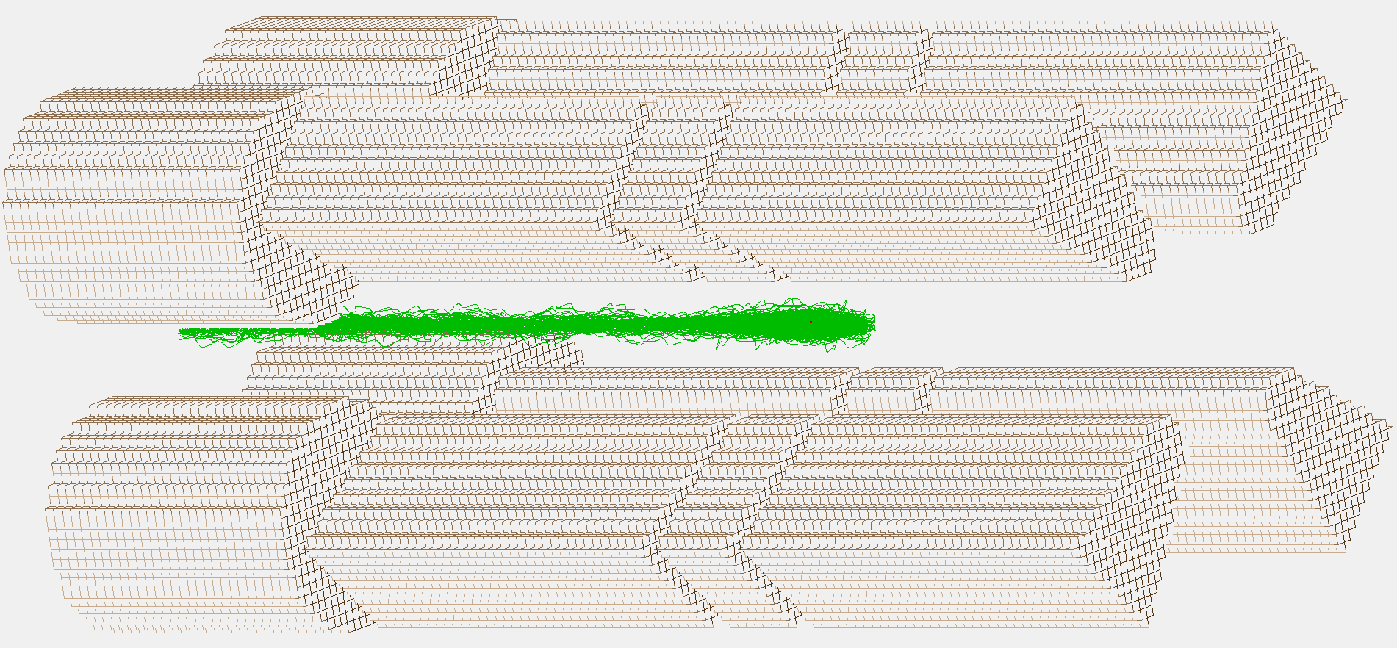
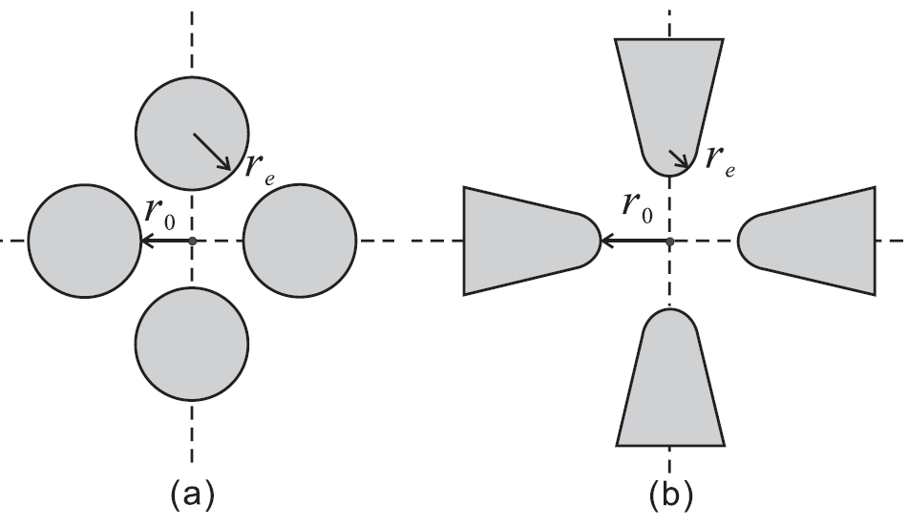
Open geometry for laser spectroscopy
Minimum quadrupole potential distortion:
r_{e}/r₀=1.14511
59.5°
r_{e}/r₀=0.357
25.5°

Slide 12
Summary and outlook
Ba-tagging in gaseous xenon
  RF-funnel successfully extract ions from 10 bar xenon (Stanford, McGill)
  Linear Paul trap (TRIUMF) & MR-TOF-MS (McGill) under development
  Laser fluorescence spectroscopy successfully developed for Ba-ion identification (Stanford, Carleton)
  Combine the RF-funnel, linear Paul trap, laser spectroscopy, MR-TOF-MS
Linear Paul Trap
  Simulation of ion deflection, capture, cooling
  More simulations, optimizations
  Build the linear Paul trap, Experiments!

Slide 13
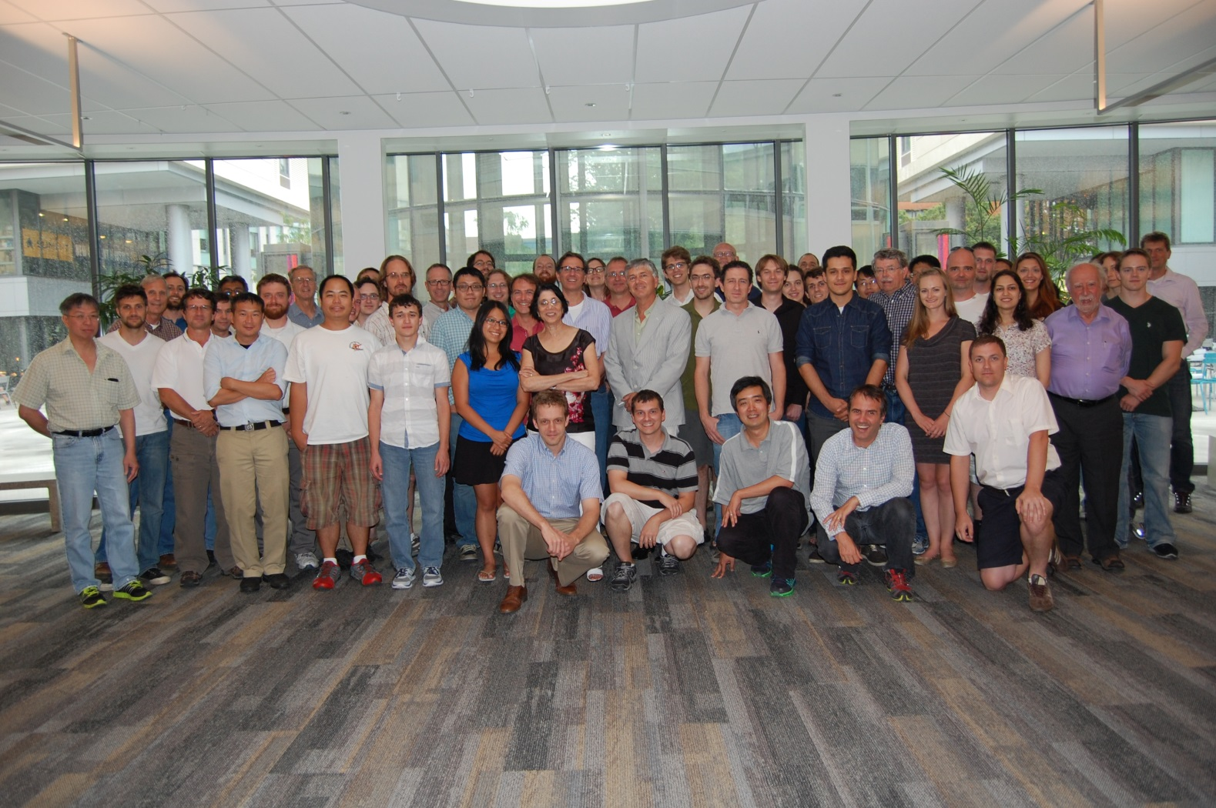







University of Alabama, Tuscaloosa AL, USA — T Didberidze, M Hughes, A Piepke, R Tsang
University of Bern, Switzerland — J-L Vuilleumier
Brookhaven National Laboratory, Upton NY, USA — M Chiu, G De Geronimo, S Li, V Radeka, T Rao, G Smith, T Tsang, B Yu
California Institute of Technology, Pasadena CA, USA — P Vogel
Carleton University, Ottawa ON, Canada — I Badhrees, Y Baribeau, M Bowcock, M Dunford, M Facina,
R Gornea, K Graham, P Gravelle, R Killick, T Koffas, C Licciardi, K McFarlane, R Schnarr, D Sinclair
Colorado State University, Fort Collins CO, USA — C Chambers, A Craycraft, W Fairbank Jr, T Walton
Drexel University, Philadelphia PA, USA — E Callaghan, MJ Dolinski, YH Lin, E Smith, Y-R Yen
Duke University, Durham NC, USA — PS Barbeau, G Swift
University of Erlangen-Nuremberg, Erlangen, Germany — G Anton, R Bayerlein, J Hoessl, P Hufschmidt, A Jamil, T Michel, T Ziegler
IBS Center for Underground Physics, Daejeon, South Korea — DS Leonard
IHEP Beijing, People’s Republic of China — G Cao, W Cen, X Jiang, H Li, Z Ning, X Sun, T Tolba, W Wei, L Wen, W Wu, J Zhao
ITEP Moscow, Russia — V Belov, A Burenkov, A Karelin, A Kobyakin, A Kuchenkov, V Stekhanov, O Zeldovich
University of Illinois, Urbana-Champaign IL, USA — D Beck, M Coon, S Li, L Yang
Indiana University, Bloomington IN, USA — JB Albert, S Daugherty, TN Johnson, LJ Kaufman, G Visser, J Zettlemoyer
University of California, Irvine, Irvine CA, USA — M Moe
Laurentian University, Sudbury ON, Canada — B Cleveland, A Der Mesrobian-Kabakian, J Farine, U Wichoski
Lawrence Livermore National Laboratory, Livermore CA, USA — O Alford, J Brodsky,
M Heffner, G Holtmeier, A House, M Johnson, S Sangiorgio
University of Massachusetts, Amherst MA, USA —S Feyzbakhsh, S Johnston, M Negus, A Pocar
McGill University, Montreal QC, Canada — T Brunner , K Murray
Oak Ridge National Laboratory, Oak Ridge TN, USA — L Fabris, D Hornback, RJ Newby, K Ziock
Pacific Northwest National Laboratory, Richland, WA, USA — EW Hoppe, JL Orrell
Rensselaer Polytechnic Institute, Troy NY, USA — E Brown, K Odgers
Université de Sherbrooke — S Charlebois, D Danovitch, R Fontaine, JF Pratte, J Sylvestre, F Bourque, T Rossignol, S Parent, M Côté, F Vachon, F Nolet,
H Dautet
SLAC National Accelerator Laboratory, Menlo Park CA, USA — J Dalmasson, T Daniels, S Delaquis,
G Haller, R Herbst, M Kwiatkowski, A Odian, M Oriunno, B Mong, PC Rowson, K Skarpaas
University of South Dakota, Vermillion SD, USA — J Daughhetee, R MacLellan
Stanford University, Stanford CA, USA — R DeVoe, D Fudenberg, G Gratta, M Jewell, S Kravitz,
D Moore, I Ostrovskiy, A Schubert, M Weber
Stony Brook University, SUNY, Stony Brook, NY, USA — K Kumar, O Njoya, M Tarka
Technical University of Munich, Garching, Germany — P Fierlinger, M Marino
TRIUMF, Vancouver BC, Canada — J Dilling, P Gumplinger, R Krücken, Y Lan, F Retière, V Strickland
The nEXO Collaboration

Slide 14
Backup slides

Slide 15
EXO-200
EXO-200 progresses
  2011 May: Started collecting data
  2011 August: first measurement of 2νββ in ¹³⁶Xe:
    Phys. Rev. Lett. 109, 032505 (2011)
    Agrees with KamLAND-Zen soon after:
  Phys. Rev. C 85, 045504 (2012)
  2014 set lower limit on 0νββ in ¹³⁶Xe:
  T_{1/2} ^{2νββ} =2.11 ± 0.04(stat) ± 0.21(syst) ×10²¹ yr
  T_{1/2} ^{2νββ} =2.38±0.02(stat)±0.14(syst) ×10²¹ yr
Nature 510, 229 (2014)
  T_{1/2} ^{0νββ} > 1.1×10²⁵ yr @ 90% confidence level

Slide 16
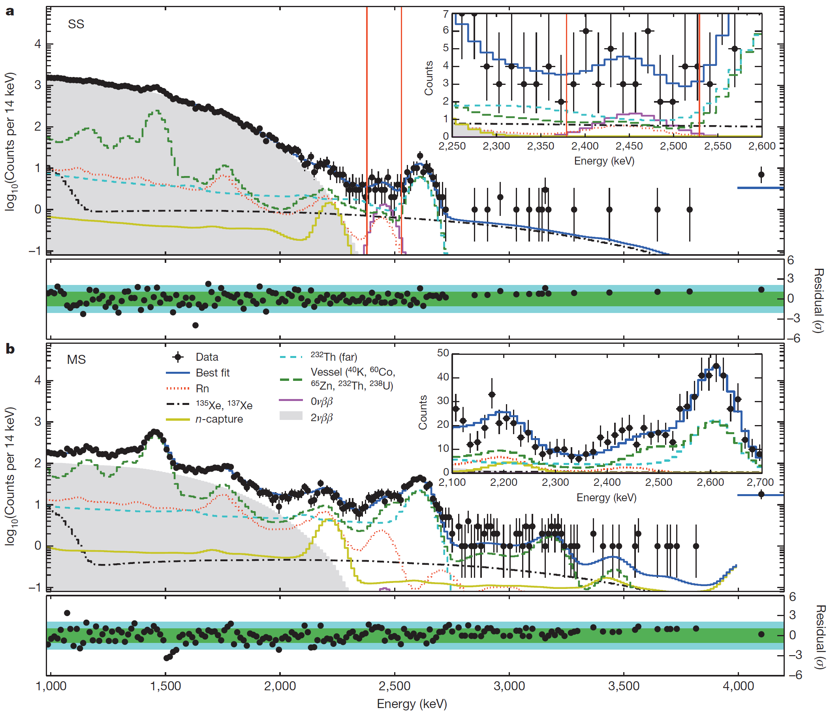
Enriched Xenon Observatory (EXO)
Q=2457.83±0.37 keV
EXO-200 Status
  Started collecting data in 2011
  Still running
Single-site events
Multi-site events
Nature 510, 229 (2014)

Slide 17
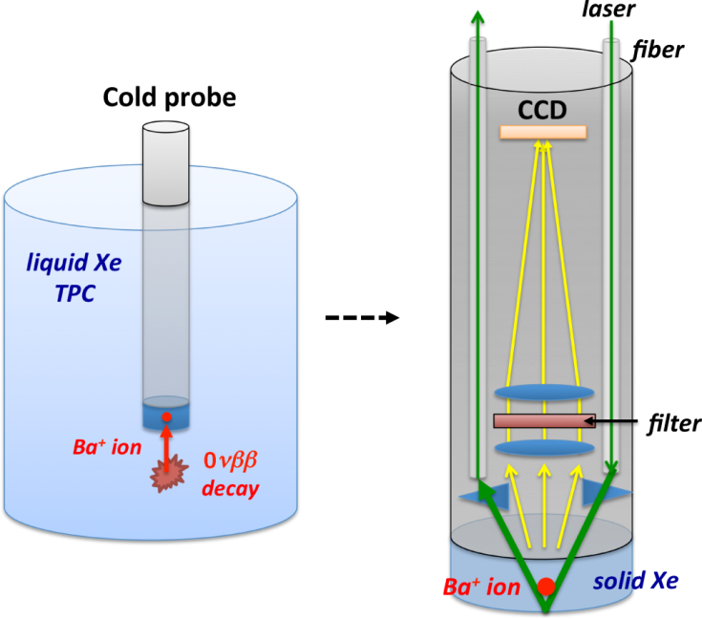
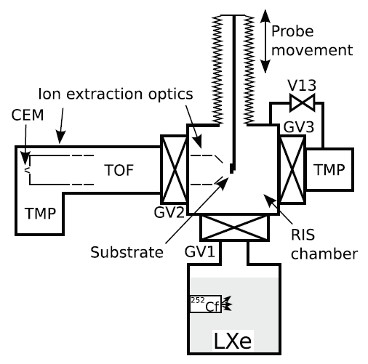
Ba-tagging
Ba-tagging for liquid Xenon
  Colorado State U.:
    Cold probe
    Freeze Ba-ion to the probe
    Laser induced florescence
      Move the probe out of TPC
      Florescence detection in situ
  Stanford U.:
    Transport Ba-ion out of TPC
    Resonance Ionization Spectroscopy
      Selectively ionize Ba
      Identification by ion’s time-of-filght (TOF)
nEXO, P.R.A 91, 022505 (2015)
nEXO, Rev. Sci. Instrum 85, 095114 (2014)

Slide 18
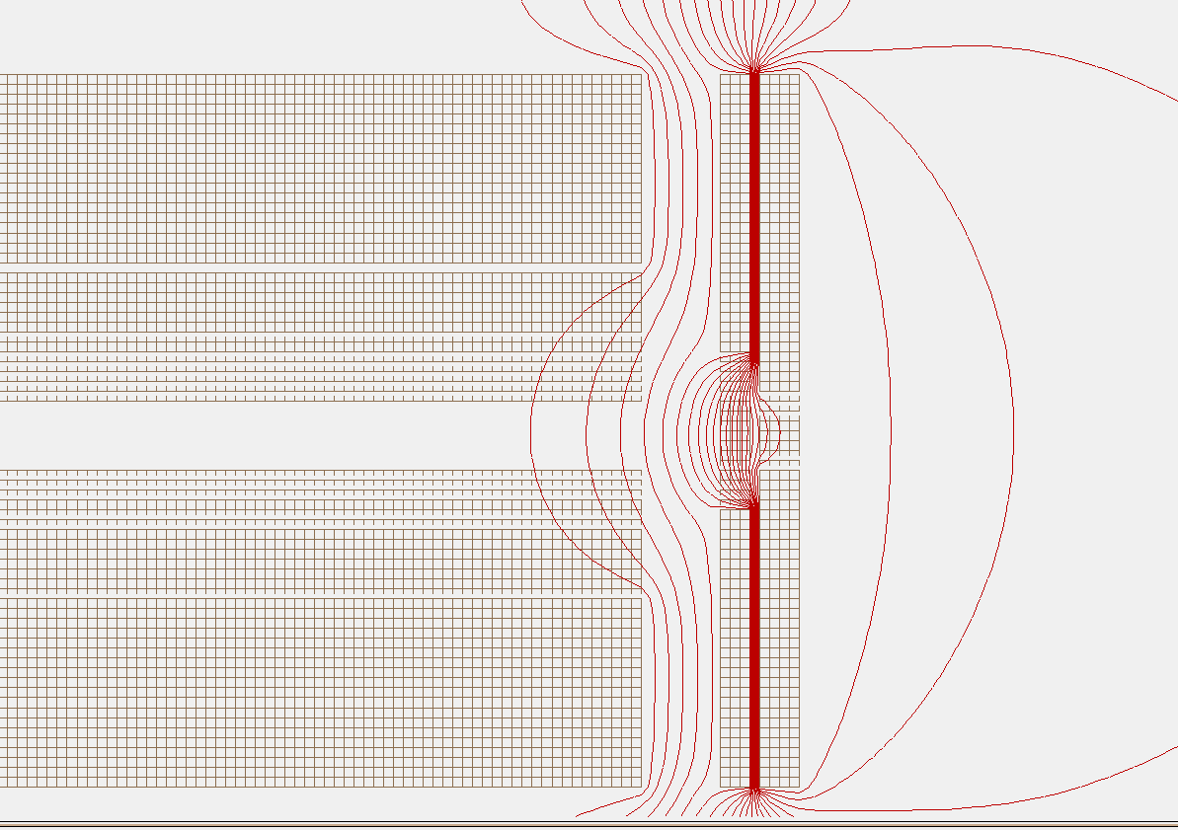
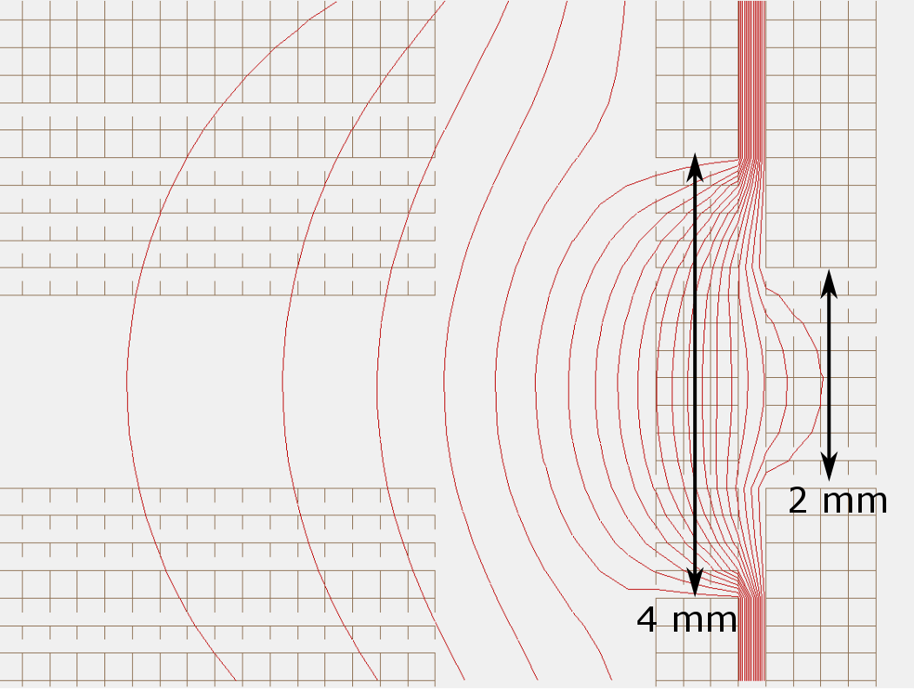
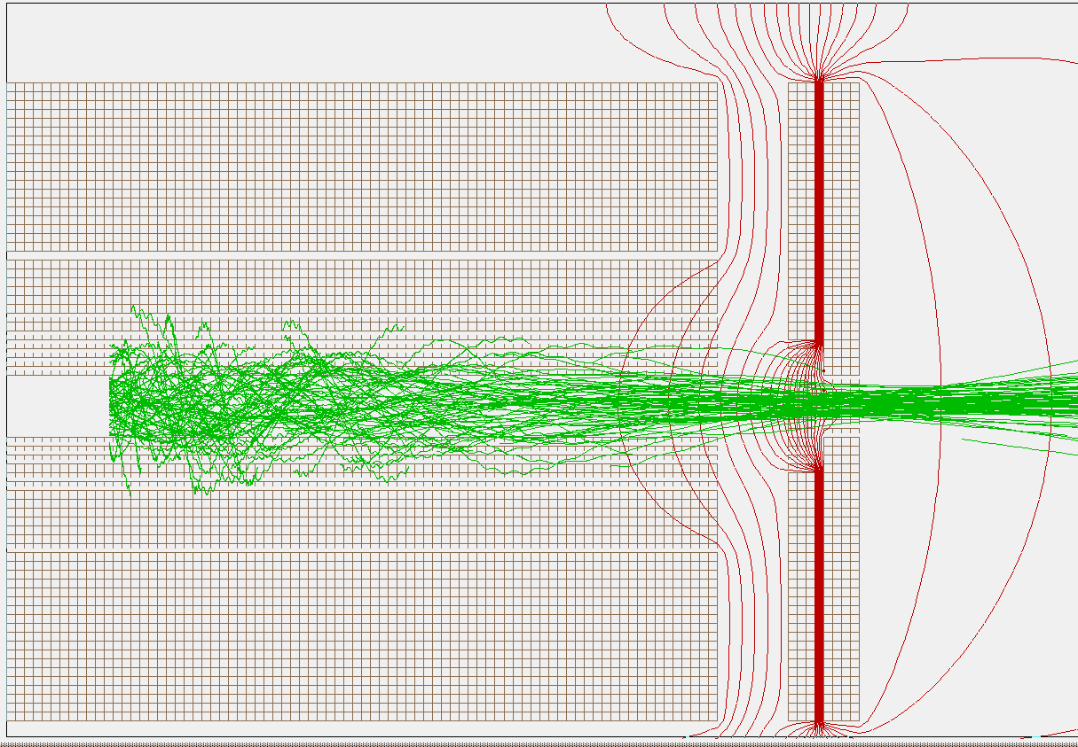
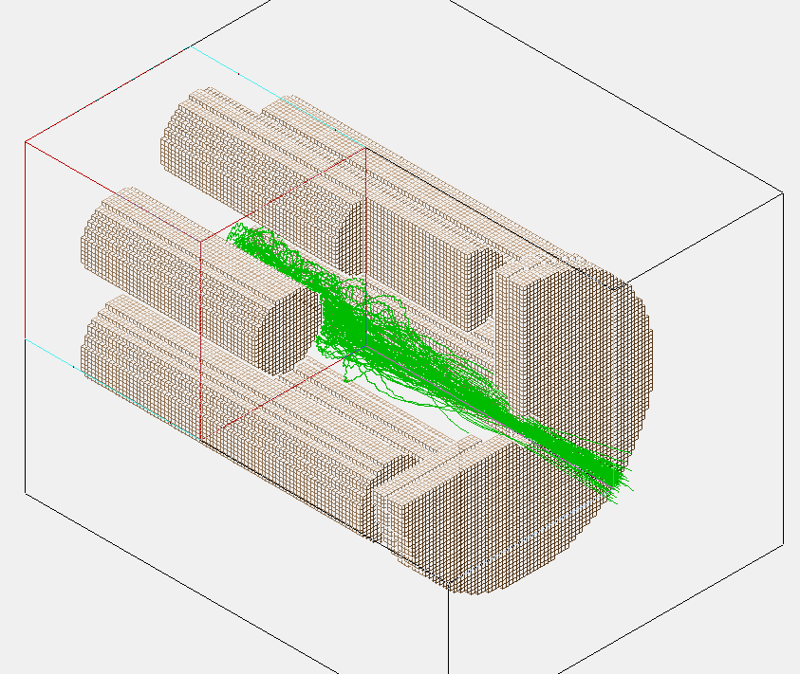
Ion extraction from SPIG: a ∅2-mm aperture
Focusing electric potential
-5 V
-30 V
-100 V
Transmission efficiency: ~98% in SIMION simulation

Slide 19
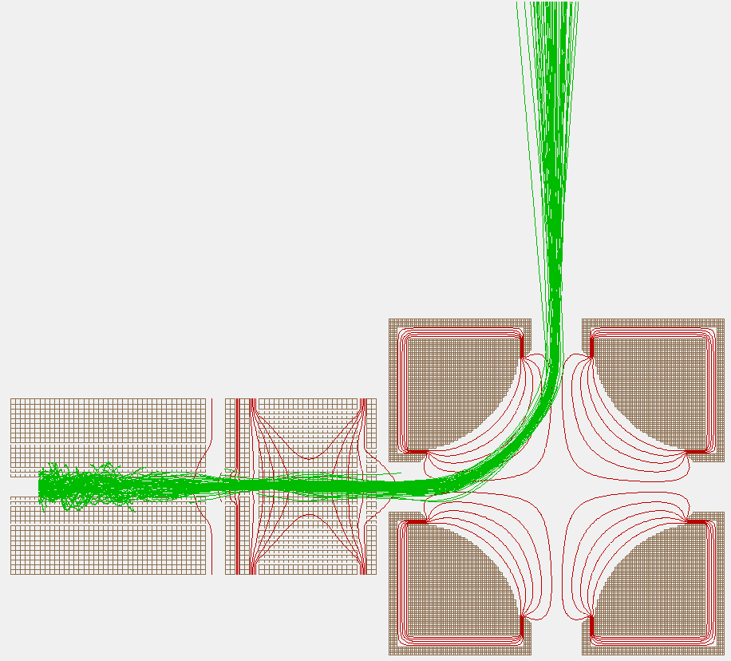
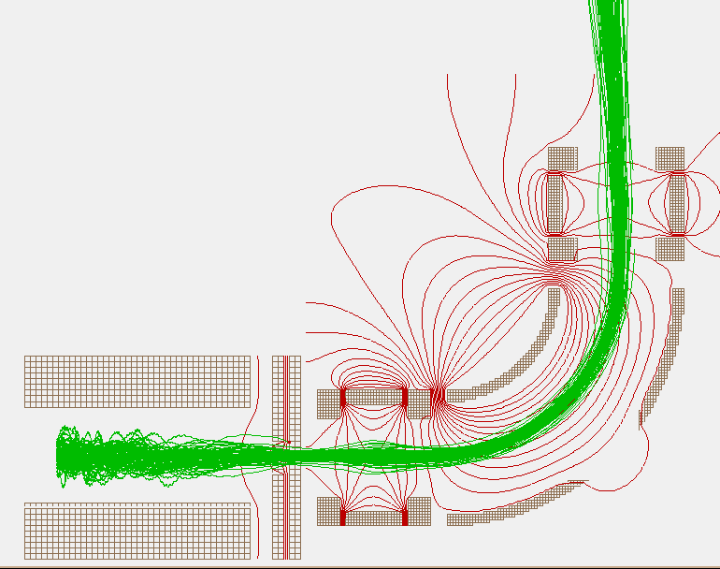
90° deflector between SPIG and linear Paul trap
  Purpose:
    Prevent He gas back flow
    Additional ions sources & ion counts measurements
  SIMION simulations:
    4-way quadruple deflector Cylindrical mirror analyzer
Second ion source
Second ion source

Slide 20
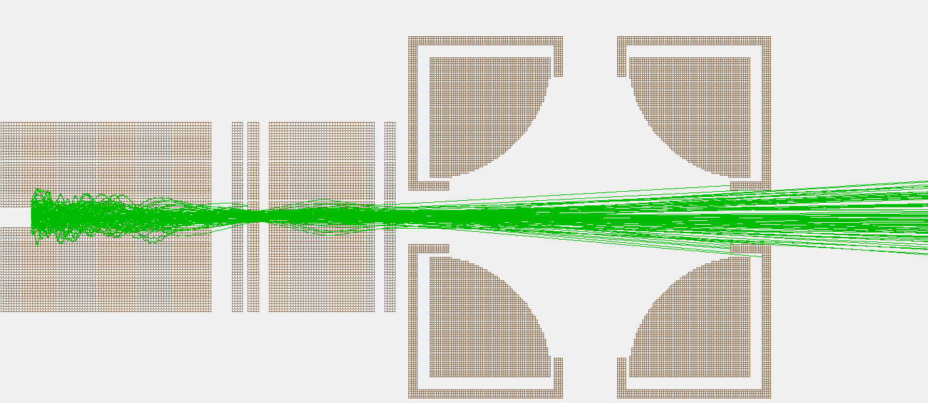
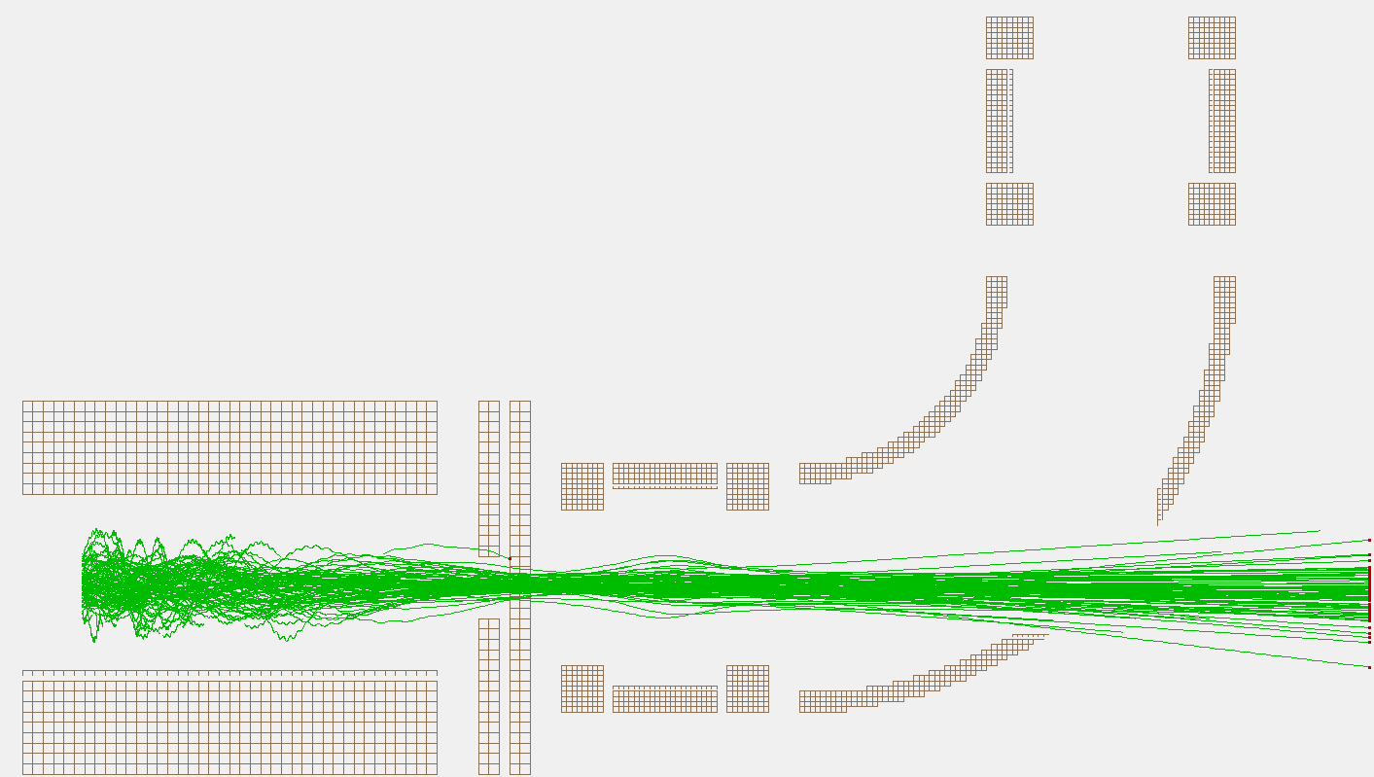
90° deflector : SIMION simulations
Ion detector
Ion loss
Ion detector

Slide 21
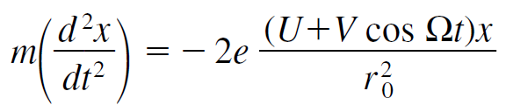
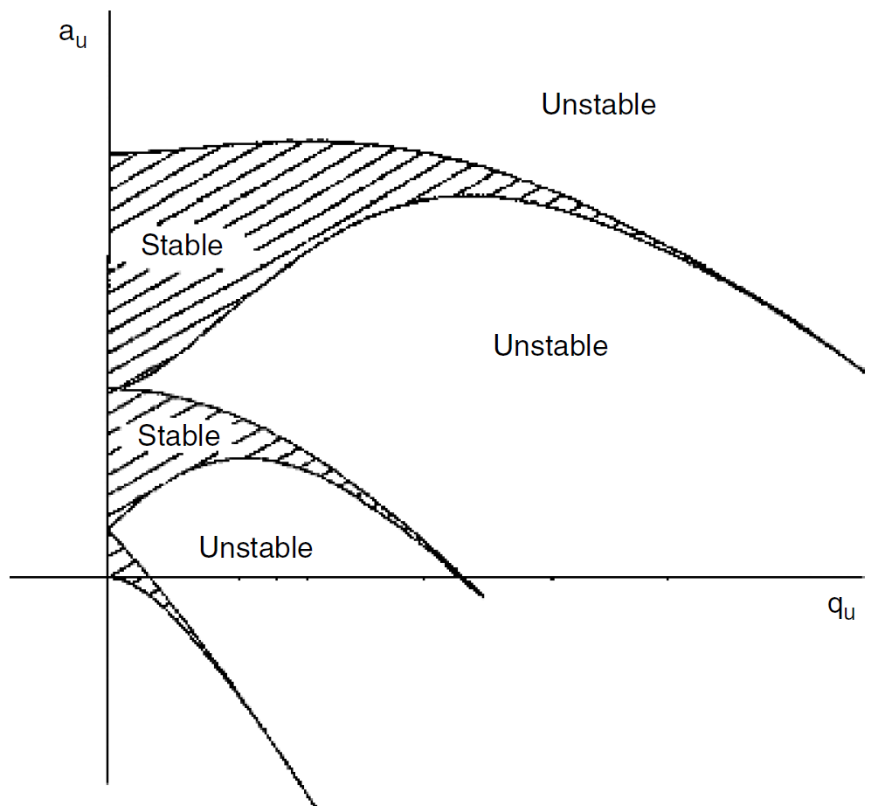
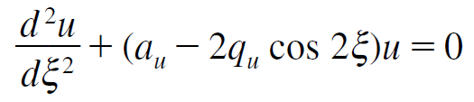

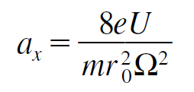
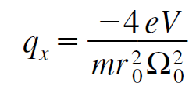
Linear Paul trap
Ion stability region in pure quadrupole potentials
  Equation of motion
  Mathieu equation
Todd, John F. J. Quadrupole storage mass spectrometry.

Slide 22
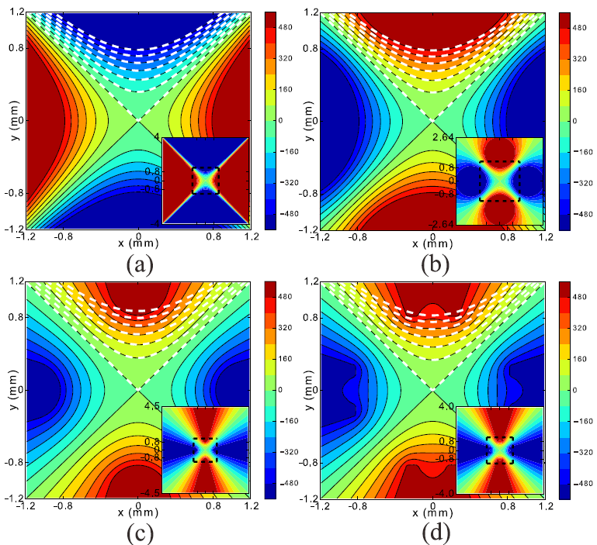
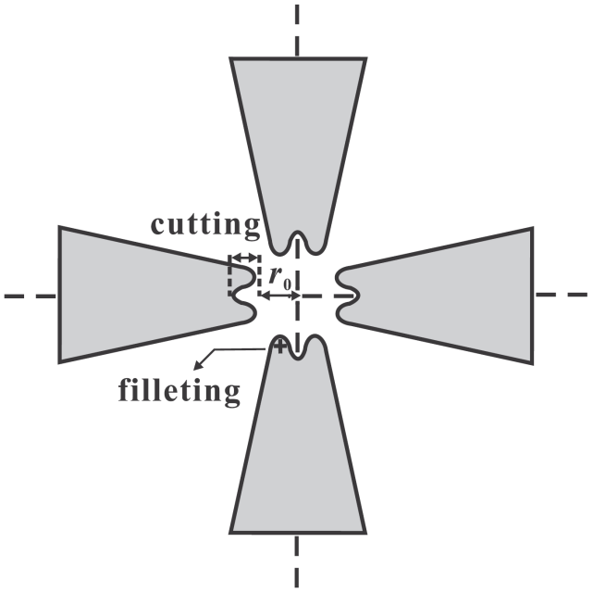
Quadrupole electrodes
Hyperbolic
Circular
Blade
Modified blade
K. Deng et al., J. Appl. Phys. 118, 113106 (2015)

Slide 23
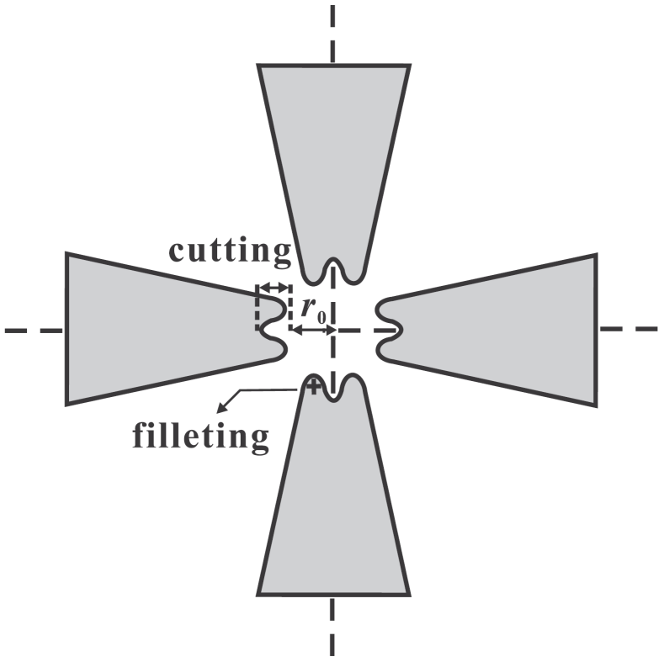
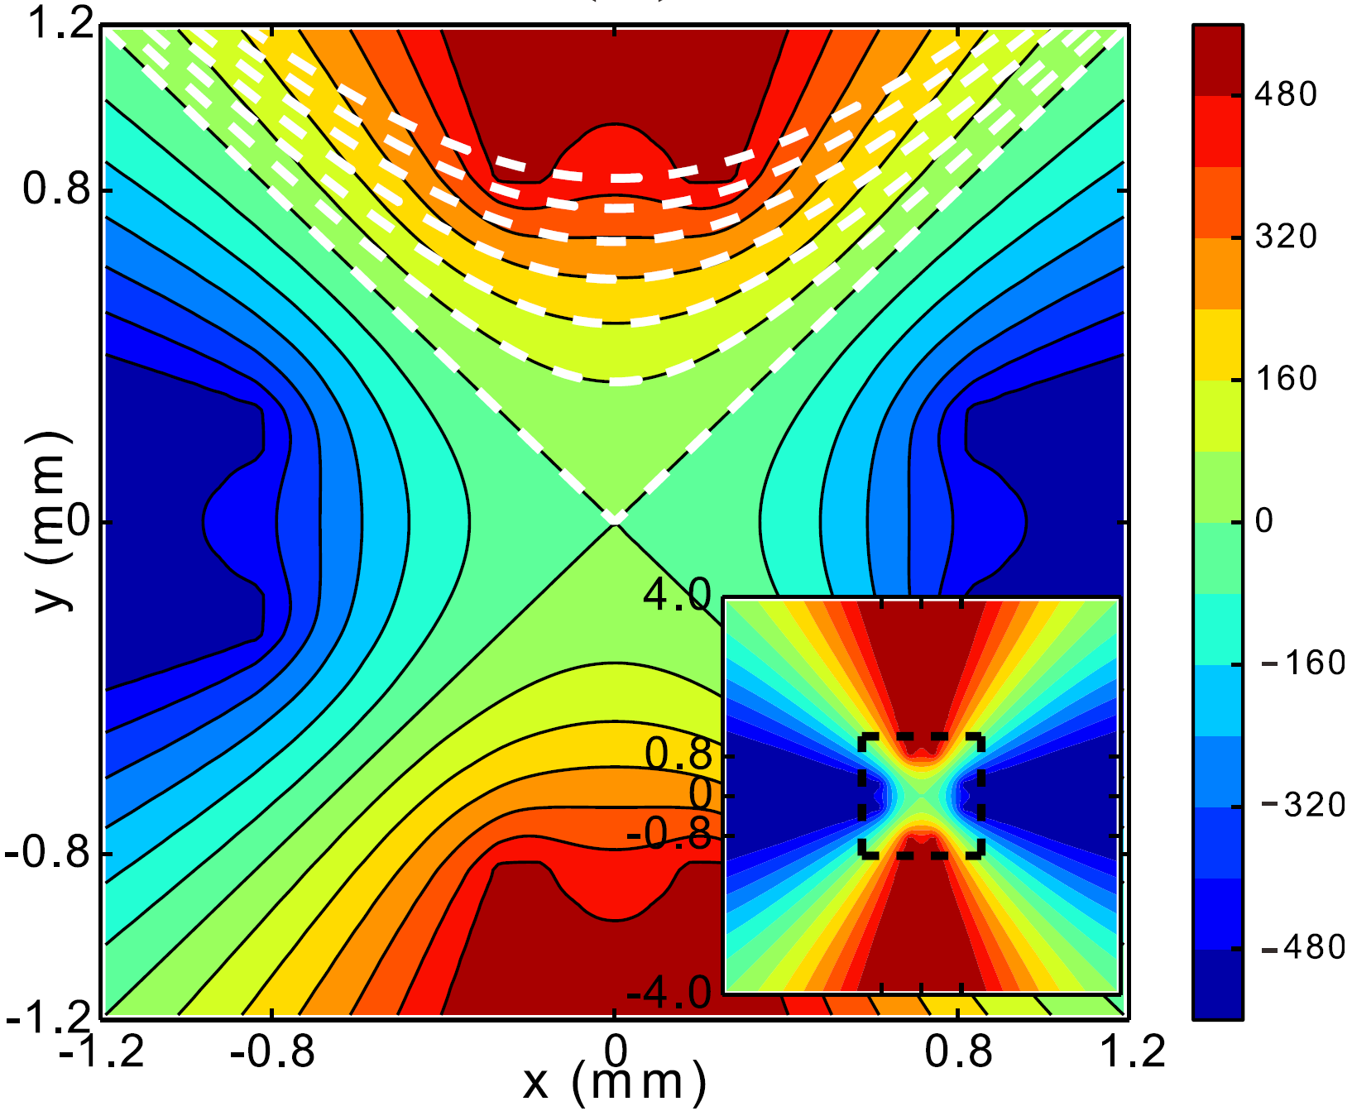
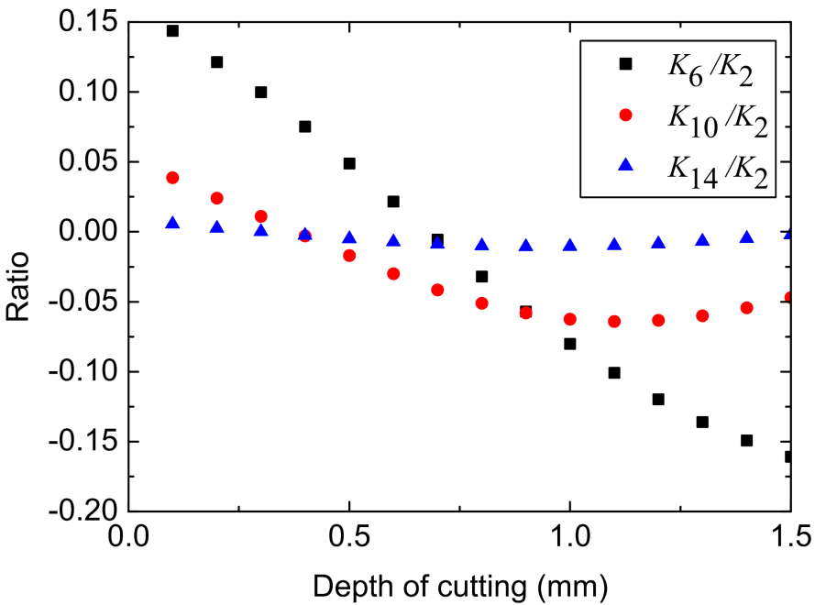
Optimized blade-like electrodes
J. Appl. Phys. 118, 113106 (2015)

